Slide 1
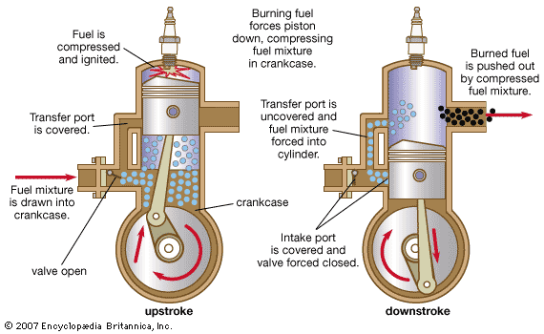
2-STROKE ENGINE

Slide 2
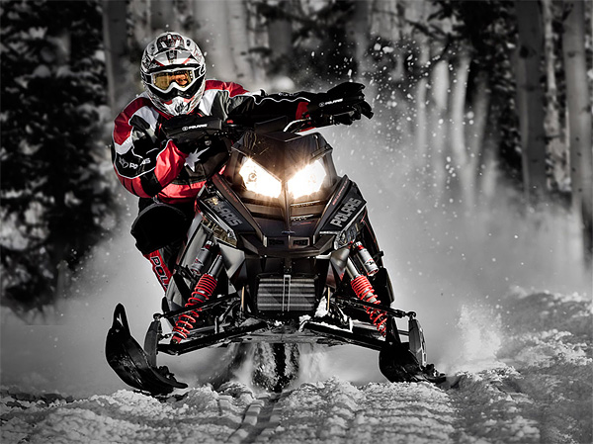
APPLICATIONS
Two Stroke Engines Are Found On:
Weed Trimmers
Snowmobiles
Older Dirt Bikes
Chainsaws
Nitro R/C Cars
Small Outboards
Older Jet Skis

Slide 3
ADVANTAGES
Less Parts = Lighter
Fires Once Every Revolution = 2x Power Of Four Stroke
Cheaper, Less Complex And Easier To Work On
Can Work In Any Orientation (Upside Down, Sideways)

Slide 4
DISADVANTAGES
No Dedicated Lubrication System (Not As Durable)
Not Fuel Efficient And Require Expensive Oil To Be Mixed With Gas (One Gallon Oil/1,000 Miles)
Produce A Lot Of Pollution Due To Burning Of Gas And Oil.

Slide 5
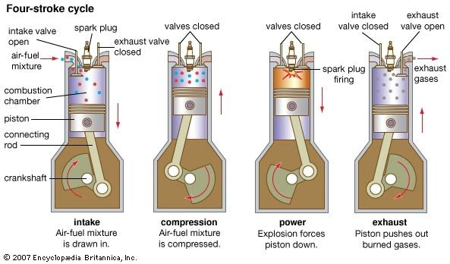
4-STROKE ENGINE

Slide 6
ADVANTAGES
Less Fuel Consumption
More Thermal Efficiency
More Volumetric Efficiency
Less Wear And Tear

Slide 7
DISADVANTAGES
MORE COMPONENTS
SEPARATE VALVE MECHANISM IS NEEDED
MORE COST
DESIGN COMPLICATED

Slide 8
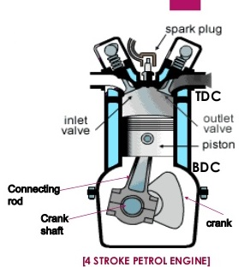
Thermodynamic cycles: Otto cycle
Efficiency = 1 – 1/r_{k}^{γ-1} where = r_{k =} compression ratio V₁/V₂

Slide 9
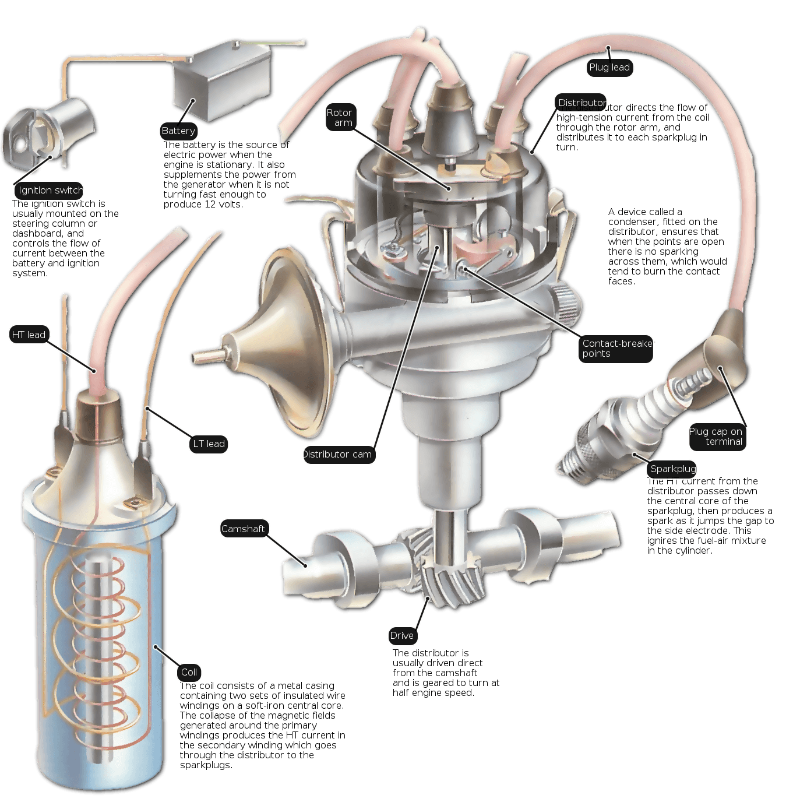
IGNITION SYSTEMS

Slide 10
What is Ignition System ???
➢ The system in an internal-combustion
engine that produces the spark
to ignite the mixture of fuel and air:
includes the battery, ignition coil,
distributor, spark plugs, and associated
switches and wiring.

Slide 11
IGNITION FUNCTION
 Produces 30,000 volt spark across spark plug
 Distributes high voltage spark to each spark plug in
correct sequence
 Times the spark so it occurs as piston is nearing top dead
Center
 Varies spark timing with load, speed, and other conditions

Slide 12
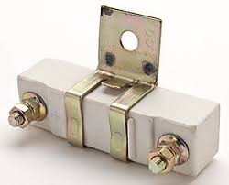
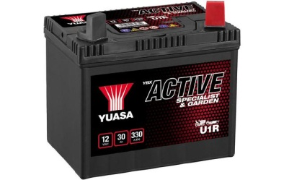
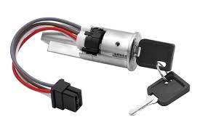
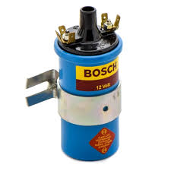
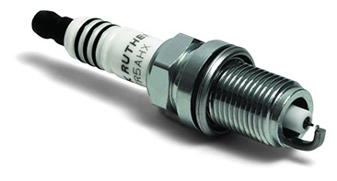
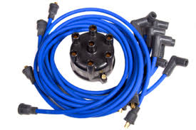
BASIC IGNITION SYSTEM
COMPONENTS
 BATTERY
 IGNITION SWITCH
 BALLAST RESISTOR
 IGNITION COIL
 SWITCHING DEVICE
 SPARK PLUG
 IGNITION SYSTEM WIRES

Slide 13
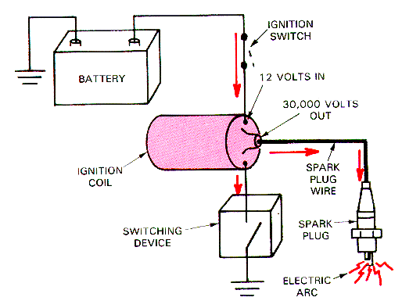
BASIC IGNITION SYSTEM
 Battery supplies power to
entire system
 Ignition Switch turns
engine on or off
 Coil transforms volts
 Switching device triggers
ignition coil
 Spark Plug and wires
distribute spark

Slide 14
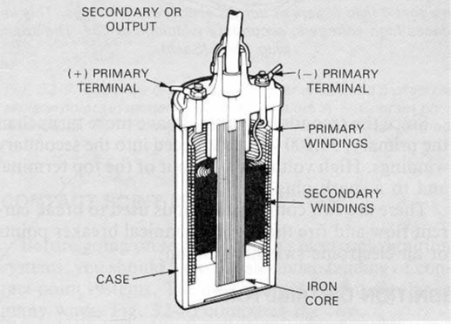
IGNITION COIL
 Transformer
 2 sets of windings
 Primary windings
 Secondary windings
 Iron core
 Produces magnetic
field

Slide 15
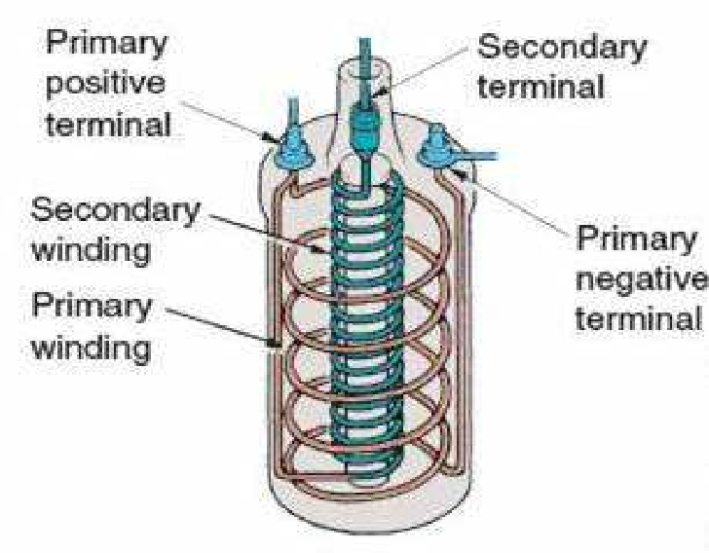

Slide 16
IGNITION SYSTEM TYPES
 Battery ignition system
 Magneto ignition system
 Distributor less ignition system

Slide 17
BATTERY IGNITION SYSTEM
➢ A battery ignition system has a 6- or 12-volt battery
charged by an engine-driven generator to supply
electricity, an ignition coil to increase the voltage, a
device to interrupt current from the coil, a distributor to
direct current to the correct cylinder, and a spark plug
projecting into each cylinder.
➢ Current goes from the battery through the primary
winding of the coil, through the interrupting device, and
back to the battery.

Slide 18
The primary circuit consist of the battery, ammeter, ignition
switch, primary coil winding, capacitor, and breaker points.
The function of these components are :
➢ Battery – Provides the power to run the system
➢ Ignition switch – allows the driver to turn the system on
and off
➢ Primary coil – produces the magnetic field to create the
high voltage in the secondary coil.
➢ Breaker points – a mechanical switch that acts as the
triggering mechanism
➢ Capacitor – protects the points from burning out.

Slide 19
The Secondary circuit converts magnetic induction into high
voltage electricity to jump across the spark plug gap, firing
the mixture at the right time. The function of the components
are –
➢ secondary coil – the part of the coil that creats the high
voltage electricity.
➢ Rotor – spin around on the top of the distributor shaft, and
distributes the spark to the right spark plug.
➢ spark plug – Take the electricity from the wires and give it
an air gap in the combustion chamber to jump across to light
the mixture.

Slide 20
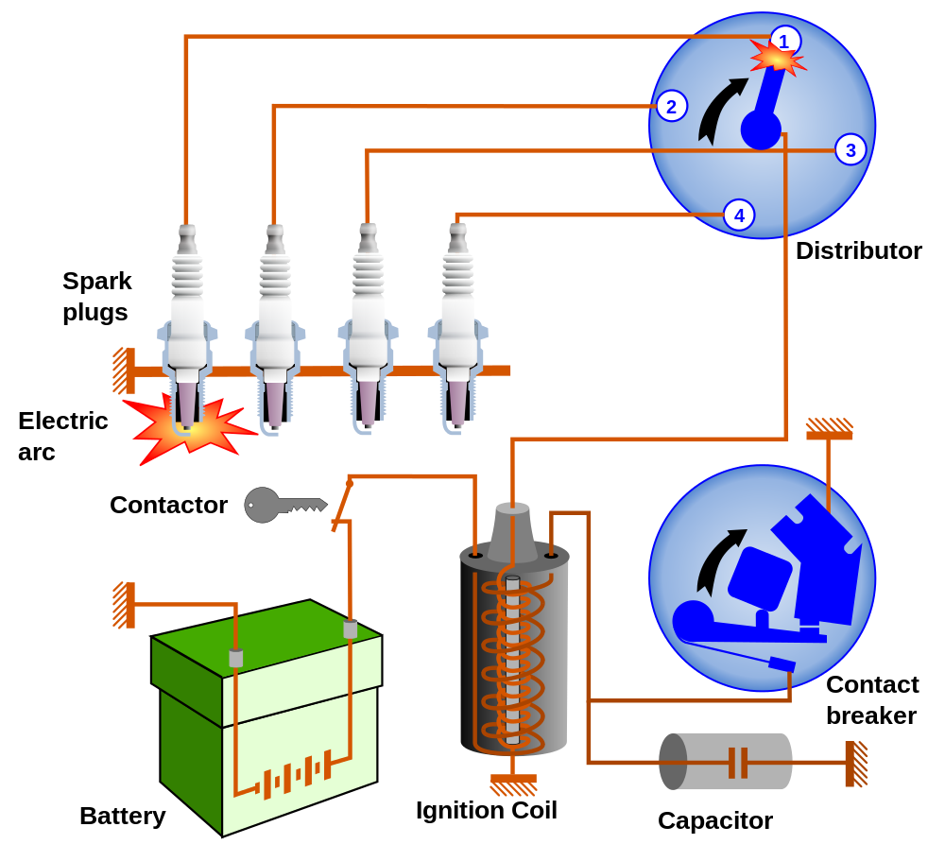
BATTERY IGNITION SYSTEM

Slide 21
MAGNETO IGNITION SYSTEM
➢ The simplest form of spark ignition is that using
a magneto.
➢ An ignition magneto, or high tension magneto, is
a magneto that provides current for the ignition system of
a spark-ignition engine, such as a petrol engine.
➢ The engine spins a magnet inside a coil, or, in the earlier
designs, a coil inside a fixed magnet, and also operates
a contact breaker, interrupting the current and causing the
voltage to be increased sufficiently to jump a small gap.
➢ The spark plugs are connected directly from
the magneto output.

Slide 22
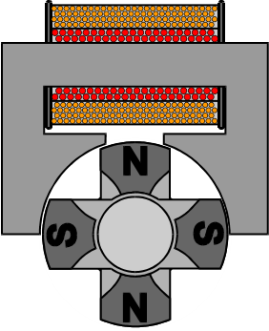
Magneto Unit
Rotor Arm
Spark Generation
Condenser
Power
Generation
Coil
Distribution
Magneto
Contact
Breaker
Ignition
Switch
IGNITION SYSTEM – Magneto System

Slide 23
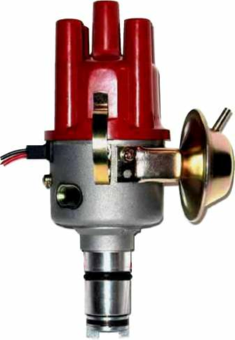
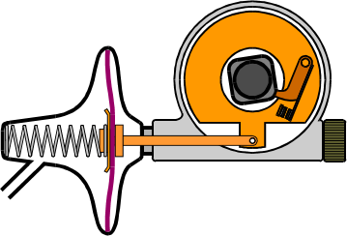
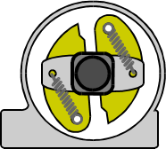
Typical
Distributor
Vacuum Advance
Diaphragm
Adjustable
Plate
Vacuum
Chamber
Cap
‘Points’
Body
Inlet
Pressure
Cam
Adjuster
Centrifugal
Advance
Input
Shaft
Centrifugal
Weights
IGNITION SYSTEM – Distributor

Slide 24
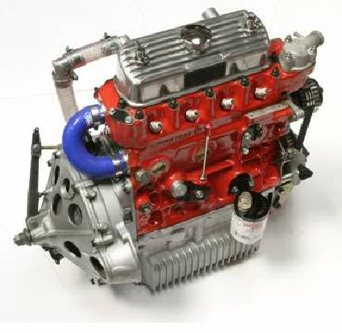
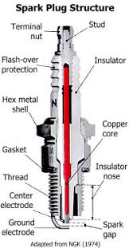
Cap Connector
Ceramic Body
Hexagon
Outer Casing
Copper Sealing Gasket
Securing Thread
Gap
Outer
Electrode
IGNITION SYSTEM – Spark Plug

Slide 25
IGNITION SYSTEM TROUBLESHOOTING
Problem
Possible causes and/or solutions
No spark out of the coil
Possible open in the ignition switch
circuit
Possible defective ignition module
(if electronic ignition coil)
Possible shorted condenser
Weak spark out of the coil
Possible high-resistance coil wire or
spark plug wire
Possible poor ground between the
distributor or module and the
engine block
Engine missing
Possible defective (open) spark plug
wire Possible
worn or fouled spark plugs
Possible defective pickup coil
Possible defective module
Possible poor electrical connections
at the pickup coil and/or module

Slide 26
Cooling Systems

Slide 27
Cooling System
An automotive cooling system must perform several functions
1. Remove excess from the engine
2. Maintain a consist engine temperature
3. Help a cold engine warm-up quickly
4. Provide a means of warming the passenger compartment

Slide 28
Cooling System
Automotive cooling systems operate around 180-212 degree F (82 to 100 deg C)
Engine coolant is used to remove heat from the cylinder to the radiator where in is then dissipated.
Engine coolant mixture should be approximately a 50/50 mixture of coolant and water.

Slide 29
Cooling System
Water soluble oil is used as a lubricant in all coolants systems components
Coolant uses lubricant in coolant to lubricate the water pump.
Coolant is a mixture of water and antifreeze. (Normally 50/50 mixture)
Some people refer to coolant as antifreeze

Slide 30
Cooling System
An automotive radiator is used as a heat exchanger.
Hot coolant from the engine is transferred to the radiator and cooler coolant is transfer to the engine by heavy duty hoses.
There are two types of radiators
Cross flow and Down Flow

Slide 31
Cooling System
The cross-flow radiator is normally shorter than a down flow allowing for shorter hood lines.
A down-flow radiator is used on larger vehicles that requires more cooling capacity.

Slide 32
Cooling System - RADIATOR
The components that make-up the radiator is
1. Radiator core: center section of the radiator
2. Radiator Tank: Medal or plastic end that cover the ends of the core and provide a coolant storage areas.

Slide 33
Cooling System - THERMOSTAT
To maintain proper engine temperature a thermostat is used.
Modern engine operate at higher operating temperature. Therefore most modern thermostat open around 195 degrees F(90.5deg. C)
The thermostat is used to regulate the flow of coolant thought-out the cooling system.
Installing a thermostat in the wrong direction can cause sever engine damage due to overheating.

Slide 34
Cooling System - FAN
Most cooling system use some type cooling fan there are 3 types of fans
A flex fan is mounted to the front of the engine and operates continually when ever the engine is running.
A Clutch fan is also mounted to the front of the engine but will only pull air through the radiator when the engine is hot
An electric fan is used on front wheel drive vehicles and will only operate when commanded by the PCM.

Slide 35
Cooling System WATER PUMP
A water pump is used to circulate coolant thought out the cooling system.
Water pumps consist of
Water pump impeller
Water pump shaft
Water pump seal
Water pump bearing
Water pump housing

Slide 36
FUEL SYSTEM
WHEN WORKING WITH FUEL SYSTEM: THERE IS AWAYS A DANGER OF FIRE.
NEVER SMOKE OR HAVE ANY TYPE OPEN FLAMES ARROUND ANY OPEN FUEL SYSTEM

Slide 37
FUEL SYSTEM
Earlier vehicles used carburetors.
Carburetor were used until the mid-80
Vehicles used carburetors until the mid Tougher emission requirement has made carburetor extinct.
New emissions standards requires HC and CO be controlled.

Slide 38
FUEL SYSTEM
Carburetor are more complicated than fuel injection. More automotive carburetor have 5 distinct circuits.
1. Idle circuit
2. Enrichment circuit
3. Off Idle Circuit
4. High Speed circuit
5. Enrichment circuit
6. Choke Circuit

Slide 39
FUEL SYSTEM
With carburetors and choke plate was is used to close off the air horn so that less air and more fuel can enrich fuel mixture during cold start-up conditions.

Slide 40
FUEL QUIZ
Choke Plate
Float
Fuel Bowl
Fuel Filter Fuel Line
Intake Manifold

Slide 41
FUEL SYSTEM
Late model vehicle have all started using fuel injection as a means of delivering fuel to combustion chamber.
Fuel injection offers some major advantage over carburetion.
A. Better fuel economy
B. No need for Manifold heat
C. Higher torque at lower speeds.

Slide 42
FUEL
Power Train Control Module
12 volts
Injector ground
Fuel Filter
Fuel Injector
NOTE: You will be asked to explain basic TBI injection at end of presentation
Fuel Tank

Slide 43
FUEL SYSTEM
Better fuel economy. With the addition of electronic engine controls fuel injection can be injected into the combustion at the instance the intake valve is opened.
With carburetion and some early fuel injection system fuel was injected into the intake manifold. Fuel then had to travel to the intake combustion chamber.

Slide 44
FUEL SYSTEM
For proper combustion the correct amount of air and fuel must mix before entering the combustion chamber.
The ideal air fuel mixture is 14.7-1

Slide 45
FUEL SYSTEM
When ever fuel is added to air the fuel mixture will become richer
When air is added fuel mixture will become leaner
Colder engine requires a richer fuel mixture than hot engines.

Slide 46
FUEL SYSTEM
When the ideal fuel mixture of 14.7-1 is reached the vehicle combustion should be ideal and render the most power with least amount of exhaust emissions.
Stoichiometric is the term used to describe the ideal fuel mixture.
All late model fuel injected engine are electronically controlled

Slide 47
FUEL SYSTEM
With the addition of fuel injection several sensor had to be added to the engine to ensure proper fuel mixture.
Some of the more importance sensor are
A. Mass air flow sensor/MAP
B. Oxygen sensor
C. Throttle position sensor
D. Coolant sensor

Slide 48
FUEL SYSTEM
The sensor system is responsible for monitoring:
A. Intake air temperature
B. Engine load
C. Engine temperature
D. RPM

Slide 49
FUEL SYSTEM
Oxygen sensor: Is mounted in the exhaust system senses the amount of oxygen in the exhaust gasses.
All Feedback carburetors and fuel injection system use and oxygen sensor to determine the amount of unburned fuel in the exhaust system.

Slide 50
FUEL SYSTEM
NOTE: Later model vehicle use 2 Oxygen sensor minimum to determine fuel mixture and catalytic converter efficiency.
NOTE: We will be covering engine controls in more detail later.

Slide 51
FUEL SYSTEM
A Mass Air Flow Sensor (MAF) or Manifold Absolute Pressure (MAP) sensor is used to determine:
A. Engine load
B. Air temperature (MAF)
C. Help determine ignition timing

Slide 52
FUEL SYSTEM
Engine temperature is very important in determining proper fuel mixture. For that reason an Engine Coolant Temperature (ECT) sensor is mounted in the intake manifold.
The ECT sends a analog signal to the PCM that is in direst proportion to the engine temperature.

Slide 53
FUEL SYSTEM
A throttle position sensor (TPS) is used by the PCM to determine the angle of the throttle.
The more the throttle is open the more air entering the engine. More air means more fuel.

Slide 54
FUEL SYSTEM
There are 3 typical types of fuel injection systems.
1. Throttle Body (TBI)
2. Port fuel injection system
3. Sequential Fuel injection system

Slide 55
FUEL SYSTEM
A throttle body fuel injection system uses either one or 2 injector mounted in a throttle body that looks similar to a carburetor.
Port fuel injection and sequential fuel injection system uses a fuel injector mounted at each cylinder
All type fuel system uses a filter inline capture dirt and contaminants before entering the engine.

