Slide 1
Combustion In Internal Combustion Engines

Slide 2
Combustion in SIE
Fuel and air
Mixture | Homogeneous
Method of ignition | Spark ignition
Type of combustion | Flame propagation
Heat cycle | Otto cycle (const. volume)
Fuel | Aromatics (ring bond type)

Slide 3
Combustion in SI Engines
Combustion in SIE
Normal Combustion
Abnormal Combustion
Pre- ignition
Detonation

Slide 4
Combustion in SIE

Slide 5
Combustion in SIE
Here flame travel across combustion chamber from start “Spark Position”
and spread all over the chamber till it reach its end in the same direction.
Or
The combustion which starts with a timed spark and initiates a flame front and the turbulent flame spreads away from the spark discharge location by a speed called “Flame Speed”.
The steps of normal combustion:
❑
❑
❑
Ignition delay.
Main combustion process (Flame Front Propagation). Afterburning.

Slide 6
P-θ Diagram
Combustion in SIE

Slide 7
1st Stage : Ignition Delay: (Constant time)(1.5 to 2 m sec)
Combustion in SIE
The first stage (A-B) corresponds to the time for the formation of the self propagating nucleus of the flame.
It is a chemical process depends on:
The nature of fuel,
The temperature and pressure of the fuel/air mixture,
The concentration of residuals ,
The chemical reaction rate.
It is also influenced by local turbulence.

Slide 8
2nd Stage: Main combustion process (Flame Front Propagation).
Combustion in SIE
(Constant crank angle)
The propagation of the flame throughout the combustion chamber.
It is a chemical-physical process depends on:
Chemical composition
Temperature and pressure
Degree of turbulence
3rd Stage: Afterburning.
The chemical reactions when the flame front reaches the cylinder walls specially when the mixture is not completely homogeneous, cause the temperature to rise to a point of maximum at (G) following the point of pressure maximum at (c).
This stage resembles the ignition delay period because it depends mainly on the rate of chemical
not the turbulence.

Slide 9
Note:-
Combustion in SIE
Maximum work and power of the cycle can be obtained when the second stage of combustion begins and ends symmetrically with respect to TDC .
This can be achieved by adjusting the ignition timing.

Slide 11
The turbulent flame spreads away from the spark discharge location by a speed called “ Flame Speed”.
Combustion in SIE
Effect of flame speed on cylinder pressure:-

Slide 12
Combustion in SIE
Flame speed vs Fuel type:-
Fuel | Max. flame speed (cm/s)
Methane, CH₄ | 37.3
Ethane, C₂H₆ | 44.2
Propane, C₃H₈ | 42.7
Hydrogen, H₂ | 291.2
Carbon Monoxide, CO | 42.9

Slide 13
Factors affecting on Flame Speed:-
Combustion in SIE
1. Load:
By throttling,
The initial pressure and the pressure at the point of ignition decrease and the residual gas in the mixture increase. The first phase of combustion prolongs and the combustion process loses its stability. To overcome this difficulty to some extent, a rich mixture is used which may ensure proper combustion, but the combustion process may continue during a substantial portion of the expansion stroke.
In part load the combustion of fuel in the spark ignition engine is poor,
causing a large amount of products of incomplete combustion in the exhaust including carbon monoxide, oxides of nitrogen and hydrocarbons which are responsible for air pollution. Part load combustion is improved by using a rich mixture but it causes wastage of fuel.
When the load is reduced, the power of an engine is reduced.

Slide 14
2. Turbulence:
Combustion in SIE
The turbulence helps in mixing and accelerates chemical reaction, this is mainly due to increasing the surface area of the flame which leads to increasing in the rate of reaction.
The flame speed increases with increasing turbulence.
3. Engine Speed:
when engine speed increases, flame speed increases due to turbulence, swirl, squish .
The flame speed increases almost linearly with the engine speed.

Slide 15
Combustion in SIE
The effect of engine speed on pressure inside engine :-

Slide 16
4. Compression ratio (r_{c} ):
Combustion in SIE
A higher compression ratio increases the pressure and temperature of the working mixture inside the cylinder.
Increased compression ratio reduced the clearance volume and therefore increases the density of the cylinder gases during burning. This increases the peak pressure and temperature and the total combustion duration decreases.
For engine have higher compression ratio, have higher flame speed.
For engine have higher compression ratio, less advance of ignition is required.

Slide 17
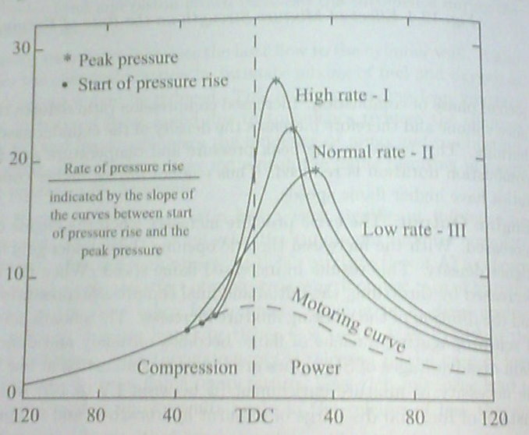
Rate of Pressure RISE

Slide 18
5. Inlet Temperature and Pressure:
Combustion in SIE
A higher initial pressure and temperature may help to form homogenous air and fuel mixture which helps in increasing the flame speed. This is possible because of an overall increase in the density of the charge.
flame speed increases with an increase in intake temperature and pressure.
6. Mixture ratio:
The A/F ratio has a very significant influence on the flame speed. The highest flame speed (minimum time for complete combustion) are obtained with richer mixture and the lowest flame speed (maximum time for complete combustion) are obtained with leaner mixture.
Next sketch shows the relation between the mixture ratio and flame speed. It can conclude that in leaner or richer mixture, the flame speed decreases. When the mixture is lean or very rich , the combustion is incomplete because of less thermal energy which resulting in lower flame speed

Slide 19
Combustion in SIE
Effect of mixture strength on flame speed:
Note:-
The highest flame speeds ( minimum time for complete combustion) are obtained with slightly rich mixture ( point A).

Slide 20
Combustion in SIE

Slide 21
7. Spark time:-
Combustion in SIE
The spark time adjust has direct effect on flame speed and it should be
before TDC (due to the ignition lag) to obtain maximum power.
The optimum angle of advance allows combustion to cease just after TDC, so that maximum possible pressure is built at a point just at the beginning of expansion stroke. This is shown as the normal curve, indicating smooth engine running.
Spark advance: lead to increase the peak pressure and temperature and it make good combustion. So that Spark Advance -------- lead to High flame speed .
Spark retard: lead to decrease the peak pressure and temperature and it
make bad combustion. So that Spark Retard -------- lead to Low flame speed.

Slide 22
Combustion in SIE

Slide 24
Or Pinging

Slide 26
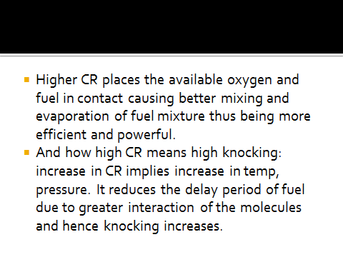

Slide 28
PHENOMENON OF KNOCKING IN SI ENGINE

Slide 29
AUTO IGINITION
A mixture of fuel and air can react spontaneously and produce heat by chemical reaction in the absence of flame to initiate the combustion or self-ignition. This type of self- ignition in the absence of flame is known as Auto-Ignition. The temperature at which the self-ignition takes place is known as self- igniting temperature.

Slide 30
PRE-IGNITION
Pre-ignition is the ignition of the homogeneous mixture of charge as it comes in contact with hot surfaces, in the absence of spark .
Auto ignition may overheat the spark plug and exhaust valve and it remains so hot that its temperature is sufficient to ignite the charge in next cycle during the compression stroke before spark occurs and this causes the pre-ignition of the charge.

Slide 31
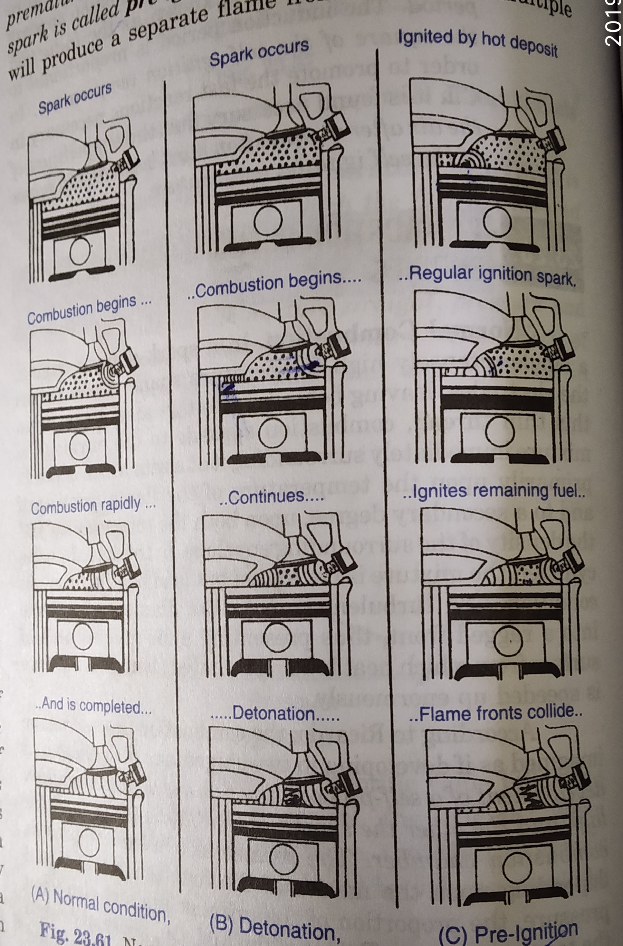

Slide 32
EFFECT OF DETONATION
Noise and Roughness.
Vibration
Mechanical Damage.
Decrease in power output and efficiency.
Pre-ignition.

Slide 33
Factors affecting Detonation or Knocking in SI engine
1.Compression ratio:
The pressure and temperature at the end of compression increases with increase in compression ratio. This in turn increase the maximum pressure during the combustion and creates a tendency to knock

Slide 34
Supercharging:
It is the process of allowing the charge at a pressure higher than atmospheric pressure. Because of supercharging the density and temperature increases there by knocking tendency increases.
Super charging is generally done on CI engines
Increasing inlet temperature:
It results in increase in knocking.

Slide 35
4.Increase in load:
increase in load result in increase in
temperature of the cylinder, there by rising the temperature and hence knocking tendency increasing at high loads.
5.Advancing the spark:
when the spark is advance the burning gas is compressed by rising piston and therefore the increase in temperature will be much more and hence the knocking tendency increases.
To avoid detonation spark must be retarded.

Slide 36
Flame travel distance:
Flame travel distance should be small to avoid detonation.
Spark plug location:
spark plug which is located centrally has minimum tendency for knocking because the flame travel distance decreases.
Engine size:
For larger engine size the flame travel distance will be longer and hence knocking chances are high, because of this reason SI engine sizes are generally limited.

Slide 37
9.Location of exhaust valve:
There are two hot spot zone in SI engines. i.e spark plug & exhaust valve. If the exhaust valve is very far from the spark plug the temperature around exhaust valve region will be high. If the spark plug is very far it will take much time and during this time the charge near exhaust valve would autoignitied due to high temperature and hence exhaust valve must be located as close to spark plug as possible. So the flame travel distance is minimized.

Slide 38
Turbulence:
With increase in turbulence the flame speed increases and hence the chances of detonation would decreases.
Engine speed:
Increase in engine speed increases turbulence & hence knocking tendency decreases.
Octane rating of fuel:
For better antiknock properties octane number must be high.

Slide 39
Rating of SI Engine Fuels – Octane Number
The Percentage by volume of Iso-Octane in a mixture of Iso-Octane and Normal Heptane, which exactly matches the knocking intensity of a given fuel.
If a mixture of 50% iso-octane and 50% n-Heptane matches the fuel under test . Then this fuel is assigned an octane number rating of 50.
Iso-octane= 100 Octane number
N-Heptane= 0 Octane number

