Slide 1
Biconnected Component

Slide 3
Articulation Point : A vertex is said to be an articulation point in a graph if removal of the vertex and associated edges disconnects the graph. So, the removal of articulation points increases the number of connected components in a graph. Articulation points are sometimes called cut vertices.

Slide 6
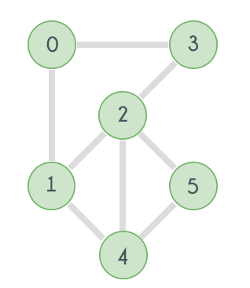
The given graph is clearly connected. Now try removing the vertices one by one and observe. Removing any of the vertices does not increase the number of connected components. So the given graph is Biconnected.

Slide 7
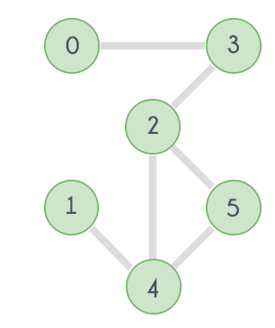
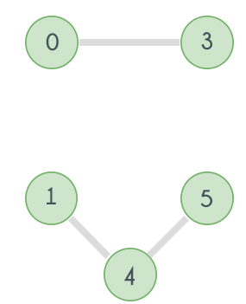
In the graph if the vertex 2 is removed, then here's how it will look
if vertex 3 is removed there will be no path left to reach vertex 0 from any of the vertices 1, 2, 4 or 5. And same goes for vertex 4 and 1. Removing vertex 4 will disconnect 1 from all other vertices 0, 2, 3 and 4. So the graph is not Biconnected.

