Slide 1
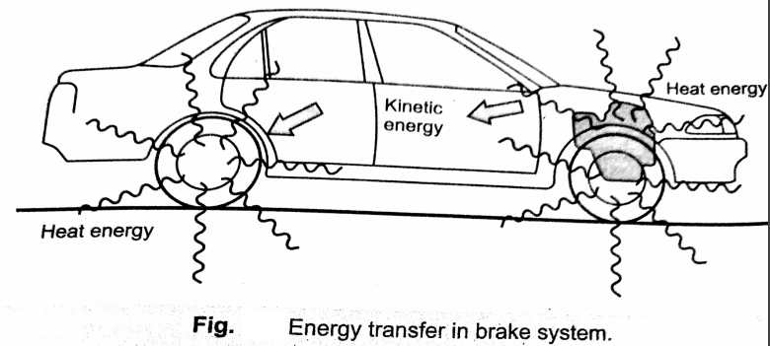
BRAKING SYSTEM:
The brakes cause the vehicle to decelerate or stop and hold the vehicle in position while stationary.
When the brakes are applied to a moving vehicle, the kinetic energy( or energy of motion) of the vehicle is transferred into heat energy by the friction as shown in fig.
The heat generated is dissipated to the surrounding air.

Slide 2
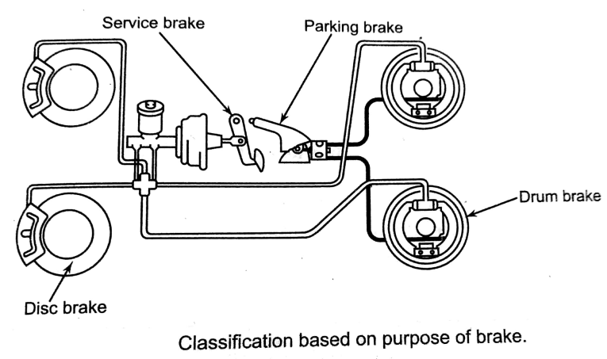
Classification of brakes:
According to the purpose of the brakes:
a) service or foot brake and b) Hand brake or parking brake.
2) According to the construction of the brakes:
Drum brakes and b) Disc brakes.
3) According to the method of operation
a) Mechanical brakes, b) Hydraulic Brakes c) vacuum brakes, d) Air brakes, e) Electric brakes.

Slide 3
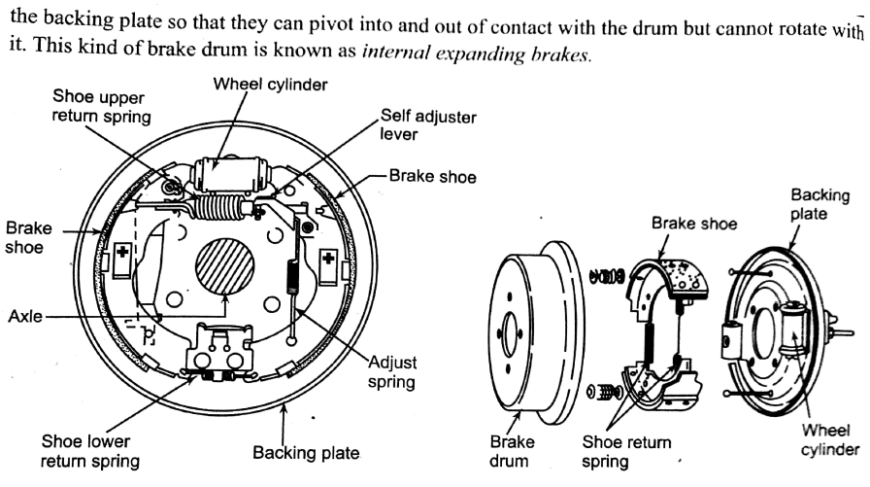
Drum brakes:

Slide 4
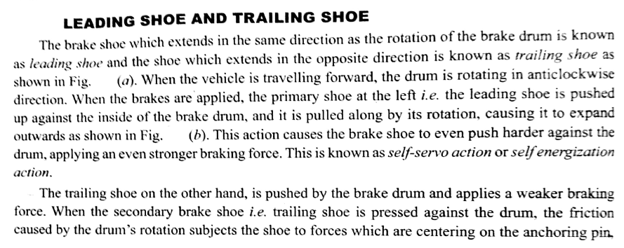

Slide 5
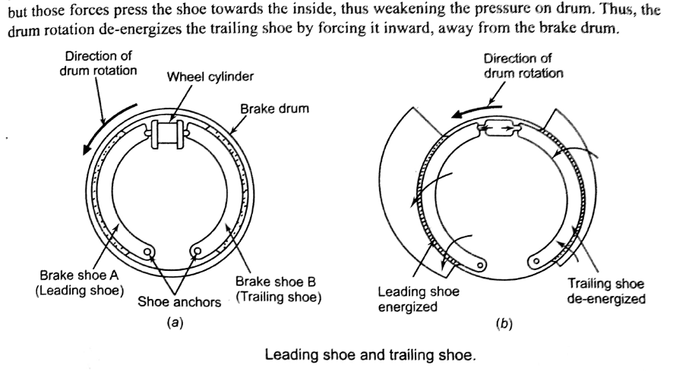

Slide 6
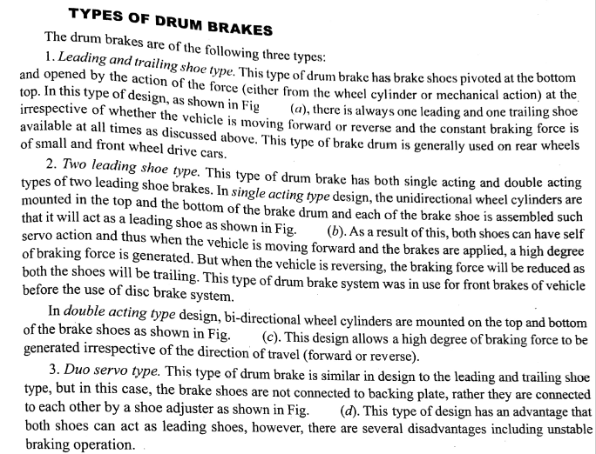

Slide 7
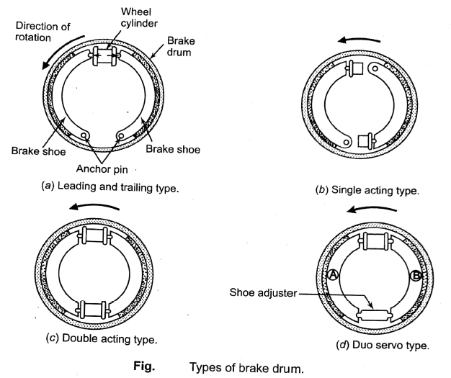

Slide 8
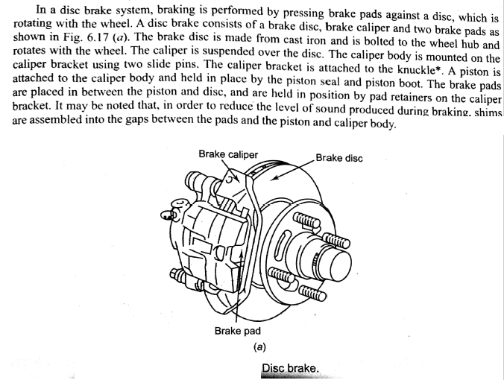
Disc brakes:

Slide 9
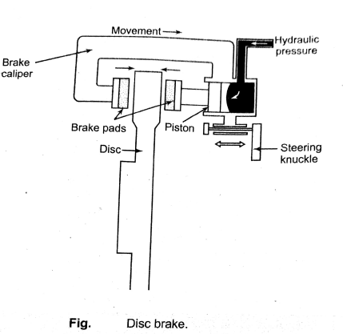

Slide 10
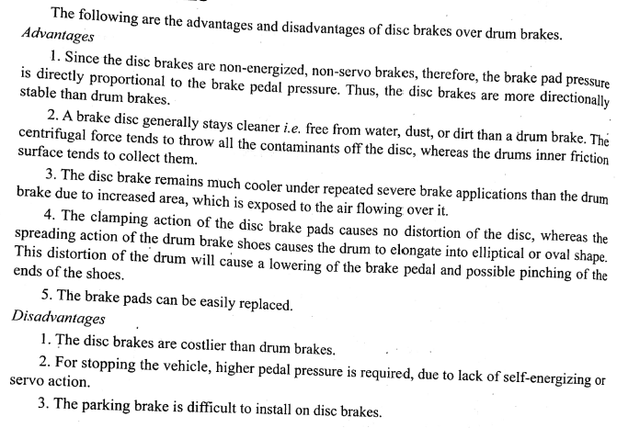
Advantages and disadvantages of disc brakes over drum brakes:

Slide 11
Mechanical Brake:

Slide 12
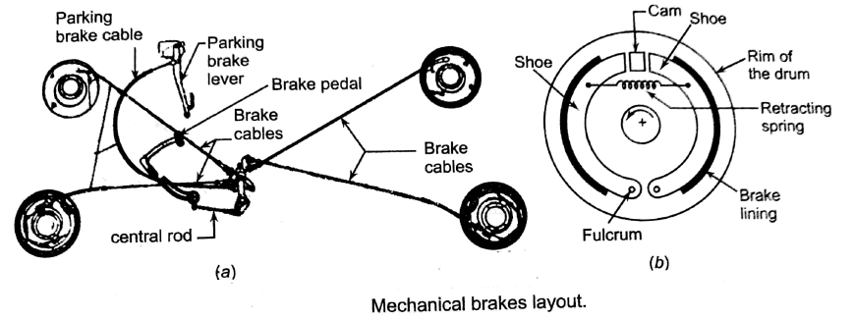

Slide 13
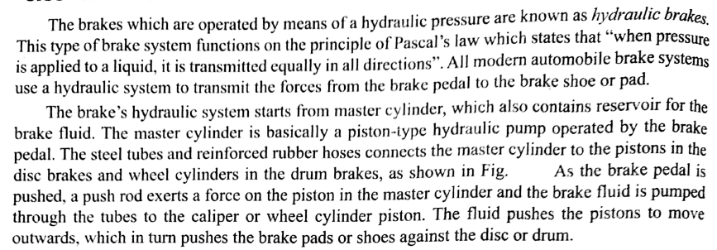
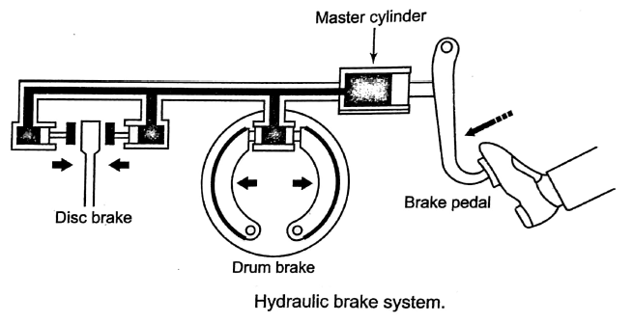
Hydraulic Brakes:

Slide 15
a) Single Master Cylinder:

Slide 16
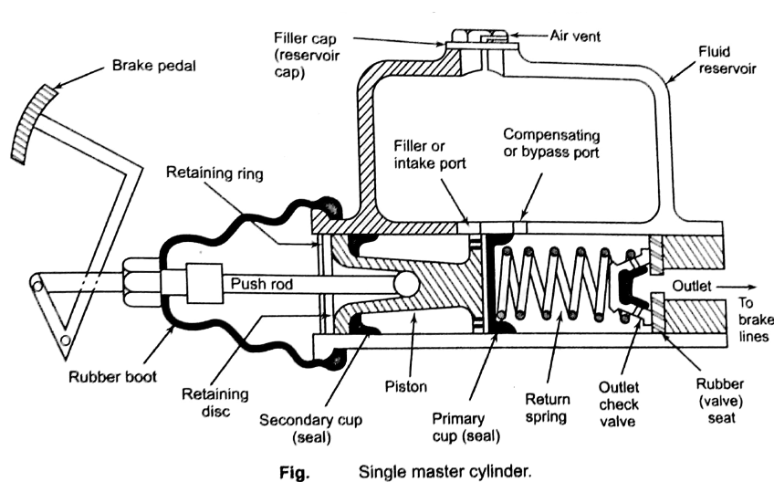

Slide 17
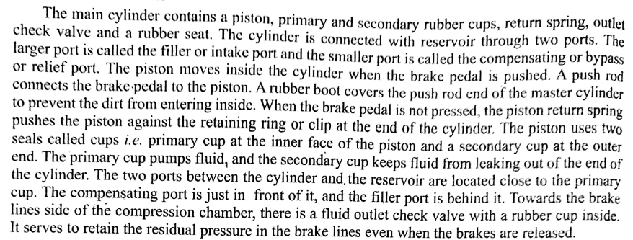

Slide 18
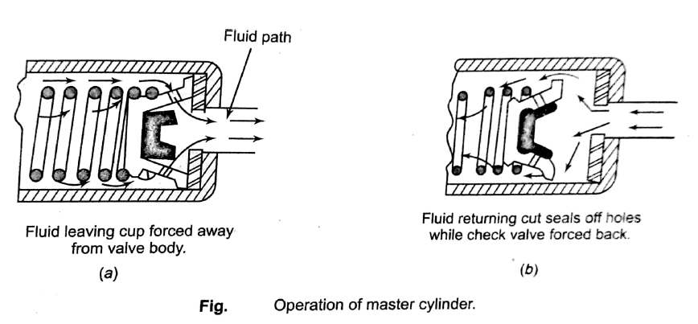

Slide 19
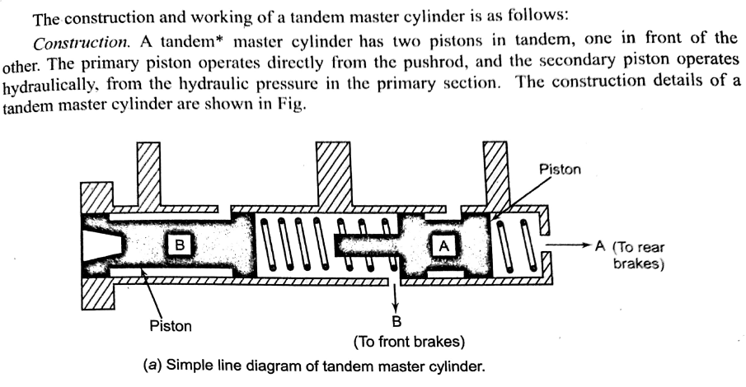
b) Tandem Master Cylinder:

Slide 20
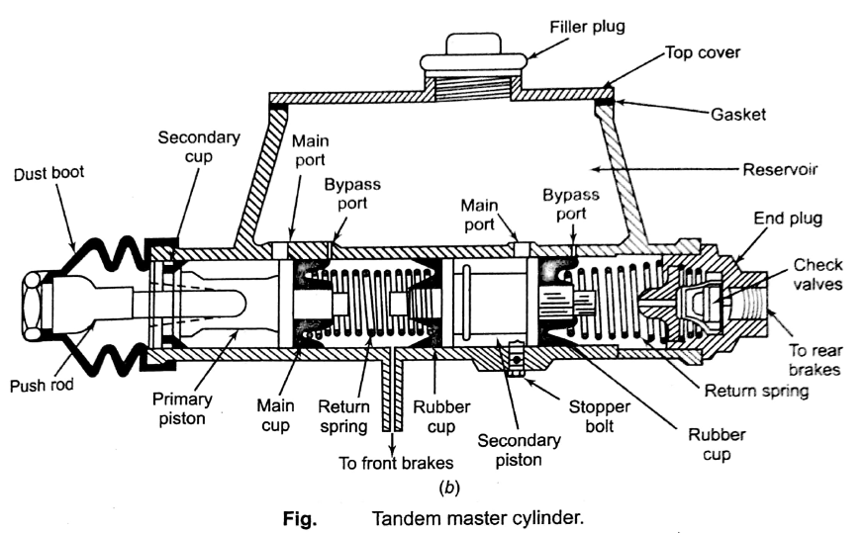

Slide 21
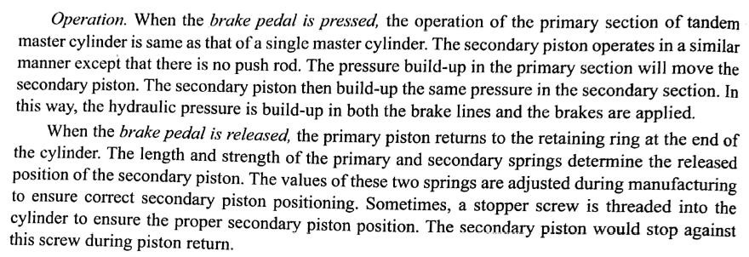

Slide 22
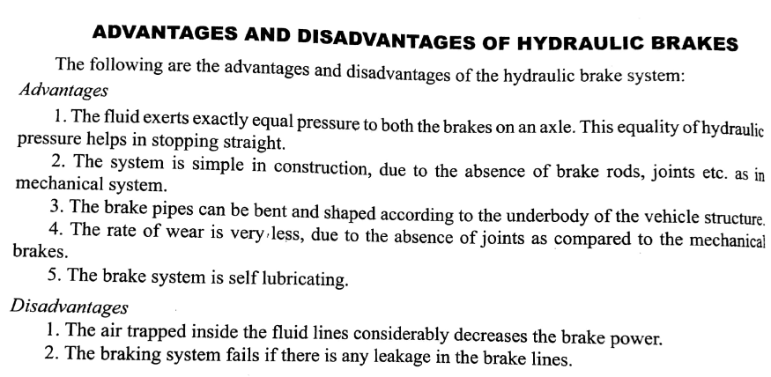

Slide 23
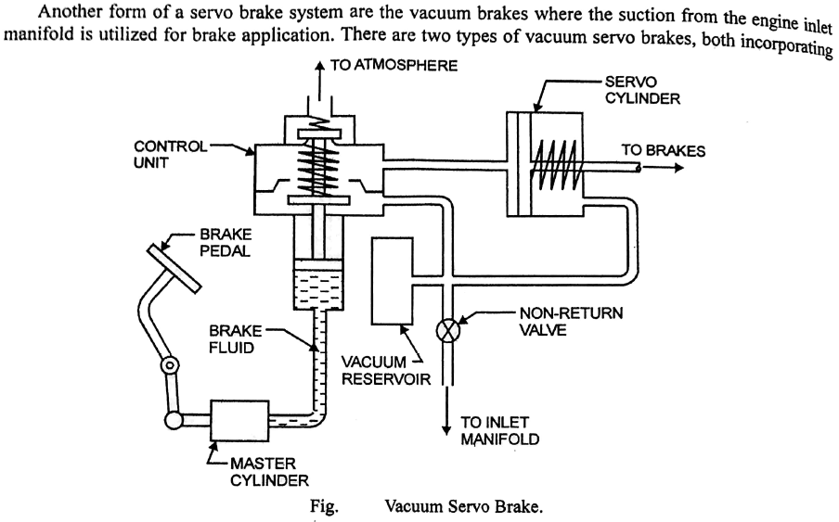
Vacuum Braking system:

Slide 24
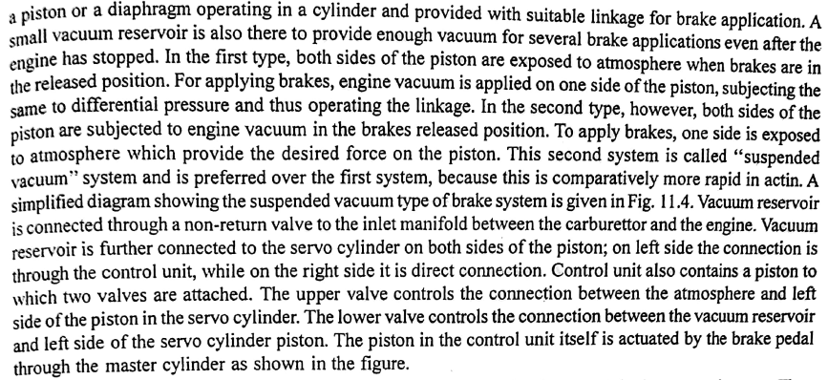

Slide 25
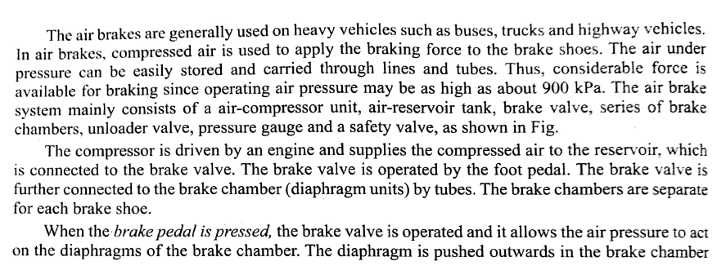
Air Braking system:

Slide 26
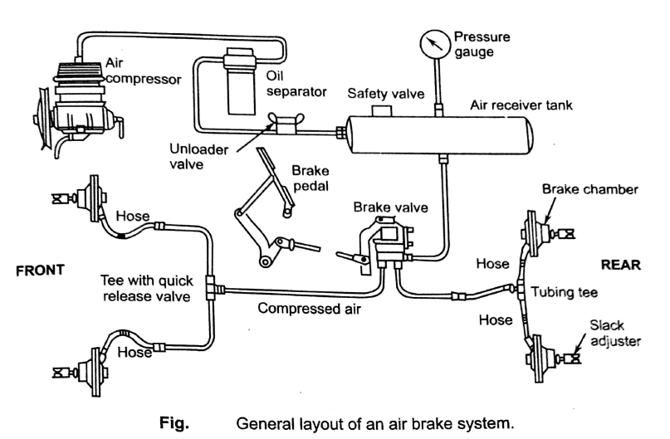

Slide 27
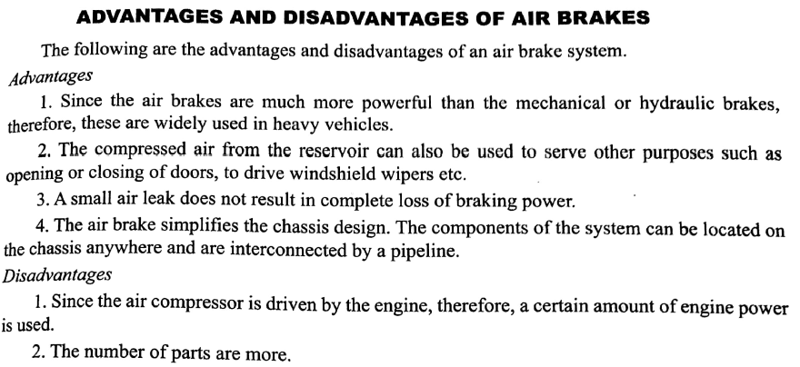

Slide 28
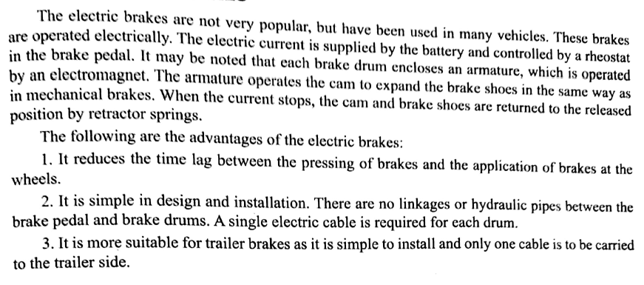
Electric Braking system:

