Slide 1
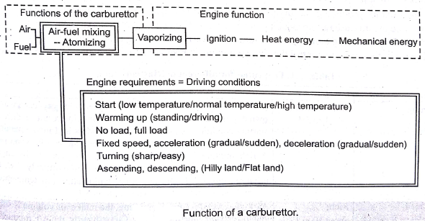
CARBURETION:
The process of formation of a combustible fuel-air mixture by mixing the proper amount of fuel with air before admission to engine cylinder is called carburetion the device which does job is called a carburetor.
Following factors affecting on carburetion:
The engine speed.
The vaporization characteristics of the fuel.
The temperature of the incoming air.
The design of the carburetor.

Slide 2
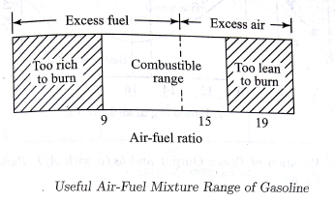
Types of Air-Fuel Mixtures:
Chemically Correct Mixture
Stoichiometric or balanced chemical mixture in which air is provided to completely burn the fuel; the excess air factor is unity.
Rich Mixture
Fuel is in excess of what is required to burn the fuel completely. The excess air factor is less than unity.
Lean Mixture
Air is in excess of what is required to burn the fuel completely. The excess air factor is greater than unity.
Range of Air-Fuel Ratio in SI Engines
9:1 (rich) to 19:1(lean) ; The stoichiometric value for gasoline is 15:1, The SI engine will not run for too rich or too lean mixtures.

Slide 3
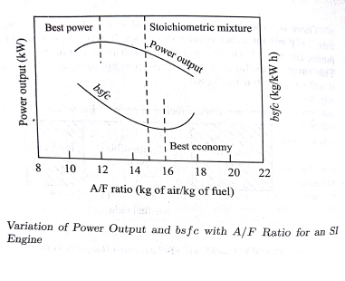
Mixture Requirements at Different Engine Conditions:
The air fuel ratio affects the power output and brake specific fuel consumption of the engine as shown in the Figure.
The mixture corresponding to maximum output on the curve is called best power A/F mixture, which is richer than the stoichiometric mixture. Says 12:1.
The mixture corresponding to maximum BSFC on the curve is called best economy mixture, which is leaner than the stoichiometric mixture. Says 16:1.

Slide 4
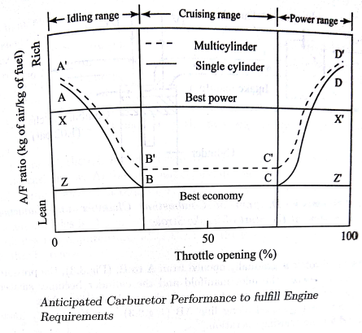
The actual A/F ratio requirement for an automotive carburetor falls in 3 ranges:
  Idling (rich)
  Cruising (lean)
  High Power (rich)

Slide 5
Idling Range (A-B)
During idling, engine operates at no load and closed throttle.
The engine requires rich mixture for starting at idling.
Rich mixture is required to compensate for the charge dilution due to exhaust gases from the combustion chamber.
Also, the amount of fresh charge admitted is less due to smaller throttle opening.
Exhaust gas dilution prevents efficient combustion by reducing the contact between the fuel and air particles.
Rich mixture improves the contact of fuel and air by providing efficient combustion at idling conditions.
As the throttle is opened further, the exhaust gas dilution reduces and the mixture requirement shifts to the leaner side.

Slide 6
Cruising Range (B-C)
Focus is on fuel economy.
No exhaust gas dilution.
Carburetor has to give best economy mixture i.e.. Lean mixture.
High Power Range (C-D)
As high power is required, additional fuel has to be supplied to achieve rich mixture in this range.
Rich mixture also prevents overheating by reducing the flame temperature and cylinder temperature.

Slide 7
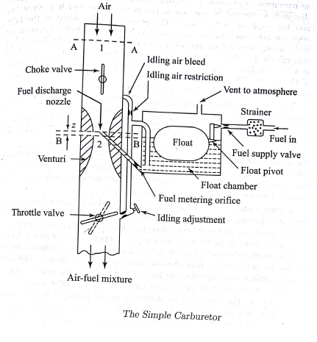
Principle of Operation of Simple Carburettor

Slide 8
Principle of Operation of Simple Carburettor
The carburettor works on Bernoulli's principle: the faster air moves, the lower its static pressure, and the higher its dynamic pressure.
The throttle (accelerator) linkage does not directly control the flow of liquid fuel. Instead, it actuates carburettor mechanisms which meter the flow of air being pulled into the engine. The speed of this flow, and therefore its pressure, determines the amount of fuel drawn into the airstream.
A simple carburetor consists of a float chamber, fuel discharge nozzle, a metering orifice, a venturi a throttle valve and choke.
The float and needle valve maintain the fuel level.
Fuel strainer is used to trap debris from the fuel and prevent choking of the fuel nozzle. It is removed periodically for cleaning.
During suction stroke air is drawn through the venturi.
Venturi accelerates the air causing a pressure drop.

Slide 9
Principle of Operation of Simple Carburettor
This pressure drop provides vacuum necessary to meter the air-fuel mixture to the engine manifold.
Fuel is fed to the fuel discharge jet, the tip of which is located at the throat of the venturi.
Pressure drop is proportional to the throttle opening or load on the engine.
Throttle valve achieves governing of SI engine by varying the A/F ratio. It is a butterfly valve located after the venturi tube. When the load is less, the throttle is in near closed position and if the load is high throttle is fully opened.
The choke valve is located between the entrance and venturi throat. It is also of butterfly type. When choke is partly closed, a large pressure drop occurs at the venturi throat, which provides a rich mixture by induction of large amount of fuel as required during idling or high load conditions. Choke valves are spring loaded to prevent excessive choking and are sometimes automatically controlled by thermostat.
For providing rich mixture during idling, an idling adjustment is provided. It has an idling passage and idling port.

Slide 10
Principle of Operation of Simple Carburettor
The system operates at starting and shuts off when 20% throttle opening is reached.
Normal venturi depression is not sufficient to provide rich mixture due to lower throttle opening. But this low pressure causes fuel rice in idling passage and it is discharged through idling port downstream of the throttle valve.
The idling air bleed sucks some air for mixing with the idling fuel and vaporizes the mixture. The additional fuel-air supply makes the mixture rich for idling.
Simple carburettor has the drawback of providing rich mixture with increasing throttle opening.

Slide 11
Compensating systems in Carburettors:
For part load conditions, the carburettor must supply economic air-fuel ratio mixture. The main metering system will not satisfy this requirement. The following compensating systems are used to achieve this:
Air Bleed Jet
Compensating Jet
Emulsion Tube
Back Suction Control Mechanism
Auxiliary Air Valve
Auxiliary Air Port
Altitude Compensating Device

Slide 12
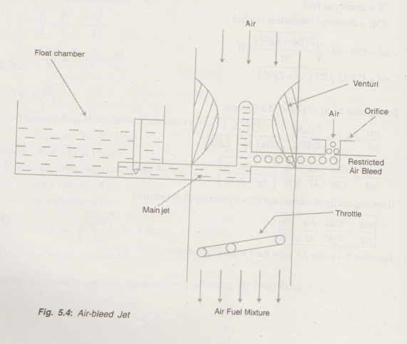

Compensating systems in Carburettors
Air Bleed Jet
It contains an air bleed to the main nozzle.
Air flow through the bleed passage is restricted by orifice.
When engine is not operating the bleed passage is filled with fuel.
When the engine starts the fuel from the bleed passage is displaced by air flow from the orifice.
The air and fuel form an emulsion at the tip of the bleed passage.
This causes faster delivery of fuel due to low viscosity and fuel discharged rises.
Thus uniform mixture ratio is supplied.

Slide 13
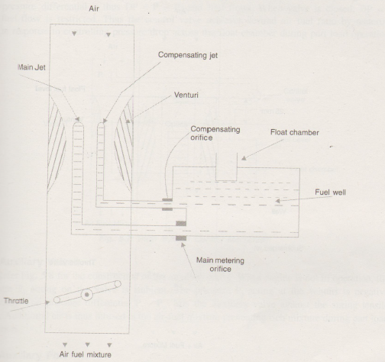
Compensating systems in Carburettors
Compensating Jet
The purpose of this is to make the mixture leaner as the throttle opens progressively.
An additional jet called compensating jet is provided with the main jet.
This jet is also connected to the fuel well and the fuel is metered through compensating orifice.
As the throttle opening increases the main jet makes the mixture richer by adding more fuel.
The compensating jet makes the mixture leaner proportionately. The total mixture will make A/F ratio constant.
When the main jet is lean, compensating jet is rich.

Slide 14
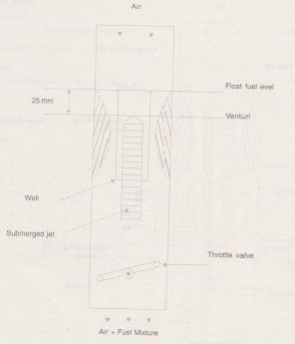
Compensating systems in Carburettors
Emulsion Tube
It is also known as submerged jet device.
Here, the main metering jet is kept at a level 25 mm below the fuel level in float chamber.
The jet is called submerged jet. The jet is placed in a well that has holes exposed to atmosphere.
When the throttle opening increases, the holes in the well are uncovered causing additional fuel and air to enter the air-fuel stream, causing the faster A/F mixture delivery during part load operation.

Slide 15
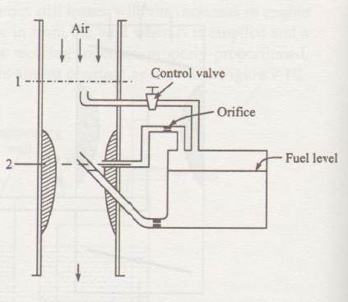
Compensating systems in Carburettors
Back Suction Control Mechanism
In this device, the top of the fuel chamber is connected to air entry by means of a large vent line fitted with a control valve.
The second line connects the fuel float chamber to venturi throat via a metering orifice.
When the control valve is opened, the pressure in float chamber is p₁ and the throat pressure is p₂ which is lower than p_{1.} This causes the fuel to flow. When the valve is closed, there is no difference in pressure and hence no fuel flow.
Thus the control valve achieves the desired air fuel ratio during part load operation.

Slide 16
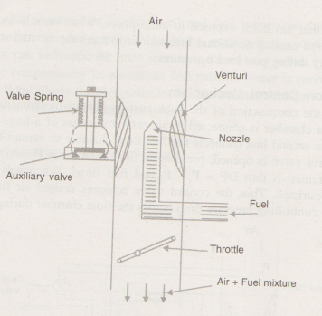
Compensating systems in Carburettors
Auxiliary Air Valve
When the engine is not in operation, the pressure p₁ acting on the valve is ambient. The pressure p₂ acting at the venturi is negative (vacuum). This pressure differential lifts the auxiliary valve against the spring tensile force.
Additional air is thus infused in the air-fuel mixture preventing rich mixture during part load operation.
I

Slide 17
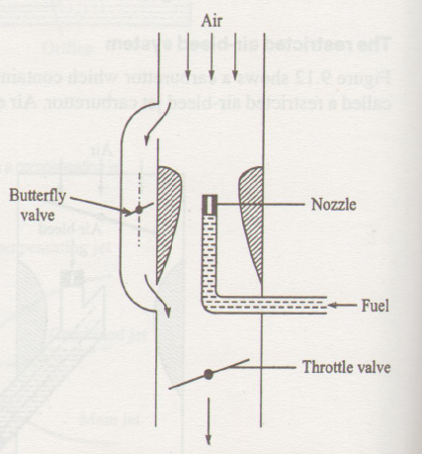
Compensating systems in Carburettors
Auxiliary Air Port
If the butterfly valve is opened, additional air passes through this port, reducing air flow through venturi. Thus pressure differential is comparatively smaller. Thus fuel drawn is reduced to compensate for loss in density of air at high altitudes.

Slide 18
Compensating systems in Carburettors
Altitude Compensation Device
This was used in high altitude car driving and for aircrafts.
At high altitudes, air density decreases and hence engine power output is affected.
A/F ratio is affected at high altitudes as carburettors are designed to operate on sea level.
To compensate for the change in air density, fuel flow has to be reduced from the calibrated value at sea level.
A mixture control system comprising a needle valve, which restricts fuel flow in proportion to altitude change acts as an altitude compensating device.

Slide 19
PETROL INJECTION SYSTEM:
The carburettors are provided with a wide range of different functions and capabilities in an effort to improve response characteristics.
But there is no one type of carburettor which can meet appropriately to all conceivable situations.
The main difference between carburettors and fuel injection system is that fuel injection system atomize the fuel by forcibly pumping it through a small nozzle under high pressure, while in a carburettor depending on low pressure created by intake air rushing through it to add the fuel to the air stream.
The following are the advantage of petrol injection system:
Improved fuel efficiency: the fuel efficiency is improved due to following reasons
Improved combustion efficiency: the combustion efficiency is better due to even distribution of fuel mixture and highly pressurized fine atomization of fuel.
Injector location: the injectors are located near to the cylinder attributing to less liquefaction.
Deceleration fuel cut off: the fuel is cut off during deceleration by injection control.

Slide 20
2) High power out put: high power is achieved due to even distribution of the fuel and increased air intake as there is no venturi resistance.
3) Minimize the emissions: because of precise control of air-fuel ratio exhaust pollution are reduced.
CLASSIFICATION OF FUEL INJECTION SYSTEM:
According to the location of the injector:
Throttle body injection: in this type of fuel injection system consists of a throttle body in which the injector assembly is attached, similar to the bottom half of a carburettor.
The injectors (one or two) are located above the throttle plate.
After the fuel is injected it goes through the intake manifold into the cylinders.
The induction mixture then passes through the intake manifold like a carburettor system and is thus also termed as wet manifold system.
b) Intake port fuel injection: this type of system is most commonly used in case of petrol injection systems.
in this type of fuel injection system, an injection is placed near each cylinder.
The fuel is sprayed into each intake port on the manifold side of the inlet valve.
In this case, mixing of air and fuel is better.

Slide 21
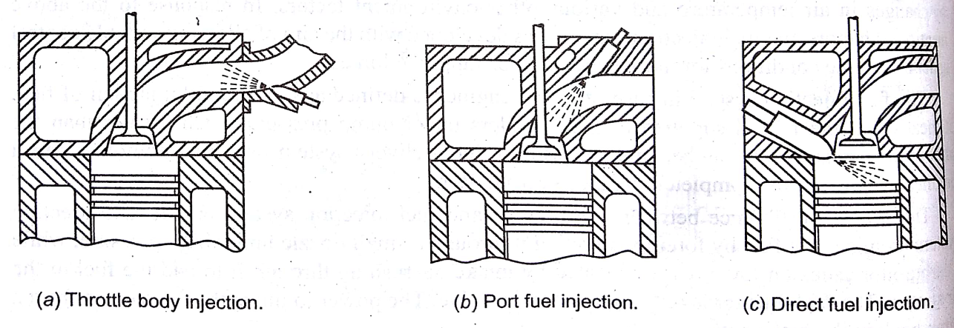
c) Direct injection: the modern petrol engines utilise direct injection system, which is referred to as gasoline direct injection(GDI).
In this type of system, the air and petrol( gasoline) are not pre mixed, air comes in the intake manifold, while the petrol is injected into the cylinders( combustion chambers).
This type of system is costly in compare to other indirect injection systems because the injectors are exposed to more heat and pressure.
This intake system is dry, making this very clean system.

Slide 22
2) According to the duration and timing of fuel injection:
Continuous injection system: in this type of system, fuel flows at all times from the fuel injectors but at variable flow rate.
The contiguous injection system can be multi point or single point, but not direct injection system.
ii) Intermittent injection type: in this type of system, the injector nozzles are opened only for the time period required. This is also called the jerk type or batch type.
iii) Sequential injection type: in this type of system, the fuel is injected at the exact moment when it will be most useful that is towards the opening of the intake stroke.
3) According to the number of injectors:
Single point(central) injection: in this type of system, one injector is used for the entire engine. e.g: throttle body injection is one such type.
Multipoint(multi port) injection: in this type of system, there is a separate injector for each cylinder mounted in the intake port.
The fuel injected into the intake port just upstream of each cylinders intake valve.

Slide 23
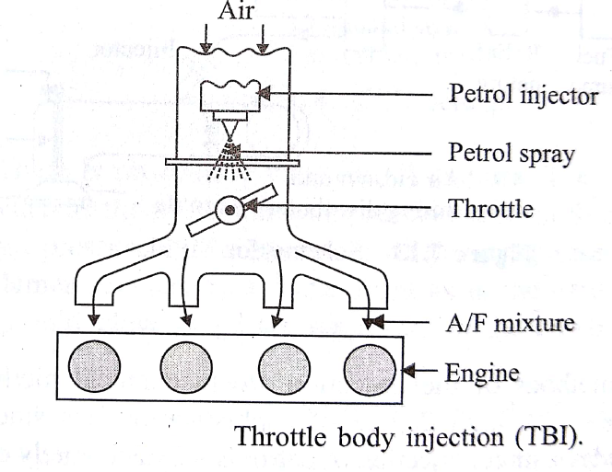
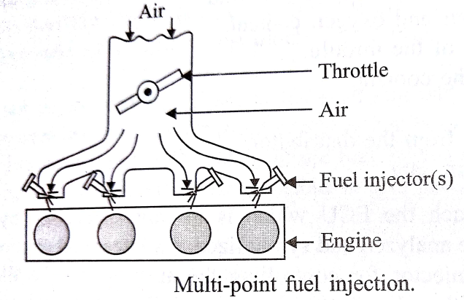
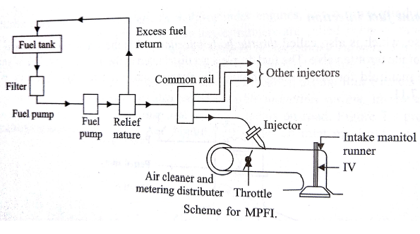

Slide 24
4) According to the control method:
Mechanical fuel injection system: present this type of system not using.
The injection system were entirely mechanical meaning that timing, pressure and distribution were all controlled by mechanical.
The main disadvantage is that the throttle opening, r.p.m controls and output was very linear but an internal combustion engine operates on different in different conditions as against linear operation this will mismatch created wide mixture variations.
ii) Electronic fuel injection system:
in this system number of sensors are used, these sensors convert various physical conditions both inside and outside the engine into electrical voltages.
These signals are then send to the systems computer and the computer based on sensors information calculates the engine fuel requirements.
then computer converts the final calculation of fuel requirement into a timed voltage pulse which encourage the injector to open at a specific time and specific duration.
The injector through its one or more holes forces the very fine atomize fuel , making it more thoroughly vaporized and there fore more readily combustible.

Slide 25
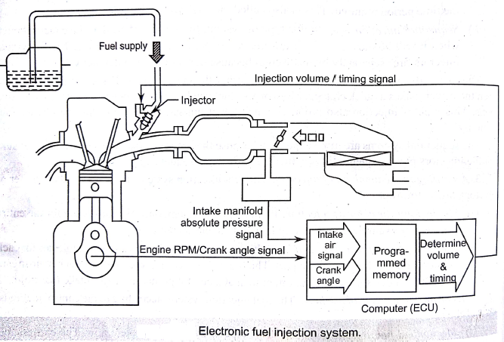

Slide 26
Types of electronic fuel injection systems:
The electronic fuel injection systems are two types according to the method used in sensing the volume of air.
D-MPFI( Manifold pressure control type)
L-MPFI (Air- flow control type)
D-MPFI:
The D-MPFI system is the manifold fuel injection system.
In this type, the vacuum in the intake manifold is first sensed.
In addition, it senses the volume of air by its density.
As air enters into the intake manifold, the manifold pressure sensor detects the intake manifold vacuum and sends the information to the ECU.
The speed sensor also sends information about the rpm of the engine to the ECU.
The ECU in turn sends commands to the injector to regulate the amount of gasoline supply for injection.
When the injector sprays fuel in the intake manifold the gasoline mixes with the air and the mixture enters the cylinders.

Slide 27
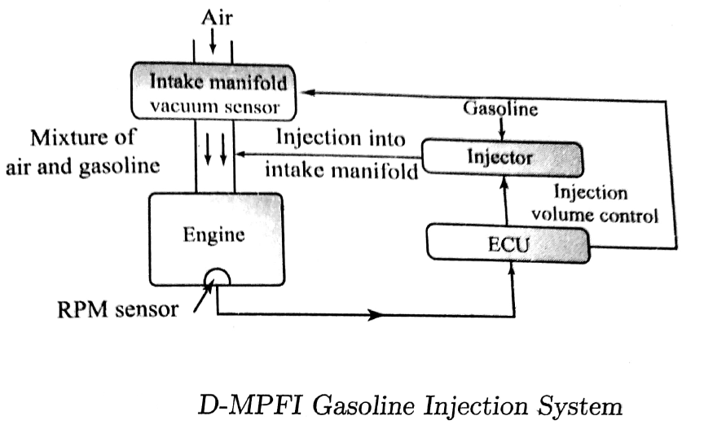

Slide 28
2) L-MPFI:
The L-MPFI system is a port fuel-injection system.
In this type the fuel metering is regulated by the engine speed and the amount of air that actually enters the engine.
This is called air-mass metering or air- flow metering.
As air enters into the intake manifold, the air flow sensor measures the amount of air and sends information to the ECU.
Similarly, the speed sensor sends information about the speed of the engine to the ECU.
The ECU processes the information received and sends appropriate commands the injector, in order to regulate the amount of fuel supply for injection.
When injection takes place, the fuel mixes with the air and the mixture enters the cylinder.

Slide 29
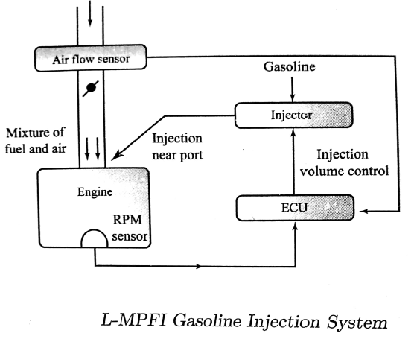

Slide 30
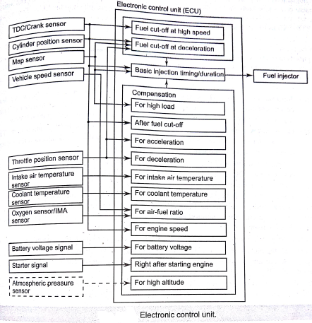
Electronic control unit(ECU):

Slide 31
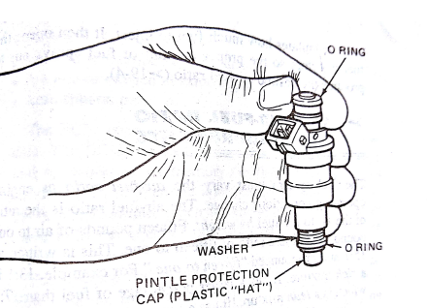
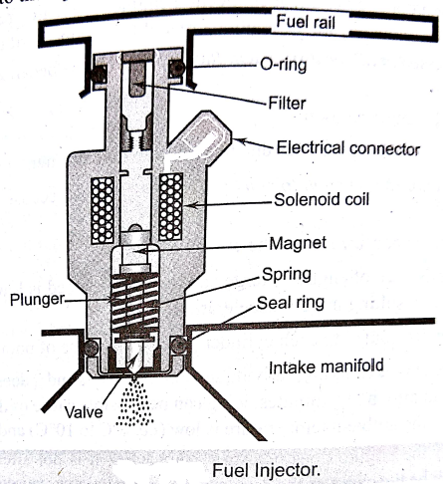
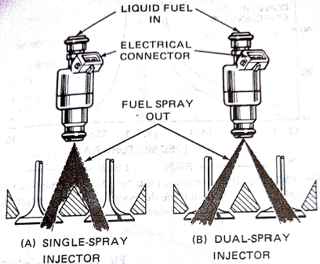
Fuel injector:

Slide 32
Fuel Injector:
A fuel injector is nothing but an electrically controlled valve.
It is supplied with pressurized fuel by the fuel pump, and it is capable of opening and closing many times per second.
The injector injects fuel according to the injection signals calculated by the ECU.
It consist of a solenoid, a plunger needle valve, and plunger housing.
When current is applied to the solenoid coil, it became an electromagnet and a force acts to draw back the plunger valve.
The needle valve is attached to the plunger valve, hence the valve is lifted.
Since fuel is pumped to the injector under pressure, therefore, when the needle valve is lifted, fuel is injected from the end of the injector.
It may be noted that the needle valve is always lifted by a fixed amount and the fuel pressure is constant.
Thus, the fuel quantity is determined by the length of the time the valve remains open.

Slide 33
FUEL SYSTEM IN DIESEL ENGINE:
The basic fuel supply system in diesel engine consists the following components:
Fuel tank
Fuel filters
Fuel feed pump
Fuel injection pump and fuel injector
Governor.
Types of fuel injection systems:
Following fuel injection systems are used in diesel engine
Air blast injection system:
In this system air is compressed to very high pressure by means of multi stage compressor and this blast of air is used to inject the fuel into the cylinder.
The air compressor is driven by the engine crankshaft.
This method was previously used in large, stationary and marine engines.
The rate of fuel supply to the engine is controlled very effectively by varying the pressure of the air.
The fuel is ignited by the high temperature of the air caused by high compression.
The compressor consumes 10 to 14% of the power developed by engine and this system is quite complicated and expensive.

Slide 34
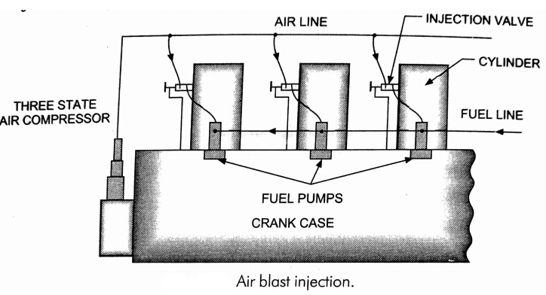

Slide 35
2) Airless or solid injection system:
In this system only the liquid fuel under high pressure is directly injected into the combustion chamber of the engine cylinder.
The fuel is burnt due to the heat of compression of the air.
This system requires a fuel pump to supply the fuel at a high pressure about 3.06bar.
The solid injection system is simple in construction, light in weight and is not so expensive.
The fuel is properly atomized and the system is suitable for engines of higher output.
The following four types solid injection systems are generally used
Individual pump fuel injection system.
Unit injection system.
Distributor injection system.
Common rail( constant pressure) fuel injection system.

Slide 36
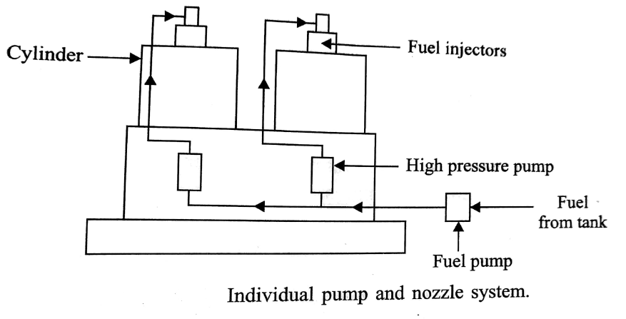
a) Individual pump fuel injection system:
the individual pump fuel injection system uses an in-line injection pump.
The in-line pump is mounted on the side of the engine and has separate pumping unit for each cylinder.
This system has a fuel pump which supplies fuel from the tank to the in line injection pump.
The in-line pump provide the high fuel pressure and meters the proper amount of fuel to each injector in each cylinder.
The medium and high- speed diesel engine use this type of fuel injection system which is also called the jerk pump system since the pump delivers the fuel in jerks and not continuously.

Slide 37
b) Unit type fuel injection system:
In this type fuel injection system , the pump and the injector are combined into one unit known as unit injector.
In this case, the high pressure fuel lines are eliminated.
The operation of the unit injector is generally by means of push rods and rocker arms.
This type of construction is very compact.
c) Distributor type fuel injection system:
The rotary distributor type of pump pressurizes and distributes fuel for each of the cylinder.
The fuel from the fuel filter flows from the transfer pump to the distributor pump itself.
The fuel is then pressurized inside the distributor pump and then high pressurized fuel directed to an injector at the appropriate cylinder.

Slide 38
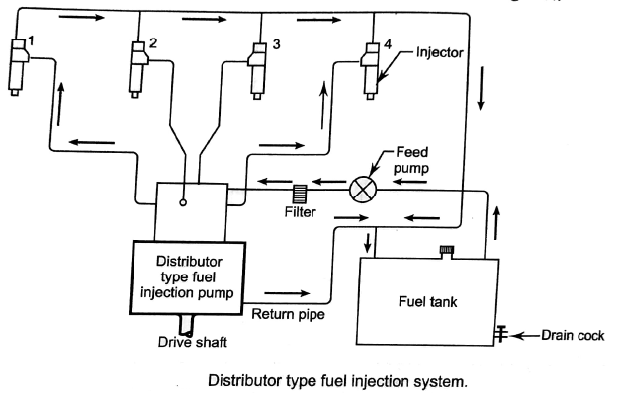

Slide 39
d) Common rail fuel injection system:
The common rail fuel injection system consist of a high-pressure and constant delivery pump, that supplies fuel at high pressure to common rail to which each fuel injector is connected.
The common rail is a high pressure accumulator of fuel and is common for all cylinders. Hence the name is given as common rail.
Then the fuel is transferred through rigid pipes to each of the fuel injector, which injects the correct amount of fuel into the combustion chamber.
The injectors are operated either mechanically or electronically, present days electronically controlled systems are used.
If the injectors are controlled by electronically the spray pattern for more powerful explosion can be achieved.
There is also no burnt fuel ( or very little, if any) and the fuel is injected at exactly the right time for all the injection.
The following are advantages of common rail fuel injection system.
Only one pump is sufficient for multi cylinder engine.
The injection pressure is produced and governed relatively independent of the engine speed.
The fuel efficiency and emission is much better due to greater burning of fuel.
The noise and vibration levels are considerably lower.

Slide 40
