Slide 1
CONVEX HULL

Slide 2
CONVEX:
A set of points (finite or infinite) in the plane is called convex if for any two points p and q in the set, the entire line segment with the endpoints at p and q belongs to the set.
CONVEX HULL :
Convex Hull of set of points is defined as smallest convex polygon that encloses all the points in the set
APPLICATION :
1. Collision Avoidance 5. Image Processing
2. Smallest Box 6. Statistics
3. Shape Analysis 7. Geographic Information System
4. Pattern Recognition 8. Game Theory

Slide 3
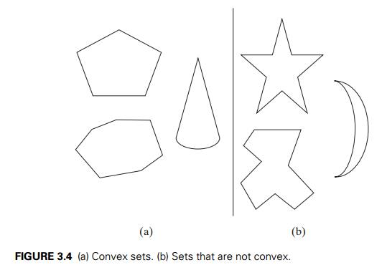
REPRESENTATION:
1. Obtain the vertices of convex hull [Extreme points]
2. Obtain vertices of convex hull in some order [eg: Clockwise]
Convex Hull of a set of points S is the boundary of the
smallest convex region that contains all points in S
inside it or on its boundary

Slide 4
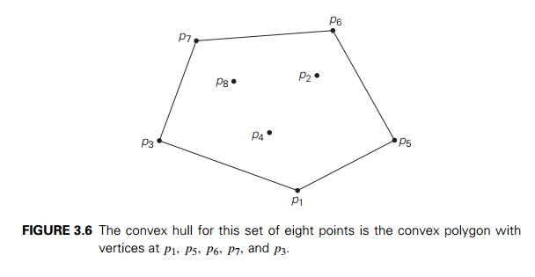
If S is convex, its convex hull is obviously S itself.
If S is a set of two points, its convex hull is the line segment connecting these points.
If S is a set of three points not on the same line, its convex hull is the triangle with the vertices at the three points given
if the three points do lie on the same line, the convex hull is the line segment with its endpoints at the two points that are farthest apart
THEOREM : The convex hull of any set S of n > 2 points not all on the same line is a convex polygon with the vertices at some of the points of S.
Extreme Points : p1, p5, p6, p7,
and p3.

Slide 5
A few elementary facts from analytical geometry are needed to implement this algorithm.
1. The straight line through two points (x₁, y₁), (x₂, y₂) in the coordinate plane can be defined by the equation
ax + by = c, where a = y₂ − y₁, b = x₁ − x₂, c = x₁y₂ − y₁x₂.
2. Such a line divides the plane into two half-planes
for all the points in one of them, ax + by > c
while for all the points in the other, ax + by < c. (For the points on the line itself, of course, ax + by = c.)
3. To check whether certain points lie on the same side of the line, we can simply check whether the expression ax + by − c has the same sign for each of these points

Slide 7
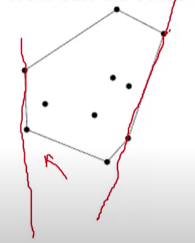
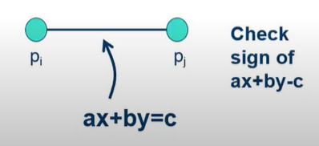
Time Complexity = O(n³) where
O(n²) :- drawing by taking each point
O(n) :- complexity test to check whether line lies inside the polygon

