Slide 1
Energy management information systems
Mr.Jarapala Ramesh babu
Assistant Professor
EEE dept.
MCET

Slide 2
Energy management information systems
An energy management information system (EMIS) is a performance management system that enables individuals and organizations to plan, make decisions and take effective actions to manage energy use and costs.
An EMIS makes energy performance visible to different levels of the organization by converting energy and utility driver data at energy account centres into energy performance information. It does this by using performance equations that are compared with the organization’s energy targets.

Slide 3
An energy management system (EMS) is a system of computer-aided tools used by operators of electric utility grids to monitor, control, and optimize the performance of the generation and/or transmission system.

Slide 4
The energy-saving meaning
1. Metering your energy consumption and collecting the data.
2.Finding opportunities to save energy, and estimating how much energy each opportunity could save. You would typically analyze your meter data to find and quantify routine energy waste, and you might also investigate the energy savings that you could make by replacing equipment (e.g. lighting) or by upgrading your building's insulation.
3. Taking action to target the opportunities to save energy (i.e. tackling the routine waste and replacing or upgrading the inefficient equipment). Typically you'd start with the best opportunities first.
4. Tracking your progress by analyzing your meter data to see how well your energy-saving efforts have worked.

Slide 5
Why is it important?
Energy management is the key to saving energy in your organization. Much of the importance of energy saving stems from the global need to save energy - this global need affects energy prices, emissions targets, and legislation, all of which lead to several compelling reasons why you should save energy at your organization specifically.
The global need to save energy
If it wasn't for the global need to save energy, the term "energy management" might never have even been coined... Globally we need to save energy in order to:
• Reduce the damage that we're doing to our planet, Earth. As a human race we would probably find things rather difficult without the Earth, so it makes good sense to try to make it last.
• Reduce our dependence on the fossil fuels that are becoming increasingly limited in supply.

Slide 6
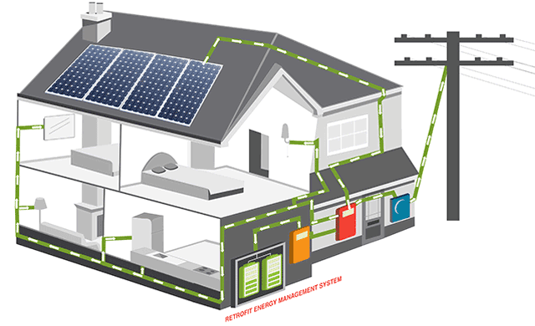
5kW solar power system 10kWh storage

Slide 13
How best to manage your energy consumption?
Metering your energy consumption and collecting the data
Finding and quantifying opportunities to save energy
Targeting the opportunities to save energy
Tracking your progress at saving energy

Slide 14
Benefits
Significant Savings.
Mitigate effects of future legislation.
Open opportunities for energy innovation

Slide 15
Advantages of EMS
Cost – effective solution.
No human errors in data collection.
Easy to configure & maintain.
Helps to identify inefficient electrical equipments.
Maximum Power Demand Analysis.
Provision of regarding Real time electrical data & energy reports over Internet / Intranet.
Graphical display of energy consumption.
Alerts through SMS.

Slide 17
Control Your Energy

Slide 18
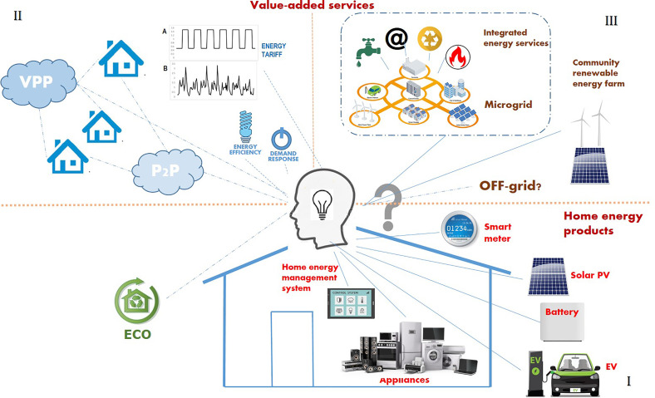

Slide 19
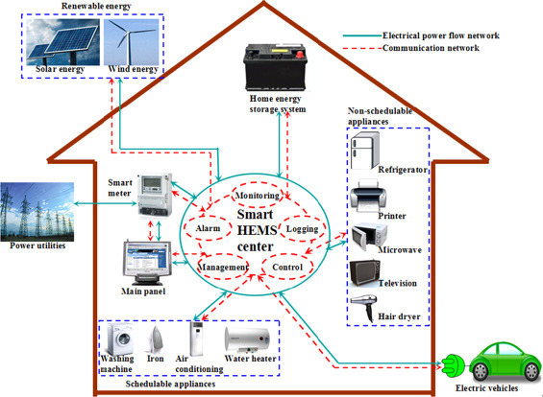
Smart Home

Slide 20
What is the difference between Scada and EMS?
A SCADA is an on-premise solution, meaning all control and data storage happens on a physical server.
On the other hand, an EMS is cloud-based, meaning all the data, programs and controls are stored and accessed over the Internet, from any computer.

Slide 21
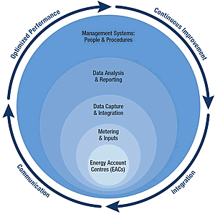
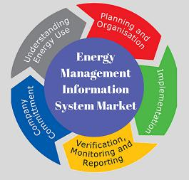

Slide 22
What are the applications of energy management system?
Energy management is utilized for saving energy by managing the energy usage of sites or facilities through the application of microprocessor, computer, ethernet, internet, and wireless sensor network.

Slide 38
