Slide 1
GEOPHYSICAL INVESTIGATIONS
UNIT-4
By,
M. Madhuri,
Assistant Professor,
Dept. Of CE,
MCET.

Slide 2
GEOPHYSICS
It is the study of earth by making use of established principles of physics
By conducting geophysical investigations the complete geology of site can be studied to construct any civil structure with safety.
The subsurface details of any site can be accessed through observations like
  Direct observations: Done by digging, trenching, drilling the ground
  Expensive, laborious and time consuming
  Indirect interfaces: Done by means of geophysical investigations
  quick, inexpensive, easy and reliable

Slide 3
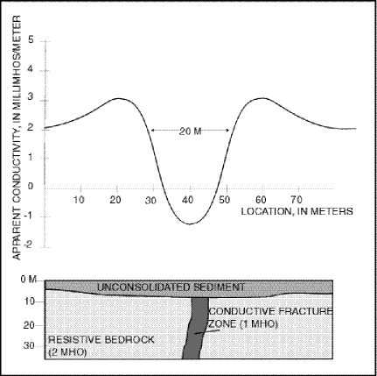
GEPHYSICAL ANOMALIES
Geophysical Anomaly is the deviation of the measured quantities from the normal distribution expected due to homogeneous subsurface conditions.
Simply it is the area where geophysical properties differ from surrounding area and which may be the result of mineralization.
The prominence of the anomaly depends mainly on the magnitude of the physical property contrasts of the concerned bodies.

Slide 4
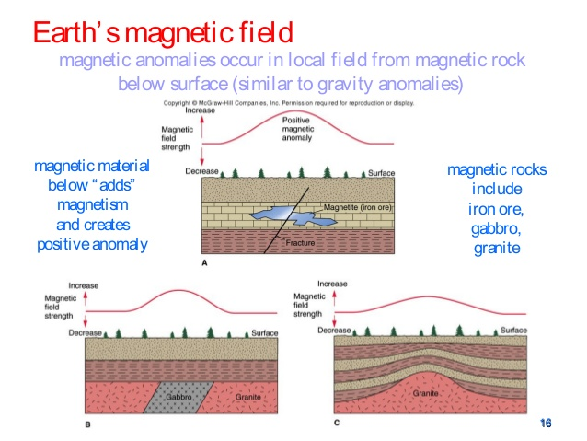
MAGNETIC METHOD
The main controlling physical property in this method is magnetic susceptibility nature of earth

Slide 5
Contd….
In magnetic method the magnetic body is directly proportional to the magnetic moment of the body and its size and is inversely proportional to the depth of its occurrence
The different parameters that are measured during magnetic investigations are
i. total magnetic field
ii. Different space components
The magnetic field is measured in terms of gamma ( 1 gamma = 10^-5 oersted)
The most common methods of magnetic investigations are
  Magnetic prospecting
  Magnetic logging
  Airborne magnetometry
  Shipborne magnetometry
The devised use in magnetic investigation is called as Magnetometers

Slide 6
APPLICATIONS OF MAGNETIC METHODS
For delineation of large structural forms favorable for accumulation of oil and gas deposits
For detection of basic and ultrabasic bodies
For location and tracing of faults
For locating strongly magnetic iron ores, and under favorable conditions for locating chromite, manganese and bauxite deposits

Slide 7
ELECTRICAL METHODS
These are the most popular methods successful in dealing with problems like ground water studies, subsurface structures, ore deposits and many others
The subsurface formations, structures, ore deposits etc. possess different electrical properties.
These differences are investigated suitably and exploited to draw the necessary conclusions.
The various electrical methods available for conducting these studies are
Electrical resistivity method
Electromagnetic method
Self-potential method
Induced polarization method

Slide 8
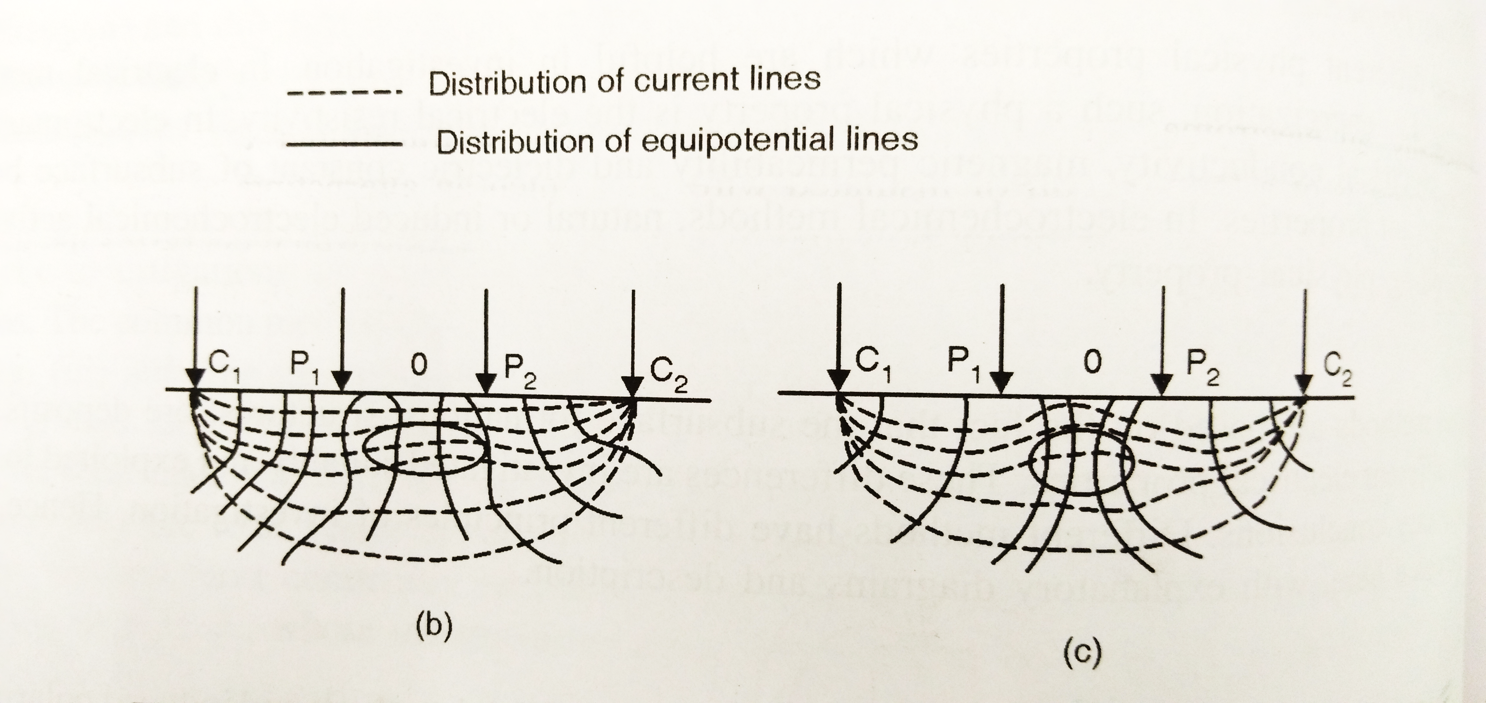
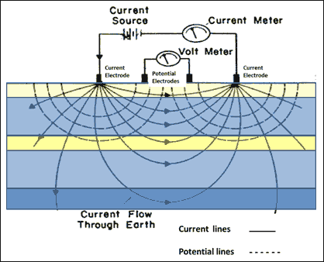
ELECTRICAL RESISTIVITY METHOD
The electrical resistivities of subsurface formations vary from one another if they are inhomogeneous and are studied with the help of resistivity method
If the subsurface body are resistive in nature the current line move away from it and in case of a conductive subsurface the current lines move towards it

Slide 9
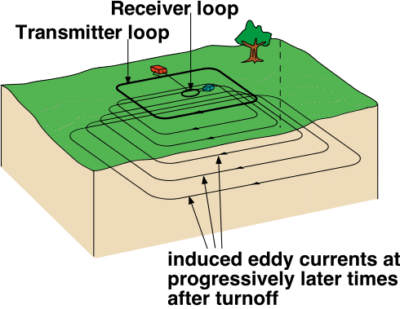
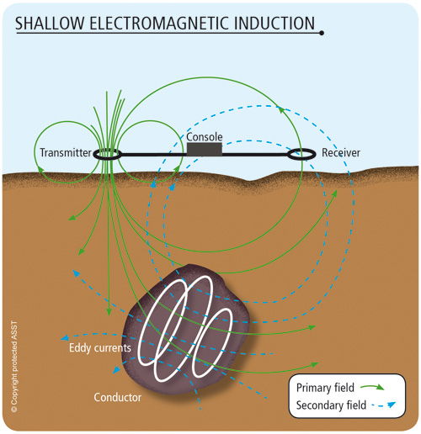
ELECTROMAGNETIC METHOD
In this method alternating magnetic or electric field are transmitted into the ground with the help of suitable source.
The electromagnetic field thus generated induces eddy currents in the conductive ore bodies in the subsurface.
These subsurface ore bodies in turn produce secondary electromagnetic fields from which the magnetic or electric component of the secondary field is investigated at the surface to locate underground ore deposits
The equipment used for this method are electromagnetic prospecting units which comprise of a transmitter and a receiver.

