Slide 1
IMPORTANCE OF GEOLOGY IN CIVIL ENGINEERING

Slide 2
SCOPE OF GEOLOGY:
Geology provides information about construction materials, resources and water supply for efficient planning of civil constructions

Slide 3
IMPORTANCE OF GEOLOGY FROM CIVIL ENGINEERING POINT OF VIEW
Before constructing any civil structure selection of site is important from point of stability of foundation
It provides a systematic knowledge of construction materials and their properties
The foundation problems of construction site are directly related to geology of that area where they are to be built
The knowledge of ETD (Erosion, Transportation, Deposition) by surface water helps in soil conservation, river control
Geological maps and sections help considerably in planning many engineering projects
Knowledge of structural geology problems like identification of faults, joints, beds, folds helps in treating them suitably.

Slide 4
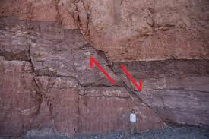
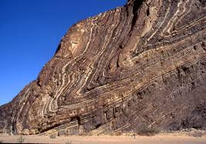
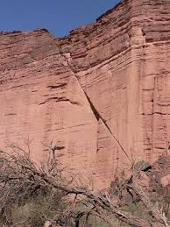
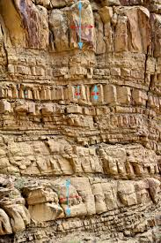
FAULT LINE
FOLD LINE
JOINTS & BEDS

Slide 5
CASE HISTORIES

Slide 6
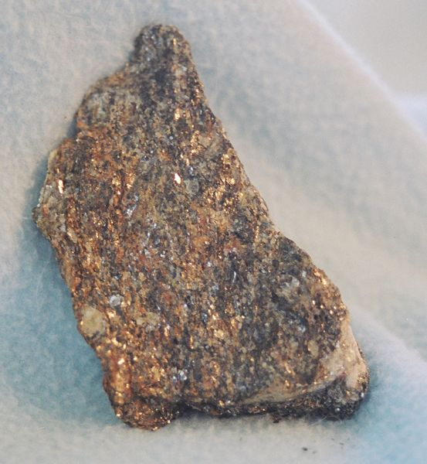
1. St. Francis Dam Disaster
Geography
  Located 40 miles NE of Los Angeles
    In city of Santa Clarita
    Developing city
    Agriculture, electricity (Edison), mostly immigrants
  Inside San Francisquito Canyon
  Geology
  San Francisquito Fault line
  Paleolithic landslide area
  Schist (severely laminated, cross-faulting, interspersed with talc)
  Sandstone
  Conglomerate

Slide 7
Background
Designed by William Mulholland, Dept. of Power and Water
1924 – construction began
  Originally
    Capacity: 30,000 acre-feet
    180 ft high, 600 ft long
  1st change
    10ft height increase
    Capacity: 32,000 acre-feet
  2nd change (July 1925)
    10ft height increase
    Capacity: 38,000 acre-feet
    Wing dyke added (600ft long)
1926 – construction complete

Slide 8
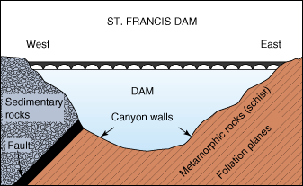
Why did the dam fail?
Major reasons:
  Rock Formations
    Conglomerate: expands with water
    Schist: badly laminated, interspersed with talc
  Fault line
  Erosion
    from running water at cracks along sides
  Paleolithic landslide

Slide 9
Cont.…
Cracks
  Created when conglomerate on side swelled when wet causing the dam to rise and crack
Construction
  Underground base missing steps
Tilting
  from extra capacity unaccounted for with increased height

Slide 10
Impacts
Deaths: 450 estimated
  Many found downstream
  Tent residents of unknown count
+900 homes destroyed
1,200 buildings damaged
10 bridges knocked out
Power lost in multiple cities
Crops, businesses and livestock affected

Slide 11
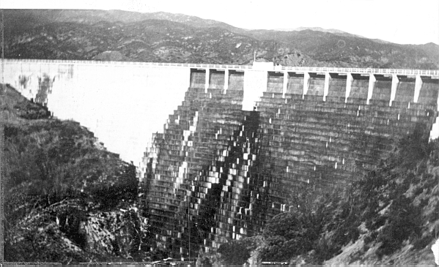
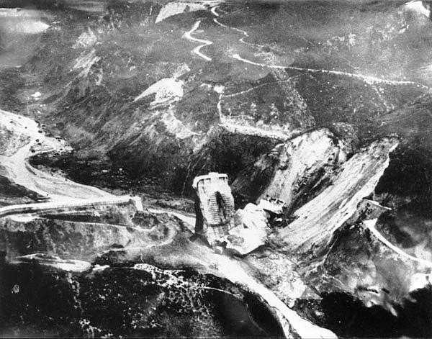
Cont.….
Cracks developed in dam and abutments
On reservoir reaching full capacity more leaks developed forming cracks
Formation of cracks
After Failure

Slide 12
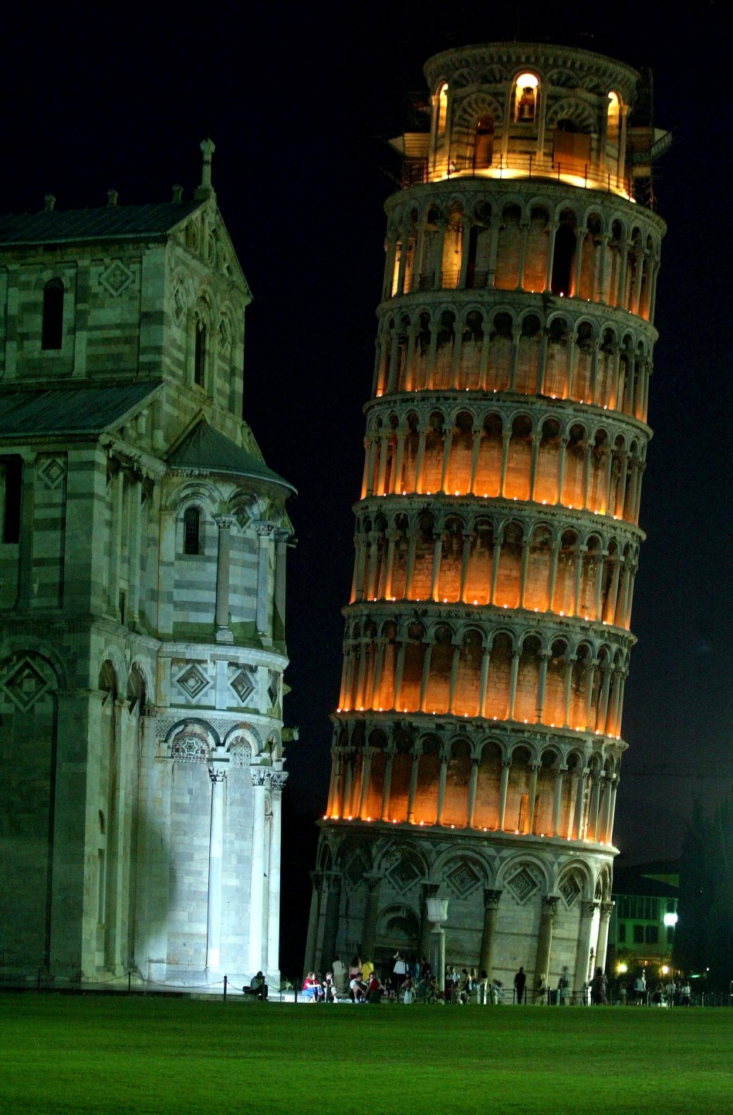
2. The Leaning Tower of Pisa
One of the “SEVEN wonders of the World.”
Located in PISA, Italy at the 'Piazza dei Miracoli' square.
Bell tower for the Cathedral.
Renowned all over the world for its peculiar inclination.
Popular tourist hotspot. Building was shut down to tourists in 1990, but has open up because of extensive restoration efforts by government agencies.
Building reopened in April, 2001.

Slide 13
Cont.….
In 1172, A widow named Berta di Bernardo left 60 cents in her will to purchase stones and construct a bell tower. It took almost 200 years to complete.
By 1178, the Third floor was complete. It was observed at this stage that the tower was leaning on the north side, and construction was on hold because of neighboring wars.
The tower kept shifting to one side over the years, around 1.2 millimeters from the vertical every year.
The differential subsidence is 1.89m; this means that the extreme north and south have subsided by 1.86m and 3.75m respectively.

Slide 14
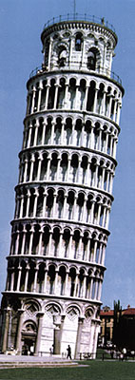
Characteristics of Tower
Weight = 14,700 metric tones
Ring shaped diameter = 19.6 m
Thickness of wall =4.1 m, and 2.7 m for all other levels.
Inclination = 5 ½ degree’s to the south.
32,240 blocks ("ashlars") for facing the exterior and interior of the cylindrical wall structure.
15 half columns at the base.
180 columns for base.
12 columns for belfry.

Slide 15
Cause of the lean of tower
Location of tower – ground comprised of layers of sand & clay.
Layers ran parallel except under the foundation of the tower, where it formed a bow shape.
The unstable mixture of soil material caused the soil to compact at a different rate, causing the tower to sink 30-40 cm
The unstable mixture of soil – caused the tower to sink to the south side.
Soil at south side compressed faster than the north side – weight of the tower was the main factor of tilt.
Tilting was also due to the fluctuations of the water levels.
This caused the tower to keep shifting, as well as rotate…later discovered by scientists that the tower’s position shifted in relation to the ground water level.

Slide 16
Stress due to lean
It was thought that the tower would tip over due to the angle of tilt.
However, it would Collapse due to enormous stress.
Stones on first few floors had most stress – they had to support the weight = 14,700 tones.
Stones on south side had stress because of incline.
The stress kept increasing as the inclination increased, therefore there was danger of the tower collapsing.
The outside of the tower is made of strong marble, but the inside is made up of rubble, hence the walls cannot support the resulting stress.

Slide 17
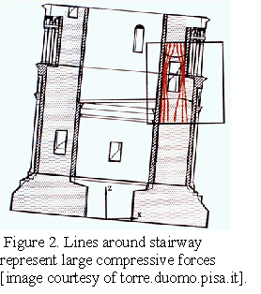
Side of tower where the stress was causing the tower walls to collapse.

Slide 18
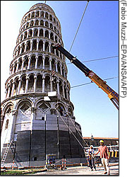
Efforts to save the tower
In 1992, plastic coated steel wires were wrapped around the south side of the second floor to prevent a type of failure called “Buckling”.
Buckling = occurs when overly stressed walls suddenly burst outwards.
The tower still continued to incline to the south side.
In 1993, the incline was halted by stacking lead ingots on the north side of the tower.
There were 750 metric tons of lead. (Acted as support)
This caused the weight of north side = weight of south side.

Slide 19
Cont......
The ground below the south side was no longer compressing faster than the north side.
Monitoring equipment was placed and indicated that the tower’s incline stopped due to the counterweights.
In 1995, work on the foundation started. The ground was frosted and preparation to add cables and weights went underway. As the ground unthawed some unseen plates cracked. The tower began slowly falling south, so a crane stacked a few more lead ingots on the north side

Slide 20
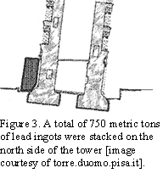
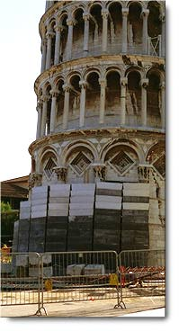

Slide 21
HIGHLIGHTS
Statics – the tower was built to stay in equilibrium however external influences such as topography of the land cause it to tilt, and rotate around its axis.
S.O.M – stress was increasing on the building as it tilted on the south side. This could have cause the tower to collapse.
“Buckling” = when overstressed material may burst outwards..
Engineers must take every minute detail when constructing any object. In the case of the Tower of Pisa, the topography of the land was unsuitable for construction.

Slide 22
3. Kaila Dam, Gujarat, India
The Kaila Dam in Kachch, Gujarat, India was constructed during 1952 - 55 as an earth fill dam with a height of 23.08 m above the river bed and a crest length of 213.36 m.
The foundation was made of shale.
The spillway was of ogee shaped and ungated.
The depth of cutoff was 3.21 m below the river bed.

Slide 23
4. Kaddam Project Dam, Andhra Pradesh, India
Kaddam Dam is a reservoir on the river Kadem, a tributary river of Godavari near Kaddam Mandal, Nirmal District, Telangana.
Built in Adilabad, Andhra in 1957 - 58, the dam was a composite structure, earth fill and/or rock fill and gravity dam.
It was 30.78 m high and 3.28 m wide at its crest. The storage at full was 1.366 * 108 m3 . The observed floods were 1.47 * 104 m3 /s.
The dam was overtopped by 46 cm of water above the crest, in spite of a free board allowance of 2.4 m that was provided, causing a major breach of 137.2 m wide that occurred on the left bank.
Two more breaches developed on the right section of the dam. The dam failed in August 1958.

Slide 24
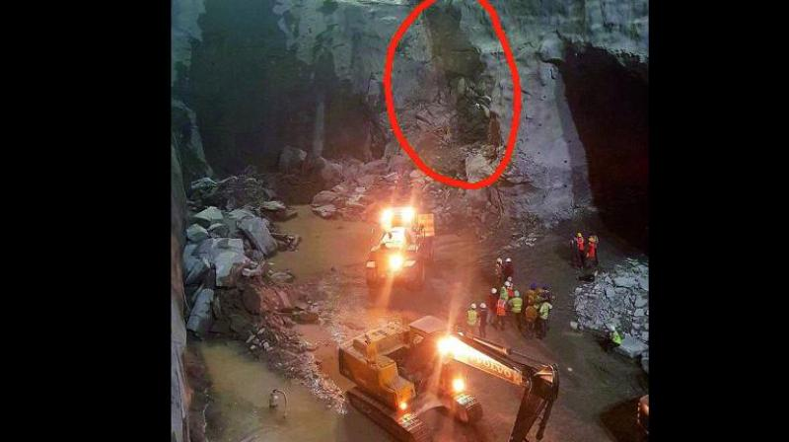
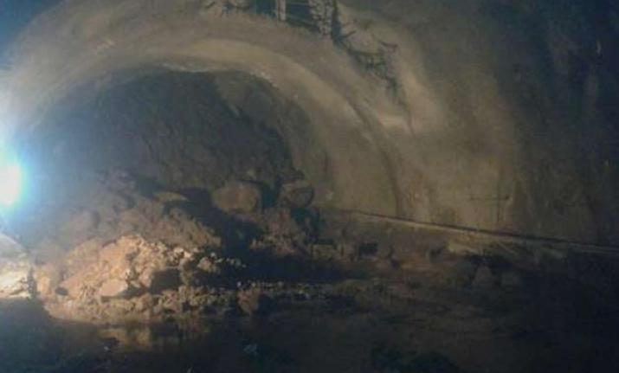
5. Kaleshwaram tunnel collapse in Telengana
The 4-km tunnel in the hillocks that connects Anantagiri and Venkatapur villages is the part of package-10 of Kaleshwaram Lift Irrigation Project (KLIP).
An explosion in the upper part of draft tube caused the collapse of a 5-tonne granite slab, according to the superintending engineer Muralidhar Rao.
Blast in the roof of the tunnel under construction due to shale gas in the rocks, collapsing the tunnel

