Slide 1
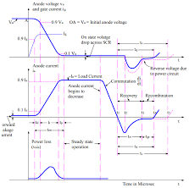
SWITCHING CHARACTERISTICS OF SCR

Slide 2
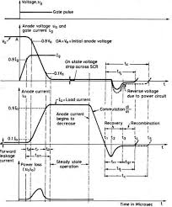
SWITCHING CHARACTERISTICS OF SCR

