Slide 1
Power Quality
by
Rajini Kanth P
Assistant Professor, Department of EEE,
Methodist College of Engineering and Technology

Slide 2
What is Power Quality(PQ)?
It is a combination of Voltage quality and current quality. Thus power quality is concerned with deviations of voltage and or current from the ideal waveform( pure sinusoidal wave).
Quality of Supply:
Quality of power supply includes a technical part (voltage quality) plus a non technical part sometimes referred to as “Quality of service”. the latter covers the interaction between the customer and the utility, eg., the speed with which the utility reacts to complaints.
IEEE Definition of PQ:
“Power quality is a concept of powering and grounding sensitive equipment in a matter that is suitable to the operation of that equipment”

Slide 3
Why power Quality is Important?

Slide 4
How does power quality affect the economy?

Slide 5
List of the types of power quality phenomena according to IEEE 1159-1995:
a. Short Duration Variations
Voltage sag
Voltage swell
Interruption
b. Long Duration Variations
Undervoltage
Overvoltage
Sustained Interruption
c. Voltage Unbalance
d. Waveform Distortion
DC Offset
Harmonics
Interharmonics
Notching
Noise
e. Electric Transients
f. Voltage fluctuations (Flicker)
g. Power Frequency Variation

Slide 6
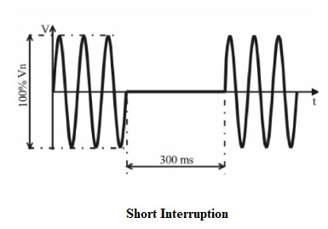

Slide 7
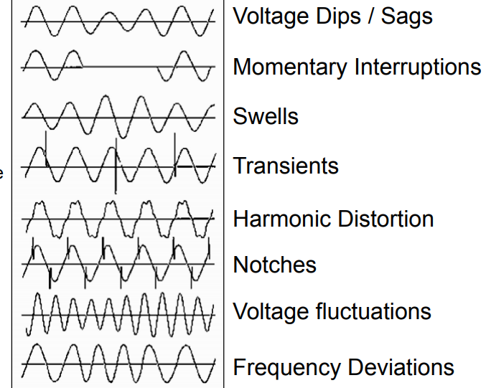

Slide 8
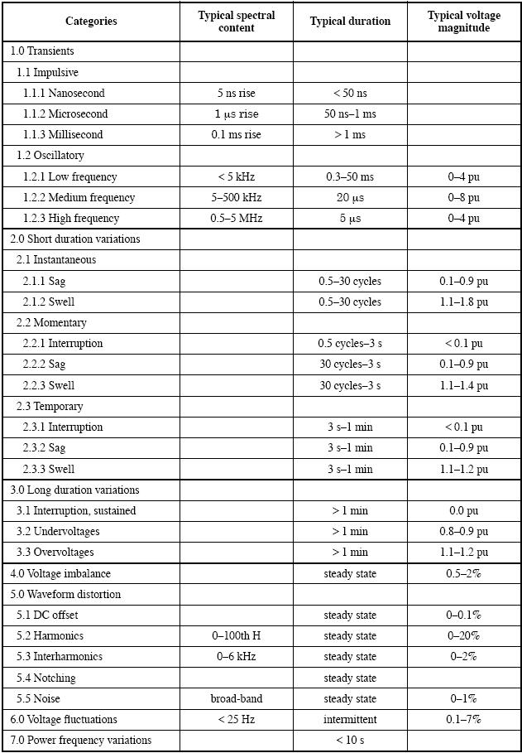
Categories and Characteristics of Power System Electromagnetic Phenomena

Slide 10
Power quality problems can be resolved in any of the following ways:
1. Design equipment and electrical systems to prevent electrical disturbances from causing equipment or systems to malfunction.
2. Analyze the symptoms of a power quality problem to determine its cause and solution.
3. Identify the medium that is transmitting the electrical disturbance and reduce or eliminate the effect of that medium.
4. Treat the symptoms of the power quality problem by the use of power conditioning equipment. Power conditioning equipment mitigates a power quality problem when it occurs

Slide 11
Power conditioning equipment needs to be used for maintaining loads coming from the power grid to the equipments like Transient Voltage Surge Suppressors, Noise filters, Harmonic filters, Isolations Transformers, Voltage Regulators, Dynamic Voltage restorer, Uninterruptible Power Supply, Generators, etc

Slide 13
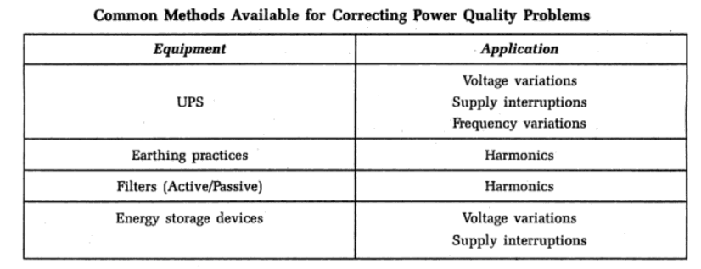
Remedies to Improve power quality problems:

Slide 14
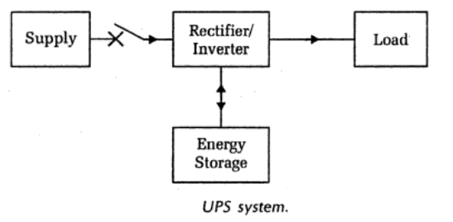
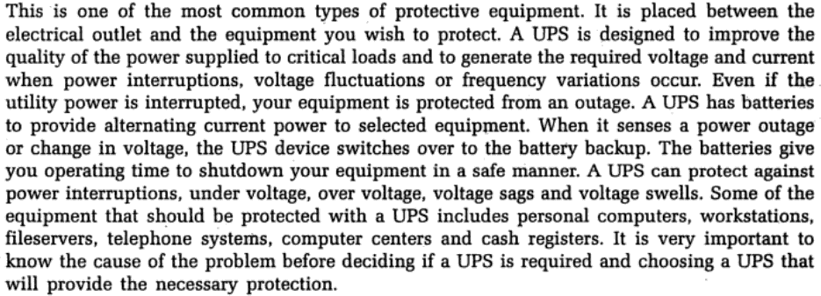
UPS:

Slide 15
