Slide 1
Methodist College of Engineering and Technology (UGC Autonomous) Abids, Hyderabad Department of EEE BE - VII Semester (2022-23)
Switchgear and Protection
by
Rajini Kanth P
Assistant Professor
Department of EEE

Slide 2
Syllabus

Slide 3
Need for Protection?

Slide 4
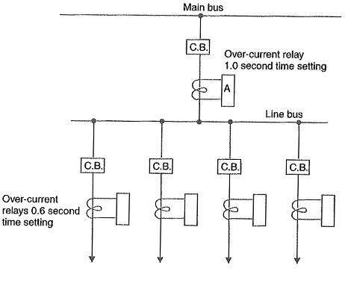
Primary and Backup Protection
Primary Protection:
If a fault occurs on any line, it will be cleared by its relay and circuit breaker. This forms the primary or main protection and serves as the first line of defense.
Backup Protection:
It is the second line of defense in case of failure of the primary protection.
Main protection can fail due to failure of one of the components in the protective system such as a relay, CT, PT, trip circuit, circuit-breaker, etc. If the primary protection fails, there must be an additional protection, otherwise, the fault may remain uncleared, resulting in a disaster.

Slide 5
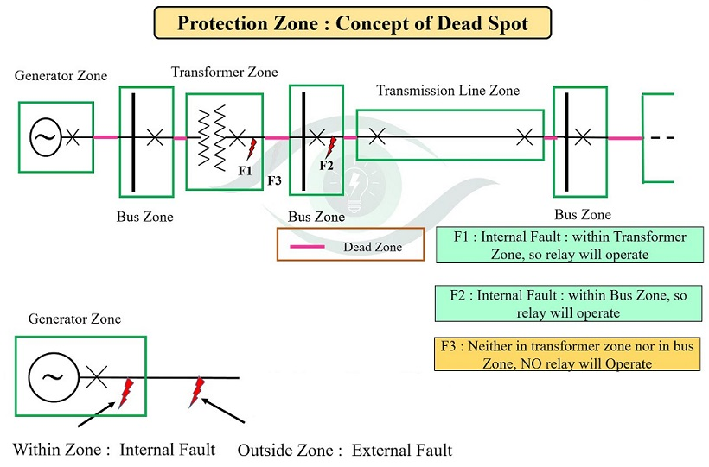
Zones of Protection and Dead spot

Slide 6
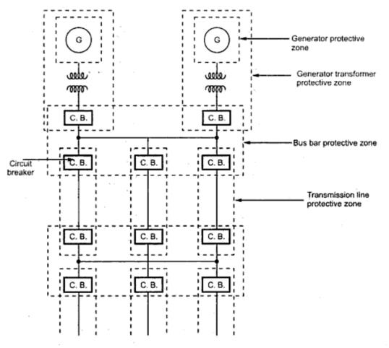
Protective zones

Slide 7
Relay
Relay Pick up value: It is the minimum value of an actuating quantity at which relay starts operating, in most of the relays actuating quantity is current in the relay coil
Reset Value: The value of an actuating quantity current or voltage below which the relay is de-energized and returns to its original position is called reset value of that relay.

Slide 8
Classification of Relays
According to principle of operation and construction:
Electromagnetic attraction type
Electromagnetic Induction type
Electrodynamic type
Electrothermal type
Physico eclectric type
Static Relays

Slide 9
According to Applications:
Over current, Over voltage and Over power relay
Under current, under voltage aunder power relay
Directional or reverse current relay
Directional or reverse power relay
Differential relay
Distance relay

Slide 10
According to Timing Characteristics:
Instantaneous relays
definite time lag relays
Inverse time lag relays
Inverse definite minimum time lag relays

Slide 11
Electromagnetic attraction type relays
Plunger type
Hinged type
Balanced beam type
Polarised moving iron type

Slide 12
Solenoid /Plunger Type

Slide 13
Hinged Armature Type

Slide 14
Balanced Beam Type

Slide 15
Polarised Type

Slide 16
Electromagnetic Induction type relay
Induction relays work only on AC quantities
Torque in Induction relay is produced when one alternating flux reacts with eddy currents induced in a rotor by another alternating flux of same frequency but displaced in phase.

Slide 19
Types of Induction Relays
Shaded Pole Structure type
Watt hour meter type

Slide 20
Shaded Pole Type

Slide 21
Watthour meter Type

Slide 22
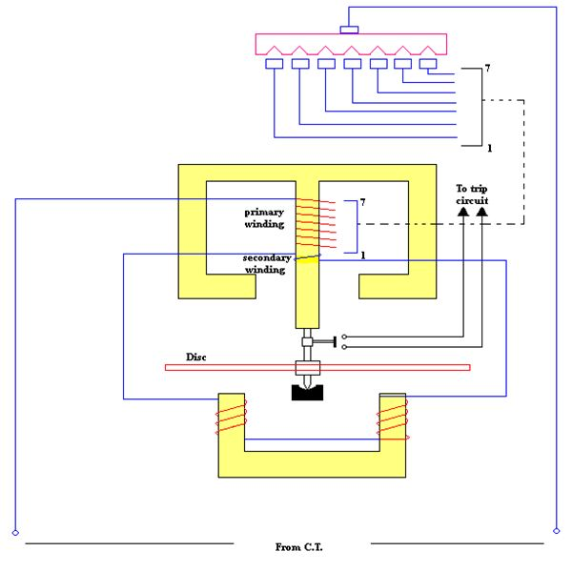
Non Directional Over current Relay
The primary winding has tappings at fixed intervals and these tappings are connected to a plug setting bridge. With the help of plug setting bridge, the number of turns can be adjusted and hence the desired current setting can be achieved.
The values of each tap are expressed in terms of percentage of full load rating of C.T. It gives the value above which the disc commences to rotate and finally closes the trip circuit.
The plug setting bridge usually provides 7 sections of tapings to give over-current range from 50% to 200% in steps of 25%.

Slide 23
Directional Over Current Relay

Slide 25
Torque Equation

Slide 27
Plug Setting Multiplier
The Value of PSM tells us about the severity of the current as seen by the relay.

Slide 28
According to the time of operation
Instantaneous Relay
Definite time O/C Relay
Inverse Time – current Relay
IDMT Relay
Very Inverse Time O/C Relay
Extremely Very Inverse Time O/C Relay

Slide 29
Protection of parallel feeder

Slide 30
Protection of Radial feeder

Slide 32
Protection of Ring main feeder

Slide 33
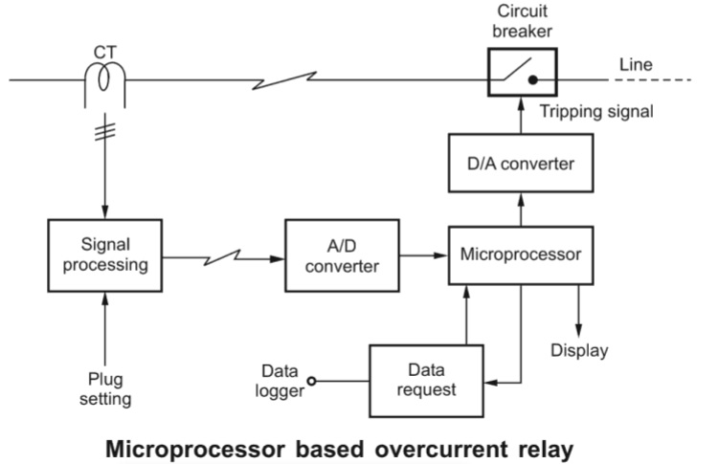
Microprocessor based Over current relay

Slide 35
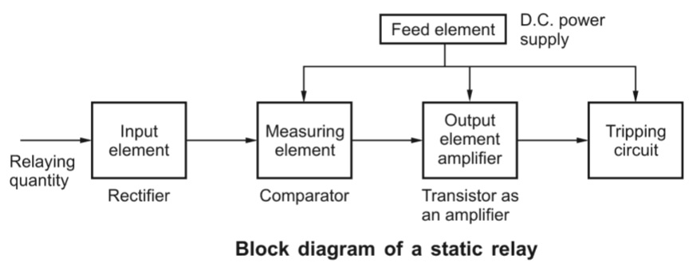
Static Relays
The relay which does not contain any moving parts is known as the static relay.
Relay contains only electronic elements (such as diodes, BJT, etc.) therefore, it is also known as a solid-state relay.

Slide 36
Static Instantaneous Over current Relay

Slide 37
The current derived from the C.T is fed to the input transformer which gives a proportional output voltage.
The output voltage of the transformer is rectified through a rectifier and then filtered at a single stage to avoid undesirable time delay in filtering, so as to ensure high speed of operation.
A limit made of a zener diode is also incorporated in the circuit to limit the rectified voltage to safe values even when the input current is very high under fault conditions.
A fixed portion of the rectified and filtered voltage (through a potential divider) is compared against a preset pick-up value by a level detector and if it exceeds the pick-up value, a signal through an amplifier is given to the output which issues the trip signal. The output device may either be a static thyristor circuit or an electromagnetic slave relay.

Slide 38
Static Definite Time Over current Relay

Slide 39
Static directional Over Current Relay

Slide 40
Protection of Transformer and Alternator
Differential Protection

Slide 41
Disadvantages of Normal Differential Protection
This Circuit operates inaccurately with heavy external faults
The C.T. s may saturate and cause unequal secondary currents and the difference of secondary currents may approach the pickup value to operate the relay unnecessarily.
The C.T. s are connected through cables called pilot cables. The impedance of such pilot cables generally causes a slight difference between the currents at the ends of the section to be protected. A sensitive relay may operate to the small difference in currents though there is no fault existing.

Slide 42
Percentage Differential Relay

Slide 45
Protection of Alternator

Slide 46
With balancing resistors

Slide 47
Restricted Earth Fault Protection

Slide 48
Stator Inter turn Fault Protection

Slide 49
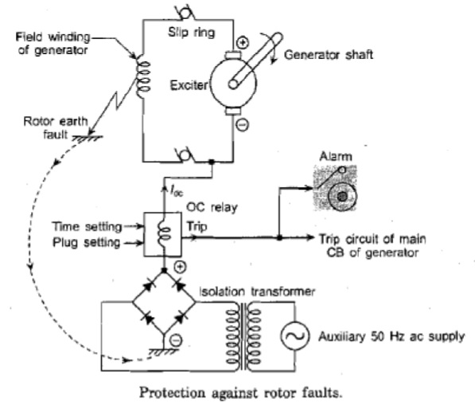
Rotor Earth fault Protection

Slide 50
Protection of Transformer

Slide 51
Buchholz Relay

Slide 52
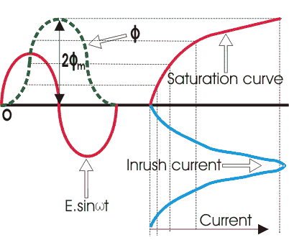
Protection of Transformer against Magnetizing inrush current

