Slide 1
Unit-1
PLC Basics: Definition and History of PLC, PLC advantages and disadvantages
Over all PLC Systems: CPUs and Programmer Monitors, PLC input and output models, Printing PLC Information
Programming Procedures: Programming Equipment, Programming Formats, Proper Construction of PLC Diagrams, Devices to which PLC input and output modules are connected, Input on/off switching devices
Input analog devices, Output analog on/off devices and output analog devices.

Slide 2
Programmable Logic Controllers
Definition:
"A digitally operating electronic apparatus which uses a programmable memory for the internal storage of instructions by implementing specific functions such as logic sequencing, timing, counting, and arithmetic to control, through digital or analog input/output modules, various types of machines or processes.”
The digital computer which is used to perform the functions of a programmable controller is considered to be within this scope.
Excluded are drum and other similar mechanical sequencing controllers.
National Electrical Manufacturing Association (NEMA)
Components
Processor
Memory
Input and output module
Power supply
Detachable programming device

Slide 3
Programmable Logic Controllers
Definition:
A PLC is a user-friendly, microprocessor-based specialized computer that carries out control functions of many types and levels of complexity.
Its purpose is to monitor crucial process parameters and adjust process operations accordingly.
Used extensively because the PLC
– Is easy to set up and program
– Behaves predictably
– Ruggedized
It can be programmed (to a degree), controlled, and operated by a person unskilled in operating (programming) computers.
Essentially, a PLC's operator draws the lines and devices of ladder diagrams with a keyboard/mouse onto a display screen.
The resulting ladder diagram is converted into computer machine language and run as a program.

Slide 4
Programmable Logic Controllers
History of PLC:
The first PLC was developed by a group of engineers at General Motors in 1968, when the company were looking for an alternative to replace complex relay control systems. In short, Invented in 1968 as a substitute for hardwired relay panels.
Previously, valid PLC standards focusing mainly on PLC programming were generally geared to current state of the art technology in Europe at the end of the 1970s.
This took into account non-networked PLC systems, which primarily execute logic operations on binary signals.
DIN 19 239, for example, specifies programming languages which possess the corresponding language commands for these applications.
No equivalent, standardised language elements existed for the PLC developments and system expansions made in the 1980s such as: processing of analogue signals, interconnection of intelligent modules, networked PLC systems etc. Consequently, PLC systems by different manufacturers required entirely different programming.

Slide 5
Programmable Logic Controllers
History of PLC:
Since 1992, an international standard exists for programmable logic controllers and associated peripheral devices (programming and diagnostic tools, testing equipment, human-to-machine (HMI) interfaces etc.).
In this context, a device configured by the user and consisting of the above components is known as a PLC system.
The range of functions has grown considerably...
15 years ago, process visualization, analogue processing or even the use of a PLC as a controller, were considered as Utopian...
Now-a-days, the support of these functions forms an integral part of many PLCs.

Slide 6
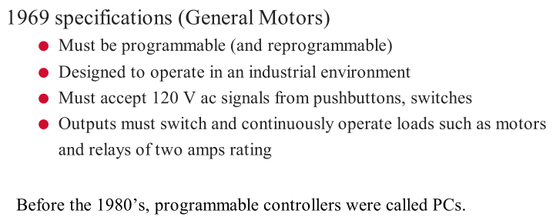
Programmable Logic Controllers
History of PLC:

Slide 7
Programmable Logic Controllers
Advantages:
Flexibility
In the past, each different electronically controlled production machine required its own controller; 15 machines might require 15 different controllers.
Now it is possible to use just one model of a PLC to run any one of the 15 machines.
Furthermore, you would probably need fewer than 15 controllers, because one PLC can easily run many machines.
Each of the 15 machines under PLC control would have its own distinct program (or a portion of one running program).
Implementing Changes and Correcting Errors
With a wired relay-type panel, any program alterations require time for rewiring of panels and devices.
When a PLC program circuit or sequence design change is made, the PLC program can be changed from a keyboard sequence in a matter of minutes.
No rewiring is required for a PLC-controlled system.
Also, if a programming error has to be corrected in a PLC control ladder diagram, a change can be typed in quickly.

Slide 8
Programmable Logic Controllers
Advantages:
Large Quantities of Contacts
The PLC has a large number of contacts for each coil available in its programming.
Suppose that a panel-wired relay has four contacts and all are in use when a design change requiring three more contacts is made.
Time would have to be taken to procure and install a new relay or relay contact block.
Using a PLC, however, only three more contacts would be typed in.
Contacts are now a “software” component.
Lower Cost
Increased technology makes it possible to condense more functions into smaller and less expensive packages.
Now you can purchase a PLC with numerous relays, timers, and counters, a sequencer, and other functions for a few hundred dollars.
Pilot Running
A PLC programmed circuit can be evaluated in the lab. The program can be typed in, tested, observed, and modified if needed, saving valuable factory time.

Slide 9
Programmable Logic Controllers
Advantages:
Visual Observation
A PLC circuit's operation can be seen during operation directly on a CRT screen.
The operation or disoperation of a circuit can be observed as it happens.
Logic paths light up on the screen as they are energized.
Troubleshooting can be done more quickly during visual observation.
Ladder or Boolean Programming Method
The PLC programming can be accomplished in the ladder mode by an engineer, electrician or possibly a technician. Alternatively, a PLC programmer who works in digital or Boolean control systems can also easily perform PLC programming.
Reliability and Maintainability
Solid-state devices are more reliable, in general, than mechanical systems or relays and timers. Consequently, the control system maintenance costs are low and downtime is minimal.

Slide 10
Programmable Logic Controllers
Advantages:
Documentation
An immediate printout of the true PLC circuit is available in minutes, if required.
There is no need to look for the blueprint of the circuit in remote files.
The PLC prints out the actual circuit in operation at a given moment.
Often, the file prints for relay panels are not properly kept up to date. A PLC printout is the circuit at the present time; no wire tracing is needed for verification.

Slide 11
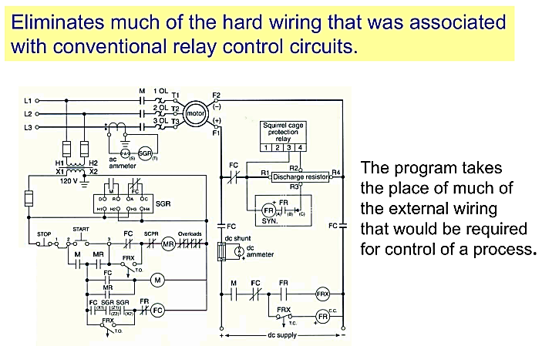
Programmable Logic Controllers
Advantages:

Slide 12
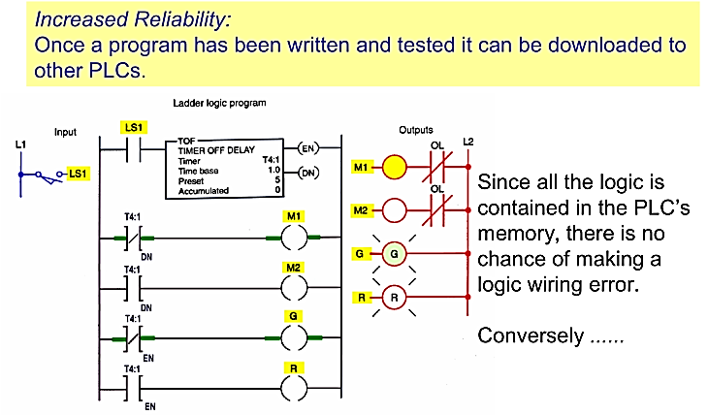
Programmable Logic Controllers
Advantages:

Slide 13
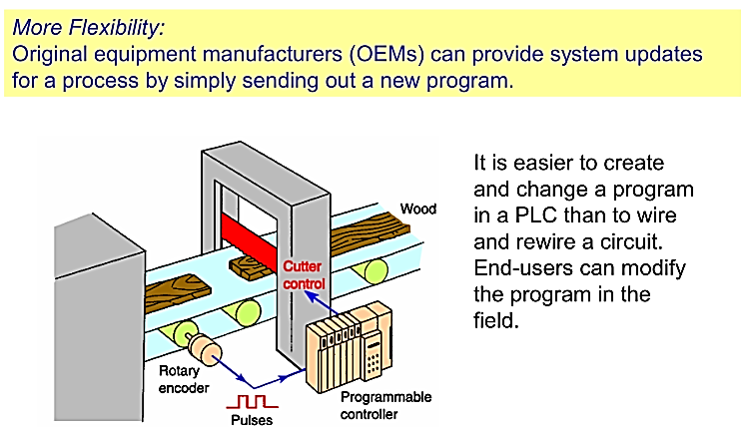
Programmable Logic Controllers
Advantages:

Slide 14
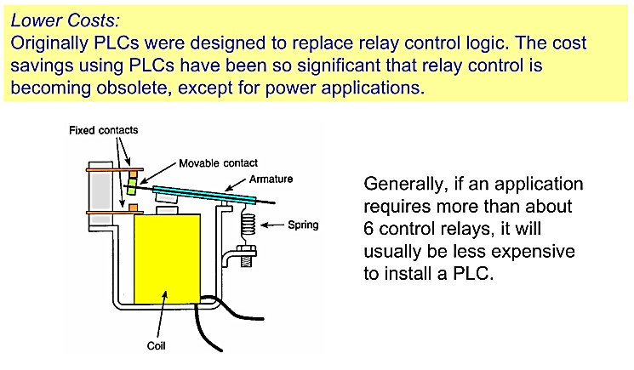
Programmable Logic Controllers
Advantages:

Slide 15
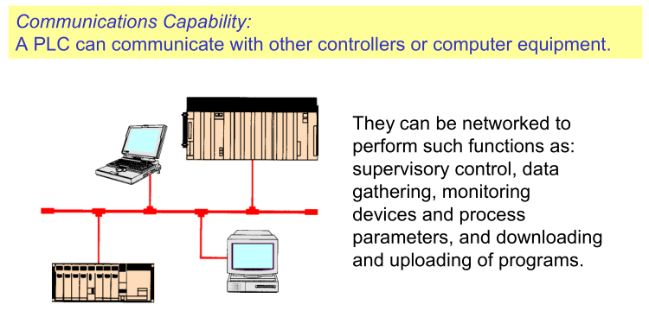
Programmable Logic Controllers
Advantages:

Slide 16
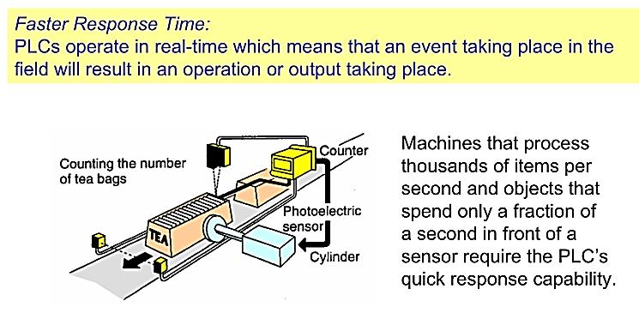
Programmable Logic Controllers
Advantages:

Slide 17
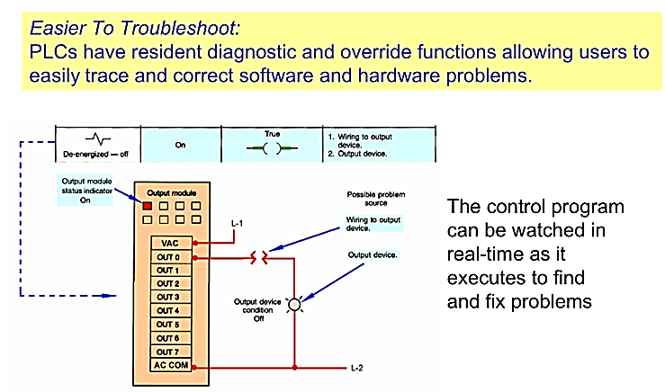
Programmable Logic Controllers
Advantages:

Slide 18
Programmable Logic Controllers
Disadvantages:
Fixed Program Applications
Some applications are single-function applications. It does not pay to use a PLC that includes multiple programming capabilities if they are not needed.
Their operational sequence is seldom or never changed, so the reprogramming available with the PLC would not be necessary.
Fail-Safe Operation
In relay systems, the stop button electrically disconnects the circuit; if the power fails, the system stops.
This, of course, can be programmed into the PLC; however, in some PLC programs, you may have to apply an input voltage to cause a device to stop. These systems may not be fail-safe.

Slide 19
Programmable Logic Controllers
Overall PLC System (Components of PLC):
1. Processor Microprocessor based, may allow arithmetic operations, logic operators, block memory moves, computer interface, local area network, functions, etc.
2. Memory Measured in words.
ROM (Read Only Memory),
RAM (Random Access Memory),
PROM (Programmable Read Only Memory),
EEPROM (Electronically Erasable Programmable ROM),
EPROM (Erasable Programmable Read Only Memory),
EAPROM (Electronically Alterable Programmable Read Only
Memory), and
Bubble Memory.

Slide 20
Programmable Logic Controllers
Overall PLC System (Components of PLC):
3. I/O Module Modular plug-in periphery
AC voltage input and output,
DC voltage input and output,
Low level analog input,
High level analog input and output,
Special purpose modules, e.g.., high speed timers,
Stepping motor controllers, etc. PID, Motion
4. Power supply AC power
5. Peripheral Hand held programmer (loader),
CRT programmer,
Operator console,
Printer,
Simulator,
EPROM loader,
Cassette loader,
Graphics processor, and
Network communication interface. MAP, LAN

Slide 21
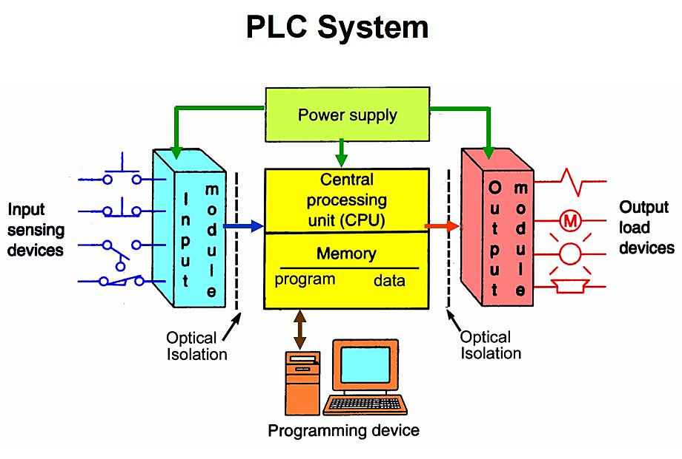
Programmable Logic Controllers
Overall PLC System (PLC Architecture or Block Diagram):

Slide 22
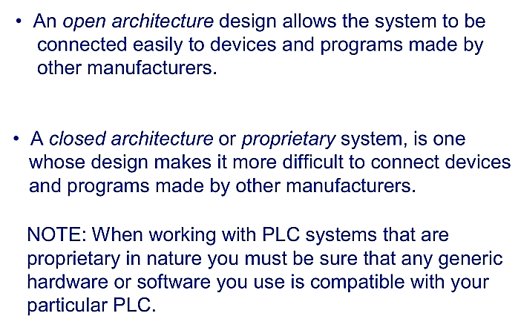
Programmable Logic Controllers
Overall PLC System (PLC Architecture or Block Diagram):

Slide 23
Programmable Logic Controllers
Overall PLC System (PLC Architecture or Block Diagram):
Programmable controllers replace most of the relay panel wiring by software programming.
Fig. A TYPICAL PLC

Slide 24
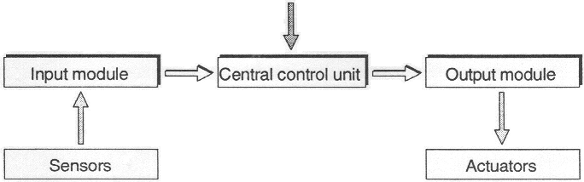
System components of a PLC
PLC Program
Overall PLC System

Slide 25
Programmable Logic Controllers
Function of input and output module
The function of an input module is to convert incoming signals from sensors into signals which can be processed by the PLC and to pass these to the central control unit.
The reverse task is performed by an output module. This converts the PLC signal into signals suitable for the actuators.
Function of CPU
The actual processing of the signals is effected in the central control unit (CCU) in accordance with the program stored in the memory.
Another name for CCU :
CPU = Central processing unit is often used

Slide 26
System components of a PLC
PLC Program
Overall PLC System

Slide 27
System components of a PLC
PLC Program
Overall PLC System
HW

Slide 28
System components of a PLC
PLC Program
Overall PLC System
SW
HW

Slide 29
System components of a PLC
PLC Program
Overall PLC System
SW
PLC
HW

Slide 30
PLC and Field
PLC Program
Overall PLC System
SW
PLC
HW
FIELD

Slide 31
PLC, Field and Controlled system
PLC Program
Overall PLC System
SW
PLC
HW
FIELD
CONTROLLED PROCESS or CONTROLLED MACHINE

Slide 32
Programmable Logic Controllers
Overall PLC System
A typical PLC can be divided into four components:
Processor unit
Power supply
Input/output section
Programming device

Slide 33
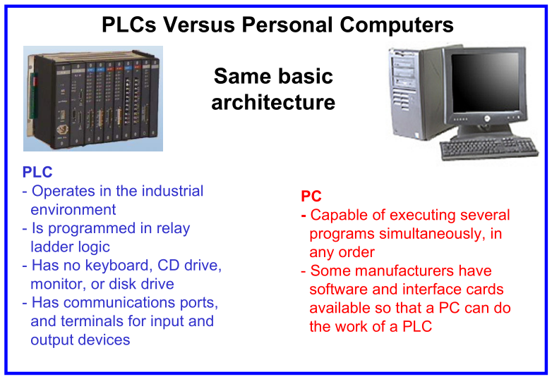
Programmable Logic Controllers
Overall PLC System

Slide 34
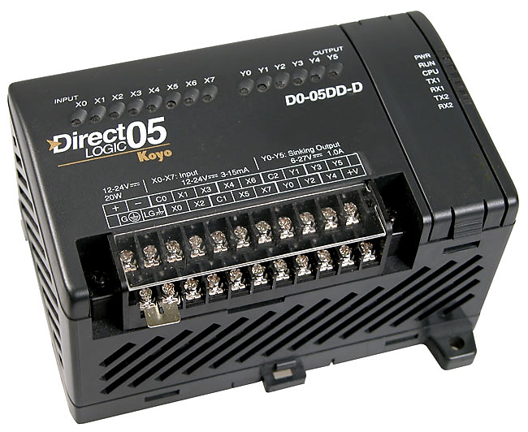
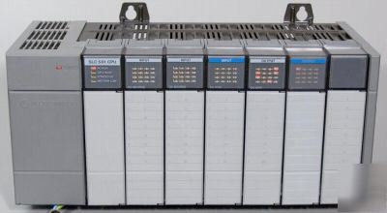
Programmable Logic Controllers
Overall PLC System
Fixed I/O
Modular I/O

Slide 35
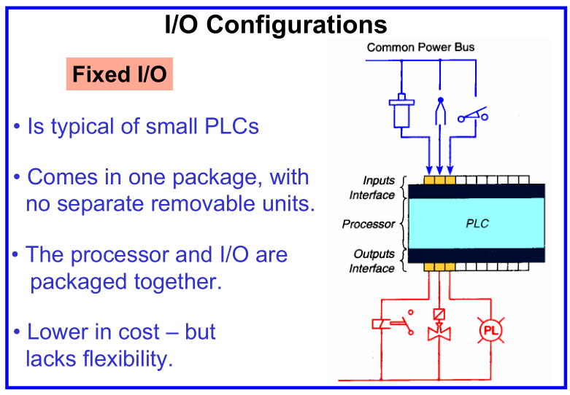
Programmable Logic Controllers
Overall PLC System

Slide 36
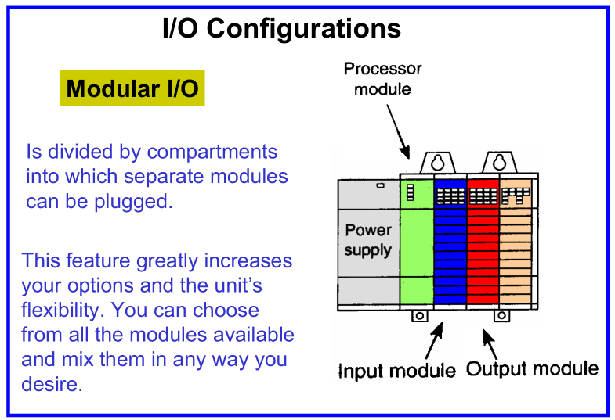
Programmable Logic Controllers
Overall PLC System

Slide 37
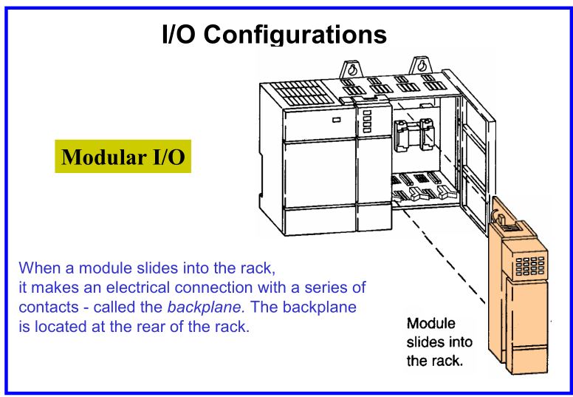
Programmable Logic Controllers
Overall PLC System

Slide 38
Programmable Logic Controllers
Overall PLC System
PLC’s with fixed I/O typically come in a complete unit that contains the processor, I/O section, and power supply.
PLC with modular I/O is modular in nature, more flexible than fixed I/O units. The I/O rack or chassis is a framework or housing into which modules are inserted.

Slide 39
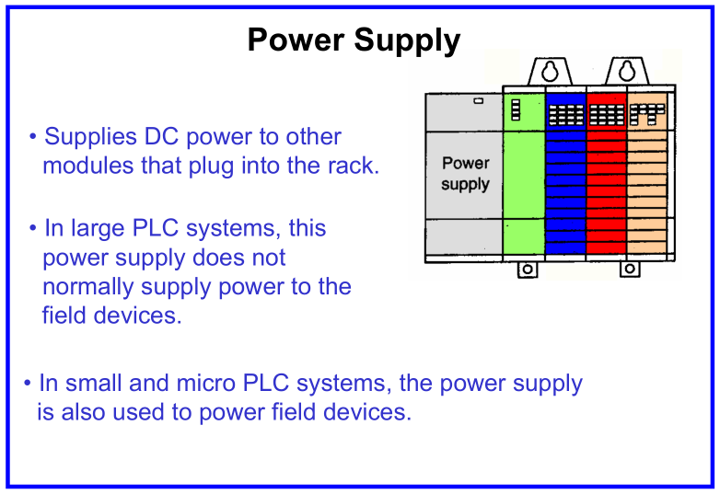
Programmable Logic Controllers
Overall PLC System

Slide 40
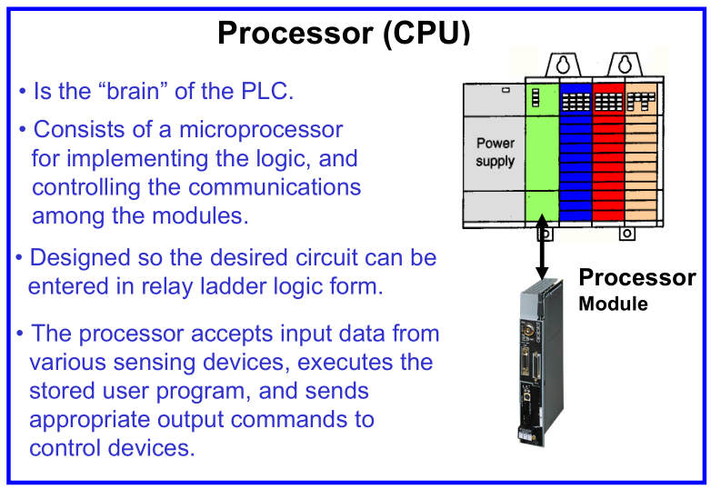
Programmable Logic Controllers
Overall PLC System

Slide 41
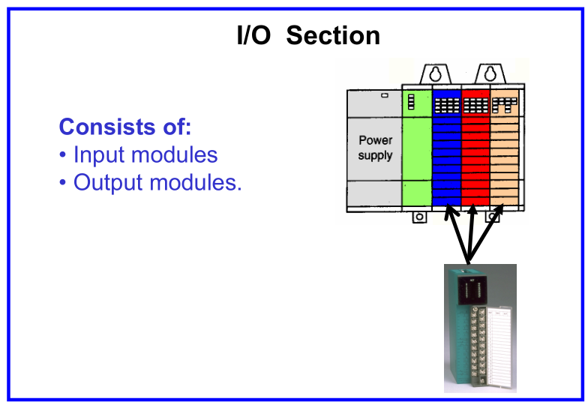
Programmable Logic Controllers
Overall PLC System

Slide 42
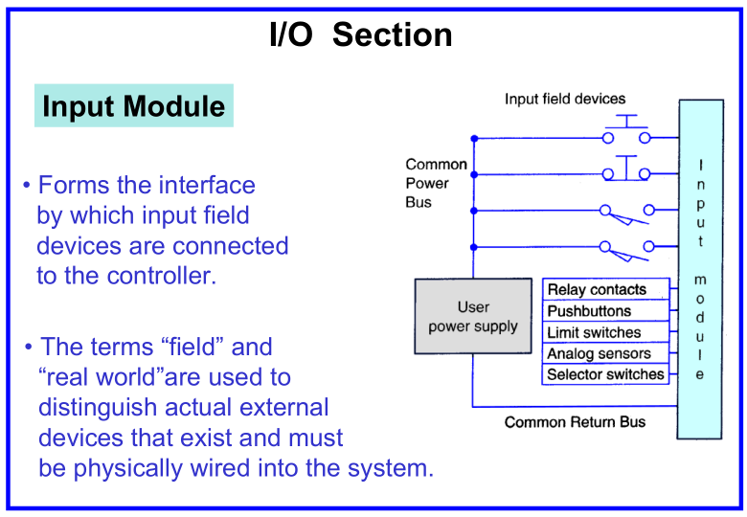
Programmable Logic Controllers
Overall PLC System

Slide 43
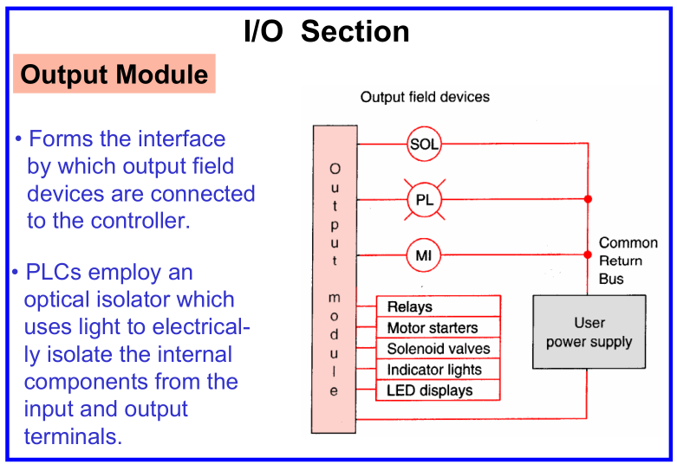
Programmable Logic Controllers
Overall PLC System

Slide 44
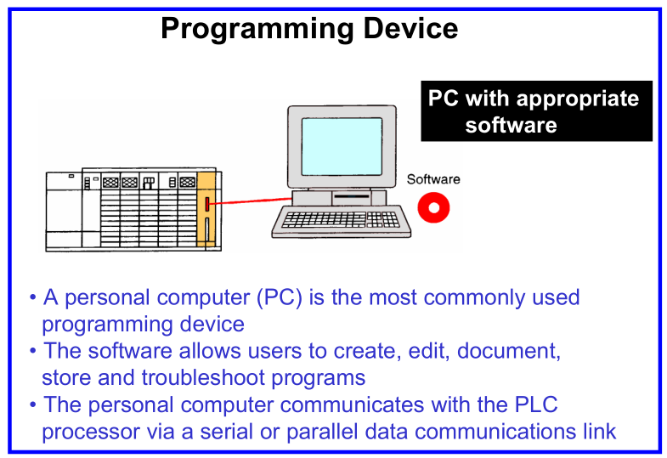
Programmable Logic Controllers
Overall PLC System

Slide 45
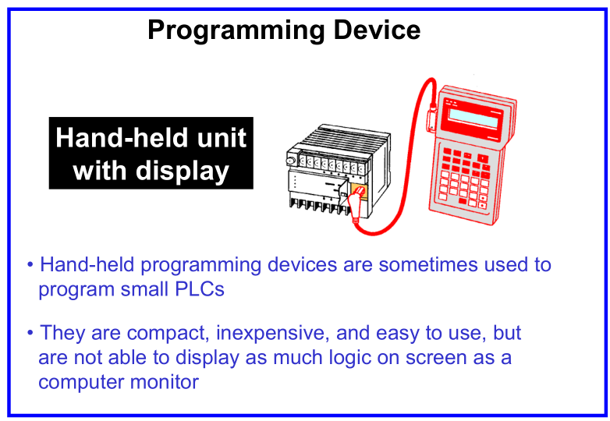
Programmable Logic Controllers
Overall PLC System

Slide 46
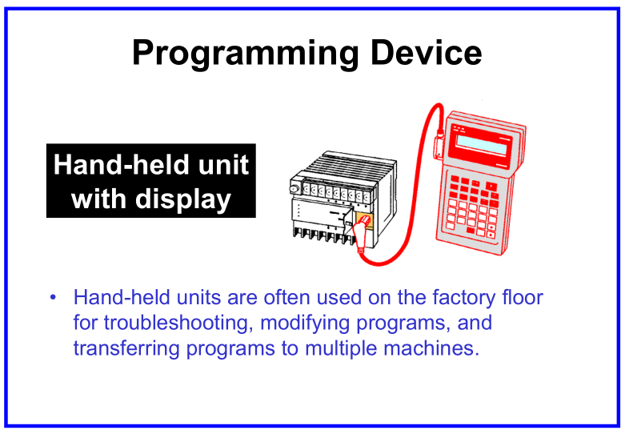
Programmable Logic Controllers
Overall PLC System

Slide 47
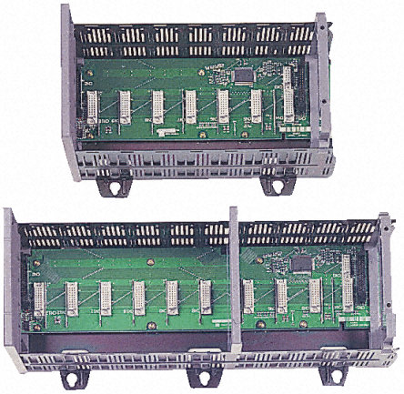
Programmable Logic Controllers
Overall PLC System
Racks or chassis come in many shapes & sizes, and typically allow 4, 8, 12, or 16 modules to be inserted. Racks contain I/O modules and the processor are referred to as local I/O. Racks that contain I/O modules, remote I/O communication cards, power supplies, and are mounted separately of away from the processor are referred to as remote I/O.

Slide 48
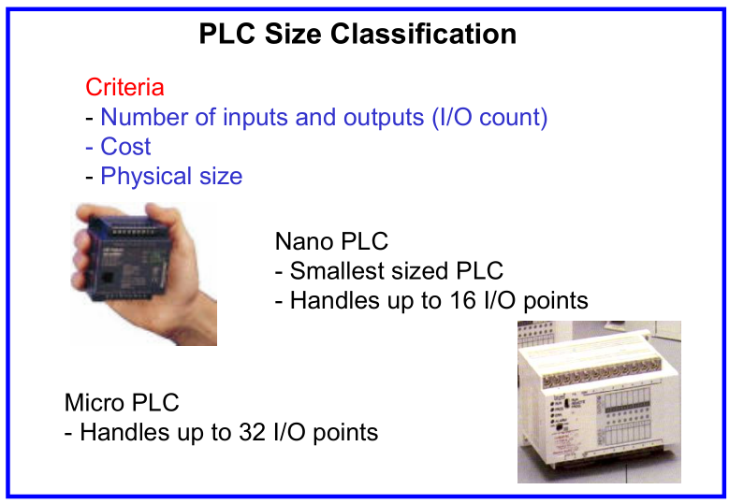
Programmable Logic Controllers
Overall PLC System

Slide 49
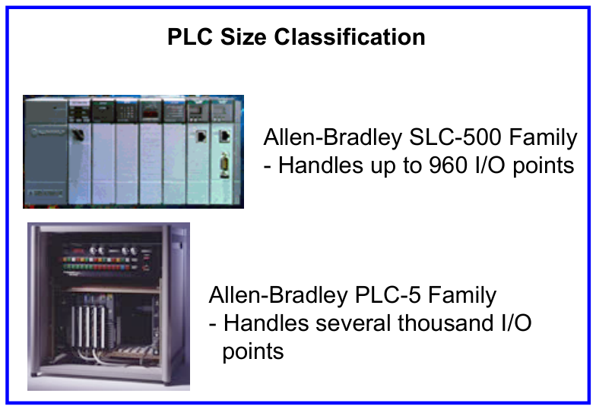
Programmable Logic Controllers
Overall PLC System

Slide 50
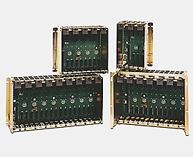
Programmable Logic Controllers
Overall PLC System
Allen-Bradley uses the rack number, location of a module within a rack, and the terminal number of a module to which an input or output device is connected to determine the device’s address.

