Slide 1
Automobile Engineering

Slide 2
1.CROUSE & Anglin, AutomotiveMechanics, TataMcGraw Hill, Publishing Co. Ltd., New Delhi, Tenth Edition - 2004.
2.Kirpal Singh., Automobile Engineering, Vol. I & II Standard Publishers, Delhi.

Slide 3
Introduction:
An Automobile (also called an automotive) is a Self Propelled vehicle which is used for the transportation of Passengers and Goods on the Ground.
A vehicle is machine which is used for the transportation of passengers and goods.
A self propelled vehicle is that in which power is produced within itself for its propulsion.
Various types of self propelled vehicles are:
Scooters, motor cycles, cars, buses, trucks, tractors, locomotives, motorboats, ships, Aero planes, helicopters, rockets….etc.,
Since an AUTOMOBILES is propelled on ground only.
MOTOR-VEHICLE is another name for self-propelled vehicle running on the ground.

Slide 4
Definition:
The automobile is a self propelled vehicle that travels on the road –William H Crouse
An automobile is a wheeled vehicle carrying its motive power unit
-Kirpal Sing
Today, Automobiles play an unimaginable role in the social and economic growth of any country.
After the introduction of Internal combustion engines, the Automobile industry has seen a tremendous growth.

Slide 5
History of Automobiles:
The automobile has been around for more than 100 years.
The first self propelled vehicle was built by Captain Nicolas Cugnot in 1769. It was powered by a steam engine and was very slow.
In 1801, Richard Trevithick improved the steam engines design by making them smaller and lighter. It was the first horseless carriage that could transport passengers.
In 1876,Nikolaus August Otto built the first four stroke engine.
Karl Benz, known as one of the founders of Mercedes-Benz ,is the first to build an automobile powered by an IC engine in 1885.
In 1886 Gottlieb Daimler designed the first four wheeled automobile. They also created the first V-slanted engine.

Slide 6
After 1886, Benz also invented accelerator for speed regulation, battery ignition system, spark plug, clutch ,gear shift ,and the radiator for cooling the engine.
With these improvements ,he started with production of the automobile ,the first in the world, in the year 1888.
However in the year 1893 that the first four wheeled automobile was introduced by him.
In 1908, Ford started to build cars with vary famous model-T, in nineteen years, a total of 15500000 units where sold in the United States alone.
Hybrid cars have also been around since the 1900’s.

Slide 7
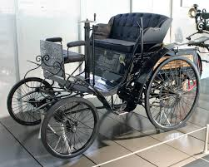
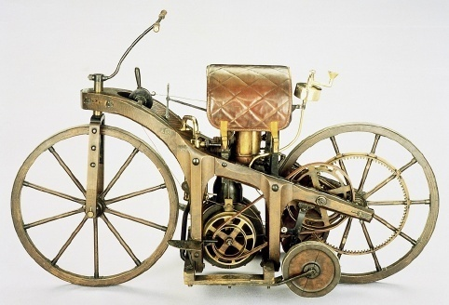
First Four and Two wheelers

Slide 8
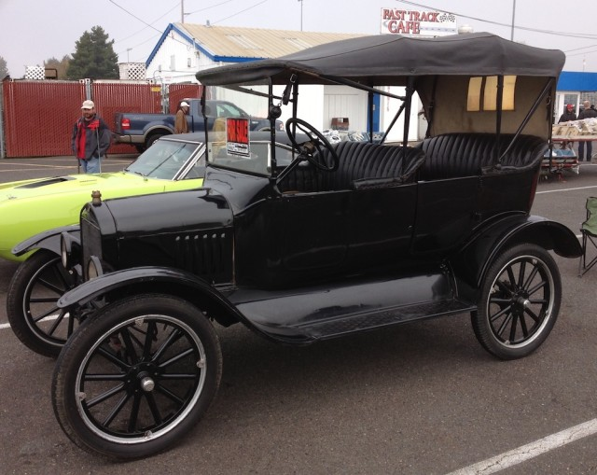
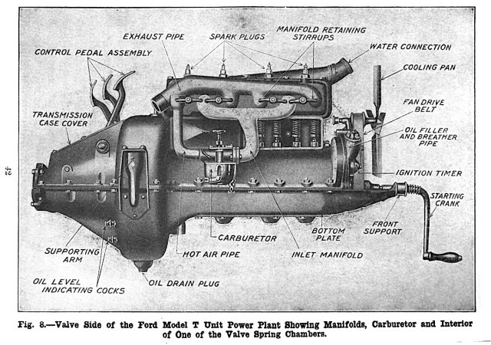
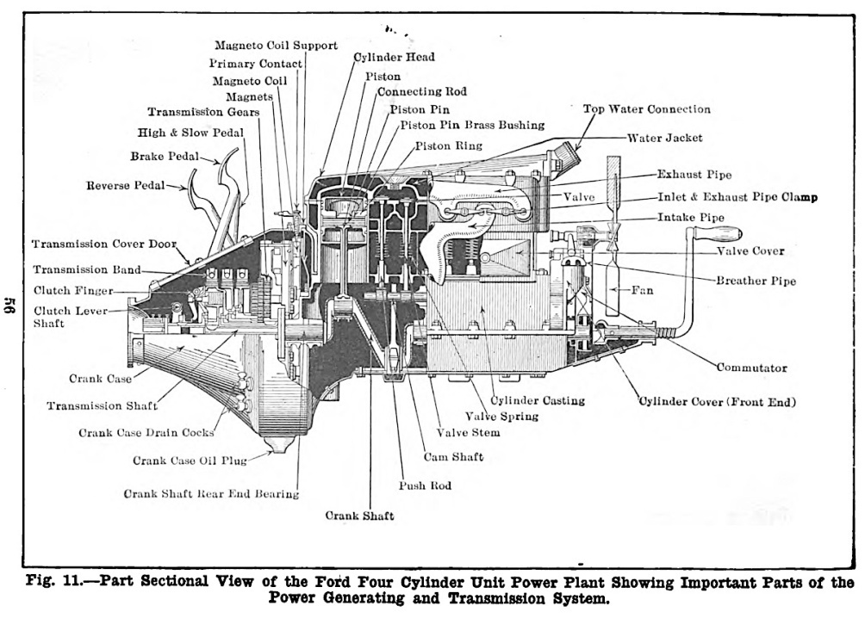
Ford Four wheel Vehicle & model-T engine

Slide 9
Present:
Today the Automobile industry is one of the biggest industry in the world.
In recent years tremendous changes have taken place in the automobile industry.
Two powerful forces have been at work
* The challenges of foreign automotive manufacturers
* Federal laws made by the Government covering.
-Automotive air pollution
-Automotive safety
-Automotive fuel economy
These two forces have caused the manufactures to develop new generations of
*Light weight vehicles
*Fuel efficient vehicle

Slide 10
Classification of Automobile:
The automobiles are classified by the following ways
On the Basis of Purpose:
Passenger Vehicle: the automobile carry passengers- eg: Busses, Passenger trains cars.
Goods vehicles : these vehicles are used for transportation of goods from one place to another, e.g: Goods lorry, goods carrier
2. On the Basis of capacity:
Heavy transport vehicle (HTV) or heavy motor vehicle (HMV),
e.g: Large trucks, buses..etc
Light transport vehicle (LTV), Light motor vehicle (LMV),e.g: small trucks mini buses.

Slide 11
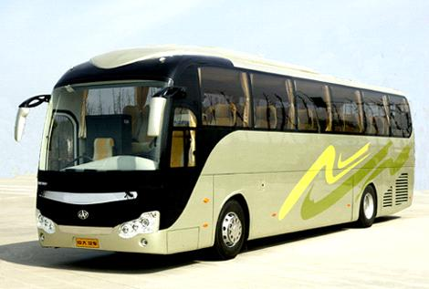
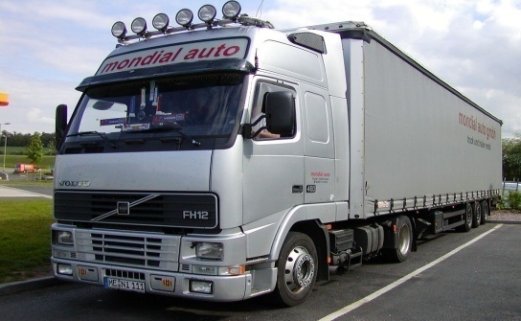
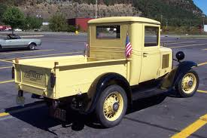
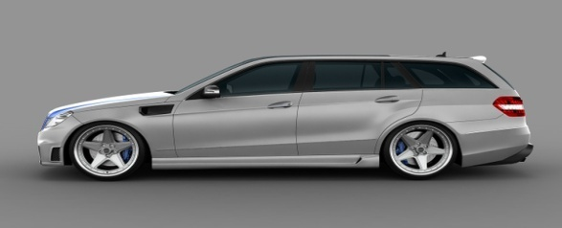
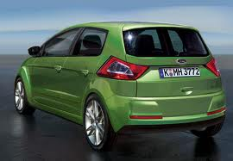
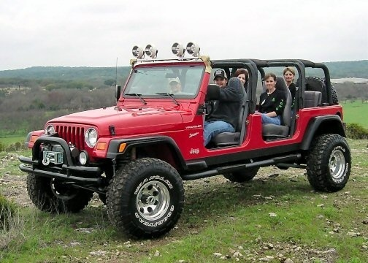
Heavy Transport Vehicle (HTV) or Heavy motor Vehicle (HMV) e.g. ., Buses, Trucks etc
Light motor Vehicle (LTV),e.g. pickup, station wagon,etc.
Light motor vehicle (LMV), e.g. Cars, jeeps, etc.

Slide 12
3. On the Basis of fuel source :
Petrol engine vehicles: Automobile powered by petrol engine, e.g: scooters, cars, mopeds, motorcycles.
Diesel engine vehicles: Automotives powered by diesel engine, e.g: trucks, buses.
Gas vehicles: Vehicles that use gas turbine as power source, e.g: Turbine powered cars.
Hydrogen vehicles: vehicles that have hydrogen as a power source, e.g: Honda FCX Clarity.
Electric vehicles: Automobiles that use electricity as a power, e.g: Electric cars, electric buses.
Hybrid Vehicles: Vehicles that use two or more power sources, e.g: Hybrid buses, hybrid cars like Toyota Prius, Honda Insight…etc

Slide 13
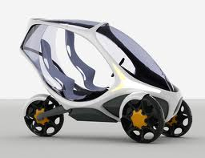
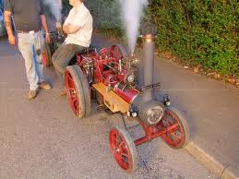
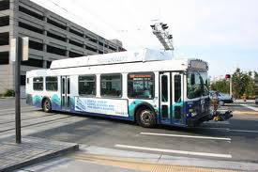

Slide 14
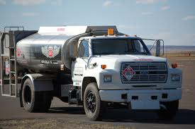
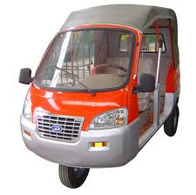
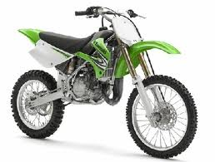
4. On the Basis of Wheels :
Two wheeler vehicle, for example : Scooter, motorcycle, scooty, etc.
Three wheeler vehicle, for example : Autorickshaw,
Three wheeler scooter for handicaps and tempo, etc.
Four wheeler vehicle, for example : Car, jeep, trucks, buses, etc.
Six wheeler vehicle, for example : Big trucks with two gear axles
5. On the basis of body style:
Sedan
Hatchback car.
Coupe car.
Station wagon.
Convertible.
Van
Special purpose vehicle, e.g. ambulance, milk van..etc.

Slide 15
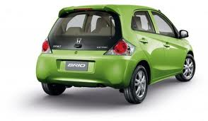
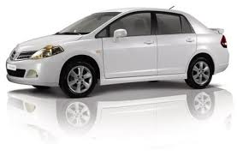
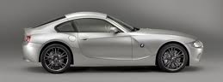
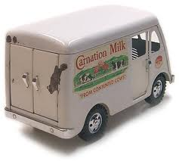
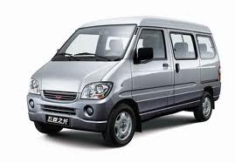
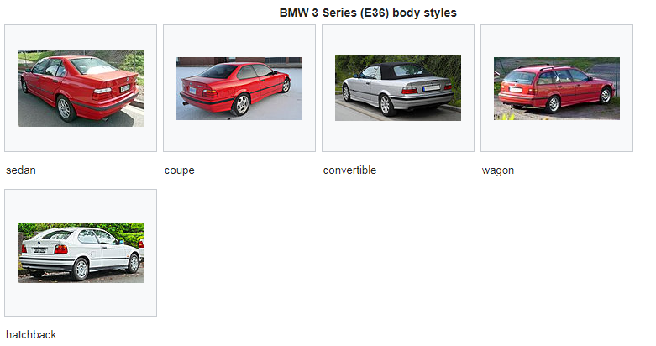

Slide 16
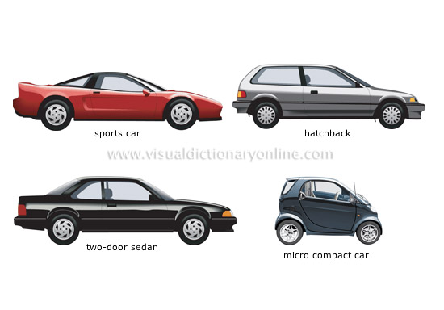
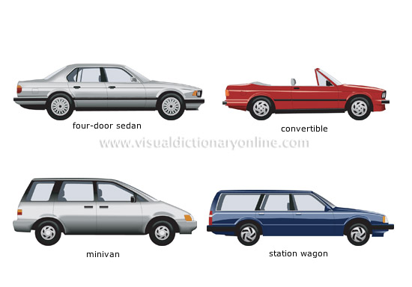
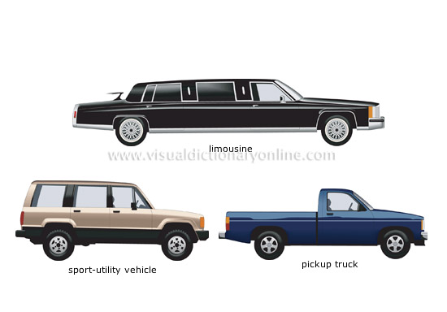

Slide 17
6. On the basis of Transmission:
Conventional vehicles with manual transmission, e.g. car with 5 gears.
Semi-automatic
Automatic : In automatic transmission, gears are not required to be changed manually.
7. On the basis of Drive:
Left hand drive
Right hand drive.
8. On the basis of Driving Axle
Front wheel drive
Rear wheel drive
All wheel drive
9. Position of Engine:
Engine in Front - Most of the vehicles have engine in the front. Example : most of the cars.
Engine in the Rear Side Very few vehicles have engine located in the rear.
Example : Nano car.

Slide 18
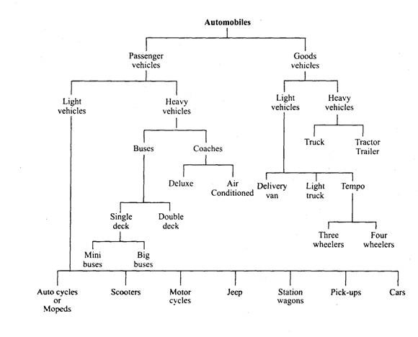
Classification of Automobile:

Slide 19
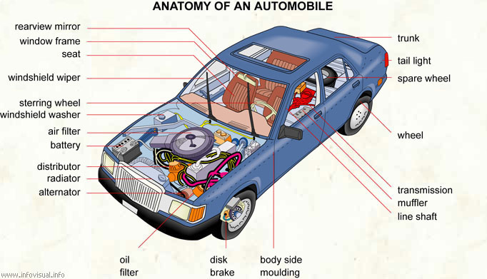

Slide 20
Components of a four wheeler Automobile
About 1500 separate parts are put together to make an automobile.
These parts are grouped into several systems.
Each system is made up of two or more parts that work together to perform a specific job.
The automotive vehicles are produced in large variety of sizes and shapes but having the same basic parts and systems.

Slide 21
Major Components of the Automobile
An automobile is made up of mainly two units, these are Chassis and Body.
“Frame” + “Basic components” = “Chassis”
“Chassis” + “Body” = “Vehicle”
The basic structure
1)Frame, 2) suspension system, 3) Axles, 4) wheels
Power Plant
petrol Engine or Diesel Engine
The transmission system
1) Clutch, 2) Gear box, 3) Bevel Pinion and Crown wheel,
4) differential

Slide 22
The Auxiliaries
  Engine Electrical systems:
  Starting system
  Ignition system
  Charging system
  2) Body Electrical system:
  Lamps & lights, Indicator lights, warning lights ,
  Other equipments like audio, horn, Air conditioning system, wiping system..etc.
The controls
  Steering system
  Braking system

Slide 23
Chassis
Chassis ( known as a carrying unit) is a French term and was initially used to denote the frame parts or basic structure of the vehicle.
Vehicle without body is called chassis. It is the back bone of the vehicle
The function of the chassis is to provide safety for the passengers and a stable platform for mounting engine, transmission, and suspension components.
The chassis consists of the frame ,suspension (Springs, shock absorbers),axles, brakes, wheels, tyres and steering mechanism.
The frame supports the power plant and this frame is supported by the suspension system, and that in turn is supported by the axles and wheels.
The chassis is sub divided as a) Power Plant, b) Running Gear.

Slide 24
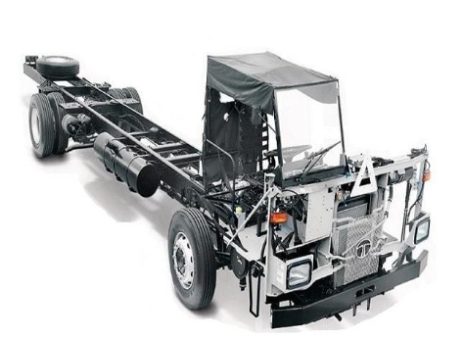
Tata LPO 1623 BSIV Chassis

Slide 25
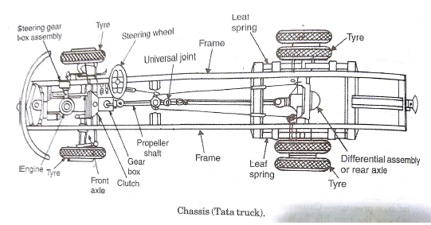
a)Power Plant: Includes the engine assembly and power transmission assembly.
b) Running Gear: includes the frame, steering system, suspension system, brakes, wheels, and tyres.

Slide 26
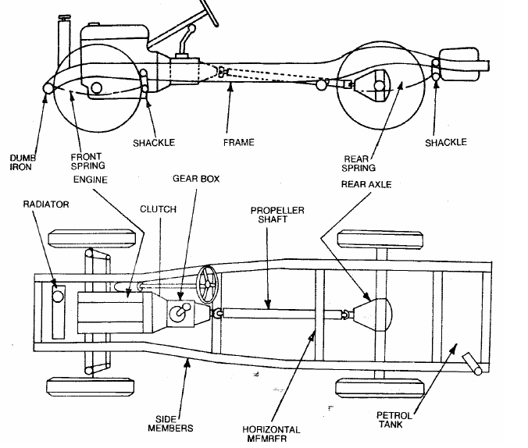

Slide 27
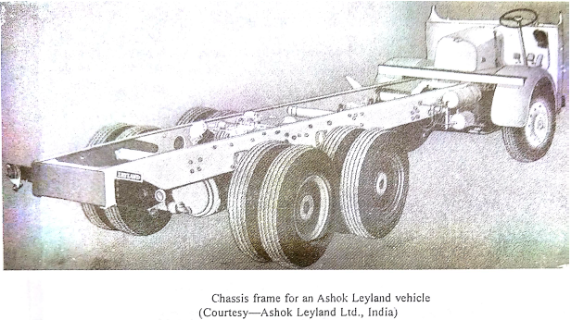
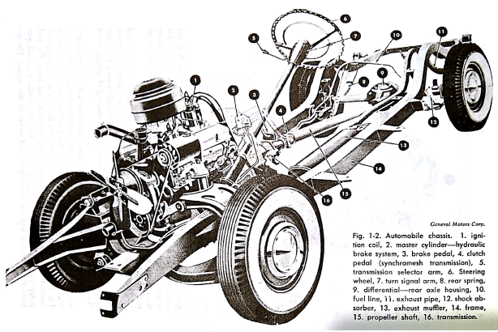

Slide 28
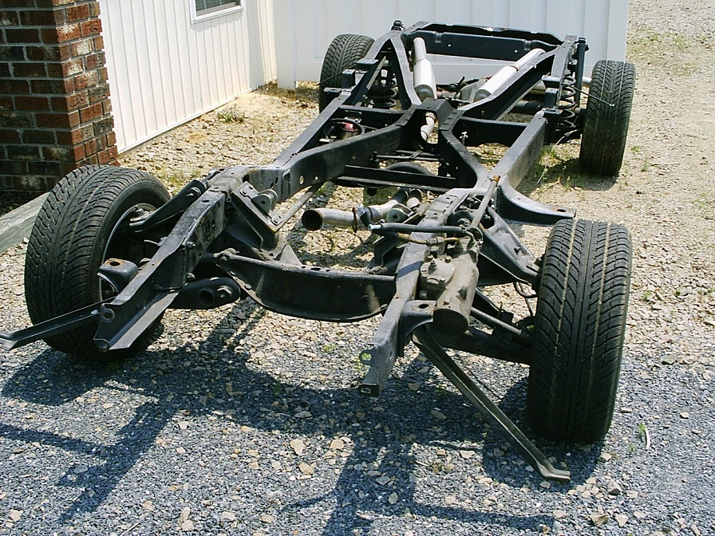

Slide 29
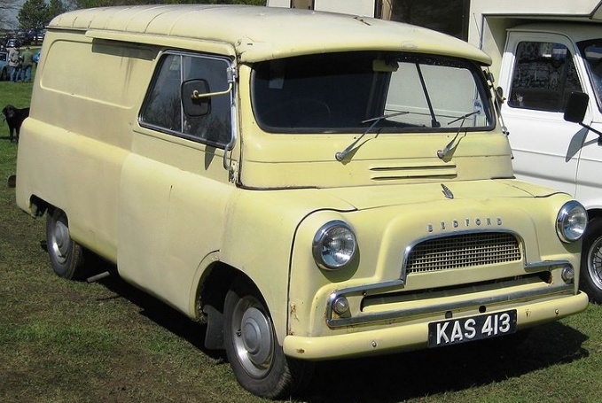
CLASSIFICATION OF CHASSIS:
The chassis may be classified as follows:
1)According to vehicle control:
Conventional chassis:
the engine is fitted in front of the driver cabin or driver seat , like as cars and previous model of TATA trucks.
Here , the driver sit behind the engine(i.e, quite far off from the front axle)and as such he cannot see the road just in front of the front tyres.
For this reason slope is provided at the mudguard and bonnet to enable the driver to see close to the wheels as far as possible.
In this arrangement portion of the chassis where engine is fitted cannot be utilised for carrying passengers and goods.

Slide 30
b) Semi – forward Chassis:
in this type of chassis where half portion of the engine is in the driver cabin and remaining half is out side of the cabin, like as Bedford pickups and TATA trucks.
In this arrangement a part of the chassis is utilised for carrying extra passengers.
c) Full- forward (Bus) chassis:
In this type of chassis the complete engine is mounted inside the cabin.
In this arrangement floor area is increased to the extent of accommodating 3 extra seats.
So the driver seat just above the front wheels and he can see full front road right from the front wheel.

Slide 31
2) According to fitting of engine:
i) a) Conventional Drive:
Conventionally the engines are fitted at front and drive is given to the wheel from the rear.
Advantages:
Enough space is available for the luggage behind the rear seat.
The weight of the vehicle is well balanced on all wheels.
Adequate space is available for steering the front wheel
It is easier to inspect, repair and adjust the engine clutch and gear box.
ii) Front Engine Drive: the engine is fitted in front and drive is also given to the front wheels only as in matador vehicle, Maruti car, B.M.C.
Advantages:
Low floor is available since there is no propeller shaft and differential at the back.
The vehicle has more adhesion on the road since more weight is placed on driving wheels. And good road holding capacity.
The clutch, gear box and differential are usually made as one unit.
iii) Engine fitted at the centre of the chassis:
in this case, the engine is fitted at the centre of the chassis i.e., under the chassis as in
Royal tiger world master buses.
This arrangement provides full space of chassis floor for use.

Slide 32
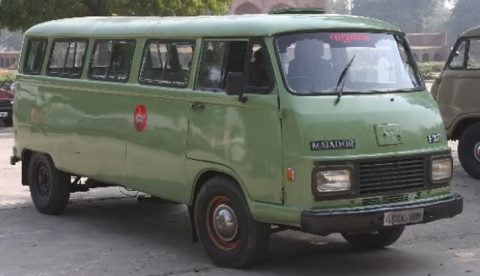
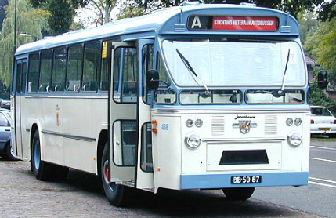
matador vehicle
Leyland Royal Tiger Worldmaster

Slide 33
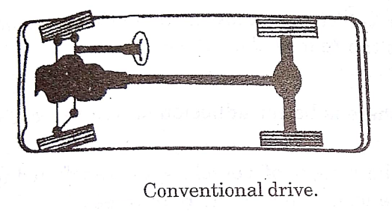
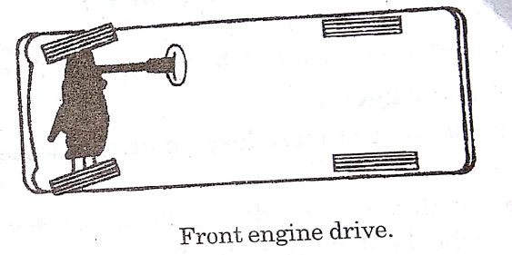
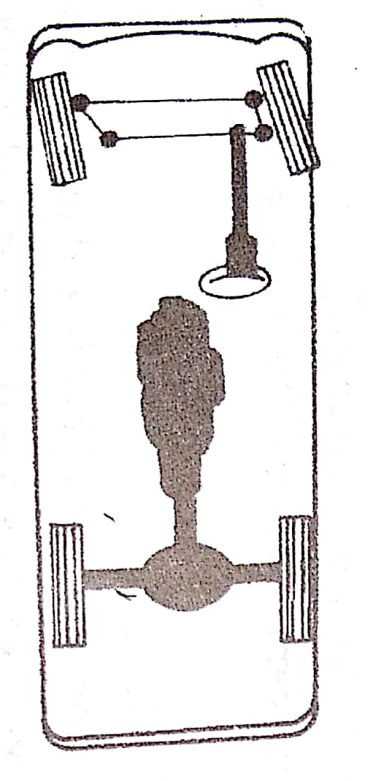
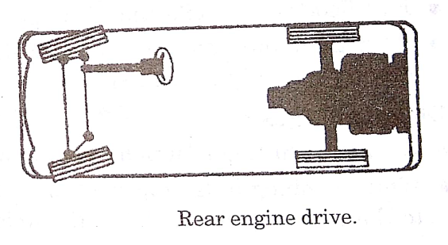


Slide 34
iv) Engine fitted at the back: where the engine fitted at rear of the vehicle, popular vehicles employing this systems e.g: Renault, Dolphin and Volkswagen..etc
Advantages:
In this system, during braking some of the weight of vehicle gets transferred to front wheels, it helps quick stopping.
Flat floor is available since long propeller shaft are eliminated.
Because of more load on driving wheels, there is better adhesion on road specially when climbing the hills.
3. According to the number of wheels fitted in the vehicles and number of driving wheels:
4x2 drive chassis vehicle: It consist of 4 wheels out of which 2 wheels are the driving wheels.
b) 4x4 drive chassis vehicle: it consist of 4 wheels and all of them are driving wheels.

Slide 35
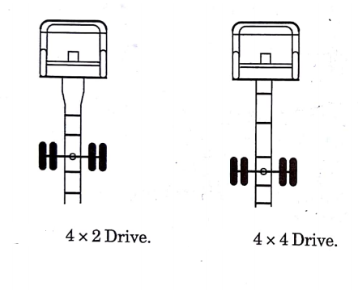
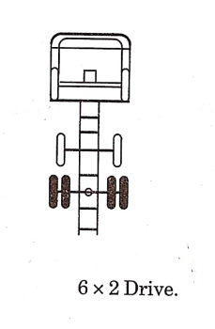
c) 6x2 drive chassis vehicle: it consist of 6 wheels out of which 2 wheels are the driving wheels.

Slide 36
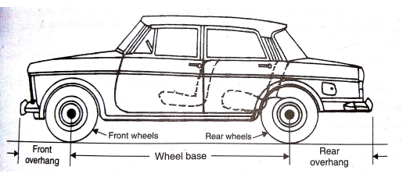
4) According to wheel base size: in the long wheel base chassis vehicle(Wheel Base is the distance between the centers of the front and rear wheels), the distance is more thereby providing more floor area of the chassis for passengers and goods.
In this type of chassis, the front overhang and particularly the rear overhang are also more.

Slide 37
FRAME:
The frame (under body) is the main part of the chassis on which the remaining systems of the chassis are mounted.
It is a rigid structure that forms a Skelton to hold all the major parts together.
The engine is mounted in the forward end of the frame and is connected to clutch and transmission unit to from a complete power assembly.
At the rear end of the frame, the rear axle housing is attached through the rear spring.
The wheel and tyre assemblies support the frame.
The steering system has some parts bolted to the frame and some to the body.
Petrol tank is fastened to rear of the frame.

Slide 38
Chassis frames are made of “steel and aluminum and their alloys” so that they are strong enough to with stand the load and at the same time are also light in weight to reduce dead weight of the vehicle.
The frame basically consist of two longitudinal members and more than two cross(transverse) members depending on the length of the automobile.
In some of the model the longitudinal members are bent both at the front and rear to accommodate jumping of front and rear axles.
FUNCTION OF FRAME:
1)To support the chassis components and the body.
2) To withstand static and dynamic loads with undue deflection.
The various loads dealt with the frame are:
The frame has to take the thrust from the engine and the transmission and other components.
It has to withstand to torsional forces trying to twist and untwist the whole structure on the bumpy ground.
It has to bear the longitudinal tensile forces during starting and acceleration and compressive forces during severe braking conditions and strong wind forces.
It act as a base or support for the body, the automobile components, the floor and the passengers.

Slide 39
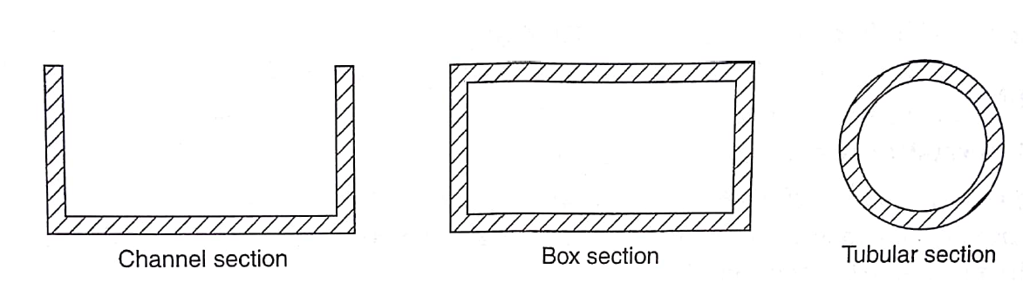
It accommodates the suspension system including the coil spring, shock absorbers, leaf springs, torsion bars..etc.,
It is the base for the body and the fuel tank.
Types of Frame- sections:
Channel section: used for long members of the frame.
Box section: used for short members of the frame
Tubular section: used for three wheelers, scooters and matadors, pick-ups frames.
The channel section is good for bending, tubular good for torsion and box good for bending and torsion.

Slide 40
Classification of frames:
Conventional frame.
Integral or unit frame.
Semi-integral frame.
1)Conventional frame: (Non load carrying frame), here the loads on the vehicle are transferred to the suspension by frame, which support the engine, power train and body.
It has two long side members and 5 to 6 cross members joined together with the help of rivets and bolts.
The body work is made of material like wood and completely isolated from the frame deflection. This type of construction is widely used in trucks.
The frame tapers from the rear to the front to permit adequate movement of the steering wheel.
The longitudinal member sweeping upward at the rear end, allow for the vertical movement of the rear axle.
The torsional rigidity of the frame is increased by providing tubular or box-section cross members.

Slide 41
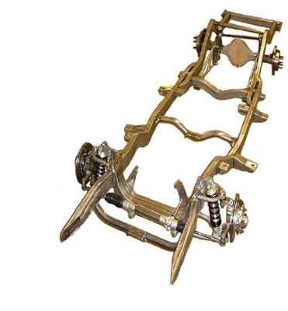
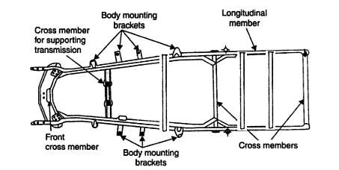
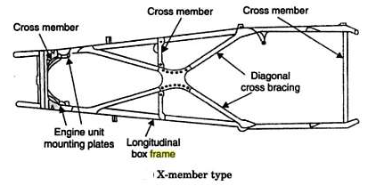

Slide 42
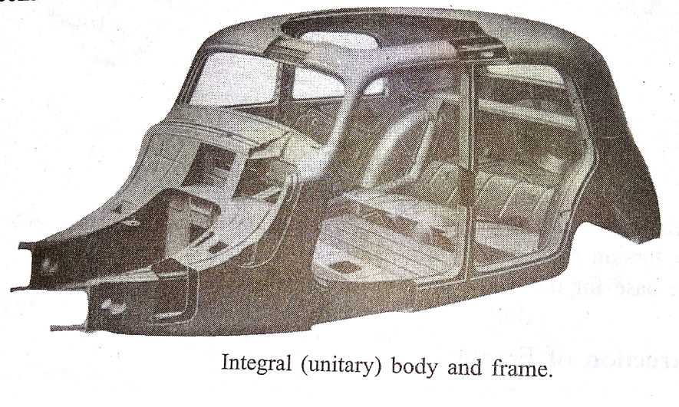
2) Integral frame or chassis less frame:
In this case both the body and the frame form one integral part and they cannot be seen separately .
The side longitudinal members are eliminated and the transverse members are designed for higher strength.
All passenger cars nowadays adopt this type and also used in buses and luxury coaches also.
The disadvantage of with this frame is repairing is difficult.

Slide 43
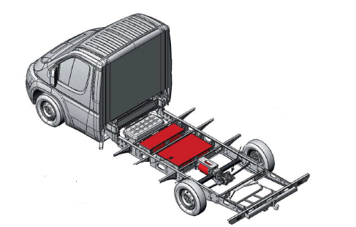
3)Semi-integral frame:
In some vehicles half frame is fixed in the front end on which engine gear box and front suspension is mounted.
It has the advantage when the vehicle is met with accident the front frame can be taken easily to replace the damaged chassis frame.
This type of frame is quite popular for small European cars and American cars, and this frame is heavy.

Slide 44

Types of frames:

Slide 45


Slide 46


Slide 47


Slide 48


Slide 49


Slide 50
BODY
Body is the super structure of the Vehicle. The chassis and body make the complete vehicle.
In large and heavier vehicles, the chassis and the body are each made as a separate unit and then bolted together.
The body usually made from a large number of steel pressing units which are welded together.
The body is bolted to the chassis at numerous points, rubber or felt strips being interposed to damp-down vibration and noise.
The body of motor vehicle should fulfill the following requirements:
Light in weight.
Cheap and easy in manufacturing.
Attractive in shape and color.
Minimum number of components.
Clear all-round vision through glass area.
Long fatigue life
Minimum resistance to air.
Good access to the engine and suspension system.
Minimum vibration during running of the vehicle
Adequate space for passengers and luggage

Slide 51


Slide 52


