Slide 1
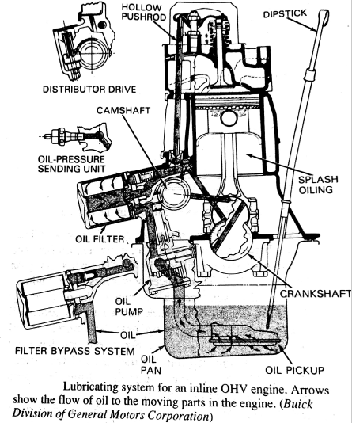
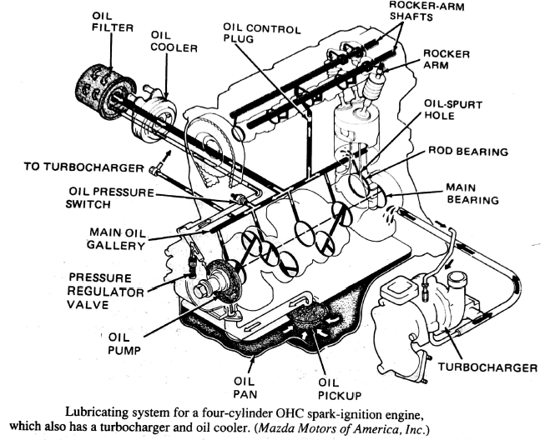
Lubricating systems
The lubrication system supplies oil to the moving components.
An oil film is formed to prevent metal parts from the coming into direct contact with one and another.
The oil film between the parts allows them to move easily, with less friction.
With lower internal friction of an engine makes it to run freely which results in more power developed by the engine.

Slide 2
Following main functions of lubrication system:
Reduce friction.
Reduce wear.
Seal internal parts of the engine.
Cool the engine.
Clean the inside of the engine.
Providing cushioning effect.
Prevent corrosion .
Type of lubrication systems:
1)Mist lubrication system – 2 STROKE
2)Wet sump lubrication system – 4 STROKE SMALL ENGINES
3)Dry sump lubrication system -4 STROKE

Slide 3
1) Mist lubrication system or Petroil lubrication system:
In two-stroke engines, the charge is compressed in the crankcase, and as such it is not suitable to have the lubricating oil in the sump.
Therefore, such engines are lubricated by adding 3 % to 6 % oil in the fuel tank itself.
The oil and fuel mixture is inducted through the carburetor.
The fuel gets vaporized and the oil, in the form of mist, goes into the cylinder through the crankcase.
The oil that impinges the crankcase walls lubricates the main and connecting rod bearings, and the rest of the oil lubricates the piston, piston rings and cylinder.
The main advantage with this system lies in the simplicity and low cost as the system does not require any oil pump, filter etc.

Slide 4
Advantage of this system:
simplicity,
Low-cost (does not required oil pump ,filter)
Disadvantages :
Causes heavy exhaust smoke.
Get contaminated with acids and result in the corrosion of bearings surface.
The engine will suffer from insufficient lubrication as the supply of fuel is less.

Slide 5
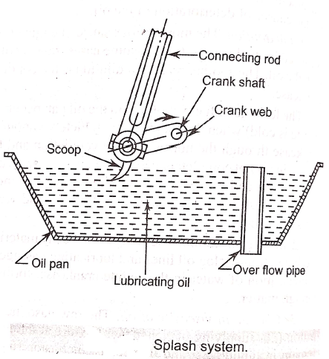
2) Wet Sump Lubrication Systems:
The bottom of the crank case contains an oil pan or sump from which the lubricating oil is pumped to various components by a pump
After lubricating the parts the oil flows back to the sump by gravity.
There are three varieties in wet sump lubricating system:
a) The splash and circulating pump system.
b) The splash and pressure system.
c) The full force-feed system.
the splash and circulating pump system:

Slide 6
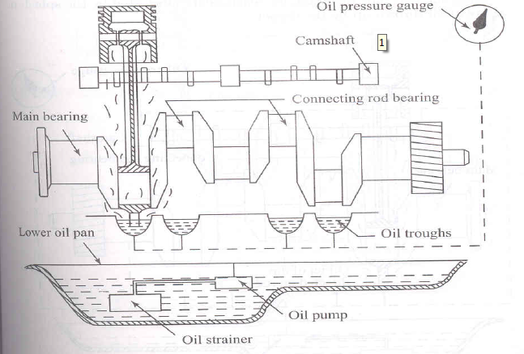
This type of lubrication system is used in light duty engines.
The lubricating oil charged into the bottom of the crank case and maintained at predetermined level.
The oil is drawn by a pump and delivered through a distributing pipe into the splash troughs
A splasher or dipper is provided under each connecting road cap.

Slide 7
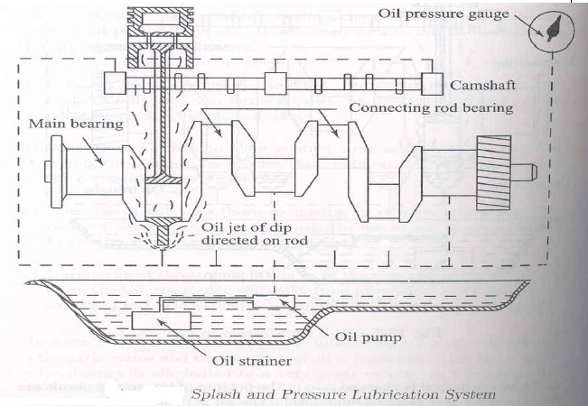
b) The splash and pressure system:
The lubricating oil is supplied under pressure to main and cam shaft bearings.
The oil is also supplied under pressure to pipes which direct a stream of oil against the dippers on the big end connecting rod bearing cup.
The crank pin bearings are lubricated by the splash or spray of oil thrown up by dipper.

Slide 8
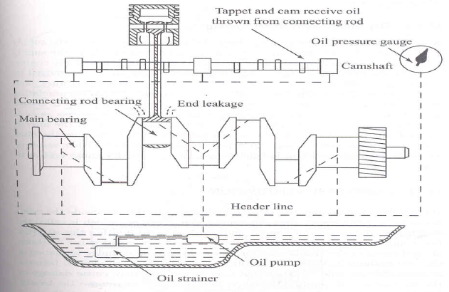
c) The full force-feed system:
The oil is forced to all the main bearings of crank shaft
Pressure relief valve are fitted to maintain the predictable pressure values.
Oil hole is drilled from the center of each crank pin to the center of an adjacent main journal through which oil can pass from the main bearing to the crank pin.

Slide 9
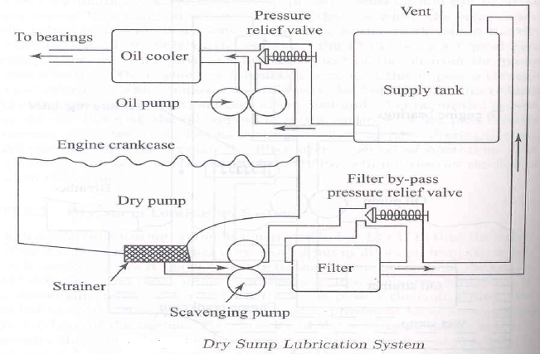
3)Dry sump lubrication system:
In this system the oil is carried in an external tank
An oil pump draws oil from the supply tank and circulates it under pressure to the various bearings of the engine.
Oil dripping from the cylinders and bearings into the sump is removed by a scavenging pump which in turn the oil is passed through a filter and fed back to the supply tank.
The capacity of scavenging pump is always greater than the oil pump
A separate oil cooler provided to remove heat from the oil.

Slide 10
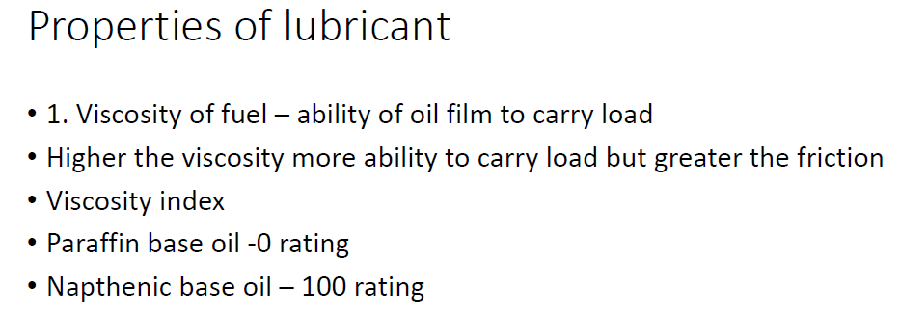

Slide 12
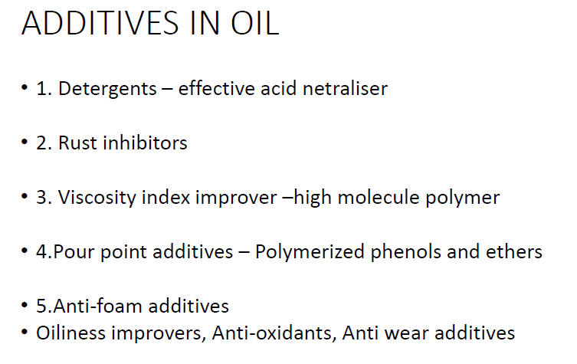

Slide 15
OIL PUMP:
The function of an oil pump is to circulate the lubricant under pressure to lubricate most of the working parts of the engine.
The pump located either inside the crank case or below the oil level in the sump.
It is generally driven by a gear mounted on the cam shaft.
The following types of oil pumps are used:
Gear type pump.
Rotor type pump.
Plunger type pump.
Vane pump.
Gear type pump: the gear type pump is very simple in construction and was the most commonly used pump.
It consists of two spur gears of equal size, one is a driven gear the other is a drive gear, enclosed in a housing.
The two gears are rotated by a shaft that is usually coupled to the camshaft.

Slide 16
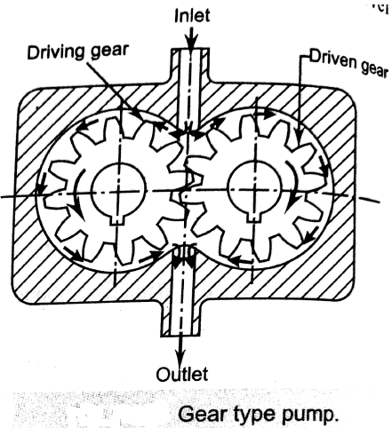
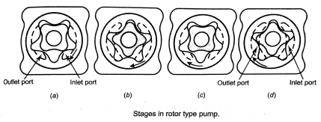
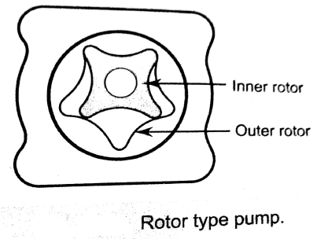
2) Rotor type pump: the rotor type oil pump resembles in construction with the gear type pump.
This type of pump is now widely used in automobiles.
In this type of pump, there are two rotors, one inner and the other outer.

Slide 17
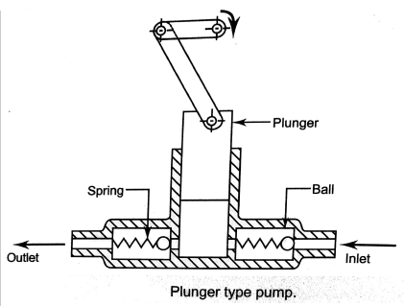
3) Plunger type pump: In this type of pump, a plunger slides up and down in a barrel.
the plunger is driven by the camshaft or by the eccentric wheel provided the crankshaft.
this type of pump is generally employed for the lubrication of small sized single cylinder engines or to supply lubricating oil at low pressure to the oil trough of splash lubricating system.

Slide 18
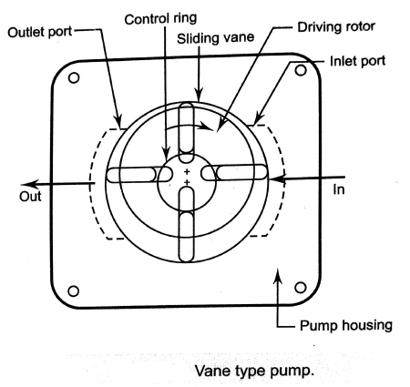
4) Vane type pump: this type of pump consist of a cylinder housing in which an eccentrically mounted driven rotor is placed.
The rotor has a number of spring loaded vanes in the rotor slots equally spaced around its periphery.
The vane can move back and forth in these slots by control ring.

