Slide 1
SUSPENSION SYSTEM:
The suspension is located between the wheels and body of a vehicle.
It serves the following purposes:
It connects the vehicle body and the wheels, and thus supports the weight of the vehicle.
It works together with wheels to absorb vibrations and shocks form the road surface, so as to improve driving comfort and protect the passengers from road shocks.
It ensure that the wheels are always firmly in contact with the road surface and maintains the inclination of body in order to improve the stability of the vehicle in any possible driving condition including acceleration, braking and cornering.
The main components of a suspension system are the springs and shock absorbers.
The spring support the weight of the vehicle and absorb shocks from the road surface.
The shock absorber controls the motion of the springs by dampening the spring action.

Slide 2
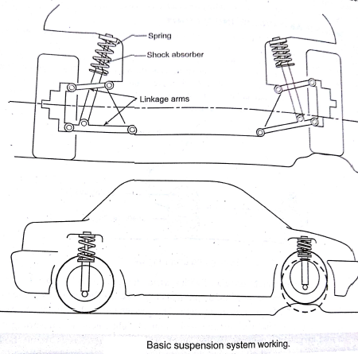
Basic requirements of a suspension system:
Following are the basic requirements of a good suspension system in automobile.
It should have minimum deflection consist with the vehicle stability in order to provide good cushioning ability along with better ride qualities.
The total weight of the suspension system should be minimum.
It should minimize tyre wear.
It should have low initial cost, operation cost and maintenance cost.

Slide 3
SPRINGS:
The springs in suspension system are used to absorb the up and down motion of the wheels when wheels pass through pot holes and bumps on the road.
This protect the passengers from getting shocks or jerks.
The springs are placed between the chasis frame and axles.
The following types of springs are generally used in automobiles:
Leaf springs. 2) Coil springs and 3)Torsion bar.
Each o these springs absorb shocks in a different way.
The leaf spring absorb shocks by bending.
Coil spring by compressing.
Torsion bar by twisting.
1)LEAF SPRINGS:
The leaf springs used in automobiles are made up of several flat long strips made from spring steel of rectangular cross section.
Each strip is called a leaf. The several strips are placed one on the other and are held together by means of a centre bolt and clamp as shown fig.
The spring assembly consist of a main leaf which extends to the full length of the spring.
The end of the main leaf are formed with loops known as eyes.
The other leaves in the springs are attached the main leaf by means of centre bolt and clamps .

Slide 4
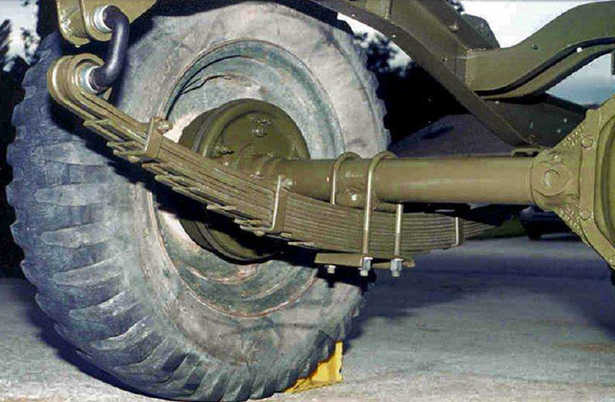
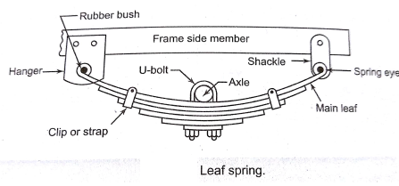
The length of each succeeding leaf is shorter than the preceding one and the complete assembly act as flexible leaves.
The centre of this arc- shaped spring is usually attached to the axle of the vehicle it supports, while the ends of the spring are attached to the frame itself.
When the vehicle goes over the bump, the spring flatter up and increases in length and during rebound, the spring returns back to its shape thereby decreasing in length.
The shackles make the spring worthy to swing in and out.
This type of spring configuration often helps to provide a softer, less rigid suspension system.

Slide 5
Types of leaf springs:
Following are the various types of leaf springs:
Full elliptical leaf spring: this type of leaf spring refers to two semi-elliptical springs connected at their ends, to form the ellipse as shown fig.
The three quarter elliptical leaf spring: this type of leaf spring refers to one semi-elliptical spring connected over a quarter elliptical spring.
Semi-elliptical leaf spring: this type of leaf spring refers to forming the shape of half ellipse as shown in fig. it is most commonly used in almost all type of trucks.
Quarter elliptical leaf spring: this type of leaf spring refers to forming the shape of half of semi- elliptical spring. This type of system is also called as cantilever spring system, the thick end of which is bolted rigidly to the frame.
Transverse leaf spring: This type of leaf spring refers to a semi elliptical spring mounted in a inverted manner, and has saddle at above forming a bow and is attached parallel to the wheel axle .

Slide 6
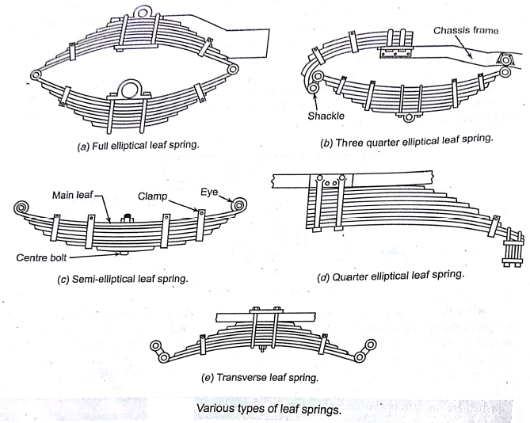

Slide 7
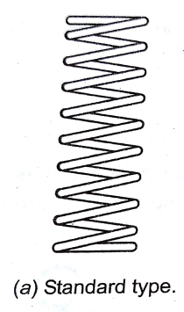
2) COIL SPRINGS:
The coil springs are extensively used in suspension system of automobiles.
a)standard coil spring:
standard coil spring is made from length of special spring steel, usually round in section.
It wound in the shape of coil as shown in fig.
The end of a coil spring are kept flat so that they seat properly.
The coil spring is very elastic and compresses when a load is put on it.
When a vehicle goes over a bump or pot hole, the spring compresses or expands to absorb the shock.

Slide 8
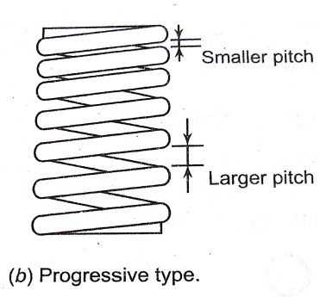
b) Progressive type coils:
In progressive type coil springs, the wire is wound into coils of progressively increased pitches as shown in fig.
When wheel hits a hole or bump, the larger pitch section absorbs shocks or impacts with the smaller pitch section of the spring completely compressed.
The coil springs are mostly used in the independent suspension systems.
The advantage of the this type of spring is that they can be assembled in compact space and are capable of storing twice the energy than that of a leaf spring.

Slide 9
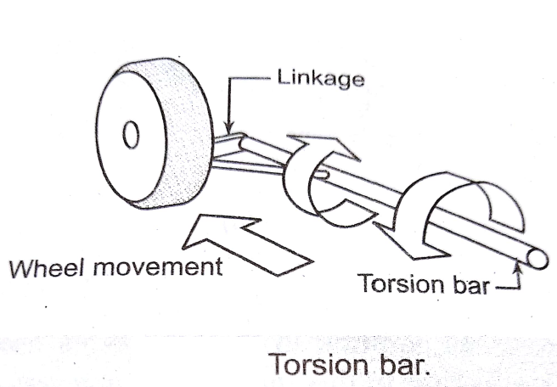
3) TORSION BAR:
The torsion bar is made from spring steel bar which functions by twisting.
One end of the torsion bar is fixed to the frame, so that it may not turn, the other end is attached to the lower control arms as shown fig.
When the vehicle goes over a bump or pot hole, the torsion rod gets the twisting effect and the elasticity of the is utilized to bring back the wheel to its normal position in same manner as a spring arrangement.
The main advantages of torsion bar suspension are durability, easy adjustability of ride height, and small profile along the width if the vehicle.
It takes up less of the vehicles interior volume as compared to coil springs.
A disadvantage is that torsion bars, unlike coil springs usually cannot provide a progressive spring rate.

Slide 10
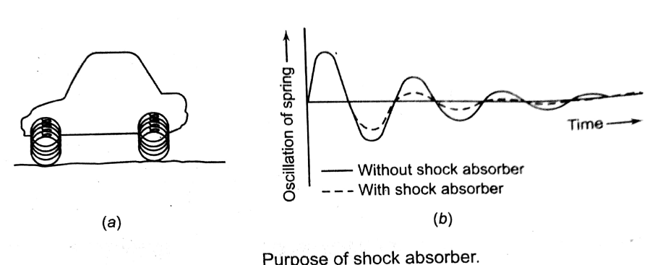
SHOCK ABSORBER:
When a vehicle moves over a rough road surface, potholes or dumps, an impact force is experienced by the wheels and the spring flexes to absorb this force.
However , the spring will oscillate in a vertical direction for a period of time before it can return to its original position.
In order to damp down this oscillating motion of spring to ensure both driving comfort and steerability a shock absorbers (sometimes called damper) is used in vehicles.
The vehicles suspension as shown in fig. when passed over road irregularities, the body of the vehicle will start to oscillate in a vertical direction and driving comfort will be damage.
In addition to this, the tyre do not contact the road surface securely when the vehicle is oscillating in this manner.
Thus the main purpose of shock absorber is to suppress this seemingly endless oscillation of the spring. As shown fig.
This is achieved by converting the kinetic energy ( motion of the spring) into heat energy, and then dissipating that heat mostly by convection to the atmosphere.

Slide 11
Types of shock Absorbers:
The shock absorbers may be classified as:
a) Mechanical shock absorbers b) Hydraulic shock absorbers.
In mechanical shock absorbers, the friction action of metallic discs is utilized to control the spring action.
This type of system has almost become obsolete due to its non predictable damping characteristics.
Hydraulic shock absorbers:
The hydraulic shock absorber uses a fluid, which is passed through an orifice, which resists the movement of fluid.
It is the resistance force that is created at this time which is used to suppress the motion of the spring.
The hydraulic shock absorbers are of following three types:
Telescope shock absorber
Cam actuated piston type shock absorber
Rotary vane type shock absorber.

Slide 12
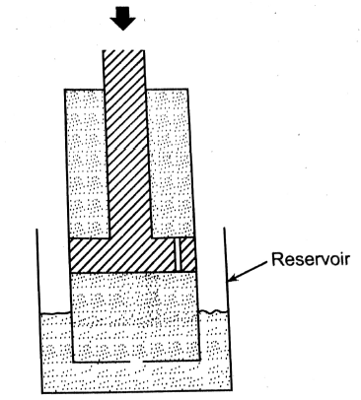
Principle of shock absorber:
In this type of set up a piston having orifices moves up and down inside an oil filled cylinder.
As it moves, the oil passes through orifice in the piston, this crate a resistance force or damping force at this time which is used to suppress the motion of the piston.
A twin tube shock absorber is fitted with a valve in the bottom of the piston as shown fig.
This allows the displaced oil to escape to a reservoir in between the inner and out tubes and when the piston rises up again, the oil is return to the inner tube.

Slide 13
i) Telescopic shock absorber:
This type of shock absorber is connected between the chassis frame and the axle.
Most of the modern passenger car suspension shock absorbers consist of direct double acting telescopic type hydraulic shock absorber.
It is called direct acting because of their direct connection between the car frame and the axle, and also called double acting, as this type of shock absorber acts on both the compression( downward movement of body) and rebound strokes( upward movement of body)
There are two chambers in this type of shock absorber that are outer chamber and inner chamber.
The outer chamber serves as a reservoir and consist of steel tube, base cup and one of the mounting brackets to the vehicle.
The inner chamber is housed in outer chamber and act as a cylinder. This cylinder is simply a drawn steel tube capable of withstanding high pressure and provides a smooth surface for the piston to seal and move.
The cylinder as well as reservoir is filled with adequate damper oil, at the bottom of the cylinder a two way valve is fitted.
The cylinder contains a combined piston and valve(also known as rebound valve) assembly which is connected to a rod.
The combined piston and valve assembly further divides the cylinder into two chambers that is upper and lower.

Slide 14
The upper chamber of the cylinder is called as rebound chamber whereas the lower one is called a compression chamber.
When the wheel goes to a bump(i.e. compression stroke), the piston and valve assembly is pushed into the lower chamber of the cylinder, compressing the oil in this chamber.
Since the oil is incompressible, so it opens the valve connected with the piston and enter into the upper chamber(i.e. rebound chamber) of the cylinder.
Some of the oil runs into the reservoir by opening the compression oil.
When the wheel goes into a pothole (i.e. rebound stroke) the piston and valve assembly is pulled up, the valve open in other direction, as this is a double type of check valve.
As the shock absorber is extended during this stroke, oil is drawn into the cylinder tube compression chamber.

Slide 15
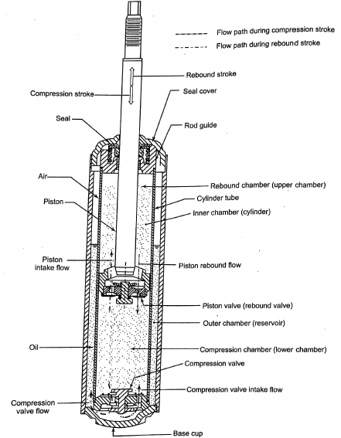

Slide 16
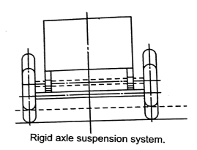
Types of suspension system:
The suspension systems are divided into the following two major system:
1) Rigid Axle suspension system, 2) Independent suspension system.
1) Rigid Axle suspension system:
In Rigid axle suspension system, the left and right wheels are connected by a single axle beams and the load directed to the wheels is supported by this arrangement as shown in fig.
When a vehicle with rigid axle suspension system encounters road irregularities , the axle tilts and the wheel no longer remains vertical, for this reason the whole of the vehicle to tilt to one side.
This type of suspension system mainly employed in large or medium-sized trucks and buses.

Slide 17
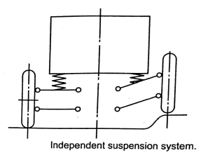
2) Independent suspension system:
in this system there are no axle beam connecting the left and right wheels and the load directed to the wheels is supported by the suspension arms.
Thus each wheel moves independently in response of its specific road conditions.
This type of suspension system is more complicated in design than the rigid axle type, but unsprung weight is lighter and wheel to ground contact better.
Therefore, driving comfort and stability are better in this type of system.
The sport utility vehicle(SUV), sports cars, modern cars, compact trucks and other similar vehicles commonly use independent suspension system.

Slide 18
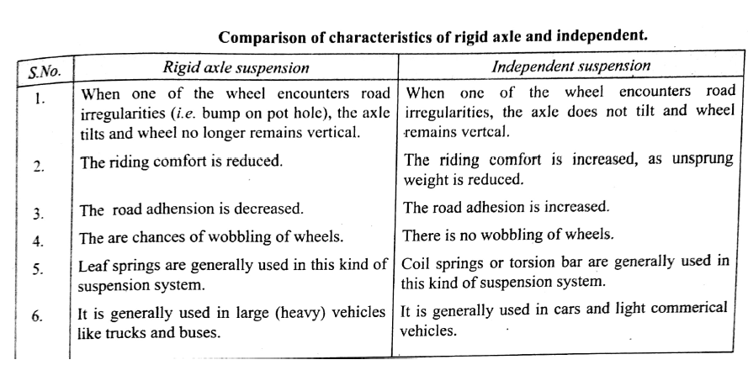

Slide 19
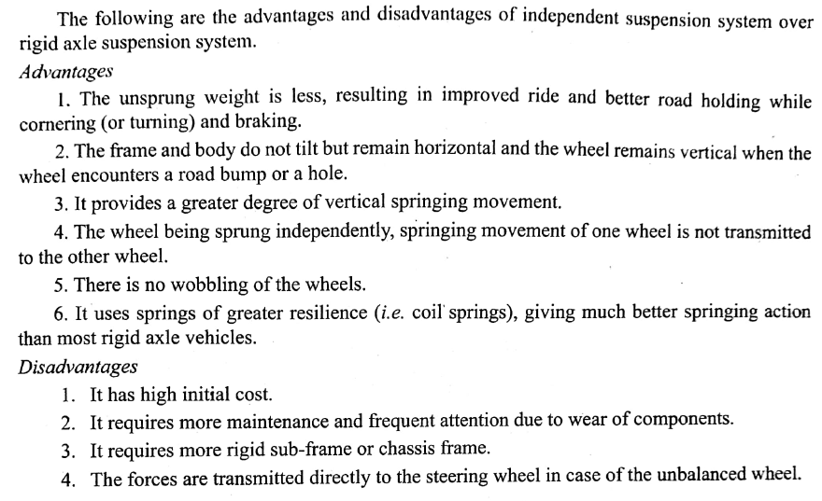
Advantages and disadvantages of independent suspension system:

Slide 20
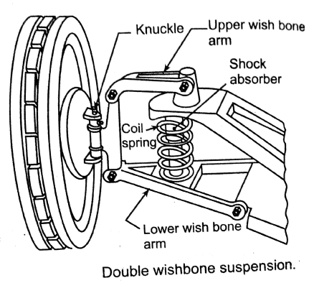
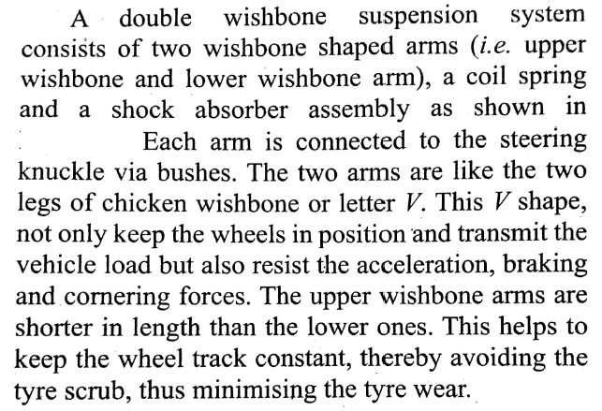
The different types of independent suspension system that are generally used in automobiles are follows:
Double wishbone system.
Macpherson strut suspension system.
Trailing link type independent system.
Swinging half axle suspension system.
Double wishbone system:

Slide 21
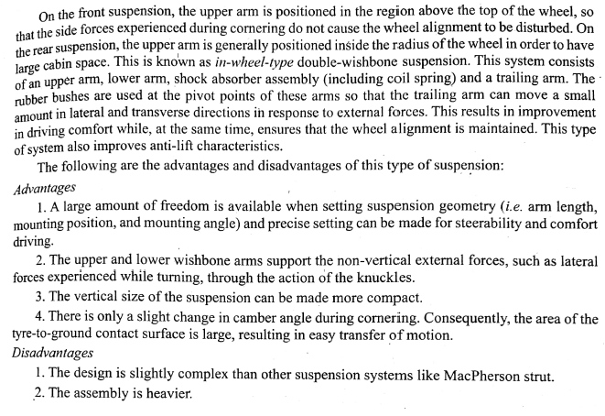

Slide 22
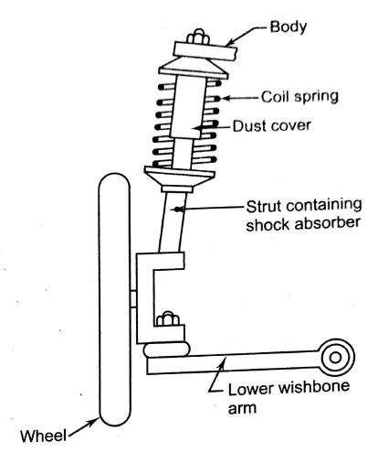
b) Macpherson strut suspension system:

Slide 23
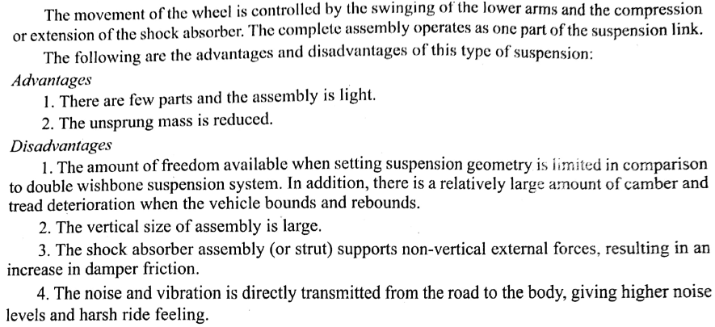

Slide 24
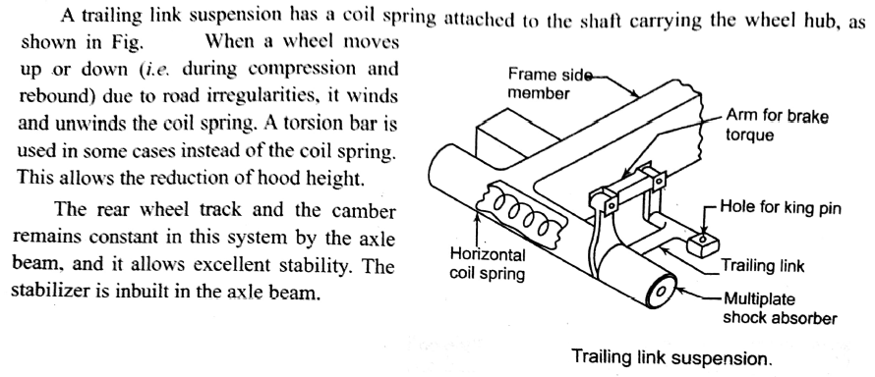
c)Trailing link type independent system:

Slide 25
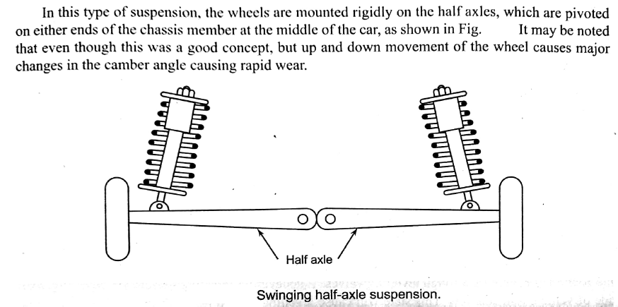
d) Swinging half axle suspension system:

