Slide 1
Transmission system:
The engine which is a the only source of motive force in a vehicle, must be able to cope with a vast range of operations from start up to high speed driving.
The transmission system is a set of gears which is used to transfer the power developed in the engine to the driving wheels according to the requirements.
The most common transmission system that have been used for the automobiles:
a) Manual transmission,
b) Automatic transmission,
c) Semi-automatic transmission,
d) Continuously-variable transmission (C.V.T.).
a) MANUAL TRANSMISSION SYSTEM
Manual transmissions also referred as stick shift transmission or just ‘stick', 'straight drive', or standard transmission because you need to use the transmission stick every time you change the gears. To perform the gear shift, the transmission system must first be disengaged from the engine. After the target gear is selected, the transmission and engine are engaged with each other again to perform the power transmission. Manual transmissions are characterized by gear ratios that are selectable by locking selected gear pairs to the output shaft inside the transmission.

Slide 2
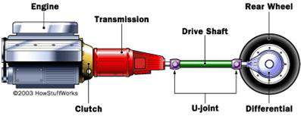
The transmission system delivers the engine power to wheels.
Components of manual transmission
The main components of manual transmission are:
Clutch
Gear box
U- joint
Shafts
Differential gear box

Slide 3
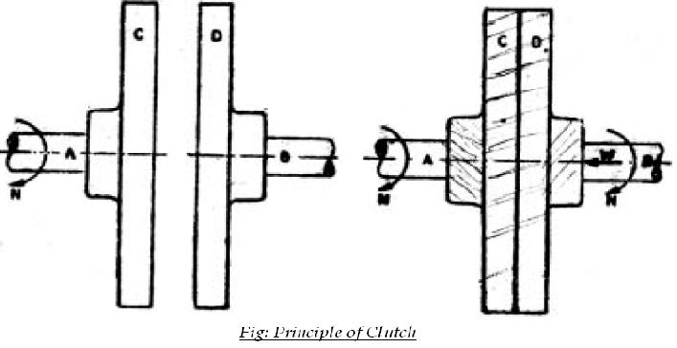
Clutch:
Clutch is a device which is used in the transmission system of automobile to engage and disengage the engine to the transmission or gear box. It is located between the transmission and the engine. When the clutch is engaged, the power flows from the engine to the rear wheels in a rearwheel- drive transmission and the vehicle moves. When the clutch is disengaged, the power is not transmitted from the engine to the rear wheels and vehicle stops even if engine is running.
It works on the principle of friction. When two friction surfaces are brought in contact with each other and they are united due to the friction between them. If one is revolved the other will also revolve.

Slide 4
The friction depends upon the surface area contact. The friction surfaces are so designed that the driven member initially slips on driving member when initially pressure is applied. As pressure increases the driven member is brought gradually to speed the driving member.
The three main parts of clutch are:
Driving member
Driven member
Operating member
The driving member consists of a flywheel mounted on the engine crank shaft. The flywheel is bolted to cover which carries a pressure plate or driving disc, pressure springs and releasing levers. Thus the entire assembly of flywheel and cover rotates all the times. The clutch housing and the cover provided with openings dissipate the heat generated by friction during the clutch operation.
The driven member consists of a disc or plate called clutch plate. It is free to slide length wise on the splines of the clutch shaft. It carries friction materials on both of its surfaces when it is gripped between the flywheel and the pressure plate; it rotates the clutch shaft through splines.

Slide 5
The operating members consists of a foot pedal, linkage, release or throw-out
bearing, release levers and springs necessary to ensure the proper operation of the clutch.
Now the driving member in an automobile is flywheel mounted on crank shaft, the driven member is the pressure plate mounted on transmission or gear box input shaft. Friction surfaces or clutch plates is placed between two members.
Operation Of Clutch:
When the clutch pedal is pressed through pedal movement, the clutch release bearing presses on the clutch release lever plate which being connected to clutch release levers, forces these levers forward. This causes the pressure plate to compress pressure springs, thus allowing it to move away from the clutch driven plate. This action releases the pressure on the driven plate and flywheel, the flywheel is now free to turn independently, without turning the transmission.
When the clutch pedal is released, reverse action takes place i.e. the driven plate is again forced against the flywheel by the pressure plate- because of the force exerted by pressure springs. The pressure plate will keep on pressing the facings of driven plate until friction created becomes equal to the resistance of the vehicle. Any further increase in pressure will cause the clutch plate and the transmission shaft to turn along with flywheel, thus achieving vehicle movement.

Slide 6
Single Clutch Plate:
It is the most common type of clutch plate used in motor vehicles. Basically it consists of only one clutch plate, mounted on the splines of the clutch plate. The flywheel is mounted on engine crankshaft and rotates with it. The pressure plate is bolted to the flywheel through clutch springs, and is free to slide on the clutch shaft when the clutch pedal is operated. When the clutch is engaged the clutch plate is gripped between the flywheel and pressure plate. The friction linings are on both the sides of the clutch plate. Due to the friction between the flywheel, clutch plate and the pressure plate the clutch plate revolves the flywheel. As the clutch plate revolves the clutch shaft also revolves. Clutch shaft is connected to the transmission gear box. Thus the engine power is transmitted to the crankshaft and then to the clutch shaft.
When the clutch pedal is pressed, the pressure plate moves back against the force of the springs, and the clutch plate becomes free between the flywheel and the pressure plate. Thus the flywheel remains rotating as long as the engine is running and the clutch shaft speed reduces slowly and finally it stops rotating. As soon as the clutch pedal is pressed, the clutch is said to be engaged, otherwise it remains engaged due to the spring forces.

Slide 7
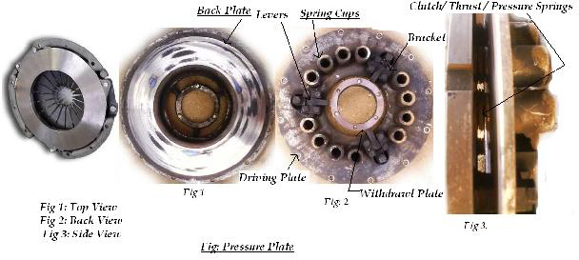
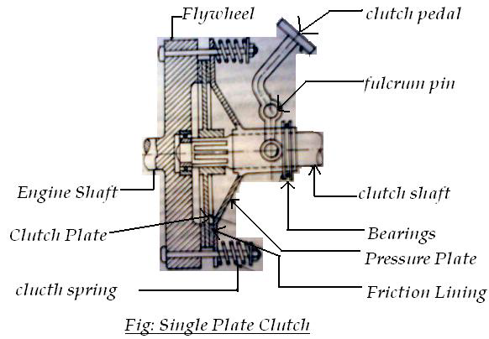

Slide 8
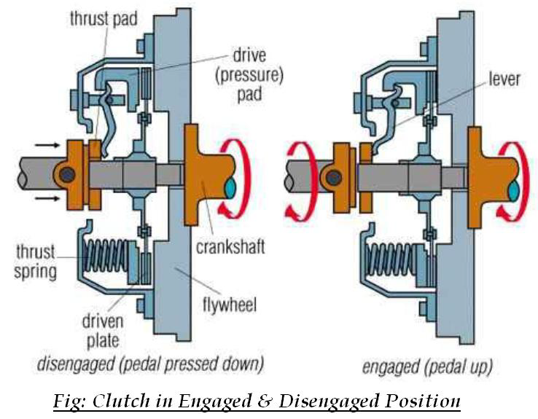

Slide 9
Multi-plate Clutch:
Multi-plate clutch consists of a number of clutch plates instead of only one clutch plate as in case of single plate clutch. As The number of clutch plates are increased, the friction surfaces also increases. The increased number of friction surfaces obliviously increases the capacity of the clutch to transmit torque.
The plates are alternately fitted to engine and gear box shaft. They are firmly pressed by strong coil springs and assembled in a drum. Each of the alternate plate slides on the grooves on the flywheel and the other slides on splines on the pressure plate. Thus, each alternate plate has inner and outer splines.
The multi-plate clutch works in the same way as a single plate clutch by operating the clutch pedal. The multi-plate clutches are used in heavy commercial vehicles, racing cars and motor cycles for transmitting high torque. The multi-plate clutch may be dry or wet. When the clutch is operated in an oil bath, it is called a wet clutch. When the clutch is operated dry it is called dry clutch. The wet clutch is used in conjunction with or part of the automatic transmission.

Slide 10
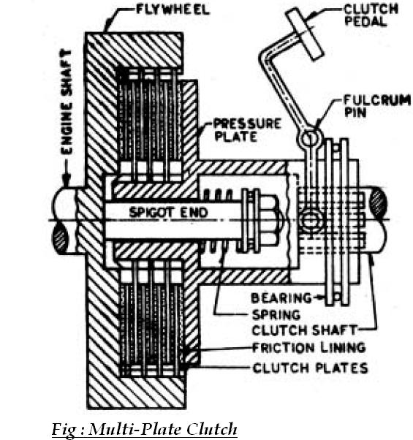
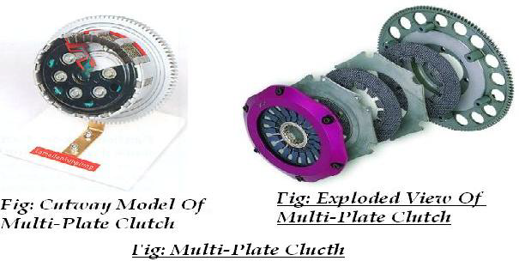

Slide 11
Cone Clutch:
Cone clutch consists of friction surfaces in the form of cone. The engine shaft consists of female cone. The male cone is mounted on the splined clutch shaft. It has friction surfaces on the conical portion. The male cone can slide on the clutch shaft. Hence the clutch is engaged the friction surfaces of the male cone are in contact with that of the female cone due to force of the spring. When the clutch pedal is pressed, the male cone slides against the spring force and the clutch is disengaged.
The only advantage of the cone clutch is that the normal force acting on the friction surfaces is greater than the axial force, as compare to the single plate clutch in which the normal force acting on the friction surfaces is equal to the axial force. The disadvantage in cone clutch is that if the angle of the cone is made smaller than 20⁰ the male cone tends to bind in the female cone and it becomes difficult to disengage the clutch. Cone clutches are generally now only used in low peripheral speed applications although they were once common in automobiles and other combustion engine transmissions. They are usually now confined to very specialist transmissions in racing, rallying, or in extreme off-road vehicles, although they are common in power boats. Small cone clutches are used in synchronizer mechanisms in manual transmissions.
.

Slide 12
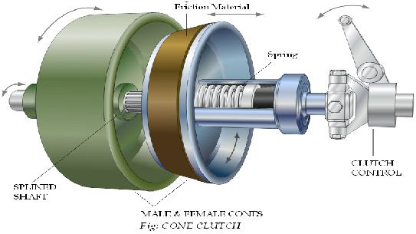
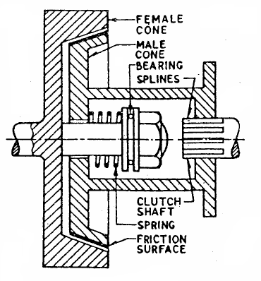

Slide 13
Dog & Spline Clutch:
This type of clutch is used to lock two shafts together or to lock a gear to shaft. It consists of a sleeve having two sets of internal splines. It slides on a splined shaft with smallest diameter splines. The bigger diameter splines match with the external dog clutch teeth on driving shaft. When the sleeve is made to slide on the splined shaft, its teeth match with the dog clutch teeth of the driving shaft. Thus the sleeve turns the splined shaft with the driving shaft.
The clutch is said to be engaged. To disengage the clutch, the sleeve is moved back on the splined shaft to have no contact with the driving shaft. This type of clutch has no tendency to slip. The driven shaft revolves exactly at the same speed of the driving shaft, as soon as the clutch is engaged. This is also known as positive clutch.

Slide 14
Centrifugal Clutch:
The centrifugal clutch uses centrifugal forces, instead of spring force for keeping it in engaged position. Also, it does not require clutch pedal for operating the clutch. The clutch is operated automatically depending on engine speed. The vehicle can be stopped in gear without stalling the engine. Similarly the gear can be started in any gear by pressing the accelerator pedal.
A centrifugal clutch works through centrifugal force. The input of the clutch is connected to the engine crankshaft while the output drives gear box shaft, chain, or belt. As engine R.P.M. increases, weighted arms in the clutch swing outward and force the clutch to engage. The most common types have friction pads or shoes radially mounted that engage the inside of the rim of housing.
On the center shaft there are an assorted amount of extension springs, which connect to a clutch shoe. When the center shaft spins fast enough, the springs extend causing the clutch shoes to engage the friction face. It can be compared to a drum brake in reverse. The weighted arms force these disks together and engage the clutch.
When the engine reaches a certain RPM, the clutch activates, working almost like
a continuously variable transmission. As the load increases the R.P.M. drops thereby disengaging
the clutch and letting the rpm rise again and reengaging the clutch. If tuned properly, the clutch will tend to keep the engine at or near the torque peak of the engine.
These results in a fair bit of waste heat, but over a broad range of speeds it is much more useful then a direct drive in many applications. Weaker spring/heavier shoes will cause the clutch to engage at a lower R.P.M. while a stronger spring/lighter shoes will cause the clutch to engage at a higher R.P.M.

Slide 15
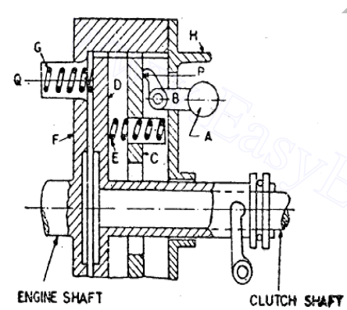
Centrifugal Clutch
Semi-centrifugal Clutch:
A semi centrifugal clutch is used to transmit power from high powered engines and racing car engines where clutch disengagements requires appreciable and tiresome drivers effort. The transmission of power in such clutches is partly by clutch springs and rest by centrifugal action of an extra weight provided in system. The clutch springs serve to transmit the torque up to normal speeds, while the centrifugal force assists at speeds higher than normal.

Slide 16
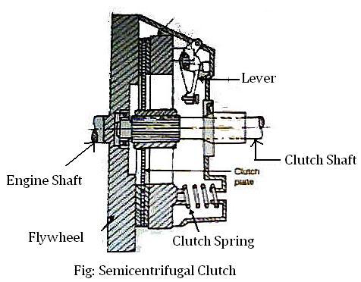
Besides clutch, pressure plate and splines shaft it mainly consists of:
Compression spring (3 numbers)
Weighted levers (3 numbers)
At normal speeds when the power transmission is low the spring keeps the clutch engaged, the weighted levers do not have any pressure on the pressure plate. At high speed, when the power transmission is high the weights fly off and levers exert pressure on the plate which keeps the clutch firmly engaged. Thus instead of having more stiff springs for keeping the clutch engaged firmly at high speeds, they are less stiff, so that the driver may not get any strain in operating the clutch.
when the speed decreases, the weights fall and the levers do not exert any pressure on the pressure plate. Only the spring pressure is exerted on the pressure plate which is sufficient to keep the clutch engaged.

Slide 17
Gear Box:
A gearbox is a mechanical method of transferring energy from one device to another and is used to increase torque while reducing speed. Torque is the power generated through the bending or twisting of a solid material. This term is often used interchangeably with transmission. Located at the junction point of a power shaft, the gearbox is often used to create a right angle change in direction, as is seen in a rotary mower or a helicopter. Each unit is made with a specific purpose in mind, and the gear ratio used is designed to provide the level of force required. This ratio is fixed and cannot be changed once the box is constructed. The only possible modification after the fact is an adjustment that allows the shaft speed to increase, along with a corresponding reduction in torque. In a situation where multiple speeds are needed, a transmission with multiple gears can be used to increase torque while slowing down the output speed. This design is commonly found in automobile transmissions. The same principle can be used to create an overdrive gear that increases output speed while decreasing torque.
Principle Of Gearing:
Consider a simple 4-gear train. It consists of a driving gear A on input shaft and a driven gear D on the output shaft. In between the two gears there are two intermediate gears B, C. Each of these gears are mounted on separate shaft. We notice that:

Slide 18
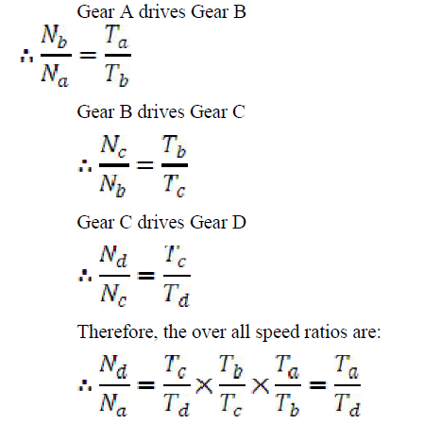
Types of Gear Boxes: The following types of gear box are used in automobiles:
Sliding Mesh
Constant Mesh
Synchromesh.

Slide 19
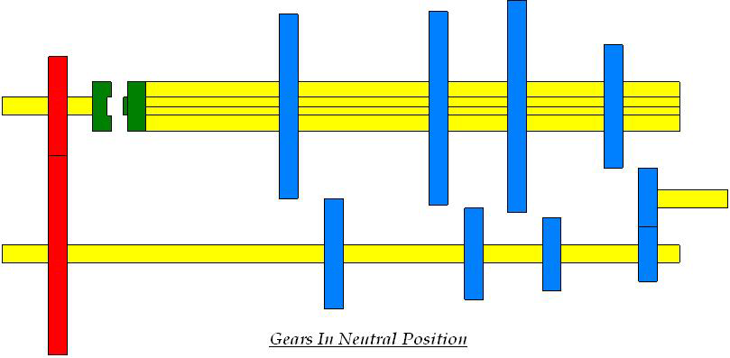
Sliding Mesh Gear Box:
It is the simplest gear box. The following figure shows 4-speed gear box in neutral position. 4 gears are connected to the lay shaft/counter shaft. A reverse idler gear is mounted on another shaft and always remains connected to the reverse gear of countershaft. This “H” shift pattern enables the driver to select four different gear ratios and a reverse gear.
Gears in Neutral:
When the engine is running and clutch is engaged the clutch shaft gear drives the countershaft gear. The countershaft rotates opposite in direction of the clutch shaft. In neutral position only the clutch shaft gear is connected to the countershaft gear. Other gears are free and hence the transmission main shaft is not turning. The vehicle is stationary.

Slide 20
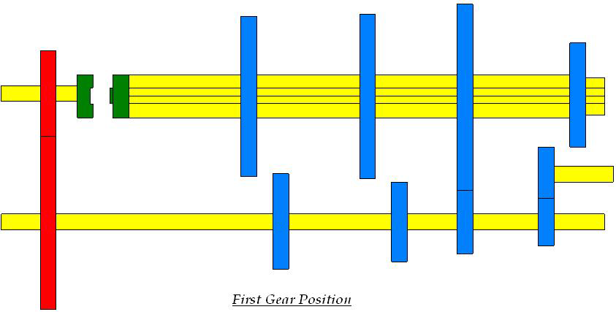
First or low shaft gear:
By operating the gear shift lever the larger gear on the main shaft is moved along the shaft to mesh with the first gear of the counter shaft. The main shaft turns in the same direction as that of the clutch shaft. Since the smaller countershaft is engaged with larger shaft gear a gear reduction of approximately 4:1 is obtained i.e. the clutch shaft turns 4 times for each revolution of main shaft.
Second speed gear:
By operating the gear shift lever the third gear on the main shaft is moved along the shaft to mesh with the third gear of the counter shaft. The main shaft turns in same direction as clutch shaft. A gear reduction of approximately 3:1is obtained.

Slide 21
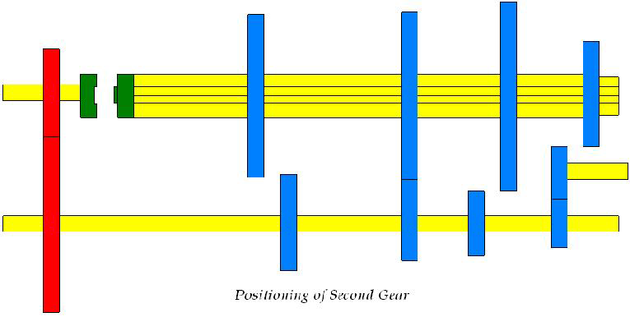
Third speed gear:
By operating the gear shift lever, the second gear of the main shaft and countershaft are demeshed and then the third gear of the main shaft are forced axially against the clutch shaft gear. External Teeth on the clutch shaft gear mesh with the internal teeth in the third and top gear. The main shaft turns in same direction as clutch shaft. A gear reduction of approximately 2:1is obtained i.e. the clutch shaft turns 2 times for each revolution of main shaft.

Slide 22
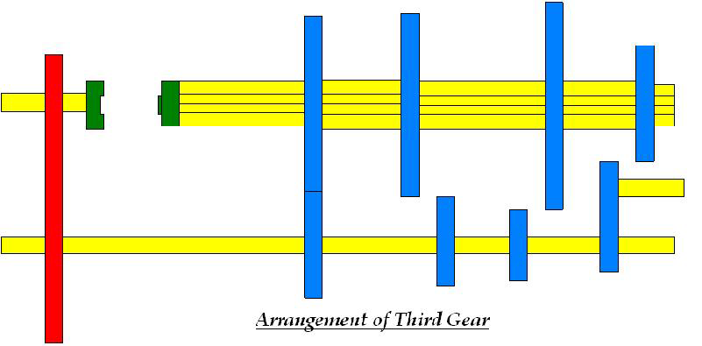
Fourth speed gear/ Top or High-Speed Gear:
By operating the gear shaft lever the third gears of the main and countershaft is demeshed and the gears present on the main shaft along with the shaft is forced axially against the clutch shaft gear. External teeth present on the main shaft engage with the internal teeth present on the main shaft. The main shaft turns along with the clutch shaft and a gear ratio of approximately 1:1 is obtained.

Slide 23
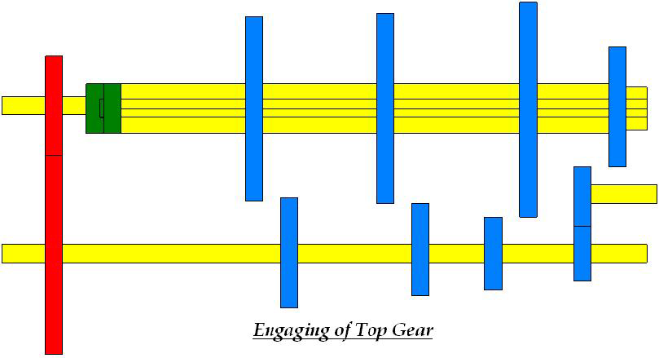
Reverse gear:
By operating the gear shift lever, the last gear present on the main shaft is engaged with the reverse idler gear. The reverse idler gear is always in mesh with the counters haft gear. Interposing the idler gear between the counter-shaft reverse gear and main shaft gear, the main shaft turns in the direction opposite to the clutch shaft. This reverses the rotation of the wheels so that the wheel backs.

Slide 24
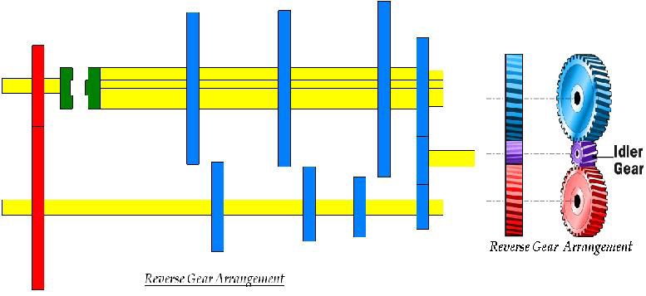

Slide 25
Constant Mesh Gear Box:
In this type of gear box, all gears of the main shaft are in constant mesh with the corresponding gears of the countershaft (Lay shaft). Two dog clutches are provided on the main shaft- one between the clutch gear and the second gear, and the other between the first gear and reverse gear. The main shaft is splined and all the gears are free on it. Dog clutch can slide on the shaft and rotates with it. All the gears on the countershaft are rigidly fixed with it.
When the left hand dog clutch is made to slide to the left by means of the gear shift lever, it meshes with the clutch gear and the top speed gear is obtained. When the left hand dog clutch meshes with the second gear, the second speed gear is obtained. Similarly by sliding the right hand dog clutch to the left and right, the first speed gear and reverse gear are obtained respectively. In this gear box because all the gears are in constant mesh they are safe from being damaged and an unpleasant grinding sound does not occur while engaging and disengaging them.

Slide 26
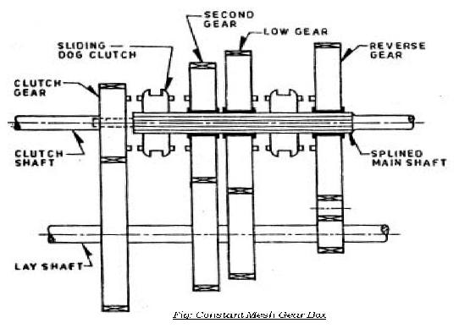

Slide 27
Syncromesh Gear Box:
In sliding Mesh Gear box the two meshing gears need to be revolve at equal peripheral speeds to achieve a jerk less engagement and it is true for constant mesh gear box in which the peripheral speeds of sliding dog and the corresponding gear on the output shaft must be equal. The peripheral speed is given byWhere d1 and N1 are pitch circle diameter and r.p.m. of gear and d2 andN2 diameter and r.p.m. of attached dog respectively. Now N1 ≠ N2 since d1 ≠ d2 . Thus there is a difference in gear and dog which necessitates double declutching. The driver has to disengage the clutch twice in quick succession therefore it is referred as double declutching. There are two steps involved in this process:
The clutch is disengaged i.e. first declutching and the gear system is placed in its neutral position. Now the clutch is reengaged and acceleration pedal is pressed to adjust the engine speed according to driver’s judgment. The clutch is disengaged(i.e. second declutching) again the appropriate gear is engaged and then the clutch is reengaged
It is that gear box in which sliding synchronizing units are provided in place of sliding dog clutches as in case of constant mesh gear box. With the help of synchronizing unit, the speed of both the driving and driven shafts is synchronized before they are clutched together through train of gears. The arrangement of power flow for the various gears remains the same as in constant mesh gear box. The synchronizer is made of frictional materials. When the collar tries to mesh with the gear, the synchronizer will touch the gear first and use friction force to drive the gear to spin at the same speed as the collar. This will ensure that the collar is meshed into the gear very smoothly without grinding. Synchromesh gear devices work on the principle that two gears to be engaged are first bought into frictional contact which equalizes their speed after which they are engaged readily and smoothly.

Slide 28
The following types of devices are mostly used in vehicles:
Pin Type
Synchronizer ring type
A synchronizing system is used for smooth meshing. Synchromesh works like a friction clutch. In the following figure two conical surfaces cone-1 is the part of the collar and the cone-2 is the part of the gear wheel. Cone1, 2 are revolving at different speeds. While cone-2 is revolving, cone-1 gradually slides into it. Friction slows or speeds up the gear wheel. Finally both the cones revolve at same speed.
In the following Fig collar and gear wheel are separate and they are revolving at different speeds. The internal cone comes in contact with the outer cone of the gear
wheel. Friction slows or speeds up the gear wheel. And when the collar and gear wheel rotate at same speed the spring loaded outer ring of the collar is pushed forward. The dog slide smoothly into mesh without clashing. The collar and gear
wheel lock and revolve at same speed. This the principle of synchromesh.

Slide 29
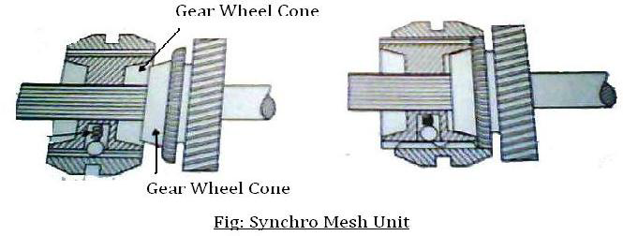
U- Joint:
A universal joint, U-joint, Cardan joint, Hardy-Spicer joint, or Hooke's joint is a linkage that transmits rotation between two non parallel shafts whose axes are coplanar but not coinciding., and is commonly used in shafts that transmit rotary motion. It is used in automobiles where it is used to transmit power from the gear box of the engine to the rear axle. The driving shaft rotates at a uniform angular speed, where as the driven shaft rotates at a continuously varying angular speed.

Slide 30
A complete revolution of either shaft will cause the other to rotate through a complete revolution at the same time. Each shaft has fork at its end. The four ends of the two fork are connected by a centre piece, the arms of which rest in bearings, provided in fork ends. The centre piece can be of any shape of a cross, square or sphere having four pins or arms. The four arms are at right angle to each other.
When the two shafts are at an angle other than 180° (straight), the driven shaft does not rotate with constant angular speed in relation to the drive shaft; the more the angle goes toward 90° the jerkier the movement gets (clearly, when the angle β = 90° the shafts would even lock). However, the overall average speed of the driven shaft remains the same as that of driving shaft, and so speed ratio of the driven to the driving shaft on average is 1:1 over multiple rotations.
The angular speed ω2 of the driven shaft, as a function of the angular speed of the driving shaft ω1 and the angle of the driving shaft φ1, is found using:
ω2 = ω1 cosα / (1-sin2α.cos2θ)
For a given and set angle between the two shafts it can be seen that there is a cyclical variation in the input to output velocity ratio. Maximum values occur when sin θ = 1, i.e. when θ = 90⁰ and 270⁰. The denominator is greatest when θ = 0or 1800 and this condition gives the minimum ratio of the velocities.

Slide 31
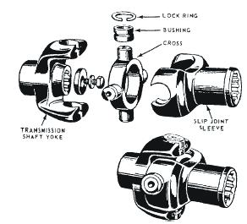
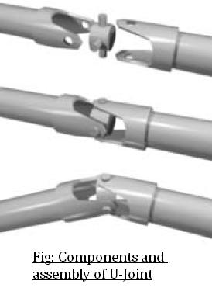

Slide 32
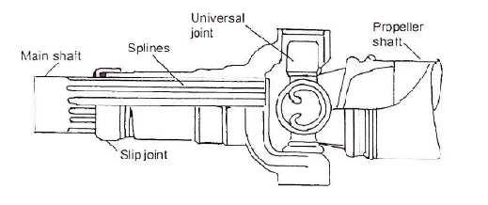
Components of Hooke’s Joint:
Slip Joint in the Propeller Shaft:

Slide 33
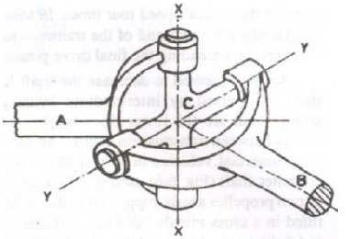
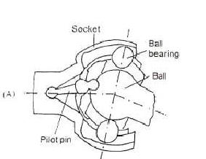
Hook Joint in the Propeller Shaft:

Slide 34
The Drive Shaft
The drive shaft, or propeller shaft, connects the transmission output shaft to the differential pinion shaft. Since all roads are not perfectly smooth, and the transmission is fixed, the drive shaft has to be flexible to absorb the shock of bumps in the road. Universal, or "U-joints" allow the drive shaft to flex (and stop it from breaking) when the drive angle changes.
Drive shafts are usually hollow in order to weigh less, but of a large diameter so that they are strong. High quality steel, and sometimes aluminum are used in the manufacture of the drive shaft. These speeds, a lot of damage can be caused if the shaft is unbalanced, or bent. Damage can also be caused shaft must be quite straight and balanced to avoid vibrating. Since it usually turns at engine if the U-joints are worn out.
There are two types of drive shafts, the Hotchkiss drive and the Torque Tube Drive. The Hotchkiss drive is made up of a drive shaft connected to the transmission output shaft and the differential pinion gear shaft. U-joints are used in the front and rear. The Hotchkiss drive transfers the torque of the output shaft to the differential. No wheel drive thrust is sent to the drive shaft. Sometimes this drive comes in two pieces to reduce vibration and make it easier to install (in this case, three U-joints are needed).The two-piece types need ball bearings in a dustproof housing as center support for the shafts. Rubber is added into this arrangement for noise and vibration reduction.

Slide 35
The torque tube drive shaft is used if the drive shaft has to carry the wheel drive thrust. It is a hollow steel tube that extends from the transmission to the rear axle housing. One end is fastened to the axle housing by bolts. The transmission end is fastened with a torque ball. The drive shaft fits into the torque tube. A U-joint is located in the torque ball, and the axle housing end is splined to the pinion gear shaft. Drive thrust is sent through the torque tube to the torque ball, to transmission, to engine and finally, to the frame through the engine mounts. That is, the car is pushed forward by the torque tube pressing on the engine.

Slide 36
Differential Unit:
Differentials are a variety of gearbox, almost always used in one of two ways. In one of
these, it receives one input and provides two outputs; this is found in every automobile.
In automobile and other wheeled vehicles, the differential allows each of the driving wheels to rotate at different speeds, while supplying equal torque to each of them. In the other, less commonly encountered, it combines two inputs to create an output that is the sum (or difference) of the inputs. In automotive applications, the differential and its housing are sometimes collectively called a "pumpkin" (because the housing resembles a pumpkin).
Purpose:-
The differential gear box has following functions:
Avoid skidding of the rear wheels on a road turning.
Reduces the speed of inner wheels and increases the speed of outer wheels, while
drawing a curve.
Keeps equal speeds of all the wheels while moving on a straight road.
Eliminates a single rigid rear axle, and provides a coupling between two rear axles.

Slide 37
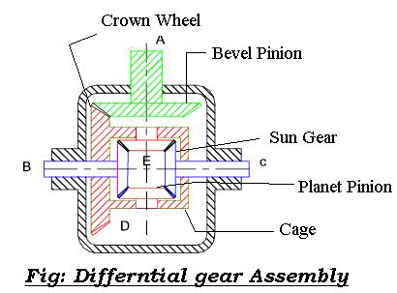
The following description of a differential applies to a "traditional" rear- or front-wheel-drive
car or truck:
Power is supplied from the engine, via the transmission or gearbox, to a drive shaft termed as propeller shaft, which runs to the differential. A spiral bevel pinion gear at the end of the propeller
shaft is encased within the differential itself, and it meshes with the large spiral bevel ring gear termed as crown wheel. The ring and pinion may mesh in hypoid orientation.
The ring gear is attached to a carrier, which holds what is sometimes called a spider, a cluster
of four bevel gears in a rectangle, so each bevel gear meshes with two neighbors and rotates counter to the third that it faces and does not mesh with. Two of these spider gears are aligned on the same axis as the ring gear and drive the half shafts connected to the vehicle's driven wheels.

Slide 38
These are called the side gears. The other two spider gears are aligned on a perpendicular axis which changes orientation with the ring gear's rotation. These two gears are just called pinion gears, not to be confused with the main pinion gear. (Other spider designs employ different numbers of pinion gears depending on durability requirements.)
As the carrier rotates, the changing axis orientation of the pinion gears imparts the motion of the ring gear to the motion of the side gears by pushing on them rather than turning against them (that is, the same teeth stay in contact), but because the spider gears are not restricted from turning against each other, within that motion the side gears can counter-rotate relative to the ring gear and to each other under the same force (in which case the same teeth do not stay in contact).
Thus, for example, if the car is making a turn to the right, the main ring gear may make 10 full rotations. During that time, the left wheel will make more rotations because it has further to travel, and the right wheel will make fewer rotations as it has less distance to travel. The side gears will rotate in opposite directions relative to the ring gear by, say, 2 full turns each (4 full turns relative to each other), resulting in the left wheel making 12 rotations, and the right wheel making 8 rotations.
The rotation of the ring gear is always the average of the rotations of the side gears. This is why if the wheels are lifted off the ground with the engine off, and the drive shaft is held (preventing the ring gear from turning inside the differential), manually rotating one wheel causes the other to rotate in the opposite direction by the same amount.

Slide 39
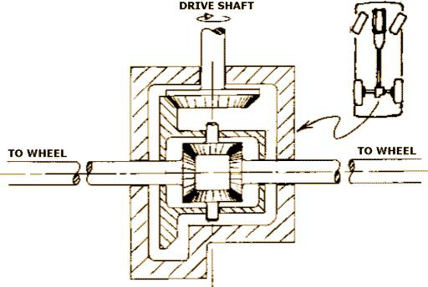
When the vehicle is traveling in a straight line, there will be no differential movement of the planetary system of gears other than the minute movements necessary to compensate for slight differences in wheel diameter, undulations in the road (which make for a longer or shorter wheel path), etc.

Slide 40
Automatic Transmission:
An automatic transmission (commonly "AT" or "Auto") is an automobile gearbox that can change gear ratios automatically as the vehicle moves, freeing the driver from having to shift gears manually.
Automatic Transmission Modes:
In order to select the mode, the driver would have to move a gear shift lever located on the steering column or on the floor next to him/her. In order to select gears/modes the driver must push a button in (called the shift lock button) or pull the handle (only on column mounted shifters) out. In some vehicles position selector buttons for each mode on the cockpit instead, freeing up space on the central console. Vehicles conforming to U.S. Government standards must have the modes ordered P-R- N-D-L (left to right, top to bottom, or clockwise). Prior to this, quadrant-selected automatic transmissions often utilized a P-N-D-L-R layout, or similar. Such a pattern led to a number of deaths and injuries owing to un-intentional gear miss-selection, as well the danger of having a selector (when worn) jump into Reverse from Low gear during engine braking maneuvers.
Automatic Transmissions have various modes depending on the model and make of the
transmission. Some of the common modes are:

Slide 41
Park Mode (P):-
This selection mechanically locks the transmission, restricting the car from moving in any direction. A parking pawl prevents the transmission—and therefore the vehicle—from moving, although the vehicle's non-drive wheels may still spin freely. For this reason, it is recommended to use the hand brake (or parking brake) because this actually locks the (in most cases, rear) wheels and prevents them from moving. This also increases the life of the transmission and the park pin mechanism, because parking on an incline with the transmission in park without the parking brake engaged will cause undue stress on the parking pin. An efficiently-adjusted hand brake should also prevent the car from moving if a worn selector accidentally drops into reverse gear during early morning fast-idle engine warm ups.
Reverse (R):-
This puts the car into the reverse gear, giving the ability for the car to drive backwards. In order for the driver to select reverse they must come to a complete stop, push the shift lock button in (or pull the shift lever forward in the case of a column shifter) and select reverse. Not coming to a complete stop can cause severe damage to the transmission. Many modern automatic gearboxes have a safety mechanism in place, which does to some extent prevent (but doesn't completely avoid) inadvertently putting the car in reverse when the vehicle is moving.
This mechanism usually consists of a solenoid-controlled physical barrier on either side of the Reverse position, which is electronically engaged by a switch on the brake pedal. Therefore, the brake pedal needs to be depressed in order to allow the selection of reverse. Some electronic transmissions prevent or delay engagement of reverse gear altogether while the car is moving.

Slide 42
Neutral/No gear (N):-
This disconnects the transmission from the wheels so the car can move freely under its own
weight. This is the only other selection in which the car can be started.
Drive (D):-
This allows the car to move forward and accelerate through its range of gears. The number of gears a transmission has depends on the model, but they can commonly range from 3, 4 (the most common), 5, 6 (found in VW/Audi Direct Shift Gearbox), 7 (found in Mercedes 7G gearboxes, BMW M5 and VW/Audi Direct Shift Gearbox) and 8 in the newer models of Lexus cars. Some cars when put into D will automatically lock the doors or turn on the Daytime Running Lamps.
Overdrive ([D], Od, Or A Boxed D):-
This mode is used in some transmissions to allow early Computer Controlled Transmissions to engage the Automatic Overdrive. In these transmissions, Drive (D) locks the Automatic Overdrive off, but is identical otherwise. OD (Overdrive) in these cars is engaged under steady speeds or low acceleration at approximately 35-45 mph (approx. 72 km/h). Under hard acceleration or below 35-45 mph, the transmission will automatically downshift. Vehicles with this option should be driven in this mode unless circumstances require a lower gear.
Second (2 or S):-
This mode limits the transmission to the first two gears, or more commonly locks the
transmission in second gear. This can be used to drive in adverse conditions such as snow and ice, as well as climbing or going down hills in the winter time. Some vehicles will automatically up-shift out of second gear in this mode if a certain rpm range is reached, to prevent engine damage.

