Slide 1
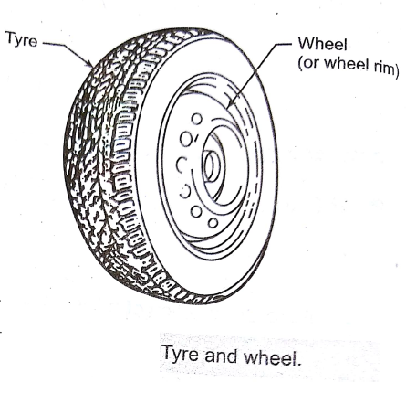
Tyres :
The tyre is fitted around the wheel rim, as shown fig.
It Provides a cushion between the vehicle and the road.
The tyre performs the following important functions:
It support the vehicle weight.
It transfer the traction ( i.e. transmit engine power through the medium of driving wheels) and to stop the vehicle with friction between the tyre and road surface.
It changes and maintain the direction of travel for smooth steering.
It absorbs road shocks and thus provides cushion for comfortable driving.

Slide 2
There are basically two type of tyres:
1)Pneumatic tyres: the main objective of a pneumatic tyre is to float the vehicle on a cushion of compressed air.
The air carries the load and therefore, the maintenance of correct inflation pressure is of great importance.
The pneumatic tyres are used on type of vehicle such as bicycle, motorcycle, cars trucks, earthmovers and aircrafts.
2)Solid tyres or Non Pneumatic tyres: these are mainly used in industrial and commercial applications.
They are manufactured from solid rubbers and plastic compounds through moulding operation.
e.g: lawn movers, skate boards, golf carts, scooters and light industrial vehicles.

Slide 3
CONSTRUCTION OF TYRE:
The tyre of an automobile is really complex in its construction, manufacture and operating stresses.
Several fabric layers or plies are impregnated with special hard rubber.
A typical tyre construction as shown fig. below:
Ply cord:
The ply cord is the main portion (main body) of the tyre. It is also called as carcass and made up of layers of fabric called plies.
Each layer sheet of cotton or nylon impregnated with rubber. These plies give strength to the tyre.
The number of plies provided in a tyre depends upon the weight of the vehicle.
For car tyres have 4 to 6 plies whereas the truck or bus tyres has 22plies.
The purpose of ply card is to sustain the inflation pressure and to bear the load and road shocks.
2) Tread: the tread is a portion of the tyre which comes in contact with the road surface.
The tread is thick rubber and its purpose is to provide better level of traction, longer life and durability.
This is pattern with grooves, lugs and voids.
The grooves run circumferentially around tyre . The lugs are that potion of the tread design which contact with road surface. The voids are space between the lugs that allow the lugs to flex and evacuated water.

Slide 4
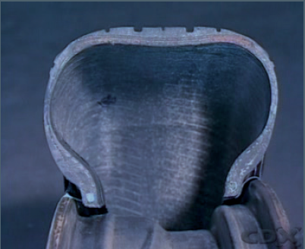
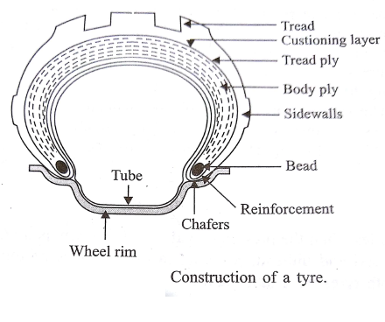

Slide 5
3) Bead: the bead is that portion which holds the tyre on the rim.
The bead is made up of high strength steel cables impregnated with rubber around which plies are wrapped, in order to give strong edge to press a against the inner edge of the rim.
4) Cushioning layer:
Also called cushion, this is layer of middle piece made of thin rubber between the tread plies.
5) Reinforcement: the reinforcement is made of woven fabric, it is around the beads as a strengthening member in the region of the beads.
6) chafer: chafer are made of fabric with a coating rubber.
They are placed around the outside of the beads to prevent the rubber tyre from being chafed or abraded by the metallic rim.
7) Sidewall: side wall of a tyre are like its cheeks and made of special rubber compound with good resistance against abrasion.
They are strong enough to resist flexing also

Slide 6
Tyre dimensions:
Sectional width: it is the width of a tyre, from sidewall to sidewall(without including engraved markings, protective ribs)
Overall width: it is the width of tyre from sidewall to sidewall including elevations, such as engraved markings, protective ribs etc.
Section height: it is the height of the tyre from the bead to the top of the tread.
4) Aspect ratio: Aspect Ration also called the profile ratio, is the ration of the section
height to the width of a tyre.
Three aspect are available, namely 60,70 and 80.
Example in a tyre with an aspect ratio of 70, the tyre width is 70% of section height.
5) Overall diameter: it is the diameter of an inflated tyre at the outermost surface of the tread or twice the inflated section height of a tyre plus the nominal rim diameter.
5) Tyre markings: the different tyre markings are engraved on sidewall indicating the tyre size, ply rating, tyre make etc.

Slide 7
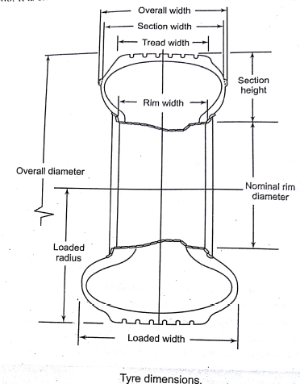
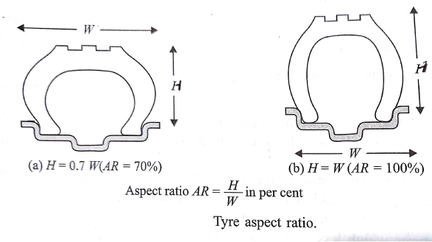

Slide 8
CLASSIFICATION OF TYRES:
The tyres, based o the construction of ply cards are classified as follows:
1. Cross ply( or bias ply) tyre:
In this type of construction, the ply cords run diagonally from bead to bead an angle of 30 to 40 degrees to the tyre axis.
There are two successive layers, which run in opposite direction forming in crisscross pattern to which tread is applied.
The plies and belts are placed at different angle which improve performance.
The main advantage of this type of construction is a smooth ride on rough surface.
The major disadvantage is that due to high rolling resistance, they consume more fuel and have less control and traction at higher speed.
2. Radial ply tyre:
In this type of construction, the ply cords extend from bead to bead in a radial manner(i.e. parallel to direction of tyre axis).
These ply cords are protected with inextensible belts made of several layers of steel cords which are placed under the tread.
This makes the tyre very stiff and due to this, they reflect every irregularity of the road surface on steering wheel.
They provide good grip at high speeds but parking of vehicles is difficult with steel radials as tyre grips ground more firmly.

Slide 9
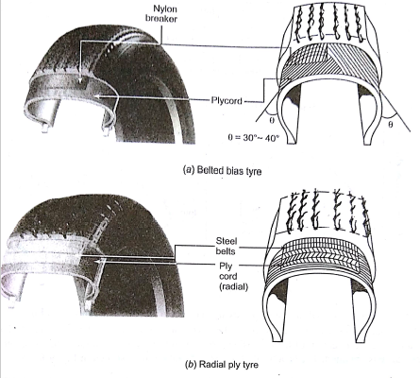
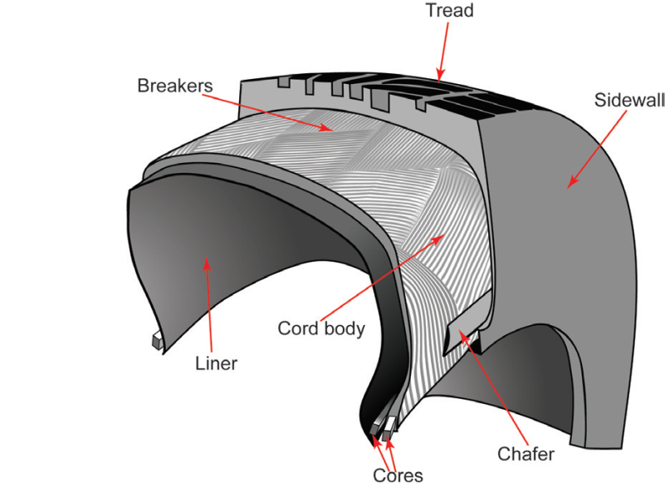
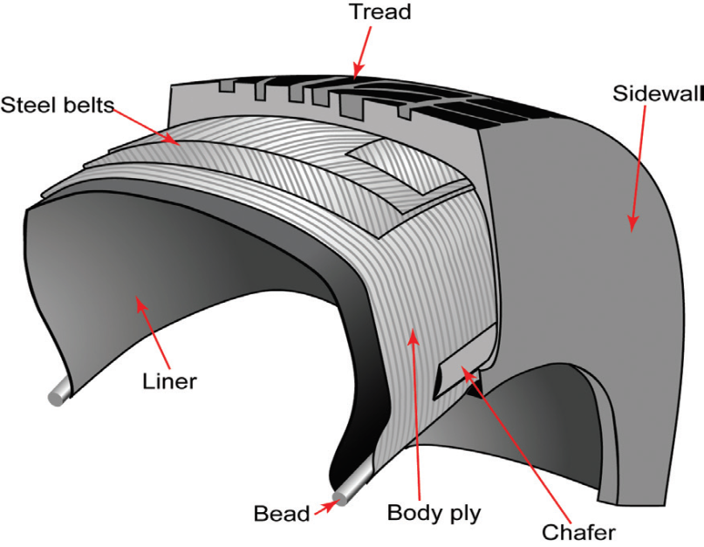

Slide 10
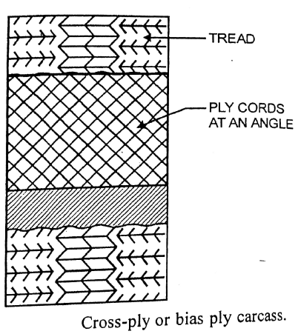
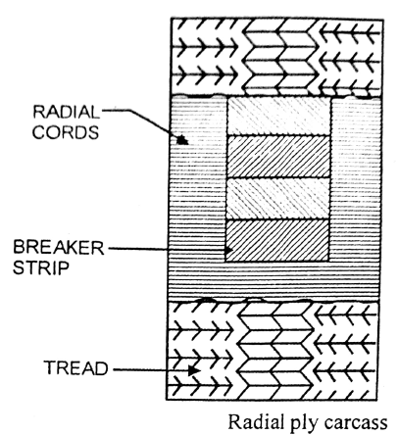

Slide 11
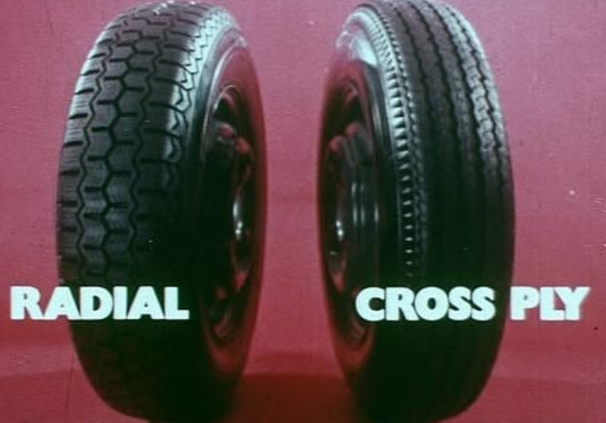
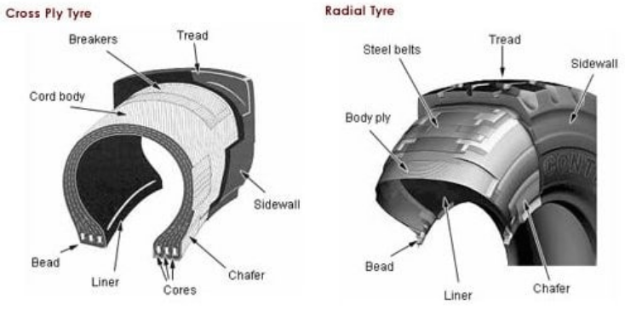

Slide 12
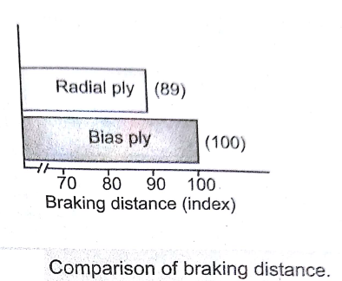
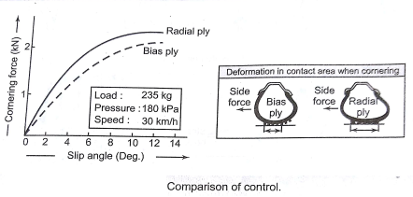
Advantages and disadvantages of radial ply tyres over cross ply tyres:
Advantages:
The radial ply tyre has shorter braking distance, it stop in shorter distance because of stiffer tread.
2) The radial ply tyre allows better control of the vehicle by maintaining precise steering, great stability and firm grip.
While taking a turn, a radial tyre had less tendency to distort and lift off the road from one side.

Slide 13
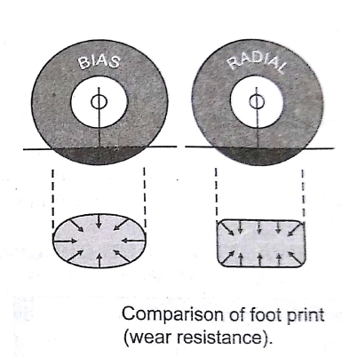
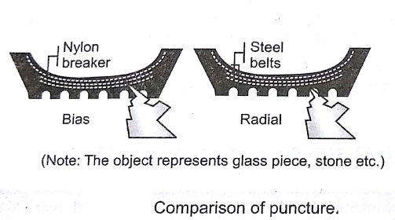
The radial ply tyres will not puncture easily because of belts as shown in fig.
4) The radial ply tyres has longer tread life. This is because of stiffer tread due to dual steel belts. This results in less movement of tread causing less slip and less internal losses and hence greater wear resistance obtained.

Slide 14
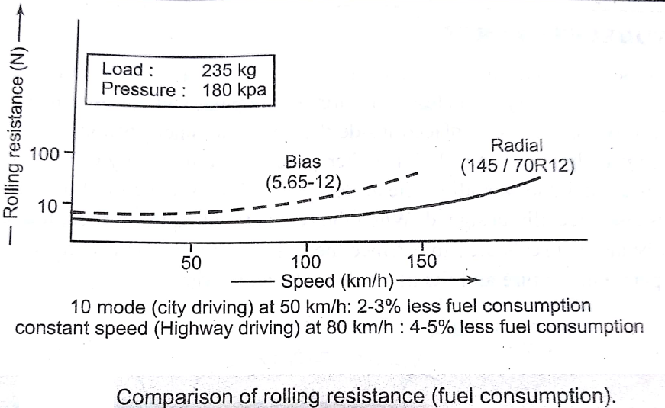
5) The radial ply tyres has better fuel economy due to lesser rolling resistance. Because of stiffer treads.

Slide 15
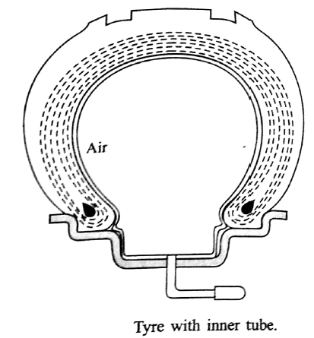
Tyre with inner tube:
The inner tube is inflated with compressed air after the tyre along with the tube is mounted on the wheel rim.
It is not possible to fit the tyre on the rim along with fully inflated tube.
The inflation is done through a non return ball fitted on the tube.
A suitable hole is provided on the rim for sticking out the valve projection from inside to the outside.
The inner tube after inflation fills all the space inside between the rim and the tyre and offer good cushioning effect.

Slide 16
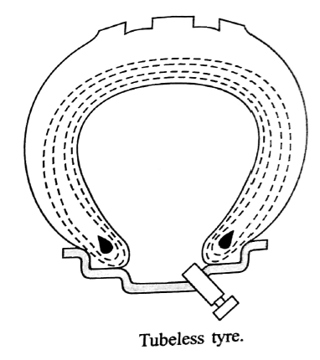
Tubless tyres:
As the name indicates these tyres have no inflated inner tubes.
The tyres is directly mounted on the rim.
As tyre alone has to withstand the internal air pressure, the section on the tyre is thicker then tyre with tube.
The tyre is inflated with compressed air after mounting on the rim of the wheel through non return ball valve.

Slide 17
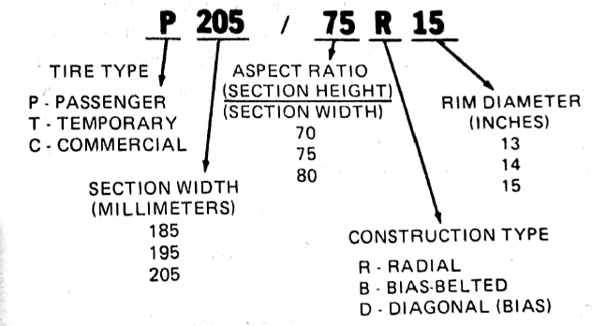
Tyre specifications:

Slide 18
