Slide 1
NON-DESTRUCTIVE TESTING
ULTRASONIC TESTING

Slide 2
ULTRASONIC TESTING Contents
Introduction
Basic principle of U T
Types of sound waves
Velocity of sound wave
Ultrasonic Transducers
Attenuation
Test techniques
Data presentation
Inspection applications
Advantages of U T
Limitations of U T

Slide 3
INTRODUCTION
Ultrasonic Testing (UT) utilizes high frequency acoustic waves generated by piezoelectric transducers .
Frequency from 1 to 10 MHz are typically used.
Ultrasonic inspection can be used for flaw detection/evaluation, dimensional measurements, material characterization, and more.
It is also commonly used to measure wall thickness in tubes and can measure diameters of bars.

Slide 4
BASIC PRINCIPLE OF UT
A typical UT inspection system consists of several functional units, such as the pulser/receiver, transducer, and display devices.
A pulser/receiver is an electronic device that can produce high voltage electrical pulses driven by the pulser, the transducer generates high frequency ultrasonic energy.
The sound energy is introduced and propagates through the materials in the form of waves.
When there is a discontinuity (such as a crack) in the wave path, part of the energy will be reflected back from the flaw surface.
The reflected wave signal is transformed into an electrical signal by the transducer and is displayed on a screen

Slide 5
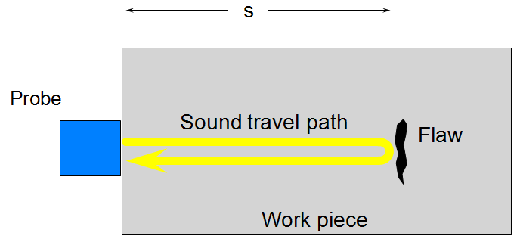
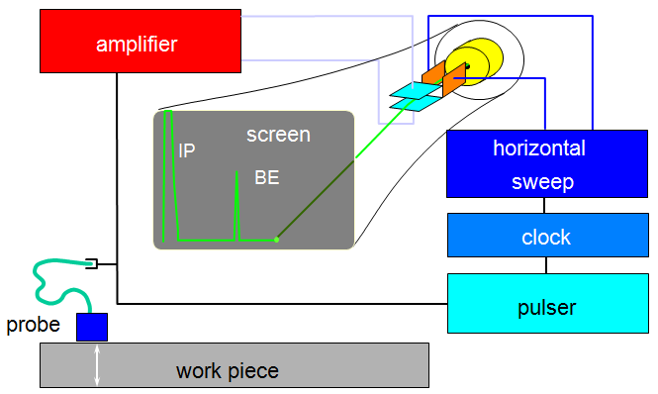
Block diagram: Ultrasonic Instrument

Slide 6
TYPES OF SOUND WAVES
Longitudinal wave
Transverse/shear wave

Slide 7
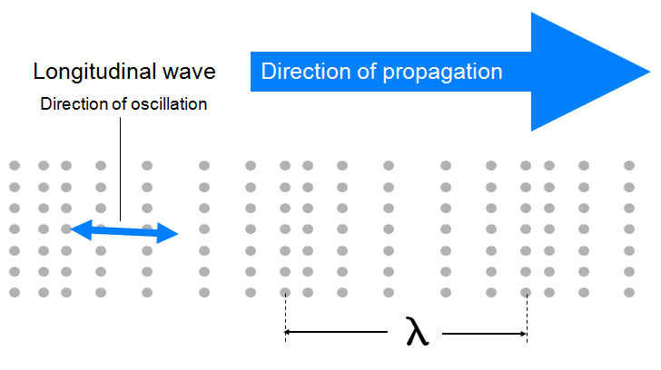
LONGITUDINAL WAVE
In longitudinal waves, the oscillations occur in the longitudinal direction or the direction of wave propagation.
Since compressional and dilational forces are active in these waves, they are also called pressure or compressional waves.
Compression waves can be generated in fluids, as well as solids because the energy travels through the atomic structure by a series of compression and expansion (rarefaction) movements.

Slide 8
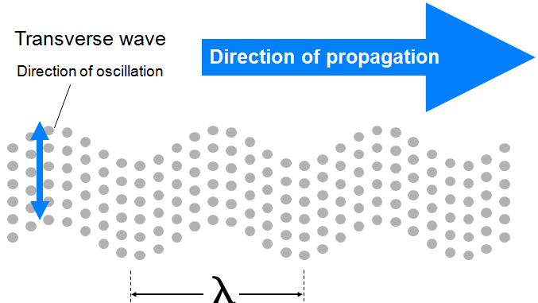
TRANSVERSE OR SHEAR WAVE
In the transverse or shear wave, the particles oscillate at a right angle or transverse to the direction of propagation.
For such a wave to travel through a material, it is necessary that each particle of the material is strongly bound to its neighbors so that as one particle moves, it pulls its neighbor with it, so velocity is above half that of longitudinal velocity.
Shear waves require an acoustically solid material for effective propagation, and therefore, are not effectively propagated in materials such as liquids or gasses.
Shear waves are relatively weak when compared to longitudinal waves.

Slide 9
VELOCITY OF ULTRASONIC WAVES
Velocity of a sound wave in a material V = f×λ
The velocity of propagation of longitudinal, transverse waves depends on density of the material, it is independent of the frequency.
Usually for a given frequency a defect which can be detected is of the order of half the wavelength in that medium.
Velocity of longitudinal, transverse and surface waves are given by
VL = √E(1-µ)/ρ(1+µ)(1-µ)
VT = √E/2ρ(1+µ) = √G/ρ
Acoustic Impedance
Z=ρv
E= Young’s Modulus
G= Modulus of Rigidity
µ= Poison’s Ratio
Ρ=Density of material
V = Sound velocity in the
material

Slide 10
Attenuation
When sound waves passes through materials the sound pressure is essentially weakened by two physical process
Scattering
Absorption
Scattering results from the fact that the material is not strictly homogeneous such as cast iron and brass.
Remedy for scattering is to lower the frequency.
Absorption is a direct conversion of sound energy into heat for which several processes like internal friction, elastic and magnetic hysteresis, heat conduction etc are responsible.
Remedies of absorption are to lower the frequency, increase the transmission voltage and increase the amplification.

Slide 11
ULTRASOUND GENERATION
Ultrasound is generated with a transducer.
A piezoelectric element in the transducer converts electrical energy into mechanical vibrations (sound), and vice versa.
Quartz and some other crystal have a lattice structure such that if a plate is cut out of the crystal with a certain orientation with respect to the crystallographic axis, and subjected it to an electric field in the right direction it will change its direction, it will contract or expands according to the polarity of the field.
Conversely when a similar deformation of the plate is brought about by an external mechanical force, electric charges appear on its opposite surfaces.
The transducer is capable of both transmitting and receiving sound energy.

Slide 12
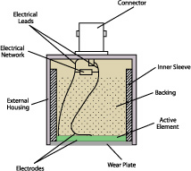
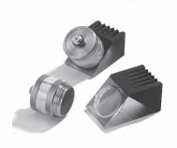
TYPES OF PROBES
Normal Beam Transducers
Angle Beam Transducers
Angle beam transducers are single element transducers used with a wedge to introduce a refracted shear wave or longitudinal wave into a test piece.

Slide 13
PIEZOELECTRIC TRANSDUCERS
PT’s contain polarized material
When electric charge is applied, dipoles are induced and dimensions change
If a force is placed on the material, it will change dimensions and create an electric field

Slide 14
TEST TECHNIQUES
Ultrasonic testing is a very versatile inspection method, and inspections can be accomplished in a number of different ways.
Ultrasonic inspection techniques are commonly divided into three primary classifications.
Pulse-echo and Through Transmission (Relates to whether reflected or transmitted energy is used)
Normal Beam and Angle Beam (Relates to the angle that the sound energy enters the test article)

Slide 15
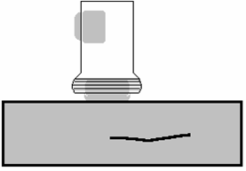
TEST TECHNIQUES - PULSE-ECHO
In pulse-echo testing, a transducer sends out a pulse of energy and the same or a second transducer listens for reflected energy (an echo).
Reflections occur due to the presence of discontinuities and the surfaces of the test article.
The amount of reflected sound energy is displayed versus time, which provides the inspector information about the size and the location of features that reflect the sound.
f
initial
pulse
back surface
echo
crack
echo
crack
0
2
4
6
8
10
plate
UT Instrument Screen

Slide 16
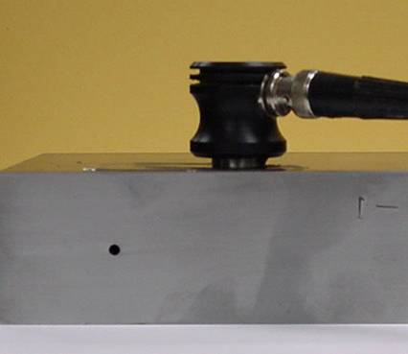
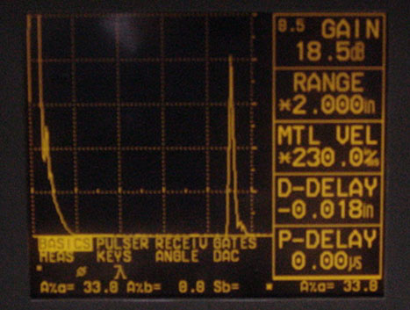
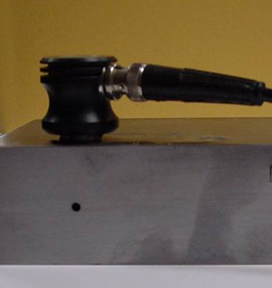
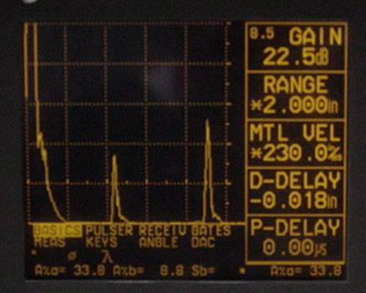
TEST TECHNIQUES – PULSE-ECHO (cont.)
Digital display showing signal generated from sound reflecting off back surface.
Digital display showing the presence of a reflector midway through material, with lower amplitude back surface reflector.
The pulse-echo technique allows testing when access to only one side of the material is possible, and it allows the location of reflectors to be precisely determined.

Slide 17
TEST TECHNIQUES – THROUGH-TRANSMISSION
Two transducers located on opposing sides of the test specimen are used. One transducer acts as a transmitter, the other as a receiver.
Discontinuities in the sound path will result in a partial or total loss of sound being transmitted and be indicated by a decrease in the received signal amplitude.
Through transmission is useful in detecting discontinuities that are not good reflectors, and when signal strength is weak. It does not provide depth information.
1
1
T
R
T
R
2
1
1
2
0
2
4
6
8
10

Slide 18
Calculations:
Length of cement block (l)= 150mm
Time (t) = 38µs
Velocity = l/t, v = 3.9km/sec.
Velocity criteria for cement quality grading:
SL.NO | PLUSE VELOSITY (Km/SEC) | QUALITY GRADE
1 | >4.5 | EXCELLENT
2 | 3.5-4.5 | GOOD
3 | 3.0-3.5 | MEDIUM
4 | <3.0 | DOUTFUL

Slide 19
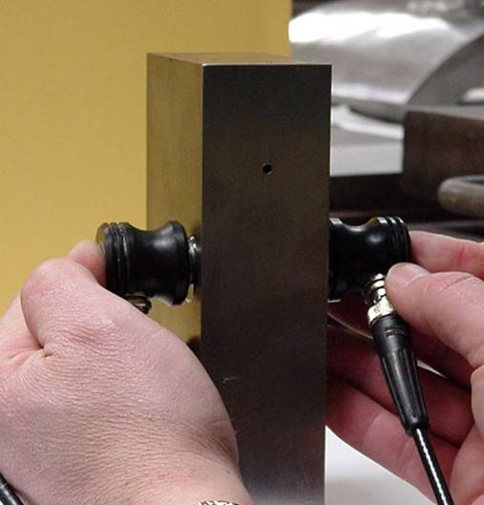
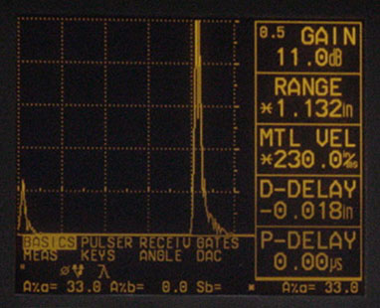
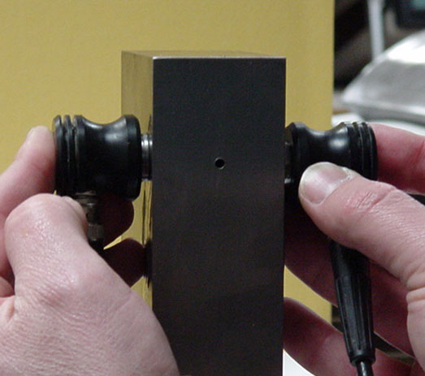
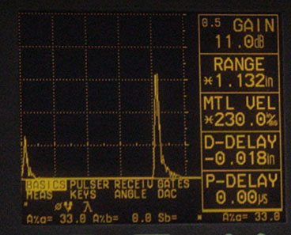
TEST TECHNIQUES – THROUGH-TRANSMISSION
Digital display showing received sound through material thickness.
Digital display showing loss of received signal due to presence of a discontinuity in the sound field.

Slide 20
TEST TECHNIQUES – NORMAL AND ANGLE BEAM
In normal beam testing, the sound beam is introduced into the test article at 90 degree to the surface.
In angle beam testing, the sound beam is introduced into the test article at some angle other than 90.
The choice between normal and angle beam inspection usually depends on two considerations:
the sound should be directed to produce the largest reflection from the feature.
obstructions on the surface of the part that must be worked around.

Slide 21
DATA PRESENTATION
Ultrasonic data can be collected and displayed in a number of different formats
The three most common formats are known in the NDT world as
A-scan presentation
B-scan presentation
C-scan presentation
Each presentation mode provides a different way of looking at and evaluating the region of material being inspected

Slide 22
A-SCAN PRESENTATION
The A-scan presentation displays the amount of received ultrasonic energy as a function of time.
The relative amount of received energy is plotted along the vertical axis and the elapsed time (which may be related to the sound energy travel time within the material) is displayed along the horizontal axis

Slide 23
B-SCAN PRESENTATION
The B-scan presentations is a profile (cross-sectional) view of the test specimen.
In the B-scan, the time-of-flight (travel time) of the sound energy is displayed along the vertical axis and the linear position of the transducer is displayed along the horizontal axis.

Slide 24
C-SCAN REPRESENTATION
The C-scan presentation provides a plan-type view of the location and size of test specimen features.
The plane of the image is parallel to the scan pattern of the transducer. C-scan presentations are produced with an automated data acquisition system, such as a computer controlled immersion scanning system.
The C-scan presentation provides an image of the features that reflect and scatter the sound within and on the surfaces of the test piece.

Slide 25
INSPECTION APPLICATIONS
Some of the applications for which ultrasonic testing may be employed include:
Flaw detection (cracks, inclusions, porosity, etc.)
Erosion & corrosion thickness gauging
Assessment of bond integrity in adhesively joined and brazed components
Estimation of void content in composites and plastics
Measurement of case hardening depth in steels
Estimation of grain size in metals

Slide 26
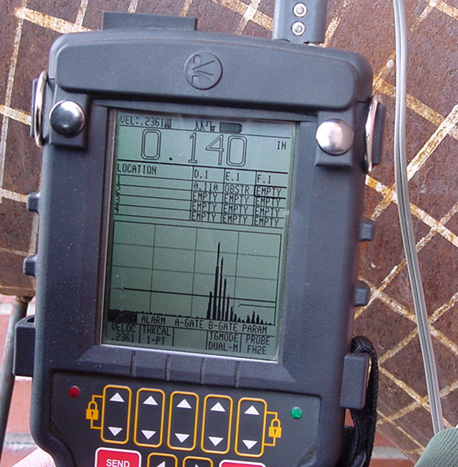
THICKNESS GAUGING
Ultrasonic thickness gauging is routinely utilized in the petrochemical and utility industries to determine various degrees of corrosion/erosion.
Applications include piping systems, storage and containment facilities, and pressure vessels.

Slide 27
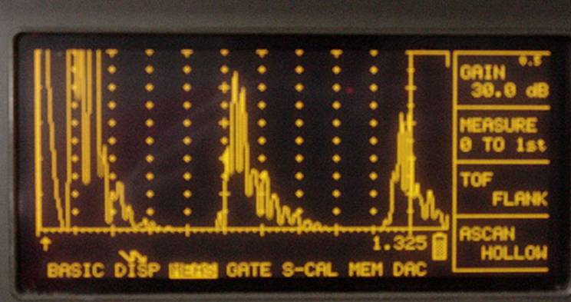
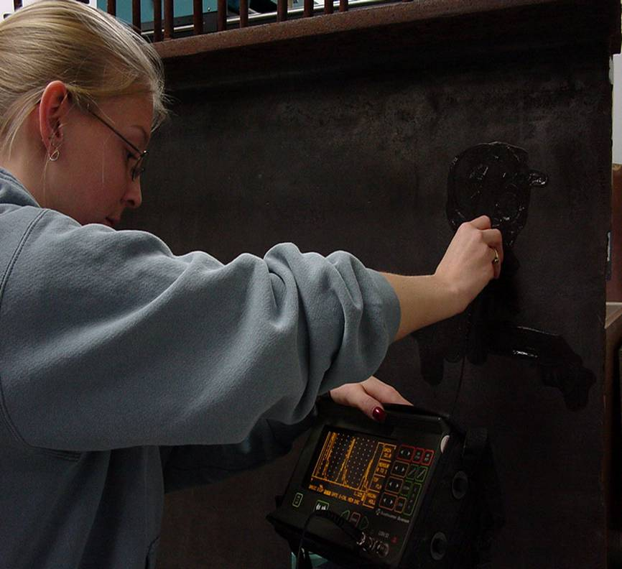
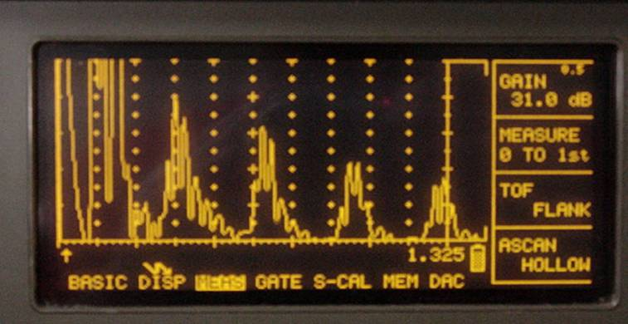
FLAW DETECTION
Contact, pulse-echo inspection for delaminations on 36” rolled beam.
Signal showing multiple back surface echoes in an unflawed area.
Additional echoes indicate delaminations in the member.

Slide 28
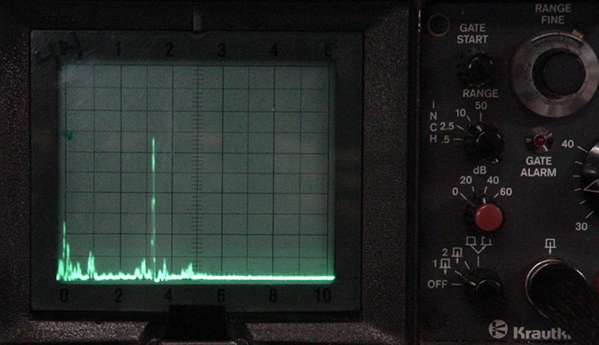
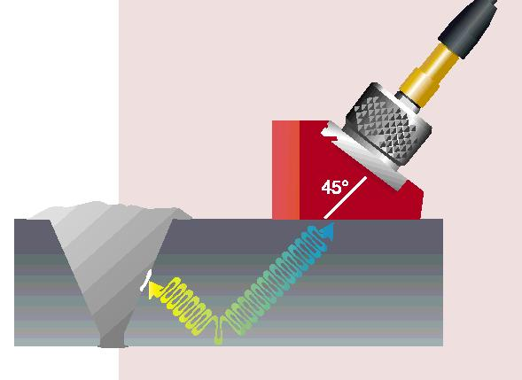
FLAW DETECTION IN WELDS
One of the most widely used methods of inspecting weldment is ultrasonic inspection.
Full penetration groove welds lend themselves readily to angle beam shear wave examination.

Slide 29
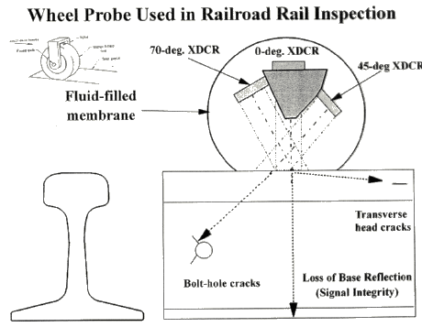
APPLICATIONS
Inspection of rails for bolts holes breaks without dismantling end assemblies
Inspection of moving strip or plate (for laminations) as regards its thickness
Routine inspection of locomotive axels and wheels pins for fatigue cracks

Slide 30
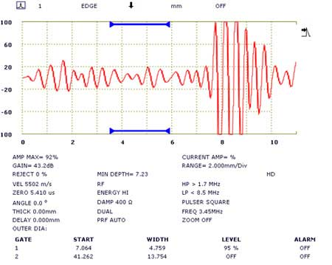
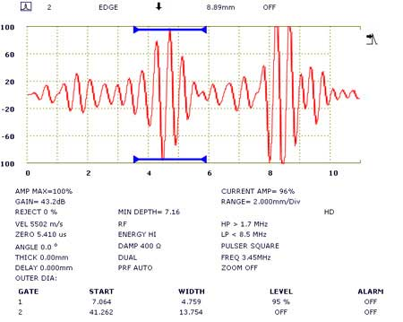
ULTRASONIC TESTING IN THE FOUNDRY INDUSTRY
Inspection of large castings and forging, for internal soundness before carrying out expensive machining operations. These include Voids, porosity, inclusions and cracks
good area of casting
porosity indication

Slide 31
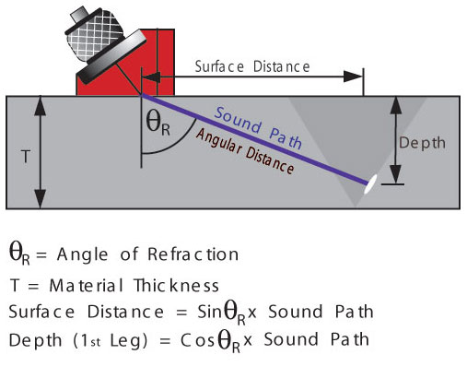
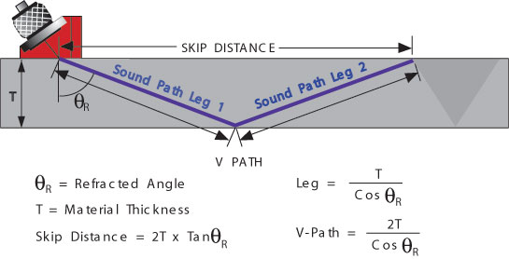
WELDMENTS (WELDED JOINTS)
The most commonly occurring defects in welded joints are
Porosity
Slag inclusions
Lack of side-wall fusion
Lack of inter-run fusion
Lack of root penetration
Undercutting, and
Longitudinal or transverse cracks

Slide 32
Miscellaneous Ultrasonic Applications
Ice
measurement of ice thickness on ponds and lakes, studies of ice buildup in coolers and other industrial processes
Concrete
monitor mechanical properties such as compressive strength

Slide 33
Medical and Biological Research Applications
These have included thickness measurements of skin layers, muscle and fat, and corneal tissue, as well as sound velocity measurements that can be related to the integrity of bone
Wood Products
Verifying bonding in laminated plywood and particle board, and measurement of elastic properties.
Minerals, Rocks, Sand, Soil
ultrasonic properties to measure physical parameters such as hardness,
elasticity, and
grain structure,
as well as compaction of soil or sand under laboratory conditions

Slide 34
Advantage of Ultrasonic Testing
Sensitive to small discontinuities both surface and subsurface.
Depth of penetration for flaw detection or measurement is superior to other methods.
Only single-sided access is needed when pulse-echo technique is used.
High accuracy in determining reflector position and estimating size and shape.
Minimal part preparation required.
Electronic equipment provides instantaneous results.
Detailed images can be produced with automated systems.
Has other uses such as thickness measurements, in addition to flaw detection.

Slide 35
LIMITATIONS OF ULTRASONIC TESTING
Surface must be accessible to transmit ultrasound.
Skill and training is more extensive than with some other methods.
Normally requires a coupling medium to promote transfer of sound energy into test specimen.
Materials that are rough, irregular in shape, very small, exceptionally thin or not homogeneous are difficult to inspect.
Cast iron and other coarse grained materials are difficult to inspect due to low sound transmission and high signal noise.
Linear defects oriented parallel to the sound beam may go undetected.
Reference standards are required for both equipment calibration, and characterization of flaws.

