Slide 1
INTERFACING
Giving input (or) retrieving output from the Mp is only through some peripherals, such as, keyboards, CRT terminal, cassette tape, etc.
So mapping of data transfer from Mp to peripherals is INTERFACING.

Slide 2
* Provides a method for transferring information between internal storage
(such as memory and CPU registers) and external I/O devices
* Resolves the differences between the computer and peripheral devices
- Peripherals - Electromechanical Devices
CPU or Memory - Electronic Device
- Data Transfer Rate
Peripherals - Usually slower
CPU or Memory - Usually faster than peripherals
Some kinds of Synchronization mechanism may be needed
- Unit of Information
Peripherals - Byte
CPU or Memory - Word
- Operating Modes
Peripherals - Autonomous, Asynchronous
CPU or Memory - Synchronous

Slide 3
Data
Processor
Address
Control
Interface
Interface
Interface
Interface
Keyboard
Magnetic
Magnetic
and
Printer
disk
tape
terminal
Each peripheral has an interface module associated with it.
Interface has the following role:
- Decodes the device address (device code)
- Decodes the commands (operation)
- Provides signals for the peripheral controller
- Synchronizes the data flow and supervises
the transfer rate between peripheral and CPU or Memory

Slide 4
INTERFACING I/O Devices
It is of 2 types:
(I/O DATA TRANSFER)
1. I/O MAPPED I/O, &
2. MEMORY MAPPED I/O.

Slide 5
MAPPING
I/O MAPPED I/O:
Same address may be for memory or I/O device.
So Intel 8085 issues IO/M’ signal for the purpose.
Two extra instructions: a) IN , b) OUT.
Suitable for a large system.
2. MEMORY MAPPED I/O:
Only one address space.
I/O device also treated as memory location.
Suitable for small system.

Slide 6
Characteristics | Memory-Mapped | Peripheral-mapped
Device address | 16 bit | 8 bit
Control signals | MEMR, MEMW | IOR, IOW
Instructions | All memory related – MOV, ADD, SUB, LOAD,… | IN, OUT
Data transfer | Between any register and I/O | Only between I/O and AX
Max no. of I/O | Memory range | 256 input and, 256 output
Execution speed | Slow | Faster
H/W | More | Less
Other features | Arithmetic or Logical operations directly performed. | Not Available.

Slide 7
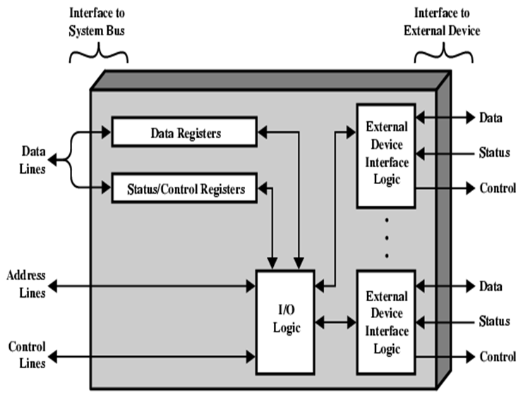

Slide 8
Port A
I/O data
register
Bidirectional
Bus
data bus
buffers
Port B
I/O data
register
I/O
Device
CPU
Chip select
CS
Register select
Internal bus
Control
Control
RS1
Timing
register
Register select
RS0
and
I/O read
Control
RD
Status
Status
I/O write
WR
register
CS RS1 RS0 Register selected
0 x x None - data bus in high-impedence
1 0 0 Port A register
1 0 1 Port B register
1 1 0 Control reg.
1 1 1 Status reg.

Slide 9
Data Transmission
Most digital messages are longer than just a few bits.
It is neither practical nor economic to transfer all bits of a
long message simultaneously.
The message is broken into smaller parts and transmitted
sequentially.
Bit-serial transmission conveys a message one bit at a time
through a channel.
Each bit represents a part of the message.

Slide 10
Bit-serial Data Transmission
The individual bits are then reassembled at the destination to
compose the message.
In general, one channel will pass only one bit at a time.
Thus, bit-serial transmission is necessary in data
communications if only a single channel is available.
Bit-serial transmission is normally just called serial
transmission and is the chosen communications method in
many computer peripherals.

Slide 11
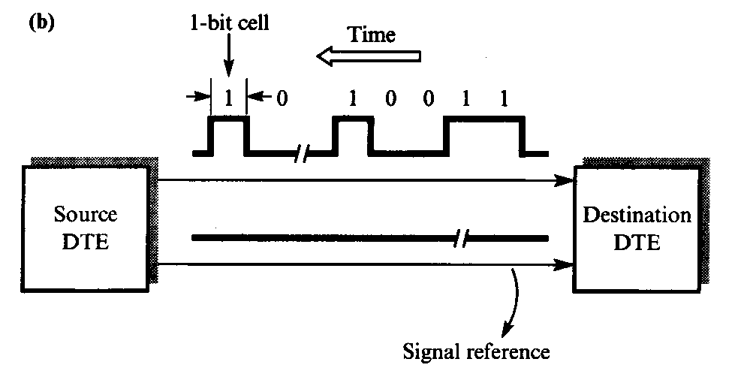
Bit-serial Data Transmission

Slide 12
Byte-serial Data Transmission
Byte-serial transmission conveys eight bits at a time through
eight parallel channels.
Although the raw transfer rate is eight times faster than in bit-
serial transmission, eight channels are needed, and the cost may
be as much as eight times higher to transmit the message.
When distances are short, both techniques may be feasible and
economic to use parallel channels in return for high data rates.
The popular Centronics printer interface is a case where byte-
serial transmission is used.

Slide 13
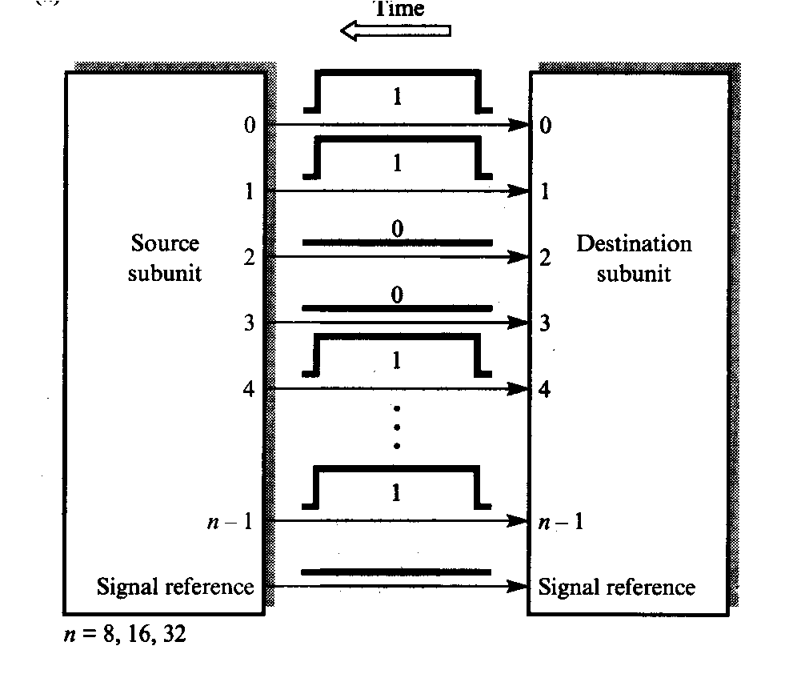
Byte Transmission
As another example, it is common practice to use a 16-bit-wide
data bus to transfer data between a microprocessor and memory
chips.
This provides the equivalent of 16 parallel channels.
On the other hand, when communicating with a timesharing
system over a modem, only a single channel is available, and
bit-serial transmission is required.

Slide 14
Synchronization
Two types of transmission:
  Asynchronous
  Synchronous
Asynchronous Transmission
In asynchronous transmission, each character is transmitted separately with separate synchronization information. This type of transmission is often used in situation when characters may be generated at random intervals, such as when a user types at a terminal. In asynchronous transmission, all of the bits that comprise a character are framed and then sent as a single transmission string.

Slide 15
ASYNCHRONOUS DATA TRANSFER
Synchronous and Asynchronous Operations
1. Synchronous Operations:- All devices derive the timing information from clock line.
2. Asynchronous Operations :- No common clock
Asynchronous data transfer between two independent units requires that
control signals be transmitted between the communicating units to
indicate the time at which data is being transmitted

Slide 16
Two Asynchronous Data Transfer methods :-
Strobe Pulse:- It is supplied by one unit to indicate the other unit when the transfer has to occur.
Handshaking :- A control signal is accompanied with each data being transmitted to indicate the presence of data. The receiving unit responds with another control signal to acknowledge receipt of data

Slide 17
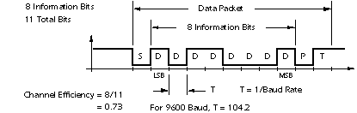
Asynchronous transmission

Slide 18
Asynchronous Transmission
Start and Stop Bit Framing
The clocks of the transmitter and the receiver are not continually synchronized. But the receiver needs to know when the character begins and ends. For this reason, the character's bit string is framed with start and stop bits. The start bit reset the receiver's clock so that it matches the transmitter's. The clock only needs to be accurate enough to stay in sync for the next 8 to 11 ticks. At least one stop bit is added to mark the end of the character and allow recognition of the next start bit.

Slide 19
Strobe Control
This method of asynchronous data transfer uses a single control line to time each transfer. The strobe may be activated by the source or the destination unit.
i) Source Initiated Data Transfer:
The data bus carries the information from source to destination. The strobe is a single line. The signal on this line informs the destination unit when a data word is available in the bus.
The strobe signal is given after a brief delay, after placing the data on the data bus. A brief period after the strobe pulse is disabled the source stops sending the data.

Slide 20
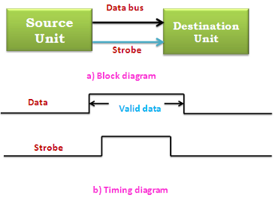

Slide 21
(ii) Destination Initiated Data Transfer:
In this case the destination unit activates the strobe pulse informing the source to send data. The source places the data on the data bus. The transmission is stopped briefly after the strobe pulse is removed.
The disadvantage of the strobe is that the source unit that initiates the transfer has no way of knowing whether the destination unit has received the data or not. Similarly if the destination initiates the transfer it has no way of knowing whether the source unit has placed data on the bus or not. This difficulty is solved by using hand shaking method of data transfer.

Slide 22
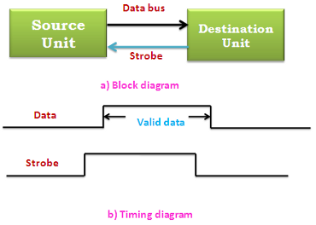

Slide 23
HANDSHAKING
Asynchronous Data Transfer
Strobe Methods
Source-Initiated
The source unit that initiates the transfer has
no way of knowing whether the destination unit
has actually received data
Destination-Initiated
The destination unit that initiates the transfer
no way of knowing whether the source has
actually placed the data on the bus
To solve this problem, the HANDSHAKE method
introduces a second control signal to provide a Reply
to the unit that initiates the transfer

Slide 24
SOURCE-INITIATED TRANSFER USING HANDSHAKE
Asynchronous Data Transfer
Data bus
Block Diagram
Source
Data valid
Destination
unit
Data accepted
unit
Data bus
Valid data
Timing Diagram
Data valid
Data accepted
Sequence of Events
Source unit
Destination unit
Place data on bus.
Enable data valid.
Accept data from bus.
Enable data accepted
Disable data valid.
Invalidate data on bus.
Disable data accepted.
Ready to accept data
(initial state).

Slide 25
DESTINATION-INITIATED TRANSFER USING HANDSHAKE
Data bus
Block Diagram
Source
Data valid
Destination
unit
Ready for data
unit
Timing Diagram
Ready for data
Data valid
Data bus
Valid data
Sequence of Events
Source unit
Destination unit
Ready to accept data.
Place data on bus.
Enable ready for data.
Enable data valid.
Disable data valid.
Accept data from bus.
Disable ready for data.
Invalidate data on bus

Slide 26
Asynchronous Transmission
Error Detection
One way to detect errors in asynchronous transmission is to add an extra bit, called a parity bit, to the end of each character in a frame.
Summary:
Uncomplicated and inexpensive but slow and
Overhead for each character.

Slide 27
Four Different Types of Transfer
Asynchronous Serial Transfer
Asynchronous serial transfer
Synchronous serial transfer
Asynchronous parallel transfer
Synchronous parallel transfer
- Employs special bits which are inserted at both
ends of the character code
- Each character consists of three parts; Start bit; Data bits; Stop bits.
1
1
0
0
0
1
0
1
Start
Stop
Character bits
bits

Slide 28
Synchronous Transmission
In some application it is necessary for large blocks of data, such as the contents of a disk file, to be transmitted. Synchronous transmission is more efficient method of transmitting large block of data. The data are usually buffered and transmitted as an entire message or frame. For this reason, clocks on both sides must maintain synchronization during transmission. This is accomplished in one of two ways:
  A separate synchronizing signal, a clock, can be constantly transmitted
  Clocking can be included in the data signal

Slide 29
Synchronous Transmission
Error Detection
Cyclic Redundancy Check (CRC) is often used in synchronous transmission. The CRC process subjects the block of data to an algorithm that computes a result based on its contents. This result is appended to the block prior to transmission. On the receiving side, the same algorithm is used and the result is compared with the CRC field. Any difference is assumed to mean frame damage during transmission and retransmission is repeated.
More efficient, higher speed and improved error detection, But expensive and complex transmitter/receiver circuitry.

Slide 30
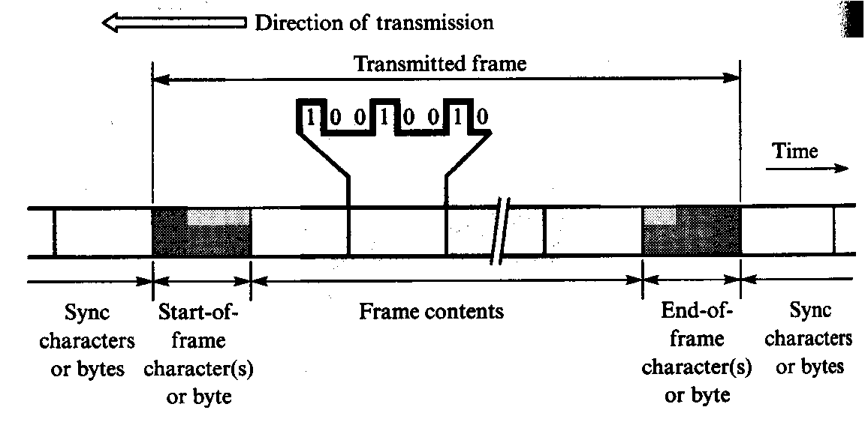

Slide 31
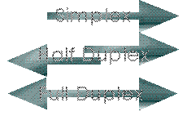
Communication Modes
Three types of communication modes: simple, half-duplex, and full-duplex.
Simplex
  One way transmitting, like Radio station. One transmitter, and the rest are receivers.

Slide 32
Hall-Duplex & Full-Duplex
Half-Duplex
  Alternating two-way transmit and receive.
  When one is transmitting, other is listening,
  then one can transmit after a quiet on the channel.
Full-Duplex
  Simultaneous transmit and receive at the same time. Of course, one frequency for transmitting, other for receiving.

Slide 33
Transmit
Bidirectional
Transmitter
Shift
data
data bus
Bus
register
register
buffers
Control
Transmitter
Transmitter
register
control
clock
Chip select
and clock
CS
Internal Bus
RS
Timing
Status
Receiver
Receiver
CS RS Oper. Register selected
register
control
clock
I/O read
and
0 x x None
RD
and clock
1 0 WR Transmitter register
Control
1 1 WR Control register
I/O write
Receive
WR
Receiver
Shift
data
1 0 RD Receiver register
register
register
1 1 RD Status register

Slide 34
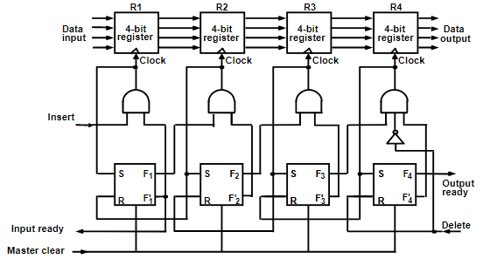
FIFO Buffer

Slide 35
Data Transfer
Modes of Transfer
  Programmed I/O
  Priority Interrupt
  Direct Memory Access
  Input-Output Processor

Slide 36
Modes Of Data Transfer
Three types of data transfer modes :
Program Controlled I/O: uses programming to transfer data , every item is initiated by instructions in the program
Interrupt I/O: this method avoids the wait loop. In this scheme the i/o device initiates the transfer instead of the processor
Direct Memory Access (DMA): in this mode of transfer large blocks of data directly between external devices and main memory

Slide 37
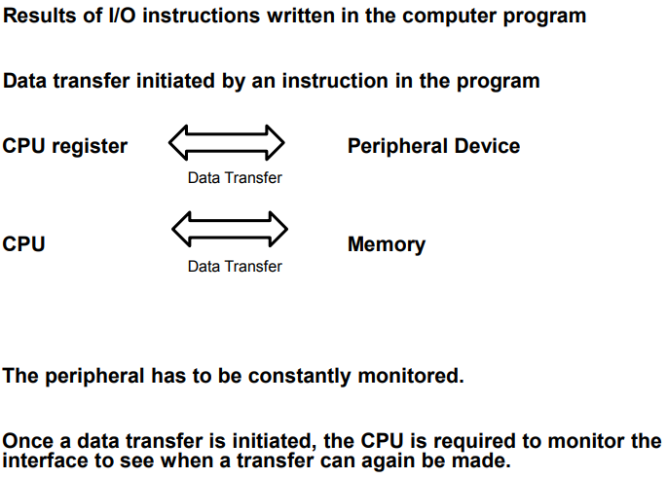
  Programmed I/O

Slide 38
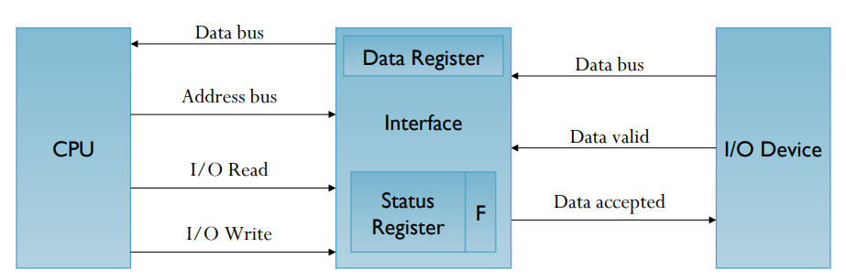
Programmed -
I/O device to CPU

Slide 39
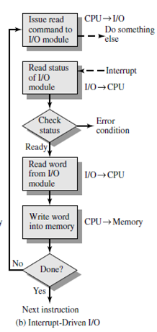

Slide 40
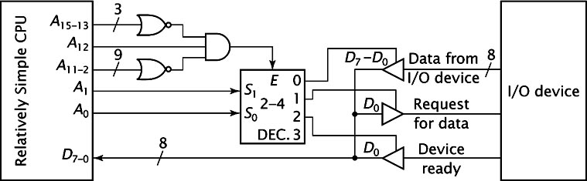
Interrupt - Polling

Slide 41
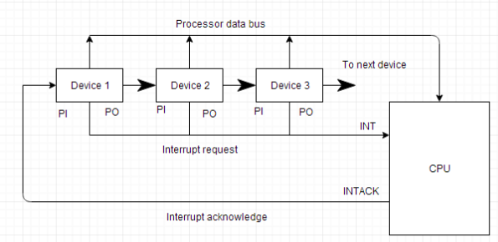
Daisy-Chaining Priority

Slide 42
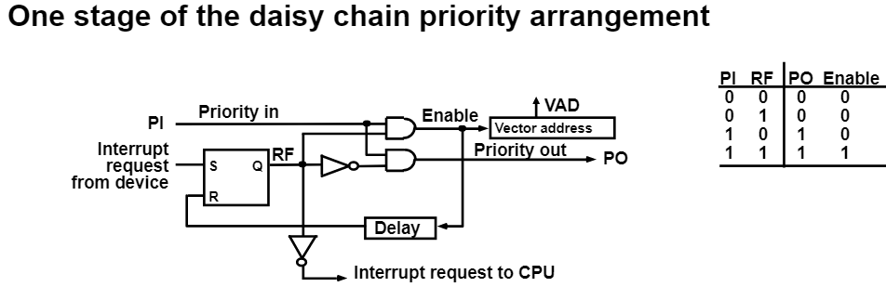

Slide 43
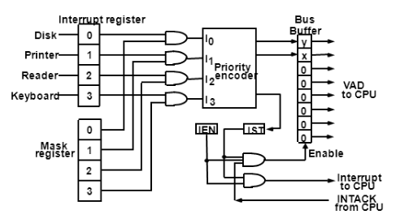
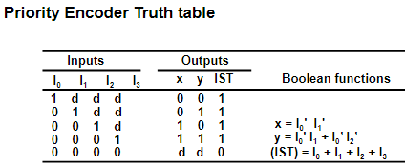
Priority Interrupt H/W

Slide 44
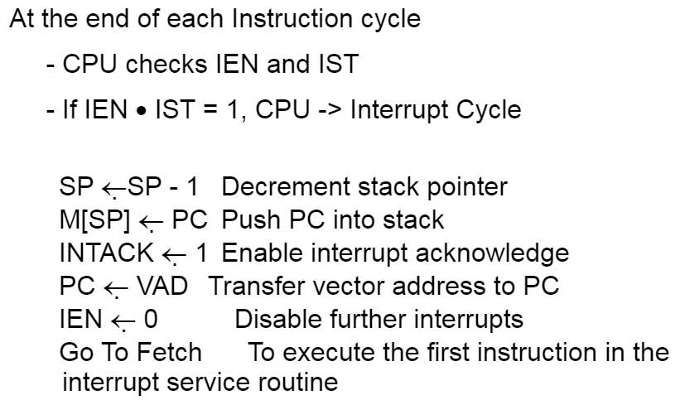
Interrupt Cycle

Slide 45
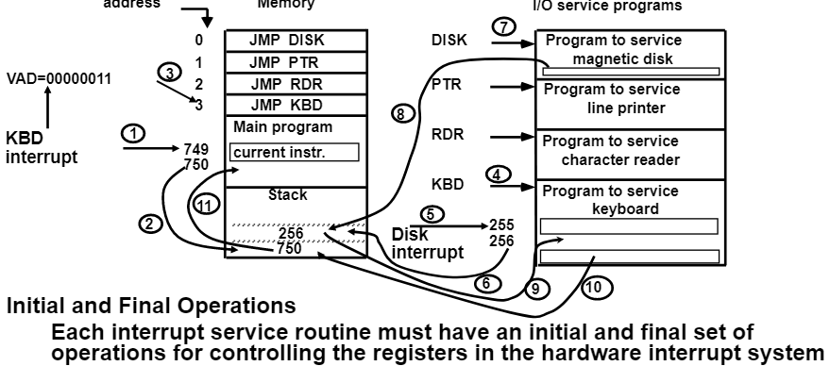
S/W Routines

Slide 46
Initial Operations:
Clear lower level mask reg.
Clear interrupt status bit IST.
Save contents of processor reg.
Set IEN.
Proceed with Service routine.
Final operations:
Clear IEN
Restore contents of Processor reg.
Clear bit in Interrupt refering to interrupt that has been serviced.
Set Lower-level priority bits in Mask reg.
Restore return address into PC and set IEN

Slide 47
Direct Memory Access
Interrupt driven and programmed I/O require active CPU intervention
  Transfer rate is limited
  CPU is tied up
DMA is the answer
  Direct Memory Access is a method of transferring data between peripherals and memory without using the CPU.

Slide 48
DMA Process
Data is transferred between memory and disk directly without involving the processor
  Interrupt still tells CPU when such a transfer has started and finished.
DMA transfers
  CPU tells the device controller operation to perform and addresses involved.
  Device controller then carries out the operation without bothering the CPU using DMA
  Bus controller arbitrates for the bus.
  Device controller informs the CPU when complete via an interrupt

Slide 49
DMA Modes
DMA can operate in one of two modes
  Byte Mode
    DMAC takes over the bus for each byte of data to be transferred & then returns control to CPU
  Burst Mode
    A block of data is transferred before returning bus control to CPU
Choice depends on the speed at which data is arriving & whether a particular application will allow the CPU to be locked off the bus for the duration of block transfer

Slide 50
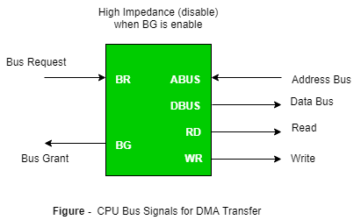

Slide 51
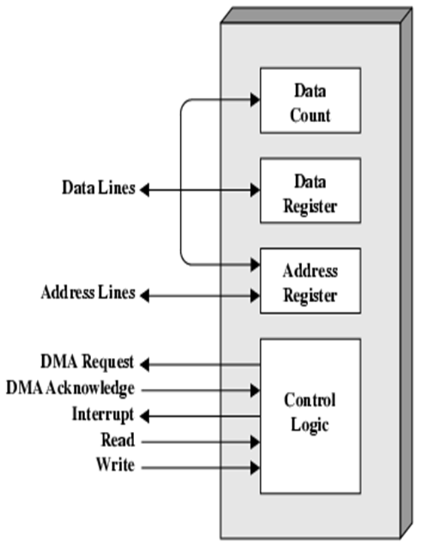

Slide 52
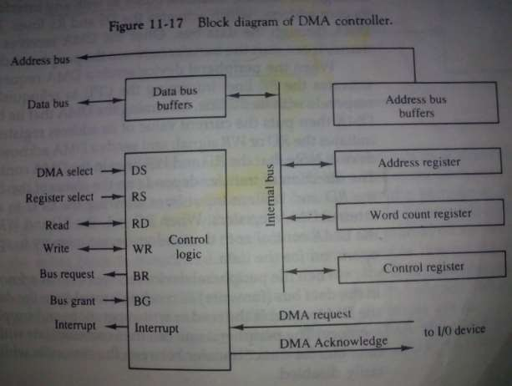
DMA controller

Slide 53
AD₀- AD₁₅
Addr
latches
Addr Bus
Mem
ALE
Data Bus
Data Bus
μp
Control Bus
Control Bus
HLDA
HOLD
1
I/O
0
HRQ
1
DMAC
DREQ
1
DACK
1

Slide 54
Input-Output Processor(IOP)
It is a processor with direct memory access capability that communicates with IO devices.
IOP is similar to CPU except that it is designed to handle the details of IO operation.
Unlike DMA which is initialized by CPU, IOP can fetch and execute its own instructions.
IOP instruction are specially designed to handle IO operation.

Slide 55
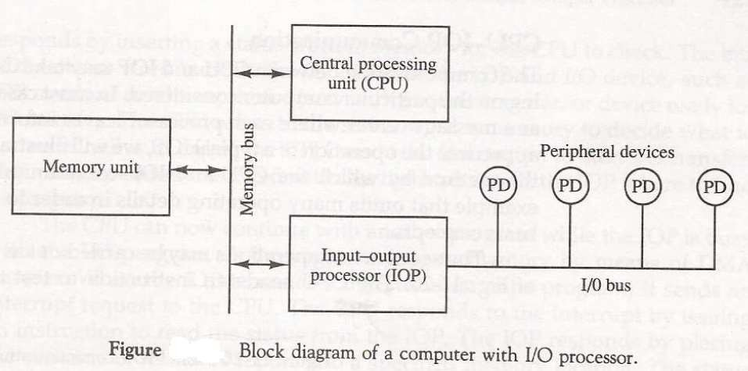
IOP

Slide 56
IOP
Memory occupies the central position and can communicate with each processor by DMA.
CPU is responsible for processing data.
IOP provides the path for transfer of data between various peripheral devices and memory.
Data formats of peripherals differ from CPU and memory. IOP maintain such problems.
Data are transfer from IOP to memory by stealing one memory cycle.

Slide 57
IOP
Instructions that are read from memory by IOP are called commands to distinguish them from instructions that are read by the CPU.

Slide 58
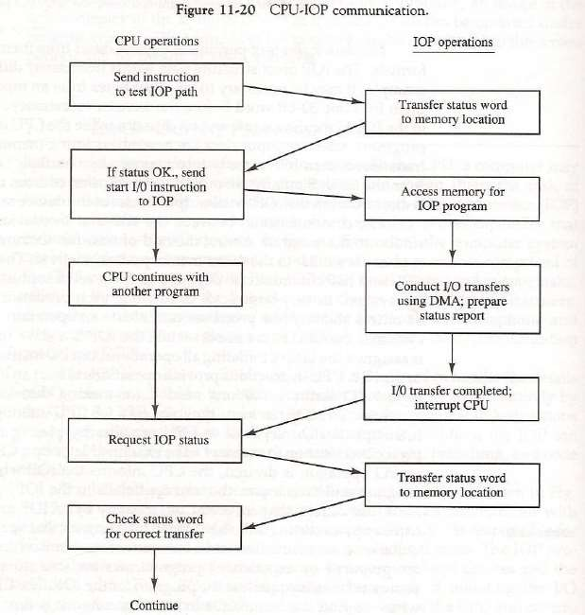

Slide 59
PROGRAMMABLE PERIPHERAL INTERFACE -8255
Features:
It is a programmable device.
It has 24 I/O programmable pins like PA,PB,PC (3-8 pins).
It is used to interface 8 bit parallel I/O device to a microprocessor.
It is used to interface to the keyboard and a parallel printer port in PCs.

Slide 60
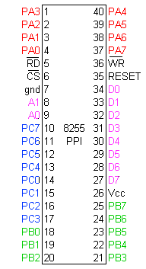
Pin Diagram

Slide 61
Function of pins:
Data bus(D₀-D₇):These are 8-bit bi-directional buses, connected to 8085 data bus for transferring data.
CS: This is Active Low signal. When it is low, then data is transfer from 8085.
Read: This is Active Low signal, when it is Low read operation will be start.
Write: This is Active Low signal, when it is Low Write operation will be start.

Slide 62
Address (A₀-A₁):This is used to select the ports. like this
A1 | A0 | Select
0 | 0 | PA
0 | 1 | PB
1 | 0 | PC
1 | 1 | Control reg.

Slide 63
RESET: This is used to reset the device. That means clear control registers.
PA₀-PA₇:It is the 8-bit bi-directional I/O pins used to send the data to peripheral or
or to receive the data from peripheral.
PB₀-PB₇:Similar to PA
PC₀-PC₇:This is also 8-bit bidirectional I/O pins. These lines are divided into two groups.
PC₀ to PC₃(Lower Groups)
PC₄ to PC₇ (Higher groups)
These two groups working in separately using 4 data’s.

Slide 64
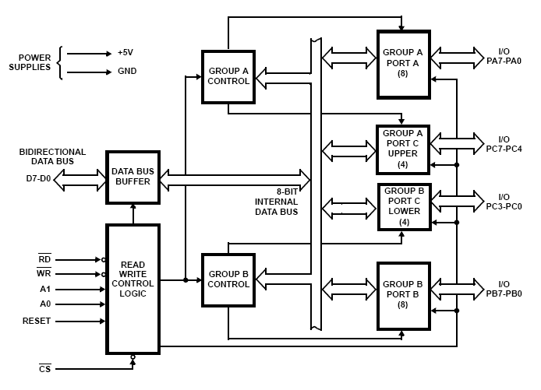
Block Diagram

Slide 65
Group A and Group B control:
Group A and B get the Control
Signal from CPU and send the command to the individual control blocks.
Group A send the control signal to port A and Port C (Upper) PC7-PC4.
Group B send the control signal to port B and Port C (Lower) PC3-PC0.
PORT A:
This is a 8-bit buffered I/O latch.
It can be programmed by mode 0 , mode 1, mode 2 .

Slide 66
PORT B:
This is a 8-bit buffer I/O latch.
It can be programmed by mode 0 and mode 1.
PORT C:
This is a 8-bit Unlatched buffer Input and an Output latch.
It is splitted into two parts.
It can be programmed by bit set/reset operation.

Slide 67
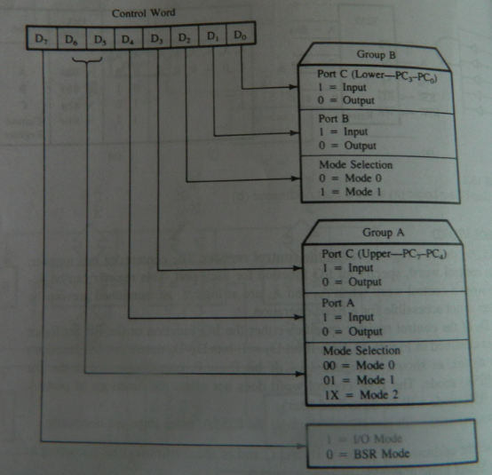
Control Word Format for I/O Mode

Slide 68
CONTROL WORD
MVI A, 83H
STA 8003H
LDA 8001H
STA 8000H
LDA 8002H
ANI 0FH
RLC
RLC
RLC
RLC
STA 8002H
HLT

Slide 69
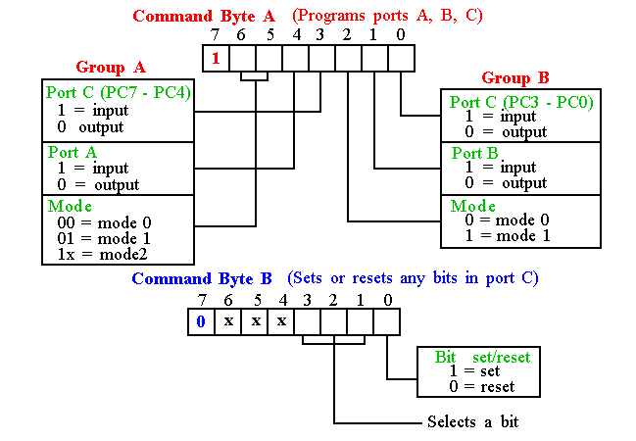
BSR

Slide 70
Operation modes:
BIT SET/RESET MODE:
The PORT C can be Set or Reset by sending OUT instruction to the CONTROL registers.
I/O MODES:
MODEO(Simple input / Output):
In this mode , port A, port B and port C is used as individually (Simply).
Features:
Outputs are latched , Inputs are buffered not latched.
Ports do not have Handshake or interrupt capability.

