Slide 1
A mini project presentation on
CAR PARKING SYSTEM
Batch No: MIP19CS06 Under the guidance of: Project Coordinators:
N. Gagan Kumar (160717733004) Mr. T. Praveen Kumar Mr. R. Sandeep
D. Likitha Rani (160717733005) Assistant Professor, CSE Assistant Professor, CSE
P. Pushpanjali (160717733043) Mrs. P. M. Tulasi
Assistant Professor, CSE

Slide 2
INTRODUCTION:
In the project “Car Parking System” we have shown the concept of displaying the number of empty slots in the parking lot and also the data of each vehicle.
The purpose of this project is to build an application program to reduce the manual work for managing the parking areas.
This application provides information about the car like car number, check in and check out time, duration, fare and the occupied slot.

Slide 3
SYSTEM ANALYSIS
Existing System
Proposed System
Software and Hardware Requirements

Slide 4
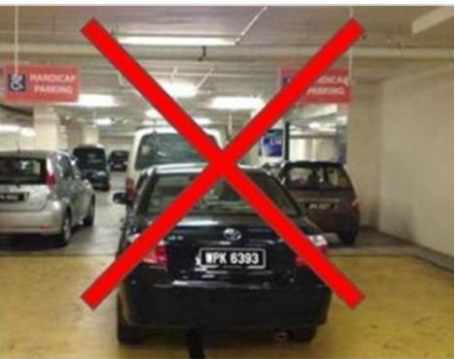
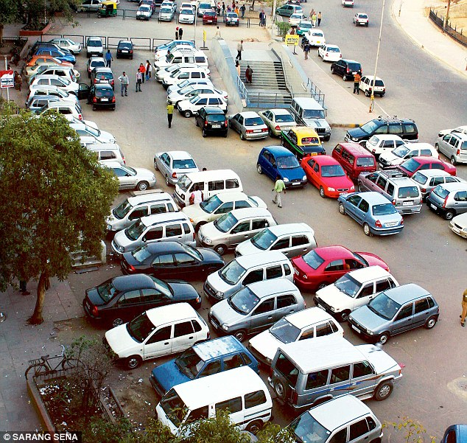
EXISTING SYSTEM:
As car enters the parking area, the concerned worker there check for the availability of slots.
This checking process involves multiple chains of asking the co-workers whether the slots are vacant. This involves a lot of manual work and it is a time consuming process.

Slide 5
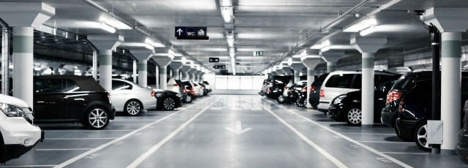
PROPOSED SYSTEM:
Our main aim is to introduce a slot for every individual vehicle to avoid improper parking and to reduce manual work by replacing the existing system with this application to manage the parking system.

Slide 6
Benefits of this system
Manage traffic well inside the malls without any havoc.
Limited parking spaces can be utilized efficiently.
Guides the drivers to the available vacant parking slots.
It helps in managing parking space effectively which results in significant revenue generation.
Entry and exit is very quick and convenient.
Decrease traffic congestion.

Slide 7
Who is going to be benefited?
Consumers
Flexibility and convenience.
Parking space Owners and Management
Parking revenue.

Slide 8
SYSTEM REQUIREMENTS:
Hardware Requirement:
Disk space:10 GB.
RAM:4GB
Processor : Intel corei5,32bit.
Software Requirement:
Turbo C++ compiler.
Windows 7,8,10.

Slide 9
SYSTEM DESIGN:
Block Diagram

Slide 10
BLOCK DIAGRAM:
Menu(list of options)
Show details
Go for parking
Delete details
Parking fee
Display the details of car
Available slots
Delete the details of the car
Calculate duration and fare
Enter details to register the slot

Slide 11
IMPLEMENTATION:
In this project we are having following module:
Administrator

Slide 12
ADMINISTRATOR:
The administrator can operate the following features:
Enter details to slot
Display details of slot
Delete details in slot
Displaying duration and fare
Back to main menu

Slide 13
ALGORITHM:
Step 1: Start
Step 2: Main menu
Step 3: If admin select go for parking then, it displays enter the details of the car.
Step 4: If admin select show details then, it show the details of car with respect to that slot.
Step 5: : If admin select parking fee then, it displays the duration and fare of particular car in that particular slot.
Step 6: If admin select delete details then, it delete the details of car with respect to that slot.

Slide 14
Step 7: If user select the slot which is already occupied then, it gives a warning that “slot occupied”. So, the user can enter the details to another slot which is empty.

Slide 15
Start
MENU
1.Go for parking
2.Go to vacate slot
3.Show details
4.Delete details
Case 1
Case 2
Case 3
Case 4
Case 5
Default
Available slots
Enter slot number
Enter slot number
Enter slot number
Enter valid option
Enter car info
Display duration and fare
Display parking data
Delete parking data
Exit
Slot occupied
Slot vacated

Slide 16
INPUT
Details of the vehicle, entry time and exit time.
OUTPUT
The computer generates the parking fare according to the duration.

Slide 17
CONCLUSION AND FUTURE SCOPE
We designed an application named as car parking system which reduces the manual work and time to calculate the duration and fare of particular car in that particular slot.
Future Scope:
Feeding data to a database and keeping record of the frequent users visiting the parking lot and can give them discount.
It can be extended by adding user to directly book slot before going to parking area.

Slide 18
REFERENCES
1) C++: 4th Edition - The Complete Reference(for concepts of C++)
2) Object oriented programming with C++ by Robert Lafore
3) A Complete Guide to Programming in C++
4) Fundamentals of C++ programming Richard L. Halterman
5) beginning C++ programming Richard Grimes

Slide 20
Thank You

