Slide 1
Introduction to 8085 Microprocessor
M. Mahesh Babu

Slide 2
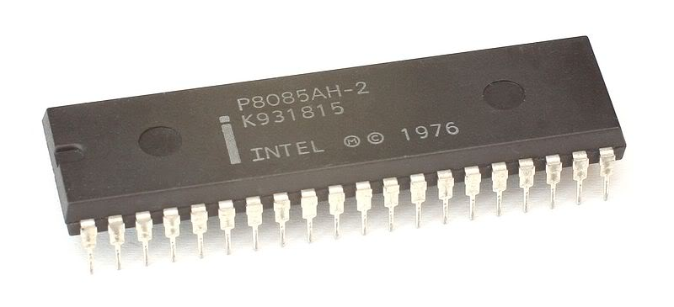
Introduction to 8085
Introduced in 1977.
It is 8-bit MP.
It is a 40 pin dual-in-line chip.
It uses a single +5V supply for its operations.
Its clock speed is about 3MHz.

Slide 3
Features of 8085
It is manufactured with N-MOS technology.
It has 16-bit address bus and hence can address up to 2¹⁶ = 65536 bytes (64KB) memory locations through A0 - A15.
The first 8 lines of address bus and 8 lines of data bus are multiplexed AD0 – AD7.
Data bus is a group of 8 lines D0 – D7 .
It supports external interrupt request.
A 16 bit program counter (PC)
A 16 bit stack pointer (SP)
Six 8-bit general purpose registers arranged in pairs: BC, DE, HL.

Slide 4
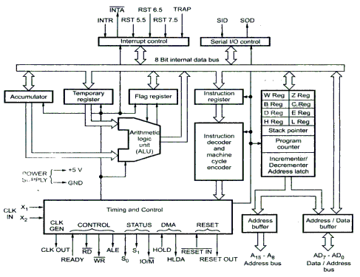
8085 Architecture

Slide 5
Intel 8085 Microprocessor
8085 consists of:
Control unit: control microprocessor operations.
ALU: performs data processing function.
Registers: provide storage internal to CPU.
Interrupts
Internal data bus

Slide 6
8085 Architecture Contd..
ALU – Arithmetic & Logic Unit
ALU of 8085 performs 8-bit arithmetic & logical operations. The operations are generally performed with Accumulator as one of the operands. The result is saved in accumulator register.
Timing & Control Unit
This unit works as the brain of the CPU and generates all the timing and control signals to perform all the internal & external operations of the CPU.
Instruction Decoder & Machine Cycle Encoder Unit
This unit decodes the op-code stored in the Instruction Register (IR) and encodes it for the timing & control unit to perform the execution of the instruction.

Slide 7
8085 Architecture Contd..
The Registers are of 8-bit & 16-bit size used for different purposes
A- Accumulator - This is an special purpose register. All the ALU operations are performed with reference to the contents of Accumulator.
B,C,D,E,H,L - General purpose registers. These registers can also be used for 16-bit operations in pairs. The default pairs are BC, DE & HL.
F – Flag register - This register indicates the status of the ALU operation.
PC – Program Counter - This is a 16-bit register used to address the memory location from where an instruction is going to be executed.
SP – Stack pointer - This is a 16-bit register used to address the top of the stack memory location.
Temp. register, W & Z - These registers are only used by 8085 and are not available for the programmer.

Slide 8
8085 Architecture Contd..
The Registers are of 8-bit & 16-bit size used for different purposes
A- Accumulator
This is an special purpose register. All the ALU operations are performed with reference to the contents of Accumulator.
B,C,D,E,H,L
General purpose registers. These registers can also be used for 16-bit operations in pairs. The default pairs are BC, DE & HL.
F – Flag register
This register indicates the status of the ALU operation.
PC – Program Counter
This is a 16-bit register used to address the memory location from where an instruction is going to be executed.
SP – Stack pointer
This is a 16-bit register used to address the top of the stack memory location.
Temporary register, W & Z
These registers are only used by 8085 and are not available for the programmer.

Slide 9
Arithmetic & Logic Unit (ALU)
It performs various arithmetic and logic operations.
The data is available in accumulator and temporary/general purpose registers.
Arithmetic Operations:
Addition, Subtraction, Increment, Decrement etc.
Logic Operations:
AND, OR, X-OR, Complement etc.

Slide 10
Accumulator
It the main register of microprocessor.
It is also called register ‘A’.
It is an 8-bit register.
It is used in the arithmetic and logic operations.
It always contains one of the operands on which arithmetic/logic has to be performed.
After the arithmetic/logic operation, the contents of accumulator are replaced by the result.

Slide 11
The Flags Register - Status Flags
Status Flags are set of flip-flops which are used to check the status of Accumulator after the operation is performed.

Slide 12
The Flags register
There is also a flag register whose bits are affected by the arithmetic & logic operations.
S-sign flag
The sign flag is set if bit D7 of the accumulator is set after an arithmetic or logic operation.
Z-zero flag
Set if the result of the ALU operation is 0. Otherwise is reset. This flag is affected by operations on the accumulator as well as other registers. (DCR B).
AC-Auxiliary Carry
This flag is set when a carry is generated from bit D3 and passed to D4 . This flag is used only internally for BCD operations.
P-Parity flag
After an ALU operation, if the result has an even # of 1s, the p-flag is set. Otherwise it is cleared. So, the flag can be used to indicate even parity.
CY-carry flag
This flag is set when a carry is generated from bit D7 after an unsigned operation.
OV-Overflow flag
This flag is set when an overflow occurs after a signed operation.

Slide 13
Status Flags
The flags are stored in the 8-bit register so that the programmer can examine these flags (data conditions) by accessing the register through an instruction.
These flags have critical importance in the decision-making process of the microprocessor.
The conditions (set or reset) of the flags are tested through the software instructions.
For example, the instruction JC (Jump on Carry) is implemented to change the sequence of a program when CY flag is set.

Slide 14
Status Flags
S = Sign Flag
Z = Zero Flag
AC = Auxiliary Carry Flag
P = Parity Flag
CY = Carry Flag

Slide 15
Status Flags
Sign Flag (S):
Used for indicating the sign of the data in the accumulator
The sign flag is set if negative (1 –negative)
The sign flag is reset if positive (0 –positive)

Slide 16
Status Flags
Auxiliary Carry Flag (AC):
It is used in BCD operations.
When there is carry in BCD addition, we add 0110 (6) to the result.
If there is carry in BCD addition, auxiliary carry is set (1).
If there is no carry, auxiliary carry is reset (0).

Slide 17
Status Flags
Parity Flag (P):
Is set(1) if the parity (the number of set bits in the result) is even.
Is cleared(0) if parity is odd.

Slide 18
Status Flags
Carry Flag (CY):
Is set if there is a carry or borrow from arithmetic operation(carry during addition/rotation, or borrow during subtraction/comparison)
1011 0101 1011 0101
+ 0110 1100 -1100 1100
-------------- ---------------
Carry 1 0010 0001 Borrow 1 1110 1001

Slide 19
Zero Flag (Z):
Is set if result obtained after an operation is 0.
Is set following an increment or decrement operation of that register
10110011
+ 01001101
---------------
1 00000000

Slide 20
Temporary Register
It is an 8-bit register.
It is used to store temporary 8-bit operand from general purpose register.
It is also used to store intermediate results.
The programmer can not access this register. However, it is internally used for execution of most of the ALU operations.

Slide 21
Instruction Register/Decoder
The opcode of instruction fetched from memory and stored in the instruction register. (Temporary store for the current instruction of a program).
Decoder then takes instruction and “decodes” or interprets the instruction. Decoded instruction then passed to next stage.
Accordingly it gives the timing and control signals
which control the registers, data buffer, ALU and external peripheral signals depending on the nature of instruction.

Slide 22
Timing and Control Unit
It controls all the operations of microprocessor and peripheral devices.
Depending upon the machine cycles received from Instruction Decoder, it generates control signals:
S0 and S1 (Status Signals).
ALE (Address Latch Enable).
RD (Read, active low).
WR (Write, active low).

Slide 23
Timing and Control Unit
IO/M (Input-Output/Memory).
READY
RESET IN
RESET OUT
CLK OUT
HOLD and HLDA

Slide 24
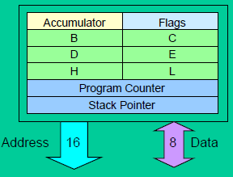
General Purpose Registers
B, C, D, E, H& L(8 bit registers)
Can be used singly
Or can be used as 16 bit register pairs
BC, DE, HL
H & L can be used as
a data pointer
(holds memory address)

Slide 25
General Purpose Registers
General Purpose Registers
B, C, D, E, H& L(8 bit registers)
Can be used singly
Or can be used as 16 bit register pairs
BC, DE, HL
H & L can be used as a data pointer (holds memory address)
Special Purpose Registers
Accumulator(8 bit register)
Store 8 bit data
Store the result of an operation
Store 8 bit data during I/O transfer

Slide 26
Program Counter
It is used to hold the address of next instruction to be executed.
It is a 16-bit register.
The microprocessor uses this register to sequence the execution of the instructions.
The microprocessor increments the value of Program Counter after the execution of the current instruction, so that, it always points to the next instruction.

Slide 27
Stack Pointer
It holds the address of top most item in the stack. The stack is a reserved area of memory in the RAM
It is also 16-bit register.
Any portion of memory can be used as stack.
This register is always decremented/incremented by 2 during push and pop.
The stack is usually accessed in a Last In First Out (LIFO) fashion.

Slide 28
Increment/Decrement Register
This register is used to increment or decrement the value of Stack Pointer or program counter as a part of execution of instructions.
During PUSH operation, the value of Stack Pointer is incremented.
During POP operation, the value of Stack Pointer is decremented.

Slide 29
Address Latch
It is a unidirectional 8-bit buffer.
The upper-byte of 16-bit address is stored in this latch. And then it is made available to the peripheral devices.
It is used to drive external high order address bus(A15-A0).
It is also used to tri-state the high order address bus under certain conditions such as
Reset, hold, halt and when address lines are is not in use.

Slide 30
Address/Data Latch
The lower-byte of address and 8-bit of data are multiplexed.
It holds either lower-byte of address or 8-bits of data.
This is decided by ALE (Address Latch Enable) signal.
If ALE = 1 then
Address/Data Latch contains lower-byte of address.
If ALE = 0 then
It contains 8-bit data.

Slide 31
Tri-State Buffers
An important circuit element that is used extensively in memory.
This buffer is a logic circuit that has three states:
Logic 0, logic1, and high impedance.
When this circuit is in high impedance mode it looks as if it is disconnected from the output completely.
The Output is Low
The Output is High
High Impedance

Slide 32
The Tri-State Buffer
This circuit has two inputs and one output.
The first input behaves like the normal input for the circuit.
The second input is an “enable”.
If it is set high, the output follows the proper circuit behavior.
If it is set low, the output looks like a wire connected to nothing.
Input
Output
OR
Input
Output
Enable
Enable

Slide 33
Serial I/O Controller
It is used to convert parallel data into serial.
Microprocessor works with 8-bit parallel data.
Serial I/O devices works with serial transfer of data.
Therefore, this unit is the interface between microprocessor and serial I/O devices.

Slide 34
Interrupt Controller
It is used to handle the interrupts.
There are 5 interrupt signals in 8085:
TRAP
RST 7.5
RST 6.5
RST 5.5
INTR
Interrupt controller receives these interrupts according to their priority and applies them to the microprocessor.
There is one outgoing signal INTA which is called Interrupt Acknowledge.

Slide 35
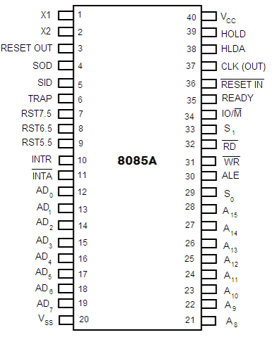
Pin Diagram of 8085

Slide 36
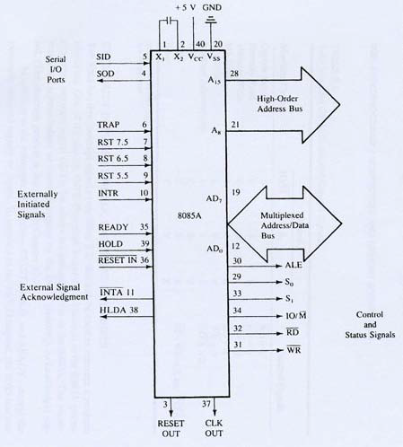
Pin description of 8085

Slide 37
Pin description
Higher Order Address pins- A₁₅ – A₈
Lower Order Address/ Data Pins- AD₇-AD₀
These are time multiplexed pins and are de-multiplexed using the pin ALE
Control Pins – RD, WR
These are active low Read & Write pins
Status Pins – ALE, IO/M (active low), S₁, S₀
ALE (Address Latch Enable)-Used to de-multiplex AD₇-AD₀
IO/M – Used to select I/O or Memory operation
S₁,S₀ – Denote the status of data on data bus
Interrupt Pins – TRAP, RST7.5, RST 6.5, RST 5.5, INTR, INTA
These are hardware interrupts used to initiate an interrupt service routine stored at predefined locations of the system memory.
Serial I/O pins – SID (Serial Input Data), SOD (Serial Output Data)
These pins are used to interface 8085 with a serial device.

Slide 38
Pin Description Contd…
Clock Pins- X₁, X₂, CLK(OUT)
X₁, X₂- These are clock input pins. A crystal is connected between these pins such that f_{crystal}= 2f₈₀₈₅ where f_{crystal}= crystal frequency & f₈₀₈₅ = operating frequency of 8085
CLK(OUT) – This is an auxiliary clock output source
Reset Pins – Reset In (active low), Reset Out
Reset In is used to reset 8085 whereas Reset Out can be used to reset other devices in the system
DMA (Direct Memory Access) pins – HOLD, HLDA
These pins are used when data transfer is to be performed directly between an external device and the main memory of the system.
Power Supply Pins - +V_{CC}, V_{SS}

Slide 39
The 8085 and Its Buses
The 8085 is an 8-bit general purpose microprocessor that can address 64K Byte of memory.
It has 40 pins and uses +5V for power. It can run at a maximum frequency of 3 MHz.
The pins on the chip can be grouped into 6 groups:
Address Bus.
Data Bus.
Control and Status Signals.
Power supply and frequency.
Externally Initiated Signals.
Serial I/O ports.

Slide 40
The Address and Data Busses
The address bus has 8 signal lines A8 – A15 which are unidirectional.
The other 8 address bits are multiplexed (time shared) with the 8 data bits.
So, the bits AD0 – AD7 are bi-directional and serve as A0 – A7 and D0 – D7 at the same time.
During the execution of the instruction, these lines carry the address bits during the early part, then during the late parts of the execution, they carry the 8 data bits.
In order to separate the address from the data, we can use a latch to save the value before the function of the bits changes.

Slide 41
The Control and Status Signals
There are 4 main control and status signals. These are:
ALE: Address Latch Enable.
This signal is a pulse that become 1 when the AD0 – AD7 lines have an address on them. It becomes 0 after that. This signal can be used to enable a latch to save the address bits from the AD lines.
RD: Read. Active low. - Read memory or IO device.
This indicates that the selected memory location or I/O device is to be read and that the data bus is ready for accepting data from the memory or I/O device
WR: Write. Active low. - Write memory or IO device.
This indicates that the data on the data bus is to be written into the selected memory location or I/O device.
IO/M: Select memory or an IO device.
This signal specifies whether the operation is a memory operation (IO/M=0) or an I/O operation (IO/M=1).
It goes high to indicate an I/O operation.
It goes low for memory operations.
S1 and S0 : Status signals
to specify the kind of operation being performed.
This status signal indicates that the read / write operation relates to whether the memory or I/O device.

Slide 42
Status Signals(S1 and S0 )
It is used to know the type of current operation of the microprocessor.
IO/M | S1 | S0 | OPERATION
0 | 1 | 1 | Opcode fetch
0 | 1 | 0 | Memory read
0 | 0 | 1 | Memory write
1 | 1 | 0 | I/O read
1 | 0 | 1 | I/O write
1 | 1 | 0 | Interrupt acknowledge
Z | 0 | 1 | Halt
Z | x | x | Hold
Z | x | x | Reset

Slide 43
Power supply and Clock frequency signals:
Vcc: + 5 volt power supply
Vss: Ground
X1, X2 :
Crystal or R/C network or LC network connections to set the frequency of internal clock generator. The frequency is internally divided by two. Since the basic operating timing frequency is 3 MHz, a 6 MHz crystal is connected externally.
CLK (Output)
Clock Output is used as the system clock for peripheral and devices interfaced with the microprocessor.

Slide 44
Frequency Control Signals
There are 3 important pins in the frequency control group.
X0 and X1 are the inputs from the crystal or clock generating circuit.
The frequency is internally divided by 2.
So, to run the microprocessor at 3 MHz, a clock running at 6 MHz should be connected to the X0 and X1 pins.
CLK (OUT): An output clock pin to drive the clock of the rest of the system.
We will discuss the rest of the control signals as we get to them.

Slide 45
The 8085 Interrupts
The 8085 has 5 interrupt inputs.
The INTR input.
The INTR input is the only non-vectored interrupt.
INTR is maskable using the EI/DI instruction pair.
RST 5.5, RST 6.5, RST 7.5 are all automatically vectored.
RST 5.5, RST 6.5, and RST 7.5 are all maskable.
TRAP is the only non-maskable interrupt in the 8085
TRAP is also automatically vectored

Slide 46
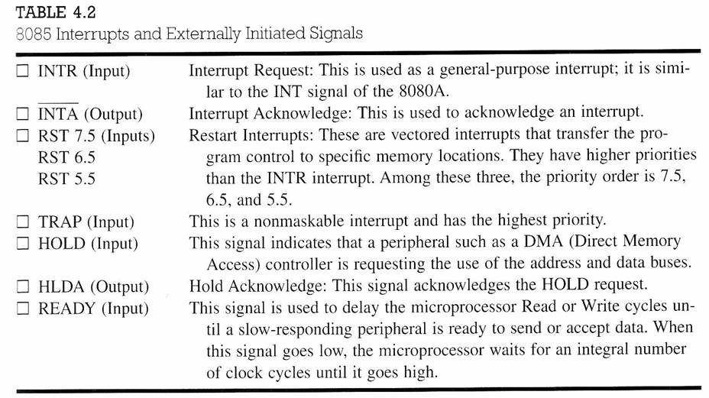
Interrupt Signals
8085 μp has several interrupt signals as shown in the following table.

Slide 47
Serial communication Signal
SID - Serial Input Data Line:
The data on this line is loaded into accumulator bit 7 whenever a RIM instruction is executed.
SOD – Serial Output Data Line:
The SIM instruction loads the value of bit 7 of the accumulator into SOD latch if bit 6 (SOE) of the accumulator is 1.

Slide 48
Reset signals
Reset In (input, active low)
This signal is used to reset the microprocessor.
The program counter inside the microprocessor is set to zero.
The buses are tri-stated.
Reset Out (Output)
It indicates CPU is being reset.
Can be used as a system RESET. The signal is synchronized to the processor clock.
Used to reset all the connected devices when the microprocessor is reset.

Slide 49
Demultiplexing AD7-AD0
From the above description, it becomes obvious that the AD7–AD0 lines are serving a dual purpose and that they need to be demultiplexed to get all the information.
The high order bits of the address remain on the bus for three clock periods. However, the low order bits remain for only one clock period and they would be lost if they are not saved externally. Also, notice that the low order bits of the address disappear when they are needed most.
To make sure we have the entire address for the full three clock cycles, we will use an external latch to save the value of AD7–AD0 when it is carrying the address bits. We use the ALE signal to enable this latch.

Slide 50
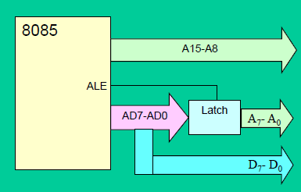
Demultiplexing AD7-AD0
Given that ALE operates as a pulse during T1, we will be able to latch the address. Then when ALE goes low, the address is saved and the AD7–AD0 lines can be used for their purpose as the bi-directional data lines.

Slide 51
Demultiplexing the Bus AD7–AD0
The high order address is placed on the address bus and hold for 3 clk periods,
The low order address is lost after the first clk period, this address needs to be hold however we need to use latch
The address AD7 –AD0 is connected as inputs to the latch 74LS373.
The ALE signal is connected to the enable (G) pin of the latch and the OC –Output control –of the latch is grounded

Slide 52
