Slide 1
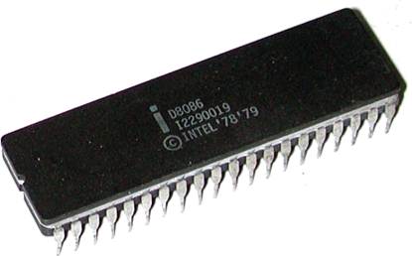
16 Bit Microprocessor Intel 8086
Presented By
M. Mahesh Babu

Slide 2
8086 Overview
Introduced in 1978.
Having Total 40 Pins.
Having Address Bus of 20 bit.
Having Data Bus of 16 bit.
HMOS Microprocessor.
Consumes Low Power.
Clock Frequencies of 5,8 &10 MHz.
Contains About 29000 Transistors.
Can Address up to 1 Mbytes of Memory.
It has more than 20,000 instructions.
Provides fourteen 16-Bit registers.

Slide 3
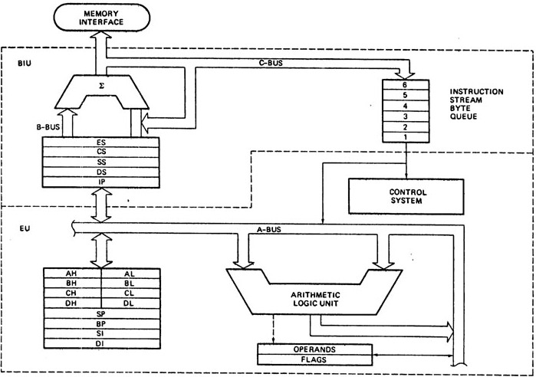
8086 Architecture

Slide 4
8086 Internal Architecture
8086 internal Architecture contains mainly following two units.
(1). BIU (Bus Interface Unit).
(2). EU (Execution Unit).
BIU contains Instruction queue, Segment registers, Instruction pointer, etc.
EU contains Control circuitry, Instruction decoder, ALU,Pointer and Index register, Flag register,etc.

Slide 5
Bus Interface Unit (BIU)
Following functions are supported by BIU.
(1). It provides a full 16 bit bidirectional data bus and 20 bit address bus.
(2). It sends address of memory or I/O.
(3). It fetches instruction from memory.
(4). It reads data from port/memory.
(5). It writes data into port/memory.
(6). It supports instruction queuing .
(7). It makes 8086’s interface to the outside world.
(8). The BIU uses a mechanism known as an instruction stream queue to implement a pipeline architecture.
(9). If the BIU is already in the process of fetching an instruction when the EU request it to read or write operands from memory or I/O, the BIU first completes the instruction fetch bus cycle before initiating the operand read / write cycle.
(10). The BIU also contains a dedicated adder which is used to generate the 20bit physical address.

Slide 6
Execution Unit (EU)
Following functions are supported by EU.
(1). The Execution unit is responsible for decoding and executing all instructions.
(2). The EU extracts instructions from the top of the queue in the BIU.
(3). During the execution of the instruction, the EU tests the status and control flags and updates them based on the results of executing the instruction.
(4). If the queue is empty, the EU waits for the next instruction byte to be fetched and shifted to top of the queue.
(5). The EU accesses the queue from the output end. It reads one instruction byte after the other from the output of the queue.
(6). It tells BIU from where to fetch instructions or data, decodes instructions & execute instructions.

Slide 7
8086’s Fourteen 16-Bit Registers
ES
Extra Segment
_{BIU registers}
_{(20 bit adder)}
CS
Code Segment
SS
Stack Segment
DS
Data Segment
IP
Instruction Pointer
AX
AH
AL
Accumulator
BX
BH
BL
Base Register
CX
CH
CL
Count Register
DX
DH
DL
Data Register
SP
Stack Pointer
BP
Base Pointer
_{EU registers}
_{16 bit arithmetic}
SI
Source Index Register
DI
Destination Index Register
FLAGS

Slide 8
Instruction Queue
It is of 6 Bytes.
To increase the execution speed, BIU fetches as many as six instruction bytes ahead to time from memory.
It operates on the principle first in first out (FIFO).
Then all bytes are given to EU one by one.
This pre-fetching operation of BIU may be in parallel with execution operation of EU.
It improves the execution speed of the instruction.

Slide 9
Registers of 8086
Intel 8086 contains following registers:
General Purpose Registers
Pointer and Index Registers
Segment Registers
Instruction Pointer
Status Flags

Slide 10
General Purpose Registers
There are four 16-bit general purpose registers:
AX
BX
CX
DX

Slide 11
General Purpose Registers
Each of these 16-bit registers are further subdivided into two 8-bit registers.
AX
BX
CX
DX
AH | AL
BH | BL
CH | CL
DH | DL

Slide 12
General Purpose Registers
AX Register: AX register is also known as accumulator register that stores operands for arithmetic operation like divided, rotate.
BX Register: This register is mainly used as a base register. It holds the starting base location of a memory region within a data segment.
CX Register: It is defined as a counter. It is primarily used in loop instruction to store loop counter.
DX Register: DX register is used to contain I/O port address for I/O instruction.

Slide 13
Register | Purpose
AX | Word multiply, word divide, word I /O
AL | Byte multiply, byte divide, byte I/O, decimal arithmetic
AH | Byte multiply, byte divide
BX | Store address information
CX | String operation, loops
CL | Variable shift and rotate
DX | Word multiply, word divide, indirect I/O (Used to hold I/O address during I/O instructions. If the result is more than 16-bits, the lower order 16-bits are stored in accumulator and higher order 16-bits are stored in DX register)

Slide 14
Pointer & Index Register
Following four registers are under this category:
(1). Stack Pointer (SP),
(2). Base Pointer (BP),
(3). Source Index (SI),
(4). Destination Index (DI).

Slide 15
Pointer & Index Register
used to keep offset addresses.
Used in various forms of memory addressing.
In the case of SP and BP the default reference to form a physical address is the Stack Segment (SS-will be discussed under the BIU)
The index registers (SI & DI) and the BX generally default to the Data segment register (DS).
SP: Stack pointer
– Used with SS to access the stack segment
BP: Base Pointer
– Primarily used to access data on the stack
– Can be used to access data in other segments

Slide 16
Pointer & Index Register
Following Registers can also be used as a general Purpose Registers.
(1). Stack Pointer (SP) is a 16-bit register pointing to program Stack, also contains 16-Bit offset address.
(2). Base Pointer (BP) is a 16-bit register pointing to data in stack segment. BP register is usually used for based indexed or register indirect addressing.
(3). Source Index (SI) is a 16-bit register. SI is used for indexed, based indexed and register indirect addressing, as well as a source data address in string manipulation Instructions
(4). Destination Index (DI) is a 16-bit register. DI is used for indexed, based indexed and register indirect addressing, as well as a destination data address in string manipulation instructions.

Slide 17
Pointer & Index Register
SI: Source Index register
– is required for some string operations
– When string operations are performed, the SI register points to memory locations in the data segment which is addressed by the DS register. Thus, SI is associated with the DS in string operations.
DI: Destination Index register
– is also required for some string operations.
– When string operations are performed, the DI register points to memory locations in the data segment which is addressed by the ES register. Thus, DI is associated with the ES in string operations.
The SI and the DI registers may also be used to access data stored in arrays

Slide 18
Segment Register
There are four segment registers in Intel 8086:
(1). Code Segment Register (CS),
(2). Data Segment Register (DS),
(3). Stack Segment Register (SS),
(4). Extra Segment Register (ES).

Slide 19
Segment Register
A segment register points to the starting address of a memory segment.
For e.g.:
The code segment register points to the starting address of the code segment.
The data segment register points to the starting address of the data segment, and so on.
The maximum capacity of a segment may be up to 64 KB.

Slide 20
Segment Register
Code segment (CS):-
It is a 16-bit register containing address of 64 KB segment with processor instructions.
The processor uses CS segment for all accesses to instructions referenced by instruction pointer (IP) register.
CS register cannot be changed directly. The CS register is automatically updated during far jump, far call and far return instructions

Slide 21
Segment Register
Stack segment (SS):-
it is a 16-bit register containing address of 64KB segment with program stack.
By default, the processor assumes that all data referenced by the stack pointer (SP) and base pointer (BP) registers is located in the stack segment.
SS register can be changed directly using POP instruction.

Slide 22
Segment Register
Data segment (DS):-
It is a 16-bit register containing address of 64KB segment with program data.
By default, the processor assumes that all data referenced by general registers (AX, BX, CX, DX) and index register (SI, DI) is located in the data segment.
DS register can be changed directly using POP and LDS instructions.

Slide 23
Segment Register
Extra segment (ES):-
It is a 16-bit register containing address of 64KB segment, usually with program data.
By default, the processor assumes that the DI register references the ES segment in string manipulation instructions.
ES register can be changed directly using POP and LES instructions.
It is possible to change default segments used by general and index registers by prefixing instructions with a CS, SS,DS or ES prefix.

Slide 24
Concept of Segmented Memory
It allows the memory addressing capacity to be 1 Mbytes.
It allows instruction code, data and stack portion of program to be more than 64KB long.
It facilitates use of separate memory areas for program, data and stack.
It permits a program or its data to be put in different areas of memory
In this program can be relocated which is very useful in multiprogramming i.e. multitasking becomes easy.

Slide 25
Concept of Segmented Memory
FFFFFH
Highest Address
7FFFFH
Top Of Extra Segment
64KB
Extra Segment Base ES=7000H
5FFFFH
Top Of Stack Segment
64KB
50000H
Stack Segment Base SS=5000H
4489FH
Top Of Code Segment
64KB
348A0H
Code Segment Base CS=348AH
2FFFFH
Top Of Data Segment
64KB
20000H
Bottom Of Data Segment

Slide 26
Physical Memory
Code segment (64KB)
Data segment (64KB)
Extra segment (64KB)
Stack segment (64KB)
00000
The memory in an 8086/88 based system is organized as segmented memory.
The CPU 8086 is able to address 1Mbyte of memory.
The Complete physically available memory may be divided into a number of logical segments.
1 MB
FFFFF

Slide 27
HARDWARE ORGANIZATION OF MEMORY ADDRESS SPACE
The memory address space of the 8086-based microcomputers has different logical and physical organizations.
Logically, memory is implemented as a single 1M × 8 memory chunks. The byte-wide storage locations are assigned consecutive addresses over the range from 0000016 through FFFFF16.
Physically, memory is implemented as two independent 512Kbyte banks: the low (even) bank and the high (odd) bank. Data bytes associated with an even address (0000016, 0000216, etc.) reside in the low bank, and those with odd addresses (0000116, 0000316, etc.) reside in the high bank.
Address bits A1 through A19 select the storage location that is to be accessed. They are applied to both banks in parallel. A0 and bank high enable (BHE) are used as bank-select signals.
Each of the memory banks provides half of the 8086's 16-bit data bus. The lower bank transfers bytes of data over data lines D0 through D7, while data transfers for a high bank use D8 through D15.

Slide 28
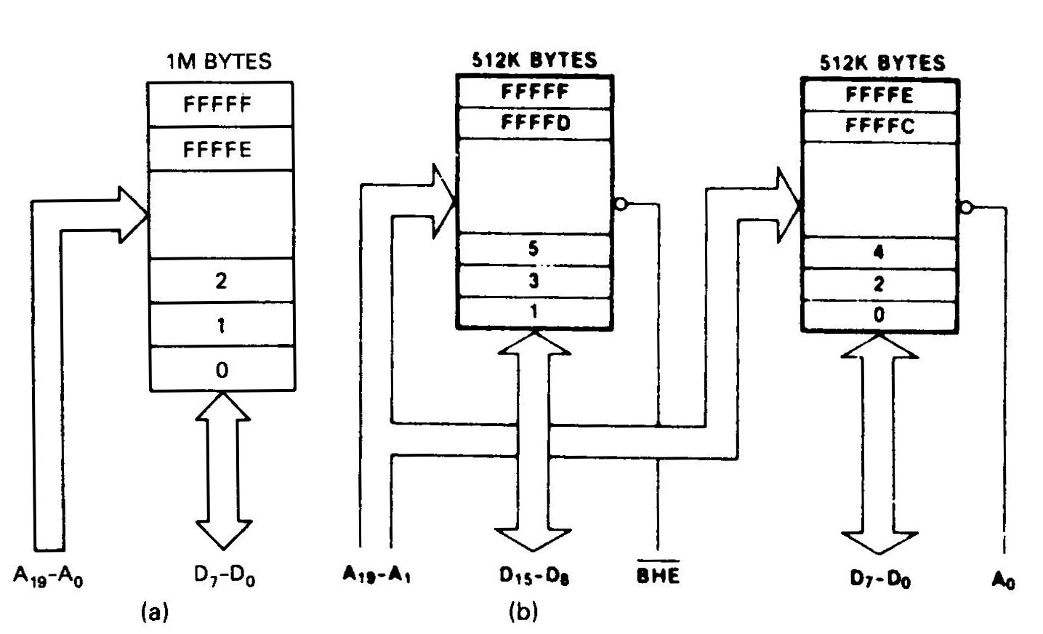
HARDWARE ORGANIZATION OF MEMORY ADDRESS SPACE
Figure: (a) Logical memory organization, and (b) Physical memory organization(high and low memory banks) of the 8086 microprocessor.

Slide 29
Default Segment Registers
Type of reference | Default segment | Alternative segment | Offset (logical address)
Instruction fetch | CS | - | IP
Stack operations | SS | - | SP
General data | DS | CS,ES,SS | Effective address
String source | DS | CS,ES,SS | SI
String destination | ES | - | DI
BX used as pointer | DS | CS,ES,SS | Effective address
BP used as pointer | SS | CS,ES,DS | Effective address

Slide 30
Instruction Pointer
The Instruction Pointer (IP) in 8086 acts as a Program Counter.
It points to the address of the next instruction to be executed.
Its content is automatically incremented when the execution of a program proceeds further.
The contents of the IP and Code Segment Register are used to compute the memory address of the instruction code to be fetched.
This is done during the Fetch Cycle.

Slide 31
Status Flags
Status Flags determines the current state of the accumulator.
They are modified automatically by CPU after mathematical operations.
This allows to determine the type of the result.
8086 has 16-bit status register.
It is also called Flag Register or Program Status Word (PSW).
A flag is a flip flop which indicates some conditions produced by the execution of an instruction or controls certain operations of the EU .
There are nine status flags and seven bit positions remain unused.

Slide 32
Flag Register (PSW)
15
14
13
12
11
10
09
08
07
06
05
04
03
02
01
00
 |  |  |  | OF | DF | IF | TF | SF | ZF |  | AF |  | PF |  | CF
Carry Flag
Undefined
Parity Flag
Auxiliary Carry Flag
Zero Flag
Sign Flag
Trap Flag
Interrupt Flag
Direction Flag
Overflow Flag

Slide 33
Flag Register (PSW)
8086 has 9 flags and they are divided into two categories:
(1). Condition Flags
(2). Control Flags

Slide 34
Flag Register (PSW)
Following are the nine flags:
Condition Flags | Control Flags
1. Carry Flag | 1. Trap Flag
2. Auxiliary Carry Flag | 2. Interrupt Flag
3. Zero Flag | 3. Directional Flag
4. Sign Flag
5. Parity Flag
6. Overflow Flag

Slide 35
Flag Register (PSW)
Overflow Flag (OF): It occurs when signed numbers are added or subtracted. An OF indicates that the result has exceeded the capacity of machine.
Trap Flag (TP): It is used for single step control.
It allows user to execute one instruction of a program at a time for debugging.
When trap flag is set, program can be run in single step mode.
Interrupt Flag (IF): It is an interrupt enable / disable flag.
If it is set, the INTR interrupt of 8086 is enabled and if it is reset then INTR is disabled.
It can be set by executing instruction STI and can be cleared by executing CLI instruction.
Direction Flag (DF): It is used in string operation.
If it is set, string bytes are accessed from higher memory address to lower memory address.
When it is reset, the string bytes are accessed from lower memory address to higher memory address.
It is set with STD instruction and cleared with CLD instruction.

Slide 36
Flag Register (PSW)
Flag | Purpose
Carry (CF) | Holds the carry after addition or the borrow after subtraction. Also indicates some error conditions, as dictated by some programs and procedures .
Parity (PF) | PF=0;odd parity, PF=1;even parity.
Auxiliary (AF) | Holds the carry (half – carry) after addition or borrow after subtraction between bit positions 3 and 4 of the result (for example, in BCD addition or subtraction.)
Zero (ZF) | Shows the result of the arithmetic or logic operation. Z=1; result is zero. Z=0; The result is 0
Sign (SF) | Holds the sign of the result after an arithmetic/logic instruction execution. S=1; negative, S=0

Slide 37
Flag Register (PSW)
Flag | Purpose
Trap (TF) | A control flag. Enables the trapping through an on-chip debugging feature.
Interrupt (IF) | A control flag. Controls the operation of the INTR (interrupt request) I=0; INTR pin disabled. I=1; INTR pin enabled.
Direction (DF) | A control flag. It selects either the increment or decrement mode for DI and /or SI registers during the string instructions.
Overflow (OF) | Overflow occurs when signed numbers are added or subtracted. An overflow indicates the result has exceeded the capacity of the Machine

Slide 38
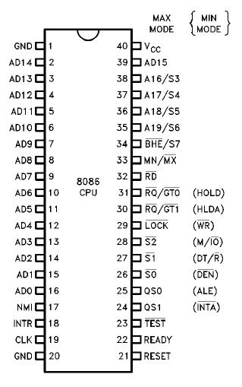
Pin Diagram of 8086
8086
Pin Diagram

Slide 39
Function Of Pins of 8086
AD15-AD0: These are the time multiplexed memory I/O address and data lines.
A19/S6,A18/S5,A17/S4,A16/S3: These are the time multiplexed address and status lines.
During T1 these are the most significant address lines for memory operations.
During I/O operations, these lines are low.
The S4 and S3 combination indicates which segment register is presently being used for memory accesses.

Slide 40
Function Of Pins of 8086
S4 Pin | S3 Pin | Indication
0 | 0 | Alternate data
0 | 1 | Stack
1 | 0 | Code or None
1 | 1 | Data
BHE (Bus High Enable) /S7: The bus high enable is used to indicate the transfer of data over the higher order ( D15-D8 ) data bus.
BHE Pin | A0 Pin | Indication
0 | 0 | Whole Word
0 | 1 | Upper Byte from/to odd address
1 | 0 | Lower Byte from/to even address
1 | 1 | None

Slide 41
Function Of Pins of 8086
RD: This signal on low indicates the peripheral that the processor is performing memory or I/O read operation.
READY: This is the acknowledgement from the slow device or memory that they have completed the data transfer.
INTR-Interrupt Request: This is a triggered input. If any interrupt request is pending, the processor enters the interrupt acknowledge cycle. This can be internally masked by resulting the interrupt enable flag. This signal is active high and internally synchronized.

Slide 42
Function Of Pins of 8086
TEST: This input is examined by a ‘WAIT’ instruction. If the TEST pin goes low, execution will continue, else the processor remains in an idle state
CLK- Clock Input: The clock input provides the basic timing for processor operation and bus control activity.
MN/MX: The logic level at this pin decides whether the processor is to operate in either minimum or maximum mode.

Slide 43
Operating Modes Of 8086
8086 microprocessors can be configured to work in either of the two modes:
(1). Minimum Mode,
(2). Maximum Mode.
• Minimum mode:
– Pull MN/MX to logic 1
– Typically smaller systems and contains a single microprocessor
• Maximum mode:
– Pull MN/MX logic 0
– Larger systems with more than one microprocessor.

Slide 44
Minimum mode: The 8086 processor works in a single processor environment. All control signals for memory and I/O are generated by the microprocessor.
Maximum mode: designed to be used when a coprocessor exists in the system.
8086 works in a multiprocessor environment. Control signals for memory and I/O are generated by an external BUS Controller.

Slide 45
Common Signals In Both Mode

Slide 46
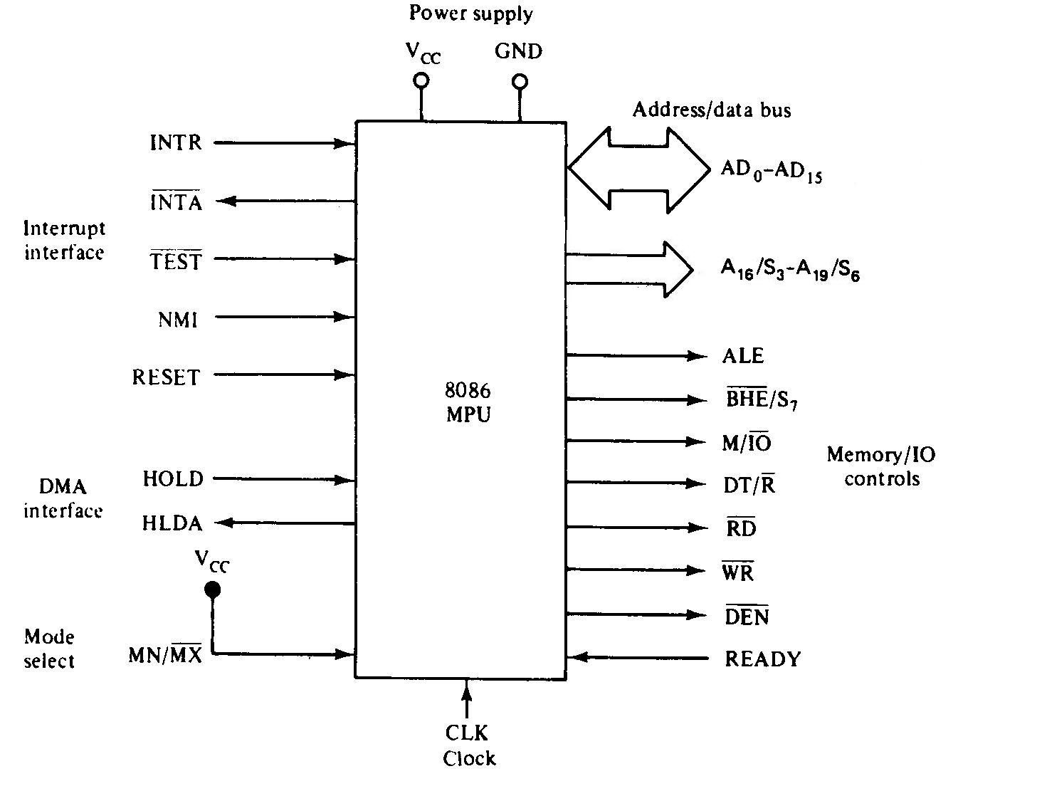
`
Signals In Minimum Mode

Slide 47
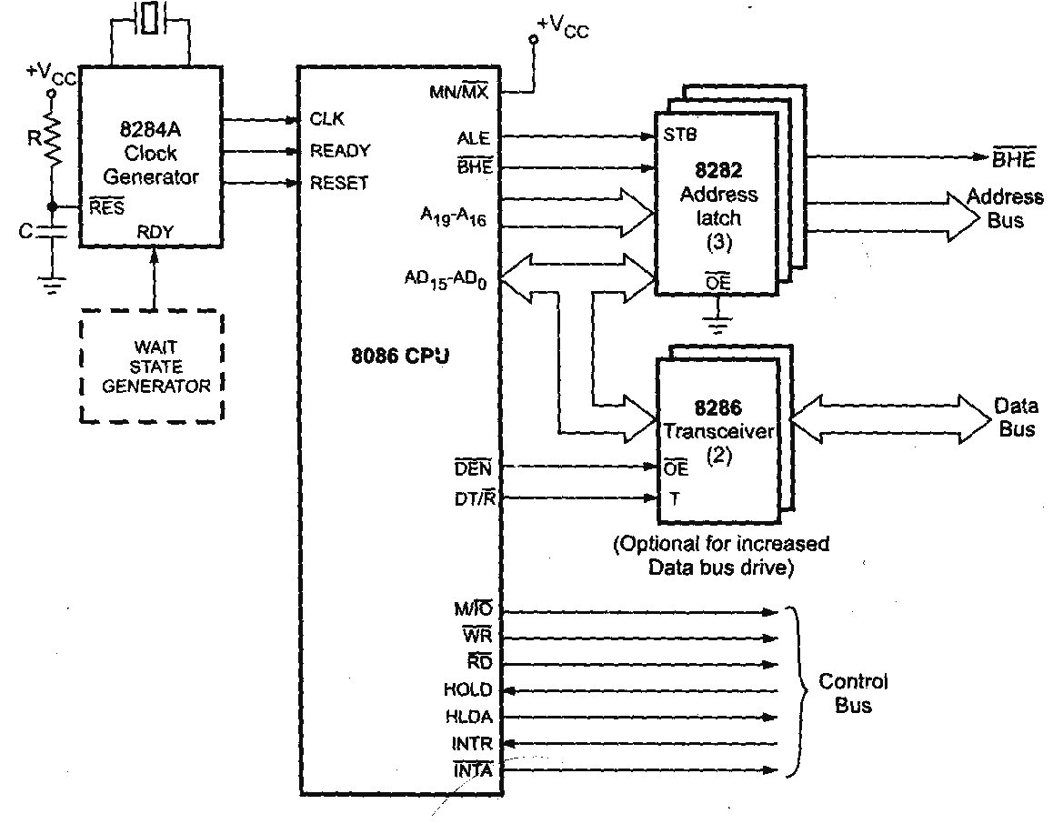
Minimum Mode 8086 System

Slide 48
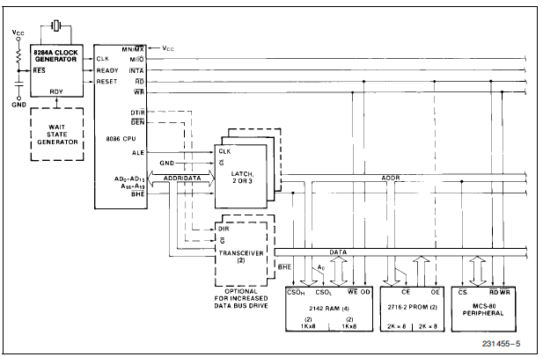
Minimum Mode 8086 Typical Configuration

Slide 49
Signals In Minimum Mode
- Address Latch Enable (ALE) is a pulse to logic 1 that signals external circuitry when a valid address is on the bus.
– IO/M line: Memory or I/O transfer is selected (complement for 8086).
– DT/R line: direction of data is selected.
– BHE (Bank High Enable) line : =0 for most significant byte of data for 8086 and also carries S7
– RD line: =0 when a read cycle is in progress.
– WR line: =0 when a write cycle is in progress.
– DEN line: (Data enable) Enables the external devices to supply data to the processor.
– Ready line: can be used to insert wait states into the bus cycle so that it is extended by a number of clock periods.

Slide 50
Signals In Minimum Mode
- INTR (Interrupt request): =1 shows there is a service request, sampled at the final clock cycle of each instruction acquisition cycle.
– INTA: Processor responds with two pulses going to 0 when it services the interrupt and waits for the interrupt service number after the second pulse.
– TEST: Processor suspends operation when =1. Resumes operation when=0. Used to synchronize the processor to external events.
– NMI (Non Maskable interrupt): A leading edge transition causes the processor go to the interrupt routine after the current instruction is executed.
– RESET: =0 Starts the reset sequence.

Slide 51
SYSTEM CLOCK
To synchronize the internal and external operations of the microprocessor a clock (CLK) input signal is used. The CLK can be generated by the 8284 clock generator IC.
8086 is manufactured in three speeds
5MHz
8MHz
10MHz
8088 operates in two different speeds
5MHz
8MHz

Slide 52
SYSTEM CLOCK
For 8086, we connect either a 15-, 24- or 30-MHz crystal between inputs X1 and X2 inputs of the clock chip (see Fig. 8-11). The fundamental crystal frequency is divided by 3 within the 8284 to give either a 5-, 8- or 10-MHz clock signal, which is directly connected to the CLK input of the 8086.

Slide 53
BUS CYCLE AND TIME STATES
A bus cycle defines the sequence of events when the MPU communicates with an external device, which starts with an address being output on the system bus followed by a read or write data transfer.
Types of bus cycles:
Memory Read Bus Cycle
Memory Write Bus Cycle
Input/Output Read Bus Cycle
Input/Output Write Bus Cycle
During these operations, a series of control signal are also produced by the MPU to control the direction and timing of the bus.
The bus cycle of the 8086 microprocessor consists of at least four clock periods. These four time states are called T1, T2, T3 and T4.
These clock period are also called T-state.

Slide 54
BUS CYCLE AND TIME STATES
T-State:
A portion of an operation carried out in one system clock period is called as T-state.
The machine cycle and instruction cycle takes multiple clock periods.
Timing Diagram is a graphical representation. It represents the execution time taken by each instruction in a graphical format. The execution time is represented in T-states.
Instruction Cycle:
The time required to execute an instruction is called instruction cycle.
Machine Cycle:
The time required to access the memory or input/output devices is called machine cycle.

Slide 56
System Timing Diagrams
T-State:
One clock period is referred to as a T-State
T-State
An operation takes an integer number of T-States
CPU Bus Cycle:
A bus cycle consists of 4 or more T-States
T1
T2
T3
T4

Slide 57
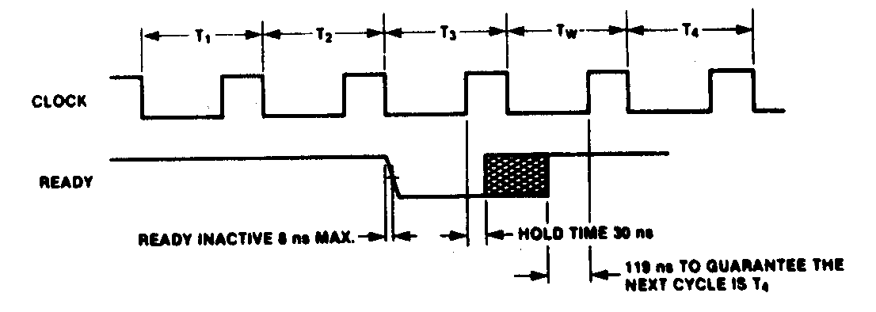

Slide 58
• T1
– Address placed on bus
– ALE active
• T2
– Change direction of Data bus for READ instructions
• T3-4
– Data transfer occurs

Slide 59
T1 - start of bus cycle. Actions include setting control signals to give the required values for ALE, DTR, IO/M putting a valid address onto the address bus.
T2 - the RD or WR control signals are issued, DEN is asserted and in the case of a write, data is put onto the data bus. The DEN turns on the data bus buffers to connect the CPU to the external data bus. The READY input to the CPU is sampled at the end of T2 and if READY is low, a wait state TW (one or more) is inserted before T3 begins.
T3 - this clock period is provided to allow memory to access the data. If
the bus cycle is a read cycle, the data bus is sampled at the end of T3.
T4 - all bus signals are deactivated in preparation for the next
clock cycle. The 8086/8088 also finishes sampling the data (in a read
cycle) in this period. For the write cycle, the trailing edge of the
WR signal transfers data to the memory or I/O, which activates
and write when WR returns to logic 1 level.

Slide 60
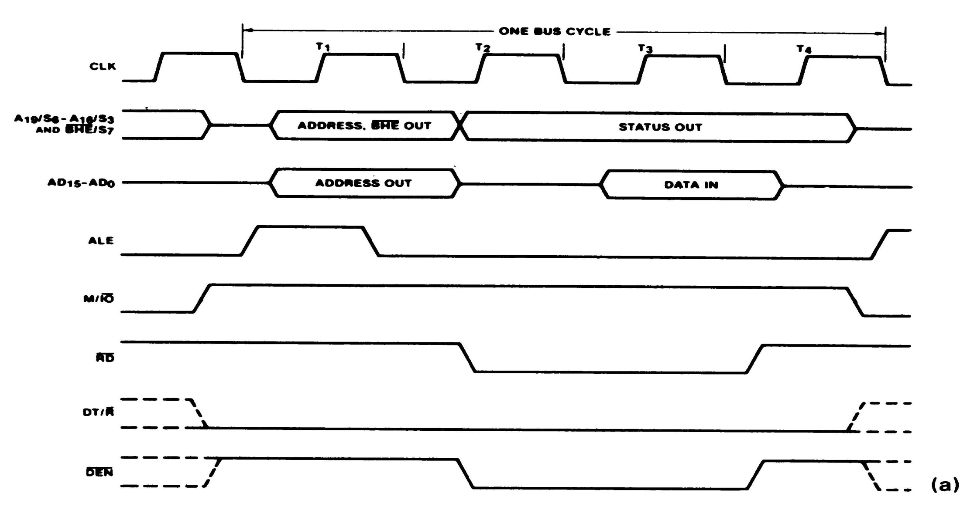
Minimum-mode memory read bus cycle of the 8086.

Slide 61
Minimum-mode memory read bus cycle of the 8086.
During period T1,
The 8086 outputs the 20-bit address of the memory location to be accessed on its multiplexed address/data bus. BHE is also output along with the address during T1.
At the same time a pulse is also produced at ALE. The trailing edge or the high level of this pulse is used to latch the address in external circuitry.
Signal M/IO is set to logic 1 and signal DT/R is set to the 0 logic level and both are maintained throughout all four periods of the bus cycle.

Slide 62
Minimum-mode memory read bus cycle of the 8086.
Beginning with period T2,
Status bits S3 through S6 are output on the upper four address bus lines. This status information is maintained through periods T3 and T4.
On the other hand, address/data bus lines AD0 through AD7 are put in the high-Z(impedance) state during T2.
Late in period T2, RD is switched to logic 0. This indicates to the memory subsystem that a read cycle is in progress. DEN is switched to logic 0 to enable external circuitry to allow the data to move from memory onto the microprocessor's data bus.

Slide 63
Minimum-mode memory read bus cycle of the 8086.
During period T3,
The memory must provide valid data during T3 and maintain it until after the processor terminates the read operation. The data read by the 8086 microprocessor can be carried over all 16 data bus lines
During T4,
The 8086 switches RD to the inactive 1 logic level to terminate the read operation. DEN returns to its inactive logic level late during T4 to disable the external circuitry.

Slide 64
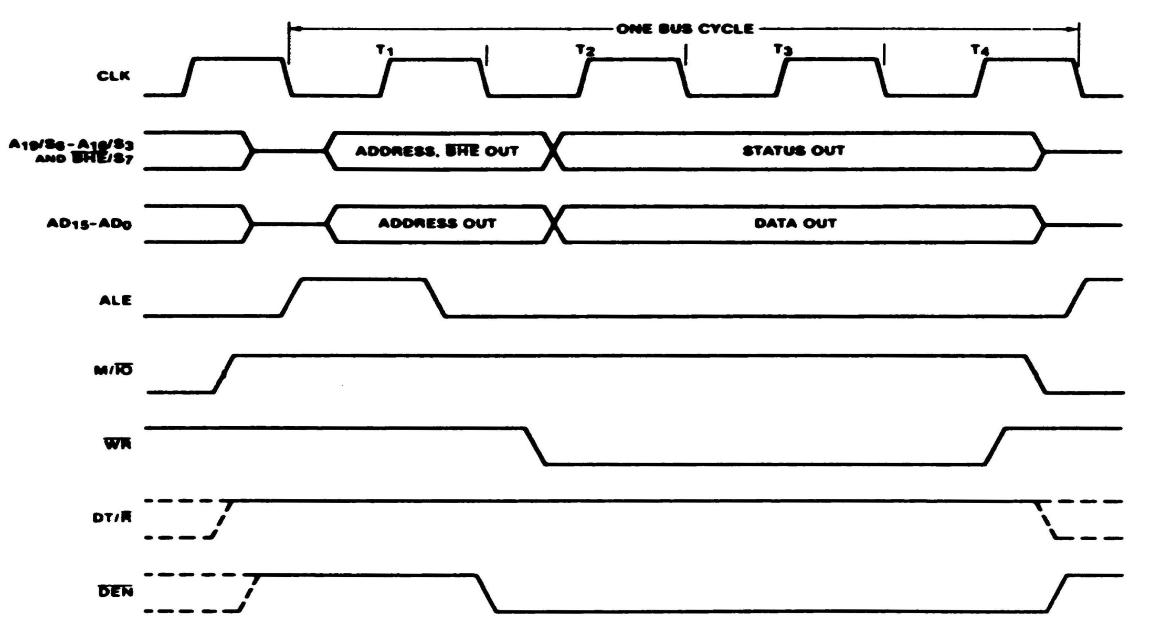
Minimum-mode memory write bus cycle of the 8086.

Slide 65
Minimum-mode memory write bus cycle of the 8086.
During period T1,
The address along with BHE are output and latched with the ALE pulse.
M/IO is set to logic 1 to indicate a memory cycle.
However, this time DT/R is switched to logic 1. This signals external circuits that the 8086 is going to transmit data over the bus.

Slide 66
Minimum-mode memory write bus cycle of the 8086.
Beginning with period T2,
WR is switched to logic 0 telling the memory subsystem that a write operation is to follow.
The 8086 puts the data on the bus late in T2 and maintains the data valid through T4. Data will be carried over all 16 data bus lines.
DEN enables the external circuitry to provide a path for data from the processor to the memory.

Slide 67
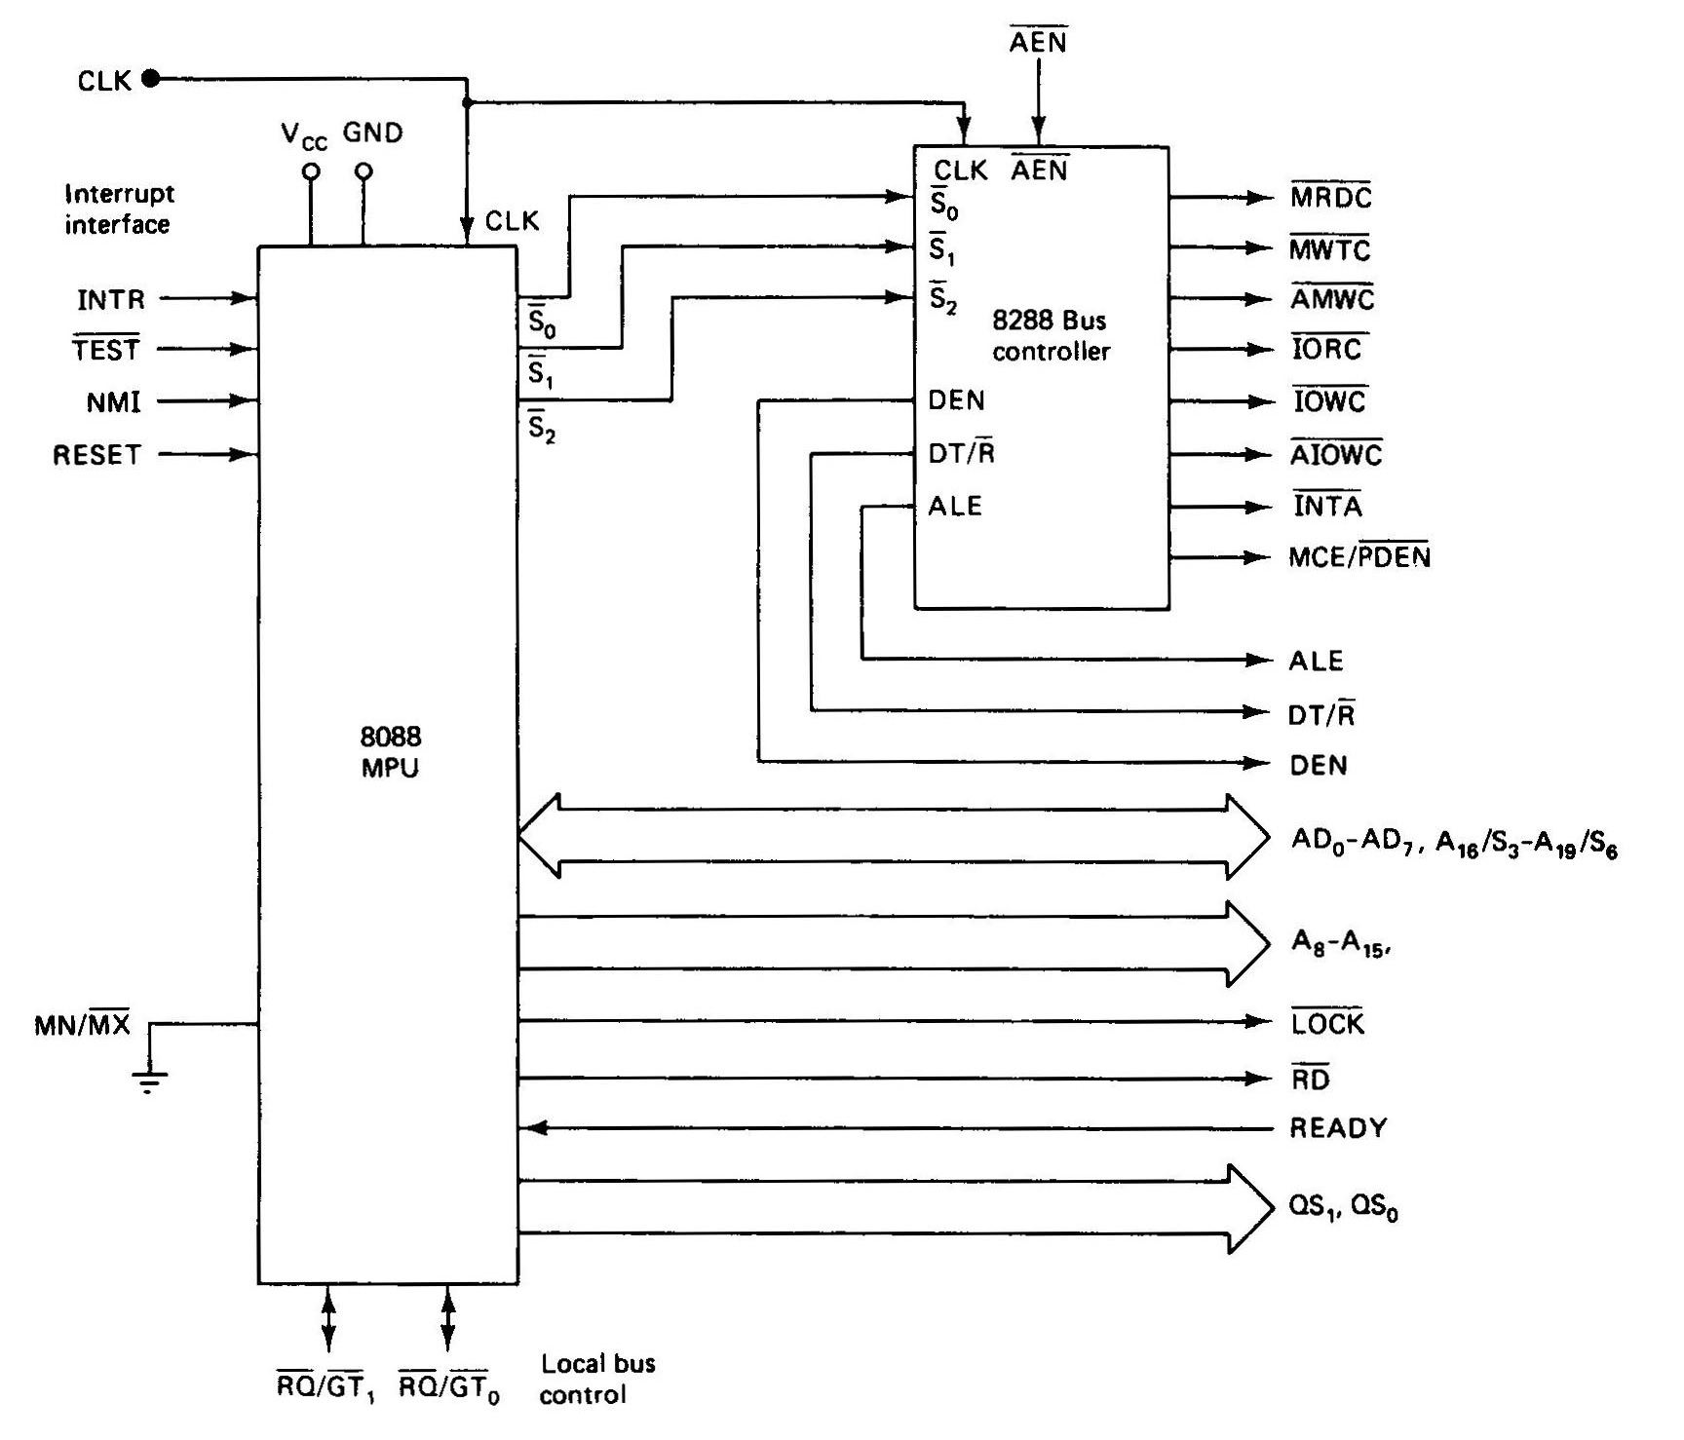
Signals In Maximum Mode

Slide 68
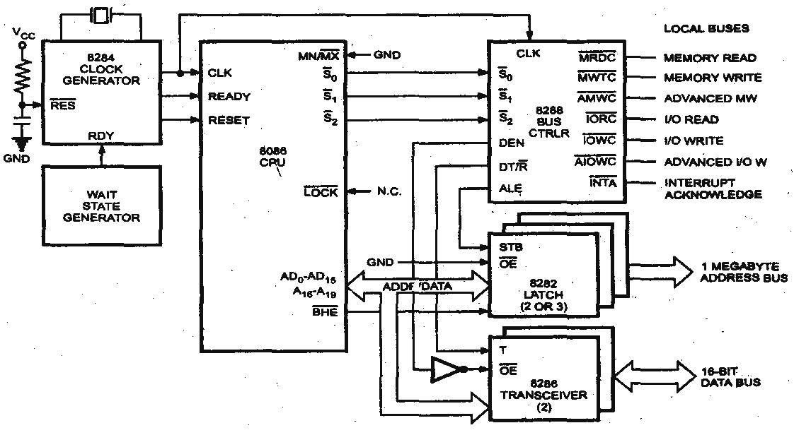
Maximum Mode 8086 System

Slide 69
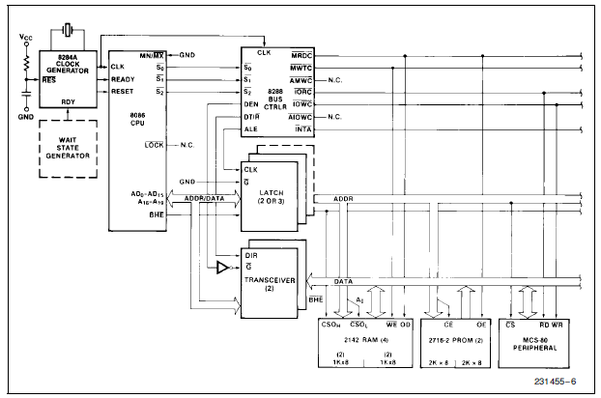
Maximum Mode 8086 Typical Configuration

Slide 70
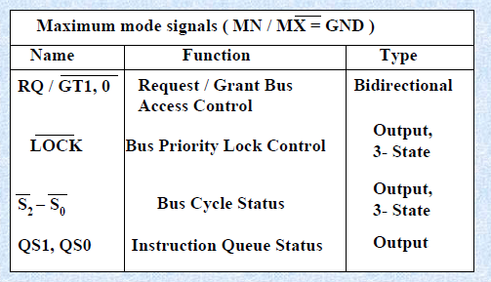
Signals In Maximum Mode

Slide 71
Signals In Maximum Mode
• LOCK: when=0, prevents other processors from using the bus
• QS0 and QS1 (queue status signals): informs about the status of the queue
• RQ/GT0 and RQ/GT1 are used instead of HOLD and HLDA lines in a multiprocessor environment as request/grant lines.
QS ¹ | QS⁰ | Indication
0 | 0 | No operation
0 | 1 | First byte of the opcode from the queue
1 | 0 | Empty queue
1 | 1 | Subsequent byte from the queue

Slide 72
Signals In Maximum Mode
• S2, S1, S0 – Status Lines: These are the status lines which reflect the type of operation, being carried out by the processor
S0 | S1 | S2 | Indication
0 | 0 | 0 | Interrupt Acknowledge
0 | 0 | 1 | Read I/O port
0 | 1 | 0 | Write I/O port
0 | 1 | 1 | Halt
1 | 0 | 0 | Code Access
1 | 0 | 1 | Read memory
1 | 1 | 0 | Write memory
1 | 1 | 1 | Passive

Slide 73
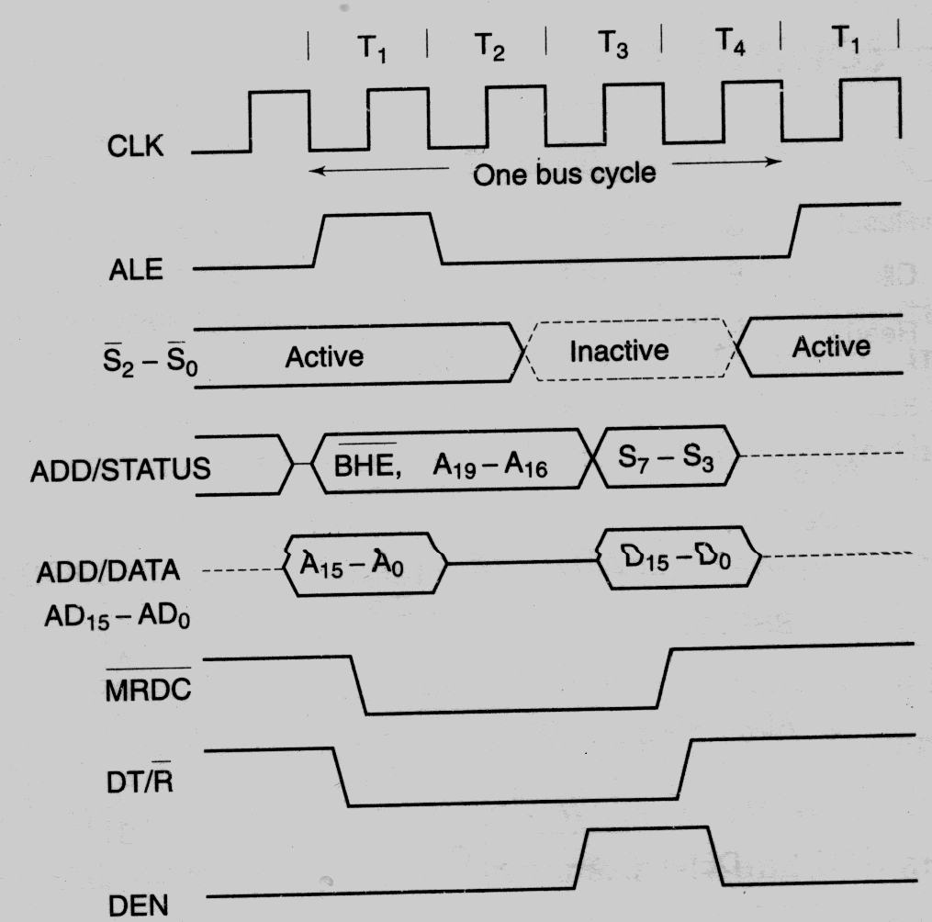
Memory Read Timing in Maximum Mode

Slide 74
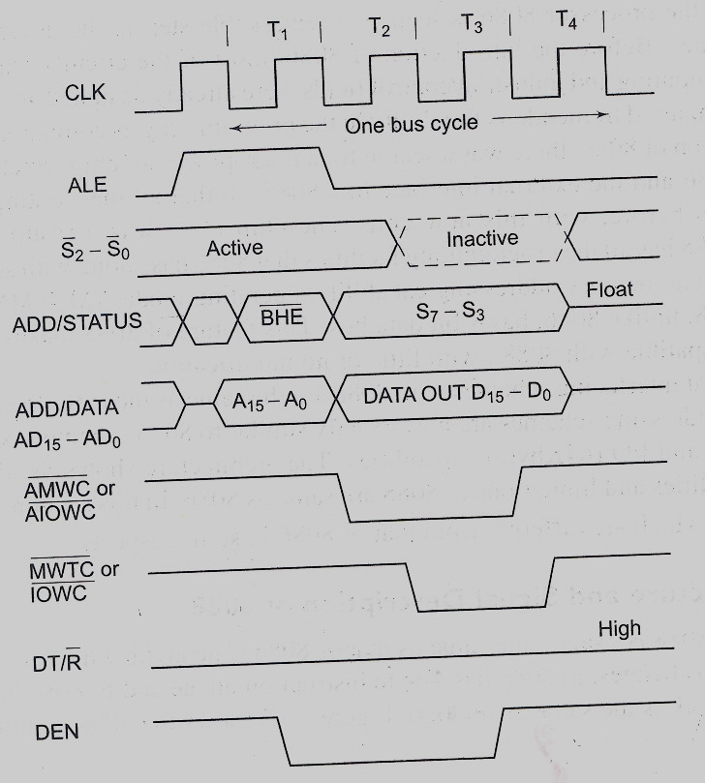
Memory Write Timing in Maximum Mode

Slide 75
Interrupts of 8086
What is an Interrupt?
Interrupt is a signal which has highest priority from hardware or software which processor should process its signal immediately.

Slide 76
Interrupt Mechanism and Types
Interrupts provide a mechanism for quickly changing program environment. Transfer of program control is initiated by the occurrence of either an event internal to the MPU or an event in its external hardware.
The section of program to which control is passed is called the interrupt service routine (ISR).
The 8088 and 8086 microprocessor are capable of implementing any combination of up to 256 interrupts.
Interrupts are divided into five groups:
External hardware interrupts
Nonmaskable interrupts
Software interrupts
Internal interrupts
reset

Slide 77
Interrupts of 8086
In early years of computing processor has to wait for the signal for processing, so processor has to check each and every hardware and software program in the system if it has any signal to process. This method of checking the signal in the system for processing is called polling method.
In this method the problem processor has to waste number of clock cycles just for checking the signal in the system, by this processor will become busy unnecessarily. If any signal came for the process, processor will take some time to process the signal due to the polling process in action. So system performance also will be degraded and response time of the system will also decrease.

Slide 78
Interrupts of 8086
So to over this problem engineers introduced a new mechanism, in this mechanism processor will not check for any signal from hardware or software but instead hardware/software will only send the signal to the processor for processing.
The signal from hardware or software should have highest priority because processor should leave the current process and process the signal of hardware or software.
This mechanism of processing the signal is called interrupt of the system.

Slide 79
Interrupts of 8086
Most microprocessors allow normal program execution to be interrupted by some external signal or by a special instruction in the program. In response to an interrupt the microprocessor stops executing its current program and calls a procedure which services the interrupt.
An IRET instruction at the end of the interrupt service procedure returns execution to the interrupted program.

Slide 80
interrupts of 8086
An 8086 interrupt can come from any one of three sources.
One source is an external signal applied to the non-maskable interrupt (NMI) input pin or to the interrupt input pin. An interrupt caused by a signal applied to one of these inputs is referred to as a hardware interrupt.
A second source of an interrupt is execution of the interrupt instruction. This is referred to as a software interrupt.
The third source of an interrupt is some error condition produced in the 8086 by the execution of an instruction.
An example of this is the divide by zero interrupt. If you attempt to divide an operand by zero, the 8086 will automatically interrupt the currently executing program.

Slide 81
Types of Interrupts
Although interrupts have highest priority than other signals, basic type of interrupts are
Hardware Interrupts: If the signal for the processor is from external device or hardware is called hardware interrupts. Example: from keyboard we will press the key to do some action this pressing of key in keyboard will generate a signal which is given to the processor to do action, such interrupts are called hardware interrupts.
Hardware interrupts can be classified into two types they are
Maskable Interrupt: The hardware interrupts which can be delayed when a much highest priority interrupt has occurred to the processor.
Non Maskable Interrupt: The hardware which cannot be delayed and should process by the processor immediately.

Slide 82
Types of Interrupts
Software Interrupts: Software interrupt can also divided in to two types. They are
Normal Interrupts: the interrupts which are caused by the software instructions are called software instructions.
Exception: unplanned interrupts while executing a program is called Exception. For example: while executing a program if we got a value which should be divided by zero is called a exception.

Slide 83
Interrupts of 8086
The 8086/8088 processor has the following interrupts:
External hardware interrupts
Non maskable interrupts
Software interrupts
Internal interrupts
Reset

Slide 84
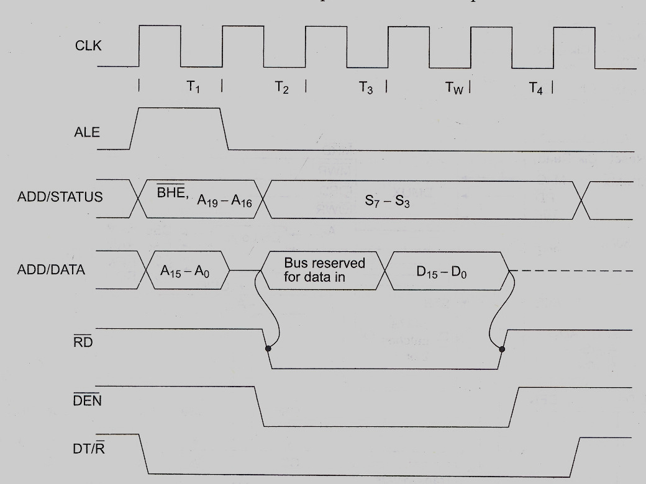
Read Cycle Timing Diagram for Minimum Mode

Slide 85
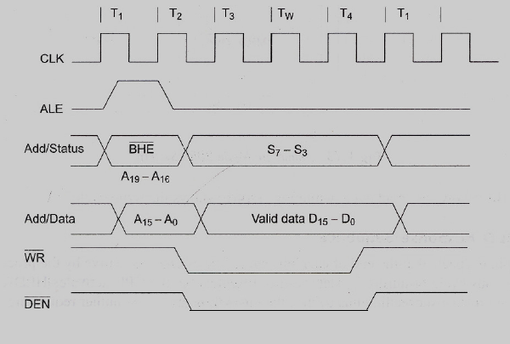
Write Cycle Timing Diagram for Minimum Mode

Slide 86
HOLD Response Sequence

Slide 87
Instruction Set of 8086

Slide 88
Assembly Language
There is a one-to-one relationship between assembly and machine language instructions
What is found is that a compiled machine code implementation of a program written in a high-level language results in inefficient code
More machine language instructions than an assembled version of an equivalent handwritten assembly language program
Two key benefits of assembly language programming
It takes up less memory
It executes much faster

Slide 89
Assembly Language Programming

Slide 90
Why do you Learn Assembly Language?
Learn how a processor works
Understand basic computer architecture
Explore the internal representation of data and instructions
Gain insight into hardware concepts
Allows creation of small and efficient programs
Allows programmers to bypass high-level language restrictions
Might be necessary to accomplish certain operations

Slide 91
Data Representation
Binary 0-1
represents the state of electronic components used in computer systems
Bit - Binary digit
Byte - 8 Bits
smallest addressable memory location (on the IBM-PC)
Word - 16 Bits
Each architecture may define its own “word size”
Double-word - 32 Bits
Quad-word - 64 Bits
Nibble - 4 Bits

Slide 92
Structure of an Assembly Language Statement
General structure of an assembly language statement
LABEL: INSTRUCTION ;COMMENT
Label—address identifier for the statement
Instruction—the operation to be performed
Comment—documents the purpose of the statement
Example:
START: ADD AX, BX ;adds contents of BX with AX

Slide 93
Structure of an Assembly Language Statement
All assembly instructions use the following format:
[label]: mnemonic [operands] [; comment]
Fields in square brackets are optional.

Slide 94
Label: used to represent either an identifier or a constant.
Mnemonic: Identifies the purpose of the statement. A Mnemonic is not required if a line contains only a label or a comment.
Operands: Specifies the data to be manipulated.
Comment: Text ignored by the assembler.

Slide 95
Instruction Assembly Notation
Each instruction is represented by a mnemonic that describes its operation—called its operation code (opcode)
MOV = move → data transfer
ADD = add → arithmetic
AND = logical AND → logic
JMP = unconditional jump → control transfer
Operands are the other parts of an assembly language Instructions
Identify whether the elements of data to be processed are in registers or memory
Source operand– location of one operand to be process
Destination operand—location of the other operand to be processed and the location of the result

Slide 96
Machine Language
A language of numbers, called the Processor’s Instruction Set
The set of basic operations a processor can perform
Each instruction is coded as a number
Instructions may be one or more bytes
Every number corresponds to an instruction

Slide 97
Machine Language

Slide 98
Continued …
Native language of the 8088/8086 (PC) is machine language (code)
One to one correspondence to assembly language statements
Instructions encoded with 0’s and 1’s
Machine instructions can take up from 1 to 6 bytes
Example: Move=MOV
The wide choice of register operands, memory operands, and addressing mode available to access operands in memory expands the move instruction to 28 different forms
Ranges in size from 2 to 6 bytes

Slide 99
Assembly Language vs Machine Language Programming
Machine Language Programming
Writing a list of numbers representing the bytes of machine instructions to be executed and data constants to be used by the program
Assembly Language Programming
Using symbolic instructions to represent the raw data that will form the machine language program and initial data constants

Slide 100
Software and the Program
Microcomputer is a general computation resource
Has the ability to process data, but does not know how the data is to be processed
Must be told:
Where to get information (data)?
What to do with the information?
Where to put the results?
This is the job of the program
Program: sequence of instructions that tells the computer what to do
Simple program—few instructions
Complex program—100Ks to millions of instructions
Microcomputer fetches and executes one instruction after the other
Instructions guide the microcomputer step by step through the task that is to be performed

Slide 101
Continued …
System software—a group of programs that enable the microcomputer to operate
The operating system (OS)
Windows2000, XP, VISTA,7
Linux etc.
Application programs—a collection of programs installed on the microcomputer for use by the operator.
Word
Excel
PowerPoint

Slide 102
Continued …
The sequence of commands used to tell a microcomputer what to do is called a program
Each command in a program is called an instruction
A program written in machine code is referred to as machine code
In 8086/8088 assembly language, each of the operations is described by alphanumeric symbols instead of just 0s or 1s.

Slide 103
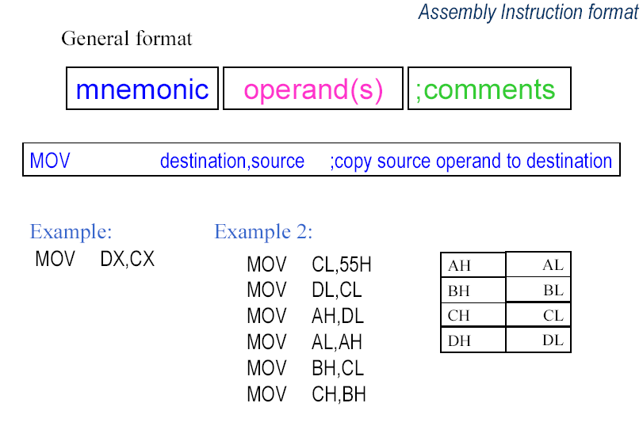

Slide 104
Assembler and the source program
Assembly language program
Assembly language program (.asm) file—known as source code
Converted to machine code by a process called assembling
Assembling performed by a software program—an 80x86 assembler
Machine (object ) code that can be run is output in the executable (.exe) file
Source listing output in (.lst) file—printed and used during execution and debugging of program
DEBUG—part of disk operating system (DOS) of the PC
Permits programs to be assembled and disassembled
Line-by-line assembler
Also permits program to be run and tested

Slide 105
8086 Instruction Format:
Instruction set
Defines the basic operations a programmer can make the microprocessor perform
8088/8086 instruction set contains 117 basic instructions

Slide 106
Instruction Set Design Parameters
What is the machine instruction length (fixed, variable, hybrid)?
Hybrid:
Operand storage in the CPU:
Number of explicit operands named per instruction:
Operand location:
Operations:
Type and size of operations:

Slide 107
Instruction Set Design Parameters
What is the machine instruction length (fixed, variable, hybrid)?
Hybrid: Multiple instruction sizes, but all have byte wide lengths— 1 to 6 bytes for 8086
Advantages of hybrid length
Allows for many addressing modes
Allows full size (16-bit) immediate data and addresses
Disadvantage of variable length
Requires more complicated decoding hardware—speed of decoding is critical in modern microprocessors.
Operand storage in the CPU: Where are operands kept other than in memory?
Registers
Number of explicit operands named per instruction: How many operands are named explicitly in a typical instruction?
2 (two) address machine

Slide 108
Continued …
Operand location: Can any ALU operand be located in memory or must some or all of the operands be internal storage in the CPU? If an operand is located in memory, how is the memory location specified?
Register-memory architecture, ALU operations allowed for 1memory operand also.
Specific memory addressing modes implemented.
Operations: What operations are provided in the instruction set?
Data movement, arithmetic/logic, flow control, string
Type and size of operations: What is the type and size of each operand and how is it specified?
The operand type is defined by the operation code.
The size of operand depends on bit W in the operation code field.

Slide 109
Information that must be coded into the instruction
Operation code—opcode
Source(s) and destination registers
Size of data-W
Addressing mode for the source or destination
Registers used in address computation
Immediate address displacement: How many bytes? 1-2
Immediate data: How many bytes? 1-2

Slide 110
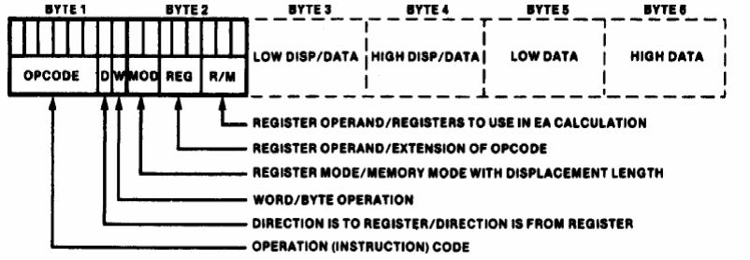
8086 General Instruction Format
The 8086 instruction sizes vary from one to six bytes. The OP code occupies six bytes and it defines the operation to be carried out by the instruction.

Slide 111
8086 General Instruction Format
There are six general formats of instructions in 8086 instruction set. The length of an instruction may vary from one byte to six bytes.
The instruction formats are described as follows:
One byte Instruction
Register to Register
Register to/from Memory with no Displacement
Register to/from Memory with Displacement
Immediate Operand to Register
Immediate Operand to Memory with 16-bit Displacement

Slide 112
8086 General Instruction Format
The instruction formats are described as follows:
One byte Instruction:
This format is only one byte long and may have the implied data or register operands. The least significant 3-bits of the opcode are used for specifying the register operand, if any. Otherwise, all the 8-bits form an opcode and the operands are implied.

Slide 113
Continued ...
Register to Register:
This format is 2 bytes long. The first byte of the code specifies the operation code and width of the operand specified by w bit. The second byte of the code shows the register operands and R/M field, as shown below.
The register represented by the REG field is one of the operands. The R/M field specifies another register or memory location, i.e. the other operand.

Slide 114
Continued ...
Register to/from Memory with no Displacement:
This format is also 2 bytes long and similar to the register to register format except for the MOD field as shown.
The MOD field shows the mode of addressing. The MOD, R/M, REG and the W fields are decided in Table 3.2.

Slide 115
Continued ...
Register to/from Memory with Displacement:
This type of instruction format contains one or two additional bytes for displacement along with 2-byte the format of the register to/from memory without displacement. The format is as shown below.

Slide 116
Continued ...
Immediate Operand to Register:
In this format, the first byte as well as the 3-bits from the second byte which are used for REG field in case of register to register format are used for opcode. It also contains one or two bytes of immediate data. The complete instruction format is as shown below.

Slide 117
Continued ...
Immediate Operand to Memory with 16-bit Displacement:
This type of instruction format requires 5 or 6 bytes for coding. The first 2 bytes contain the information regarding OPCODE, MOD, and R/M fields. The remaining 4 bytes contain 2 bytes of displacement and 2 bytes of data as shown.
The opcode usually aooears in the first byte. but in a few instructions, a register destination is in the first byte and few other instructions may have their 3-bits of opcode in the second byte.

Slide 118
Continued …

Slide 119
Continued …
Byte 1 information:
Opcode field (6-bits)—specifies the operation to be performed by the instruction(such as ADD, SUB etc.)
D (1-bit)—Register direction Bit: tells register operand in REG field in Byte-2 is the source or destination operand.
D = 1 􀃆data flow to the REG field from R/M
D = 0 􀃆data flow from the REG field to R/M
W (1-bit)—Data size Bit: specifies whether operation will be performed on 8-bit or 16-bit data.
Byte = 0 - 8 bits
Word =1 – 16 bits

Slide 120
Continued …
Byte 2 information:
Byte 2 has three fields:
Mode field (MODE) – 2 bits
Register field (REG) – 3 bits
Register/Memory field (R/M) – 3 bits
REG (3-bit Register field):
REG field is used to identify the register for the first operand.
Selects the register for a first operand, which may be the source or destination.

Slide 121
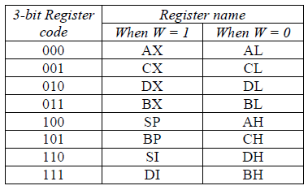
Continued …

Slide 122
Continued …
Byte 2 information:
MOD bits explanation:
MOD (2-bit mode field)—specifies the type of the second operand
Memory mode: 00, 01,10—Register to memory move operation
00 = no immediate displacement (register used for addressing)
01 = 8-bit displacement (imm8) follows (8-bit offset address)
10 = 16-bit displacement (imm16) follows (16-bit offset address)
Register mode: 11—register to register move operation
11 = register specified as the second operand

Slide 123
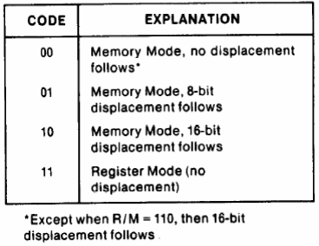
Continued …

Slide 124
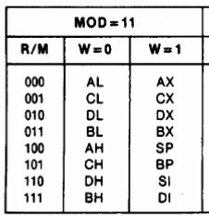
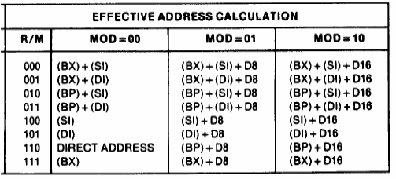
Continued …
The table shows 24 memory addressing modes i.e. 24 different ways of accessing data stored in memory.
Aid to remember:
SubInspector DIxit is a BoXer ( [SI+BX] and [DI]+[BX] )
SubInspector DIxit knows to control BP ( [SI+BP] and [DI]+[BP] )
He says’ SImple DIet DIRECTs a BoXer' ( [SI], [DI], Direct addressing, [BX] )

Slide 125
Continued …
S-bit: This bit is called as sign extension bit. The S bit is used along with W-bit to show the type of the operation.
For, example
8-bit operation with 8-bit immediate operand is indicated by S = 0, W = 0;
16-bit operation with 16-bit immediate operand is indicated by S = 0, W = 1 and
16-bit operation with a sign extended immediate data is given by S = 1, W = 1
V-bit: This is used in case of shift and rotate instructions. This bit is set to 0, if shift count is 1 and is set to 1, if CL contains the shift count.

Slide 126
Continued …
Z-bit: This bit is used by REP instruction to control the loop. If Z bit is equal to I, the instruction with REP prefix is executed until the zero flag matches the Z bit.
The REG code of the different registers (either as source or destination operands) in the opcode byte are assigned with binary codes. The segment registers are only 4 in number hence 2 binary bits will be sufficient to code them. The other registers are 8 in number, so at least 3-bits will be required for coding them.
To allow the use of 16-bit registers as two 8-bit registers they are coded with W bit as shown in Table.

Slide 127
Continued …
W Bit | Register Address (Code) | Register | Segment 2bits | Segment Register
0 | 000 | AL
0 | 001 | CL | 00 | ES
0 | 010 | DL | 01 | CS
0 | 011 | BL | 10 | SS
0 | 100 | AH | 11 | DS
0 | 101 | CH
0 | 110 | DH
0 | 111 | BH

Slide 128
8086 Instruction Set:
The 8086 has approximately 117 different instructions set.
The 8086 instruction contains
no operand,
single operand, and
two operand instructions.
8086 do not permit memory-to-memory operations.

Slide 129
8086 Instruction Set:
Different types of instruction of 8086 are given below:
Data transfer instructions
Arithmetic instructions
Logical instructions
Control transfer instructions
Processor Control Instructions
String Manipulation instructions
Interrupt Control instructions

Slide 130
Addressing Modes
When the 8086/8088 executes an instruction, it performs the specified function on data
These data, called operands,
May be a part of the instruction
May reside in one of the internal registers of the microprocessor
May be stored at an address in memory

Slide 131
Addressing Modes of 8086
Addressing mode indicates a way of access data or operands.
Depending upon the data types used in the instruction and the memory addressing modes, any instruction may belong to one or more addressing modes, or some instruction may not belong to any of the addressing modes.
The addressing modes describe the types of operands and the way they are accessed for executing an instruction.

Slide 132
Addressing Modes of 8086
The 8086 has 12 addressing modes. The various 8086 addressing modes can be classified into five groups.
Addressing modes for accessing immediate and register data (register and immediate modes).
Addressing modes for accessing data in memory (memory modes)
Addressing modes for accessing I/O ports (I/O modes)
Relative addressing mode
Implied addressing mode

Slide 133
Addressing Modes of 8086
Here, we will present the addressing modes of the instructions depending upon their types. According to the flow of instruction execution, the instructions may be categorised as
Sequential control flow instructions or Data category addressing modes.
Control transfer instructions or Branch category addressing modes.

Slide 134
Continued …
Sequential control flow instructions or Data category.
Immediate addressing mode
Register addressing mode
Implied addressing mode
Direct addressing mode
Register indirect addressing mode
Register Relative addressing mode
Based Indexed addressing mode
Relative Based Indexed addressing mode

Slide 135
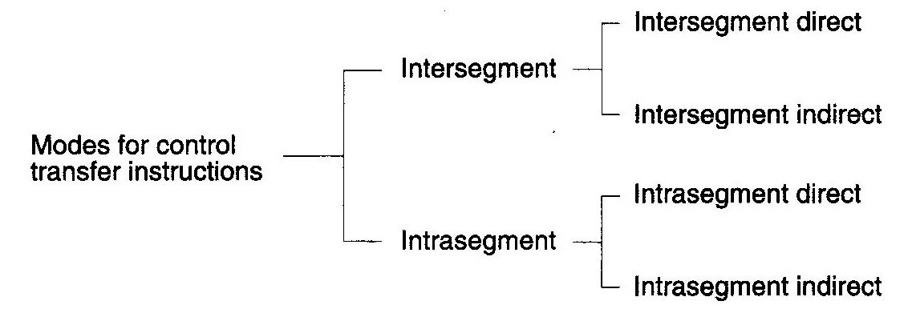
Continued …
Control transfer instructions or Branch category.
Intersegment
Intrasegment

Slide 136
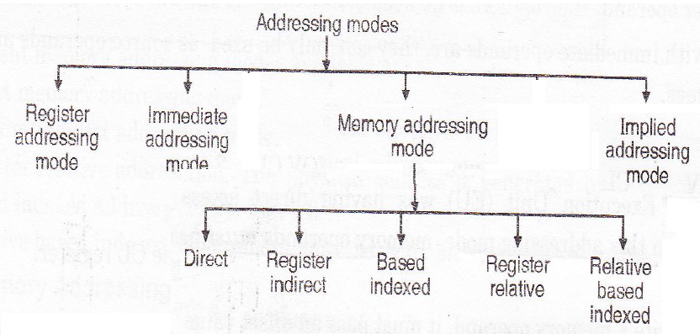

Slide 137
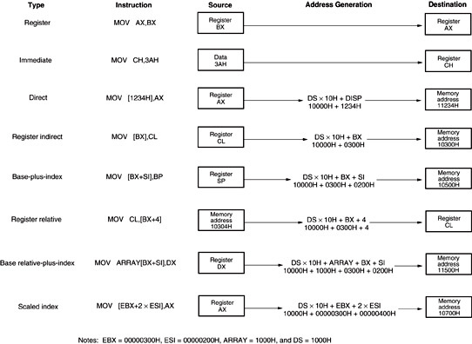

Slide 138
Continued …
Register addressing mode:
Data is in register and Instruction Specifies the perticular register
The operand to be accessed is specified as residing in an internal register of the 8086
Eg MOV AX, BX
Move (MOV) contents of BX (the source operand), to AX (the destination operand)
Both operands are in the internal registers

Slide 139
The operand to be accessed is specified as residing in an internal register of 8086.
Example 1 : MOV DX (Destination Register) , CX (Source Register) - Which moves 16 bit content of CS into DX.
Example 2 : MOV CL, DL - Moves 8 bit contents of DL into CL
MOV BX, CH is an illegal instruction.
* The register sizes must be the same.

Slide 140
Continued …
Immediate addressing mode:
In this type of addressing, immediate data is a part of instruction, and appears in the form of successive byte or bytes.
Example 1: MOV AX, 0005H
In the above example, 0005H is the immediate data. The immediate data may be 8-bit or 16-bit in size.

Slide 141
Immediate operand is Constant data contained in an Instruction
MOV CL,02H
MOV CX,0F0H
ADD 5

Slide 142
EFFECTIVE ADDRESS (EA)
The offset of a memory operand is called the operand’s effective address (EA).
Is an unsiged 16 bit no. That expresses the operands distance in byte from the begining of the segment
8086 has Base registers and Index registers
So EU calculates EA by summing a Displacement, Content of Base register and Content of Index register.

Slide 143
Continued …
Displacement is an 8 or 16 bit number.
It is generally derived from the position of operand name.
It’s value is constant.
Programmer may specify either BX or BP is to be used as Base Register
Similarly either SI or DI may be specified as Index Register

Slide 144
Continued …
Direct addressing mode:
In the direct addressing mode, a 16-bit memory address (offset) is directly specified in the instruction as a part of it.
Example 2: MOV AX, [5000H]
Here, data resides in a memory location in the data segment, whose effective address may be computed using 5000H as the offset address and content of DS as segment address. The effective address, here, is 10H*DS+5000H.

Slide 145
Continued …
Direct addressing mode:
EA is taken from the displacement field of instruction.
PA=This addr. is added with Seg.Regi*10 H
MOV [1023],AL

Slide 147
Continued …
Register indirect addressing mode:
Sometimes, the address of the memory location which contains data or operand is determined in an indirect way, using the offset registers.
In this addressing mode, the offset address of data is in either BX or SI or Dl register.
The default segment is either DS or ES. The data is supposed to be available at the address pointed to by the content of any of the above registers in the default data segment.
Example 4: MOV AX, [BX]
Here, data is present in a memory location in DS whose offset address is in BX.
The effective address of the data is given as 10H*DS+[BX].

Slide 148
Continued …
Register indirect addressing mode:
EA of may be taken directly from one of the base register or index register.
PA=This addr. is added with Seg.Regi*10 H
MOV [SI],AL

Slide 149
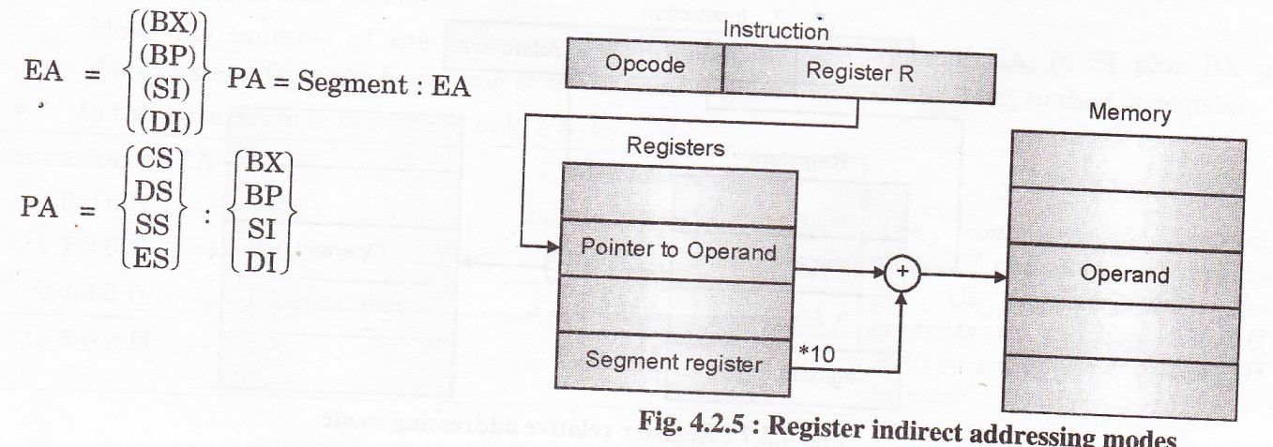

Slide 150
Continued …
Register Relative addressing mode:
The data is available at an effective address formed by adding an 8-bit or 16-bit displacement with the content of any one of the registers BX, BP, SI and Dl in the default (either DS or ES) segment. The example given below explains this mode.
Example 6: MOV AX, 50H[BX]
Here, the effective address is given as 10H*DS+50H+[BX].

Slide 151
Register Relative addressing mode:
EA is Sum of 8 or 16 bit displacement and contents of base register or an index register
PA = This addr. is added with Seg.Regi*10 H
MOV [BX+1100],AL

Slide 152
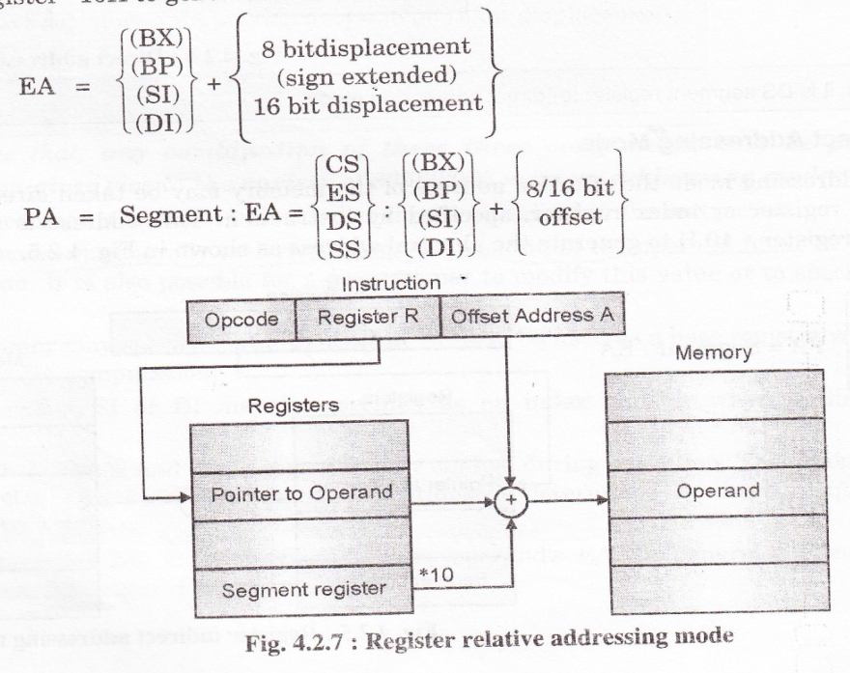

Slide 153
Continued …
Based Indexed addressing mode:
The effective address of data is formed, in this addressing mode, by adding content of a base register (any one of BX or BP) to the content of an index register (any one of SI or Dl). The default segment register may be ES or DS.
Example 7: MOV AX, [BX] [SI]
Here, BX is the base register and SI is the index register. The effective address is computed as 10H*DS+[BX]+[SI].

Slide 154
Based Indexed addressing mode:
EA is sum of Base register and Index register .
Both of which are specified by the instruction
PA=This addr. is added with Seg.Reg*10 H
MOV [BX+SI],AL

Slide 156
Continued …
Relative Based Indexed addressing mode:
The effective address is formed by adding an 8 or 16-bit displacement with the sum of contents of any one of the base registers (BX or BP) and any one of the index registers, in a default segment.
Example 8: MOV AX, 5 OH [BX][SI]
Here, 50H is an immediate displacement, BX is a base register and SI is an index register. The effective address of data is computed as 160H*DS+[BX]+[SI]+50H.

Slide 157
Relative Based Indexed addressing mode:
EA is Sum of a Base register ,an Index Register and Displacement .
PA = This addr. is added with Seg.Regi*10 H
MOV CX,[BX+SI+0400]

Slide 158
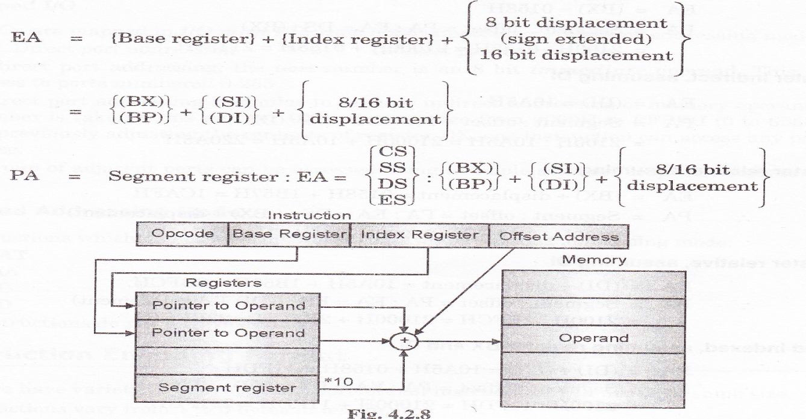

Slide 159
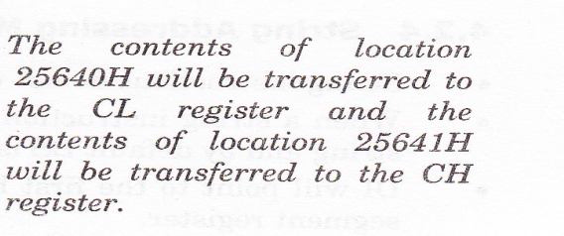
MOV CX,[BX+SI+0400]

Slide 160
Control transfer instructions
For the control transfer instructions, the addressing modes depend upon whether the destination location is within the same segment or a different one.
It also depends upon the method of passing the destination address to the processor.
Basically, there are two addressing modes for the control transfer instructions, viz. intersegment and intrasegment addressing modes.

Slide 161
Control transfer instructions
Basically, there are two addressing modes for the control transfer instructions, viz. intersegment and intrasegment addressing modes.
If the location to which the control is to be transferred lies in a different segment other than the current one, the mode is called intersegment mode.
If the destination location lies in the same segment, the mode is called intrasegment mode

Slide 162
Continued …
Intrasegment Direct Mode addressing mode:
In this mode, the address to which the control is to be transferred lies in the same segment in which the control transfer instruction lies and appears directly in the instruction as an immediate displacement value.
the displacement is computed relative to the content of the instruction pointer IP.
The effective address to which the control will be transferred is given by the sum of 8 or 16 bit displacement and current content of IP.
In case of jump instruction, if the signed displacement (d) is of 8 bits (i.e. –128 < d < +128), we term it as short jump and if it is of 16 bits (i.e. –32768 < d < +32768), it is termed as long jump.

Slide 163
Continued …
Intrasegment Indirect Mode addressing mode:
In this mode, the displacement to which the control is to be transferred, is in the same segment in which the control transfer instruction lies, but it is passed to the instruction indirectly.
Here, the branch address is found as the content of a register or a memory location.
This addressing mode may be used in unconditional branch instructions.

Slide 164
Continued …
Intersegment Direct Mode addressing mode:
In this mode, the address to which the control is to be transferred is in a different segment.
This addressing mode provides a means of branching from one code segment to another code segment. Here, the CS and IP of the destination address are specified directly in the instruction.

Slide 165
Continued …
Intersegment Indirect Mode addressing mode:
In this mode, the address to which the control is to be transferred lies in a different segment and it is passed to the instruction indirectly, i.e. contents of a memory block containing four bytes, i.e. IP(LSB), IP(MSB), CS(LSB) and CS(MSB) sequentially.
The starting address of the memory block may be referred using any of the addressing modes, except immediate mode.

Slide 167
Intel 8088/8086 Instruction Set Overview
Data Transfer(14)
MOV, PUSH, POP, XCHG, IN, OUT, XLAT, LEA, LDS, LES, LAHF, SAHF, PUSHF, POPF
Arithmetic(20)
ADD, ADC, INC, AAA, BAA, SUB, SSB, DEC, NEG, CMP, AAS, DAS, MUL, IMUL, AAM, DIV, IDIV, AAD, CBW, CWD
Logic (12)
NOT, SHL/SAL, SHR, SAR, ROL, ROR, RCL, RCR, AND, TEST, OR, XOR
String Manipulation(6)
REP, MOVS, XMPS, SCAS, LODS, STOS
Control Transfer(26)
CALL, JMP, RET, JE/JZ, JL/JNGE, JLE/JNG, JB/JNAE, JBE/JNA, JP/JPE, JO, JS, JNE/JNZ, JNL/JGE, JNLE/JG, JNB/JAE, JNBE/JA, JNP/JPO, JNO, JNS, LOOP, LOOPZ/LOOPE, LOOPNZ/LOOPNE, JCXZ, INT, INTO, IRETR
Processor Control(12)
CLC, CMC, STC, CLD, STD, CLI, STI, HLT, WAIT, ESC, LOCK, NOP

Slide 168
Data Movement Instructions (14)
(abbreviations below:d=destination, s=source)
General Data Movement Instructions
MOV d,s -moves a byte or word; most commonly used instruction
PUSH s -stores a word (register or memory) onto the stack
POP d -removes a word from the stack
XCHG d,s -exchanges data, reg.-reg. Or memory to register
XLAT -translates a byte using a lookuptable (has no operands)
IN d,s -moves data (byte or word) from I/O port to AX or AL
OUT d,s -moves data (byte or word) from AX or AL to I/O port
LEA d,s -loads effective address (not data at address) into register
LDS d,s -loads 4bytes (starting at s) to pointer (d) and DS
LES d,s -loads 4bytes (starting at s) to pointer (d) and ES

Slide 169
LAHF-loads the low-order bytes of the FLAGS register to AH
SAHF-stores AH into the low-order byte of FLAGS
PUSHF-copies the FLAGS register to the stack
POPF-copies a word from the stack to the FLAGS register

Slide 170
Data movement using MOV
MOV d,s
d=destination (register or effective memory address),
s=source (immediate data, register or memory address)
MOV can transfer data from:
any register to any register (except CS register)
memory to any register (except CS)
immediate operand to any register (except CS)
any register to a memory location
immediate operand to memory
MOV can not perform memory to memory transfers (must use a register as an intermediate storage).
MOV moves a word or byte depending on the operand bit-lengths; the source and destination operands must have the same bit length.
MOV cannot be used to transfer data directly into the CS register.

Slide 171
Typical number of clock cycles to carry out MOV are
2 clocks for register-register
4 clocks for immediate-register
8+ea clocks for memory-register (8086)
12+ea clocks for memory-register (8088)

Slide 172
Number of clock cycles to calculate effective address
The number of clock cycles needed for an instruction depends on the addressing mode.
For 8088/8086 systems, calculation of the effective address(16 bits) of the operand can take several clock cycles (these extra clock cycles are not needed for 80286 or later microprocessors):
Examples Extra clock cycles needed for calculating effective address:
Overriding the default segment register adds 2 clock cycles (ea+2)
Instructions which involve purely register to register or immediate data to register operations do not need extra clock cycles to calculate the effective address.

Slide 173
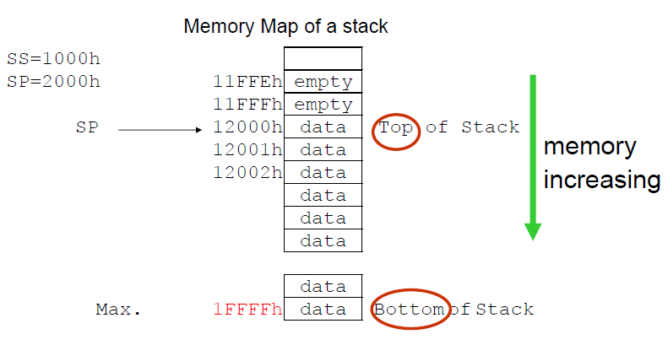
The stack
The stack is a block of memory reserved for temporary storage of data and registers. Access is LAST-IN, FIRST-OUT (LIFO)
The last memory location used in the stack is given by (the effective address calculated from the SP register) and (the SS register):
Example:

Slide 174
The stack
Data may be stored onto the stack using the PUSH instruction - this automatically decrements SP by 2 (all stack operations involve words). The POP instruction removes data from the stack (and increments SP by 2).
The stack may be up to 64K-bytes in length.

Slide 175
PUSH and POP instructions
Examples:
PUSH AX ; stores AX onto the stack
POP AX ; removes a word from the stack and loads it into AX
PUSHF ; stores the FLAGS register onto the stack
POPF ; removes a word from the stack and loads it into FLAGS
PUSH may be used with any register to save a word (the register contents) onto the stack. The usual order (e.g. as with MOV) of storing the lower order byte in the lower memory location is used.
PUSH may also be used with immediate data, or data in memory.
POP is the inverse of the PUSH instruction; it removes a word from the top of the stack. Any memory location or 16-bit register (except CS) may be used as the destination of a POP instruction.
PUSHF and POPF saves and loads the FLAGS register to/from the stack, respectively.

Slide 176
PUSH and POP instructions
The stack memory area is set by SS (Stack Segment) register, and SP (Stack Pointer) register. Generally operating system sets values of these registers on program start.
"PUSH source" instruction does the following:
Subtract 2 from SP register.
Write the value of source to the address SS:SP.
"POP destination" instruction does the following:
Write the value at the address SS:SP to destination.
Add 2 to SP register.
The current address pointed by SS:SP is called the top of the stack.

Slide 177
PUSH instructions
Syntax for PUSH instruction: PUSH REG PUSH SREG PUSH memory PUSH immediate
REG: AX, BX, CX, DX, DI, SI, BP, SP. SREG: DS, ES, SS, CS. memory: [BX], [BX+SI+7], 16 bit variable, etc... immediate: 5, -24, 3Fh, 10001101b, etc...

Slide 178
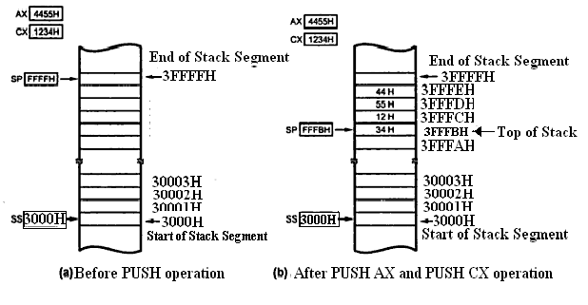

Slide 179
POP instructions
Syntax for POP instruction: POP REG POP SREG POP memory
REG: AX, BX, CX, DX, DI, SI, BP, SP. SREG: DS, ES, SS, (except CS). memory: [BX], [BX+SI+7], 16 bit variable, etc...

Slide 180
example: push ax mov ah,09h mov dx,OFFSET aMessage int 21h pop ax

Slide 181
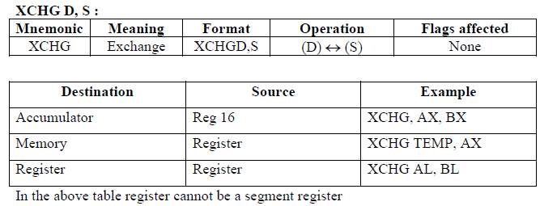
Exchange Instruction (XCHG)
XCHG exchanges the contents of two registers or a register and memory. Both byte and word sized exchanges are possible.
Memory to Memory exchanges using XCHG are NOT allowed.

Slide 182
Exchange Instruction (XCHG)
Examples:
XCHG AX,BX ;exchange the contents of AX and BX
XCHG CL,BL ;exchange CL and BL contents
XCHG DX,FRED ;exchanges content of DX and memory DS:FRED

Slide 183
Translate Instruction (XLAT)
Many applications need to quickly convert byte sized codes to other values, mapping one byte value to another (e.g. mapping keyboard binary codes to ASCII code).
XLAT can perform a byte translation using a look-up table containing up to 256 elements.

Slide 184
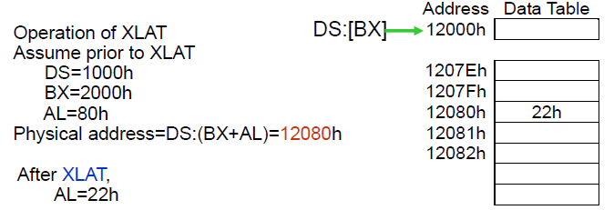
Translate Instruction (XLAT)
XLAT assumes that the 256-byte table starts at the address given by DS:BX (i.e. effective address formed by the DS and BX registers). AL is used as an index to point to the required element in the table prior to the execution of XLAT. The result of XLAT instruction is returned in the same register (AL).

Slide 185
LEA(load effective address)
LEA loads the offset of a memory address into a 16-bit register. The offset address may be specified by any of the addressing modes.
LEA does not affect any flag.
Examples(with BP=1000h):
LEA AX,[BP+40h] ;SS:[1000h+40h] = SS:[1040h]
;load 1040h into AX
LEA BX,FRED ;load the offset of FRED (in data segment) to BX
LEA CX,ES:FRED ;loads the offset of FRED (in extra segment) to CX
LEA BP,SS:Stack_Top ;Load BP with offset of Stack_Top in SS
LEA CX, [BX][DI] ;Load CX with EA = [BX] + [DI]

Slide 186
LDS-Load data and DS
LDS Register, Memory address of the first word
LDS reads two words from the consecutive memory locations and loads them into the specified register and the DS segment registers.
Examples:
LDS BX, [4326] ;Copy content of memory at displacement 4326H in DS to BL, content of 4327H to BH. Copy content at displacement of 4328H and 4329H in DS to DS register.
LDS SI, SPTR ;Copy content of memory at displacement SPTR and SPTR + 1 in DS to SI reg. Copy content of memory at displacements SPTR + 2 and SPTR + 3 in DS to DS reg. DS:SI now points at start of the desired string.
LDS is useful for initializing the SI and DS registers before a string operation. E.g. LDS SI, sting_pointer
The source for LDScan be displacement, index or pointer register (except SP).

Slide 187
LES -Load data and ES
LES – LES Register, Memory address of the first word
LES reads two words from memory and is very similar to LDS except that the second word is stored in ES instead of DS.
LES is useful for initializing that DI and ES registers for strings operation.
Examples:
LES BX, [789AH] ;Copy content of memory at displacement 789AH in DS to BL, content of 789BH to BH, content of memory at displacement 789CH and 789DH in DS is copied to ES register.
LES DI, [BX] ;Copy content of memory at offset [BX] and offset [BX] + 1 in DS to DI register. Copy content of memory at offset [BX] + 2 and [BX] + 3 to ES register.

Slide 188
Flag transfer instructions:LAHF, SAHF
LAHF: Load AH from Lower Byte of Flag
This instruction loads the AH register with the lower byte of the flag register.
This instruction may be used to observe the status of all the condition code flags (except overflow) at a time.
SAHF: Store (copy) AH to Lower Byte of Flag Register
This instruction sets or resets the condition code flags (except overflow ) in the lower byte of the flag register depending upon the corresponding bit positions in AH.
If a bit in AH is 1, the flag corresponding to the bit position is set, else it is reset.

Slide 189
IN
IN – IN Accumulator, Port
The IN instruction copies data from a port to the AL or AX register. If an 8-bit port is read, the data will go to AL. If a 16-bit port is read, the data will go to AX.
The IN instruction has two possible formats, fixed port and variable port.
For fixed port type, the 8-bit address of a port is specified directly in the instruction. With this form, any one of 256 possible ports can be addressed.
Examples:
IN AL, OC8H ;Input a byte from port OC8H to AL
IN AX, 34H ;Input a word from port 34H to AX

Slide 190
IN
IN – IN Accumulator, Port
For the variable-port form of the IN instruction, the port address is loaded into the DX register before the IN instruction.
Since DX is a 16-bit register, the port address can be any number between 0000H and FFFFH. Therefore, up to 65,536 ports are addressable in this mode.
The IN instruction does not change any flag.
Examples:
MOV DX, 0FF78H ;Initialize DX to point to port
IN AL, DX ;Input a byte from 8-bit port 0FF78H to AL
IN AX, DX ;Input a word from 16-bit port 0FF78H to AX

Slide 191
OUT
OUT – OUT Port, Accumulator
The OUT instruction copies a byte from AL or a word from AX to the specified port.
The OUT instruction has two possible forms, fixed port and variable port.
For the fixed port form, the 8-bit port address is specified directly in the instruction. With this form, any one of 256 possible ports can be addressed.
Examples:
OUT 3BH, AL ;Copy the content of AL to port 3BH
OUT 2CH, AX ;Copy the content of AX to port 2CH

Slide 192
OUT
OUT – OUT Port, Accumulator
For variable port form of the OUT instruction, the content of AL or AX will be copied to the port at an address contained in DX.
Therefore, the DX register must be loaded with the desired port address before this form of the OUT instruction is used.
Examples:
MOV DX, 0FFF8H ;Load desired port address in DX
OUT DX, AL ;Copy content of AL to port FFF8H
OUT DX, AX ;Copy content of AX to port FFF8H
The OUT instruction does not affect any flag.

Slide 193
Instructions for moving strings
String instructions are repeated when prefixed by the REP mnemonic (CX contains the repetition count)
MOVS d,s -(MOVSB,MOVSW) memory to memory data transfer
MOVS – MOVS Dest. String Name, Source String Name
MOVSB – MOVSB Dest. String Name, Source String Name
MOVSW – MOVSW Dest. String Name, Source String Name
Example:
MOV SI, Offset Source -Load offset of start of source string in DS into SI
MOV DI, Offset Dest. -Load offset of start of destination string in ES into DI
CLD -Clear DF to auto increment SI and DI after move
MOV CX, 04H -Load length of string into CX as counter
REP MOVSB -Move string byte until CX = 0

Slide 194
Instructions for moving strings
LODS s -(LODSB and LODSW) copies data into AX or AH
This instruction copies a byte from a string location pointed to by SI to AL, or a word from a string location pointed to by SI to AX.
Example:
CLD -Clear direction flag so that SI is auto-incremented
MOV SI, Offset SRC -Point SI to start of string
LODS SRC -Copy a byte or a word from string to AL or AX

Slide 195
Instructions for moving strings
If DF is 0, SI will be automatically incremented (by 1 for a byte string, and 2 for a word string) to point to the next element of the string.
If DF is 1, SI will be automatically decremented (by 1 for a byte string, and 2 for a word string) to point to the previous element of the string.
LODS does not affect any flag.

Slide 196
Instructions for moving strings
STOS d -(STOSB,STOSW) stores data from AH or AX
This instruction copies a byte from AL or a word from AX to a memory location in the extra segment pointed to by DI.
Example
MOV DI, OFFSET TARGET
STOS TARGET
Note: The assembler uses the string name to determine whether the string is of type byte or type word. If it is a byte string, then string byte is replaced with content of AL. If it is a word string, then string word is replaced with content of AX.
MOV DI, OFFSET TARGET
STOSB
Note: “B” added to STOSB mnemonic tells assembler to replace byte in string with byte from AL. STOSW would tell assembler directly to replace a word in the string with a word from AX.

Slide 197
Instructions for moving strings
In effect, it replaces a string element with a byte from AL or a word from AX.
After the copy, DI is automatically incremented or decremented to point to next or previous element of the string.
If DF is cleared, then DI will automatically incremented by 1 for a byte string and by 2 for a word string.
If DI is set, DI will be automatically decremented by 1 for a byte string and by 2 for a word string. STOS does not affect any flag.

Slide 198
Instructions for moving strings
CMPS / CMPSB / CMPSW (COMPARE STRING BYTES OR STRING WORDS)
This instruction can be used to compare a byte / word in one string with a byte / word in another string.
SI is used to hold the offset of the byte or word in the source string, and DI is used to hold the offset of the byte or word in the destination string.
The CMPS instruction can be used with a REPE or REPNE prefix to compare all the elements of a string.
Example:
MOV SI, OFFSET FIRST -Point SI to source string
MOV DI, OFFSET SECOND -Point DI to destination string
CLD DF -cleared, SI and DI will auto- increment after compare
MOV CX, 100 -Put number of string elements in CX
REPE CMPSB -Repeat the comparison of string bytes until end of string or until compared bytes are not equal

Slide 199
Instructions for moving strings
The AF, CF, OF, PF, SF, and ZF flags are affected by the comparison, but the two operands are not affected.
After the comparison, SI and DI will automatically be incremented or decremented to point to the next or previous element in the two strings.
If DF is set, then SI and DI will automatically be decremented by 1 for a byte string and by 2 for a word string.
If DF is reset, then SI and DI will automatically be incremented by 1 for byte strings and by 2 for word strings.
The string pointed to by SI must be in the data segment.
The string pointed to by DI must be in the extra segment.

Slide 200
Instructions for moving strings
SCAS / SCASB / SCASW (SCAN A STRING BYTE OR A STRING WORD)
SCAS (scan string) compares each string element with the value stored in AX(for word strings) or AL(for byte strings). The string element is pointed to ES:DI.
If SCAS is prefixed by REPNZ the string is searched for the byte or word in the accumulator.
If SCAS is prefixed by REPZ, the scan is repeated until the string element differs from the value in the accumulator.
Example:(with ES:DI set to string A and CX set to string length)
REPNZ SCAS stringA ;scan stringA until item in accumulator is found
REPZ SCAS stringA ;scan until not equal to the content of accumulator

Slide 201
Instructions for moving strings
SCAS / SCASB / SCASW (SCAN A STRING BYTE OR A STRING WORD)
The following program segment scans a text string of 80 characters for a carriage return, 0DH, and puts the offset of string into DI:
Example:
MOV DI, OFFSET STRING
MOV AL, 0DH ;Byte to be scanned for into AL
MOV CX, 80 CX ;used as element counter
CLD ;Clear DF, so that DI auto increments
REPNE SCAS STRING ;Compare byte in string with byte in AL

Slide 202
Instructions for moving strings
REP / REPE / REPZ / REPNE / REPNZ (PREFIX) (REPEAT STRING INSTRUCTION UNTIL SPECIFIED CONDITIONS EXIST)
REP repeats a string instruction and automatically decrements the count in register CX after each repetition until CX equals zero.
Example(with CX=5)
REP MOVSB; repeats MOVSB 5 times i.e. transfers 5 bytes.
REPE(repeat while equal) and REPZ(repeat while zero) operate in the same way but are used for SCAS and CMPS. REPE and REPZ have an extra (in addition to CX being nonzero) condition of repeating only when the zero flag is set; ie the string comparison is stopped as soon as the two strings are not equal.

Slide 203
Instructions for moving strings
REP prefix
REPNZ and REPNE also repeat while CX is non zero. The extra condition is that the zero flag is clear for the repetition to continue.
3 ways to repeat a string instruction are
REP -repeat if CX is nonzero
REPE, REPZ -repeat if CX is nonzero and the zero flag is 1
REPNZ, REPNE -repeat if CX is nonzero and the zero flag is 0

Slide 204
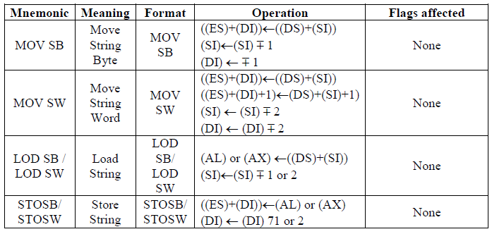
String Instructions

Slide 205
Addition - Add
Aritmetic Instructions
ADD reg, imm ADC reg, imm
ADD reg, mem ADC reg, mem
ADD reg, reg ADC reg, reg
ADD mem, imm ADC mem, imm
ADD mem, reg ADC mem, reg

Slide 206
Example ADD
MOV AL, 10h
ADD AL, 20h ;AL = 30h
MOV BX, 200h ;BX = 0200h
MOV AH, 89h ;AX = 8930h
ADD AX, 9876h ;AX = 21A6h
ADC BX, 01h ;BX = 0202h

Slide 207
Subtraction - SUB
SUB reg, imm SBB reg, imm
SUB reg, mem SBB reg, mem
SUB reg, reg SBB reg, reg
SUB mem, imm SBB mem, imm
SUB mem, reg SBB mem, reg

Slide 208
Example. SUB
MOV AL, 10h
ADD AL, 20h ;AL = 30h
MOV BX, 200h ;BX = 0200h
MOV AH, 89h ;AX = 8930h
SBB AX, 0001h ;AX = 892Eh
SBB AX, 0001h ;AX = 892Dh

Slide 209
Compare - CMP
CMP reg, imm
CMP reg, mem
CMP reg, reg
CMP mem, reg
There is no “CMP mem, imm”

Slide 210
Ex. CMP
MOV CX, 10h
CMP CX, 20h ;Z=0,S=1,C=1,O=0
MOV BX, 40h
CMP BX, 40h ;Z=1,S=0,C=0,O=0
MOV AX, 30h
CMP AX, 20h ;Z=0,S=0,C=0,O=0

Slide 211
Negation
Compute 2’complement.
Carry flag always set.
Usage
NEG reg
NEG mem

Slide 212
Ex. NEG
MOV CX, 10h
NEG CX ; CX = 0FFF0h
MOV AX,0FFFFH
NEG AX ; AX = 1
MOV BX,1H
NEG BX ; BX = 0FFFFh

Slide 213
Multiplication
IMUL (Integer multiplication) unsigned multiplication
MUL (Multiplication) signed multiplication.
MUL reg IMUL reg
MUL mem IMUL mem
Always perform with accumulator.
Effected flag are only over and carry flag.

Slide 214
8 bit multiplication
AL is multiplicand
AX keep the result
MOV AL,10h ; AL = 10h
MOV CL,13h ; CL = 13h
IMUL CL ; AX = 0130h

Slide 215
16 bit multiplication
AX is multiplicand
DX:AX keep the result
MOV AX,0100h ; AX = 0100h
MOV BX,1234h ; BX = 1234h
IMUL BX ; DX = 0012h
; AX = 3400h

Slide 216
Division
IDIV (Integer division) unsigned division.
DIV (Division) signed division.
DIV reg IDIV reg
DIV mem IDIV mem
Always perform with accumulator.
Effected flag are only over and carry flag.

Slide 217
8 bit division
AL is dividend
AL keep the result
AH keep the remainder
MOV AX, 0017h
MOV BX, 0010h
DIV BL ; AX = 0701

Slide 218
16 bit multiplication
DX:AX dividend.
AX keep the result, DX keep the remainder.
MOV AX,4022h ;
MOV DX,0000h ;
MOV CX,1000h ;
DIV CX ;AX = 0004
;DX = 0022

Slide 219
Conversion
Byte to Word : CBW
Signed convert AL -> AX
Word to Double word : CWD
Signed convert AX -> DX:AX

Slide 220
Ex. Conversion
MOV AL,22h
CBW ; AX=0022h
MOV AL,F0h
CBW ; AX=FFF0h
MOV AX, 3422h
CWD ; DX=0000h
; AX=3422h

Slide 222
Example about flag with arithmetic

Slide 223
Example about flag with arithmetic
NEG -> Carry flag always 1, INC/DEC does not effect any flag

Slide 224
Bit Manipulation
Instruction Operation Example Comments
not src <- NOT src not bl
and src <- dest AND src and al,054h test dest AND src test bx,0F7h Only affects flags
or dest <- dest OR src or flag,040h
xor dest <- dest XOR xor flags,97h src
sal/shl shift left by count sal ah,8 or count in CX
shr logical shift right shr bl,1 or count in CX
sar shift right by sar bh,6 or count in CX count
rol rotate left by rol bx,.8 or count in CL count
ror rotate right by rol ax,cl or count in CL count
rcl left by count rcl dh,1 or count in CL
rcr right by count rcr dl,5 or count in CL

Slide 225
Logic and bit manipulation Instructions (12)
The binary bits in a byte or word can be manipulated directly using the following set of 12 instructions:
Logical:
AND d,s ;Logical AND, result put in d
NOT d ;Complement seach bit of d
OR d,s ;Logical OR, result stored in d
XOR d,s ;LOGICAL XOR,result put in d
TEST d,s ;AND to update flags P, Z, S. d unchanged
Shift:
SAL/SHL d,c ;shift bits left c times. Insert zero
SAR d,c ;shift right c times. Insert sign bit
SHR d,c ;shift right c times. Insert zeros

Slide 226
Logic and bit manipulation Instructions (12)
Rotate:
ROL d,c ;rotates all bits left c times
ROR d,c ;rotate all the bits right c times
RCL d,c ;rotate left through carry flag,c times
RCR d,c ;rotate right through carry flag, c times
For the 8088/8086, the count in the shift and rotate instructions is either =1 or a number stored in the CL register. (immediate count is only allowed in the 80286 and above)
The destination operand, d, can be registers or a memory location. The source operands in the logic instructions can be immediate data, another register or the contents of a memory location.
Both bytes and word sized operands are permitted.

Slide 227
AND
AND – AND Destination, Source
This instruction ANDs each bit in a source byte or word with the same numbered bit in a destination byte or word. The result is put in the specified destination. The content of the specified source is not changed.
The source can be an immediate number, the content of a register, or the content of a memory location.
The destination can be a register or a memory location.
The source and the destination cannot both be memory locations.
CF and OF are both 0 after AND. PF, SF, and ZF are updated by the AND instruction. AF is undefined. PF has meaning only for an 8-bit operand.

Slide 228
AND
AND – AND Destination, Source
Example:
AND CX, [SI] ;AND word in DS at offset [SI] with word in CX register; Result in CX register
AND BH, CL ;AND byte in CL with byte in BH; Result in BH
AND BX, 00FFH ;00FFH Masks upper byte, leaves lower byte unchanged.

Slide 229
OR
OR – OR Destination, Source
This instruction ORs each bit in a source byte or word with the same numbered bit in a destination byte or word. The result is put in the specified destination. The content of the specified source is not changed.
The source can be an immediate number, the content of a register, or the content of a memory location.
The destination can be a register or a memory location.
The source and destination cannot both be memory locations.
CF and OF are both 0 after OR. PF, SF, and ZF are updated by the OR instruction. AF is undefined. PF has meaning only for an 8-bit operand.

Slide 230
OR
OR – OR Destination, Source
Example:
OR AH, CL ;CL ORed with AH, result in AH, CL not changed
OR BP, SI ;SI ORed with BP, result in BP, SI not changed
OR SI, BP ;BP ORed with SI, result in SI, BP not changed
OR BL, 80H ;BL ORed with immediate number 80H; sets MSB of BL to 1
OR CX,TABLE [SI] ;CX ORed with word from effective address TABLE [SI]; Content of memory is not changed.

Slide 231
XOR
XOR – XOR Destination, Source
This instruction Exclusive-ORs each bit in a source byte or word with the same numbered bit in a destination byte or word. The result is put in the specified destination. The content of the specified source is not changed.
The source can be an immediate number, the content of a register, or the content of a memory location.
The destination can be a register or a memory location.
The source and destination cannot both be memory locations.
CF and OF are both 0 after XOR. PF, SF, and ZF are updated. PF has meaning only for an 8-bit operand. AF is undefined.

Slide 232
XOR
XOR – XOR Destination, Source
Example:
XOR CL, BH ;Byte in BH exclusive-ORed with byte in CL. Result in CL. BH not changed.
XOR BP, DI ;Word in DI exclusive-ORed with word in BP. Result in BP. DI not changed.
XOR WORD PTR [BX], 00FFH ;Exclusive-OR immediate number 00FFH with word at offset [BX] in the data segment. Result in memory location [BX]

Slide 233
NOT
NOT – NOT Destination
The NOT instruction inverts each bit (forms the 1’s complement) of a byte or word in the specified destination. The destination can be a register or a memory location.
This instruction does not affect any flag.
Example:
NOT BX ;Complement content or BX register
NOT BYTE PTR [BX] ;Complement memory byte at offset [BX] in data segment.

Slide 234
TEST
TEST – TEST Destination, Source
This instruction ANDs the byte / word in the specified source with the byte / word in the specified destination. Flags are updated, but neither operand is changed.
The test instruction is often used to set flags before a Conditional jump instruction.
The source can be an immediate number, the content of a register, or the content of a memory location.
The destination can be a register or a memory location.
The source and the destination cannot both be memory locations.
CF and OF are both 0’s after TEST. PF, SF and ZF will be updated to show the results of the destination. AF is be undefined.

Slide 235
TEST
TEST – TEST Destination, Source
Example:
TEST AL, BH ;AND BH with AL. No result stored; Update PF, SF, ZF.
TEST CX, 0001H ;AND CX with immediate number 0001H; No result stored; Update PF, SF, ZF
TEST BP, [BX][DI] ;AND word are offset [BX][DI] in DS with word in BP. No result stored. Update PF, SF, and ZF

Slide 236
ROTATE AND SHIFT INSTRUCTIONS
SAL/SHL Instruction - Shift operand bits left, put zero in LSB(s)
SAL/AHL destination, count
SAR Instruction - Shift operand bits right, new MAB = old MSB
SAR destination, count.
SHR Instruction - Shift operand bits right, put zero in MSB
SHR destination, count.
ROL Instruction - Rotate all bits of operand left, MSB to LSB
ROL destination, count.
ROR Instruction - Rotate all bits of operand right, LSB to MSB –
ROR destination, count
RCL Instruction - Rotate operand around to the left through CF
RCL destination, source.
RCR Instruction - Rotate operand around to the right through CF
RCR destination, count

Slide 237
ROTATE AND SHIFT INSTRUCTIONS
A shift left by one bit position is equivalent to multiplying by two. Using SAL the most significant bit is shifted into the carry flag and the least significant bit is filled with a zero.
A shift right by one position is equivalent to dividing by two when the sign bit is maintained (using SAR).
ROL and ROR rotate the bits left and right respectively.
The ROL instruction fills the least significant bit with the most significant bit which is also placed in the carry flag.
ROR fills the most significant bit with the least significant bit.

Slide 238
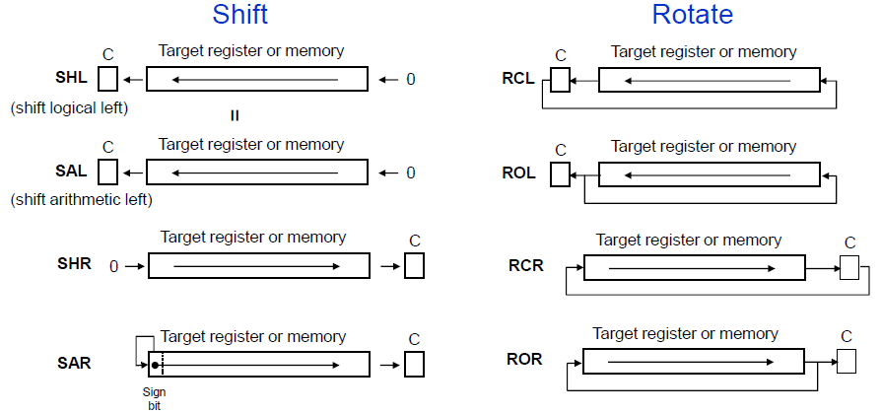
ROTATE AND SHIFT

Slide 239
SHR – SHR Destination, Count
SHR Instruction - SHR instruction shifts the bits in op1 to right by the number of times specified by op2 .
Example:
SHR BP, 1 ; Shift word in BP by 1 bit position to right ; and 0 is kept to MSB
MOV CL, 03H ;Load desired number of shifts into;CL
SHR BYTE PYR[BX] ;Shift bytes in DS at offset BX;and rotate 3 bits to right and ;keep 3 0’s in MSB
SHR SI, 1 ;SI = 10010011 10101101 , CF = 0; Result: SI = 01001001 11010110 ; CF = 1, OF = 1, SF = 0, ZF = 0

Slide 240
SAL – SAL Destination, Count
SHL – SHL Destination, Count
SAL / SHL Instruction - SAL instruction shifts the
bits in the operand specified by op1 to its left by the count specified in op2. As a bit is shifted out of LSB position a 0 is kept in LSB position. CF will contain MSB bit.
Example:
SAL BX, 1 ;CF = 0, BX = 1110010111010011;Shift BX register contents by 1 bit towards left ;CF = 1, BX = 110010111010011
MOV CL, 02h ;Load desired number of shifts in CL
SAL BP, CL ;Shift word in BP left CL bit positions, 0 in LSBs
SAL BYTE PTR [BX], 1 ;Shift byte in DX at offset [BX] 1 bit position left, 0 in LSB

Slide 241
SAR – SAR Destination, Count
SAR Instruction - SAR instruction shifts the bits in the operand specified by op1 towards right by count specified in op2.As bit is shifted out a copy of old MSB is taken in MSB
MSB position and LSB is shifted to CF.
Example:
SAR AL, 1 ; AL = 00011101 = +29 decimal, CF = 0;Shift signed byte in AL towards right ;( divide by 2 ) ;AL = 00001110 = + 14 decimal, CF = 1
SAR BH, 1 ;BH = 11110011 = - 13 decimal, CF = 1 ;Shifted signed byte in BH to right ;BH = 11111001 = - 7 decimal, CF = 1
SAR DX, 1 ;Shift word in DI one bit position right, new MSB = old MSB
MOV CL, 02H ;Load desired number of shifts in CL
SAR WORD PTR [BP], CL ;Shift word at offset [BP] in stack segment right by two bit positions, the two MSBs are now copies of original LSB

Slide 242
RCL – RCL Destination, Count
RCL Instruction - RCL instruction rotates the bits in the operand specified by op1 towards left by the count specified in op2.The operation is circular, the MSB of operand is rotated into a carry flag and the bit in the CF is rotated around into the LSB of operand.
Example:
CLC ;put 0 in CF
RCL AX, 1 ;save higher-order bit of AX in CF
RCL DX, 1 ;save higher-order bit of DX in CF
MOV CL, 4 ;Load the number of bit positions to rotate into CL
RCL SUM [BX], CL ;Rotate byte or word at effective address SUM [BX] 4 bits left Original bit 4 now in CF, original CF now in bit 3.

Slide 243
RCR – RCR Destination, Count
RCR Instruction - RCR instruction rotates the bits in the operand specified by op1 towards right by the count specified in op2.
RCR affects only CF and OF. OF will be a 1 after a single bit RCR if the MSB was changed by the rotate.
Example:
RCR BX, 1 ;Word in BX is rotated by 1 bit towards ;right and CF will contain MSB bit and ;LSB contain CF bit .
RCR BL, 1 ;CF = 1, BL = 00111000;Result: BL = 10011100, CF =0 ;OF = 1 because MSB is changed to 1.
MOV CL, 4 ;Load CL for rotating 4 bit position
RCR BYTE PTR [BX], 4 ;Rotate the byte at offset [BX] in DS 4 bit positions

Slide 244
ROL – ROL Destination, Count
the operand specified by op1 towards left by the count specified in op2. ROL moves each bit in the operand to next higher bit position. The higher order bit is moved to lower order position. Last bit rotated is copied into carry flag.
Example:
ROL AX, 1 ;Word in AX is moved to left by 1 bit ;and MSB bit is to LSB, and CF ;CF =0 ,BH =10101110
ROL BH, 1 ;Result: CF ,Of =1 , BH = 01011101
MOV CL, 08H ;Load number of bits to rotate in CL
ROL BH, CL ;BX = 01011100 11010011;CL = 8 bits to rotate ;Rotate BX 8 bits towards left ;CF =0, BX =11010011 01011100
ROL FACTOR [BX], 1 ;Rotate the word or byte in DS at EA = FACTOR [BX] by 1 bit position left into CF

Slide 245
ROR – ROR Destination, Count
ROR Instruction - ROR instruction rotates the bits in the operand op1 to wards right by count specified in op2. The last bit rotated is copied into CF.
Example:
ROR BL, 1 ;Rotate all bits in BL towards right by 1 bit position, LSB bit is moved to MSB ;and CF has last rotated bit.
ROR BX, 1 ;CF =0, BX = 00111011 01110101;Rotate all bits of BX of 1 bit position ;towards right and CF =1, BX = 10011101 10111010
MOVE CL, 04H ;CF = 0, AL = 10110011,; Load CL
ROR AL, CL ;Rotate all bits of AL towards right ;by 4 bits, CF = 0 ,AL = 00111011
MOV CL, 08H ;Load CL with number of bit positions to be rotated
ROR WORD PTR [BX], CL ;Rotate word in DS at offset [BX] 8 bit position right

Slide 246
Control transfer instructions
These instructions cause change in the sequence of the execution of instruction.
This change can be through a condition or sometimes unconditional.
The conditions are represented by flags.

Slide 247
Control transfer instructions
These instructions cause change in the sequence of the execution of instruction.
This change can be through a condition or sometimes unconditional.
The instruction pointer (IP) has the address of the next instruction stored in memory. Normally the program executes the instructions in the same sequence as they are stored in memory
The sequential execution of instructions may be deliberately broken by changing the content of the instruction pointer in order to execute conditional branches, loops, and procedures.
The conditions are represented by flags.

Slide 248
Control transfer instructions
Unconditional Branches:
JMP d ;Unconditional jump
CALL d ;call procedure
RET ;return from procedure
Iterations
LOOP d ;loops to d until CX=0
LOOPE/LOOPZ d ;loop while equal
LOOPNE/LOOPNZ d ;loops while not zero

Slide 249
Control transfer instructions
Conditional Branches:
JE/JZ d ; jump zero; if Z=1
JNE/JNZ d ; jump not zero; if Z=0
JL/JNGE d ; jump less; if (S xor O)=1
JNL/JGE d ; jump not less; if (S xor O)=0
JLE/JNG d ; less or equal; if ((S xor O) or Z)=1
JNLE/JG d ; jump greater; if ((S xor O) or Z)=0
JB/JC/JNAE d ; jump below; if C=1
JNB/JNC/JAE d ; jump not carry; if C=0

Slide 250
Control transfer instructions
Conditional Branches:
JBE/JNA d ; jump below or equal; if (C or Z)=1
JNBE/JA d ; jump above; if (C or Z)=0
JP/JPE d ; parity equal; if P=1
JNP/JPO d ; jump not parity; if P=0
JO d ; jump overflow; if O=1
JNO d ; jump no overflow; if O=0
JS d ; jump sign; if S=1
JNS d ; jump not sign; if S=0
JCXZ d ; jump if CX=0

Slide 251
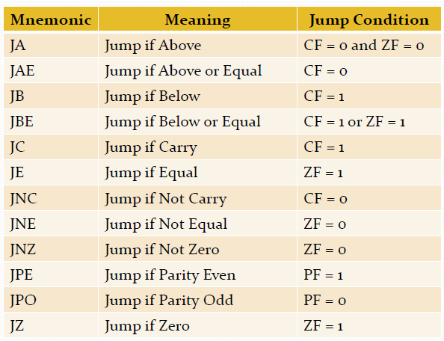

Slide 252
Unconditional JUMP
JMP instruction loads the instruction pointer (IP) with the new address of the next instruction, leaving all the other registers unchanged.
The destination of jump may be intra-segment and specified by an 8-bit signed operand which is added to the IP. A direct short jump is produced eg: JMP SHORT FRED;
The 8-bit operand is usually a label, and assembler directive SHORT tells the assembler to code the instruction as a short (ie label is within -128 to +127 bytes) jump.
A signed 16-bit operand (direct near jump)
eg. JMP WORD PTR FRED;
The assembler replaces the contents of the instruction pointer with the offset address of where the label FRED is located. The directive WORD PTR indicates the label is a word.
Indirect addressing which provides a new effective address for IP.
Eg. JMP WORD PTR [BX] ; jumps to the address given by the contents of the memory location pointed by BX

Slide 253
Unconditional JUMP
The destination of the JMP may be inter-segment. In this case, both IP and CS must be changed.
The new values for IP and CS may be specified either
indirectly (eg. JMP DWORD PTR [SI])
or directly (eg. JMP DWORD PTR FRED).
IP is replaced by the first word pointed to by the operand and CS is replaced by the next word.
Summary of Jump : 5 types
(1).Direct short jump: IP:=IP+disp8
(2).Direct near jump: IP:=IP+disp16
(3).Direct far jump: IP:=disp16,CS:=base16
(4).Indirect near jump: IP=[reg],or IP=reg
(5).Indirect far jump: IP=[reg],CS:=[reg+2]

Slide 254
Conditional JUMP
Only short jump (ie the jump destination is specified by an 8-bit signed offset which is added to the IP) is possible for the conditional jump instructions of the 8088/8086. Register names cannot be used as the operand of a conditional jump instruction.
To perform a conditional jump outside the 8-bit offset range, it is necessary to combine a conditional short jump with an unconditional jump.
The set of conditional jumps instructions cover all the possible combinations of zero, carry, overflow, sign and parity flags in the FLAGS register.
In addition to testing for the various combinations of the C, O, S, Z, and P flags, there is an instruction to test if the CX register is zero.

Slide 255
Conditional JUMP
JA/JNBE Instruction - Jump if above/Jump if not below nor equal.
JA / JNBE - This instruction performs the Jump if above (or) Jump if not below or equal operations according to the condition, if CF and ZF = 0 .
Example:
CMP AX, 4371H ;Compare by subtracting 4371H ;from AX
JA RUN_PRESS ;Jump to label RUN_PRESS if ;AX above 4371H
CMP AX, 4371H ;Compare ( AX – 4371H)
JNBE RUN_PRESS ;Jump to label RUN_PRESS if ;AX not below or equal to 4371H

Slide 256
Conditional JUMP
JAE/JNB/JNC Instructions - Jump if above or equal/Jump if not below/Jump if no carry.
JAE / JNB / JNC - This instructions performs the Jump if above or equal, Jump if not below, Jump if no carry operations according to the condition, if CF = 0.
Examples:
1. CMP AX, 4371H ;Compare ( AX – 4371H)
JAE RUN ;Jump to the label RUN if AX is ;above or equal to 4371H .
2. CMP AX, 4371H ;Compare ( AX – 4371H)
JNB RUN_1 ;Jump to the label RUN_1 if AX ;is not below than 4371H
3. ADD AL, BL ; Add AL, BL. If result is with in
JNC OK ;acceptable range, continue

Slide 257
Conditional JUMP
JB/JC/JNAE Instruction - Jump if below/Jump if carry/Jump if not above nor equal
JB/JC/JNAE Instruction - This instruction performs the Jump if below (or) Jump if carry (or) Jump if not below/ equal operations according to the condition, if CF = 1
Example:
1. CMP AX, 4371H ;Compare ( AX – 4371H )
JB RUN_P ;Jump to label RUN_P if AX is ;below 4371H
2. ADD BX, CX ;Add two words and Jump to
JC ERROR ; label ERROR if CF = 1

Slide 258
Conditional JUMP
JBE/JNA Instructions - Jump if below or equal /Jump if not above
JBE/JNA Instruction - This instruction performs the Jump if below or equal (or) Jump if not above operations according to the condition, if CF and ZF = 1
Example:
1. CMP AX, 4371H ;Compare ( AX – 4371H )
JBA RUN ;Jump to label RUN if AX is ;below or equal to 4371H
2. CMP AX, 4371H ;Compare ( AX – 4371H )
JNA RUN_R ;Jump to label RUN_R if AX is ;not above than 4371H

Slide 259
Conditional JUMP
JCXZ Instruction - Jump if the CX register is zero
JCXZ Instruction - This instruction performs the Jump if CX register is zero. If CX does not contain all zeros, execution will simply proceed to the next instruction.
Example:
JCXZ SKIP_LOOP ;If CX = 0, skip the process
NXT: SUB [BX], 07H ;Subtract 7 from data value
INC BX ; BX point to next value
LOOP NXT ; Loop until CX = 0
SKIP_LOOP: MOV ;Next instruction

Slide 260
Conditional JUMP
JE/JZ Instruction - Jump if equal/Jump if zero
JE/JZ Instruction - This instruction performs the Jump if equal (or) Jump if zero operations according to the condition if ZF = 1
Example:
NXT: CMP BX, DX ;Compare ( BX – DX )
JE DONE ;Jump to DONE if BX = DX,
SUB BX, AX ;Else subtract AX
INC CX ;Increment counter
JUMP NXT ;Check again
DONE: MOV AX, CX ;Copy count to AX
IN AL, 8FH ;read data from port 8FH
SUB AL, 30H ;Subtract minimum value
JZ STATR ;Jump to label if result of ;subtraction was 0

Slide 261
Conditional JUMP
JG/JNLE Instruction - Jump if greater/Jump if not less than nor equal
JG/JNLE Instruction - This instruction performs the Jump if greater (or) Jump if not less than or equal operations according to the condition if ZF =0 and SF = OF
Example:
CMP BL, 39H ;Compare by subtracting ;39H from BL
JG NEXT1 ;Jump to label if BL is ;more positive than 39H
CMP BL, 39H ;Compare by subtracting ;39H from BL
JNLE NEXT2 ;Jump to label if BL is not less than or equal 39H

Slide 262
Conditional JUMP
JGE/JNL Instruction - Jump if greater than or equal/Jump if not less than
JGE/JNL Instruction - This instruction performs the Jump if greater than or equal / Jump if not less than operation according to the condition if SF = OF
Example:
CMP BL, 39H ;Compare by the ;subtracting 39H from BL
JGE NEXT11 ;Jump to label if BL is ;more positive than 39H ; or equal to 39H
CMP BL, 39H ;Compare by subtracting ;39H from BL
JNL NEXT22 ;Jump to label if BL is not ;less than 39H

Slide 263
Conditional JUMP
JL/JNGE Instruction - Jump if less than/Jump if not greater than or equal
JL/JNGE Instruction - This instruction performs the Jump if less than / Jump if not greater than or equal operation according to the condition, if SF ≠ OF
Example:
CMP BL, 39H ;Compare by subtracting 39H ;from BL
JL AGAIN ;Jump to the label if BL is more ;negative than 39H
CMP BL, 39H ;Compare by subtracting 39H ;from BL
JNGE AGAIN1 ; Jump to the label if BL is not ;more positive than 39H or ;not equal to 39H

Slide 264
Conditional JUMP
JLE/JNG Instruction - Jump if less than or equal/Jump if not greater
JLE/JNG Instruction - This instruction performs the Jump if less than or equal / Jump if not greater operation according to the condition, if ZF=1 and SF ≠ OF
Example:
CMP BL, 39h ; Compare by subtracting 39h ;from BL
JLE NXT1 ;Jump to the label if BL is more ;negative than 39h or equal to 39h
CMP BL, 39h ;Compare by subtracting 39h ;from BL
JNG AGAIN2 ;Jump to the label if BL is not ;more positive than 39h

Slide 265
Conditional JUMP
JNA/JBE Instruction - Jump if not above/Jump if below or equal
JNG/JLE Instruction - Jump if not greater/ Jump if less than or equal
JNGE/JL Instruction - Jump if not greater than nor equal/Jump if less than
JNL/JGE Instruction - Jump if not less than/ Jump if greater than or equal
JNLE/JG Instruction - Jump if not less than nor equal to /Jump if greater than

Slide 266
Conditional JUMP
JNAE/JB Instruction - Jump if not above or equal/Jump if below
JNO Instruction – Jump if no overflow
JNP/JPO Instruction – Jump if no parity/ Jump if parity odd
JNS Instruction - Jump if not signed (Jump if positive)
JNZ/JNE Instruction - Jump if not zero / jump if not equal
JO Instruction - Jump if overflow

Slide 267
Conditional JUMP
JNB/JNC/JAE Instruction - Jump if not below/Jump if no carry/Jump if above or equal
JPE/JP Instruction - Jump if parity even/ Jump if parity
JPO/JNP Instruction - Jump if parity odd/ Jump if no parity
JS Instruction - Jump if signed (Jump if negative)
JZ/JE Instruction - Jump if zero/Jump if equal

Slide 268
Conditional JUMP
JNE/JNZ Instruction - Jump if not equal/Jump if not zero
JNE/JNZ Instruction - This instruction performs the Jump if not equal / Jump if not zero operation according to the condition, if ZF=0
Example:
NXT: IN AL, 0F8H ;Read data value from port
CMP AL, 72 ;Compare ( AL – 72 )
JNE NXT ;Jump to NXT if AL ≠ 72
IN AL, 0F9H ;Read next port when AL = 72
MOV BX, 2734H ; Load BX as counter
NXT_1:ADD AX, 0002H ;Add count factor to AX
DEC BX ;Decrement BX
JNZ NXT_1 ;Repeat until BX = 0

Slide 269
Loops
The 8088/8086 has 3 instructions which are designed for performing a section of code for a fixed number of times:
LOOP d;
LOOPE/LOOPZ d;
LOOPNE/LOOPNZ d;
The operand used in loop is assigned 8 bit offset, usually specified by a label in assembly language.
LOOP decrements CX and checks if CX is zero. If it is not, LOOP jumps (short) to the specified destination.

Slide 270
Loops
LOOPE is similar to LOOP except that an additional test is performed. LOOPE decrements CX and checks to see if CX is zero and if the zero flag is set. LOOPE will only jump if both CX is non zero and the zero flag is set.
LOOPNZ is also similar. LOOPNZ decrements CX and tests to see if CX is zero and the zero flag is zero. LOOPNZ will only jump if both CX is non zero and Z is non zero.
Loops may be nested (loops within loops) and the STACK is often used to store and recover the counter register of the outer loops

Slide 271
Processor Control Instructions
STC - Set the carry flag to 1
CLC - Clear carry flag.
CMC -Invert the carry flag.
STD - Set the direction flag to 1
CLD -Clear direction flag so that string pointers auto increment
STI - Set interrupt flag ( IF)
CLI
EXTERNAL HARDWARE SYNCHRONIZATION INSTRUCTIONS:
HLT
WAIT
ESC
LOCK
NOP

