Slide 8
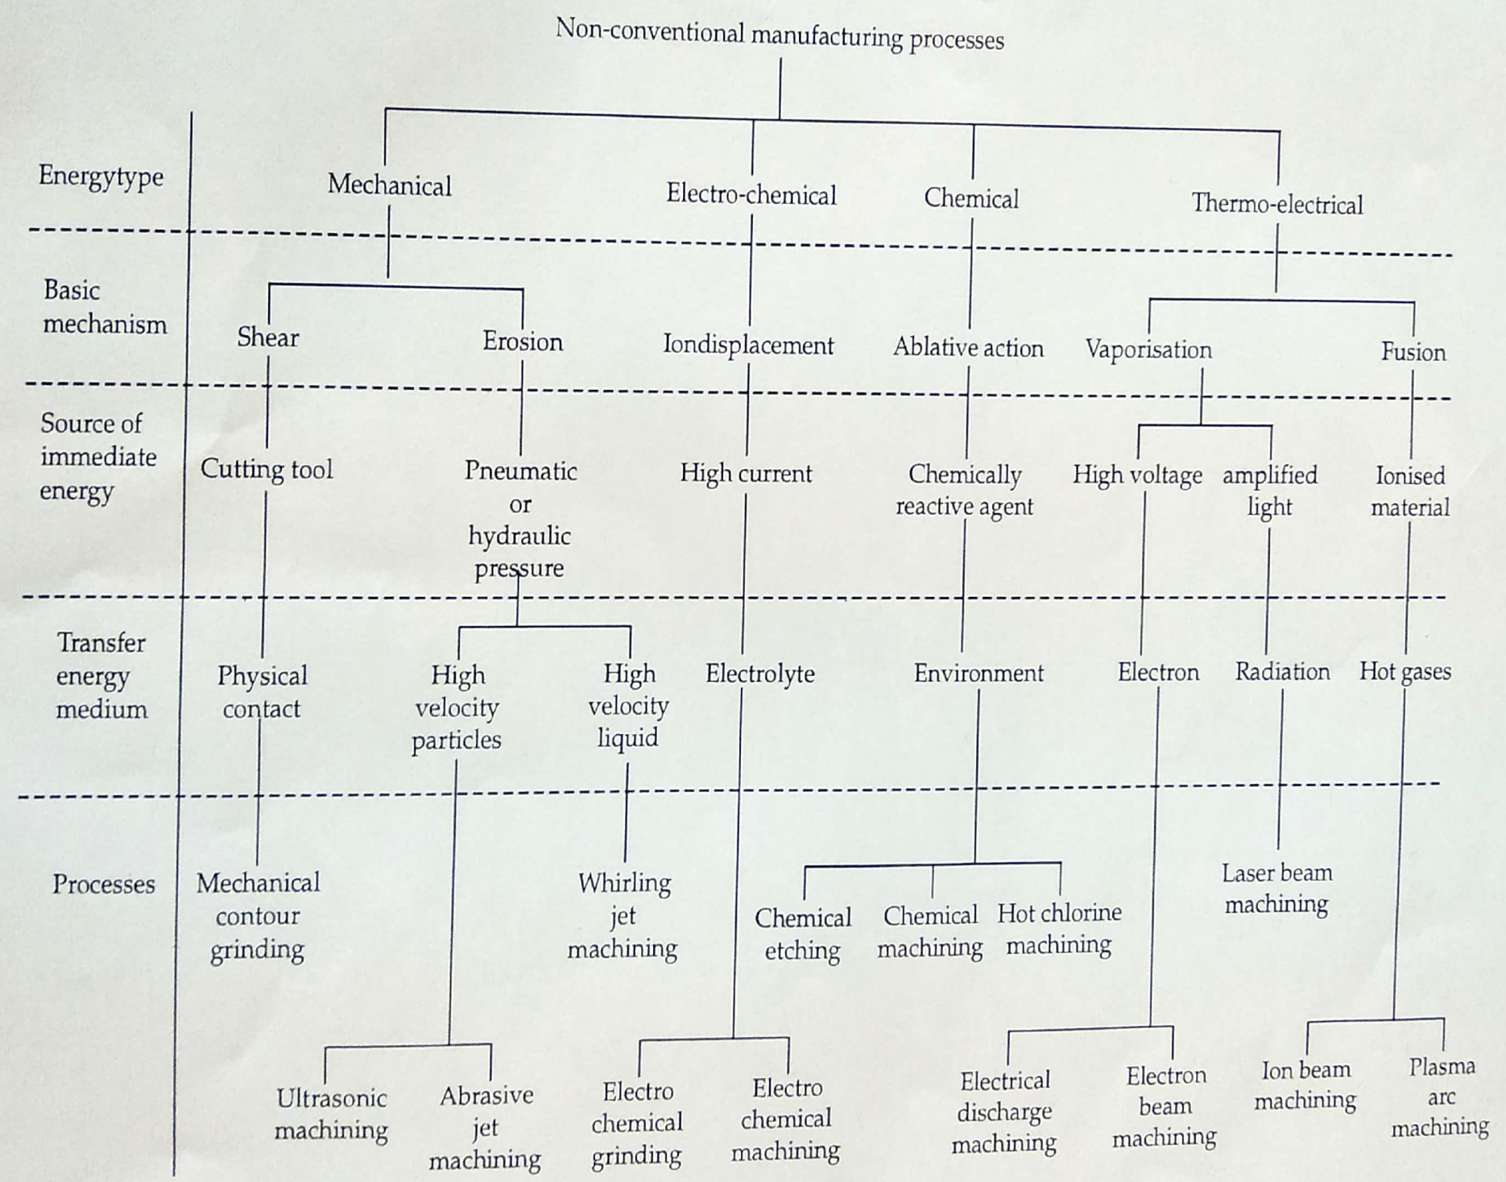

Slide 13
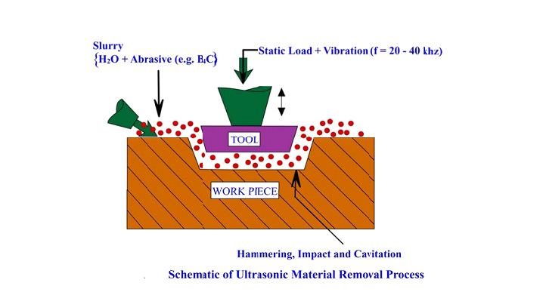
PINCIPLE OF WORKING

Slide 18
When alternate magnetic field is applied to Ferro magnetic material, dimensions of the material changes.
During this process, the material expands or contracts.

Slide 20
Horn or Trunk
Horn: Mechanically modifies the vibratory energy to give the required force – amplitude ratio.

Slide 22
Tool Material: Brass; HSS; MS; SS; WC and Monel
/ Silver soldering or screwed

Slide 23
Size of abrasives: 200 to 2000 grit
200 to 1200 for rough surface;
1200 to 2000 for smooth surface

Slide 24
Liquid Properties
Low Viscosity
Good wetting
Good Thermal conductivity
Non- corrosive
Liquid Functions
Acts as an acoustic bond between the work piece and tool.
Helps in efficient transfer of energy between the tool and work piece.
Acts as a coolant
Provides a medium to carry the abrasive to the cutting zone
Helps to carry away the work abrasive and swarf

Slide 31
Instructional Objectives

Slide 32
Abrasive Jet Machining - Process

Slide 33
AJM EQUIPMENT

Slide 34
Construction of AJM Equipment
Compressor: Pressurizes the gas.
Filter: Filters the gas before entering mixing chamber.
Drier: For removing any moisture in the air.
Mixing chamber: Mix the gas and abrasive particles.
Hopper: For feeding the abrasive powder.
Vibrator: Controls the abrasive powder feed rate in the mixing chamber.
Abrasive jet: Mixture of a gas (or air) and abrasive particles. Most commonly, aluminium oxide or silicon carbide particles are used.
Pressure gauges and flow regulators: To control the pressure and regulate the flow rate of abrasive jet.
Nozzle: It forces the abrasive jet over the workpiece. Nozzle is made of hard and resistant material like tungsten carbide.

Slide 35
Process Variables

Slide 36
Process Variables

Slide 37
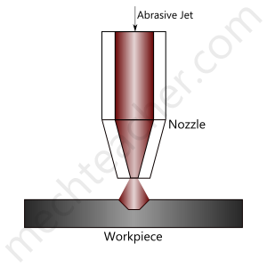
Process Parameters of Abrasive Jet Machining
Process parameters of Abrasive Jet Maching (AJM) are factors that influence its Metal Removal Rate (MRR).
In machining process, Metal Removal Rate (MRR) is the volume of metal removed from a given workpiece in unit time.
Important process parameters of abrasive jet machining:
Abrasive mass flow rate
Nozzle tip distance
Gas Pressure
Velocity of abrasive particles
Mixing ratio
Abrasive grain size

Slide 38
Abrasive mass flow rate:
Is a major process parameter that influences the metal removal rate in abrasive jet machining.
Mass flow rate of the gas (or air) in abrasive jet is inversely proportional to the mass flow rate of the abrasive particles.
Due to this fact, when continuously increasing the abrasive mass flow rate, Metal Removal Rate (MRR) first increases to an optimum value (because of increase in number of abrasive particles hitting the workpiece) and then decreases.
However, if the mixing ratio is kept constant, Metal Removal Rate (MRR) uniformly increases with increase in abrasive mass flow rate.

Slide 39
Nozzle tip distance:
Nozzle Tip Distance (NTD) is the gap provided between the nozzle tip and the workpiece.
Upto a certain limit, Metal Removal Rate (MRR) increases with increase in nozzle tip distance. After that limit, MRR remains constant to some extent and then decreases.
In addition to metal removal rate, nozzle tip distance influences the shape and diameter of cut.
For optimal performance, a nozzle tip distance of 0.25 to 0.75 mm is provided.

Slide 40
Gas pressure:
Air or gas pressure has a direct impact on metal removal rate.
In abrasive jet machining, metal removal rate is directly proportional to air or gas pressure.
Velocity of abrasive particles:
Whenever the velocity of abrasive particles is increased, the speed at which the abrasive particles hit the workpiece is increased.
Because of this reason, in abrasive jet machining, metal removal rate increases with increase in velocity of abrasive particles.

Slide 41
Mixing ratio:
Mixing ratio is a ratio that determines the quality of the air-abrasive mixture in Abrasive Jet Machining (AJM).
It is the ratio between the mass flow rate of abrasive particles and the mass flow rate of air (or gas).
When mixing ratio is increased continuously, metal removal rate first increases to some extent and then decreases.

Slide 42
Abrasive grain size:
Size of the abrasive particle determines the speed at which metal is removed.
If smooth and fine surface finish is to be obtained, abrasive particle with small grain size is used.
If metal has to be removed rapidly, abrasive particle with large grain size is used.

Slide 43
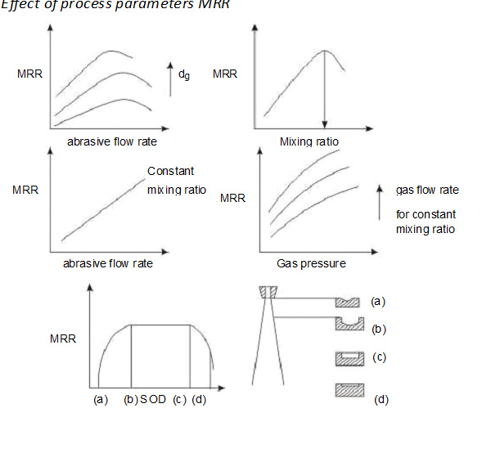
Effect of Process Parameters

Slide 44
Advantages of Abrasive Jet Machining:
Surface of the workpiece is cleaned automatically.
Smooth surface finish can be obtained.
Equipment cost is low.
Hard materials and materials of high strength can be easily machined.

Slide 45
Disadvantages of Abrasive Jet Machining:

Slide 46
Applications
For drilling holes of intricate shapes in hard and brittle materials
For machining fragile, brittle and heat sensitive materials
AJM can be used for drilling, cutting, deburring, cleaning and etching.
Micro-machining of brittle materials

Slide 47
Water Jet Machining (WJM)
Water Jet Machining (WJM) is a mechanical energy based non-traditional machining process used to cut and machine soft and non-metallic materials.
It involves the use of high velocity water jet to smoothly cut a soft workpiece. It is similar to Abrasive Jet Machining (AJM).
In water jet machining, high velocity water jet is allowed to strike a given workpiece.
During this process, its kinetic energy is converted to pressure energy. This induces a stress on the workpiece.
When this induced stress is high enough, unwanted particles of the workpiece are automatically removed.

Slide 48
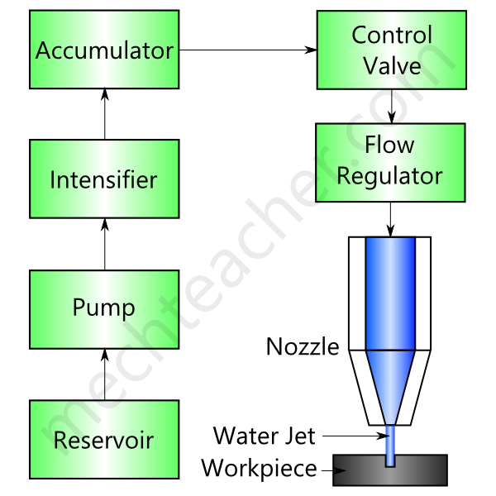
Schematic diagram of Water Jet Machining:
Water Pr. - 4000 bar
Velocity – 1 km / sec
Orifice dia. – 0.1 to 0.3 mm

Slide 49
Construction & Working of Water Jet Machining (WJM):
Reservoir: For storing water.
Pump: It pumps the water from the reservoir.
Intensifier: Pressurizes the water acquired from the pump to a desired level. (Apprx. 4000 bar)
Accumulator: For temporarily storing the pressurized water.
Control Valve: It controls the direction and pressure of pressurized water that is to be supplied to the nozzle.
Flow regulator: It is used to regulate the flow of water.

Slide 50
Nozzle: It renders the pressurized water as a water jet at high velocity.
When water jet strikes the workpiece, stresses are induced.
These stresses are used to remove material from the workpiece.

Slide 51
Advantages of Water Jet Machining (WJM):
Water jet machining is a relatively fast process.
It prevents the formation of heat affected zones on the workpiece.
It automatically cleans the surface of the workpiece.
WJM has excellent precision. Tolerances of the order of ±0.005″ can be obtained.
It does not produce any hazardous gas.
It is eco-friendly.

Slide 52
Disadvantages of Water Jet Machining:
Only soft materials can be machined.
Very thick materials cannot be easily machined.
Initial investment is high.
Applications of Water Jet Machining:
Water jet machining is used to cut thin non-metallic sheets.
It is used to cut rubber, wood, ceramics and many other soft materials.
It is used for machining circuit boards.
It is used in food industry.

