Slide 1
UNIT-5
STEAM POWER CYCLES
RANKINE CYCLE

Slide 2
A Vapor Power Cycle
Q_{in}
2
3
Boiler
W_{out}
W_{in}
Compressor
(pump)
Turbine
Heat exchanger
(Condenser)
1
4
T
Q_{out}
P
2
3
2
3
1
4
1
4
v

Slide 3
Optimization of a Vapor Power Plant
Objectives: design an optimal vapor power cycle
use idealized Carnot cycle as the model
consider all theoretical and practical limitations and redesign the cycle accordingly ⇨Idealized Rankine Cycle
Optimize the Rankine cycle using concepts of superheating, reheating and regeneration
Discuss ways of increasing the efficiency of an idealized Rankine cycle.
Carnot cycle
3
2
T
T
2
3
(a)
OR
(b)
1
4
1
4
Modifed: 11/5/01
s
s

Slide 4
Practical Problems Associated with a Power Plant Using a Carnot Cycle
Maximum temperature limitation for a cycle (a). What is the maximum temperature in the cycle?
Isentropic expansion in a turbine from 3-4. What is the quality of the steam inside the turbine? Will high moisture content affect the operation of the turbine?
Isentropic compression process in a pump from 1-2. Can one design a condenser and a transmission line system that precisely controls the quality of the vapor in order to achieve an isentropic compression?
Even if we can, is it practical to handle two-phase flow (liquid + vapor) using such a system?
The latter two problems can be resolved by the use of cycle b from previous slide.
However, cycle b requires the compression (1-2)of liquid at a very high pressure (exceeding 22 MPa for steam; Q: where do we get this number?) and that is not practical.
Also, to maintain a constant temperature above the critical temperature is also difficult since the pressure will have to change continuously.

Slide 5
Consider a modified cycle - A Rankine cycle
To avoid transporting and compressing two-phase fluid:
We can try to condense all fluid exiting from the turbine into saturated liquid before compressed it by a pump.
Q_{in}
T
3
2
3
Boiler
W_{out}
W_{in}
Compressor
(pump)
2
Turbine
1
4
Heat exchanger
(Condenser)
1
s
4
Q_{out}
When the saturated vapor enters the turbine, as its temperature and pressure decreases, condensation occurs, leading to liquid. These liquid droplets can significantly damage the turbine blades due to corrosion and/or erosion.
One possible solution: superheating the vapor.
It can also increase the thermal efficiency of the cycle (since T_{H} ↑).

Slide 6
Ideal Rankine Cycle - Energy analysis
Assumptions: steady flow process, no generation, neglect KE and PE changes for all four devices,
First Law: 0 = (net heat transfer in) - (net work out) + (net energy flow in)
⇒ 0 = (q_{in} - q_{out}) - (W_{out} - W_{in}) + (h_{in} - h_{out})
T
3
1-2: Pump (q=0)
⇨ W_{pump} = h₂ - h₁ = v(P₂-P₁)
2-3: Boiler (W=0) ⇨ q_{in} = h₃ - h₂
3-4: Turbine (q=0) ⇨ W_{out} = h₃ - h₄
4-1: Condenser (W=0) ⇨ q_{out} = h₄ - h₁
2
1
4
s
Thermal efficiency η = W_{net}/q_{in} = 1 - q_{out}/q_{in} = 1 - (h₄-h₁)/(h₃-h₂)
W_{net} = W_{out} - W_{in} = (h₃-h₄) - (h₂-h₁)

Slide 7
Example - Ideal Rankine Cycle
Q_{in}
2
3
boiler
W_{out}
Turbine
W_{in}
pump
Consider the Rankine power cycle as shown. Steam enters the turbine as 100% saturated vapor at 6 MPa and saturated liquid enters the pump at a pressure of 0.01 MPa. If the net power output of the cycle is 50 MW. Determine (a) the thermal efficiency, (b) the mass flow rate of the system, (c) the rate of heat transfer into the boiler, (d) the mass flow rate of the cooling water from the condenser, in kg/s, if the cooling water enters at 20°C and exits at 40°C.
condenser
1
4
Q_{out}
T
3
2
1
4
s

Slide 8
Solution
At the inlet of turbine, P₃=6MPa, 100% saturated vapor x₃=1, from saturated table A-5, h₃=h_{g}=2784.3(kJ/kg), s₃=s_{g}=5.89(kJ/kg K)
From 3-4, isentropic expansion: s₃=s₄=5.89 (kJ/kg K)
From 4-1, isothermal process, T₄=T₁=45.8°C (why?)
From table A-5, when T=45.8°C, s_{f4}=0.6491, s_{fg4}=7.5019, h_{f4}=191.8, h_{fg4}=2392.8
x₄ = (s₄-s_{f4})/s_{fg4} = (5.89-0.6491)/7.5019 = 0.699
h₄ = h_{f4}+x₄* h_{fg4} = 191.8+0.699(2392.8) = 1864.4 (kJ/kg)
At the inlet of the pump: saturated liquid h₁=h_{f1}=191.8
q_{out} = h₄-h₁=1672.6(kJ/kg)
At the outlet of the pump: compressed liquid v₂=v₁=v_{f1}=0.00101(m³/kg)
work input to pump W_{in} = h₂-h₁ = v₁ (P₂-P₁) = 0.00101(6000-10) = 6.05
h₂ = h₁ + v₁ (P₂-P₁) =191.8 + 6.05 = 197.85 (kJ/kg)
In the boiler, q_{in}=h₃-h₂=2784.3-197.85=2586.5(kJ/kg)

Slide 9
Solution (cont.)
(a) The thermal efficiency η = 1-q_{out}/q_{in}= 1-1672.6/2586.5=0.353=35.3%
(b) Net work output dW/dt=50MW=(dm/dt)(W_{out}-W_{in})=(dm/dt)((h₃-h₄)-(h₂-h₁))
mass flow rate (dm/dt)=50000/((2784.3- 1864.4 )-(197.85-191.8))=54.7(kg/s)
( c) heat transfer into the boiler q_{in} = (dm/dt)(h₃-h₂)=54.7(2586.5)=141.5(MW)
(d) Inside the condenser, the cooling water is being heated from the heat transfered from the condensing steam.
q _{cooling water} = q_{out} = (dm/dt)(h₄-h₁) = 54.7(1672.6) = 91.49 (MW)
(dm/dt)_{cooling water} C_{p} (T_{out} - T_{in}) = q _{cooling water}
C _{p, water} = 4.177(kJ/kg K)
(dm/dt)_{cooling water} = 91490/(4.177*(40-20)) = 1095.2 (kg/s)
⇨Very large amount of cooling water is needed ⇦

Slide 10
Thermal Efficiency – How to enhance it?
Thermal efficiency can be improved by manipulating the temperatures and/or pressures in various components
(a) Lowering the condensing pressure (lowersT_{L,} but decreases quality, x₄ )
(b) Superheating the steam to a higher temperature (increases T_{H} but requires higher temp materials)
(c) Increasing the boiler pressure (increases T_{H} but requires higher temp/press materials)
T
3
(c) increase pressure
T
3
2
(b) Superheating
2
1
4
2
T
1
4
1
4
s
(a) lower pressure(temp)
Low quality
high moisture content
2
s
Red area = increase in W net
1
Blue area = decrease in W net
s

Slide 11
Reheating
The optimal way of increasing the boiler pressure without increasing the moisture content in the exiting vapor is to reheat the vapor after it exits from a first-stage turbine and redirect this reheated vapor into a second turbine.
T
high-P
turbine
5
3
3
high-P
turbine
Low-P
turbine
low-P
turbine
boiler
4
4
4
5
2
6
1
6
2
pump
1
condenser
s

Slide 12
Reheat Rankine Cycle
Reheating allows one to increase the boiler pressure without increasing the moisture content in the vapor exiting from the turbine.
By reheating, the average temperature of the vapor entering the turbine is increased, thus, it increases the thermal efficiency of the cycle.
Multistage reheating is possible but not practical. One major reason is because the vapor exiting will be superheated vapor at higher temperature, thus, decrease the thermal efficiency. Why?
Energy analysis: Heat transfer and work output both change
q_{in} = q_{primary} + q_{reheat} = (h₃-h₂) + (h₅-h₄)
W_{out} = W_{turbine1} + W_{turbine2} = (h₃-h₄) + (h₅-h₆)

Slide 13
Regeneration
From 2-2’, the average temperature is very low, therefore, the heat addition process is at a lower temperature and therefore, the thermal efficiency is lower. Why?
Use a regenerator to heat the liquid (feedwater) leaving the pump before sending it to the boiler. This increases the average temperature during heat addition in the boiler, hence it increases efficiency.
Extract steam @ 6
From turbine to provide
heat source in the
regenerator
Lower temp
heat addition
higher temp
heat addition
3
T
5
T
2’
4
6
2
2
3
1
4
1
7
s
s
Use regenerator to heat up the feedwater

Slide 14
Regenerative Cycle
Improve efficiency by increasing feedwater temperature before it enters the boiler.
Two Options:
Open feedwater : Mix steam with the feedwater in a mixing chamber.
Closed feedwater: No mixing.
Open FWH
5
T
5
boiler
4
Open
FWH
6
(y)
6
(y)
7
(1-y)
2
3
(1-y)
4
3
2
Pump 2
1
7
s
Pump 1
1
condenser

Slide 15
Regenerative Cycle - Analysis
Assume y percent of steam is extracted from the turbine and is directed into open feedwater heater.
Energy analysis:
q_{in} = h₅-h₄, q_{out} = (1-y)(h₇-h₁),
W_{turbine, out} = (h₅-h₆) + (1-y)(h₆-h₇)
W_{pump, in} = (1-y)W_{pump1} + W_{pump2}
= (1-y)(h₂-h₁) + (h₄-h₃)
= (1-y)v₁(P₂-P₁) + v₃(P₄-P₃)
In general, more feedwater heaters result in higher cycle efficiencies.

Slide 16
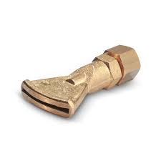
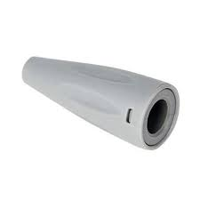
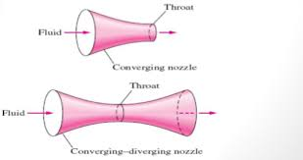
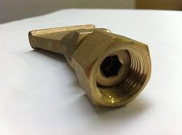
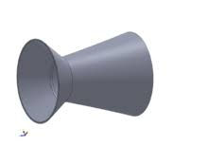
STEAM NOZZLES
STEAM NOZZLES

Slide 17
STEAM NOZZLES

Slide 18
STEAM NOZZLES

Slide 19
STEAM NOZZLES

Slide 20
STEAM NOZZLES

Slide 21
STEAM NOZZLES

Slide 22
h1 + V₁² /2+ Q = h2 + V₂² /2 + W
➔dQ = dh + d(V² /2) + dW
STEAM NOZZLES

Slide 23
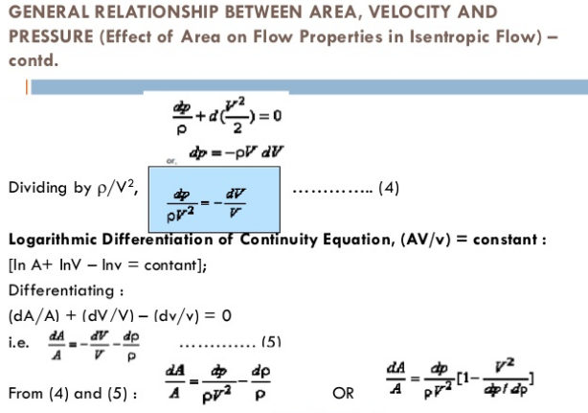
STEAM NOZZLES

Slide 24
STEAM NOZZLES

Slide 25
STEAM NOZZLES

Slide 26
STEAM NOZZLES

Slide 27
STEAM NOZZLES

Slide 28
STEAM NOZZLES

Slide 29
STEAM NOZZLES

Slide 30
STEAM NOZZLES

Slide 31
STEAM NOZZLES

Slide 32
STEAM NOZZLES

Slide 33
STEAM NOZZLES

Slide 34
STEAM NOZZLES

Slide 35
STEAM NOZZLES

Slide 36
STEAM NOZZLES

Slide 37
STEAM NOZZLES

Slide 38
STEAM NOZZLES

Slide 39
STEAM NOZZLES

Slide 40
STEAM NOZZLES

Slide 41
STEAM NOZZLES

Slide 42
STEAM NOZZLES

Slide 43
STEAM NOZZLES

Slide 44
STEAM NOZZLES

Slide 45
STEAM NOZZLES

Slide 46
STEAM NOZZLES

Slide 47
STEAM NOZZLES

Slide 48
THANKYOU
V UNIT
COMPLETED
SYLLABUS
COMPLETED

