Slide 1
Cell Theory
1

Slide 2
Review
Characteristics of living things.
2

Slide 3
Review
Living things -
Are made up of units called cells.
Reproduce.
Are based on a universal genetic code (DNA).
Grow and develop.
Obtain and use materials and energy.
Respond to their environment.
Maintain a stable internal environment.
When taken as a group, change over time.³

Slide 4
Review
Living things -
...are made up of Cells
...contain Materials and energy
... Maintain Stable internal environment
... Grow
...they Respond to Environment
...they carry Genetic code
...they Reproduce
...they Change over time.
4

Slide 5
Review
Microscopes
Light Microscopes
Light that passes through specimen.
Electron Microscopes
Use beams of electrons to produce images.
5

Slide 6
Most cells are too small to be seen with unaided eye.
Before 17th century, no one knew cells existed.
6

Slide 7
Anton van Leeuwenhoek
1632 - 1723
Dutch scientist
(Holland)
Made 1st hand- held microscope
•Observed microscopic organisms in pond water
8

Slide 8
Anton van Leeuwenhoek
8

Slide 9
Anton van Leeuwenhoek
9

Slide 10
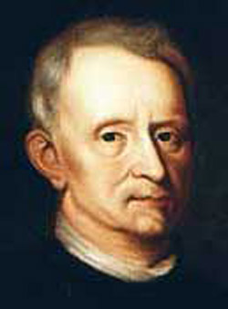
Robert Hooke
1635 - 1703
Englishman
developed an improved microscope
observed small organisms
1665 - noted box-like structures in thin slice of cork
viewed plant cell walls
called cells
reminded him of sleeping rooms in monasteries
11

Slide 11
Robert Hooke Microscope

Slide 12
Robert Hooke Dead Cork Tissue under microscope

Slide 13
Robert Hooke
Made drawings of his observations
Drawing of cork - plant cell walls
Published drawings in
Micrographia in 1665

Slide 14
Robert Brown
1773 - 1858
Scottish botanist
discovered cell nucleus

Slide 15
Matthias Shleiden
1814 - 1881
German
Studied plant structure under microscope
Proposed that all plants composed of cells
Co-founder of Cell Theory

Slide 16
Theador Schwann
1810 - 1882
Examined animal tissue
Observed structures similar to what Shleiden observed in plants
Stated that all living things were made of cells
Co-founder of Cell Theory

Slide 17
Rudolf Virchow
1821 - 1902
German
doctor
showed that cells are result of division of preexisting cells

Slide 18
Rudolf Virchow
Virchow’s idea contradicted the idea of spontaneous generation (idea that nonliving things could give rise to organisms)
Also, developed a standard method of autopsy that is still used today

Slide 19
Cell Theory
The combined work of Schleiden, Schwann, & Virchow is known as the "Cell Theory".

Slide 20
What were their contributions to Cell Theory?
Shleiden
Schwann
Virchow

Slide 21
What were their contributions to Cell Theory?
Shleiden - All plants composed of cells
Schwann - All living things composed of cells
Virchow - Cells are result of division of preexisting cells

Slide 22
Three Basic Principles of Cell Theory - Review
All living things are made of one or more cells.
Cells are the basic unit of structure & function in living things.
Cells come only from the reproduction of existing cells.

Slide 23
Two groups of cells
Cells can be divided into two groups:
Prokaryotes and Eukaryotes

Slide 24
Prokaryotes Meaning
Pro = before Karyote = kernel or nucleus
Do not have a nucleus
Prokaryotic cells are generally smaller and less complex than eukaryotic cells
Have genetic material (but it is not contained in nucleus)
Carry out all activities of living things.
Example - bacteria
24

Slide 25
Kingdom Monera
The kingdoms Monera which includes all the bacteria and the protoctista which includes the protoza, the diatoms and some algae are in a way the lowest among the living world.
All bacteria, majority of Protoctists and many fungi are microscopic and generally referred to as microorganisms.
This emphasizes the fact that kingdom Monera is the only prokaryotic kingdom and also it is the most primitive;

Slide 26
KINGDOM MONERA Features:
Includes the bacteria and cyanobacteria (commonly called blue-green algae). Since only bacteria are prokaryotic (lacking a true nucleus), that is without nuclear membrane), monera is the only prokaryotic kingdom.
Bacteria were the first organisms to evolve on planet earth after life originated around 3.5 billion years ago and were the only organisms on earth for almost the next two billion years.
All bacteria and cyanobacteria are single celled or unicellular (monere : single)
Monerans are also the most numerous of all living organisms.

Slide 27
KINGDOM MONERA
STRUCTURE OF A BACTERIAL CELL
The single celled bacterum has a cell wall made of compound peptido-glycan covering the cell membrane; a single chromosome.
The cell has ribosomes but no membrane bound organelles.

Slide 28
SIMPLE STRUCTURE OF A BACTERIAL CELL- Diagrammatic

Slide 29
Bacterial Cell structure-description
Cell wall
All prokaryotes have a rigid cell wall, which protects and gives shape to the cell. The cell wall is made up of a chemical, peptidoglycan, unique to bacteria.
Pili (Singular : pilus)
Pili are short and thin thread like structures projecting out from the cell wall in some bacteria.
Flagella
Some bacteria move with the help of one or two flagella. Flagella are longer and thicker than pili. Their structure is different from flagella of eukaryotes.
Plasma Membrane
Plasma membrane, present below the cell wall, encloses the cytoplasm and other cell contents. It is made up of lipids and proteins, as in eukaryotes.
Genetic Material
One circular chromosome made of a double helical molecule of DNA is located in a region of the cytoplasm called nucleoid. Since the chromosome is not lodged within a true nucleus, bacteria are termed prokaryotes. Hence Monera is the prokaryotic kingdom. Apart from the chromosome many species of bacteria possess rings of DNA called plasmids, which replicate along with bacterial chromosome and bear genes for antibiotic resistance, sex factor etc.
Cell Organelles
Membrane bound organelles like endoplasmic reticulum, mitochondria, chloroplast, golgi complex are absent. Only ribosomes are present, which are different from those of eukaryotes

Slide 30
Monera - General body functions
A. Nutrition
The four nutritional categories found in bacteria are :
(i) Autotrophs - synthesize their own organic food.
(ii) Saprotrophs - feed on dead and decaying matter.
(iii) Symbionts - use food from other living organisms with which they are associated for mutual benefit.
(iv) Parasites - absorb food from living organisms and cause harm to them.
B. Respiration
Respiration in bacteria may be either
(i) aerobic i.e. using oxygen for respiration or
(ii) anaerobic i.e. respiration in the absence of oxygen.
Cellular respiration or breakdown of food to release energy occurs in mesosomes which are the inner extensions of the cell membrane.
C. Reproduction
(i) Asexual Reproduction
Bacteria reproduce asexually by binary fission under favourable conditions it takes about 20 minutes for one bacteria to divide into two by binary fission.

Slide 31
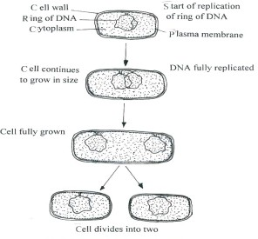
Reproduction in Monerans i) Asexual Reproduction

Slide 32
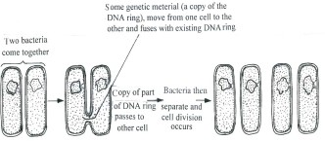
ii). Sexual Reproduction Some bacteria show a primitive mode of sexual reproduction. It is different from sexual reproduction in higher form. The steps are: A. Two conjugating (lie very close for exchange of genes) bacteria are held together by pili. B. A segment of DNA strand is transferred from one bacterium to another bacterium.

Slide 33
Diversity and Evolution of Life: Beneficial and harmful bacteria
They harm humans and animals by causing many diseases. On the other hand, some bacteria are very useful.
Beneficial and harmful bacteria:
Diseases Caused By Bacteria
Beneficial Activities of Bacteria
Name of Bacterium Name of Diseases Caused
1. Vibrio cholerae Cholera
2. Salmonella typhi Typhoid
3. Clostridium tetani Tetanus
4. Corynebacterium diptheriae Diphtheria
5. Mycobacterium tuberculosis Tuberculosis
Bacterium Activities
1. Rhizobium: Found in roots of legumes, (Peas, grams, Pulses etc) fixes atmospheric nitrogen as ammonia, which is then converted into useful amino acid.
2. Azotobacter Makes the soil fertile. It fixes atmospheric nitrogen in the soil.
3. Streptomycetes Produces Streptomycin antibiotic.
4. Lactobacillus Ferments lactose (milk sugar) to lactic acid. This helps in setting of milk into curd.
5. Methanogenic bacteria Sewage treatment

Slide 34
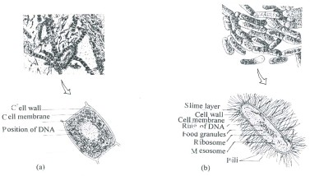
Cyanobacteria
These were earlier called the blue green algae. A very successful group on primitive earth.
They could carry out photosynthesis and the oxygen releases during the process changed the earth’s atmosphere and gradually the level of oxygen increased in the earth’s atmosphere.

Slide 35
Differences between Bacteria and Cyanobacteria
Bacteria | Cyanobacteria
Smaller cells May have flagella Some bacteria (green) carry out photosynthesis in a different way and do not release oxygen Sexual reproduction by conjugation. | Comparatively larger cells Do not have flagella. They all carry out photosynthesis in the usual manner as in green plants and release oxygen Conjugation has not been observed.

Slide 36
Archaebacteria
Kingdom Monera includes two groups:-
1. Archaebacteria and
2. Eubacteria
Archaebacteria includes bacteria that live in unusual environments particularly at low levels of oxygen. Main types of Archaebacteria are
• Methanogenic bacteria that live in sewage and intestinal tracts of animals
• Thermoacidophilic bacteria that live in hot springs.
• Halophilic bacteria live in salty conditions e.g. where hot sun concentrates sea water.
Eubacteria include cyanobacteria and all other bacteria.

Slide 37
Eukaryotes
eu = true
karyote = kernal or nucleus
Have a true nucleus
Generally larger and more complex cells
Have genetic material in nucleus
Some are uni-cellular organisms Others multi-cellular organisms
Examples - plants, animals, fungi, protists

Slide 39
Review
Major differences between prokaryote and eukaryote cells

Slide 40
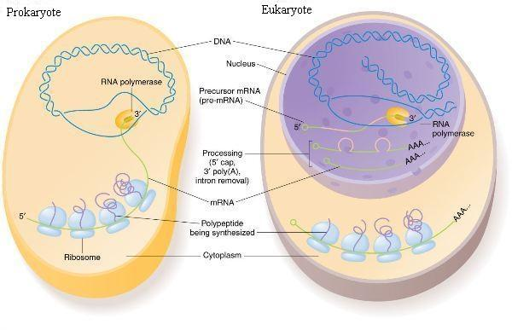

Slide 41
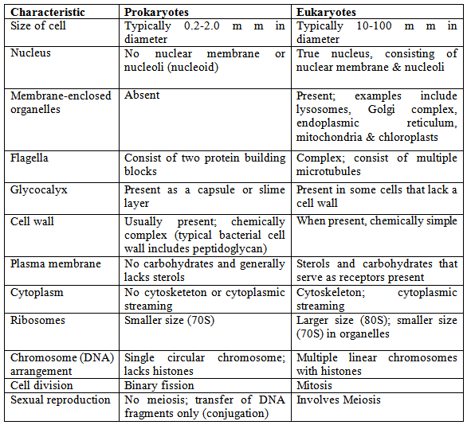

Slide 42
KINGDOM PROTOCTISTA (UNICELLULAR EUKARYOTES)
Protoctista are unicellular eukaryotes. Protozoa and diatoms and algae are included in it.
They have membrane bound organelles such as nucleus with chromosomes enclosed in nuclear membrane, mitochondria, chloroplast (in photosynthetic protoctists only), golgi bodies and endoplasmic reticulum.
Mitochondria are the respiratory organelles.
Protoctists are either photosynthetic, parasitic or saprotrophic.
For locomotion, protoctists may have cilia or flagella (Fig.) having 9 + 2 arrangement of microtubules unlike those of bacteria, which have the 9 + 1 arrangement of microtubules.
They reproduce both asexually and sexually.
Some protoctists are beneficial to humans while others are harmful.

Slide 43
Classification of Protoctista
The kingdom protoctista includes –
Phylum Protozoa which has the following four classes : Rhizopoda: Example Amoeba Flagellata: Example Euglena Ciliata: Example Paramecium Sporozoa: Example Plasmodium
Phylum Bacillariophyta : Example diatoms
The algae belong to:- Phylum Chlorophyta : Example Chlorella Phylum Phaeophyta : Example Brown algae Phylum Rhodophyta : Exmaple Red algae Phylum Oomycota: Example Phytophthora

Slide 44
Some examples of Protoctists
1. Amoeba
Amoeba is commonly found in the mud in fresh water ponds and ditches containing decaying leaves.
– It has blunt pseudopodia for locomotion.
– It captures food by pseudopodia to form a food vacuole.
– It has a contractile vacuole for osmoregulation.
-- Reproduction : . Asexual reproduction is by binary fission. Sexual reproduction is absent in Amoeba
2. Entamoeba
One common species is Entamoeba histolytica which cause amoebic dysentery in humans. It is amoeboid in form. New host gets infected when the cyst is swallowed along with contaminated food or water. The cyst bursts and releases Entamoeba in the intestines where it causes local abscesses (open injury). The symptoms of amoebic dysentery are abdominal pain, nausea, blood and mucus with stool.
3. Plasmodium (The malarial parasite)
The life cycle of Plasmodium has both asexual and sexual phases.
– The asexual phase is spent in the human blood.
– Sexual phase is spent in the female Anopheles mosquito

Slide 45
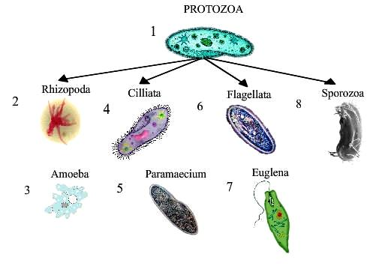
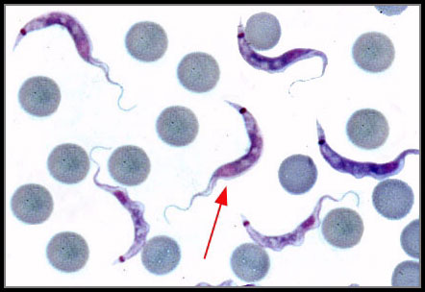
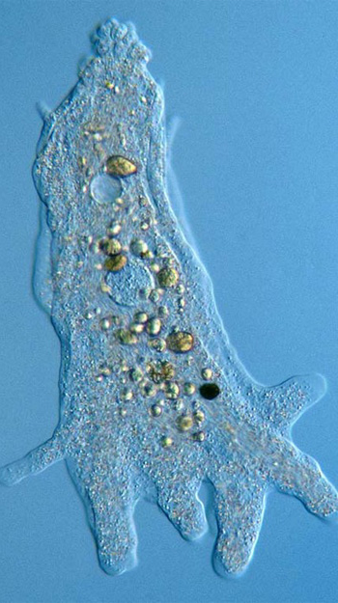
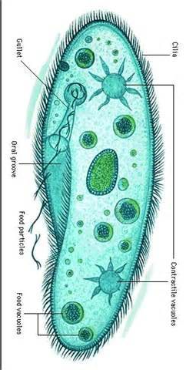
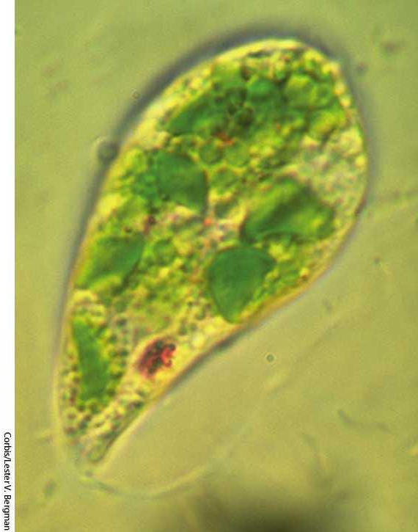
PROTOZOANS: Class 1. Flagellata or Mastigophora
Class 2. Rhizopoda
Class 3. Ciliophora
Class 4. Sporozoa

Slide 46
Protists
(green Algae)
seaweed)

Slide 47
Kingdom Protista
4. Euglena – A fresh water Flagellate
Euglena is abundantly found in stagnant waters such as pools, ponds, ditches etc. containing decaying organic matter. The organism has the following parts...
Pellicle - elastic body covering made up of protein.
Cytostome and Reservoir - the cell mouth leading into a tubular cytopharynx which opens into a vesicle called reservoir.
Stigma - a prominent red pigment spot. It is sensitive to light.
Contractile Vacuole - for osmoregulation.
Flagellum - for propulsion in water.
Chloroplast - contain green coloured chlorophyll is for photosynthes.
Reproduction - is by binary fission.
5. The Diatoms
– The diatoms are found in both fresh and salt water and in moist soil.
– Thousands of species of diatoms form food for aquatic animals.
– Diatoms are either unicellular, colonial or filamentous and occur in a wide variety of shapes.
– Each cell has a single prominent nucleus and plastids. They produce shells (cell walls) containing silica.
6. Other Algae
– Algae can be unicellular e.g. Chlamydomonas or multi-cellular like Spirogyra

Slide 48
– Algae can prepare their own food by photosynthesis as they contain chlorophyll. Some algae have other pigments also e.g. blue pigment (Phycocyanin), a brown pigment (Fucoxanthin) or a red pigment (Phycoerythrin). Depending on the pigment present, the algae are called blue, green, brown or red algae.
– Structurally the algae have a definite cell wall, cell membrane, a nucleus, cytoplasm and choloroplast. The chloroplast is cup-shaped in Chlamydomonas and ribbon-shaped in Spirogyra. Pyrenoid bodies are attached to chloroplasts.
Usefulness of Algae
Provide food for fish as part of phytoplankton (organisms floating on the water surface)
These are rich sources of vitamins A and E.
Many marine forms are important sources of iodine, potassium and other minerals.
Blue-green algae increase the soil fertility by fixing atmospheric nitrogen.
Some algae can fix atmospheric nitrogen, so they are a source of natural fertilizer for the plants.
A group of algae (diatoms) deposit silica in their walls. After their death these algae are preserved as fossils. Their deposits in large amounts are used as f lters, and for lining of furnaces.

Slide 49
Kingdom Fungi
The kingdom Fungi includes a diverse group of organisms that are neither plant nor animal. A characteristic that places fungi in a different kingdom from plants, bacteria, and some protists is chitin in their cell walls.They absorb nutrition from other organisms while playing the important role of ecological decomposers.
These unique multicellular eukaryotes include edible examples like mushrooms and organisms such as yeast, which makes our bread rise and ferments our beer and wine. Fungi are the principal decomposers in ecological systems and their impact on our world as decomposers is absolutely crucial to every ecosystem.
Members of the kingdom Fungi are eukaryotes, meaning they have complex cells with a nucleus and organelles. Most are multicellular, with the exception of single-celled yeast. Structurally, fungi are made up of individual feathery filaments called hyphae.
The hyphae group together to form a conglomerate called the mycelium. You may notice that when you cut into a mushroom, it has a spongy feel. This is because it is actually made up of a mass of very tightly packed hyphae, and thus, is not exactly solid.
Similar to animals, all fungi are heterotrophic, meaning that they cannot make their own food like plants; they acquire their food by absorbing dissolved molecules, typically by secreting digestive enzymes into their environment. Fungi do not photosynthesize. Growth is their means of mobility, except for spores (a few of which are flagellated), which may travel through the air or water.

Slide 50
Fungi

Slide 51
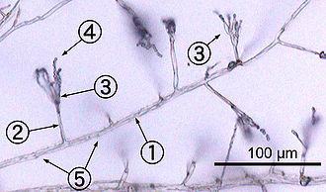
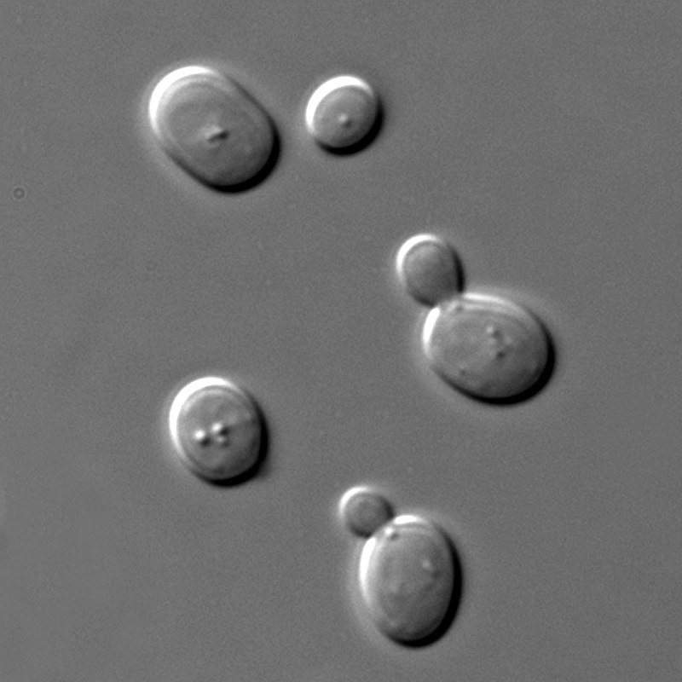
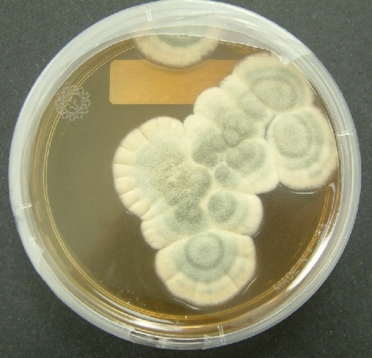
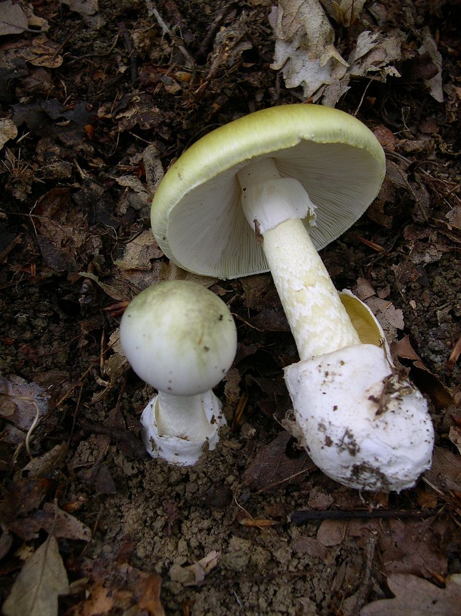
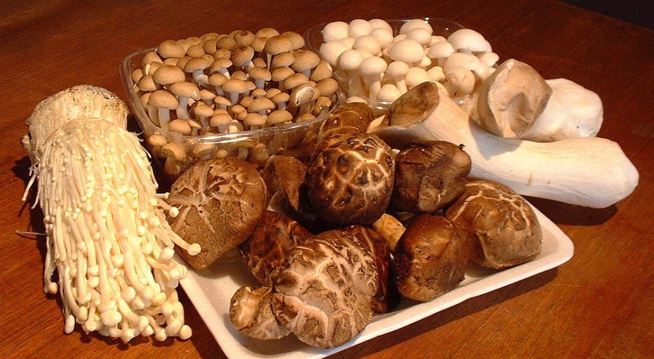

Slide 52
General Characteristics of Fungi:
Eukaryotic
Decomposers – the best recyclers around
No chlorophyll – non photosynthetic
Most multicellular (hyphae) –some unicellular (yeast)
Non-motile
Cell walls made of chitin (kite-in) instead of cellulose like that of a plant
Are more related to animals than plant kingdom
Lack true roots, leaves and stems
Absorptive heterotrophs -Digest food externally and then absorb it
Lack of chlorophyll affects the lifestyle of fungi…
Not dependant on light
Can occupy dark habitats
Can grow in any direction
Can invade the interior of a substrate with absorptive filaments

Slide 53
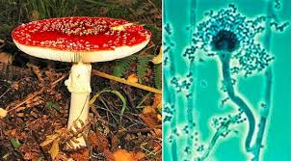
Structures
Body of fungus made of tiny filaments or tubes called hyphae.
Contain cytoplasm and nuclei (more than 1)
Each hyphae is one continuous cell
Cell wall made of chitin
A tangled mess of hyphae is called mycelium
Rhizoids are root-like parts of fungi that anchor them to the substrate (whatever they are bonding to)
Mycelium increase the surface area of the fungi to absorb more nutrients.

Slide 54
CLASSIFICATION OF FUNGI:
Fungi can be classified into 5 groups
Fungi evolved from an aquatic, flagellated ancestor
Chytrids
Glomeromycetes (Mycorrhizae fungi)
Mycorrhizae are mutually beneficial associations of plant roots and fungi
Common and may have enabled plants to colonize land
Help create an extending network for the plant to absorb more nutrients and water
Ascomycetes (Sac fungi) e.g.,Truffles and yeast
Basidiomycetes (club fungi) e.g., Puff ball mushroom
Zygomycetes (zygote fungi)

Slide 55
Fungus Reproduction:
Fungi produce spores in both asexual and sexual life cycles
Mushrooms let out spores from their pores that are carried by the wind to meet other spores and become a new fungi
Yeast are unicellular and divide into new fungal cells (mitosis)
Fungi Structure and Function
o In some fungi, fusion of haploid hypha produces a heterokaryotic stage containing nuclei from two parents (fusion of cytoplasm)
o After the nuclei fuse, meiosis produces haploid spores (can grow in fungi and are the asexual part of the life cycle)
General Fungi Reproduction Cycles:
But fungal groups do differ in their life cycles and reproductive structures
Reproduction in Basidiomycetes: Basidiomycota (typical mushroom)
ASCOMYCOTA
3 Modes of Nutrition in Fungi:
Saprophytes
Parasites
Mutualists (symbionts)

Slide 56
