Slide 1
UNIT -II
TYPES OF NATURAL DISASTERS
Hydrometereological Disasters
Cyclones
Floods
Drought
Desertification
Thunderstorms
Hail storms
2) Geographical based Disasters
Earth quake
Tsunami
Landslides
Avalanches

Slide 2
Hydrometereological Disasters
Cyclones
Cyclone is a region of low atmospheric pressure surrounded by high atmospheric pressure resulting in swirling atmospheric disturbance accompanied by powerful winds blowing in anticlockwise direction in the Northern Hemisphere and in the clockwise direction in the Southern Hemisphere
They occur mainly in tropical and temperate regions
General Characteristics
Strong winds
Exceptional rain
Storm surge

Slide 3
Various Names of cyclones
Typhoons in the Northwest Pacific Ocean west of the dateline
Hurricanes in the North Atlantic Ocean, the Northeast Pacific Ocean east of the dateline, or the South Pacific Ocean.
Tropical cyclones - the Southwest Pacific Ocean and Southeast Indian Ocean.
Severe cyclonic storm” (the North Indian Ocean)
Tropical cyclone (the Southwest Indian Ocean)
Willie-Willie in Australia
Tornado in South America

Slide 4
Stages of Cyclone Formation
The development of a cyclone covers three stages namely
Formation and initial development state
Fully matured
Weakening or decay

Slide 5
Formation and initial development state:
Four atmospheric/ oceanic conditions are necessary for the formation of a cyclone namely:
A warm sea temperature in excess of 26 degree centigrade, to a depth of 60 meters, which provides abundant water vapor in the air by evaporation.
High relative humidity (degree to which the air is saturated by water vapor) of the atmosphere to a height of about 7000 meters, facilitates condensation of water vapor into droplets and clouds, releases heat energy and induces drop in pressure.
Atmospheric instability (an above average decrease of temperature with altitude) encourages considerable vertical cumulus cloud convection when condensation of rising air occurs.
A location of at least 4-5 latitude degrees from the Equator allow the influence of the force due to the earth’s rotation (Coriolis force) to take effect in inducing cyclonic wind circulation around low pressure centers.

Slide 6
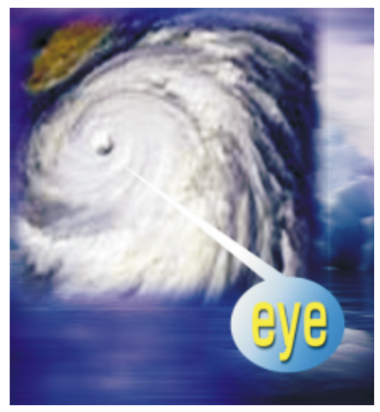
Fully matured
The main feature of a fully mature tropical cyclone is a spiral pattern of highly turbulent giant cumulus thundercloud bands. These bands spiral inwards and form a dense highly active central cloud core which raps around a relatively calm zone.
This is called the “eye “of a cyclone. The eye looks like a black hole or a dot surrounded by thick clouds. The outer circumference of the thick cloud is called the ‘eye wall’.

Slide 7
Weakening or decay:
A tropical cyclone begins to weaken as soon as its source of warm moist
air is abruptly cut off. It happens,
when the cyclone hits the land,
Or
the cyclone moves to a higher altitude
Or
when there is the interference of another low pressure.
Cyclone may last for less than 24 hours to more than 3 weeks.
On an average the life cycle of a cyclone takes six days.
The longest cyclone is typhoon John which lasted for 31 days (August to September, 1994 in the north east and north west pacific basins).

Slide 8
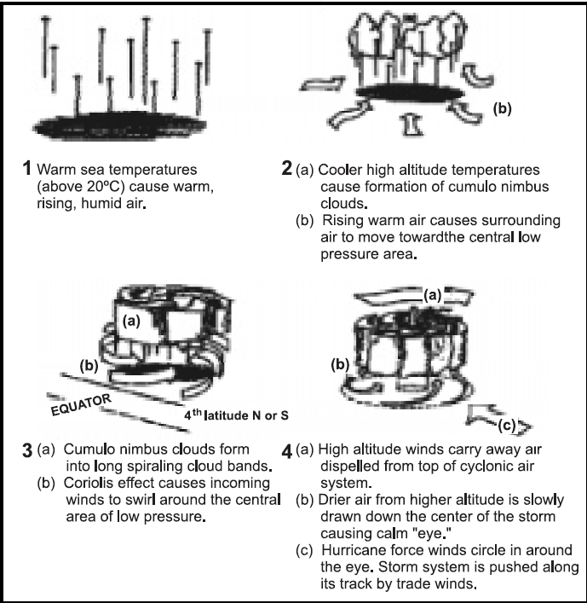
Stages of cyclone formation

Slide 9
Indian Cyclones
7516.6 kilometers long Indian coastline is the earth’s most cyclone battered stretch of the world.
Around 8 per cent of the total land area in India is prone to cyclones.
About two-third of the cyclones that occur in the Indian coastline occur in the Bay of Bengal.
Five or six tropical cyclones occur every year, of which two or three could be severe.
Winds move with a speed between 65 Km/h and 117 Km/h for cyclonic storms and for severe cyclonic storm they move between 119 Km/h and 164

Slide 10
S.No | States / Union Territories | Length of Coastline (km) | Area (000’ km2) | Population (million)
1 | Gujarat | 1,600 | 196.00 | 4.12
2 | Maharashtra | 840 | 307.70 | 7.87
3 | Goa | 300 | 3.70 | 0.12
4 | Karnataka | 400 | 191.80 | 4.48
5 | West Bengal | 950 | 88.70 | 6.80
6 | Tamil Nadu | 720 | 130.10 | 5.56
7 | Orissa | 560 | 155.70 | 3.15
8 | Kerala | 1,014 | 39.00 | 2.90
9 | Andhra Pradesh | 960 | 275.00 | 6.63
10 | Andaman & Nicobar Islands | ---- | 8.50 | 0.03
11 | Lakshadweep | ---- | 0.03 | 0.005

Slide 11
Death associate with noteworthy Tropical Cyclones
S.No | Year | Area | Death Toll
1 | 1971 | Eastern Coast | 9658
2 | 1972 | Andhra Pradesh & Orissa | 100
3 | 1977 | Chennai, Kerala & AP | 14204
4 | 1979 | Andhra Pradesh | 594
5 | 1981 | Gujarat | 470
6 | 1982 | Gujarat & Maharashtra | 500
7 | 1984 | Tamilnadu & AP | 512
8 | 1985 | Andhra Pradesh | 5000
9 | 1990 | Andhra Pradesh | 957
10 | 1990 | Andhra Pradesh | 250
11 | 1999 | Orissa | 8913

Slide 12
Warning
India has one of the best cyclone warning systems in the world.
The India Meteorological Department (IMD) is the nodal department for wind detection, tracking and forecasting cyclones.
Cyclone tracking is done through INSAT satellite.
The cyclone warning are issued to State Government officials in four stages: i.e.
(i) pre-cyclone watch issued 72 hours in advance,
(ii) cyclone alert issued at least 48 hours in advance ,
(iii) cyclone warning issued at least 24 hours in advance, and
(iv) as post landfall outlook issued at least 12 hours in advance
of expected time of landfall.
Cyclone warning is disseminated by satellite based disaster warning systems, radio, television, telephone, fax, public announcements.

Slide 13
Effects of cyclone
Physical damage
Structures will be damaged or destroyed by the wind
force, flooding and storm surge
Light pitched roofs of most structures(industrial buildings) will suffer severe damage.
Casualties and public heath
contamination of water supplies may lead to viral outbreaks, diarrhea, and malaria
Water supplies
Ground and pipe water supply may get contaminated by flood waters

Slide 14
Crops and food supplies
high winds and rains ruin the standing crop and food stock lying in low lying areas.
Plantation type crops such as banana and coconut are extremely vulnerable.
Salt from the sea water may get deposited on the agricultural land and increase the salinity.
The loss of the crop may lead to acute food shortage
Communication
severe disruption in the communication links
electricity and communication towers, telephone poles, telephone lines are destroyed
Transport lines (road and rail) may be curtailed
Lack of proper communication affects effective distribution of relief materials

Slide 15
Possible Risk Reduction Measures
Coastal belt plantation
green belt plantation along the coastal line in a scientific interweaving pattern can reduce the effect of the hazard.
Providing a cover through green belt sustains less damage.
Forests act as a wide buffer zone against strong winds and flash floods.
Without the forest the cyclone travel freely inland.
The lack of protective forest cover allows water to inundate large areas and cause destruction.
Hazard mapping
Meteorological records of the wind speed and the directions give the probability of the winds in the region
A hazard map will illustrate the areas vulnerable to cyclone in any given year.
It will be useful to estimate the severity of the cyclone and various damage intensities in the region.
The map is prepared with data inputs of past climatological records, history of wind speed, frequency of flooding etc

Slide 16
Land use control
Least critical activities are placed in vulnerable areas.
Location of settlements in the flood plains is at utmost risk.
Siting of key facilities must be marked in the land use.
Policies should be in place to regulate land use and building codes should be enforced
Engineered structures
Structures need to be built to withstand wind forces.
Good site selection is also important.
Majority of the buildings in coastal areas are built with locally available materials and have no engineering inputs.
Good construction practice should be adopted such as:
Cyclonic wind storms inundate the coastal areas. It is advised to construct on stilts or on earth mound.
Houses can be strengthened to resist wind and flood damage. All elements holding the structures need to be properly anchored to resist the uplift or flying off of the objects.
For example, avoid large overhangs of roofs, and the projections should be tied down.

Slide 17
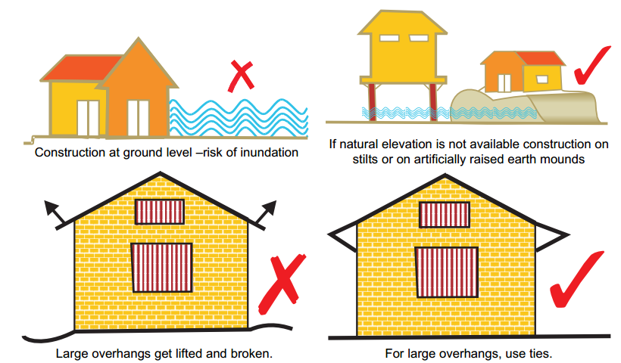
A row of planted trees will act as a shield. It reduces the energy.
Buildings should be wind and water resistant.
Buildings storing food supplies must be protected against the winds
and water.

Slide 18
Protect river embankments.
Communication lines should be installed underground.
Provide strong halls for community shelter in vulnerable locations
Flood management
Torrential rains, strong wind and storm range leads to flooding in the cyclone affected areas.
There are possibilities of landslides too.
Improving vegetation cover–The roots of the plants and trees keep the soil intact and prevent erosion and slow runoff to prevent or lessen flooding.
The use of tree planted in rows will act as a windbreak. Coastal shelterbelt plantations can be developed to break severe wind speeds. It minimizes devastating effects.
The Orissa calamity has also highlighted the need for urgent measures like shelterbelt plantation along cyclone-prone coastal areas.

