Slide 1
DISASTER MITIGATION AND MANAGEMENT

Slide 2
What is a Disaster?
Disaster is a sudden, calamitous event bringing great damage, loss, and destruction and devastation to life and property.
WHO defines Disaster as "any occurrence that causes damage, ecological disruption, loss of human life, deterioration of health and health services, on a scale sufficient to warrant an extraordinary response from outside the affected community or area”.
But as Civil Students, we can say as:
It is a natural accident, which causes great damage to life, property and Structures which cannot be reused.
It may also be termed as “a serious disruption of the functioning of society, causing widespread human, material or environmental losses which exceed the ability of the affected society to cope using its own resources.”

Slide 3
Damages by Disasters
Damages done by disasters are inevitable and they cannot be reduced and predicted and only method is to manage them and mitigate them. The damage caused by disasters is immeasurable.
The damage caused by disasters depends on:
Geographical location of place
Climate of the place
Type of Surface of Earth and
Degree of Vulnerability
A disaster may have the following main features:-
Unpredictability
Unfamiliarity
Speed
Urgency
Uncertainty and
Threat
This influences the mental, socio-economic, political and cultural state of the affected area.
Vulnerability, Hazards and Risk are the main key points when ever disaster mitigation and management is considered.

Slide 4
What is Vulnerability?
Vulnerability may be defined as “The extent to which a community, structure, services or geographic area is likely to be damaged or disrupted by the impact of particular hazard, on account of their nature, construction and proximity to hazardous terrains or a disaster prone area
Vulnerabilities can be categorized into
Physical and
Socio-economic vulnerability
Physical Vulnerability:
It includes who and what may be damaged or destroyed by natural hazard such as earth-quakes or floods.
It is based on the physical condition of people and elements at risk, such as
buildings, infrastructure etc; and their proximity, location and nature of the hazard.
It also relates to the technical capability of building and structures to resist the
forces acting upon them during a hazard event.
Unchecked growth of settlements in unsafe areas exposes the people to the hazard.
In case of an earth-quake or landslide the ground may fail and the houses on the
top may topple or slide and affect the settlements at the lower level even if they are designed well for earthquake forces

Slide 5
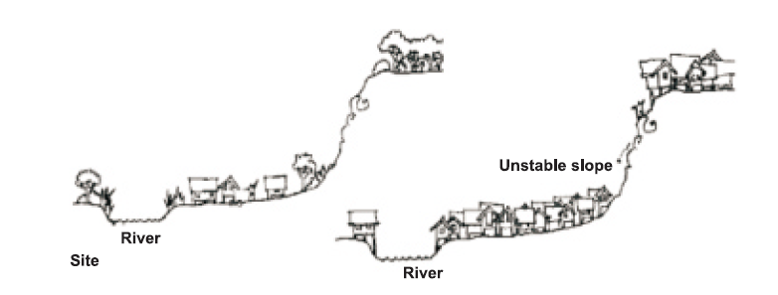
Socio-economic Vulnerability
The degree to which a population is affected by a hazard will not merely lie in the physical components of vulnerability but also on the socio-economic
conditions.
The socio-economic condition of the people also determines the intensity of the impact.
For example, people who are poor and living in the sea coast don’t have the
money to construct strong concrete houses. They are generally at risk and lose their shelters whenever there is strong wind or cyclone. Because of their
poverty they too are not able to rebuild their houses

Slide 6
What is capacity?
Capacity can be defined as “resources, means and strengths which exist in households and communities and which enable them to cope with, withstand, prepare for, prevent, mitigate or quickly recover from a disaster”. People’s capacity can also be taken into account. Capacities could be:
Physical Capacity
Socio-economic Capacity
Hazards are always prevalent, but the hazard becomes a disaster only when
there is greater vulnerability and less of capacity to cope with it
What is risk?
Risk is a “measure of the expected losses due to a hazard event occurring in a given area over a specific time period.
Risk is a function of the probability of particular hazardous event and the losses each would cause.” The level of risk depends upon:
Nature of the hazard
Vulnerability of the elements which are affected
Economic value of those elements
A community/locality is said to be at ‘risk 'when it is exposed to hazards and is likely to be adversely affected by its impact.

Slide 7
Types of Disasters
Natural Disasters
Artificial Disasters(Man/Human Made)
Natural Disasters | Earthquakes Landslides Floods River erosion Cyclones Tsunami Forest Fires etc…
Artificial Disasters | Nuclear Disasters Chemical Disasters Industrial Disasters Mine Disasters Biological Disasters Traffic accidents Stampede

Slide 8
Various Types of Hazards
Types | Hazards
Geological Hazards | Earthquake Landslide Tsunami Dam burst Volcanic eruption Mine Fire
Water & Climatic Hazards | Tropical Cyclone Tornado and Hurricane Floods Drought Hailstorm Cloudburst Landslide Heat & Cold wave Snow Avalanche Sea erosion
Environmental Hazards | Environmental pollutions Deforestation Desertification Pest Infection
Biological | Human / Animal Epidemics Pest attacks Food poisoning Weapons of Mass Destruction

Slide 9
Various Types of Hazards
Types | Hazards
Chemical, Industrial and Nuclear Accidents | Chemical disasters Industrial disasters Oil spills/Fires Nuclear
Accident related | Boat / Road / Train accidents / air crash, Rural / Urban fires, Bomb /serial bomb blasts Forest fires Building collapse Electric Accidents Festival related disasters(Stampede) Mine flooding

Slide 10
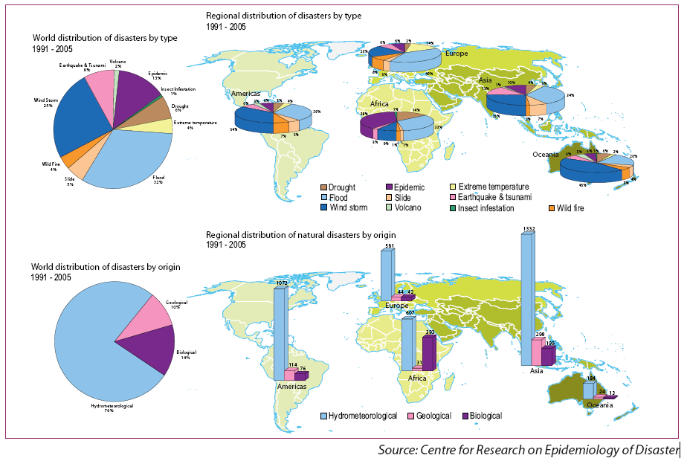
DISTRIBUTION OF DISASTERS

Slide 11
World’s Deadliest Disasters
Name of the Event | Year | Country & Region | Fatalities
Earthquake | 1556 | China, Shaanxi | 830000
Yellow River Flood | 1887 | China | 900,000 – 2,00,0000
Great Chinese Famine | 1985-1961 | China | 15,000,000 - 43,000,000
Bhola Cyclone | 1970 | West Bengal | 500,000
Bangladesh Cyclone | 1991 | Bangladesh | 139,000
Tsunami | 2004 | Indonesia, India Srilanka,Malaysia Bangladesh Thailand | 230,210
Earthquake | 2010 | Haiti | 316,000

Slide 12
India’s Deadliest Disasters
Name of the Event | Year | Country & Region | Fatalities
Earthquake | 1737 | Bengal | 300,000 deaths
Great Famine | 1876-1878 | Southern India | 58.5 Million affected 5.5 million deaths due to starvation
The Indian Famine | 1896-1897 | Whole India | 1.25 – 10 Million deaths
Drought | 1972 | India | 200 Million affected
Drought | 1987 | Haryana | 300 Million affected
Orissa Super Cyclone | 1999 | Orissa | 10000 deaths
Gujarat Earthquake | 2001 | Bhuj | 25000 deaths 6.3 million affected
Floods | 2013 | Uttarakhand | 100000 affected

Slide 13
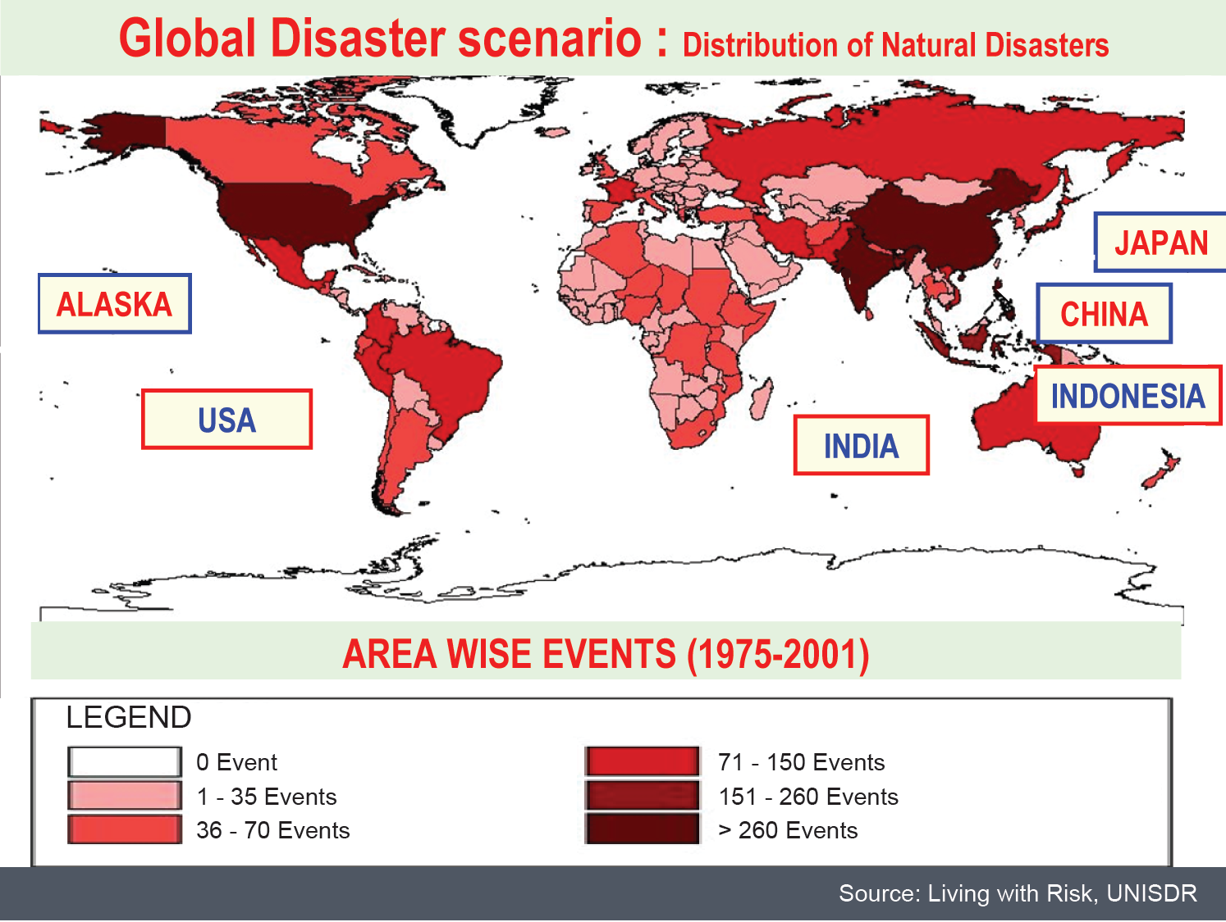

Slide 15
Disaster Events (1900-2009)
Disaster Deaths (1900 - 2009)
Source: Centre for Research on Epidemiology of Disasters (CRED)

Slide 16
Worst Man Made Disasters
Name of the Event | Year | Country & Region | Fatalities
London’s Killer Fog | 1952 | London | 12,000 deaths
The Al-Mishraq Fire | 2003 | Iraq | Environmental Damages
The Nuclear Power Plant Explosion in Chernobyl | 1986 | Chernobyl, Russia | 100,000 fatal cancers
The Kuwait Oil Fires | 1991 | Kuwait | Environmental Damages
The Destruction of the Aral Sea | 1960 | Russia | Environmental Damages
The Exxon Valdez Oil Spill | 1989 | Alaska | 11 million gallons of oil spilled Quarter Million birds were killed
Dioxin Pollution | 1976 | Italy | many children were affected by the serious skin disease
The Union Carbide Gas Leak | 1984 | Bhopal, India | Over 500,000 affected and 15000 died

Slide 17
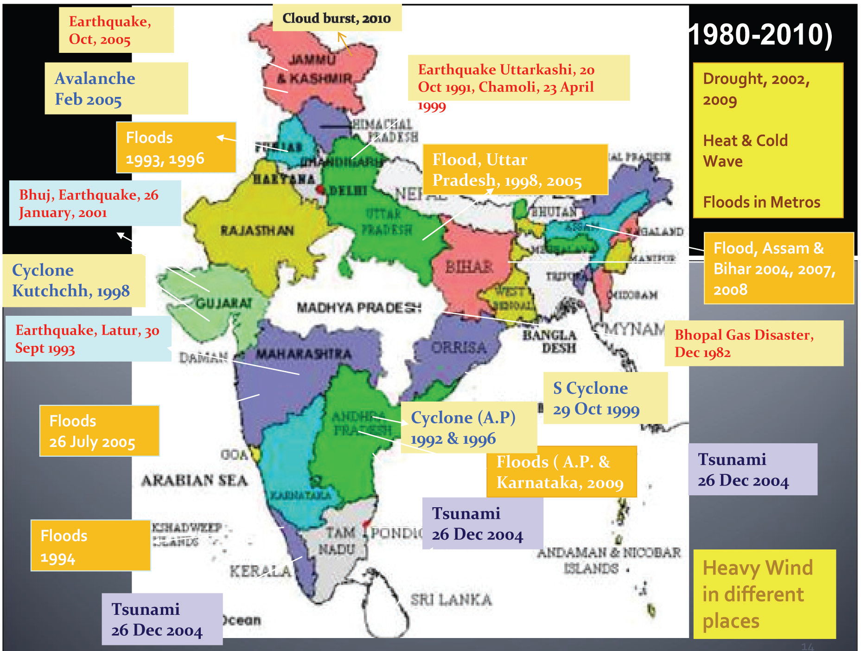
Major Disasters in India from 1980-2010

Slide 18
International Decade for Disaster Reduction (Jan 1st 1990-1999)
Resolution was first passed on 11 Dec 1987 to designate 1990-1999 as Natural
disaster reduction decade (Resolution 42/169)
Second Wednesday of October is International Day for Natural Disaster
Reduction during the decade
The Objective is to reduce through concerted international action
the loss of life
property damage
social and
economic damage
caused due to earth quakes, cyclones, tsunamis, drought etc and other
calamities of natural origin.

Slide 19
The goals of the decade are as below
To improve the capacity if each country to mitigate the effects of natural disasters effectively, paying special attention to assisting countries in assessment of disaster damage potential and in the establishment of early warning systems and disaster resistant structures when and where required.
To devise appropriate guidelines and strategies for applying existing scientific and technical knowledge taking in to account the cultural and economic diversity among nations.
To foster scientific and engineering endeavors aimed at closing critical gaps in knowledge in order to reduce loss of property and life.
To disseminate existing and new technological information related to measures for assessment, prediction and mitigation of natural disasters.
To develop measures for assessment, prediction, prevention and mitigation of natural disasters through programmes of technical assistance and knowledge transfer, demonstration projects, tailored to specific disasters and locations and to evaluate the effectiveness of those programmes.

Slide 20
Policy Measures to be taken up at National Level
To formulate national disaster mitigation programmes as well as economic, land use and insurance policies for disaster prevention and particularly in developing countries to integrate them fully in to their national development programmes.
To participate during the decade in concerted international action for the reduction of natural disasters and as appropriate establish national committees in cooperation with the relevant scientific and technological communities and other concerned sectors with a view to attaining the objectives and goals of the decade.
To encourage their local administrations to take appropriate steps to mobilize necessary support from the public and private sectors and to contribute to the achievement of the purposes of the decade.
To keep the Secretary General informed of the plans of their countries and of assistance that can be provided so that United Nations may become an international centre for the exchange of information and the coordination of international efforts concerning activities in support of the objectives and goals of the decade thus enabling each state to benefit from the experience of other countries.

Slide 21
Policy Measures to be taken up at National Level
To take measures as appropriate , to increase public awareness of damage risk probabilities and of the significance of preparedness, prevention, relief and short term recovery activities with respect to natural disasters and to enhance community preparedness through education, training, taking in to account the specific role of the new media.
To pay due attention to the impact of natural disasters on health care, particularly to activities to reduce the vulnerability of hospitals and health centers, as well as the impact on food storage facilities, human shelter and other social and economic infrastructures.
To improve the early international availability of appropriate emergency supplies through the storage or earmarking of such supplies in disaster prone areas
Scientific and technological institutions, financial institutions , including banks and industrial enterprises, foundations and other related non-governmental organizations are encouraged to support and participate fully in the programmes and activities of the decade prepared and implemented by the international community, including governments, international organizations and non-governmental organizations.

Slide 22
Actions to be taken by United Nations
The organs, organizations and bodies of the United Nations System are urged to accord priority, as appropriate and in a concerted manner, to natural disaster preparedness, prevention, relief and short term recovery, including economic damage risk assessment, in their operational activities, the Secretary- General is requested in this regard, to ensure that adequate means are made available to the Office of the United Nations Disaster Relief Coordinator so that it may diligently discharge its specific role and responsibilities in the field of disaster mitigation and response in conformity with its mandate as contained in general assembly resolution 2816(XXVI).
The Secretary General is requested, in close association with the relevant organizations of the United Nations System, in particular through the department of Public Information of the Secretariat, as well as national information authorities, to assist in the formulation and implementation during the Decade of public information programmes aimed at raising public awareness of disaster prevention.
The United Nations Resident Coordinators and the field representatives are requested to work closely and in a coordinated manner with governments to achieve the objectives and goals of the decade.

Slide 23
The regional commissioners are urged to play an active role in implementing the activities of the decade, considering that natural disasters often transcend national boundaries.
The Secretary General is requested to designate the Director General for Development and International Economic Cooperation in accordance with his mandate as set out in General Assembly resolution 32/197 of 20th December 1977, as the focal point for overview and coordination of programmes and activities of the UN system referred to in the present resolution in close cooperation with the Office of the United Nations Disaster Relief Coordinator and as appropriate in consultation with the Director Of the Secretariat of the Decade.
The Secretary General is requested to report biennially (2 years) to the General Assembly, through the Economic and Social Council on the activities of the decade.

Slide 24
Organizational Arrangements during the Decade
Special High Level Council
internationally prominent persons
to promote public awareness and mobilize the necessary support from the public and private sectors
Scientific and Technical Committee
20-25 eminent experts
Identify gaps in technical knowledge
Secretariat
Financial Arrangements
Review
Midterm review has been conducted in 1994

