Slide 1
DISASTER MITIGATION AND MANAGEMENT
UNIT - V

Slide 2
PROFILE OF INDIA
History of disasters during last three decades
431 Disasters occurred in India during last thirty(30) years
1,43,039 people died
US$ 4800 crore loss has been incurred approximately

Slide 3
VULNERABILITY PROFILE OF INDIA
India is highly Vulnerable to disaster due to its unique Geo-Climatic and Socio-economic conditions
Highly vulnerable to floods,drought,cyclones, earthquakes,landslides,avalanches,forest fires
58.6% of landmass is prone to Earthquakes of moderate to very high intensity
12% of landmass(40 Million hectares) is prone to floods and river erosion

Slide 4
5,700km of coastline out of 7516 km is prone to cyclones and tsunamis
68% of cultivable land is vulnerable to drought
Hilly areas are at risk from landslides and avalanches

Slide 5
Human induced Factors responsible for increased disasters
Demographic Pressure
Deteriorating environmental conditions
Deforestation
Unscientific development
Faulty agricultural practices and grazing
Unplanned urbanization

Slide 6
Losses due to disasters in India
Total economic loss due to disaster is accounted for 2% of GDP
Year | Losses
1991- 1995 | 36,000 Cr
1996- 2000 | 54,000 Cr
2001- 2005 | 86,000 Cr
Disaster Type | Damage caused
Floods | 32%
Tropical Cyclones | 30%
Droughts | 22%
Earthquakes | 10%
Other disasters | 6%

Slide 7
DISASTER MANAGEMENT

Slide 8
Emergency Management is the discipline of dealing with and avoiding risks
It involves preparing for disaster before it occurs, disaster response, supporting and rebuilding society after disasters have occurred.
It is a continuous process of managing hazards from converting to disasters.
It involves thorough integration of emergency plans at all levels of government and non-government involvement.
It involves a long term work on infrastructure, public awareness

Slide 9
Disaster/Emergency Management Cycle
The Process of Disaster Management involves
four phases
Mitigation
Preparedness
Response
Recovery
All the above four phases occur in a cyclic
process

Slide 10
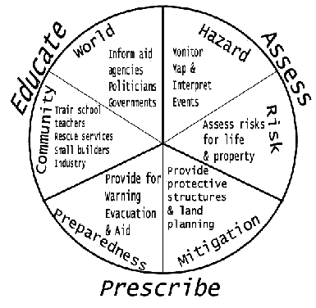
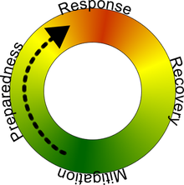
Disaster Management Cycle

Slide 11
MITIGATION
Mitigation measures or efforts are an attempt to prevent hazards from developing in to disasters
It focuses on long term measures for reducing or eliminating risk
Mitigation measures can be Structural or Non-Structural
Structural measures can be technological solutions such as Flood leaves , earthquake resistant structures etc but it may have adverse effects on eco system

Slide 12
Non-structural measures include legislation, land-use planning and insurance
Mitigation measures include providing regulations such as mandatory evacuations, communication of potential risks to the public
A precursor activity to mitigation is identification of risks
Hazard specific risk(R_{h}) is calculated by
R_{h} = H X V_{h}
Where H is Hazard and V is Vulnerability

Slide 13
PREPAREDNESS
It is a continuous cycle of
Planning , Organizing , Training , Equipping
Exercising , evaluation and improvement activities
to ensure
effective coordination , enhancement of capabilities
to prevent, protect against, respond to, recover
from and mitigate the effects of disasters

Slide 14
Common preparedness measures include:
Communication plans with easily understandable terminology and methods
Proper maintenance and training of emergency services
Development and exercise of emergency population warning methods combined with emergency shelters and evacuation plans
Stockpiling, inventory and maintain disaster supplies and equipment
Develop organizations of trained volunteers among civilian populations
Casualty prediction
Examples: Red Cross, Federal emergency Management Agency

Slide 15
RESPONSE
This phase includes mobilization of necessary
emergency services and first responders in the
Disaster areas
These services include
Fire fighters
Police
Ambulance
Disaster relief operation(Military)
Special Rescue teams

Slide 16
A well rehearsed emergency plan during
preparedness phases helps in efficient
coordination of rescue.
Discipline and Agility(Creativity,Improvisation and
adaptability) are very important while responding
to a disaster.

Slide 17
RECOVERY
The aim of recovery is to restore the affected area to its previous state.
Recovery efforts are made after the immediate needs are addressed.
It involves rebuilding destroyed property,re-employment and repair of essential infrastructure
Reduce the pre-disaster risk inherent in the community by “Build Back Better”
Effective mitigative measures should be applied during the recovery phase to reduce future losses.

Slide 18
4Rs is a term used to describe the emergency management cycle locally
Reduction = Mitigation
Readiness = Preparedness
Response
Recovery

