Slide 1
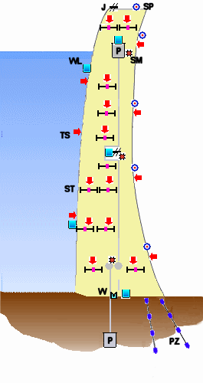
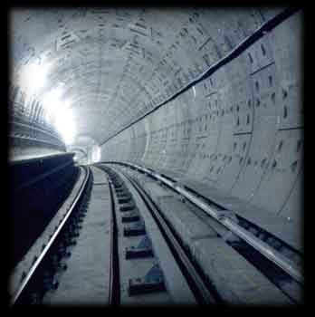
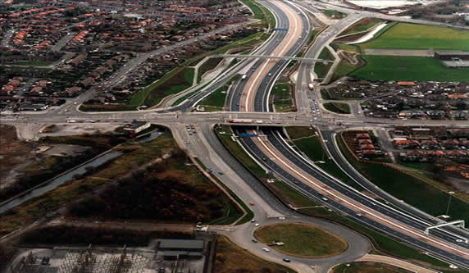
CIVIL ENGINEERING

Slide 2
Civil engineering work includes:
dams
embankments
motorways
bridges
buildings
cuttings
quarries
tunnels
mines
All these need to take into account:
Geological factors
Geological rock properties
rock type
fracture/joints
weathering
dip of rocks
folding/faulting
cleavage
water table depth
porosity/permeability
rock strength
Geological factors
Rock properties

Slide 3
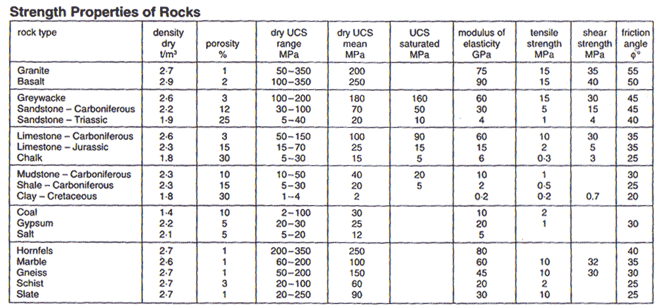

Slide 4
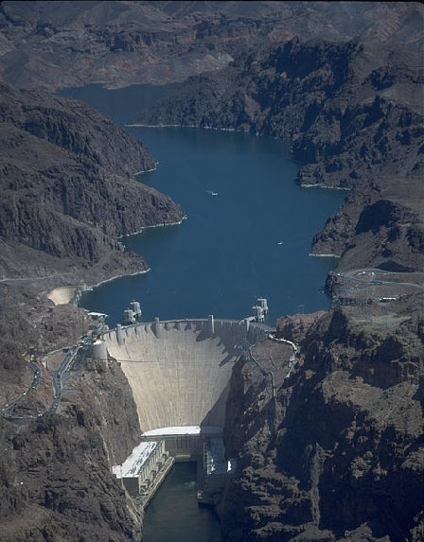
Dams
&
Reservoirs

Slide 5
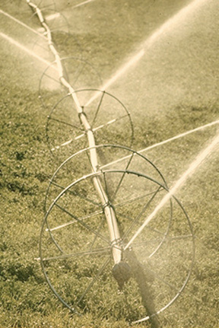
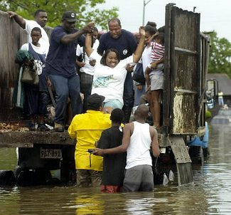
Dams & reservoirs are constructed for a wide range of uses:
Power generation
Water supply
Irrigation
Flood control

Slide 6
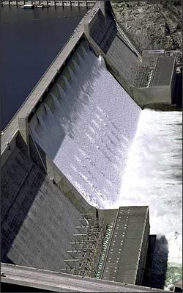
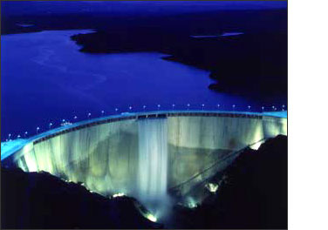
Types of Dams
There are many different designs of dam, which include two principal types:
Gravity Dams
Arch Dams

Slide 7
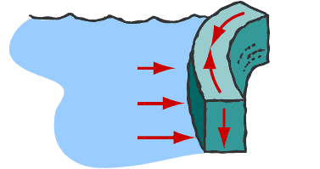
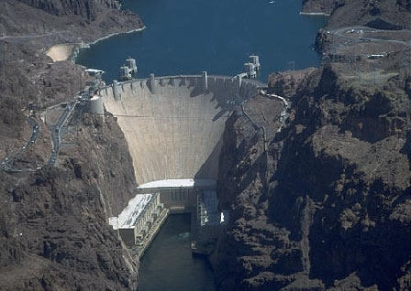
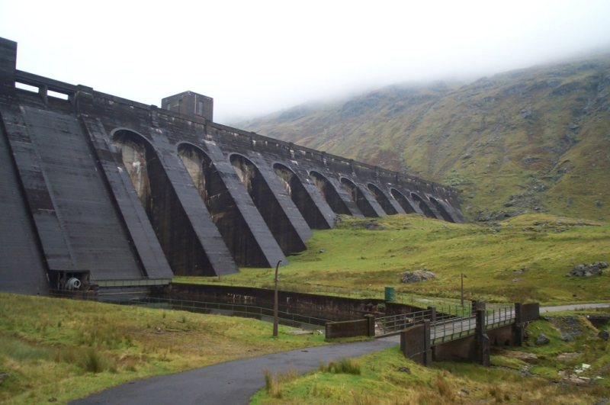
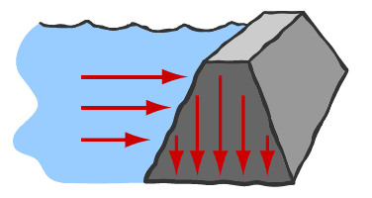
Arch Dam
Gravity Dam

Slide 8
When building dams & reservoirs geologists must take into account:
geological structures
rock properties

Slide 9
Types of Dams Across Constricted Valleys
Gravity Dams
These rely on their weight to hold them in position and thereby impound the water. They are usually made from reinforced earth, masonry or concrete.
Arch Dams
The arch squeezes together as the water pushes against it. The stress of the impounded water is also transmitted horizontally into the rock of the valley sides. These are made from thin concrete walls.

Slide 10
In building major structures like arch dams and gravity dams geological factors and geological rock properties must be taken into account. These include:
Valley shape and rock structure
Foundation strength
Porosity and permeability
Zones of structural weakness and high permeability

Slide 11
1. Valley Shape:
Narrow, deep and steep-sided valleys are the key characteristics looked for in valley shape. This is due to:
Ideally, above a chosen dam site a valley should widen and remain as flat as possible
Deep valleys maximise water storage
Valley constriction minimises dam length reducing costs
Narrow width of dam makes it structurally stronger

Slide 12
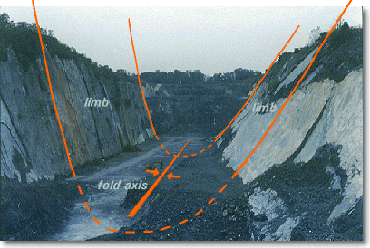
2. Rock Structure:
The rock structure surrounding the reservoir has to be looked at carefully:
Synclinally folded rocks dip towards the reservoir, reducing possible leakage but increasing their liability to slip into the reservoir. Anticlines increase leakage but are less prone to slip.
The rocks of the valley sides must not be liable to slippage because as the reservoir fills, the water table rises to lubricate zones of weakness.
Other zones of weakness include fault zones which must be avoided. Also fault zones may have associated earthquakes.

Slide 13
3. Foundation Strength:
Obviously good foundations are highly desirable because the force of the dam must not exceed the strength of the ground. Or it will fail!
Site to serve as a foundation for major dams depends on factors:
Existing rock type
Extent of weathering it has undergone
Occurrence of intrusions
Extent of fracturing
Occurrence of geological structures – Faults, Joints
Mode and number of rock types
Gravity Dams

Slide 14
Suitability of Rocks as Foundation
Igneous rocks: Massive Plutonic and/or Hypabassal igneous rocks (Granite, Syenites, gabbro etc.,) are most desirable as they are very strong and durable (not effected by weathering).
Sedimentary rocks: Bedding and its orientation, thickness of beds, nature and extent of compaction and cementation, grain size etc., influence the strength and durability of the rock. Sandstone -well cemented types and limestone – if massive, are considered competent and suitable for dam foundation. Whereas laterites, shales are most undesirable.
Metamorphic rocks: Gneisses are generally competent, unless the posses very high degree of foliation. Quartzite is considered to desirable as it is very hard and highly resistant to weathering.Schists, Marbles, Slates etc., are considered unsuitable for dam sites.

Slide 15
Gravity Dams
Where foundations are weak (clays and mudstones) gravity dams made out of earth are used, in order to spread the weight.
The foundations for gravity dams should show limited compaction when loaded with the weight of the dam. Consequently deeply weathered sites or poorly consolidated glacial deposits are avoided.
Existing fractures or bedding should be minimal, and should dip upstream.
On firmer foundations (igneous and metamorphic rocks) gravity dams made out of concrete and masonry are used.

Slide 16
Arch Dams
The construction of arch dams relies on the rock mass strength of the valley sides.
Where there is sufficient strength, thin arch dams, which are cheap and economical to build, may be adequate.
However, since the stresses imposed in such situations are horizontal instead of vertical, an absence of fractures parallel to the valley sides is essential.
In general, only rocks with very high rock mass strength are suitable for building arch dams, and in all cases uniformity of the rock body is desirable.

Slide 17
4. Porosity & Permeability:
The porosity and permeability of the rocks surrounding the reservoir and the dam indicate sources of potential leakage. Such as:
Gravity Dams
Permeable soils
Aquifers
Faults
Joints
Beds dipping away from the reservoir e.g. anticlines
A dam should not be built on a permeable base because leakage under a dam generates pressure which lifts the dam and may cause it to fail.
Rocks with calcite cement may become more permeable as the calcite dissolves away.

Slide 18
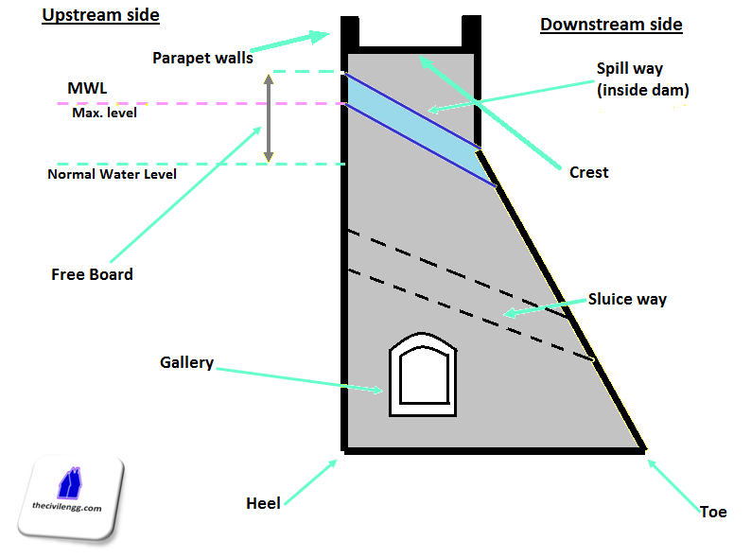
Parts of a Dam

Slide 19
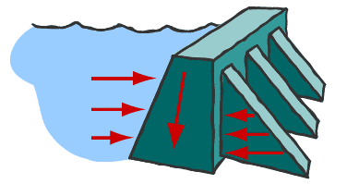
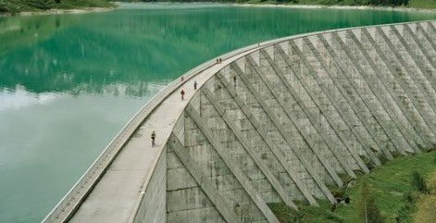
Buttress dams
A buttress dam or hollow dam is a dam with a solid, water-tight upstream side that is supported at intervals on the downstream side by a series of buttresses or supports. The dam wall may be straight or curved. Most buttress dams are made of reinforced concrete and are heavy, pushing the dam into the ground.

Slide 20
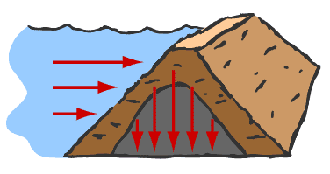
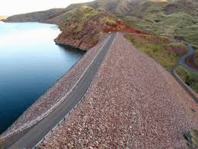
Earthen dams
Earth fill dam, also called Earth Dam, or Embankment Dam, dam built up by compacting successive layers of earth, using the most impervious materials to form a core and placing more permeable substances on the upstream and downstream sides.
These are planned in places where underlying materials are too weak to support a masonry dam (where competent rocks are at deeper depths).

Slide 21
Geological Factors
Rock Properties
Rock type
Weathering
Structural weaknesses (bedding, joints, faults & cleavage)
Depth to rockhead
Rock strength
Porosity
Permeability
Civil Engineering
Hydrogeology
Depth to water table

Slide 22
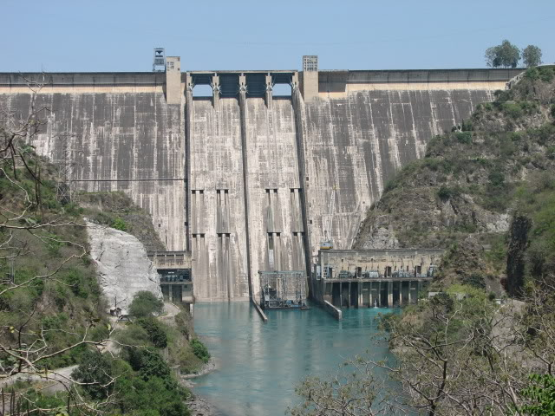
Geology of Major Dam sites in INDIA
Bhakra – Nangal Project – Punjab
It is located on a thick Sandstone beds intercalated with bands of Silt stones and lies in southern limb of Ramgarh-Dhar Anticline.
Downstream Dip – 70°
Strike – Slightly oblique (NW-SE).
Claystones – 30m (Upstream), 76m (downstream), 9m (band in middle third section of dam).

Slide 23
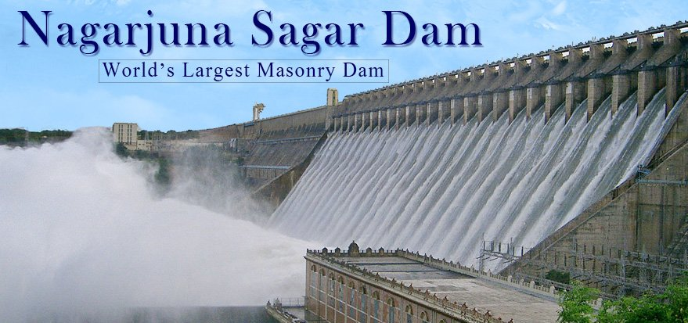
Nagarjuna sagar Dam
The rock types exposed in and around the dam sites are the Granite-Gneisses of the peninsular gneissic complex and the Quartzites and shales belonging to Srisailam stage of Cudappah systems. Few dolerite dykes intrusive into granite-gneisses.
Strike – N 60° W-S 60° E and N 40° E-S 40° W.
Quartizes and shales are - 3° to 5° dip towards downstream.
Minor Faults rarely exceeding 0.60-0.91m are observed in Quartzites and shales.
Weathering of granite gneisses are limited to 0.6-4.6m.

