Slide 1
Unit : IV
Environmental Pollution
&
Environmental Legislations

Slide 2
Pollution
Definition : Any matter i.e, Solid , Liquid ,gas etc present in a medium such as Air, Water, Soil etc, in such concentrations for a considerable period of time which can alter its natural environment is called a Pollutant and the phenomenon is known as Pollution.

Slide 3
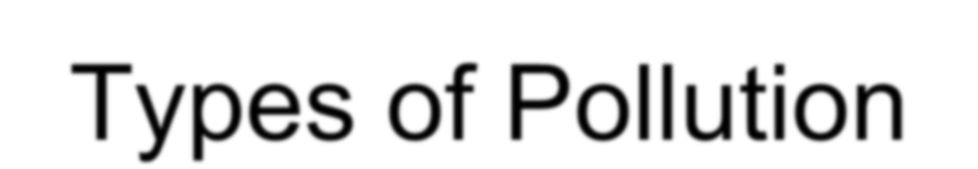


Types of Pollution
Air
Water
Land or Soil
Noise
Thermal

Slide 4
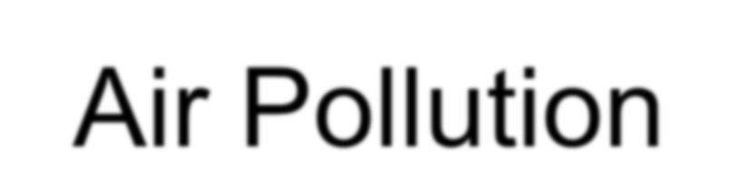

Air Pollution
Air pollution occurs due to the presence of undesirable solid or gaseous particles in the air in quantities that are harmful to human health and environment

Slide 5
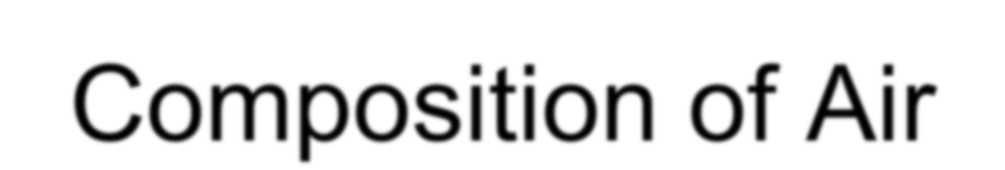
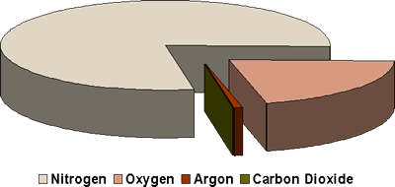
Composition of Air
Composition of Air

Slide 6

Types of pollutants
Primary pollutants
Pollutants that are emitted directly from identifiable sources – produced by both natural events or human activities
Eg. Dust storms, emission from vehicles
Secondary pollutants When certain chemical
reactions take place among the primary pollutants
Eg. Sulphuric acid

Slide 7

Primary pollutants
Carbon oxides (CO2 and CO)
Nitrogen oxides
Sulphur oxides
Volatile organic compounds – hydro carbons
Suspended particulate matter

Slide 8
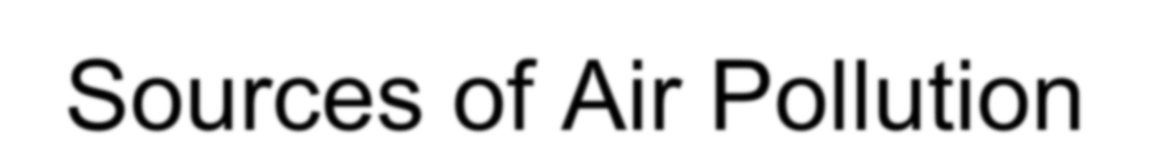
Sources of Air Pollution
Vehicles
Industries
Dust and storm
Air crafts, jet

Slide 9

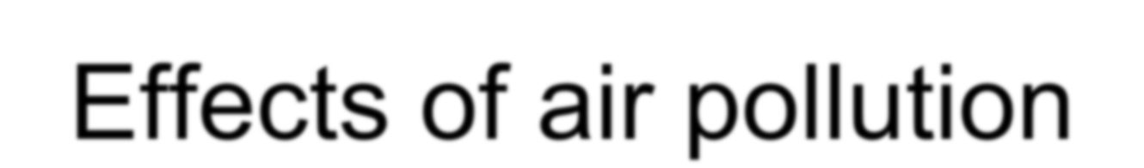
Effects of air pollution
Prolonged smoking or exposure to air pollutants can overload or break down the natural defenses such as hair in our nose, sticky mucas in the lining of the upper respiratory tract causing diseases like lung cancer, asthma, chronic bronchitis etc.,

Slide 10

Cigarette smoking is responsible for the greatest exposure to carbon monoxide.Exposure to air containing even 0.001% of carbon monoxide for several hours can cause collapse, coma and even death.
CO is attached to blood hemoglobin for a long time, it accumulates and reduces the oxygen carrying capacity of blood. This impairs perception and thinking, slows reflexes and causes headaches, drowsiness, dizziness and nausea and blurred vision.

Slide 11

Nitrogen oxides and suspended particles both can irritate lungs, aggravate asthma or chronic bronchitis and increase respiratory infections.
Many volatile organic compounds such as benzene and formaldehyde and toxic particulates such as lead and cadmium can cause mutations, reproductive problems and cancer, breathlessness and irritation of the eye, nose and throat.

Slide 12

Sulphur dioxide irritates respiratory tissues, chronic exposure causes a condition similar to bronchitis.
It also reacts with water, oxygen and other materials to form sulphur containing acids – The acids can become attached to particles which when inhaled are very corrosive to the lung.

Slide 13

Chronic exposure of the leaves to air pollutants can break down the waxy coating that helps prevent excessive water loss and leads to damage from diseases, pests, drought and frost.
It also affects photosynthesis, respiration and other metabolisms.

Slide 14
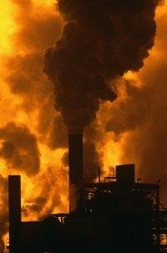

Slide 15
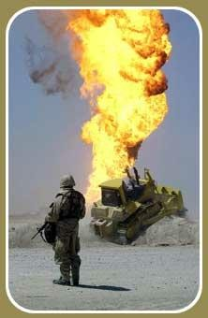

Slide 16
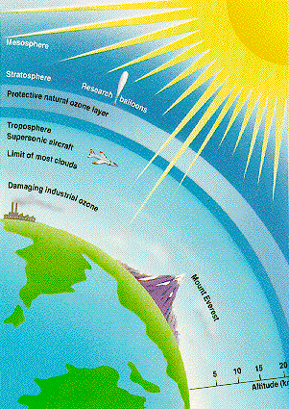

Slide 17

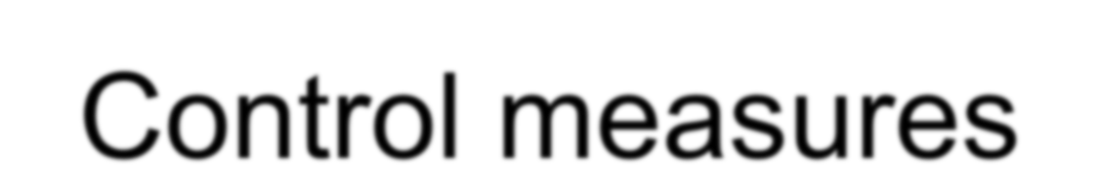
Control measures
Proper fuel and exhaust system in vehicles
Use of dry and wet collectors, filters, electrostatic precipitators.
Providing greater height to the stacks – discharge pollutants away from the ground.
Substitution of raw materials that cause more pollution.

Slide 18


Water pollution
71% of earth’s surface is covered by water-but only a tiny fraction is available as fresh water.
97% of total water is found in oceans and 3% is fresh water.
Out of this 2.997% is locked in ice caps. The only 0.003% of total volume is available as soil moisture, ground water, water vapour, water in lakes, streams, rivers and wetlands.

Slide 19
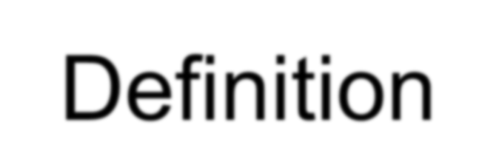
Definition
When the quality or composition of water changes directly or indirectly as a result of man’s activities such that it becomes unfit for any purpose it is said to be polluted.

Slide 20

Sources of Water Pollution
Industrial Effluents
Water is discharged from industries after having been used in production processes. This waste water may contain acids, alkalis, salts, poisons, oils and in some cases harmful bacteria.
Mining and Agricultural Wastes
Mines, especially gold and coal mines, are responsible for large quantities of acid water.
Agricultural pesticides, fertilizers and herbicides may wash into rivers and stagnant water bodies.
Sewage Disposal and Domestic Wastes
Sewage as well as domestic and farm wastes were often
allowed to pollute rivers and dams.

Slide 21
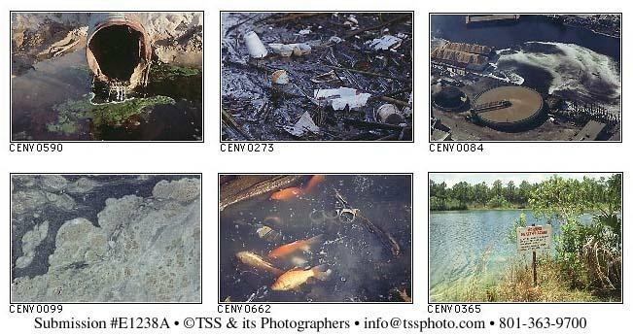

Slide 22
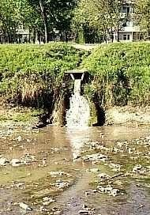

Slide 23
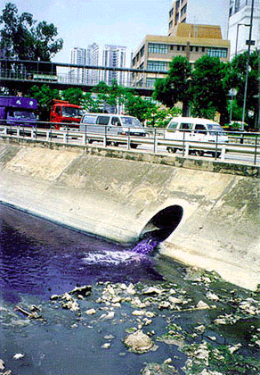

Slide 24
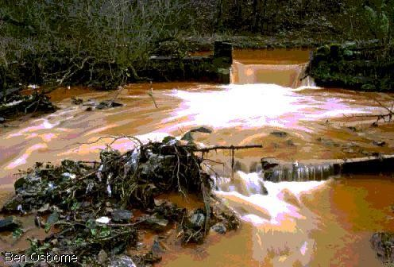
.

Slide 25
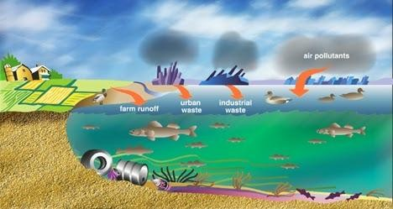

Slide 26
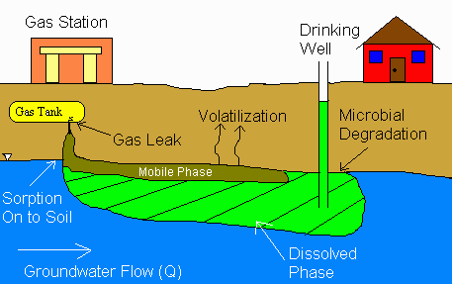

Slide 27
Control measures
Prevention of untreated disposal
Setting up treatment plants
Root Zone Process – using reefs

Slide 28
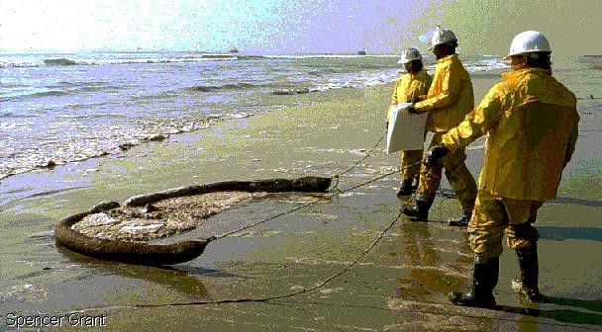
.

Slide 29
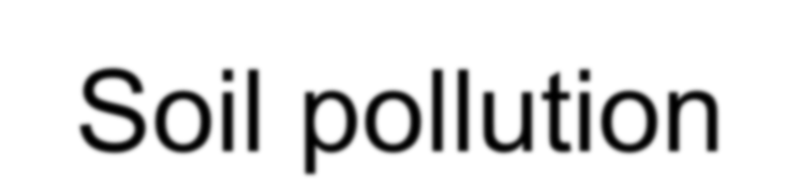
Soil pollution
Soil is thin covering over the land consisting of a mixture of minerals, organic materials, living organisms, air and water.

Slide 30

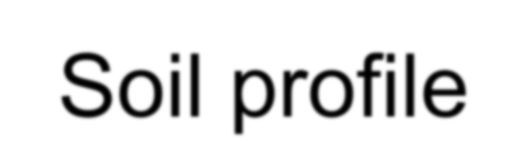
Soil profile
The top layer – O horizon- freshly fallen and decomposed leaves, twigs, animal wastes, fungi and other organic materials- brown or black in colour
Uppermost layer- A horizon-partially decomposed organic matter and inorganic mineral particles – darker and looser
B horizon – subsoil contains less aquatic material and fewer organisms than A zone.
C horizon – weathered parent material

Slide 31
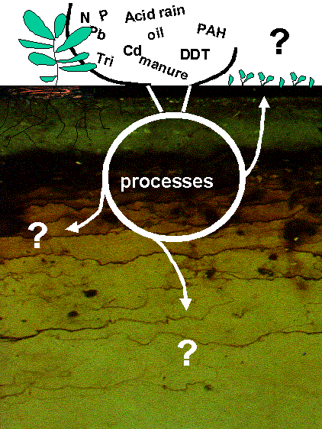

Slide 32
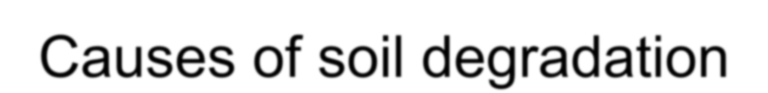

Causes of soil degradation
Erosion
By wind and water accelerated by human activities such as farming, construction, overgrazing by livestock, burning of grass cover, deforestation.

Slide 33


Excess use of fertilizers
Fertilizers, insecticides, herbicides, pesticides, fungicides, rodenticides
Soil fertility is lost
Kill beneficial insects

Slide 34
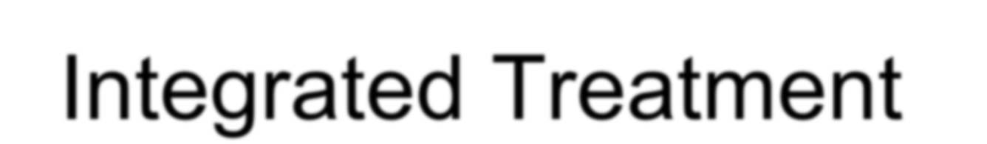


Integrated Treatment Methods
Continuous contour trenches or benches
Live check dams – planting grass, shrubs and trees etc.
Bund constructed out of stones.
Earthen check bund- local soil,across the stream

Slide 35
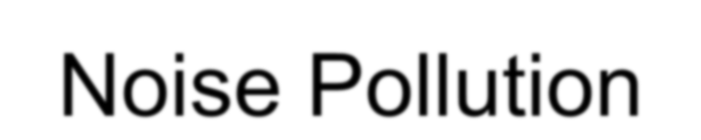

Noise Pollution
Noise is unwanted and undesirable sound
Permitted noise level is 125 decibels

Slide 36
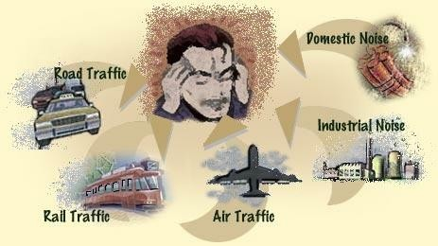

Slide 37
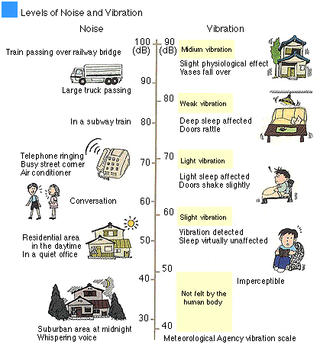

Slide 38

dB n sounds dB | Environmental condition
0 | Threshold of hearing
10 | Rustle of leaves
20 | Broadcasting studio
30 | Bedroom at night
40 | Library
50 | Quiet office
60 | Conversational speech
70 | Average radio
74 | Light traffic noise
90 | Subway train
100 | Symphony orchestra
110 | Rock band
120 | Aircraft takeoff
146 | Threshold of pain
Decibel levels of commo

Slide 39

Ambient noise levels dB
Zone | Day time | Night time
Silent zone | 50 | 40
Residential zone | 55 | 45
Commercial zone | 65 | 55
Industrial zone | 70 | 70

Slide 40
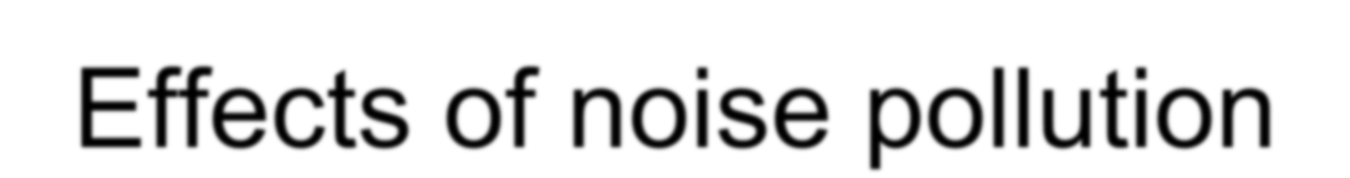

Effects of noise pollution
Physical damage to ear- temporary thresh hold shift-TTS – hearing loss
Mental fatigue
Changes in Psychological behaviour

Slide 41
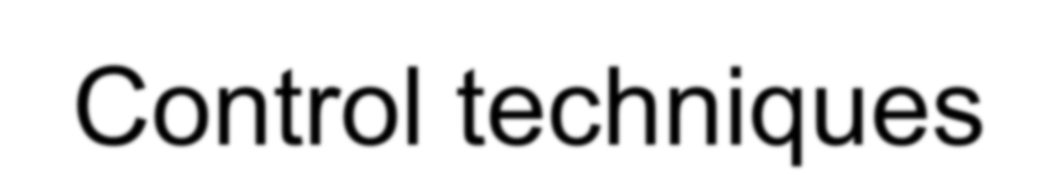
Control techniques
Reduce noise at source
Block the path of noise
Increase the path length and protect the recipient
Trees help in damping the sound waves

Slide 42

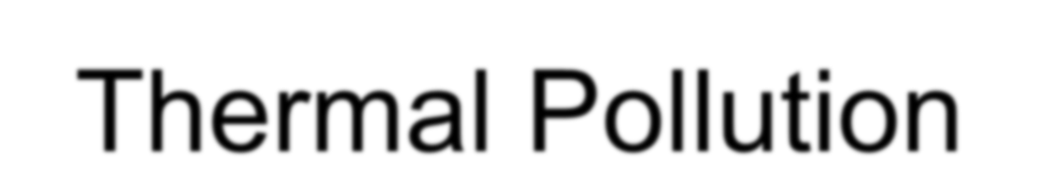
Thermal Pollution
Sources- discharge of warm water into river
Effects-changes the ecological balance of river
Death of fish
Effect on plants
Control- passing the heated water through a cooling pond or cooling tower after it leaves the condenser

Slide 43
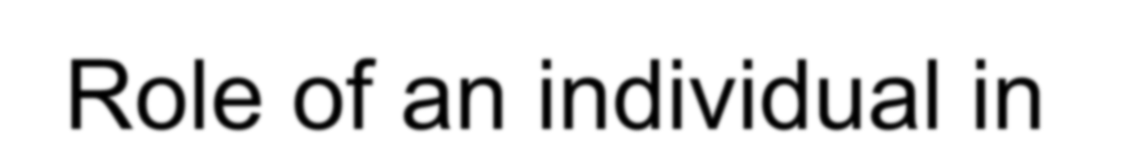
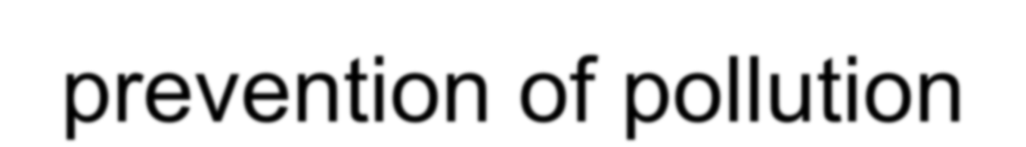
Role of an individual in prevention of pollution
???

Slide 44
Environmental Legislations
Environmental Protection Act, 1986
Air ( Prevention and Control of Pollution) Act, 1981
Water ( Prevention and Control of Pollution) Act, 1974
Forest Conservation Act, 1980
Wildlife Protection Act, 1972

Slide 45
Environmental Protection Act, 1986
Introduced after the Bhopal Gas tragedy was occurred on the mid night of 2nd Dec 1984 at the UNION CARBIDE INDIA LTD, a pesticide plant in Bhopal. A leak of methyl isocyanate gas causing a death of 3,787 people and also injured 5,58,125 people.
The Govt of India enacted the Environment ( Protection) Act in the year 1986 under article 253 of the constitution. The purpose of the Act to provide a frame work on water, air, land and the inter-relationships with the human beings and other living micro-organisms
Also Known as the “Father of All Acts”
The Act came into force on Nov, 19th 1986, the birth anniversary of late Prime Minister Indira Gandhi, who was a pioneer of environmental protection issues in India.

Slide 46
..
Some important features of this Act are:
The central Government put restrictions on an area in which any industry or operations shall not be carried out without any safe-guards.
Emissions and effluents standards in respect of 61 categories of
industries have been evolved and notified.
Who ever fails (or) violate the environmental pollution Act, be punishable with imprisonment upto 5 years or with fine which may extend to one lakh rupees or both.

Slide 47
Air ( Prevention and Control of Pollution) Act, 1981
A team of Indians attended UN conference on “Human Environment” which was held at Stockholm ( Europe ) in the month of June 1972.
Later the Air ( Prevention & Control of Pollution ) Act was enacted in the Indian Parliament in 1981..
The objective of the Air Act is to establishment of Central and State Boards to prevent and control and reduce air pollution.
The air act has many sections in which 19, 20, 31A, 37 plays a vital role.
Section -19 deals with the declaration of measures in case of
industries to be established / already established. For eg: Dust
collector, noise recorder in addition to other relevant ones are
important measures to establish a crushing unit.
Section -20 deals the standards for emission of air pollutants.
Section -31A deals with the closure of industry and disconnecting
the electricity.
Section – 37 deals with the penalties for violation of rules

Slide 48
Water ( Prevention and Control of Pollution) Act, 1974
The Water Act 1974 was enacted in Parliament to prevent and control of water pollution and maintaining or restoring of wholesomeness of water.
This Act also to prevent the pollution of water by industrial, agricultural and , municipalities including domestic waste water that can contaminate natural water resources.
Waste waters with high levels of pollutants that enter wetlands, rivers, wells etc cause serious health hazards. Individuals can do several things to reduce water pollution by avoiding chemicals for household use; reducing the use of pesticides in gardens and identifying the polluting sources .

Slide 49
..
The salient features and provisions of the Act are:
Maintenance and restoration of quality of all types of surface and ground
water.
Establishment of State boards for pollution control.
Prevention and control of water pollution.
Central Government resolve disputes among the States if any arise
To evolve methods of utilization of sewage and trade effluents in
agriculture with proper treatment.

Slide 50
Forest Conservation Act, 1980
Forest is a biotic community composed predominantly of trees, shrubs, bushes etc. whereas forest produce includes timber, charcoal, oils, resins, tree bark, seeds, fruits , flowers, grass, honey, wax etc. Increasing population is causing for decrease in biotic community ie forests and implementation of forest conservation is essential and mandatory. Forest (Conservation ) Act was enacted in the parliament in 1980.
The State Governments or other agencies (eg ITDA ) cannot violate the Forest ( Conservation ) Act unless prior approval by the Central Government.

Slide 51
..
The objectives of the Forest ( Conservation ) Act are:
Restrictions on preservation of forests and use of forest land for
other purposes.
Forest land or any portion thereof may not be used for non-forest
purposes.
Forest land may not be assigned by way of lease to a private
person or to any corporation / agency.
Forest land may not be cleared off trees which have grown naturally in that land.
Prohibition of hunting, shooting, fishing, poisoning of water in forest areas.
No clearance of forest land for cultivation or other purposes
Protection of timber from fire.

Slide 52
Wildlife Protection Act, 1972
The Wildlife Act was passed in 1972 to protect the wildlife and their habitats. The habitat destruction due to agriculture, industries, urbanization and other human activities had led to the erosion of the country’s wildlife.
Important activities and provisions of the act:
It defines the wildlife related terminology.
Enactment of an All India Wildlife Protection Act (1972).
It provides for the appointment of wildlife advisory Board, Wildlife warden, their powers, duties etc.
Becoming a party to the Convention of International Trade in Endangered Species of Fauna and Flora (CITES, 1976).
Launching a “national component of UNESCO’s ‘Man and Biosphere Programme’ (1971).

Slide 53
..
Under the Act, comprehensive listing of endangered wildlife species was done for the first time and prohibition of hunting of the endangered species was mentioned.
Protection to some endangered plants.
The Act provides for setting up of National Parks, Wildlife Sanctuaries etc.
The Act provides for the constitution of Central Zoo Authority.
There is provision for trade and commerce in some wildlife species with license for sale, possession, transfer etc.
The act imposes a ban on the trade or commerce in scheduled animals.
It provides for legal powers to officers and punishment to offenders.

Slide 54
Environmental protection begins with
YOU!!!

