Slide 1
Solid-Based Rapid Prototyping Systems
Starting material is a solid
Solid-based RP systems include the following processes:
Laminated object manufacturing
Fused deposition modeling

Slide 2
Fused Deposition Modeling- FDM
Fused Deposition Modeling (FDM) is an additive manufacturing technology.
Used for modeling, prototyping and production applications.
Developed by S. Scott Crump in the late 1980s
Commercialized in early 1990s
Principle of laying down molten material in layers
Nozzle is heated to melt the thermoplastics material
The print head moves on X-Y Axis to draw the layer
The platform drops down on Z for each layer
Separate dissolvable support material
Several material and color options

Slide 3
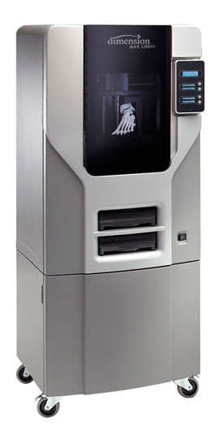
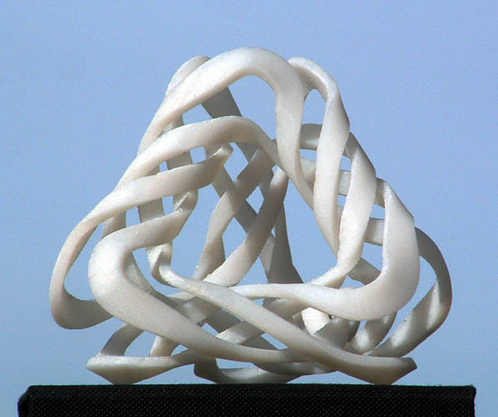
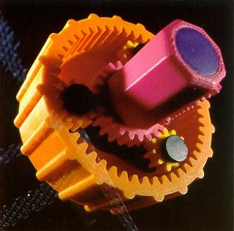
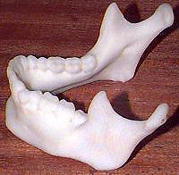
Fused Deposition Modeling (FDM)
Current market leaders
Stratasys, Inc.
The fused deposition modeling (FDM) technology was developed by S. Scott Crump in the late 1980s and was commercialized in 1990. The double material approach was developed by Stratasys in 1999.
"Ribbon Tetrus" (Carlo Séquin)
www.nybro.com.au
Stratasys Dimension SST 1200
Courtesy, Dr. Robin Richards, University College London, UK

Slide 4
FDM process steps
Step 1: Pre-processing
A CAD model is constructed, then converted into the STL format ready for the FDM process.
Step 2:Production
FDM machine processes .STL file by creating sliced layers of the model.
The first layer of the physical model is created
The model is then lowered by the thickness of the next layer.
The process is repeated until completion of the model.

Slide 5
Step 3: Post processing
The model and any supports are removed by washing or stripping it away.
The surface of the model is then finished and cleaned

Slide 6
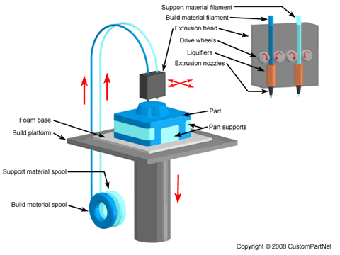

Slide 7
Fused Deposition Modeling (FDM) Process
A spool of thermoplastic wire (typically acrylonitrile butadiene styrene (ABS)) with a 0.012 in (300 μm) diameter is continuously supplied to a nozzle
The nozzle heats up the wire and extrudes a hot, viscos strand (like squeezing toothpaste of of a tube).
A computer controls the nozzle movement along the x- and y-axes, and each cross-section of the prototype is produced by melting the plastic wire that solidifies on cooling.
In the newest models, a second nozzle carries a support wax that can easily be removed afterward, allowing construction of more complex parts. The most common support material is marketed by Stratasys under the name WaterWorks

Slide 8
ADVANTAGES
FDM is clean, simple to use.
Thermoplastic parts can endure exposure to heat, chemical, humid or dry environments, mechanical stress.
Soluble support materials make it possible to produce complex geometric and cavities that would be difficult to build with traditional manufacturing methods.
Economical (inexpensive materials)
Enables multiple colors
Easy to build DIY kits (one of the most common technologies for home 3D printing)
A wide range of materials possible by loading the polymer

Slide 9
DISADVANTAGES
Materials suite currently limited to thermoplastics.
The extrusion head must continue moving or else material bumps up.
Supports are required.
Part strength is weak perpendicular to the build axis.
As layer increases, the build up increases.
Temperature fluctuation during production could lead to delamination.

Slide 10
KEY APPLICATION AREAS
Conceptual Models
Engineering Models
Functional Testing Prototypes
Aerospace-human supporting rovers
Automotive – automobile parts
Commercial – mobile covers
Medical – drug injection system

Slide 11
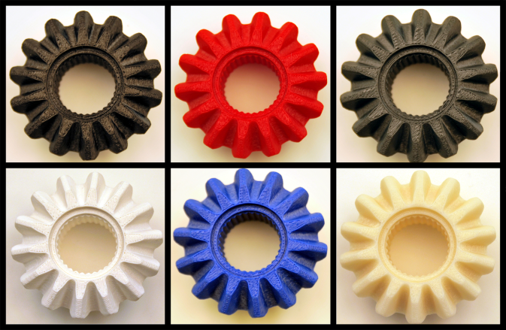
Fused Deposition Modeling (FDM)
KEY METRICS
ADVANTAGES
Maximum build size | 20” x 20” x 20”
Resolution in (x,y) | +/- (0.002” - 0.005”)
Resolution in z | +/- (0.002” - 0.01”)
Speed | Slow
Cost | Medium
Available materials | Thermoplastics (ABS, PC, ULTEM…)
Economical (inexpensive materials)
Enables multiple colors
Easy to build DIY kits (one of the most common technologies for home 3D printing)
A wide range of materials possible by loading the polymer
KEY APPLICATION AREAS
Conceptual Models
Engineering Models
Functional Testing Prototypes
www.redeyeondemand.com
DISADVANTAGES
Materials suite currently limited to thermoplastics (may be resolved by loading)

Slide 12
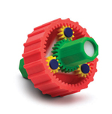
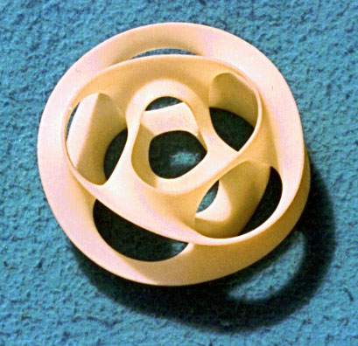
FDM: companies and applications
FDM™ is a patented technology of Stratasys™ Inc.
Gear assembly Toy design using FDM models of different colors
Monkey Cinquefoil Designed by Prof Carlo Sequin, UC Berkeley
5 monkey-saddles closed into a single edged toroidal ring

