Slide 1
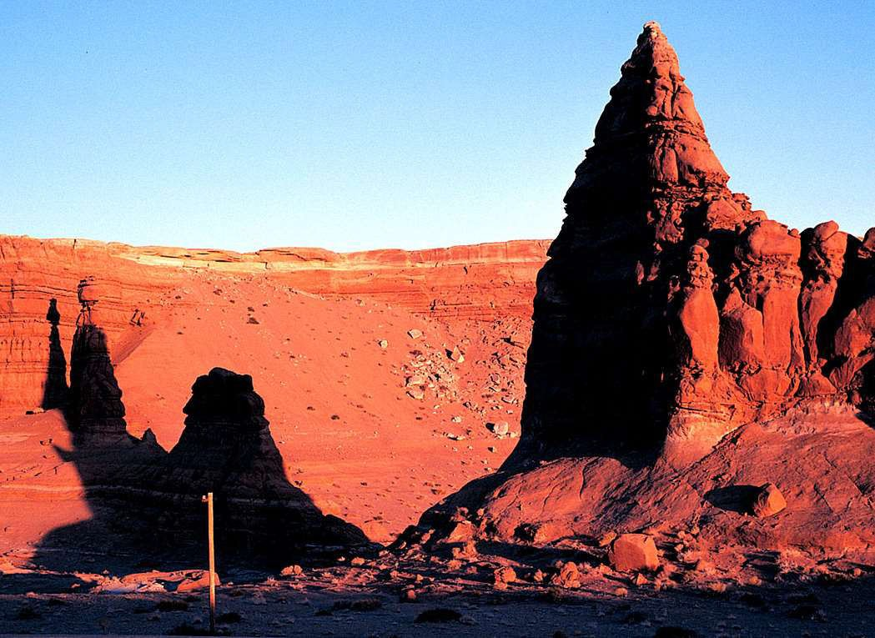











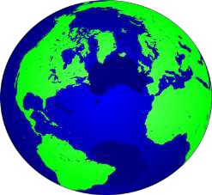












WELCOME
1

Slide 2
What we see on the earth’s natural
surface?

Slide 3
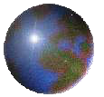



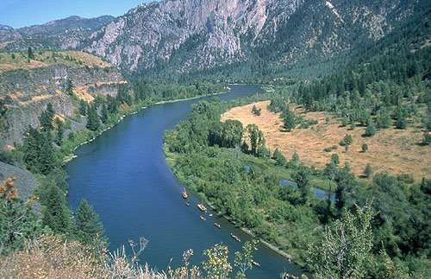
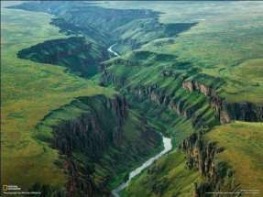
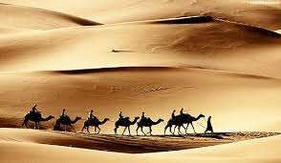
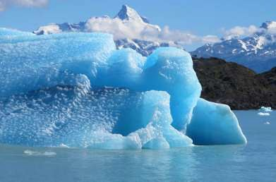
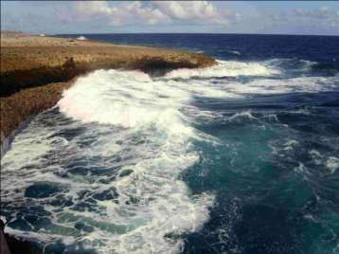
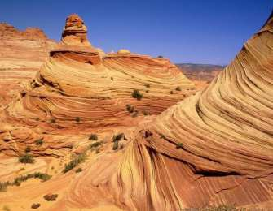
Various landform features
1
2
3
4
5
6

Slide 4
Landforms? Which? & Where? How these features are formed?

Slide 5
Geomorphology
The word Geomorphology derived from Greek: geo, "earth"; morfé, "form"; and logos, "study"; is the scientific study of landforms and the processes that shape them.
It is a composite science, is the study of landforms including, in recent times especially, investigations into the processes that cause and alter the landforms.
Geomorphology is practiced within physical geography, geology, geodesy, engineering geology, archaeology and geotechnical engineering.

Slide 6
Why Geomorphology?
To understand geomorphological processes of various environment.
To detect natural and environmental hazards efficiently, e.g. earthquake, flooding, landslide, tsunami, volcanism etc.
To identify various landform features and landscapes
To identify various landform features from satellite images Coastal and river research
Vulnerability studies

Slide 7
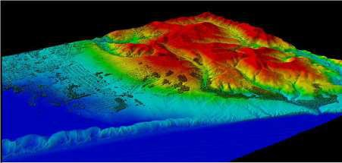
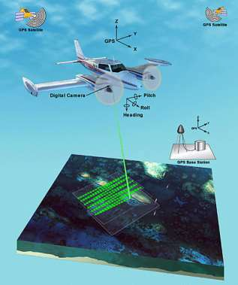
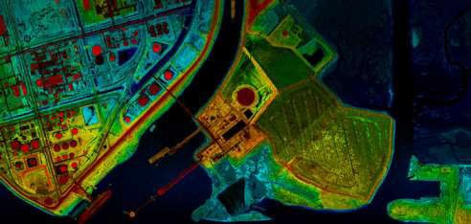
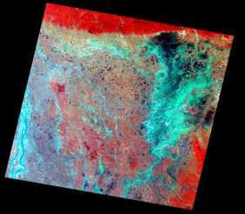
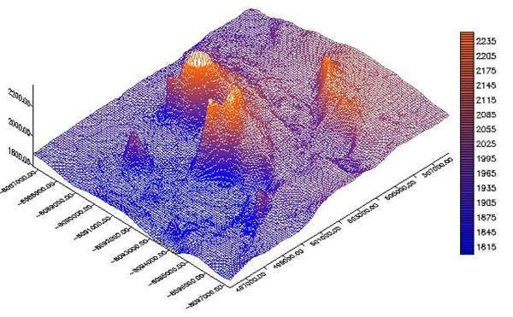
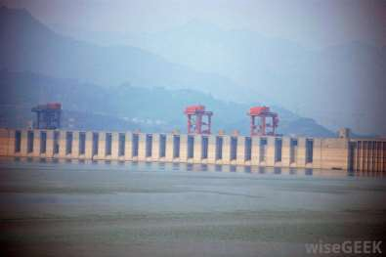
Applications of Geomorphology

Slide 8
What are the processes work behind the landforms?

Slide 9
Geomorphic Process
The process responsible for the formation and alteration of the
earth's surface.
The physical and chemical interactions between the earth's surface and the natural forces acting upon it to produce landforms.
The processes are determined by such natural environmental variables as geology, climate, vegetation and base level, to say nothing of human interference.

Slide 10
Geomorphic Process (Cont…)
Definition:
The geomorphic processes are all those physical and chemical changes which effect a modification of the earth’s surgical form [W. D. Thornbury (1968): Principles of Geomorphology, pp. 34].
A process by which the earth’s land forms are changed or maintained [Jim Gardner (1979): Physical Geology].

Slide 11
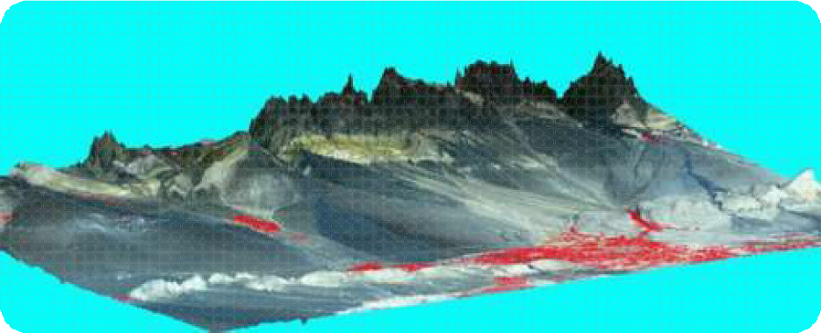
Agent of Geomorphological Processes
River activities- Humid Geomorphic Environment
Wind activities - Arid Geomorphic Environment
Glacier activities - Glacial and Peri-Glacial Geomorphic Environments
Wave activities - Marine and Coastal Geomorphic
Environment

Slide 12
Activities of the Agent of Geomorphic Processes
Three types of activities are done
Erosional activities
Transportation
Depositional activities

Slide 13
Activities of the Agent of Geomorphic Processes
Activities
Results
Erosional activities
Erosional landform features
Transportation
Transportation
Deposition activities
Depositional landform features

Slide 14

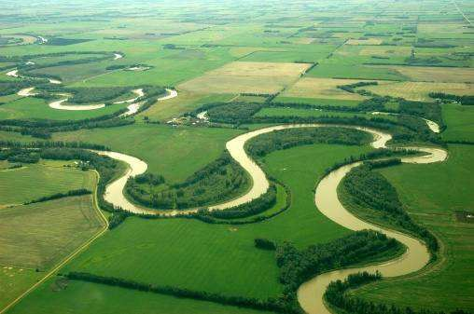
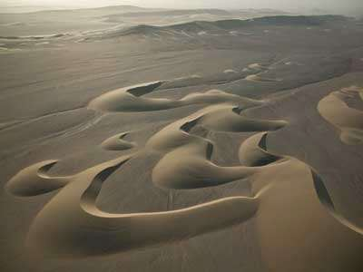


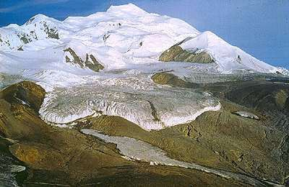
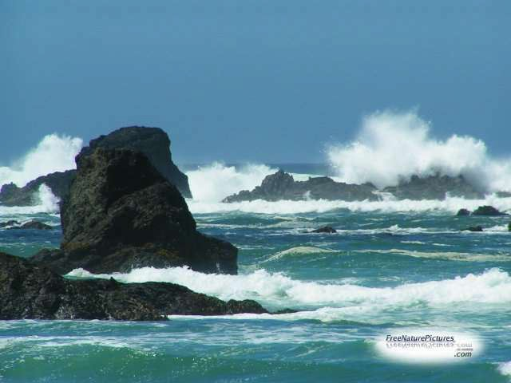

Agents of Change...
River activities
Wind activities
Glaciers activities
Wave activities
14

Slide 15




GEOMORPHOLOGICAL PROCESSES
Terrestrial Processes
Extra-terrestrial Processes
Exogenetic Processes
Endogenetic Processes
Weathering
Erosion/Degradation Transportation
Faulting and Folding
Volcanism
Earthquake
Landslide
Diastrophism
Metamorphism
iii.
Deposition/Aggradation
Mass movement
Denudation
•Physical Weathering
•Chemical Weathering
•Biological Weathering
15

Slide 16
Types of Geomorphic Processes
Geomorphic Processes
Terrestrial processes
Extra-terrestrial processes, e.g. fall of meteorite
(mass/rock from outer space).
Terrestrial processes
  Exogenetic / Exogenous Processes
  Endogenetic / Endogenous Processes
17

Slide 17
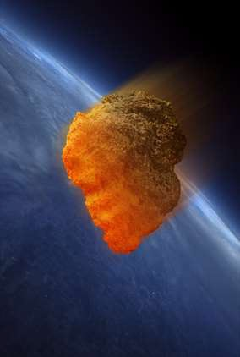
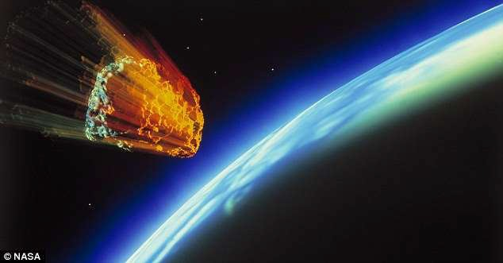
Extra-terrestrial processes,
e.g. fall of meteorite
18

Slide 18
Types of Geomorphic Processes (Cont…)
Exogenetic/Exogenous Processes
Outer geomorphological processes = exogenetic processes (solar radiation, wind, temperature changes, water) create relief sculptures, surface features.
Endogenetic Processes

Slide 19
Types of Geomorphic Processes (Cont…)
Endogenetic Processes
Inner geomorphological processes = endogenetic processes (earthquakes, volcanoes, folding and faulting) create rough features of the Earth´s relief. e.g. oceanic basins, mountain ranges, oceanic ridges and trenches, rift valleys, folds, faults and volcanoes, etc.

Slide 20
Basic difference between the two process
Processes that are caused by forces from within the
Earth are endogenous processes.
By contrast, exogenous processes come from forces
on or above the Earth's surface.
Endogenic Processes | Exogenic Processes
Originate in the interior of the earth. | Originate on the surface of the earth.
Causes sudden or rapid movements | Causes slow movements.
Eg: Earthquake, faulting, diastrophism | Eg: Erosional and Depositional

Slide 21
Types of Exogenetic / Exogenous Processes
Weathering
Erosion/ Degradation
Transportation
Deposition/Aggradation
Mass movement

Slide 22
Denudation
It means to make the things exposed.
The processes by which the rocks on the earth’s surface are broken into pieces through the application of external physical forces and the debris are transported elsewhere is known as denudation.
This denudation work is performed through three processes such as weathering, erosion and transportation.
Denudation= Weathering + Erosion + Transportation

Slide 23

Weathering
Sun
Rain
Pressure
24

Slide 24
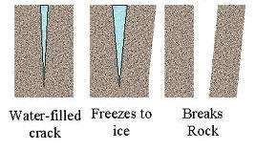
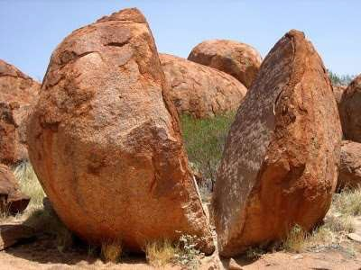
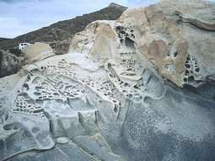
Weathering
The weathering is a process by which the rocks on the surface of the earth is broken mechanically into pieces due to snow or frost, the variation of temperature and pressure or due to chemical (dissolution) action on the materials.
Even the rocks are dislodged by the animals. But the rocks weathered this way, are not transported elsewhere.

Slide 25
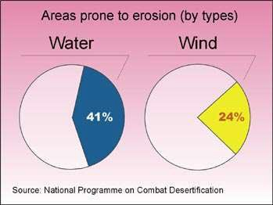
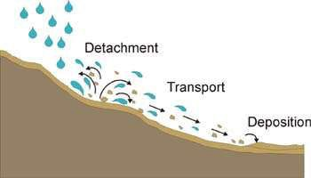
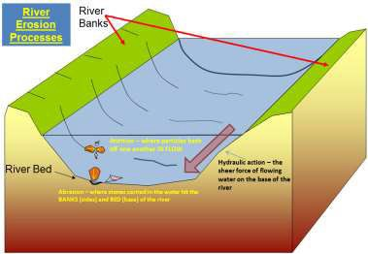
Erosion
Erosion and transportation are accomplished together.
The process by which the rocks of the earth’s crust are eroded by the river, wind, glacier, ocean currents etc. are transported elsewhere is known as erosion.

Slide 26



Degradation
Degradation is the lowering of a bottomland surface through the process of erosion;
Conceptually it is the opposite of the vertical component of aggradation and is most frequently applied to sediment removed from a channel bed or other low-lying parts of a stream channel.

Slide 27
Weathering vs. Erosion
Weathering = process of disintegration or decomposition of rocks which stay then in the same place.
Erosion = process of disintegration or decomposition of rocks which are transported somewhere else.

Slide 28
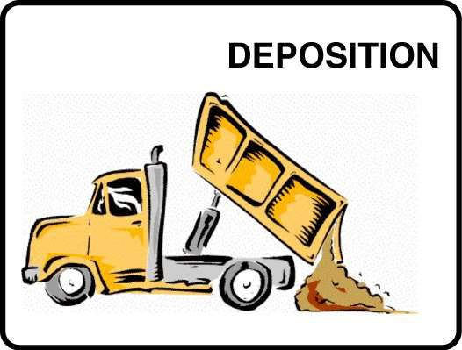
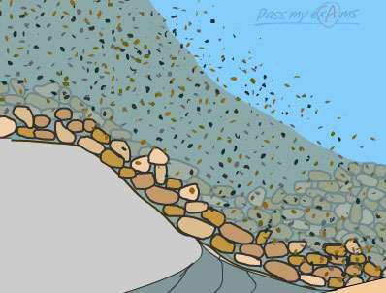
Deposition
Deposition is the constructive process of accumulation into beds or irregular masses of loose sediment or other rock material by any natural agent;

Slide 29
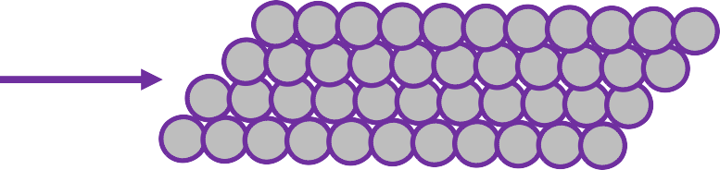


Aggradation
Aggradation is the raising or elevating of a bottomland surface through the process of alluvial deposition;
Conceptually it is the vertical component of accretion and is most frequently applied to sediment deposition on a channel bed, bar or other near-channel surfaces, flood plain, or, less often, low- lying alluvial terrace.

Slide 30
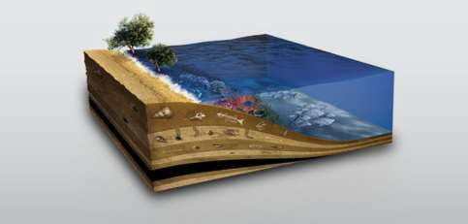
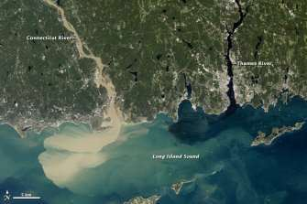
Sedimentation
Sedimentation is the process by which sediment is mechanically deposited from suspension within a fluid, generally water, or ice, thereby accumulating as layers of sediment that are segregated owing to differences in size, shape, and composition of the sediment particles.
31

Slide 31
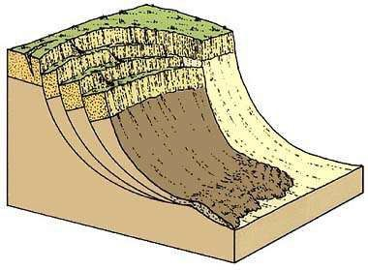
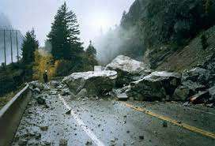
Mass movement/Mass Wasting
Mass movement is any downslope transfer, through gravitational and generally water-facilitated (viscous) processes, of near-surface soil and rock material;
Rates of mass movement range from very slow creep to nearly
instantaneous slope failure.
32

Slide 32
GEOMORPHOLOGICAL PROCESSES
Terrestrial Processes
Extra-terrestrial Processes
Exogenetic Processes
Endogenetic Processes
Weathering
Erosion/Degradation Transportation
Faulting and Folding
Volcanism
Earthquake
Landslide
Diastrophism
Metamorphism
iii.
Deposition/Aggradation
Mass movement
Denudation
•Physical Weathering
•Chemical Weathering
•Biological Weathering
33

Slide 33
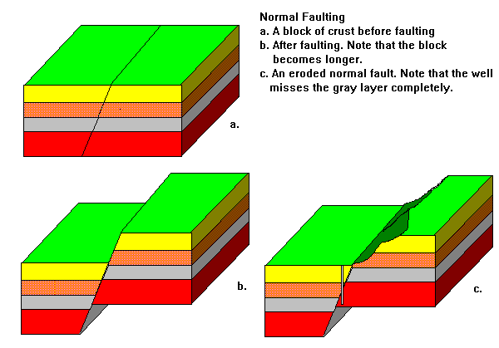
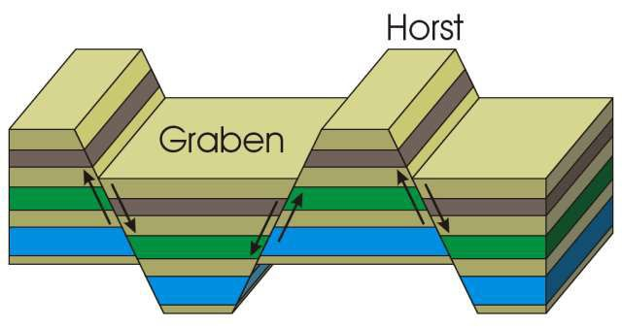
Faulting
Fault is a planar or gently curved fracture in the rocks of the earth’s crust, where compressional or tensional forces cause relative displacement of the rocks on the opposite sides of the fracture.

Slide 34
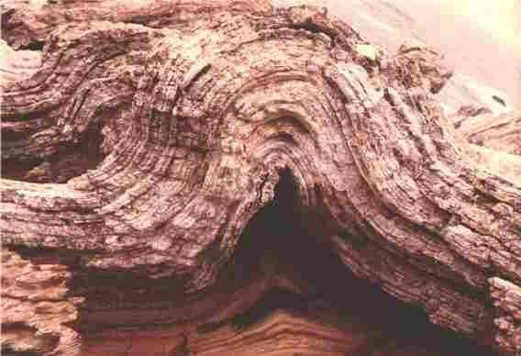
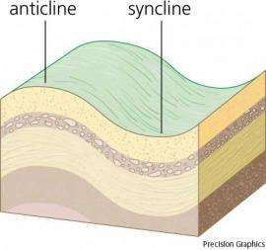
Folding
Fold is an undulation or waves in the stratified rocks of the
earth’s crust.
A fold occurs when one or a mass of originally flat and planar surfaces, such as sedimentary strata, are bent or curved as a result of permanent deformation.

Slide 35
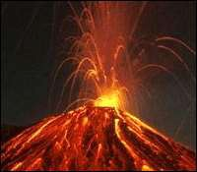
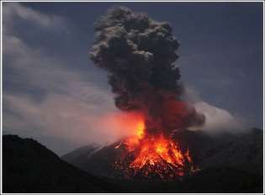
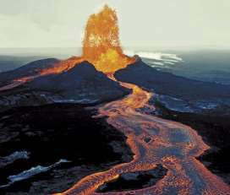
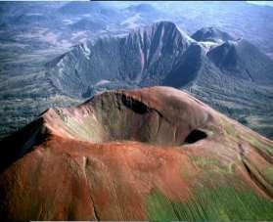
Volcanism
Volcanism is the phenomenon of eruption of molten rock (magma) onto the surface of the earth, where lava and volcanic gases erupt through a break in the surface called a vent.
Eruption of the volcanoes or the magma is the main
sources of igneous rocks on the surface of the earth.
36

Slide 36

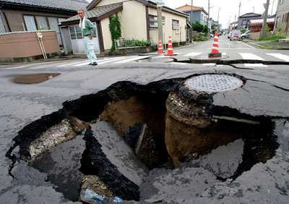
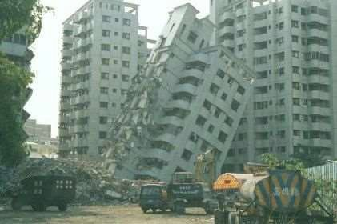
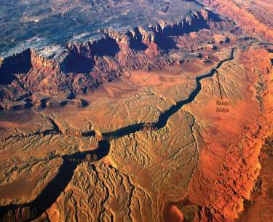
Earthquake
An earthquake is a vibration or oscillation of the surface of the earth caused by sudden release of enormous pressure.

Slide 37
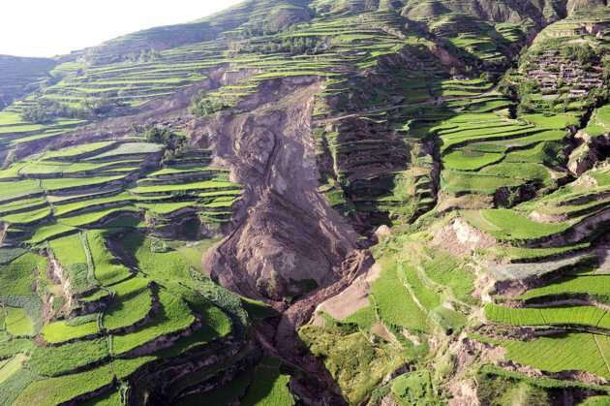
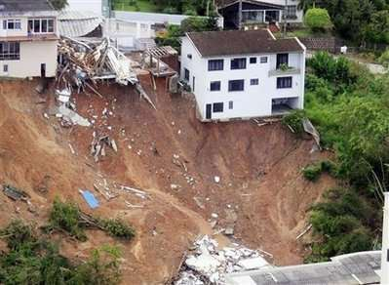
Landslide
A landslide, also known as a landslip, which includes a wide range of ground movements, such as rock fall, deep failure of slopes and shallow debris flows, which can occur in offshore, coastal and onshore environments.

Slide 38
Diastrophism
Diastrophism
is also called tectonism, large-scale
deformation of earth’s crust by natural processes, which leads to the formation of continents and ocean basins, mountain systems, plateaus, rift valleys, and other features by mechanisms such as plate movement, volcanic loading, or folding.
Internal forces active here

Slide 39
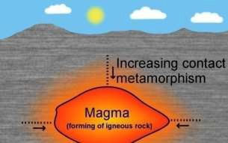
Metamorphism
Metamorphism is the change in rock structure, minerals or geologic structure.
It is a process of change in the physical structure of rock as a result of long-term heat, pressure and introduction of chemically active fluids, especially a change that increases the rock's hardness and crystalline structure.
The change occurs primarily due to heat, pressure, and the
introduction of chemically active fluids.

Slide 40
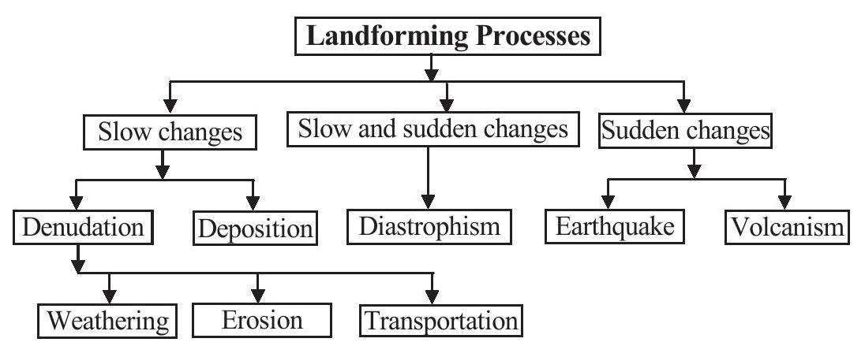
Geomorphological Processes at a glance

Slide 41




Thanks To All
43

