Slide 1
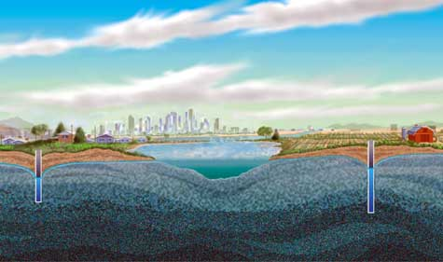
Groundwater

Slide 2
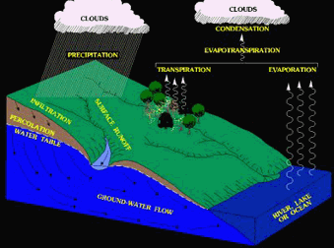
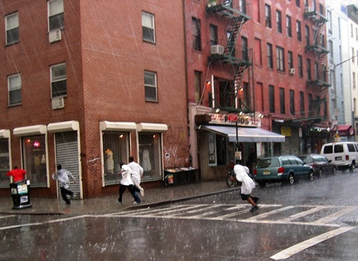
Groundwater
INFILTRATE = sink into (soak into).
When precipitation falls, it will runoff of IMPERMEABLE surfaces, and it will INFILTRATE PERMEABLE surfaces.

Slide 3
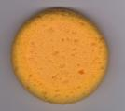
Permeable
Permeable- water CAN move through the material
Example: Sponge

Slide 4
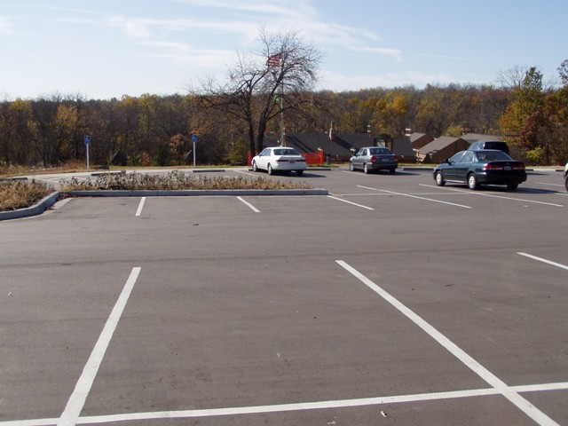
Impermeable
Impermeable- water CANNOT move through the object
Impermeable
Example: Asphalt or Concrete

Slide 5
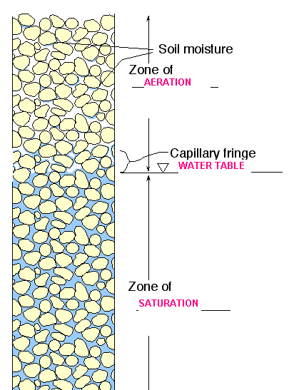
Zones of Groundwater
Zone of Aeration – pores filled w/ air & Water
Zone of saturation – all pores filled w/ Water
Water Table – division b/w zone of aeration & zone of saturation

Slide 6
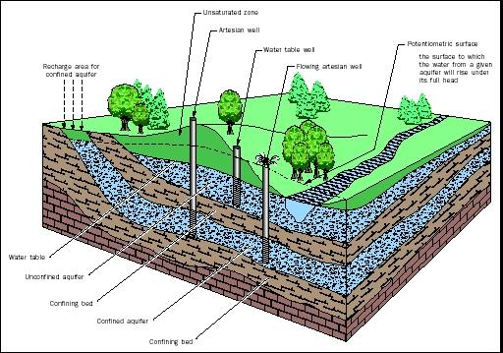
Water table well: a well that reaches the water table, the water must be pumped out.
Artesian well: a well that reaches a confined aquifer, the water flows due to pressure.

Slide 7
Porosity
Porosity: Amount of open space in rocks and sediment that can hold water (and air).
Rounded sediments of the same size can hold more water than odd shaped sediments of different sizes.
High porosity
Low porosity

Slide 8
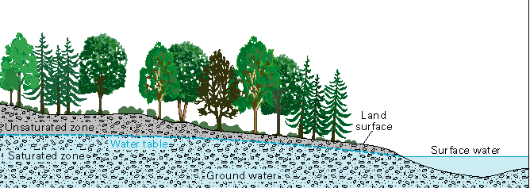
Groundwater intersects the surface
Water comes out of the ground when the groundwater meets the surface. It can be a spring, a lake, or a stream.

Slide 9
Aquifers
What is an Aquifer? A layer of permeable rock with high porosity that lets water move freely
Why are they so important? Most drinking water comes from aquifers.
Wells dug into a confined aquifer will give the most consistent supply of fresh water.
Water flows in an aquifer the same way it would flow on earth’s surface. It flows down slope.

Slide 10
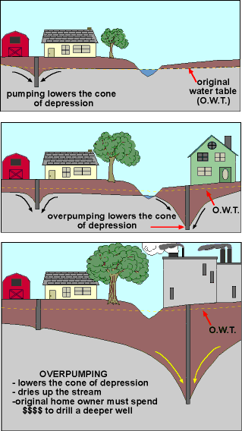
A cone of depression (dips down) forms along the water table when a well is dug.
Over pumping will lower the cone of depression.

Slide 11
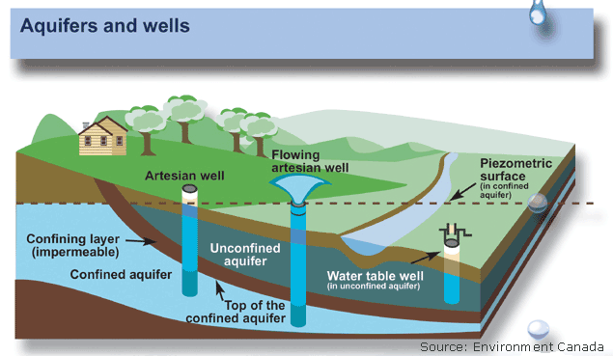
Aquifers

Slide 12
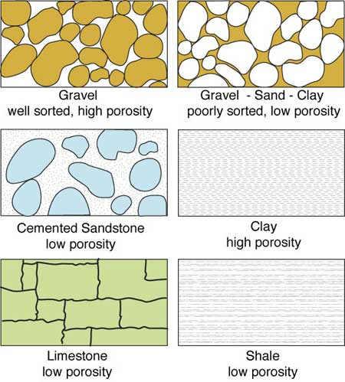

Slide 13
