Slide 1
Laminated Object Manufacturing (LOM)
CONTENTS
HISTORY
MATERIALS USED
PROCESS
ADVANTAGES
DISADVANTAGES
APPLICATIONS

Slide 2
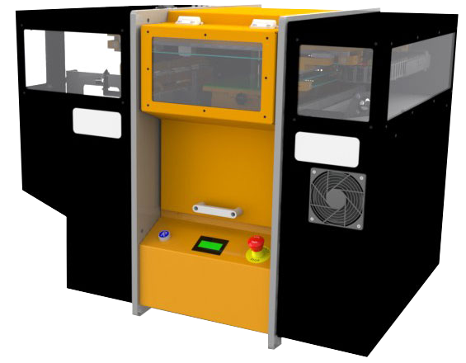
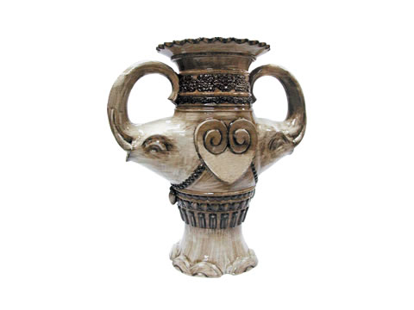
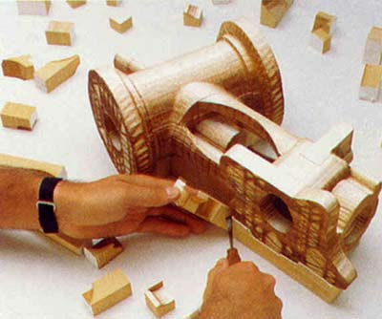
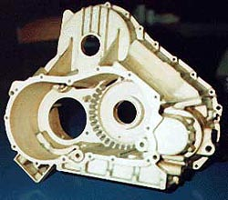
Laminated Object Manufacturing (LOM)
Current market leaders
Mcor Technologies (Ireland)
Solido (Israel)
Strataconception (France)
Kira Corporation (Japan)
Laminated Object Manufacturing (LOM) was developed by Helisys of Torrance, CA, in the 1990s. Helisys went out of business in 2000 and their LOM equipment is now serviced by Cubic Technologies.
Equipment picture
Mcor Technologies Matrix 300+
(uses A4 paper and water-based adhesive)
Courtesy, Cubic Technologies

Slide 3
Laminated Object Manufacturing
Called LOM. (Helisys)
Paper is coated heat-activated glue so it will stick. (spool)
Paper is bonded with last piece with heated rollers.
Design is cut out of paper with a laser.
The excess paper is cross hatched for removal.
Produces large parts.
Wood like texture

Slide 4
Laminated Object Manufacturing (LOM)
In this technology, objects are built by gluing profiled pieces of paper, plastic, or another material in a layered manner.
The paper used is has one of its surfaces coated with a glue that melts when heated.

Slide 5
Materials Used:
While the original system had used Kraft paper, other materials were introduced progressively.
Polymeric material
Polymer matrix composite
Composites for tooling
Metals
Ceramics

Slide 6
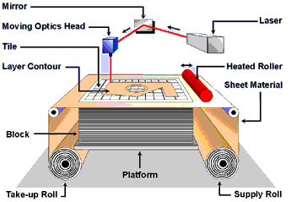

Slide 7
Laminated Object Manufacturing (LOM)
Sheets of material (paper, plastic, ceramic, or composite) are either precut or rolled.
A new sheet is loaded on the build platform and glued to the layer underneath.
A laser beam is used to cut the desired contour on the top layer.
The sections to be removed are diced in cross-hatched squares; the diced scrap remains in place to support the build.
The platform is lowered and another sheet is loaded. The process is repeated.
The product comes out as a rectangular block of laminated material containing the prototype and the scrap cubes. The scrap/support material is separated from the prototype part.

Slide 8
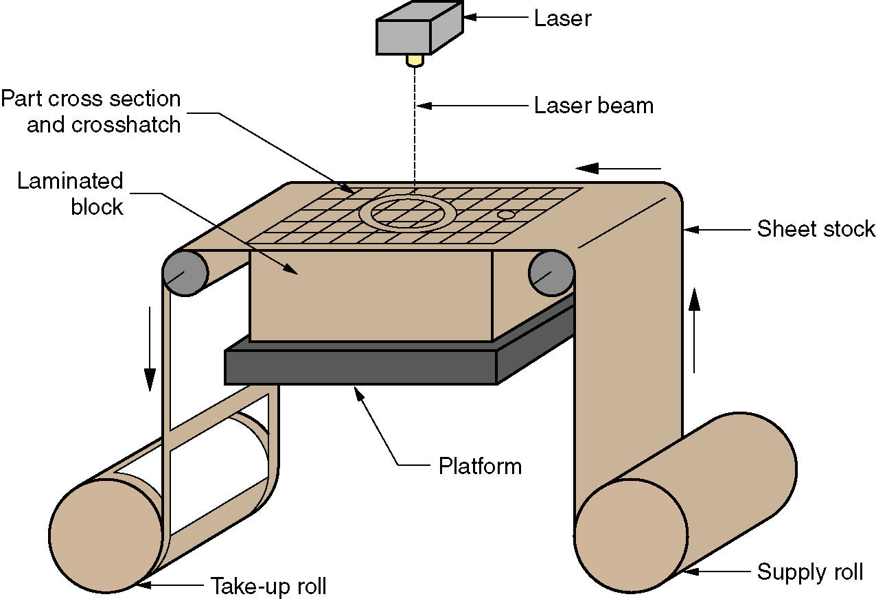
Laminated Object Manufacturing
Figure 34.5 Laminated object manufacturing.

Slide 9
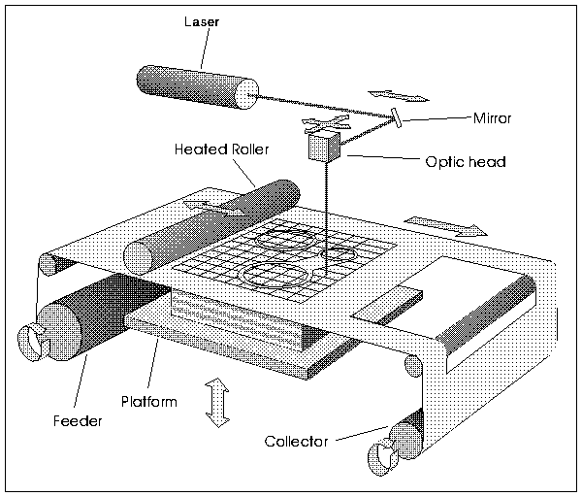
Laminated Object Modeling (LOM)
Paper is pulled across the table
Laser beam cuts the outline of the part, plus removal grids
A large, fixed size rectangle surrounding the part is also cut.
The table is lowered by t (= paper thickness)
Fresh paper rolled on top of the previous layer
Laser cuts new layer
A heated roller activates glue to stick the
fresh layer
Repeat steps 4-7 to complete part
Break away removal blocks to get final
part

Slide 10
ADVANTAGES
Relatively high-speed process
Low cost (readily available materials)
Large builds possible (no chemical reactions)
Parts can be used immediately after the process (no need for post-curing)
No additional support structure is required (the part is self-supported)
A variety of organic and inorganic materials can be used
Environmentally friendly

Slide 11
DISADVANTAGES
Removal of the scrap material is laborious
Emission of smoke or fumes
Can be fire hazard
Finish, accuracy and stability of objects not as good as materials used with other RP methods
The ‘z’ resolution is not as high as for other technologies
Limited material set
Need for sealing step to keep moisture out

Slide 12
KEY APPLICATION AREAS
Investment casting Pattern Making
Concept verification
Masters for silicon–rubber injection tools
Decorative Objects

Slide 13
Laminated Object Manufacturing (LOM)
KEY METRICS
Maximum build size | 40in x 40in x 20in
Resolution in (x,y) | +/- .004 in
Resolution in z | Variable
Speed | Medium
Cost | Low
Available materials | Paper, Plastic Sheet

Slide 14
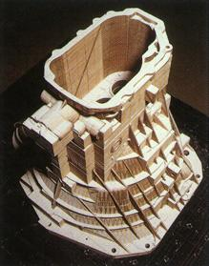
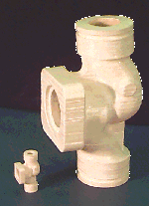
LOM Examples

Slide 15
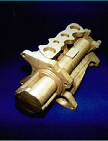
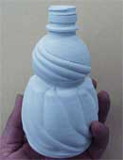
LOM: companies, applications
Original technology developed by Helisys Inc.;
Helisys acquired by Corum.
1. Cubic Technologies Inc [www.cubictechnologies.com]
2. KIRA Corp, Japan [www.kiracorp.co.jp]
[source: Corum Inc]
[source: KIRA corporation]

