Slide 1
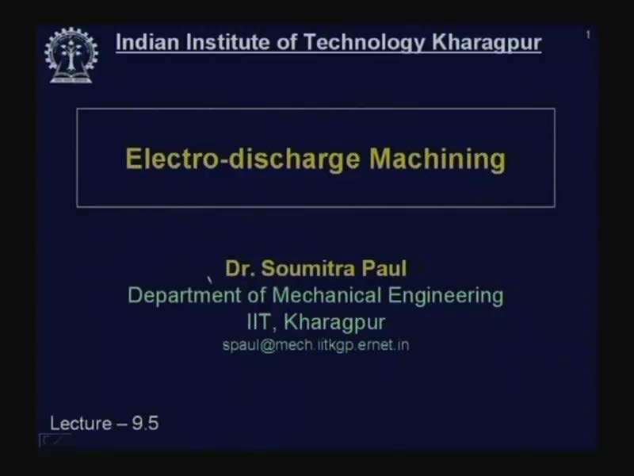
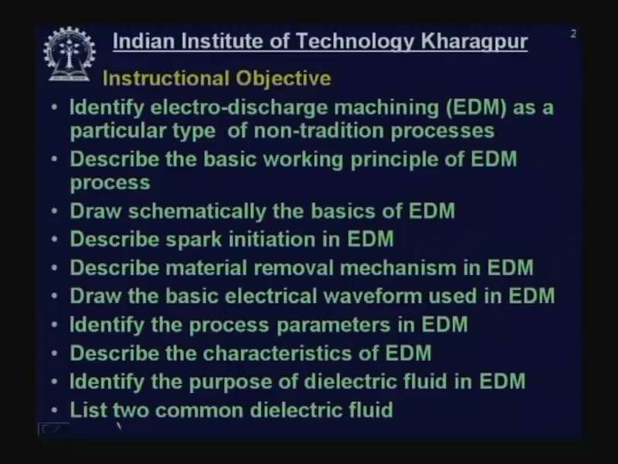

Slide 2
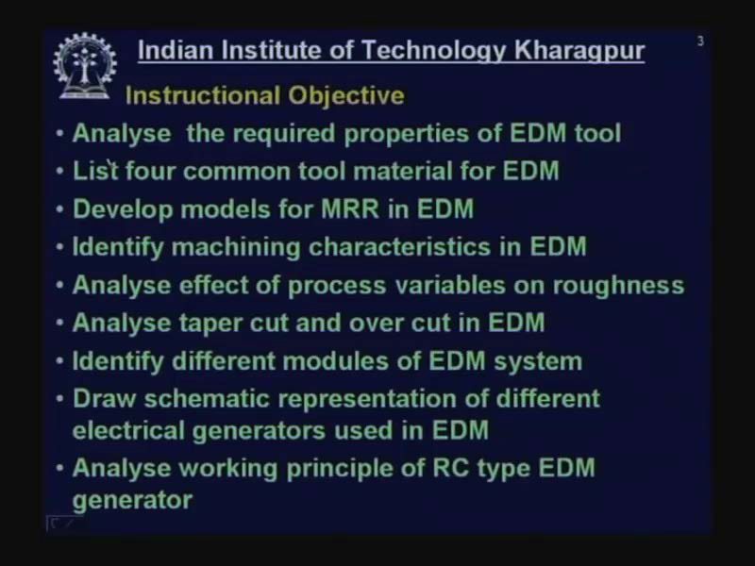

Slide 3
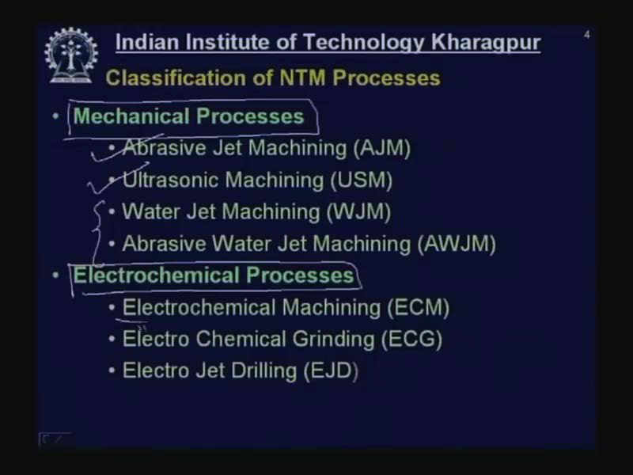

Slide 4
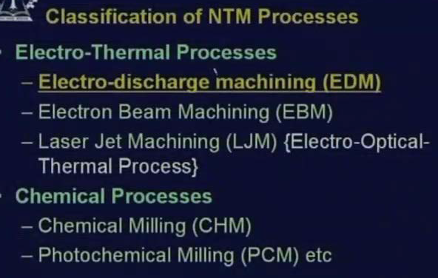

Slide 5
ELECTRO DISCHARGE MACHINING
EDM is a thermal erosion process whereby material is melted and vaporized from an electrically conducive workpiece immersed in a liquid dielectric with a series of spark discharges between the tool electrode and the workpiece created by a power supply.
The EDM system consists of a shaped tool or wire electrode, and the part. The part is connected to a power supply to create a potential difference between the workpiece and the tool.
When the potential difference is sufficiently high, a transient spark discharges through the fluid, removing a very small amount of metal from the workpiece.

Slide 6
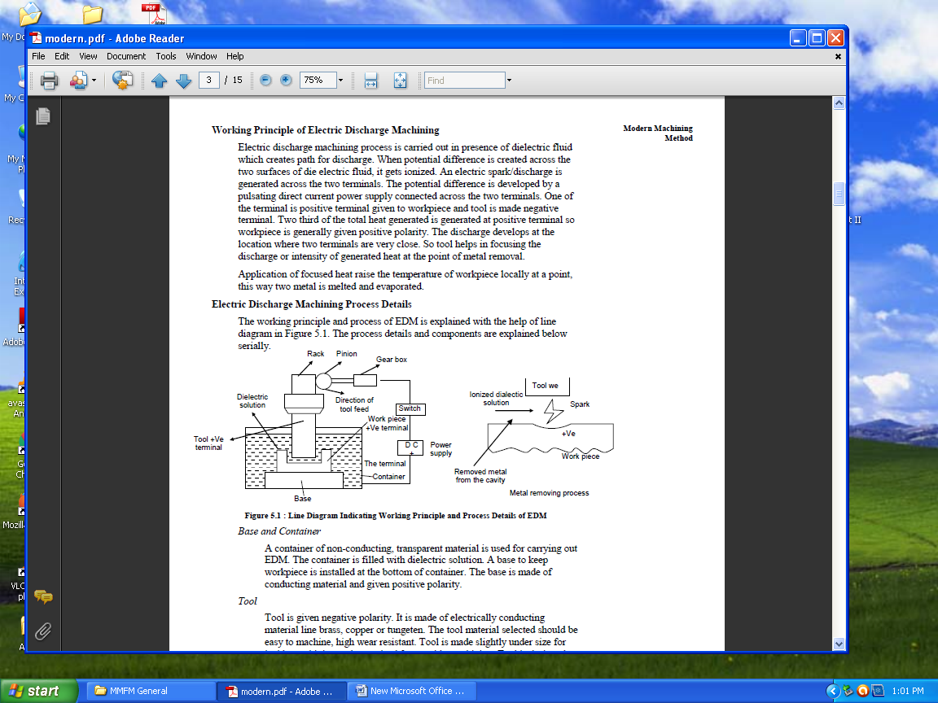

Slide 7
Working principle of EDM
A high voltage is applied across the narrow gap between the electrode and the workpiece.
This high voltage induces an electric field in the insulating dielectric that is present in narrow gap between electrode and workpiece.
This cause conducting particles suspended in the dielectric to concentrate at the points of strongest electrical field.
When the potential difference between the electrode and the workpiece is sufficiently high, the dielectric breaks down and a transient spark discharges through the dielectric fluid, removing small amount of material from the workpiece surface.

Slide 8
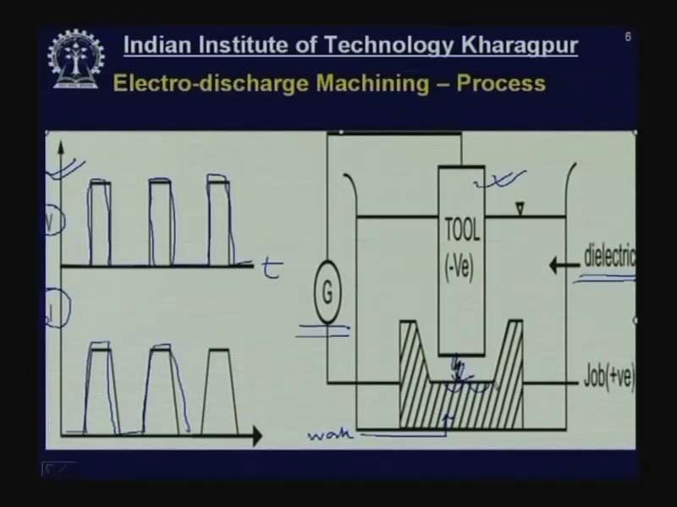

Slide 9
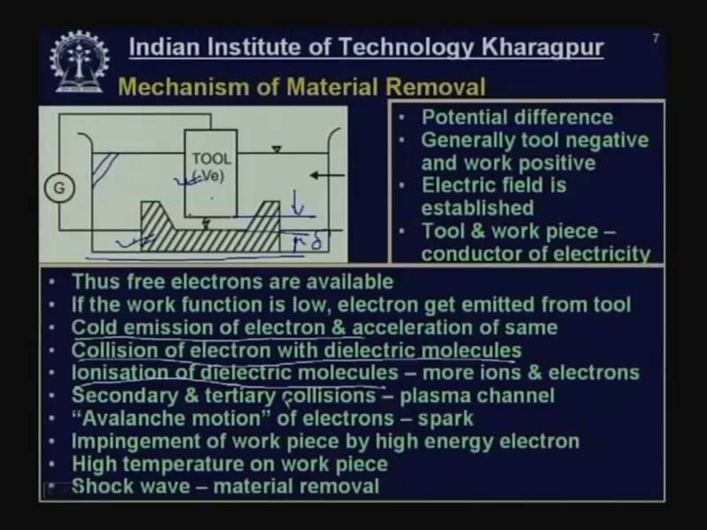

Slide 10
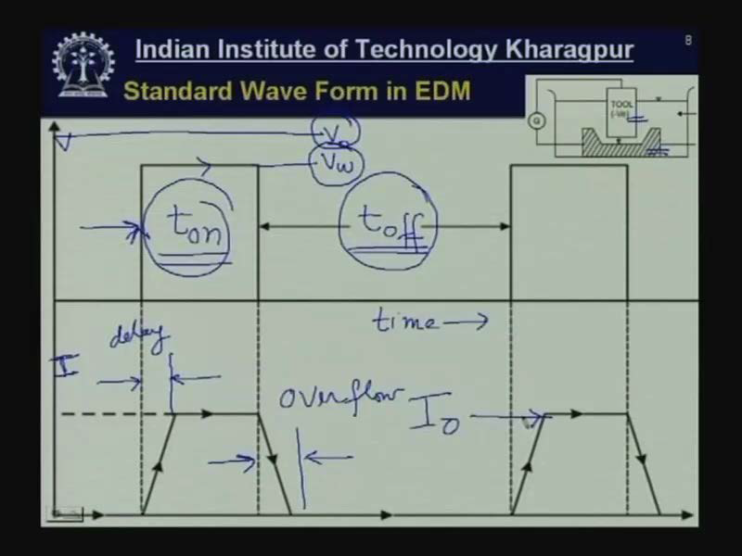

Slide 11
Process-Basics

Slide 12
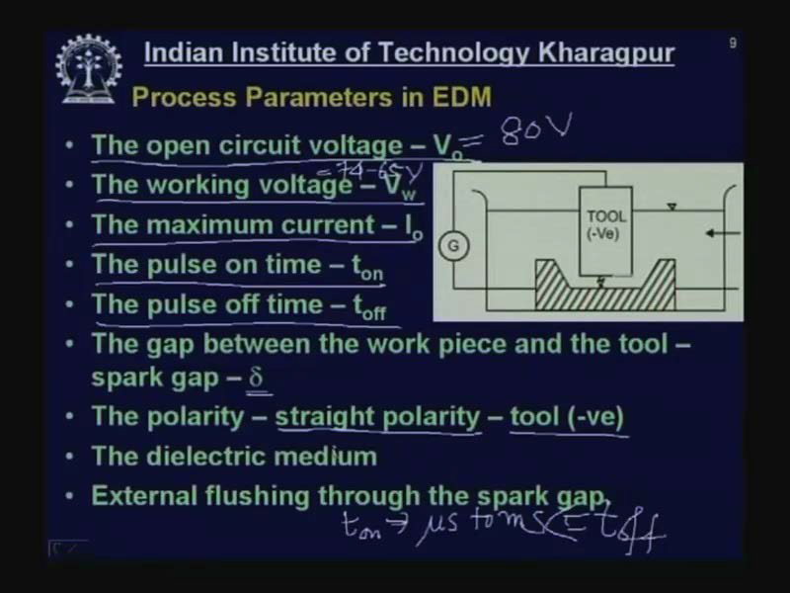

Slide 13
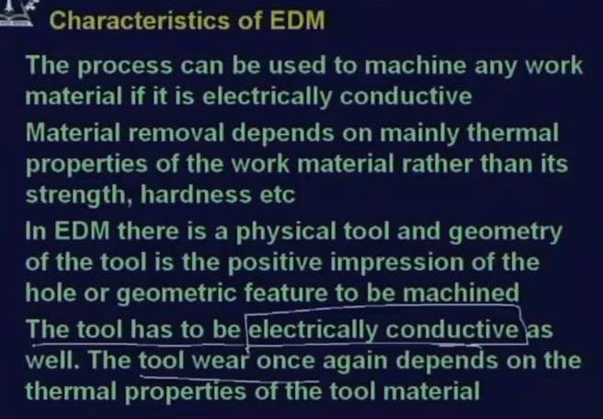

Slide 14
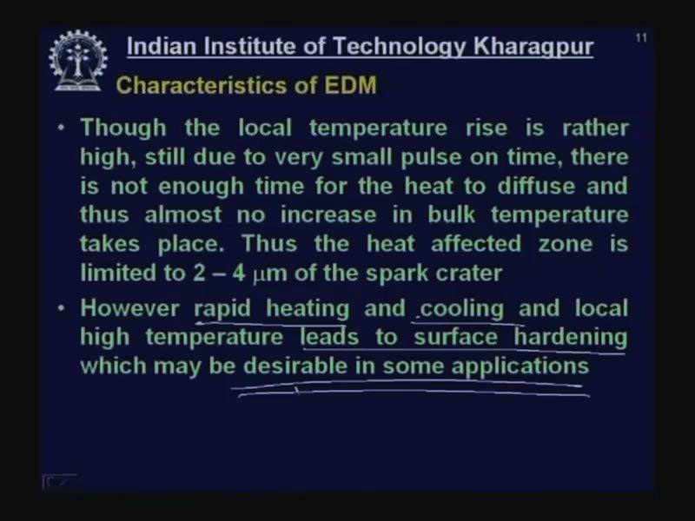

Slide 15
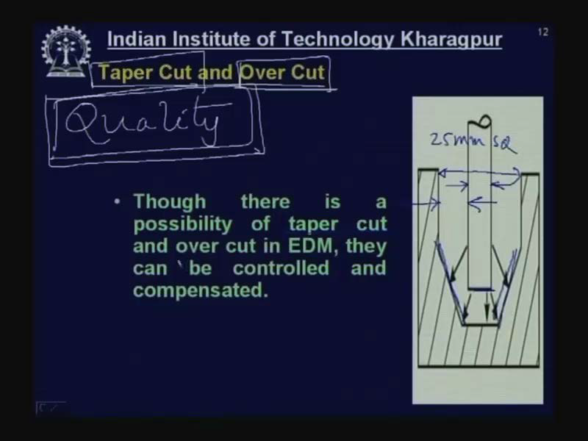

Slide 16
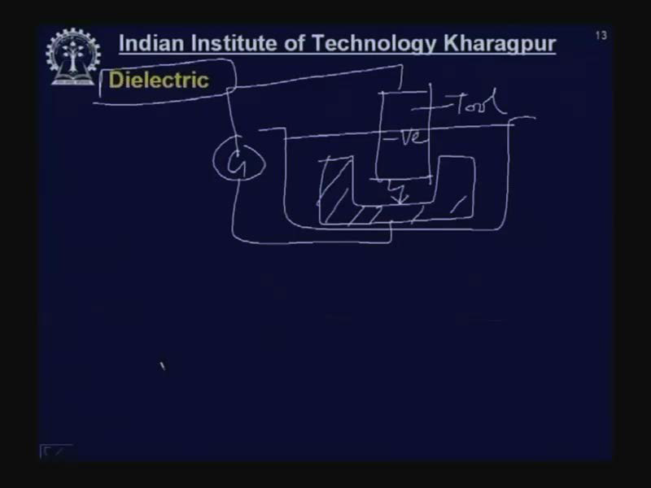

Slide 17
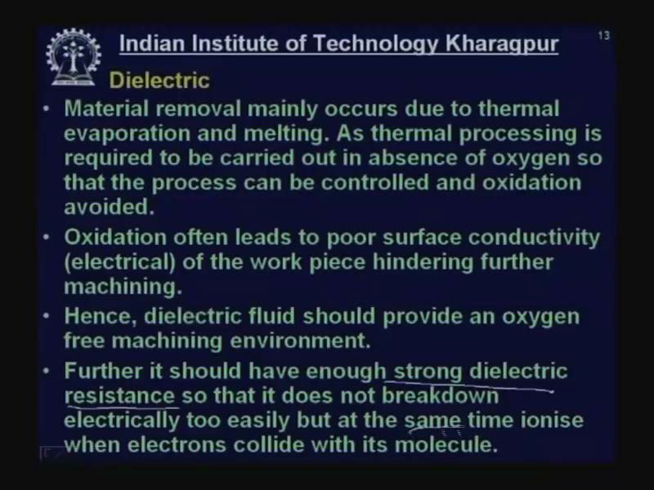

Slide 18
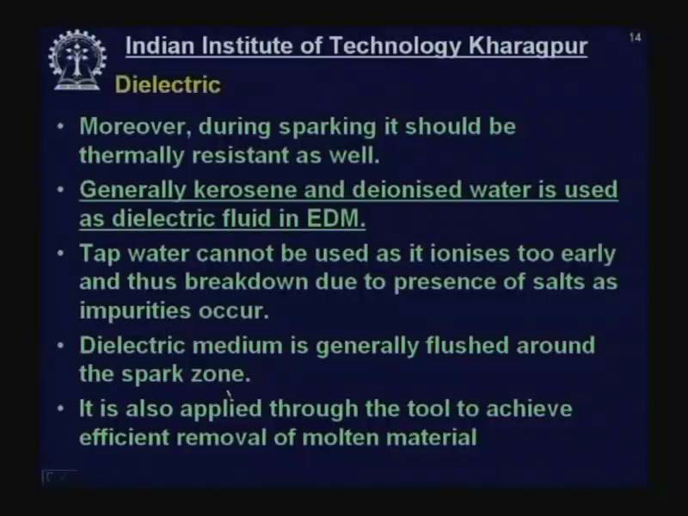

Slide 19
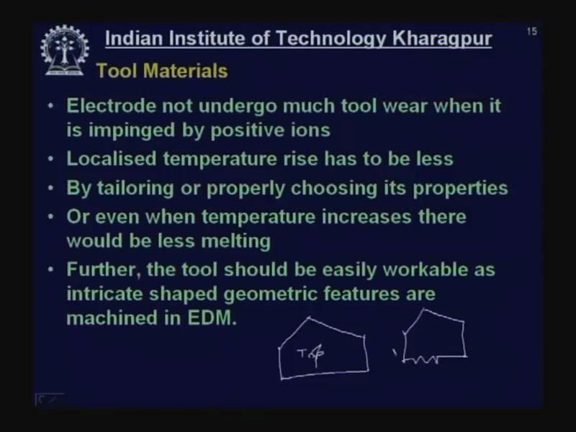

Slide 20
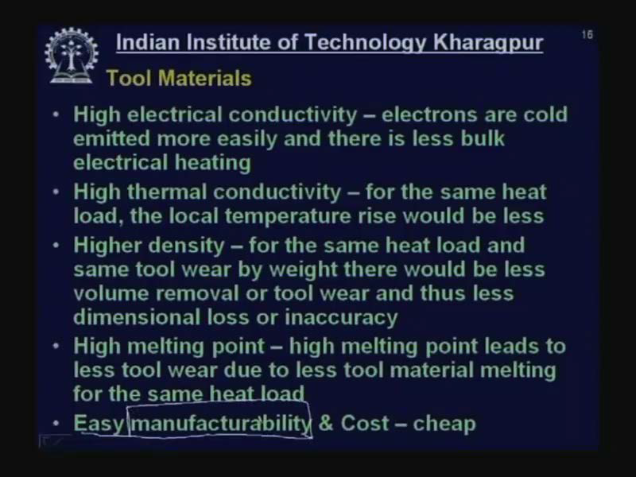
Tool Material Characteristics

Slide 21
TOOL MATERIAL
Copper
Brass
Graphite

Slide 22
Types of EDM
1. Die Sinker EDM
2. Wire Cut EDM
3. Powder Mixed EDM

Slide 23
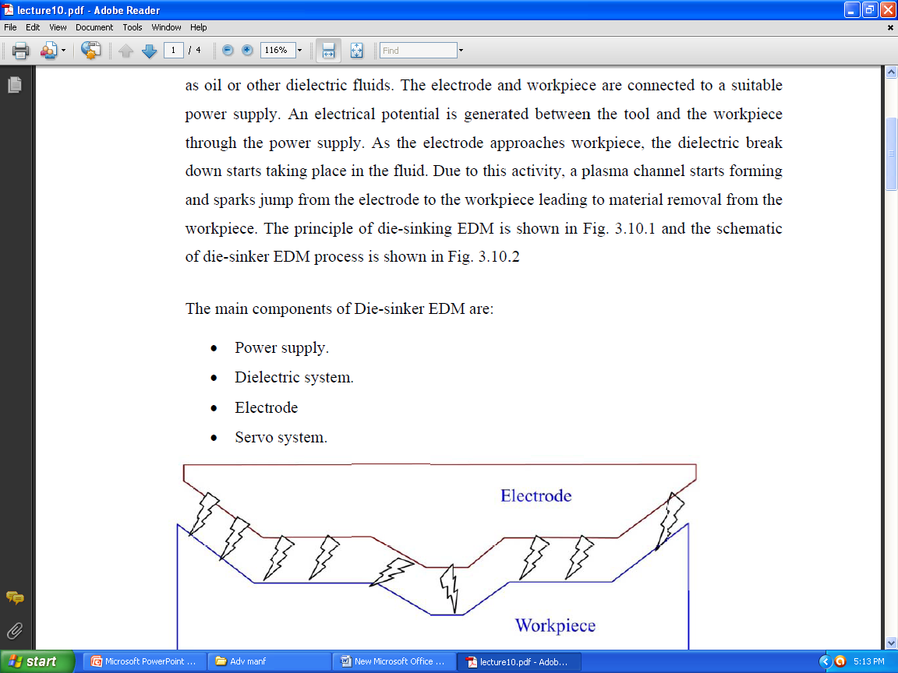

Slide 24
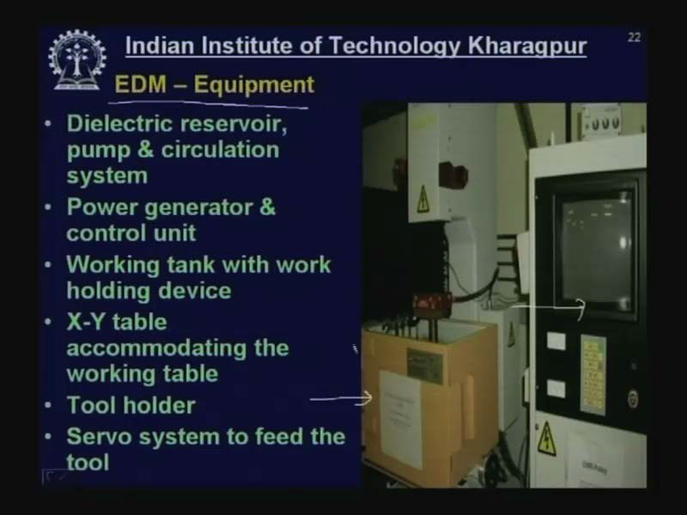

Slide 25
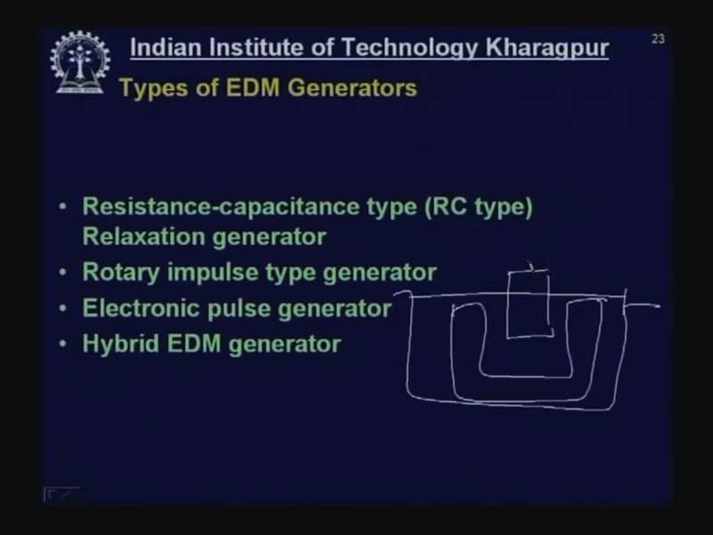

Slide 26
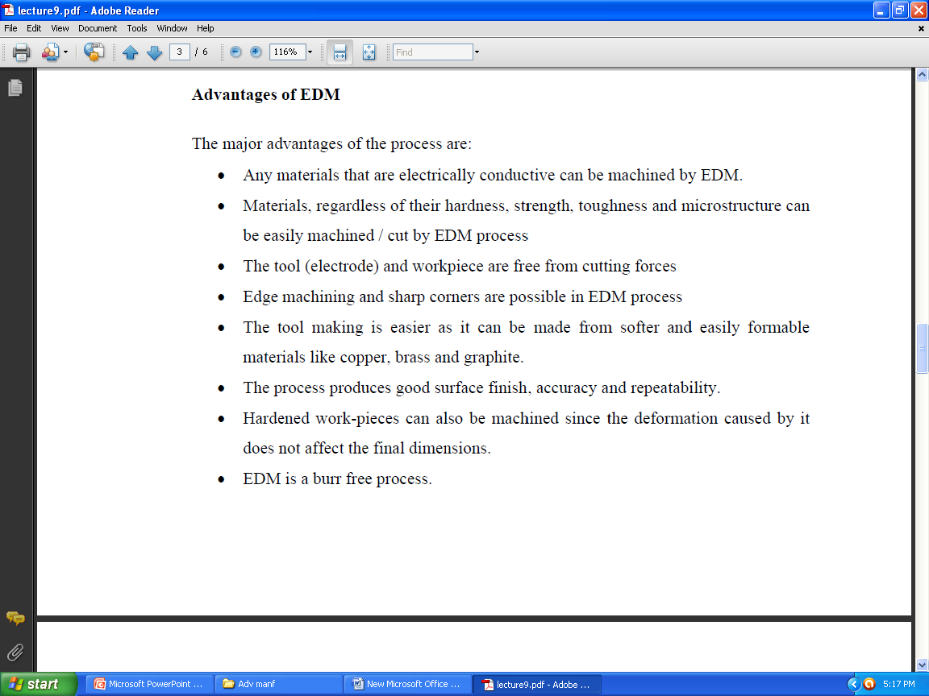

Slide 27
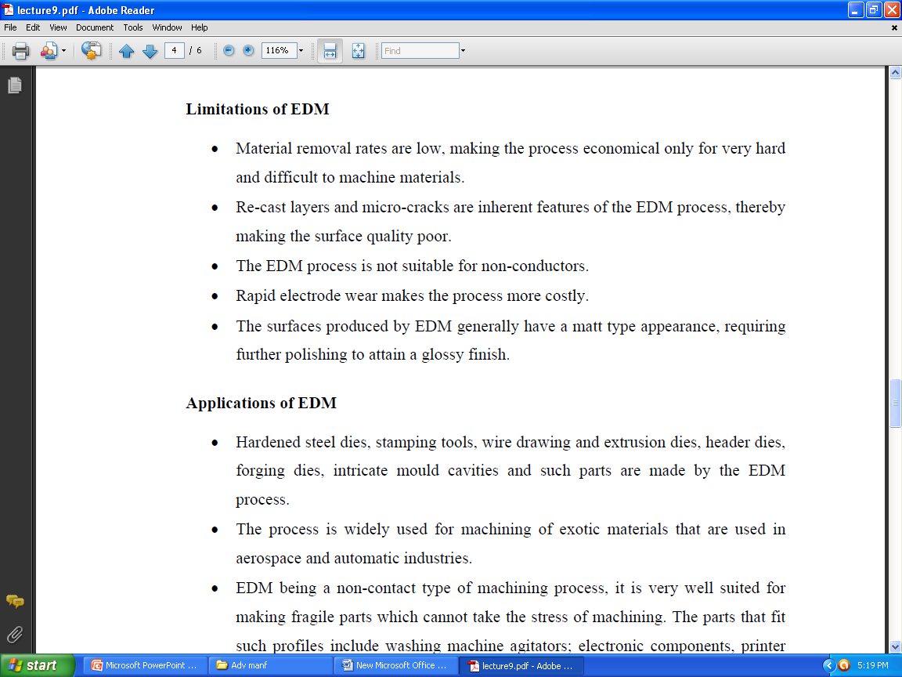

Slide 28
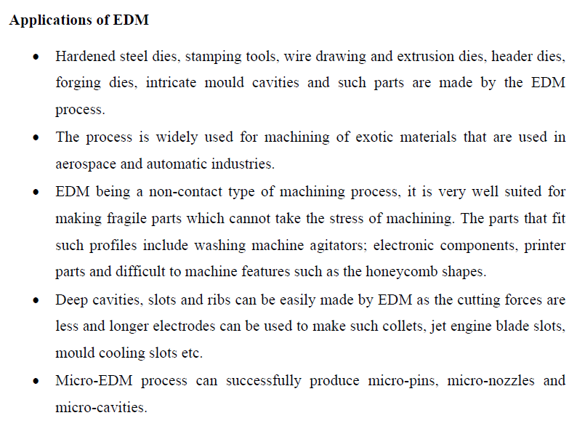

Slide 29
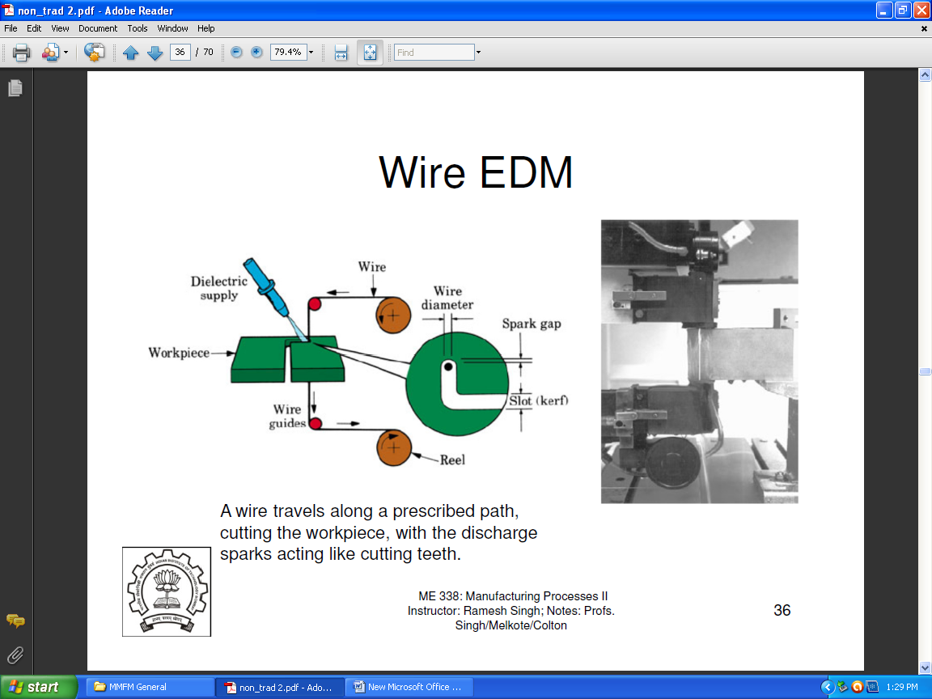

Slide 30
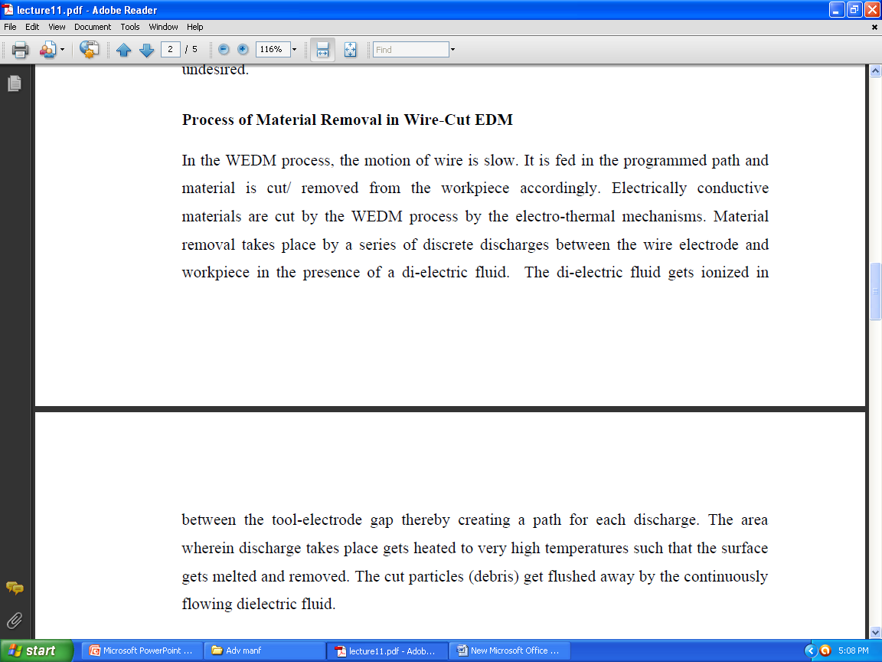

Slide 31
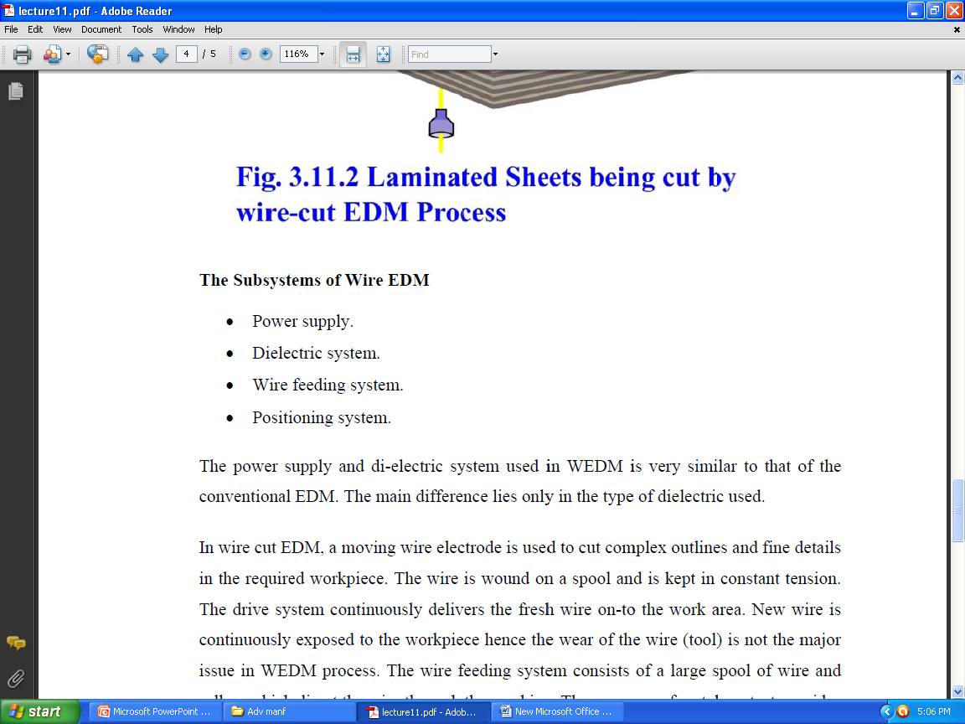

Slide 32
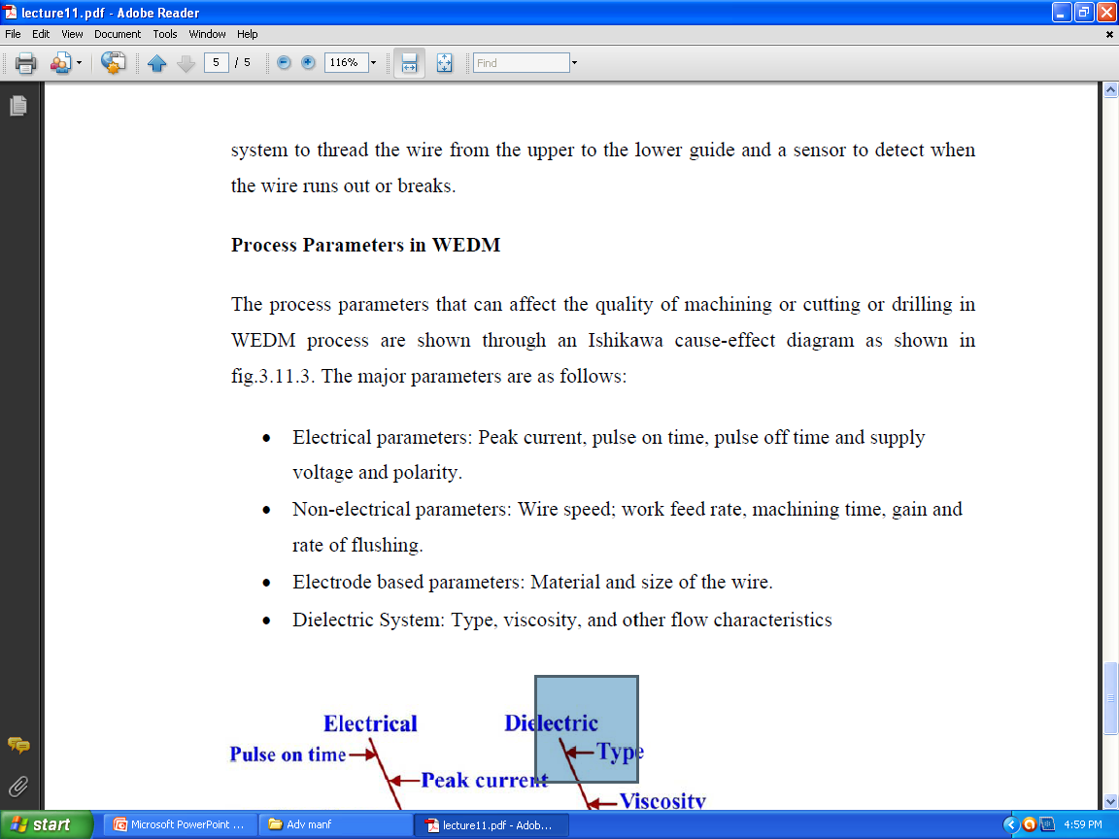
PROCESS PARAMETERS IN WEDM

Slide 33
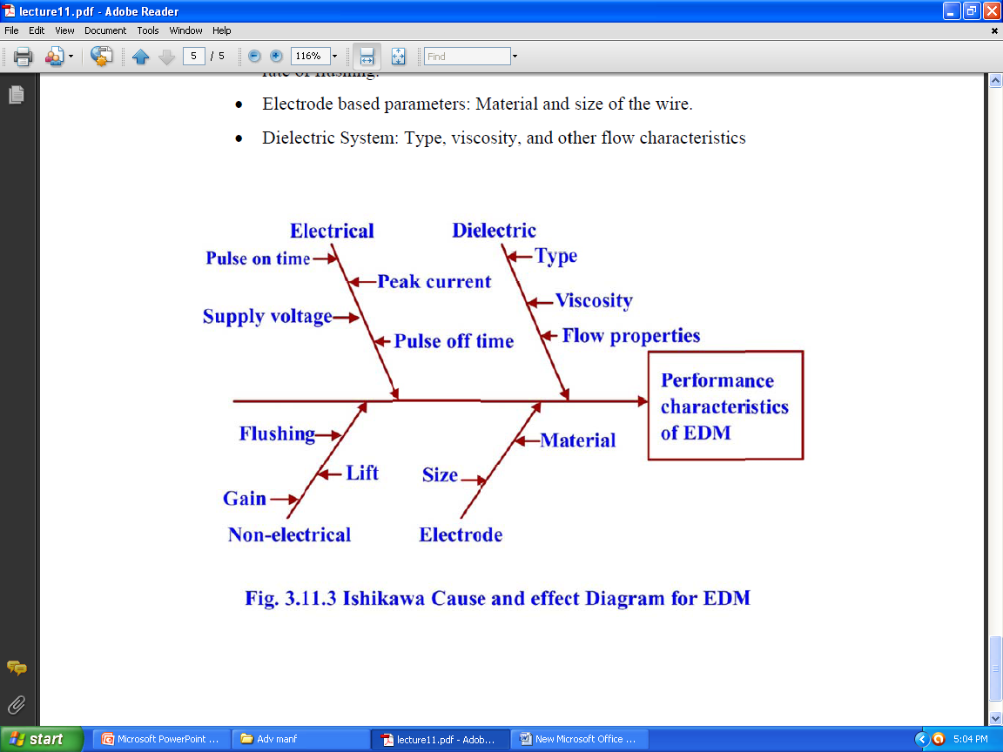
MachiningTime
Feed rate
Size

Slide 34
Applications of Wire-Cut EDM
For cutting aluminium, brass, copper, carbides, graphite, steels and titanium.
Aerospace, Medical, Electronics and Semiconductor applications
Tool & Die making industries.
For cutting the hard Extrusion Dies
In making Fixtures, Gauges & Cams

Slide 35
Cutting of Gears, Strippers, Punches and Dies
Manufacturing hard Electrodes.
Manufacturing micro-tooling for Micro-EDM,
Micro-USM and such other micromachining
applications

