Slide 7
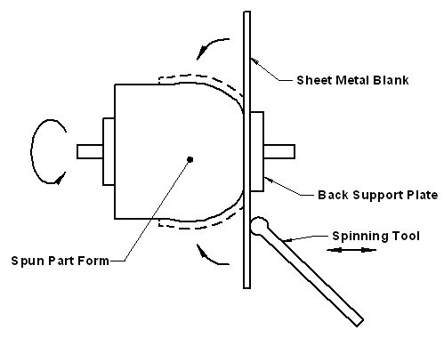
Metal spinning
Metal spinning, also known as spin forming or spinning or metal turning.
It is a metalworking process by which a disc or tube of metal is rotated at high speed and formed into an axially symmetric part.
Spinning can be performed by hand or by a CNC lathe.
Metal spinning does not involve removal of material, as in conventional wood or metal turning, but forming (moulding) of sheet material over an existing shape.

Slide 8
SPINNING PROCESS
A formed block is mounted in the drive section of a lathe.
A pre-sized metal disk is then clamped against the block by a pressure pad, which is attached to the tailstock.
The block and workpiece are then rotated together at high speeds.
A localized force is then applied to the workpiece to cause it to flow over the block.

Slide 14
TYPES

Slide 15
Hot spinning
"Hot spinning" involves spinning a piece of metal on a lathe while high heat from a torch is applied to the workpiece.
Once heated, the metal is then shaped as the tool on the lathe presses against the heated surface forcing it to distort as it spins.
Parts can then be shaped or necked down to a smaller diameter with little force exerted, providing a seamless shoulder.

Slide 18
TOOL MATERIALS
Hardened steel for using with aluminum
Solid brass for spinning stainless steel or mild steel
Rotating tools may also be coated with thin film of ceramic to prolong tool life.

Slide 23
Objects can be built using one piece of material to produce parts without seams.

Slide 24
The diameter and depth of formed parts are limited only by the size of the equipment available.
If a crack forms or the object is dented, it must be scrapped. Repairing the object is not cost-effective.

Slide 26
Commercial applications include rocket nose cones, cookware, gas cylinders, brass instrument bells, and public waste receptacles.
Virtually any ductile metal may be formed, from aluminum or stainless steel, to high-strength, high-temperature alloys including Incone and Hastelloy.

