Slide 3
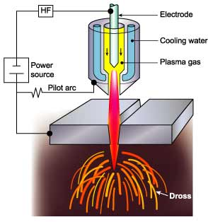

Slide 4
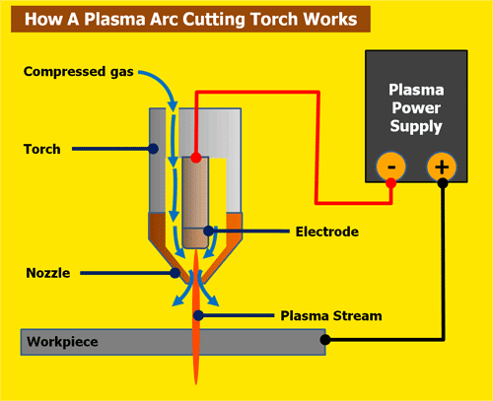

Slide 14
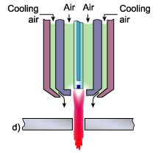
Developed in 1960 - for cutting mild steel
The inert or un-reactive plasma forming gas (argon or nitrogen) can be replaced with air (less expensive gas).
Requires a special electrode of hafnium or zirconium mounted in a copper holder.
Hafnium – Most expensive

Slide 15
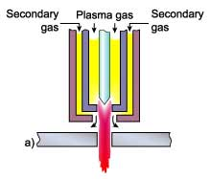
The beneficial effects of the secondary gas are increased arc constriction and more effective 'blowing away' of the dross.
The advantages compared with conventional plasma are:
Reduced risk of 'double arcing'
Higher cutting speeds
Reduction in top edge rounding
The plasma forming gas is normally argon, argon-H₂ or nitrogen.
Secondary gas is selected according to the metal cut.
Steel: air, oxygen, nitrogen
Stainless steel: nitrogen, argon-H₂, CO₂
Aluminium : argon-H₂, nitrogen / CO₂

Slide 16
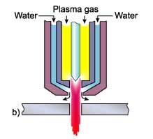
Water Injection
Nitrogen is normally used as the plasma gas.
Water is injected radially into the plasma arc to induce a greater degree of constriction.
The temperature is also considerably increased, to as high as 30,000°C.
Advantages:
Improvement in cut quality and squareness of cut
Increased cutting speeds
Less risk of 'double arcing‘
Reduction in nozzle erosion

Slide 17
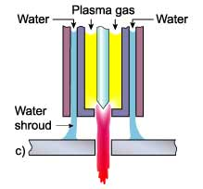
The plasma can be operated either with a water shroud or even with the workpiece submerged some 50 to 75mm below the surface of the water.
Water acts as a barrier to provide the following advantages:
Fume reduction
Reduction in noise levels
Improved nozzle life
Noise levels at high current levels of 115dB for conventional plasma, a water shroud was effective in reducing the noise level to about 96dB and cutting under water down to 52 to 85dB.
Water shroud does not increase the degree of constriction, hence squareness of the cut edge and the cutting speed are not noticeably improved.

Slide 25
In IBM a stream of charged atoms (ions) of an inert gas, such as argon, is accelerated in a vacuum by high energies and directed toward a solid workpiece.
The beam removes atoms from the workpiece by transferring energy and momentum to atoms on the surface of the object.
When an atom strikes a cluster of atoms on the workpiece, it dislodges between 0.1 and 10 atoms from the workpiece material....

Slide 27
Vacuum Chamber filled with argon gas. The gas is ionized by the electrons.
A stream of ions is thus generated and is directed on to the target material.
Vacuum
10⁻⁴ Torr

Slide 28
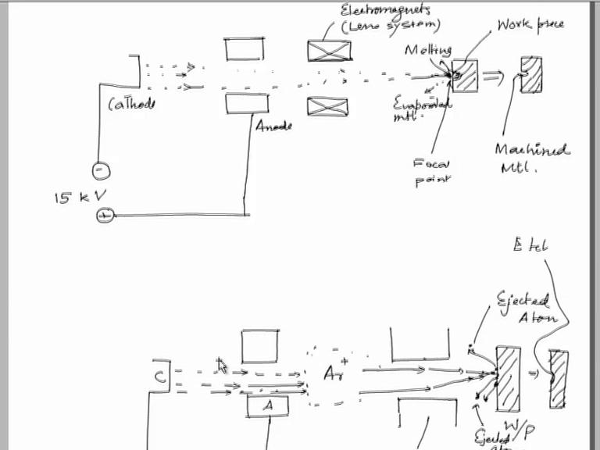
EBM

Slide 29
IBM

Slide 32
Sputtering Coefficient: The no. of atoms dislodged by each bombarding ion.
It is a function of:
The energy and atomic weight of the incident ion
The angle of incidence and
The binding energy of atoms in the material being machined.

