Slide 1

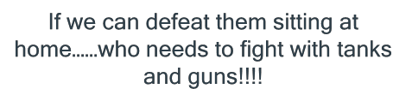
Lavanya Pamulaparty
Assoc.Prof
HOD-CSE
.

Slide 2
“Man is still the most extraordinary computer of all”
  - John F. Kennedy
“Security, is not about making IT perfect, but making customer lastingly satisfied and confident.”
- Stephane Nappo
“Threat is a mirror of security gaps Cyber-threat is mainly the reflection of our weaknesses. An accurate vision of digital and behavioural gaps is crucial for a consistent cyber-resilience.”
                - Web Source

Slide 3
Agenda
Cyber Crime
First Hour
Second Hour
Social Engineering and Security
Last Hour
Cyber Law and Discussions

Slide 4
Cybercrimes
- Introduction & Approaches

Slide 5
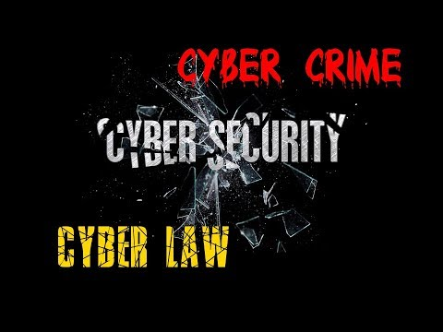

Slide 6
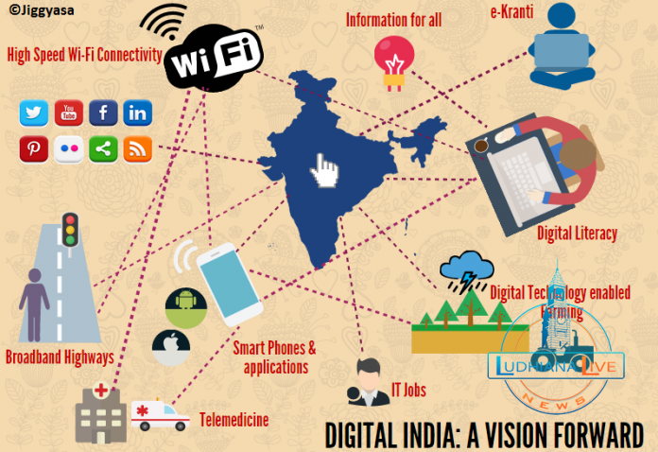

Slide 7
Cybercrimes and Cybercriminals
There have been many stories in the media about computer crime.
Sometimes hackers have been portrayed as “heroes”
Perceptions about hacking and computer crime are changing because of increased dependency on the Internet for our infrastructure.

Slide 8
A "Typical" Cybercriminal
Parker (1998) believes that typical computer hackers tend to exhibit three common traits:
  Precociousness;
  Curiosity;
  Persistence.
Many people conceive of the typical computer hacker as someone who is a very bright, technically sophisticated, young white male – as portrayed in the popular movie War Games.

Slide 9
A Typical Computer Criminal (continued)
Parker suggests that we carefully distinguish between hackers, as nonprofessional or "am- ateur" criminals, and professional criminals.
He points out that stereotypical computer hackers, unlike most professional criminals, are not generally motivated by greed.
He also notes that hackers seem to enjoy the "sport of joyriding," another characteristic that allegedly distinguishes stereotypical hackers from professional criminals.

Slide 10
A Typical Computer Criminal (continued)
Many computer criminals have been company employees, who were formerly loyal and trustworthy and who did not necessarily possess great computer expertise.
Some employees have been tempted by flaws in computer systems.
So in this case, opportunity more than anything else seems to have been the root cause of many individuals who have been involved in computer crimes.

Slide 11
A Typical Computer Criminal (continued)
If Forester and Morrison (1994) are correct, at least three categories for typical computer criminals are needed:
1. (amateur) teenage hackers;
2. professional criminals;
3. (once) loyal employees who are unable to resist a criminal opportunity presented by cyber-technology.

Slide 12
Some Notorious Cybercriminals
Kevin Metnick: “Public Cyber-enemy No. 1”;
Robert Morris and the "Internet Worm";
Onel de Guzman and the ILOVEYOU Virus;
"Mafia Boy" and the Cyber-Attacks on E-commerce Sites;
"Dimitri" and Microsoft Corporation;
"Curador" and Identity Theft;
Notorious Hacker Cults;
  Chaos" ;
  The Legion of Doom“;
  The Cult of the Dead Cow."

Slide 13
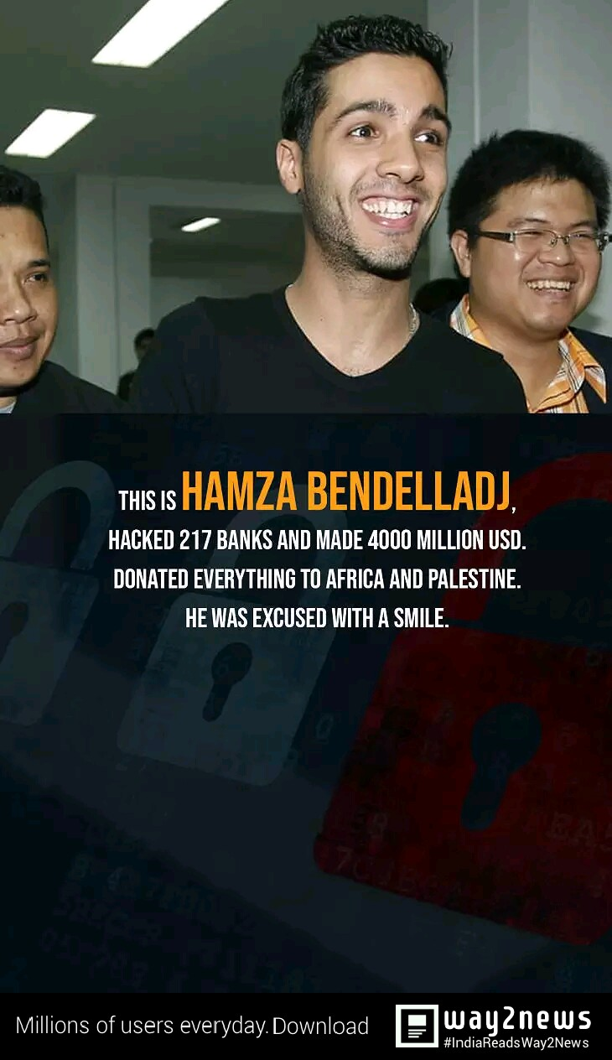
SPY EYE

Slide 14
Hacking vs. Cracking
Can any Relevant Legal Distinctions Be Drawn?
Computer criminals are often referred to as hackers.
The term "hacker" has taken on a pejorative connotation.

Slide 15
Hacking vs. Cracking (continued)
Himanen (2001) notes that the term "hacker" originally applied to anyone who "programmed enthusiastically" and who believed that "information sharing is a powerful positive good."
A hacker as an "expert or enthusiast of any kind."
Note that a hacker need not be a computer enthusiast.
  e.g., someone can be an astronomy hacker.

Slide 16
Hacking vs. Cracking (continued)
The Hacker Jargon File defines a "cracker" is one "who breaks security on a system."
Crackers often engage in acts of theft and vandalism, once they have gained access.
Some use the expressions white hat and black hat to distinguish between the two types of hacking behavior.
  “White hat hackers" refers to "innocent" or non-malicious forms of hacking, while "black hat hackers" refers roughly to what we described above as "cracking."

Slide 17
Hackers and the Law
Courts and juries understand very well distinctions in crimes involving breaking and entering into property in physical space.
  A person who picks the lock of a door handle, or who turns an unlocked door handle but does not enter someone's house, would not likely receive the same punishment as someone who also turns enters that person's house.
  A person who illegally enters someone's house only to snoop would probably not receive the same punishment as someone who also steals items or vandalize property, or both.

Slide 18
Defining Cybercrime
When is a crime a computer crime?
The problem of criteria.
  Are all crimes involving the use or presence of a computer necessarily computer crimes?
  Gotterbarn asks is a murder committed with a surgeon’s scalpel is an issue for medical ethics or just an ordinary crime.

Slide 19
Defining Cybercrime (continued)
If Gotterbarn is correct, we can ask whether having a separate category of cybercrime is necessary or even useful.
Some crimes have involved technologies other than computers, but we do not have separate categories of crime for them?
  For example, people steal televisions; but we don't have a category of television crime.
  People also steal automobiles but we don't have a category of automobile crime.

Slide 20
Determining the Criteria
Consider three hypothetical scenarios:
Scenario 1: Lee steals a computer device (e.g., a printer) from a computer lab;
Scenario 2: Lee breaks into a computer lab and then snoops around;
Scenario 3: Lee enters a computer lab that he is authorized to use and then places an explosive device, which is set to detonate a short time later, on a computer system in the lab.

Slide 21
Determining the Criteria (continued)
Each of the acts described in these three scenarios is criminal in nature.
But should they necessarily be viewed as a computer crime or cybercrime?
Arguably, it would not have been possible to commit any of these specific crimes if computer technology had never existed.
But the three criminal acts can easily be prosecuted as ordinary crimes involving theft, breaking and entering, and vandalism.

Slide 22
Preliminary Definition of a Computer Crime
Forester and Morrison (1994) defined a computer crime as:
  a criminal act in which a computer is used as the principal tool. [Italics added]
This definition rules out a computer crimes, if the crimes committed in the three scenarios.
Forester and Morrison's definition of computer crime might seem plausible.
But is it adequate?

Slide 23
Preliminary Definition of Computer Crime (continued)
Consider the following scenario:
Scenario 4: Lee uses a computer to file a fraudulent income-tax return.
Arguably, a computer is the principal tool used by Lee to carry out the criminal act.
Has Lee has committed a computer crime?
But Lee could have committed the same crime by manually filling out a standard (hardcopy) version of the income-tax forms by using a pencil or pen.

Slide 24
Coherent Definition of Computer Crime
Girasa (2002) defines "cybercrime" as a generic term covering a multiplicity of crimes found in penal code or in legislation having the "use of computer technology as its central component."
What is meant by "central component?"
Was a computer a central component in Lee's cheating in filing out the income tax return?
Is Girasa's definition of cybercrime an improvement over Forester and Morrison’s?

Slide 25
Coherent Definition of Cybercrime (continued)
We can define a (genuine) cybercrime as a crime in which:
  the criminal act can be carried out only through the use of cyber-technology and can take place only in the cyber realm. (Tavani, 2000)
Like Forester and Morrison's definition, this one rules out the three scenarios involving the computer lab as genuine cybercrimes.
It also rules out the income tax scenario.

Slide 26
Genuine Cybercrimes
If we accept the working definition of cybercrime proposed by Tavani (2000), then we can sort out and identify specific cybercrimes.
We can also place those crimes into appropriate categories.

Slide 27
Three Categories of Cybercrime
1. Cyberpiracy - using cyber-technology in unauthorized ways to:
a. reproduce copies of proprietary software and proprietary information, or
b. distribute proprietary information (in digital form) across a computer network.
2. Cybertrespass - using cyber-technology to gain or to exceed unauthorized access to:
a. an individual's or an organization's computer system, or
b. a password-protected Web site.
3. Cybervandalism - using cyber-technology to unleash one or more programs that:
a. disrupt the transmission of electronic information across one or more computer networks, including the Internet, or
b. destroy data resident in a computer or damage a computer system's resources, or both.

Slide 28
Examples of the Three Categories of Cybercrime
Consider three actual cases:
1. Distributing proprietary MP3 files on the Internet via peer-to peer (P2P) technology;
2. unleashing the ILOVEYOU computer virus;
3. Launching the denial-of-service attacks on commercial Web sites.
We can use our model of cybercrime to see where each crime falls.

Slide 29
Categorizing specific Cybercrimes
Crimes involving the distribution of proprietary MP3 files would come under the category of cyberpiracy (category i).
The crime involving the ILOVEYOU or "love bug" virus clearly falls under cybervandalism (category iii).
The denial-of-service attacks on Web sites falls under the heading of cybertrespass (category ii), as well asunder category (iii); it spans more than one cybercrime category.

Slide 30
Distinguishing Cybercrimes from Cyber-related Crimes
Many crimes that involve the use of cyber-technology are not genuine cybercrimes.
Crimes involving pedophilia, stalking, and pornography can each be carried with or without the use of cybertechnology.
Hence, there is nothing about these kinds of crimes that is unique to cybertechnology.
These and similar crimes are better understood as instances of cyber-related crimes.

Slide 31
Cyber-related Crimes
Cyber-related crimes could be further divided into two sub-categories:
  cyber-exacerbated crimes;
  cyber-assisted crimes.
Thus, crimes involving cybertechnology could be classified in one of three ways:
  Cyber-specific crimes (genuine cybercrimes);
  Cyber-exacerbated crimes;
  Cyber-assisted crimes.

Slide 32
Cyber-exacerbated vs. Cyber-assisted crimes
Further differentiating cyber-related crimes into two sub-categories enables us to distinguish between a crime in which one:
  (a) uses a personal computer to file a fraudulent income-tax return, from
  (b) crimes such as Internet pedophilia and cyberstalking.
In (a), a computer assists the criminal in a way that is trivial and possibly irrelevant.
In (b), cyber-technology plays a much more significant (exacerbating) role.

Slide 33
Cybercrimes and Cyberrelated Crimes
Cybercrimes
Cyberrelated Crimes
Cyberspecific
Cyberexacerbated
Cyberassisted
Income-tax cheating (with a computer)
Physical assault with a computer
Property damage
using a computer
hardware device (e.g., throwing a hardware device through a window)
Cyberpiracy Cybertrespass
Cybervandalism
Cyberstalking
Internet Pedophilia
Internet Pornography

Slide 34
Organized Crime on the Internet
Career criminals, including those involved in organized crime, are now using cyberspace to conduct many of their criminal activities.
Gambling and drug trafficking have moved to an Internet venue.
Scams involving Internet adoption and Internet auctions have increased.
These kinds of crimes tend to receive far less attention in the popular media than those perpetrated by teenage hackers.

Slide 35
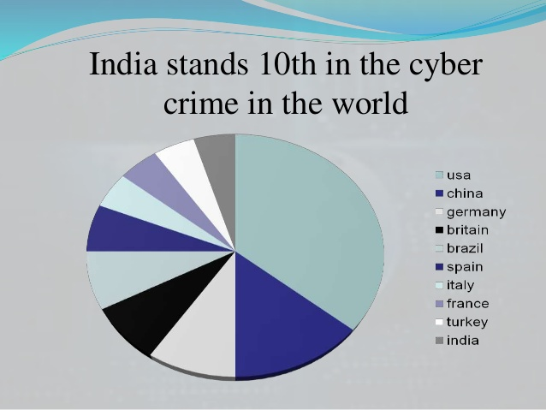

Slide 36
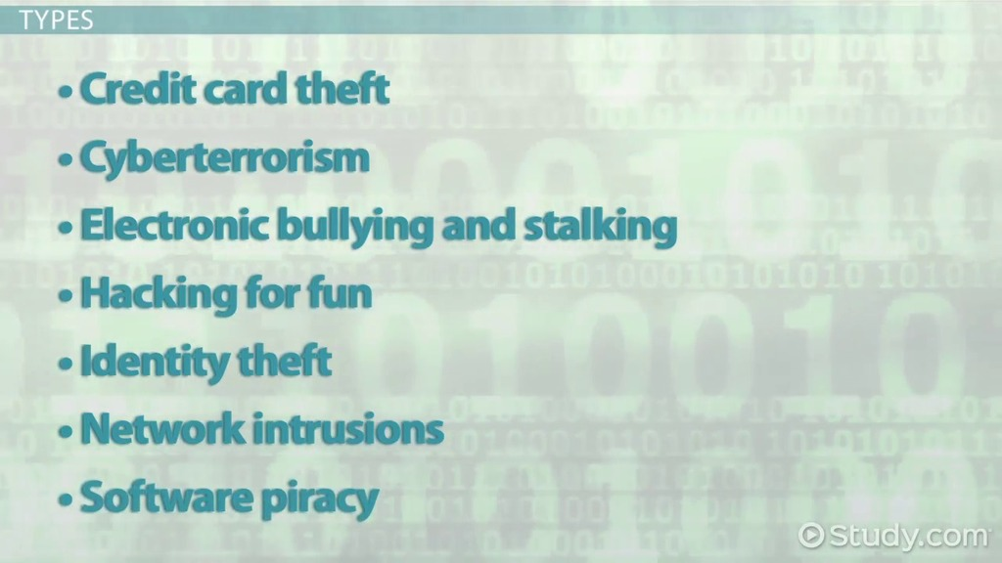
Cyber Crime Types

Slide 37
Short Video on Cyber Crimes

Slide 38
Social Engineering and Security
- Approaches

Slide 39
Social Media and Networking
Social media are computer-mediated technologies that facilitate the creation and sharing of information, ideas, career interests and other forms of expression via virtual communities and networks. The variety of stand-alone and built-in social media services currently available introduces challenges of definition; however, there are some common features:
Social media are interactive Web 2.0 Internet-based applications.
User-generated content, such as text posts or comments, digital photos or videos, and data generated through all online interactions, is the lifeblood of social media.
Users create service-specific profiles for the website or app that are designed and maintained by the social media organization.
Social media facilitate the development of online social networks by connecting a user's profile with those of other individuals or groups.

Slide 40
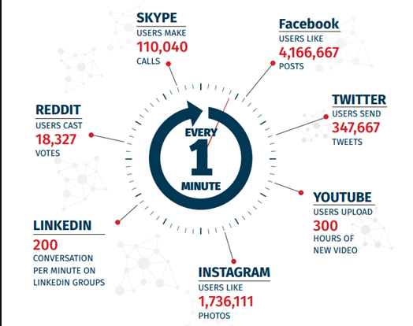
Social Networking Data In A Minute

Slide 41
Social Networking sites have been in the limelight for more a decade. Popular social networking websites include Facebook, LinkedIn, Instagram, Twitter, Whatsapp. The growth and impact of these websites at an exponential rate have attracted the cyber offenders to commit cybercrimes in social media posing threat to privacy of individuals as well as national security.

Slide 42
Social Media Cybercrimes
Cybercrime on social networks can be broken down into three categories:
The traditional broad-sweep scams, trying to lure you to click on something or visit pages that will push malware on to your computer
Searching for careless public exposure of personal data
Social media as a platform to connect, exchange ideas and trade stolen information

Slide 43
Most Popular Types of Social Media Attacks
Reconnaissance: An attacker can glean useful information by reading the social media posts of a brand, as well as the posts by its employees

Slide 44
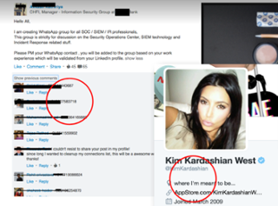

Slide 45
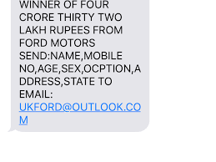
Technical exploit delivery: Social media is a very effective malware delivery mechanism. Malicious links can be rapidly distributed through social media posts, comment threads and via private messages.

Slide 46
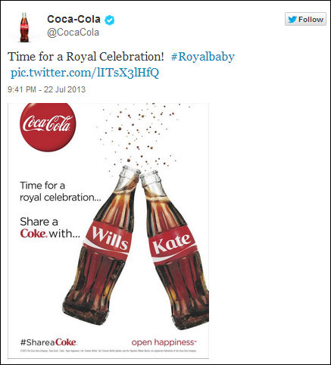
Brand Hijacking:
Digital brand hijacking can make or break your business. In the age of digitalization, intangible assets such as the brand name and your brand’s reputation comprise as much as 88% percent of enterprise market value. Cybercriminals can easily hijack your online brand by creating fake company pages and online communities, abusing your brand and it’s reputation for personal gain.

Slide 47
Weaponization of social media profiles. Complete and convincing fake accounts are created and then linked to many other phony profiles in order to boost their credibility.
More than 500 fraud-dedicated social media groups around the world were studied, with an estimated total of more than 220,000 members investigated for this report. More than 60%, or approximately 133,000 members, were found on Facebook alone.

Slide 48
Many of the fraud-dedicated social groups are very public - visible and open to all.
During the period of this study, they detected the contents of over 15,000 compromised credit cards (called "CVV2 freebies" in fraudster lingo) that were published on social media networks.

Slide 49

Malicious bots. Social media bots are often used to mass distribute malicious content. Bots can generate fake likes, retweets and views to fake user profiles to boost credibility and reach

Slide 50
Distributed denial of service (DDoS) attacks against company pages
Attackers can launch a DDoS-like attacks against a brand’s official Facebook page, for example, and flood it with bot-generated comments, which are too numerous for the brand to respond to, and come in faster than the company can delete.

Slide 51
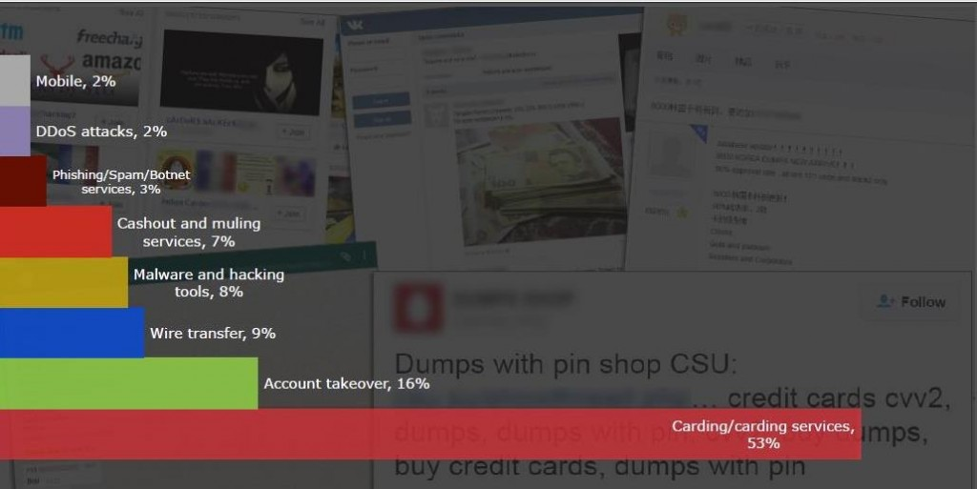
Social engineering

Slide 52
7 Types of Social Media Crime Faced
1. Profile Hacking
Facebook is the most hacked social networking site and it generally happens because of the following reasons:
Not logging out from the account
Sharing passwords or having passwords that are easily predicted
Hacking the email with which you login to your Facebook account
Logging in through Facebook options for apps

Slide 53
What if your Facebook profile gets hacked? You can log on to: www.facebook.com/hacked and follow the procedure in order to claim your profile back.

Slide 54
Case Study on Facebook

Slide 55
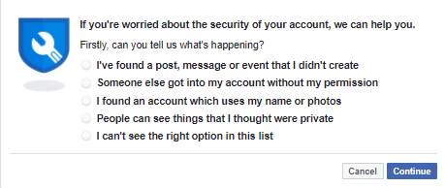

Slide 56
How to avoid your profile from hacking on Facebook
Ensure that your password is a mixture of words and special characters. Don’t have the same passwords for various social media accounts.
Log out every time you login from a device that is unfamiliar to you or not in use. Most case hacking takes place in this case, people tend to update something funny so that people can make fun of you creating an embarrassing scenario for you.

Slide 57
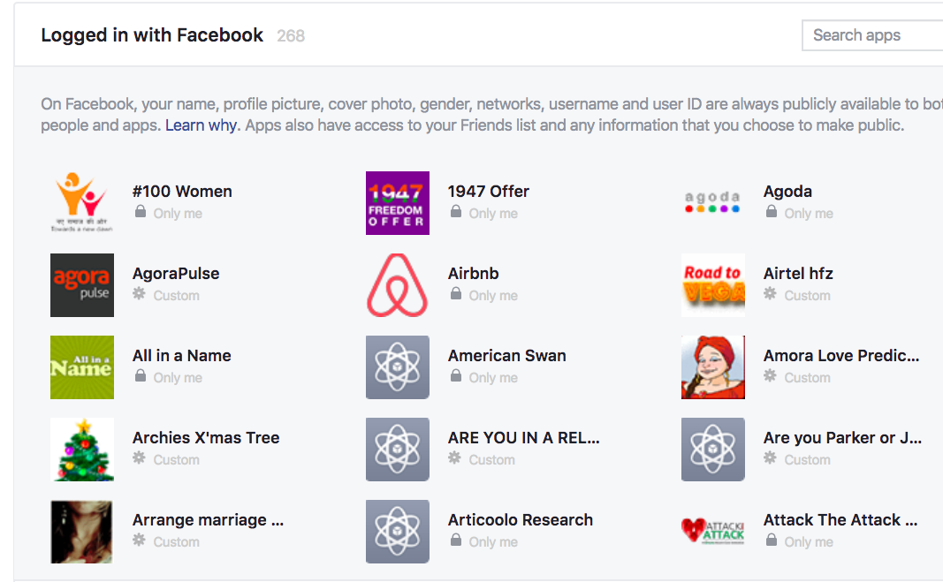
Be aware of the malicious apps that you subscribe to from your Facebook account.
Example:

Slide 58

Example

Slide 59


Slide 60
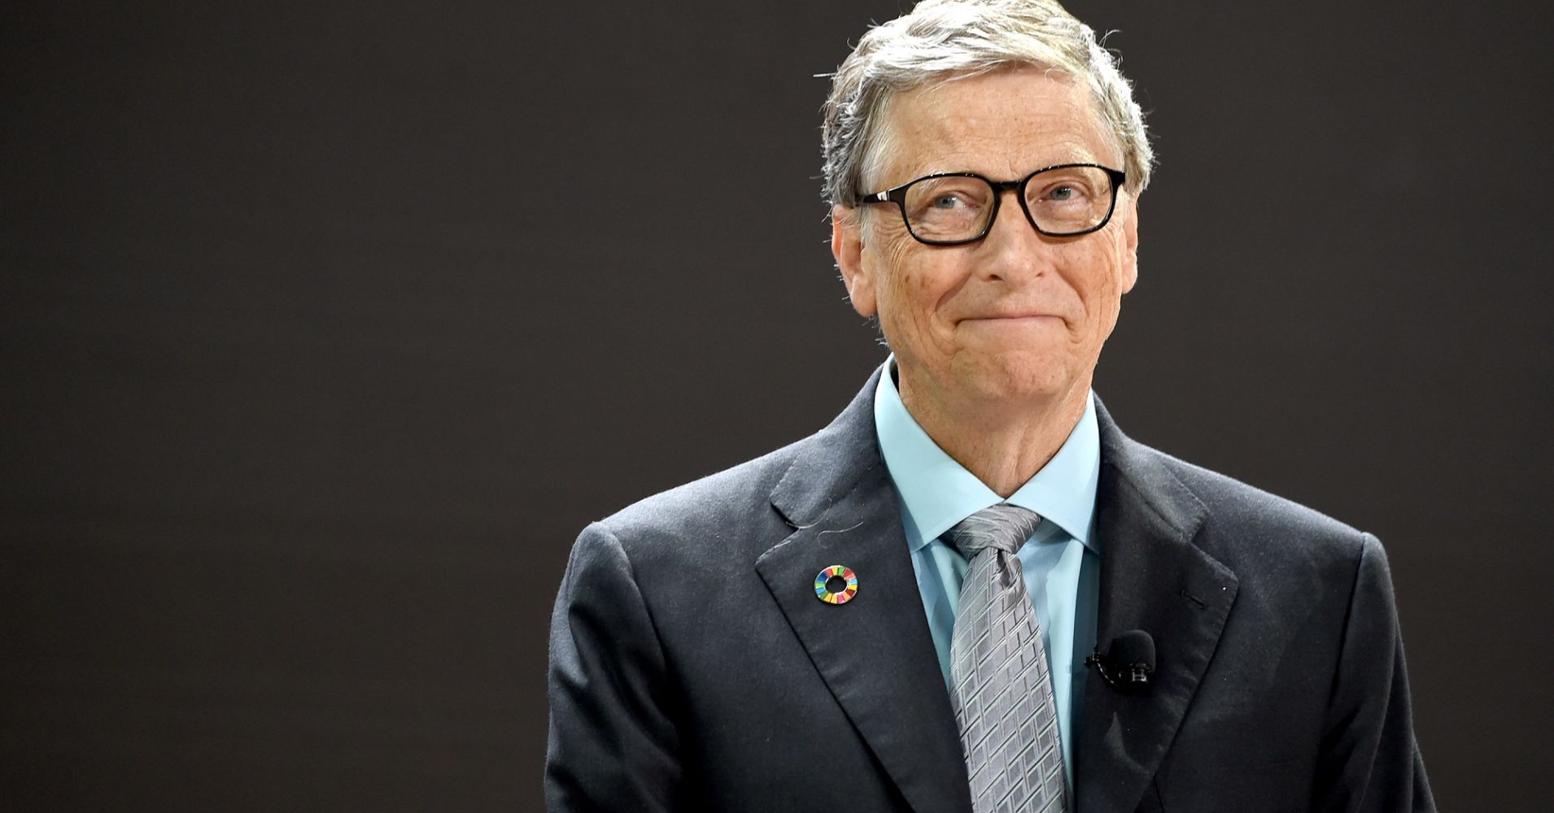

Slide 61
2. Photo Morphing
Photo morphing is a special effect that allows a person to morph or change one image or shape into another without any difficulty. As per the 4th quadrant of 2017, there is roughly around 3.2 Billion images shared every day. It is easy for a hacker to use your images, morph it and then use it for sites or blackmailing for financial/sexual gains.

Slide 62
Tips to follow to be safe from photo morphing
Facebook has strong privacy settings which protect your account and things you share on it.
Don’t add strangers, people who are mutual friends (unless and until you know them). Identify fake profiles or pages that are sending you request or asking you to follow them.

Slide 63
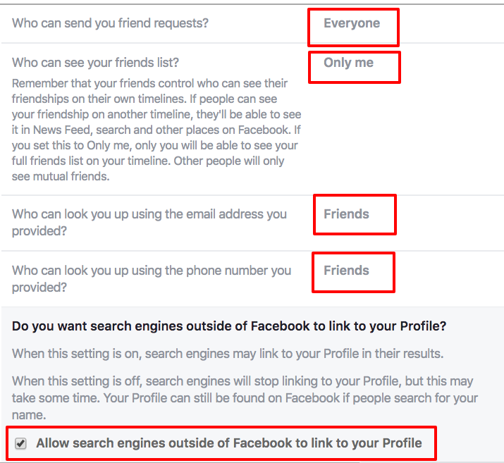

Slide 64
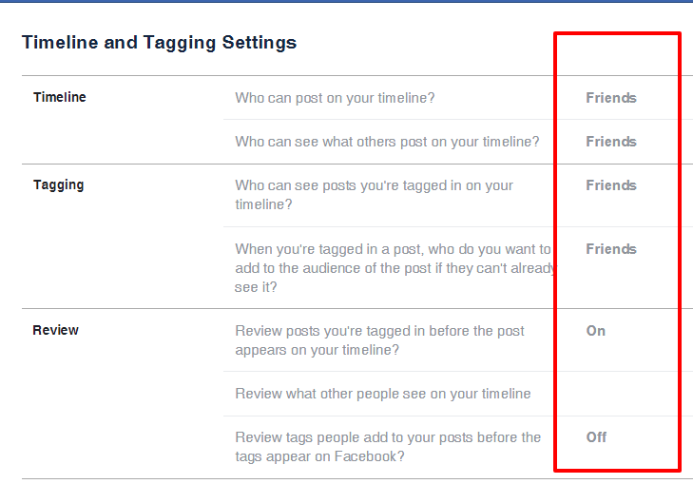

Slide 65
3. Offer and Shopping Scams
You would often come across messages, post which would say ‘Click on the link to claim the offer’ or ‘spin the wheel to win.’ These offers would generally ask you to forward the message to another 20 people once you have registered in order to get the code or coupon. You won’t get coupons but the host would get your personal information.

Slide 66
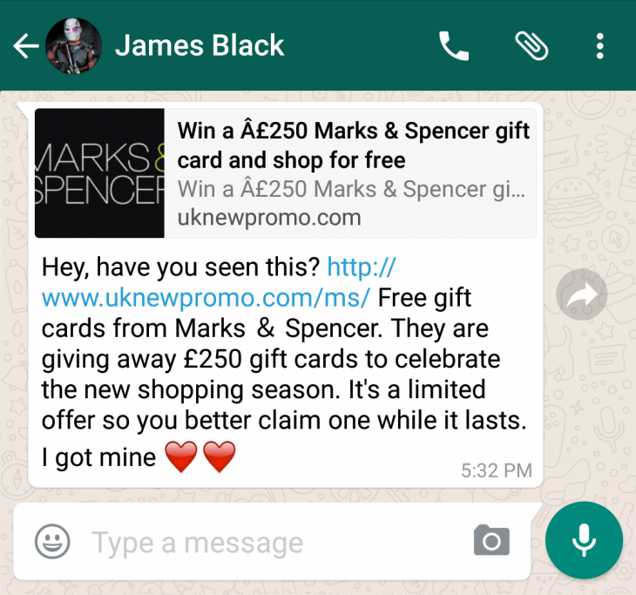
Example

Slide 67
Tips to follow to be safe from Offer and Shopping Scams
The simplest thing to do is to make a quick check of the promotion/deal of the brand or the organization of their social media page/their homepage.
Don’t buy fake social media followers as they are more likely to get your credit card details and later use it or ask you to share your id and password to get you genuine followers.

Slide 68

Tips to follow to be safe from Offer and Shopping Scams
Do not transfer money or give in card details if the discounts are too-steep, or have poor reviews, or unclear refund policies.
A lot of people trust offers like shown below and end up shopping and getting no discount

Slide 69
4. Romance and Dating Scams
There are people out there who would connect to you on social media, interact with you, and persuade you to move to a different form of communication through various excuses. Once they realize that you are falling for them, they would send you small gifts to show you that it’s same on either side.
After a point the romantic period would start declining and they would start asking for monetary help in the form of recharge, booking flight tickets to meet and the list only grows.

Slide 70
Tips to follow to be safe from Romance and Dating Scams
Don’t accept friend requests from random people.
Don’t reply to messages to people who are not in your friend list.
Facebook generally warns people when they get messages from people who are not in their friend list.
Do not chat with anyone and everyone especially someone you don’t know.

Slide 71
Tips to follow to be safe from Romance and Dating Scams
Don’t transfer your card or bank details with anybody at any cost. If somebody is threatening you, report about it to the police.
Don’t strip or send your nudes through digital.
If the fraudster is calling you to some place, alone to give you something or asking you to go on a date then please don’t go.

Slide 72
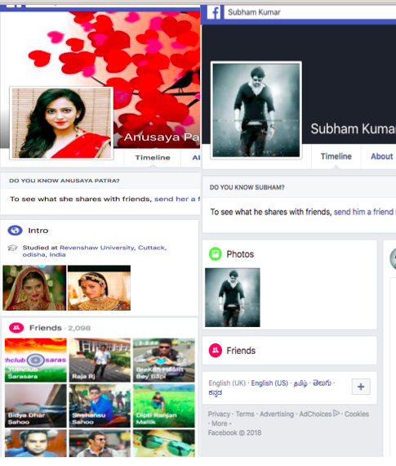
Fake profiles

Slide 73
How to identify if the profiles are genuine or fake?
A fake profile on Facebook will not use their genuine pictures
They don’t have many friends.
Their profiles are just recently built.
Even if you make someone your friend, try to scroll their profile to check their status updates and their experiences they share, if there are not any – they are more likely to be fake.
Notes:
(Having said this there are people who takes photographs of other genuine people as their profiles are public and use it to create a fake profile)

Slide 74
5. Link Baiting
Link bait happens when the content of your website or pages gets linked to other sites because they want to and not because they have asked you. A few instances where link bait has been showcased are-
Your photo just got leaked on internet, check here:
Look what people are talking about you:

Slide 75
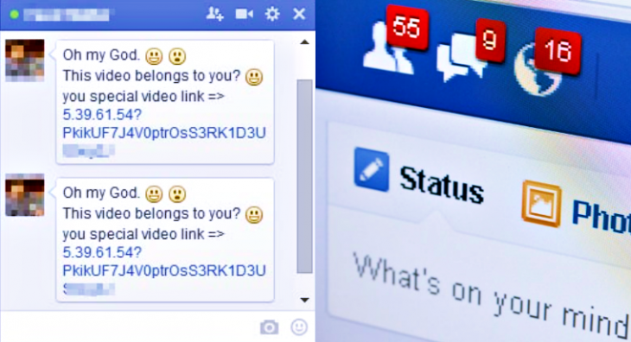
Tips to follow to be safe from Link Baiting
Make sure that you don’t click on these links. Check where these links are coming from. They usually come through WhatsApp or Messenger.

Slide 76
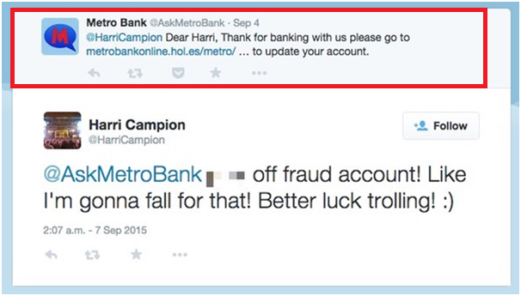
On open platforms like Twitter, people tend to create fake accounts of your genuine profiles and they use this identity to strike a conversation.

Slide 77
6. Information Theft
Informational theft occurs when an imposter identifies key pieces of personally identifiable information like social security, driving license number in order to impersonate someone else

Slide 78
Tips to follow to be safe from Information Theft
If you have a name which is common then differentiate it with something that people know would connect to your business.
Ensure that you get the right SEO and report your business page through Facebook India.
It is possible to merge pages on Facebook, so you can merge the fake page with yours and claim that you are the official owner of the page.
Ensure that you don’t store credit card details and crucial passwords on Social Media messengers too.

Slide 79
7. Cyber Bullying
Posting any kind of humiliating content on the social media or sending vulgar messages online, or threatening to commit any act of violence, or stalking by means of calls, messages or threatening of child pornography is called as cyberbullying.

Slide 80
Tips to follow to stay safe from cyberbullying
Approach the police when you are getting harassed online.
Do not sit idle as that would only make the bully think that you are scared and won’t be of any harm to them.

Slide 81
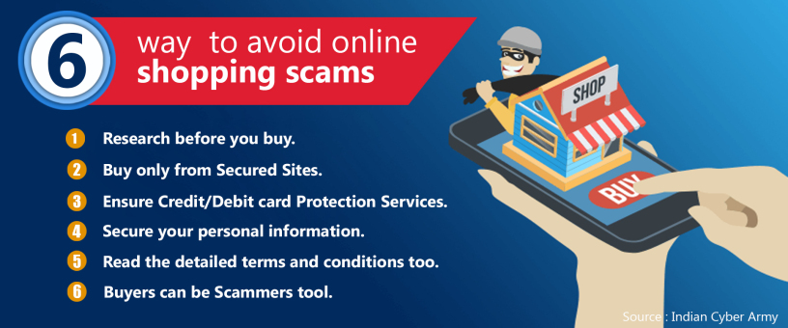

Slide 82
Cyber Crime Approaches
Virus
Hacking
Denial of service attack
Virus Dissemination
Computer Vandalism
Cyber Terrorism
Software Piracy

Slide 83
Virus
A computer virus is a type of malicious software that, when executed, replicates itself by modifying other computer programs and inserting its own code. When this replication succeeds, the affected areas are then said to be "infected" with a computer virus
Computer viruses currently cause billions of dollars' worth of economic damage each year, due to causing system failure, wasting computer resources, corrupting data, increasing maintenance costs, etc.
Viruses often perform some type of harmful activity on infected host computers, such as acquisition of hard disk space or central processing unit(CPU) time, accessing private information (e.g., credit card numbers), corrupting data, displaying political or humorous messages on the user's screen, spamming their e-mail contacts, logging their keystrokes, or even rendering the computer useless.

Slide 84
How to detect a computer virus?
Your computer speed is slower than normal?
Computer programs are crashing?
Changing file sizes and strange messages?

Slide 85
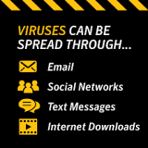

Slide 86
Hacking
Hacking is identifying weakness in computer systems or networks to exploit its weaknesses to gain access.
Example of Hacking: Using password cracking algorithm to gain access to a system.

Slide 87
Hacker
A hacker is an individual who uses computer, networking or other skills to overcome a technical problem. The term hacker may refer to anyone with technical skills, but it often refers to a person who uses his or her abilities to gain unauthorized access to systems or networks in order to commit crimes.
Types of hackers
The security community has informally used references to hat color as a way different types of hacker are identified, usually divided into three types:
  white hat
  black hat
  gray hat

Slide 88
White hat hackers:
also known as ethical hackers, strive to operate in the public's best interest, rather than to create turmoil.
Black hat hackers:
intentionally gain unauthorized access to networks and systems with malicious intent, whether to steal data, spread malware or profit from ransomware, vandalize or otherwise damage systems or for any other reason -- including gaining notoriety.
Gray hat hackers:
fall somewhere between white hat hackers and black hat hackers. While their motives may be similar to those of white hat hackers, gray hats are more likely than white hat hackers to access systems without authorization at the same time, they are more likely than black hat hackers to avoid doing unnecessary damage to the systems they hack.

Slide 89
Malware
Any software intentionally designed to cause damage to a computer, server or computer network.
Malware does the damage after it is implanted or introduced in some way into a target’s computer and can take the form of executable code, scripts, active content, and other software. The code is described as computer viruses, worms, Trojan horses, ransomware, spyware, adware, and scareware, among other terms.
Malware has a malicious intent, acting against the interest of the computer user—and so does not include software that causes unintentional harm due to some deficiency, which is typically described as a software bug.

Slide 90
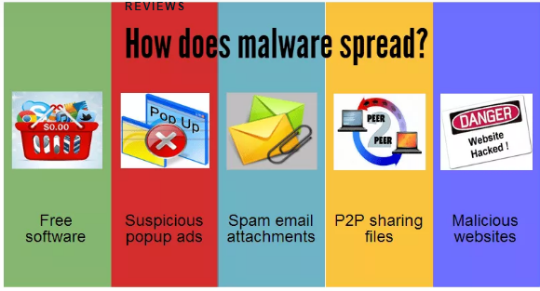

Slide 91
Trojan Horse Attack
Trojan Horse is activated when the software or attachment is executed.
Trojan Horse releases virus, monitors computer activity, installs backdoor, or transmits information to hacker.
Trojan Horse arrives via email or software like free games.

Slide 92
Denial of Service Attacks
In a denial of service attack, a hacker compromises a system and uses that system to attack the target computer, flooding it with more requests for services than the target can handle. In a distributed denial of service attack, hundreds of computers (known as a zombies) are compromised, loaded with DOS attack software and then remotely activated by the hacker.

Slide 93
Password cracking:
various measures used to discover computer passwords. This is usually accomplished by recovering passwords from data stored in, or transported from, a computer system. Password cracking is done by either repeatedly guessing the password, usually through a computer algorithm in which the computer tries numerous combinations until the password is successfully discovered.
Password cracking can be done for several reasons, but the most malicious reason is in order to gain unauthorized access to a computer without the computer owner’s awareness. This results in cybercrime such as stealing passwords for the purpose of accessing banking information.

Slide 94
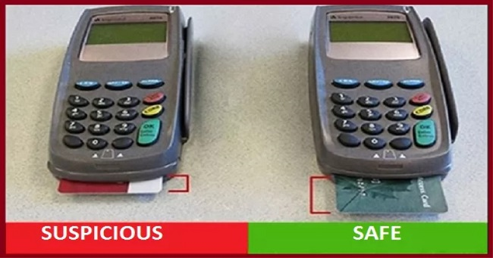

Slide 95
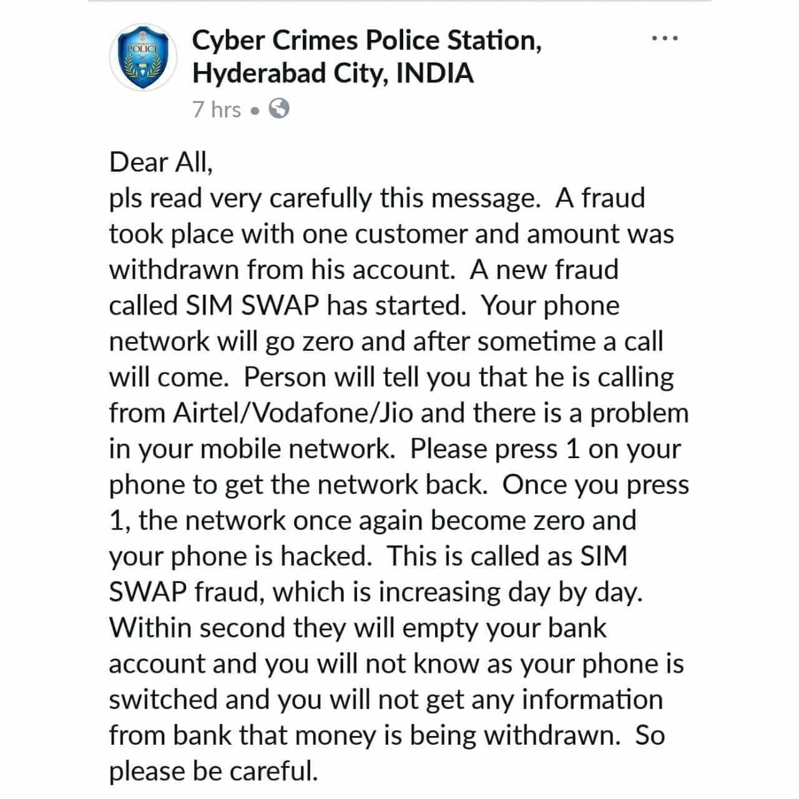

Slide 96
Quiz
1.The first computer virus is --------
A. I Love You
B. Blaster
C. Sasser
D. Creeper

Slide 97
2. MCAfee is an example of
A. Photo Editing Software
B. Quick Heal
C. Virus
D. Antivirus

Slide 98
3.Which of the following is known as Malicious software?
A. illegalware
B. badware
C. malware
D. maliciousware

Slide 99
4.To protect a computer from virus, you should install -------- in your computer.
A. backup wizard
B. disk cleanup
C. antivirus
D. disk defragmenter

Slide 100
5.VIRUS stands for
A. Very Intelligent Result Until Source
B. Very Interchanged Resource Under Search
C. Vital Information Resource Under Seize
D. Viral Important Record User Searched

Slide 101
6.Which of the following is not an antivirus software?
A. AVG
B. Avast
C. Code Red
D. MCAfee

Slide 102
7.Which of the following is/are threats for electronic payment systems?
A. Computer worms
B. Computer virus
C. Trojan horse
D. All of the above

Slide 103
8.To protect yourself from computer hacker, you should turn on a
A. Script
  B. Firewall
  C. VLC
  D. Antivirus

Slide 104
9.Firewalls are used to protect against --------
A. data driven attacks
B. fire attacks
C. virus attacks
D. unauthorised access

Slide 105
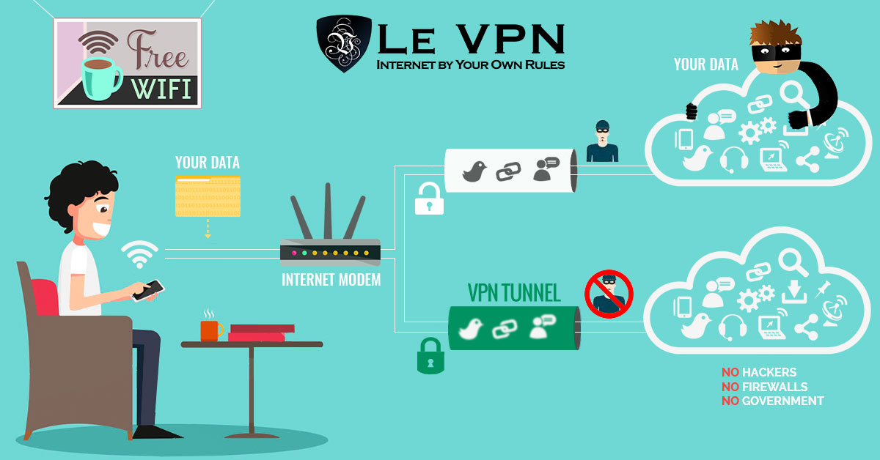

Slide 106
How Can We Protect
Read privacy policy carefully when you submit the data through internet
Encryption: lot of websites uses SSL(secure socket layer) to encrypt the data
Disable remote connectivity
Use anti virus software
Insert firewalls, popup blocker
Use secure connection
Maintain backup
Use secure connections
Use strong passwords, do not give personal information unless required

Slide 107
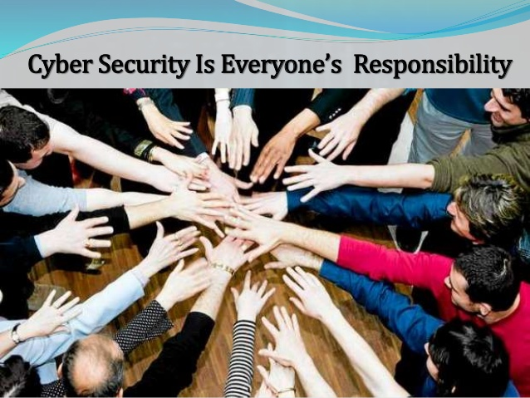

Slide 108
CyberLaw
- Approaches

Slide 109
Law Enforcement Techniques to Catch Cybercriminals
Law-enforcement agencies, in addition to placing wiretaps on phones, have used electronic devices to detect and track down professional criminals.
Federal law enforcement agents use a controversial technology known as keystroke monitoring software.
Keystroke monitoring records every key struck by a user and every character of the response that the system returns to the user.

Slide 110
Law Enforcement Techniques (continued)
Keystroke-monitoring software can trace the text included in electronic messages back to the original sequence of keys and characters entered at a user's computer keyboard.
This technology is especially useful in tracking the activities of criminals who use encryption tools to encode their messages.

Slide 111
Law Enforcement : Some Controversial Practices
Echelon is the federal government's once super secret system for monitoring voice and data communication worldwide.
Carnivore is a controversial "packet sniffing" program that monitors the data traveling between networked computers.
The USA Patriot Act gives the federal government broader powers to "snoop" on individuals suspected of engaging in criminal or terrorist activities.

Slide 112
Entrapment on the ‘Net
Detective James McLaughlin of Keene, NH posed as a young boy in boy-love chat rooms.
Under this alias, McLaughlin searched for adults using the Internet to seek sex with underage boys.
Gathering evidence from conversations recorded in Internet chat rooms, McLaughlin was able to trap and arrest an adult on charges of child molestation.
Philip Rankin, living in Norway, communicated with McLaughlin under the assumption that the police officer was a young boy.
Rankin agreed to travel to Keene, NH to meet in person at a McDonald's restaurant.
When Rankin arrived at restaurant, McLaughlin arrested him.

Slide 113
Industrial Espionage
On October 2, 1996, Congress passed the Economic Espionage Act of 1996, making it a federal crime to profit from the misappropriation of someone else's trade secret.
The Espionage Act specifically includes language about "downloads," "uploads," "e-mails," etc.
Some economists worry that economic espionage in the high-tech industry, threatens US competition in a global market.

Slide 114
National and International Efforts to Fight Cybercrime
Problems of jurisdiction arise at both the national and international levels.
Girasa (2002) points out that jurisdiction is based on the concept of boundaries, and laws are based on "territorial sovereignty."
Cyberspace has no physical boundaries.

Slide 115
Jurisdictional Problems in Cyberspace
Hypothetical Scenario: Virtual Casino.
Suppose it is legal to gamble on-line in Nevada but not in Texas.
A Texas resident “visits” a gambling Web site, whose server is in Nevada.
If the Texas resident “breaks the law,” in which state did the crime take place?

Slide 116
Jurisdictional Problems in Cyberspace (continued)
Hypothetical Scenario: International Law Suits Involving Microsoft Corporation.
Suppose that Microsoft Corporation develops and releases, globally, a software product that is defective.
The defect causes computer systems using it to crash under certain conditions.
These system crashes, in turn, result both in severe disruption and damage to system resources.

Slide 117
Jurisdictional Problems in Cyberspace (continued)
What recourse should consumers and organizations who purchase this product have in their complaint against Microsoft?
In the U.S. there are strict liability laws.
But certain disclaimers and caveats are often issued by manufacturers to protect themselves against litigation.

Slide 118
Microsoft Scenario (Continued)
Suppose that several countries in which Microsoft has sold its new product also have strict liability laws.
Should Microsoft Corporation be held legally liable in each country in which its defective product has been sold?
Should that corporation then be forced to stand trial in each of these countries?

Slide 119
Microsoft Scenario (Continued)
In the case involving the ILOVEYOU Virus, several nations wanted Onel Guzman extradited to stand trial in their countries.
Using the same rationale, perhaps it would follow that Microsoft should stand trial in each country where its defective product caused some damage.
If Microsoft were forced to stand trial in each of these countries, and if the corporation were to be found guilty in these nations' courts, the economic results for Microsoft could be catastrophic.

Slide 120
Law in India
The Information Technology Act, 2000 (also known as ITA-2000, or the IT Act) is an Act of the Indian Parliament (No 21 of 2000) notified on 17 October 2000. It is the primary law in India dealing with cybercrime and electronic commerce. It is based on the United Nations Model Law on Electronic Commerce 1996 (UNCITRAL Model) recommended by the General Assembly of United Nations by a resolution dated 30 January 1997
“To provide legal recognition for transactions carried out by means of electronic data interchange and other means of electronic communication, commonly referred to as "electronic commerce", which involve the use of alternatives to paper-based methods of communication and storage of information, to facilitate electronic filing of documents with the Government agencies and further to amend the Indian Penal Code, the Indian Evidence Act, 1872, the Bankers' Books Evidence Act, 1891 and the Reserve Bank of India Act, 1934 and for matters connected therewith or incidental thereto.” The Act essentially deals with the following issues:
- Legal Recognition of Electronic Documents - Legal Recognition of Digital Signatures
- Offenses and Contraventions -Justice Dispensation Systems for cyber crimes.

Slide 121
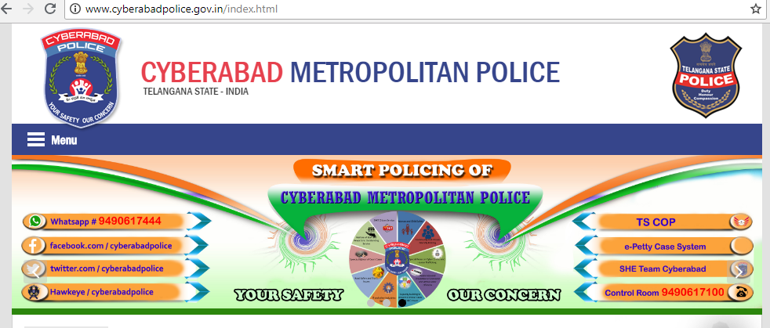

Slide 122
International Treaties
The Council of Europe (COE) is currently considering some ways for implementing an international legal code that would apply to members of the European Union.
On April 27, 2000 the Council released a first draft of an international convention of "Crime in Cyberspace."
In May 2000, the G8 (Group of Eight) Countries met to discuss an international treaty involving cybercrime.

Slide 123
International Treaties (continued)
The Council of Europe released its first draft of the COE Convention on Cybercrime.
A recent draft of that treaty addresses four types of criminal activity in cyberspace:
  Offenses against the confidentiality, availability; and integrity of data and computer systems;
  Computer-related offenses (such as fraud);
  Content-related offenses (such as child pornography);
  Copyright-related offenses.

Slide 124
Some Tools/Technologies for Combating Cybercrime
Some encryption and biometrics technologies have been controversial.
One controversial form of encryption technology was the Clipper Chip.
Several nations threatened not to purchase American-manufactured electronics goods that contained the Clipper Chip.

Slide 125
Biometric Technologies
Biometrics is the biological identification of a person, which includes eyes, voice, hand prints, finger prints, retina patterns, and handwritten signatures (Power, 2002).
van der Ploeg (2001) notes that using biometrics, one's "iris can be read" in the same way that one's voice can be printed.“
One's fingerprints can be "read" by a computer that is "touch sensitive" and "endowed with hearing and seeing capacities.”

Slide 126
Biometric Technologies (continued)
In February 2002 an iris-scanning device, which is a type of biometric identification scheme, was first tested at London's Heathrow Airport.
The scanning device captures a digital image of one's iris, which is then stored in a database.
That image can then be matched against images of individuals, such as those entering and leaving public places such as airports.

Slide 127
Facial Recognition Programs
At Super Bowl XXXV in January 2001, face-recognition technology was used by law-enforcement agencies to scan the faces of persons entering the football stadium.
The scanned images were then instantly matched against electronic images (faces) of suspected criminals and terrorists, contained in a central computer database.
Initially, this was controversial; after September 11, 2001, it was supported.

Slide 128
The EURODAC Project
Proposals to use of biometric identifiers in Europe have also generated controversy.
The Eurodac Project is a European Union proposal to use biometrics in controlling illegal immigration and border crossing in European countries by asylum seekers.
The proposal was first considered by the European Council on November 24, 1997.
The decision to go forward with Eurodac was made in 2002.

Slide 129
Short Video on Facing Real time Capturing

Slide 130
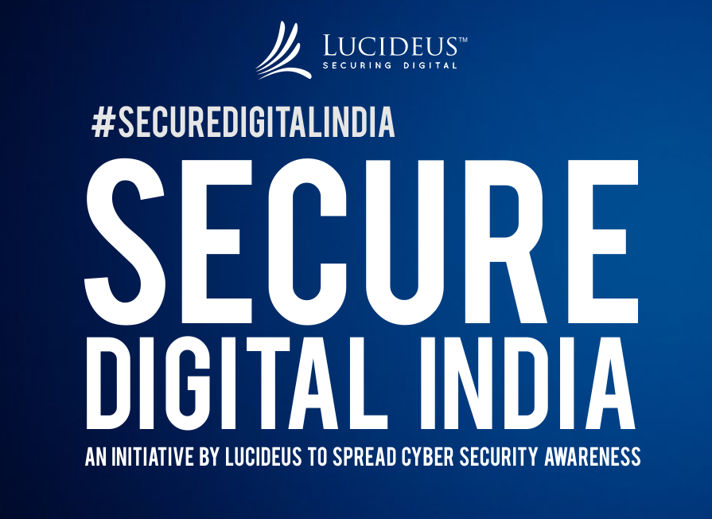

Slide 131

Thank You !

