Slide 1
Programming in C
Dr. Lavanya Pamulaparty

Slide 2
Man is still the most extraordinary computer of all.
  - John F. Kennedy
Things are always at their best in their beginning.
  - Blaise Pascal
  .
"You cannot teach a man anything, you can only help him find it within himself."
- Galileo Galilee

Slide 3
Agenda
C Language – An Introduction and Overview
- Execution Environment
Variables,Datatypes and Expression
Basic I/O Functions
First Hour
Second Hour
Discussion Item Three – A Placeholder for text
Add a second line of text here
Last Hour
Discussion Item Five – A Placeholder for text
Add a second line of text here

Slide 4
C Language
- Introduction & Overview

Slide 5
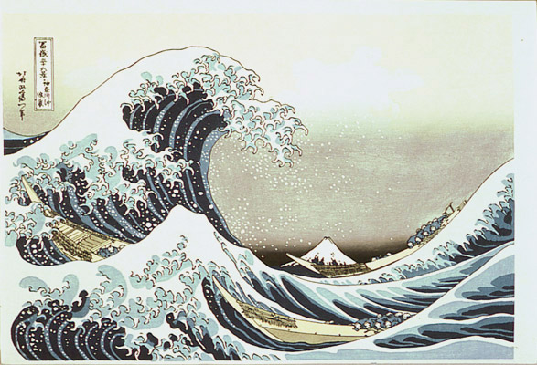
Introduction
Currently, the most commonly-used language for embedded systems
“High-level assembly”
Very portable: compilers exist for virtually every processor
Easy-to-understand compilation
Produces efficient code
Fairly concise

Slide 6
Background
Created in ‘70s by Dennis Ritchie at Bell Labs
A general-purpose “systems” programming language, multi-domain
  applications
  compilers
  operating systems
Platform & architecture independent
Standardized in late ‘80s by ANSI → “ANSI C”
Is actually known as a mid-level language
Most commonly used language in industry

Slide 7
Overview
a ‘typed’ language
  fundamental: characters, integers, floating-point
  derived: pointers, arrays, structures, unions
“basic” arithmetic & logical operations only
typical control-flow constructs
  statement grouping
  decision
  selection
  looping

Slide 8
Overview (Contd.)
functions:
  may return anything (or nothing)
  no nesting
  may be recursive
  may exist in separate source files compiled individually or combined into a single file
variable scope (declarations, actually):
  local to a function
  local to a source file, global to all functions within
  global to entire program

Slide 9
Overview (Contd.)
uses a “preprocessor” during compilation
  macro substitution
  include files
  conditional compilation
depends on libraries for everything else!
  input / output
  file access
  composite object manipulation
    i.e., arrays, lists, strings
  dynamic memory allocation

Slide 10
Widely used High-Level languages
Language | Application Area | Origin of Names/
FORTRAN | Scientific programming | Formula translation
COBOL | Business data processing | Common Business-Oriented Language
C | System programming | Predecessor language was named B
Ada | Real-time distributed systems | -
C++ | Object-Oriented Programming | Incremental modification of C
Java | Web programming | Originally named “Oak”

Slide 11
Environment
- Execution Sequence

Slide 12
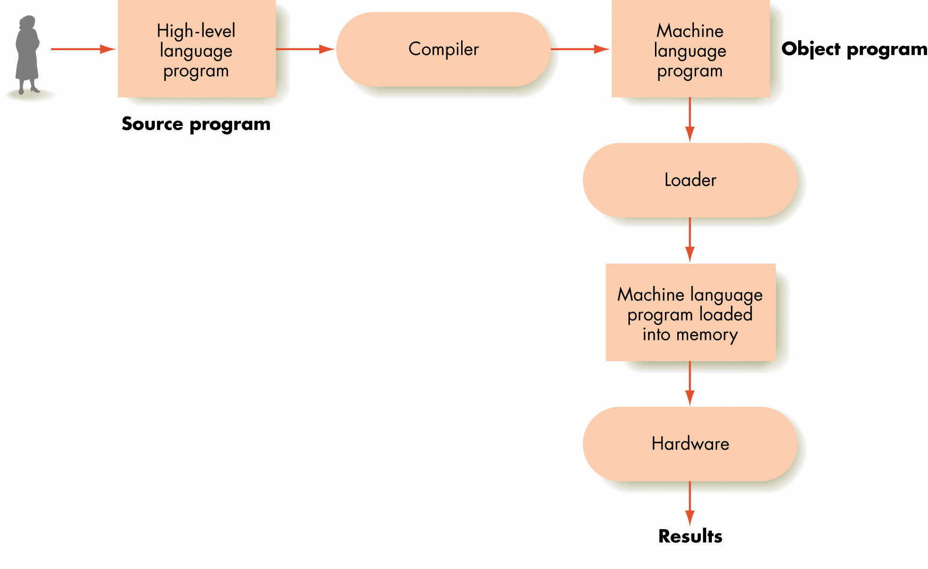
Overall Execution Sequence on a High-Level Language Program

Slide 13
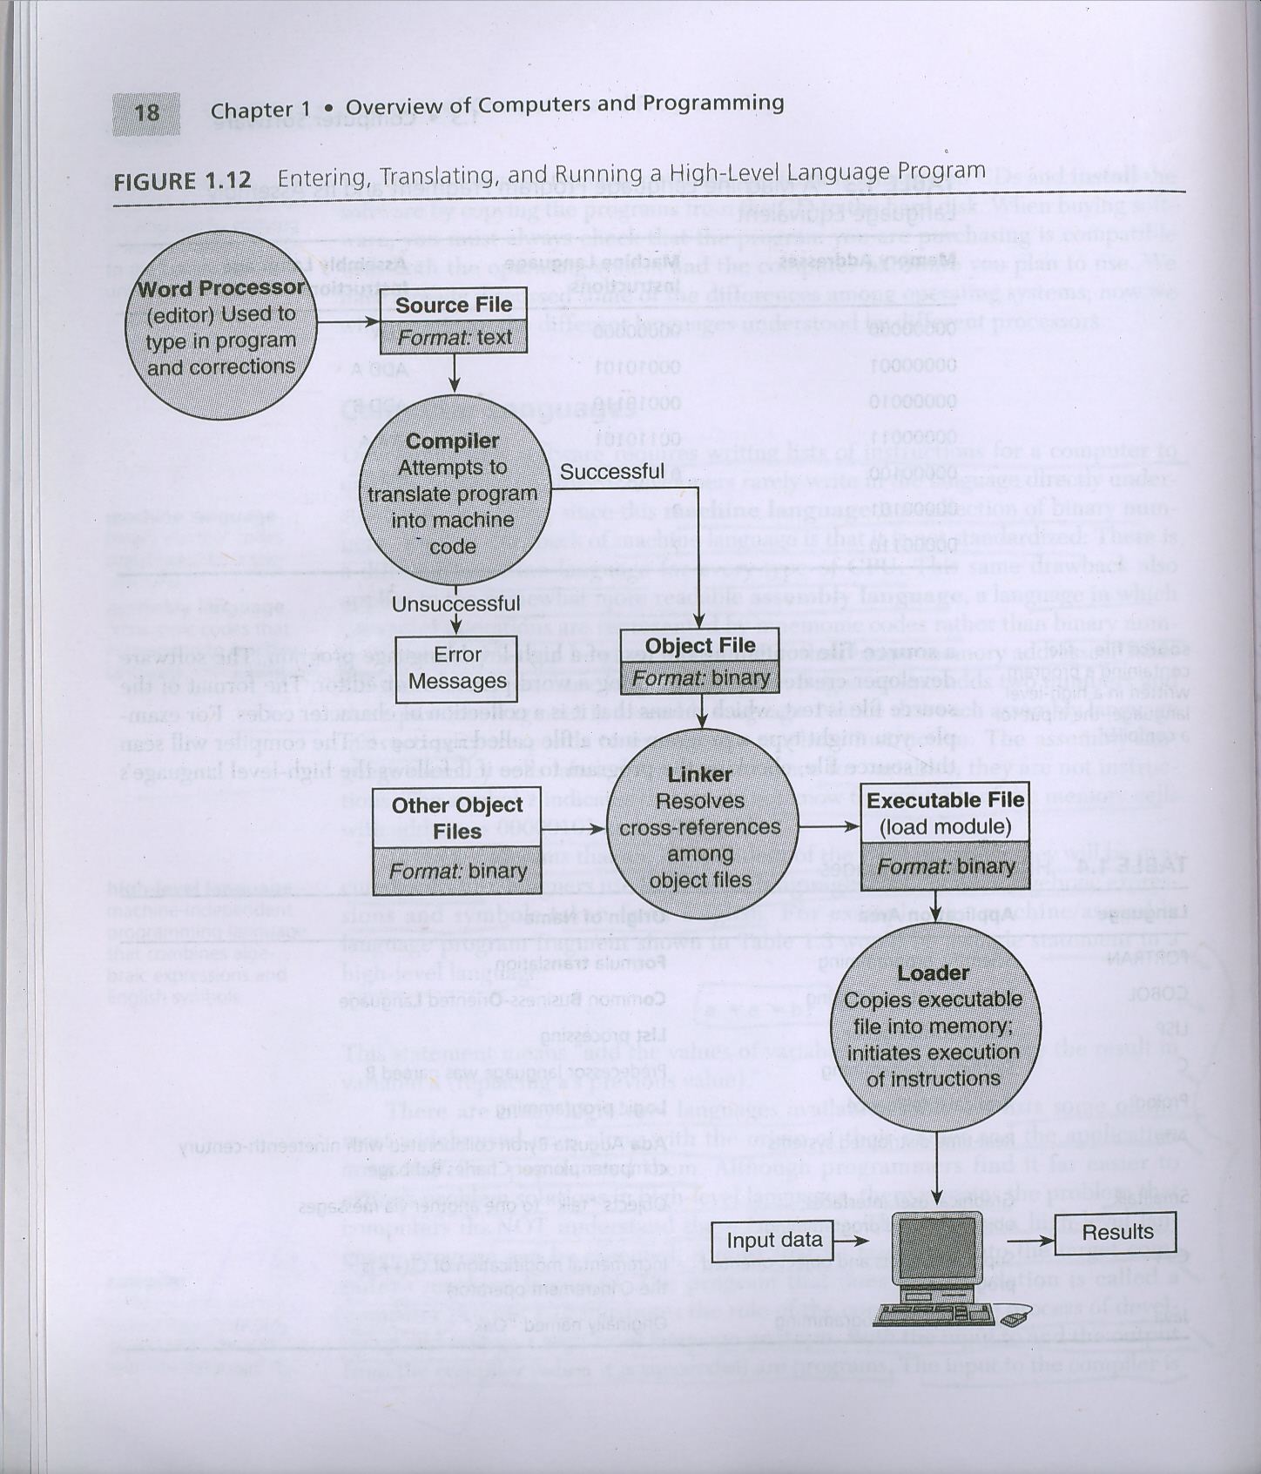

Translating a High-Level Language Program
#include<stdio.h>
int main(void)
{
printf("Hello World\n");
return(0);
}
Hello.c
ELF??????????????????????ô???????4?????(?
??L$ƒäðÿqüU‰åQƒìÇ$????èüÿÿÿƒÄY]aüÃ??Hell
gcc -c Hello.c
Hello.o
gcc –o exe Hello.o
./exe

Slide 14
Variable Declarations, Data types,
Expressions
- Variables and Operators

Slide 15
Variables
  Variable names (identifiers) correspond to locations in the computer's memory (Von Neuman model)
  Every variable has a name, a type, a size and a value
  Whenever a new value is placed into a variable (through scanf, for example), it replaces (and destroys) the previous value. (Destructive write)
  Reading variables from memory does not change them
A visual representation (memory map)
i
36443
variable
address
45
value
int
4 bytes
datatype
size

Slide 16
Keywords

Slide 17
Expression
Expressions are computations that return a value.
Like variables, a value is an instance of a data type.
Examples of expressions are:
  45 (int)
  2+3 (int)
  2.0/5.0 (double)
  “Hello” (string)
  x (the current value of variable int x)

Slide 18
Arithmetic Operators
Binary Operator (two operands)
  + (addition) - (subtraction) * (multiplication)
  / (division) % (modulus, remainder) (no ** )
Unary Operator (single operands)
  - (no + )
  Example:
    int i=1, j=2, k=3, x;
    x=i+2*j-22/k;
    x=-1+j;
    x=1+-j;
    x=+i+j;
    x=22%k;
    float f=1.5, g=0.5, y;
    y=2.5*f+4.0*g;
  Exercise: Try -5%3 -5%-3 5%-3
  (hint: -5/3=-1 -5/-3=1 5/-3=-1 and R=x-y*i)
  Mixed data types will be discussed later
  Operators that have more than two operands use functional notation a = f(x,y,x).
(x=1 + 4 -7 = -2)
(x= 1)
(x= -1)
(wrong expression)
(x= 1, remainder)
(y=5.75)
Ans: -2 -2 2

Slide 19
Arithmetic Operators
C operation
Arithmetic
Algebraic
C expression
operator
expression
Addition
+
f + 7
f + 7
Subtraction
-
p
–
c
p
-
c
Multiplication
*
bm
b * m
Division
/
x / y
x / y
Modulus
%
r mod s
r % s

Slide 20
Precedence

Slide 21
Relational Operators
  == != < > <= >=
  Result is a integer: 1 means TRUE
  0 means FALSE
  No logical type variable and constants
  No space between the operators
  Example:
0
Meaning | C | Expression | Result
equal not equal greater less greater equal less equal | == != > < >= <= | 5 == 3 5 != 3 5 > 3 5 < 3 5 >= 3 5 <= 3
1
1
0
1
0

Slide 22
Relational Operators

Slide 23
Logical (Boolean) Operators
Example:
Expression Result
5||3
5||0
5&&3
5&&0
i&&j (if i=0, j=0)
i&&j+1 (if i=5, j=0)
!5
!0
!i (if i=5)
Binary Operators
  && (and) || (OR)
Unary Operator
  ! (not)
Operand must be int
  Use float or double, the result may not predictable
  nonzero (TRUE) zero (FALSE)
Result is int
  1 (TRUE) 0 (FALSE)
  Express connected by && or || are evaluated from left to right, and evaluation stops as soon as the truth or falsehood of the result is known. i.e. ‘expr1 && expr2’ is not equal to ‘expr2 && expr1’. This is called short-circuit evaluation.
  ‘inward == 0’ normally be written as ‘!inward’
      Example:
      3 < 7 < 5
      3 < 7 && 7 < 5
1
1
1
0
0
1
0
1
0
(3 < 7) < 5 1 < 5 1
1 && 0 0

Slide 24
Conditional (ternary) Operator
Syntax
    expr1 ? expr2 : expr3
  If expr1 ≠ 0, then execute expr2 and ignore expr3
  If expr1 = 0, then execute expr3 and ignore expr2
  Example: x = i+j ? i+1 : j+1
  Example:
  x = 5 ? 4 : 2; /* x = 4 */
  Example:
  j = 4;
  i = 2
  x = i+j ? i+1 : j-1 /* x = 3 */
  Example:
  l = a > b ? a : b; /* the larger of a and b */
  Example:
  max =(a > b)?((a>c)?a:c):(b>c)?b:c);
  /* the maximum number among a, b, and c */
  Example:
  x = a > 0 ? a: -a; /* the absolute value of a */

Slide 25
sizeof Operator
Syntax
    sizeof(expr)
  The number of bytes occupied by expr
  For most computers
    sizeof(3) 2 or 4 (bytes)
    (depending on16 bit CPU or 32 bit CPU), where 3 is an integer
    sizeof(3L) 4 (long int)
    sizeof(3.0) 8 (double float)
  Example:
    double i;
    printf(“%d”,sizeof(i)); 8
  Usually, this operator is used to get the size of an organized variable (like struct, union, …)
  This is one of a few functions that are built-in. No #include is required.

Slide 26
Address Operator
Syntax
  &var
  Get the address of the variable
  & means the address of var
  Type of var may be
    (a) fundamental data type
    (b) organized data type
  Example:
  int i=100;
  printf(“%d %d”, &i, i);
Address
Content
1000
1001
RAM
1002
100
1003
1004
1005

Slide 27
Basic I/O Function
– printf()

Slide 28
Formatted Input/Output
  printf and scanf are basic I/O functions
  Streams (input and output)
    gets, puts, getchar, putchar (in <stdio.h>)
Streams
  Sequences of characters organized into lines
    Each line consists of zero or more characters and ends with newline character
    ANSI C must support lines of at least 254 characters
  Performs all input and output
  Can often be redirected
    Standard input – keyboard
    Standard output – screen
    Standard error – screen

Slide 29
Formatting Output with printf
printf
  Precise output formatting
    Conversion specifications: flags, field widths, precisions, etc.
  Can perform rounding, aligning columns, right/left justification, inserting literal characters, exponential format, hexadecimal format, and fixed width and precision

Slide 30
Formatting Output with printf (cont.)
Format :
printf( format-control-string, other-arguments);
  Format control string: describes output format,
    Ordinary characters: copy to output stream: printf(“this is an output\n”);
    Conversion specifications: leading with character ‘%’
    Format:
    %-w.plx
      [-]: optional ⇒ left justification, if exists
      [w]: optional ⇒ minimal width (wider if necessary). The padding character is blank normally and zero if the field width was specified with a leading zero
      [.]: optional ⇒ separates field w and p

Slide 31
Formatting Output with printf (cont.)
      [p]: optional ⇒ maximum field width for a string ⇒ precision of floating number
      [l]: long integer
      [x]:d ⇒ decimal signed integer
      i ⇒ decimal signed integer (the d and i specifiers are different when used in scanf)
      u ⇒ decimal unsigned integer
      x ⇒ hexadecimal unsigned integer (0 – 9 and a – f)
      X ⇒ unsigned hexadecimal integer (0 – 9 and A – F)
      h or l ⇒ length modifiers; place before any integer conversion specifier to indicate that a short or long integer is displayed respectively

Slide 32
      h or l ⇒ length modifiers; place before any integer conversion specifier to indicate that a short or long integer is displayed respectively
      o ⇒ octal unsigned integer
      f ⇒ floating pointer number
      g ⇒ either f or e, whichever is shorter
      c ⇒ single character
      s ⇒ character string
      e ⇒ exponential floating pointer number
  Other-arguments: correspond to each conversion specification in format-control-string, such as variables.

Slide 33
The printf Function
printf (“That equals %f kilometers.\n”, kms) ;
Function name
Placeholder
Print list
Format string
Function arguments

Slide 34
Printing Integers
  Whole number (no decimal point): 25, 0, -9
  Positive, negative, or zero
  Only minus sign prints by default
Example:
Program Output
3 #include <stdio.h>
4
455
455
455
-455
32000
2000000000
707
455
65081
1c7
1C7
5 main()
6 {
7 printf( "%d\n", 455 );
8 printf( "%i\n", 455 ); /* i same as d in printf */
9 printf( "%d\n", +455 );
10 printf( "%d\n", -455 );
11 printf( "%hd\n", 32000 );
12 printf( "%ld\n", 2000000000 );
13 printf( "%o\n", 455 );
14 printf( "%u\n", 455 );
15 printf( "%u\n", -455 );
16 printf( "%x\n", 455 );
17 printf( "%X\n", 455 );
18
19
20 }

Slide 35
Printing Floating-Point Numbers
Floating Point Number
  Have a decimal point (33.5)
  Exponential notation (computer's version of scientific notation)
    150.3 is 1.503 x 10² in scientific
    150.3 is 1.503E+02 in exponential (%E stands for exponent)
    Can use %e or %E
  %f : print floating point with at least one digit to left of decimal
  %g (or G) : prints in f or e with no trailing zeros (1.2300 becomes 1.23)
  Use exponential if exponent less than -4, or greater than or equal to precision (6 digits by default)
Example:
5 #include <stdio.h>
6
7 int main()
Program Output
8 {
9 printf( "%e\n", 1234567.89 );
1.234568e+006
1.234568e+006
-1.234568e+006
1.234568E+006
1234567.890000
1.23457e+006
1.23457E+006
10 printf( "%e\n", +1234567.89 );
11 printf( "%e\n", -1234567.89 );
12 printf( "%E\n", 1234567.89 );
13 printf( "%f\n", 1234567.89 );
14 printf( "%g\n", 1234567.89 );
15 printf( "%G\n", 1234567.89 );
16
17 return 0;
18 }

Slide 36
Printing Strings and Characters
Example:
%c
  Prints char argument
  Cannot be used to print the first character of a string
%s
  Requires a pointer to char as an argument (line 8)
  Cannot print a char argument
  Prints characters until NULL ('\0') encountered
  Single quotes for character constants ('z')
  Double quotes for strings "z" (which actually contains two characters, 'z' and '\0')
1 /* Fig 9.5: fig09_05c */
2 /* Printing strings and characters */
3 #include <stdio.h>
4
5 int main()
6 {
7 char character = 'A';
8 char string[] = "This is a string";
9 const char *stringPtr = "This is also a string";
10
11 printf( "%c\n", character );
12 printf( "%s\n", "This is a string" );
13 printf( "%s\n", string );
14 printf( "%s\n", stringPtr );
15
16 return 0;
17 }
Program Output
A
This is a string
This is a string
This is also a string

Slide 37
Other Conversion Specifiers
%p
  Displays pointer value (address)
%n
  Stores number of characters already output by current printf statement
  Takes a pointer to an integer as an argument
  Nothing printed by a %n specification
  Every printf call returns a value
    Number of characters output
    Negative number if error occurs
%%
  Prints a percent sign

Slide 38
Example:
Program Output
3 #include <stdio.h>
The value of ptr is 0065FDF0
The address of x is 0065FDF0
Total characters printed on this line is: 41
This line has 28 characters
28 characters were printed
Printing a % in a format control string
4
5 int main()
6 {
7 int *ptr;
8 int x = 12345, y;
9
10 ptr = &x;
11 printf( "The value of ptr is %p\n", ptr );
12 printf( "The address of x is %p\n\n", &x );
13
14 printf( "Total characters printed on this line is:%n", &y );
15 printf( " %d\n\n", y );
16
17 y = printf( "This line has 28 characters\n" );
18 printf( "%d characters were printed\n\n", y );
19
20 printf( "Printing a %% in a format control string\n" );
21
22 return 0;
23 }

Slide 39
Printing with Field Widths and Precisions
Field width (Size of field in which data is printed)
  If width larger than data, default right justified
    If field width too small, increases to fit data
    Minus sign uses one character position in field
  Integer width inserted between % and conversion specifier. Example: %4d : field width of 4
Precision (Meaning varies depending on data type)
  Integers (default 1): Minimum number of digits to print, If data too small, prefixed with zeros
  Floating point: Number of digits to appear after decimal (e and f).
    g : maximum number of significant digits
  Strings: Maximum number of characters to be written from string
  Format: Use a dot (.) then precision number after % Example: %.3f

Slide 40
Printing with Field Widths and Precisions (cont)
Field width and precision
    Can both be specified using format of %width.precision
    Example: %5.3f
    Negative field width (-): left justified; Positive field width: right justified
    Precision must be positive
    Can use integer expressions to determine field width and precision values
      Place an asterisk (*) in place of the field width or precision
      Matched to an int argument in argument list
      Example: printf( "%*.*f", 7, 2, 98.736 );

Slide 41
Example:
2 /* Using precision while printing integers,
Program Output:
3 floating-point numbers, and strings */
Using precision for integers
0873
000000873
Using precision for floating-point numbers
123.945
1.239e+02
124
Using precision for strings
Happy Birth
4 #include <stdio.h>
5
6 int main()
7 {
/* Initialize variables */
8 int i = 873;
9 double f = 123.94536;
10 char s[] = "Happy Birthday";
/* print */
11
12 printf( "Using precision for integers\n" );
13 printf( "\t%.4d\n\t%.9d\n\n", i, i );
14 printf( "Using precision for floating-point numbers\n" );
15 printf( "\t%.3f\n\t%.3e\n\t%.3g\n\n", f, f, f );
16 printf( "Using precision for strings\n" );
17 printf( "\t%.11s\n", s );
18
19 return 0;
20 }

Slide 42
Using Flags in the printf Format-Control String
Flags
  Supplement formatting capabilities
  Place flag immediately to the right of percent sign
  Several flags may be combined
Flag | Description
- (minus sign) | Left justify the output within the specified field.
+ (plus sign) | Display a plus sign preceding positive values and a minus sign preceding negative values.
space | Print a space before a positive value not printed with the + flag
# | Prefix 0 to the output value when used with the octal conversion specifier Prefix 0x or 0X to the output value when used with the hexadecimal conversion specifiers x or X Force a decimal point for a floating point number printed with e, E, f, g, or G that does not contain a fractional part. (Normally the decimal point is only printed if a digit follows it.) For g and G specifiers, trailing zeros are not eliminated.
0 (zero) | Pad a field with leading zeros

Slide 43
Example:
2 /* Right justifying and left justifying values */
3 #include <stdio.h>
4
5 int main()
6 {
7 printf( "%10s%10d%10c%10f\n\n", "hello", 7, 'a', 1.23 );
8 printf( "%-10s%-10d%-10c%-10f\n", "hello", 7, 'a', 1.23 );
9 return 0;
10 }
hello7a1.230000
hello7a1.230000
Program Output:

Slide 44
Example:
2 /* Using the # flag with conversion specifiers
3 o, x, X and any floating-point specifier */
4 #include <stdio.h>
5
6 int main()
7 {
8 int c = 1427;
9 double p = 1427.0;
Program Output:
10
02623
0x593
0X593
1427
1427.00
11 printf( "%#o\n", c );
12 printf( "%#x\n", c );
13 printf( "%#X\n", c );
14 printf( "\n%g\n", p );
15 printf( "%#g\n", p );
16
17 return 0;
18 }

Slide 45
  Example:
  int i=1256;
  printf(“%d”,i); 4 characters 1256
  printf(“%5d”,i); 5 characters 1256
  printf(“%05d”,i); 5 characters 01256
  printf(“%x”,i); 3 characters 788
  printf(“%-5d”,i); 5 characters 1256
  Example:
  float buf=125.12;
  printf(“%f”,buf); 125.119995 (floating number precision error)
  printf(“%.0f”,buf); 125
  printf(“%7.2f”,buf); 125.12
  printf(“%07.2f”,buf); 0125.12
  Example:
  char buf[] = “hello, world”;
  printf(“%10s”,buf); hello, world
  printf(“%-10s”,buf); hello, world
  printf(“%20s”,buf); hello, world
  printf(“%20.10s”,buf); hello, wor
  printf(“%-20.10s”,buf); hello, wor
  printf(“%.10s”,buf); hello, wor

Slide 46
Printing Literals and Escape Sequences
Printing Literals
  Most characters can be printed
  Certain "problem" characters, such as the quotation mark "
  Must be represented by escape sequences
    Represented by a backslash \ followed by an escape character
Table of all escape sequences
Escape sequence | Description
\’ | Output the single quote (‘) character.
\” | Output the double quote (“) character.
\? | Output the question mark (?) character.
\\ | Output the backslash (\) character.
\a | Cause an audible (bell) or visual alert
\b | Move the cursor back one position on the current line.
\f | Move the cursor to the start of the next logical page.
\n | Move the cursor to the beginning of the next line.
\r | Move the cursor to the beginning of the current line.
\t | Move the cursor to the next horizontal tab position
\v | Move the cursor to the next vertical tab position.

Slide 47
Basic I/O Function
– scanf()

Slide 48
Formatting Input with Scanf
scanf
  Input formatting
  Capabilities
    Input all types of data
    Input specific characters
    Skip specific characters
Format scanf(format-control-string, other-arguments);
  Format-control-string: describes formats of inputs
    %*wlx
    [*]: optional conversion only, result is not stored
    [w]: optional minimum width (wider if necessary). The padding character is blank normally and zero if the field width was specified with a leading zero
    [l]: long integer
    [x]: see the table next page
  Other-arguments
    Pointers to variables where input will be stored (address of variables)
  Can include field widths to read a specific number of characters from the stream

Slide 49
Conversion specifier Description
Integers
d i o u x or X h or l | Read an optionally signed decimal integer. The corresponding argument is a pointer to integer Read an optionally signed decimal, octal, or hexadecimal integer. The corresponding argument is a pointer to integer. Read an octal integer. The corresponding argument is a pointer to unsigned integer. Read an unsigned decimal integer. The corresponding argument is a pointer to unsigned integer. Read a hexadecimal integer. The corresponding argument is a a pointer to unsigned integer. Place before any of the integer conversion specifiers to indicate that a short or long integer is to be input.

Slide 50
Floating-point Number
e,E,f,g,G I or L |  | Read a floating point value. The corresponding argument is a pointer to a floating point variable. Place before any of the floating point conversion specifiers to indicate that a double or long double value is to be input
Characters and strings
c s | Read a character. The corresponding argument is a pointer to char no null (‘\0’) is added Read a string. The corresponding argument is a pointer to an array of type char that is large enough to hold the string and a terminating null (‘\0’) character which is automatically added.

Slide 51
Scan set
[scan char |  | Scan a string for a set of characters that are stored in an array.
Miscellaneous
p n % | Read an address of the same form produced when an address is output with %p in a printf statement Store the number of characters input so far in this scanf. The corresponding argument is a pointer to integer Skip a percent sign (%) in the input

Slide 52
Formatting Input with scanf
Scan sets
  Set of characters enclosed in square brackets []
    Preceded by % sign
  Scans input stream, looking only for characters in scan set
    Whenever a match occurs, stores character in specified array
    Stops scanning once a character not in the scan set is found
  Inverted scan sets
    Use a caret ^: [^aeiou]
    Causes characters not in the scan set to be stored
Skipping characters
  Include character to skip in format control
  Or, use * (assignment suppression character)
    Skips any type of character without storing it

Slide 53
Example:
2 /* Reading characters and strings */
3 #include <stdio.h>
4
5 int main()
6 {
7 char x, y[ 9 ];
8
9 printf( "Enter a string: " );
/* initialize variables */
10 scanf( "%c%s", &x, y );
11
/* input */
12 printf( "The input was:\n" );
13 printf( "the character \"%c\" ", x );
14 printf( "and the string \"%s\"\n", y );
/* print */
15
16 return 0;
17 }
Program Output:
Enter a string: Sunday
The input was:
the character "S" and the string "unday"

Slide 54
Example:
2 /* Reading and discarding characters from the input stream */
3 #include <stdio.h>
4
5 int main()
6 {
7 int month1, day1, year1, month2, day2, year2;
8
9 printf( "Enter a date in the form mm-dd-yyyy: " );
10 scanf( "%d%*c%d%*c%d", &month1, &day1, &year1 );
11 printf( "month = %d day = %d year = %d\n\n",
12 month1, day1, year1 );
13 printf( "Enter a date in the form mm/dd/yyyy: " );
14 scanf( "%d%*c%d%*c%d", &month2, &day2, &year2 );
15 printf( "month = %d day = %d year = %d\n",
16 month2, day2, year2 );
17
18 return 0;
19 }
Program Output:
Enter a date in the form mm-dd-yyyy: 11-18-2000
month = 11 day = 18 year = 2000
Enter a date in the form mm/dd/yyyy: 11/18/2000
month = 11 day = 18 year = 2000

Slide 55
The Preprocessor
The C preprocessor permits you to define simple macros that are evaluated and expanded prior to compilation.
Commands begin with a ‘#’. Abbreviated list:
  #define : defines a macro
  #undef : removes a macro definition
  #include : insert text from file
  #if : conditional based on value of expression
  #ifdef : conditional based on whether macro defined
  #ifndef : conditional based on whether macro is not defined
  #else : alternative
  #elif : conditional alternative
  defined() : preprocessor function: 1 if name defined, else 0

Slide 56
Program Control
- Standard C Statements

Slide 57
  Selection structure
    if
    if/else
  Repetition control structures
    While

Slide 58
Selection Structure: if
Selection structure:
  Used to choose among alternative courses of action
  Pseudocode:
    If (student’s grade is greater than or equal to 60)
    Print “Passed”
If condition true
  Print statement executed and program goes on to next statement
  If false, print statement is ignored and the program goes onto the next statement
  Indenting makes programs easier to read
    C ignores whitespace characters
Pseudocode statement in C:
    if ( grade >= 60 )
    printf( "Passed\n" );
  C code corresponds closely to the pseudocode

Slide 59
if Selection Structure (cont.)
A decision can be made on any expression.
    zero - false
    nonzero - true
  Example:
    (3 – 4) is true
true
print “Passed”
grade >= 60
false

Slide 60
Selection Structure: if/else
if/else
  if: only performs an action if the condition is true
  if/else: Specifies an action to be performed both when the condition is true and when it is false
Pseudocode:
  If (student’s grade is greater than or equal to 60)
  Print “Passed”
  else
  Print “Failed”
  Note spacing/indentation conventions
C code:
    if ( grade >= 60 )
    printf( "Passed\n");
    else
    printf( "Failed\n");

Slide 61
if/else Selection Structure (cont.)
Ternary conditional operator (?:)
  Takes three arguments (condition, value if true, value if false)
  Creates an if/else expression. Recall that expressions are computations that yield a single value.
  Our pseudocode could be written:
    printf( "%s\n", grade >= 60 ? "Passed" : "Failed" );
  Or it could have been written:
    grade >= 60 ? printf( “Passed\n” ) : printf( “Failed\n” );

Slide 62
if/else Selection Structure
Compound statement:
  Set of statements within a pair of braces
  Example:
    if ( grade >= 60 )
    printf( "Passed.\n" );
    else {
    printf( "Failed.\n" );
    printf( "You must take this course again.\n" );
    }
  Without the braces,
    if ( grade >= 60 )
    printf( "Passed.\n" );
    else
    printf( "Failed.\n" );
    printf( "You must take this course again.\n" );
  the statement
  printf( "You must take this course again.\n" );
  would be executed under every condition.

Slide 63
Essentials of Repetition
Loop
  Group of instructions computer executes repeatedly while some condition remains true
Counter-controlled repetition
  Definite repetition: know how many times loop will execute
  Control variable used to count repetitions
Sentinel-controlled repetition
  Indefinite repetition
  Used when number of repetitions not known
  Sentinel value indicates "end of data“

Slide 64
Essentials of Counter-Controlled Repetition
Counter-controlled repetition requires
  The name of a control variable (or loop counter)
  The initial value of the control variable
  A condition that tests for the final value of the control variable (i.e., whether looping should continue)
  An increment (or decrement) by which the control variable is modified each time through the loop
  Example:
    int counter = 1; /* initialization */
    while ( counter <= 10 ) { /* repetition condition */
    printf( "%d\n", counter );
    ++counter; /* increment */
    }
  The statement
    int counter = 1;
    Names counter
    Declares it to be an integer
    Reserves space for it in memory
    Sets it to an initial value of 1
    This is not an executable statement, it is a declaration.

Slide 65
Repetition Structure: while
1
2 Class average program with
3 counter-controlled repetition */
4 #include <stdio.h>
5
6 int main()
7 {
8 int counter, grade, total, average;
9
10 /* initialization phase */
11 total = 0;
12 counter = 1;
13
14 /* processing phase */
15 while ( counter <= 10 ) {
16 printf( "Enter grade: " );
17 scanf( "%d", &grade );
18 total = total + grade;
19 counter = counter + 1;
20 }
21
22 /* termination phase */
24 printf( "Class average is %d\n", average );
25
26 return 0; /* indicate program ended successfully */
27 }
printf( "Enter grade, -1 to end: " );
scanf( "%d", &grade );
while ( grade != -1 ) {
total = total + grade;
counter = counter + 1;
printf( "Enter grade, -1 to end: " );
scanf( "%d", &grade );
} /* termination phase */
if ( counter != 0 ) {
average = ( float ) total / counter;
printf( "Class average is %.2f", average );
}
else
printf( "No grades were entered\n" );
Program Output:
Enter grade: 98
Enter grade: 76
Enter grade: 71
Enter grade: 87
Enter grade: 83
Enter grade: 90
Enter grade: 57
Enter grade: 79
Enter grade: 82
Enter grade: 94
Class average is 81

Slide 66
Program Control
- Additional C Statements

Slide 67
  additional repetition control structures
    for
    do/while
  switch additional multiple selection structure
  break statement
    Used for exiting immediately and rapidly from certain control structures
  continue statement
    Used for skipping the remainder of the body of a repetition structure and proceeding with the next iteration of the loop

Slide 68
Repetition Structure: for
for loops syntax
    for ( initialization ; loopContinuationTest ; increment )
    statement
    Example: Prints the integers from one to ten
  for ( counter = 1; counter <= 10; counter++ )
  printf( "%d\n", counter );
For loops can usually be rewritten as while loops:
    initialization;
    while ( loopContinuationTest ) {
    statement;
    increment;
    }
Initialization and increment
  Can be comma-separated list of statements
    Example:
    for ( i = 0, j = 0; j + i <= 10; j++, i++)
    printf( "%d\n", j + i );
No semicolon (;) after last expression

Slide 69
for Structure (cont.)
Arithmetic expressions
  Initialization, loop-continuation, and increment can contain arithmetic expressions. If x equals 2 and y equals 10
    for ( j = x; j <= 4 * x * y; j += y / x )
  is equivalent to
    for ( j = 2; j <= 80; j += 5 )
Notes about the for structure:
  "Increment" may be negative (decrement)
  If the loop continuation condition is initially false
    The body of the for structure is not performed (i.e. pre-test)
    Control proceeds with the next statement after the for structure
  Control variable
    Often printed or used inside for body, but not necessarily

Slide 70
1
2 Summation with for */
3 #include <stdio.h>
4
5 int main()
6 {
7 int sum = 0, number;
1. Initialize variables
2. for repetition structure
8
9 for ( number = 2; number <= 100; number += 2 )
10 sum += number;
11
12 printf( "Sum is %d\n", sum );
13
14 return 0;
15 }
Program Output:
Sum is 2550
2 + 4 + 8 + … +100 = 2550

Slide 71
Repetition Structure: do/while
  Similar to the while structure
  do/while is a “post-test” condition. The body of the loop is performed at least once.
    All actions are performed at least once
  Format:
      do {
      statement;
      } while ( condition );
    Example: Prints the integers from 1 to 10.
    (letting counter = 1):
      do {
      printf( "%d ", counter );
      } while (++counter <= 10);
Flowchart of the do/while repetition structure
action(s)
true
condition
false

Slide 72
1
2 Using the do/while repetition structure */
3 #include <stdio.h>
4
5 int main()
6 {
7 int counter = 1;
8
1. Initialize variable
2. Loop
3. Print
9 do {
10 printf( "%d ", counter );
11 } while ( ++counter <= 10 );
12
13 return 0;
14 }
Program Output:
1 2 3 4 5 6 7 8 9 10

Slide 73
Multiple-Selection Structure: switch
switch
  Useful when a variable or expression is tested for all the values it can assume and different actions are taken
Format
  Series of case labels and an optional
  default case
    switch ( value ){
      case '1':
        actions
      case '2':
        actions
      default:
        actions
      }
  break; exits from structure
Flowchart of the switch structure
case 1
true
case 1
break
action(s)
false
case 2
true
case 2
break
action(s)
false
…
case n
true
case n
break
action(s)
false
default
action(s)

Slide 74
1
2 Counting letter grades */
3 #include <stdio.h>
4
5 int main()
6 {
7 int grade;
8 int aCount = 0, bCount = 0, cCount = 0, dCount = 0, 9
9 fCount = 0;
10
11 printf( "Enter the letter grades.\n" );
12 printf( "Enter the EOF character to end input.\n" );
13
14 while ( ( grade = getchar() ) != EOF ) {
15
16 switch ( grade ) { /* switch nested in while */
17
18 case 'A': case 'a': /* grade was uppercase A */
19 ++aCount; /* or lowercase a */
20 break;
21
22 case 'B': case 'b': /* grade was uppercase B */
23 ++bCount; /* or lowercase b */
24 break;
25
26 case 'C': case 'c': /* grade was uppercase C */
27 ++cCount; /* or lowercase c */
28 break;
29
30 case 'D': case 'd': /* grade was uppercase D */
31 ++dCount; /* or lowercase d */
32 break;
33
34 case 'F': case 'f': /* grade was uppercase F */
35 ++fCount; /* or lowercase f */
36 break;
37
1. Initialize variables
2. Input data
3. Use switch loop to update count

Slide 75
38 case '\n': case' ': /* ignore these in input */
39 break;
40
41 default: /* catch all other characters */
42 printf( "Incorrect letter grade entered." );
43 printf( " Enter a new grade.\n" );
44 break;
45 }
46 }
47
48 printf( "\nTotals for each letter grade are:\n" );
49 printf( "A: %d\n", aCount );
50 printf( "B: %d\n", bCount );
51 printf( "C: %d\n", cCount );
52 printf( "D: %d\n", dCount );
53 printf( "F: %d\n", fCount );
54
55 return 0;
56 }
4. Print results
Enter the letter grades.
Enter the EOF character to end input.
A
B
C
C
A
D
F
C
E
Incorrect letter grade entered. Enter a new grade.
D
A
B
Totals for each letter grade are:
A: 3
B: 2
C: 3
D: 2
F: 1
Program Output:

Slide 76
The break and continue Statements
break
  Causes immediate exit from a while, for, do/while or switch structure
  Program execution continues with the first statement after the structure
  Common uses of the break statement
    Escape early from a loop
    Skip the remainder of a switch structure
continue
  Skips the remaining statements in the body of a while, for or do/while structure
    Proceeds with the next iteration of the loop
  while and do/while
    Loop-continuation test is evaluated immediately after the continue statement is executed
  for
    Increment expression is executed, then the loop-continuation test is evaluated

Slide 77
continue Statement
  while (expr) {
  statement
  …
  continue;
  statement
  …
  }
  for (expr1; expr2; expr3) { statement
  …
  continue;
  statement
  …
  }
skip
skip
  do {
  statement
  …
  continue;
  statement
  …
  } while(expr)
skip

Slide 78
break Statement
  while (expr) {
  statement;
  …
  if (expr)
  break;
  statements;
  }
  statement;
  …
  switch (i) {
  case 1:
  statement_1;
  case 2:
  statement_2;
  case 3:
  statement_3; break;
  case 4:
  statement_4;
  }
  statements;
  for (expr1; expr2; expr3) { statement
  …
  if (expr)
  break;
  statements;
  }
  statements;

Slide 79
Equality (==) vs. Assignment (=) Operators
Dangerous error
  Does not ordinarily cause syntax errors
  Any expression that produces a value can be used in control structures
  Nonzero values are true, zero values are false
    Example: using ==:
      if ( payCode == 4 )
      printf( "You get a bonus!\n" );
    Checks paycode, if it is 4 then a bonus is awarded
    Example: replacing == with =:
      if ( payCode = 4 )
      printf( "You get a bonus!\n" );
    This sets paycode to 4
    4 is nonzero, so expression is true, and bonus awarded no matter what the paycode was
  Logic error, not a syntax error

Slide 80
Examples
Ex_1:
if (i=1) y = 3;
y = 3 is always executed
this is not the same as
if (i==1) y = 3;
Ex_2:
if (i!=0) y=3;
if (i) y=3;
Ex_3:
if (i==0) y=3;
⇒ if (!i) y=3;

Slide 81
Examples:
Ex_1:
if (i>2)
if (j==3)
y=4;
else
y=5;
Ex_2:
if (a>b)
c = a;
else
c = b;
c=(a>b)?a:b
if (i>2) {
if (j==3)
y=4;
}
else
y=5;
if (x==5)
y = 1;
else
y = 0;
⇒ y = (x==5);
if (i>2)
if (j==3)
y=4;
else
;
else
y=5;
if (x<6)
y = 1;
else
y = 2;
y = 2-(x<6);
or y = 1+(x>=6);
≠
=

Slide 82
Examples:
while loop:
while (expr₁, expr₂, …, expr_{n})
statement
Example:
while (scanf(“%d”, &i), i--)
printf(“%d”,i);
Switch
  switch (i) {
  case 1: j+=5;
  case 2;
  case 3: j+=4;
  case 4: j+=3;
  }
1
2
3
N
N+1
≠ 0
N+2
= 0
i = 1
i = 2
i = 3
i = 4

Slide 83
Functions

Slide 84
Modularity
How do you solve a big/complex problem?
Divide it into small tasks and solve each task. Then combine these solutions.
Divide and Conquer

Slide 85
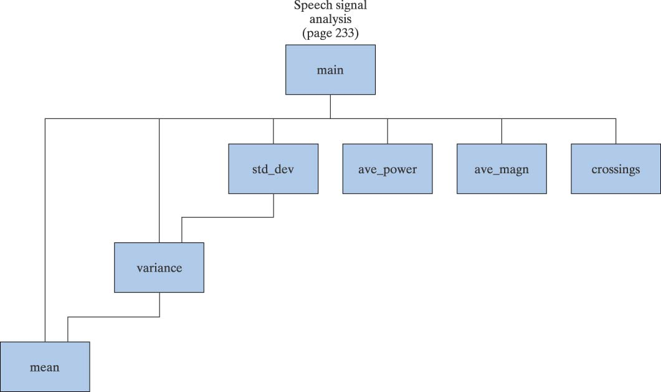
Modularity (cont’d)
In C we use functions also referred to as modules to perform specific tasks that we determined in our solution
Structure Chart
Shows how the program separated into tasks and which tasks reference other tasks.
NOTE: It does NOT indicate the sequence of steps in the program!

Slide 86
Advantages of using modules
Modules can be written and tested separately
Modules can be reused
Large projects can be developed in parallel
Reduces length of program, making it more readable
Promotes the concept of abstraction
  A module hides details of a task
  We just need to know what this module does
  We don’t need to know how it does it

Slide 87
Function definition
return_type function_name (parameters)
{
declarations;
statements;
}
int my_add_func(int a, int b)
{
int sum;
sum = a + b;
return sum;
}

Slide 88
Functions - Example
Function prototype
  Like a variable declaration
    Tells compiler that the function will be defined later
    Helps detect program errors
    Note semicolon!!
Function definition
  See previous slide
  Note, NO semicolon
Function return
  return statement terminates execution of the current function
  Control returns to the calling function
  if return expression;
    then value of expression is returned as the value of the function call
    Only one value can be returned this way
Function call
  main() is the 'calling function'
  product() is the 'called function'
  Control transferred to the function code
  Code in function definition is executed
#include <stdio.h>
/* function prototype */
double product(double x, double y);
int main()
{
double var1 = 3.0, var2 = 5.0;
double ans;
ans = product(var1, var2);
printf("var1 = %.2f\n"
"var2 = %.2f\n",var1,var2);
printf("var1*var2 = %g\n", ans);
}
/* function definition */
double product(double x, double y)
{
double result;
result = x * y;
return result;
}
Notes:
Show structure from the template: miles_to_kilometers.c
The function prototype declares the return data type, the function's name, and the data types of its parameters. Any parameter names included in the list are actually ignored by the compiler. The names are included to help document the function.
Function prototype helps reduce program errors, because by using it, the compiler can then detect the wrong number or the wrong type of data items that are passed to the function

Slide 89
Programmer-Defined Functions Terminology
Function Prototype describes how a function is called
int my_add_func(int a, int b);
Function Call
result = my_add_func(5, X);
Function implementation
int my_add_func(int a, int b)
{
…
}
Function parameters
  Formal parameters
  Actual parameter
  Formal parameters must match with actual parameters in order, number and data type.
  If the type is not the same, type conversion will be applied (coercion of arguments). But this might cause some errors (double→int) so you need to be careful!

Slide 90
Pre-defined Functions
So far, we used several pre-defined functions!
#include <stdio.h>
#include <math.h>
int main(void)
{
double angle;
printf(“Input angle in radians: \n“);
scanf(“%lf”, &angle);
printf(“The sine of the angle is %f\n“,
sin(angle) );
return 0;
}
double sin(double radian);
double sin(double radian)
{
/* details of computing sin */
}

Slide 91
Example: value returning function
n!=n*(n-1)*…*1, 0! = 1 by definition
Function name
Return Type
int fact(int n)
{
int factres = 1;
while(n>1)
{
factres = factres*n;
n--;
}
return(factres);
}
Parameter Declarations
Declarations
Statements

Slide 92
Example – use fact()
#include <stdio.h>
int fact(int n); /* prototype */
int main(void)
{
int t= 5,s;
s = fact(t) + fact(t+1);
printf(“result is %d\n”, s);
return 0;
}
t = 5
s = ?
Function call

Slide 93
Example – execution of factorial function (cont’d)
fact( 5 )
int fact(int n)
{
int factres = 1;
while(n>1)
{
factres = factres*n;
n--;
}
return(factres);
}
t = 5
s = ?
n = 5
factres = 1

Slide 94
Example – execution of factorial function (cont’d)
int fact(int n)
{
int factres = 1;
while(n>1)
{
factres = factres*n;
n--;
}
return(factres);
}
t = 5
s = ?
n = 5 4 3 2 1
factres = 1 5 20 60 120

Slide 95
Example – execution of factorial function (cont’d)
#include <stdio.h>
int fact(int n); /* prototype */
int main(void)
{
int t= 5,s;
s = 120 + fact(t+1);
printf(“result is %d\n”, s);
return 0;
}
t = 5
s = ?
Function call

Slide 96
Example – execution of factorial function (cont’d)
fact( 6 )
int fact(int n)
{
int factres = 1;
while(n>1)
{
factres = factres*n;
n--;
}
return(factres);
}
t = 5
s = ?
n = 6
factres = 1
t+1

Slide 97
Example – execution of factorial function (cont’d)
int fact(int n)
{
int factres = 1;
while(n>1)
{
factres = factres*n;
n--;
}
return(factres);
}
t = 5
s = ?
n = 6 5 4 3 2 1
factres = 1 6 30 120 360 720

Slide 98
Example – execution of factorial function (cont’d)
#include <stdio.h>
int fact(int n); /* prototype */
int main(void)
{
int t= 5,s;
s = 120 + 720;
printf(“result is %d\n”, s);
return 0;
}
t = 5
s = 840
result is 840

Slide 99
Trace functions
What is the output of the following program
#include <stdio.h>
int function1(int x)
{
x = 2;
printf("Out1 = %d\n",x);
return(x+1);
}
int main()
{
int x = 4, y;
y = function1(x);
printf("Out2 = %d\n",x);
printf("Out3 = %d\n",y);
return 0;
}
Output
Out1 = 2
Out2 = 4
Out3 = 3

Slide 100
Exercise
What is the output of the following program
#include <stdio.h>
void function2()
{
printf("In function 2\n");
}
void function1()
{
function2();
printf("In function 1\n");
}
void function3()
{
printf("In function 3\n");
function2();
}
int main()
{
function1();
function3();
return 0;
}
Output
In function 2
In function 1
In function 3
In function 2

Slide 101
Parameter Passing
Call by value
  formal parameter receives the value of the actual parameter
  function can NOT change the value of the actual parameter (arrays are an exception)
Call by reference
  actual parameters are pointers
  function can change the value of the actual parameter

Slide 102
Example program – Call by value
#include<stdio.h>
void main()
{
int a=10;
printf(“%d”,a); a=10
fun(a);
printf(“%d”,a); a=10
}
void fun(int x)
{
printf(“%d”,x) x=10
x++;
printf(“%d”,x); x=11
}

Slide 103
Call by reference
Calling a function by passing pointers as parameters (address of variables is passed instead of variables)
int a=1; void fun(int *x)
fun(&a); {
defn;
}
Any modification done to variable a will effect outside the function also

Slide 104
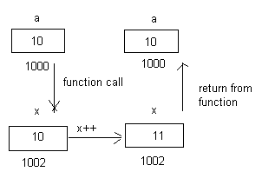
Explanation

Slide 105
Example Program – Call by reference
#include<stdio.h>
void main()
{
int a=10;
printf(“%d”,a); a=10
fun(a);
printf(“%d”,a); a=11
}
void fun(int x)
{
printf(“%d”,x) x=10
x++;
printf(“%d”,x); x=11
}

Slide 106

Explanation
a and x are referring to same location. So value will be over written.

Slide 107
Call by value => copying value of variable in another variable. So any change made in the copy will not affect the original location.
Call by reference => Creating link for the parameter to the original location. Since the address is same, changes to the parameter will refer to original location and the value will be over written.

Slide 108
Recursive Functions
A function that invokes itself is a recursive function.
  int fact(int k)
  {
  if (k == 0)
  return 1;
  else
  return k*fact(k-1);
  }
k!=k*(k-1)!

Slide 109
#include <stdio.h>
int fact(int k)
{
if (k == 0)
return 1;
else
return k*fact(k-1);
}
int main()
{
int n;
int nf;
printf("Enter n\n");
scanf("%d",&n);
nf = fact(n);
printf("Factorial = %d\n", nf);
system("pause");
return(0);
}

Slide 110
Fibonacci Numbers
int fibonacci(int k)
{
int term;
term = 1;
if (k>1)
term = fibonacci(k-1)+fibonacci(k-2);
return term;
}

Slide 111
#include <stdio.h>
int fibonacci(int k)
{
int term = 1;
if (k>1)
term = fibonacci(k-1)+fibonacci(k-2);
return(term);
}
int main()
{
int n;
int nfib;
printf("Enter n\n");
scanf("%d",&n);
nfib = fibonacci(n);
printf("Fibonacci = %d\n",nfib);
system("pause");
return(0);
}
/* Iterative Version of Fibonacci Function */
int fibonacci(int k)
{
int a,b,c,i;
if (k<=1)
return 1;
else
{
a = 1;
b = 1;
i = 2;
while (i<=k)
{
c = a + b;
a = b;
b = c;
i = i + 1;
}
return(c);
}
}

Slide 112
Arrays & Pointers

Slide 113
Arrays in C
All elements of same type – homogenous
Unlike Java, array size in declaration
int array[10];
int b;
array[0] = 3;
array[9] = 4;
array[10] = 5;
array[-1] = 6;
Compare: C: int array[10];
Java: int[] array = new int[10];
First element (index 0)
Last element (index size - 1)
No bounds checking!
Allowed – usually causes no error
array[10] may overwrite b

Slide 114
Arrays and Pointers
A variable declared as an array represents a contiguous region of memory in which the array elements are stored.
  int x[5]; // an array of 5 4-byte ints.
All arrays begin with an index of 0
An array identifier is equivalent to a pointer that references the first element of the array
  int x[5], *ptr;
  ptr = &x[0] is equivalent to ptr = x;
Pointer arithmetic and arrays:
  int x[5];
  x[2] is the same as *(x + 2), the compiler will assume you mean 2 objects beyond element x.
little endian byte ordering
0
1
2
3
0
1
2
3
4
memory layout for array x

Slide 115
Addressing Concept
Pointer stores the address of another entity
It refers to a memory location
int i = 5;
int *ptr; /* declare a pointer variable */
ptr = &i; /* store address-of i to ptr */
printf(“*ptr = %d\n”, *ptr); /* refer to referee of ptr */
Notes:
As its name suggests, … Syntactically, a pointer variable is declared as a type identifier followed by an asterisk “*”.

Slide 116
What actually ptr is?
ptr is a variable storing an address
ptr is NOT storing the actual value of i
ptr
address of i
int i = 5;
int *ptr;
ptr = &i;
printf(“i = %d\n”, i);
printf(“*ptr = %d\n”, *ptr);
printf(“ptr = %p\n”, ptr);
i
5
Output:
i = 5
*ptr = 5
ptr = effff5e0
value of ptr = address of i
in memory
Notes:
This code segment appeared in the appetizer.

Slide 117
Twin Operators
&: Address-of operator
  Get the address of an entity
    e.g. ptr = &j;
Addr | Content | Addr | Content | Addr | Content | Addr | Content
1000 | i: 40 | 1001 | j: 33 | 1002 | k: 58 | 1003 | m: 74
1004 | ptr: 1001 | 1005 |  | 1006 |  | 1007

Slide 118
Twin Operators
*: De-reference operator
  Refer to the content of the referee
    e.g. *ptr = 99;
Addr | Content | Addr | Content | Addr | Content | Addr | Content
1000 | i: 40 | 1001 | j: 99 | 1002 | k: 58 | 1003 | m: 74
1004 | ptr: 1001 | 1005 |  | 1006 |  | 1007

Slide 119
Example: Pass by Reference
Modify behaviour in argument passing
void f(int j)
{
j = 5;
}
void g()
{
int i = 3;
f(i);
}
void f(int *ptr)
{
*ptr = 5;
}
void g()
{
int i = 3;
f(&i);
}
i = ?
i = 3
i = ?
i = 5
Notes:
The program segment on the left is demonstrating “pass by value”, i.e. the value, actually a copy, of the variable i is passed as argument to function f(). The other program shows you “pass by reference”. The address of the variable i is passed to f() instead, thus allowing us to modify the content stored in the variable.

Slide 120
An Illustration
int i = 5, j = 10;
int *ptr;
int **pptr;
ptr = &i;
pptr = &ptr;
*ptr = 3;
**pptr = 7;
ptr = &j;
**pptr = 9;
*pptr = &i;
*ptr = -2;
Data Table
Name | Type | Description | Value
i | int | integer variable | 5
j | int | integer variable | 10

Slide 121
An Illustration
int i = 5, j = 10;
int *ptr; /* declare a pointer-to-integer variable */
int **pptr;
ptr = &i;
pptr = &ptr;
*ptr = 3;
**pptr = 7;
ptr = &j;
**pptr = 9;
*pptr = &i;
*ptr = -2;
Data Table
Name | Type | Description | Value
i | int | integer variable | 5
j | int | integer variable | 10
ptr | int * | integer pointer variable

Slide 122
An Illustration
int i = 5, j = 10;
int *ptr;
int **pptr; /* declare a pointer-to-pointer-to-integer variable */
ptr = &i;
pptr = &ptr;
*ptr = 3;
**pptr = 7;
ptr = &j;
**pptr = 9;
*pptr = &i;
*ptr = -2;
Data Table
Name | Type | Description | Value
i | int | integer variable | 5
j | int | integer variable | 10
ptr | int * | integer pointer variable
pptr | int ** | integer pointer pointer variable
Double Indirection

Slide 123
An Illustration
int i = 5, j = 10;
int *ptr;
int **pptr;
ptr = &i; /* store address-of i to ptr */
pptr = &ptr;
*ptr = 3;
**pptr = 7;
ptr = &j;
**pptr = 9;
*pptr = &i;
*ptr = -2;
Data Table
Name | Type | Description | Value
i | int | integer variable | 5
j | int | integer variable | 10
ptr | int * | integer pointer variable | address of i
pptr | int ** | integer pointer pointer variable
*ptr | int | de-reference of ptr | 5

Slide 124
An Illustration
int i = 5, j = 10;
int *ptr;
int **pptr;
ptr = &i;
pptr = &ptr; /* store address-of ptr to pptr */
*ptr = 3;
**pptr = 7;
ptr = &j;
**pptr = 9;
*pptr = &i;
*ptr = -2;
Data Table
Name | Type | Description | Value
i | int | integer variable | 5
j | int | integer variable | 10
ptr | int * | integer pointer variable | address of i
pptr | int ** | integer pointer pointer variable | address of ptr
*pptr | int * | de-reference of pptr | value of ptr (address of i)

Slide 125
An Illustration
int i = 5, j = 10;
int *ptr;
int **pptr;
ptr = &i;
pptr = &ptr;
*ptr = 3;
**pptr = 7;
ptr = &j;
**pptr = 9;
*pptr = &i;
*ptr = -2;
Data Table
Name | Type | Description | Value
i | int | integer variable | 3
j | int | integer variable | 10
ptr | int * | integer pointer variable | address of i
pptr | int ** | integer pointer pointer variable | address of ptr
*ptr | int | de-reference of ptr | 3

Slide 126
An Illustration
int i = 5, j = 10;
int *ptr;
int **pptr;
ptr = &i;
pptr = &ptr;
*ptr = 3;
**pptr = 7;
ptr = &j;
**pptr = 9;
*pptr = &i;
*ptr = -2;
Data Table
Name | Type | Description | Value
i | int | integer variable | 7
j | int | integer variable | 10
ptr | int * | integer pointer variable | address of i
pptr | int ** | integer pointer pointer variable | address of ptr
**pptr | int | de-reference of de-reference of pptr | 7

Slide 127
An Illustration
int i = 5, j = 10;
int *ptr;
int **pptr;
ptr = &i;
pptr = &ptr;
*ptr = 3;
**pptr = 7;
ptr = &j;
**pptr = 9;
*pptr = &i;
*ptr = -2;
Data Table
Name | Type | Description | Value
i | int | integer variable | 7
j | int | integer variable | 10
ptr | int * | integer pointer variable | address of j
pptr | int ** | integer pointer pointer variable | address of ptr
*ptr | int | de-reference of ptr | 10

Slide 128
An Illustration
int i = 5, j = 10;
int *ptr;
int **pptr;
ptr = &i;
pptr = &ptr;
*ptr = 3;
**pptr = 7;
ptr = &j;
**pptr = 9;
*pptr = &i;
*ptr = -2;
Data Table
Name | Type | Description | Value
i | int | integer variable | 7
j | int | integer variable | 9
ptr | int * | integer pointer variable | address of j
pptr | int ** | integer pointer pointer variable | address of ptr
**pptr | int | de-reference of de-reference of pptr | 9

Slide 129
An Illustration
int i = 5, j = 10;
int *ptr;
int **pptr;
ptr = &i;
pptr = &ptr;
*ptr = 3;
**pptr = 7;
ptr = &j;
**pptr = 9;
*pptr = &i;
*ptr = -2;
Data Table
Name | Type | Description | Value
i | int | integer variable | 7
j | int | integer variable | 9
ptr | int * | integer pointer variable | address of i
pptr | int ** | integer pointer pointer variable | address of ptr
*pptr | int * | de-reference of pptr | value of ptr (address of i)

Slide 130
An Illustration
int i = 5, j = 10;
int *ptr;
int **pptr;
ptr = &i;
pptr = &ptr;
*ptr = 3;
**pptr = 7;
ptr = &j;
**pptr = 9;
*pptr = &i;
*ptr = -2;
Data Table
Name | Type | Description | Value
i | int | integer variable | -2
j | int | integer variable | 9
ptr | int * | integer pointer variable | address of i
pptr | int ** | integer pointer pointer variable | address of ptr
*ptr | int | de-reference of ptr | -2

Slide 131
Pointer Arithmetic
What’s ptr + 1?
The next memory location!
What’s ptr - 1?
The previous memory location!
What’s ptr * 2 and ptr / 2?
Invalid operations!!!

Slide 132
Pointer Arithmetic and Array
float a[4];
float *ptr;
ptr = &(a[2]);
*ptr = 3.14;
ptr++;
*ptr = 9.0;
ptr = ptr - 3;
*ptr = 6.0;
ptr += 2;
*ptr = 7.0;
Data Table
Name | Type | Description | Value
a[0] | float | float array element (variable) | ?
a[1] | float | float array element (variable) | ?
a[2] | float | float array element (variable) | ?
a[3] | float | float array element (variable) | ?
ptr | float * | float pointer variable
*ptr | float | de-reference of float pointer variable | ?

Slide 133
Pointer Arithmetic and Array
float a[4];
float *ptr;
ptr = &(a[2]);
*ptr = 3.14;
ptr++;
*ptr = 9.0;
ptr = ptr - 3;
*ptr = 6.0;
ptr += 2;
*ptr = 7.0;
Data Table
Name | Type | Description | Value
a[0] | float | float array element (variable) | ?
a[1] | float | float array element (variable) | ?
a[2] | float | float array element (variable) | ?
a[3] | float | float array element (variable) | ?
ptr | float * | float pointer variable | address of a[2]
*ptr | float | de-reference of float pointer variable | ?

Slide 134
Pointer Arithmetic and Array
float a[4];
float *ptr;
ptr = &(a[2]);
*ptr = 3.14;
ptr++;
*ptr = 9.0;
ptr = ptr - 3;
*ptr = 6.0;
ptr += 2;
*ptr = 7.0;
Data Table
Name | Type | Description | Value
a[0] | float | float array element (variable) | ?
a[1] | float | float array element (variable) | ?
a[2] | float | float array element (variable) | 3.14
a[3] | float | float array element (variable) | ?
ptr | float * | float pointer variable | address of a[2]
*ptr | float | de-reference of float pointer variable | 3.14

Slide 135
Pointer Arithmetic and Array
float a[4];
float *ptr;
ptr = &(a[2]);
*ptr = 3.14;
ptr++;
*ptr = 9.0;
ptr = ptr - 3;
*ptr = 6.0;
ptr += 2;
*ptr = 7.0;
Data Table
Name | Type | Description | Value
a[0] | float | float array element (variable) | ?
a[1] | float | float array element (variable) | ?
a[2] | float | float array element (variable) | 3.14
a[3] | float | float array element (variable) | ?
ptr | float * | float pointer variable | address of a[3]
*ptr | float | de-reference of float pointer variable | ?

Slide 136
Pointer Arithmetic and Array
float a[4];
float *ptr;
ptr = &(a[2]);
*ptr = 3.14;
ptr++;
*ptr = 9.0;
ptr = ptr - 3;
*ptr = 6.0;
ptr += 2;
*ptr = 7.0;
Data Table
Name | Type | Description | Value
a[0] | float | float array element (variable) | ?
a[1] | float | float array element (variable) | ?
a[2] | float | float array element (variable) | 3.14
a[3] | float | float array element (variable) | 9.0
ptr | float * | float pointer variable | address of a[3]
*ptr | float | de-reference of float pointer variable | 9.0

Slide 137
Pointer Arithmetic and Array
float a[4];
float *ptr;
ptr = &(a[2]);
*ptr = 3.14;
ptr++;
*ptr = 9.0;
ptr = ptr - 3;
*ptr = 6.0;
ptr += 2;
*ptr = 7.0;
Data Table
Name | Type | Description | Value
a[0] | float | float array element (variable) | ?
a[1] | float | float array element (variable) | ?
a[2] | float | float array element (variable) | 3.14
a[3] | float | float array element (variable) | 9.0
ptr | float * | float pointer variable | address of a[0]
*ptr | float | de-reference of float pointer variable | ?

Slide 138
Pointer Arithmetic and Array
float a[4];
float *ptr;
ptr = &(a[2]);
*ptr = 3.14;
ptr++;
*ptr = 9.0;
ptr = ptr - 3;
*ptr = 6.0;
ptr += 2;
*ptr = 7.0;
Data Table
Name | Type | Description | Value
a[0] | float | float array element (variable) | 6.0
a[1] | float | float array element (variable) | ?
a[2] | float | float array element (variable) | 3.14
a[3] | float | float array element (variable) | 9.0
ptr | float * | float pointer variable | address of a[0]
*ptr | float | de-reference of float pointer variable | 6.0

Slide 139
Pointer Arithmetic and Array
float a[4];
float *ptr;
ptr = &(a[2]);
*ptr = 3.14;
ptr++;
*ptr = 9.0;
ptr = ptr - 3;
*ptr = 6.0;
ptr += 2;
*ptr = 7.0;
Data Table
Name | Type | Description | Value
a[0] | float | float array element (variable) | 6.0
a[1] | float | float array element (variable) | ?
a[2] | float | float array element (variable) | 3.14
a[3] | float | float array element (variable) | 9.0
ptr | float * | float pointer variable | address of a[2]
*ptr | float | de-reference of float pointer variable | 3.14

Slide 140
Pointer Arithmetic and Array
float a[4];
float *ptr;
ptr = &(a[2]);
*ptr = 3.14;
ptr++;
*ptr = 9.0;
ptr = ptr - 3;
*ptr = 6.0;
ptr += 2;
*ptr = 7.0;
Data Table
Name | Type | Description | Value
a[0] | float | float array element (variable) | 6.0
a[1] | float | float array element (variable) | ?
a[2] | float | float array element (variable) | 7.0
a[3] | float | float array element (variable) | 9.0
ptr | float * | float pointer variable | address of a[2]
*ptr | float | de-reference of float pointer variable | 7.0

Slide 141
Pointer Arithmetic and Array
float a[4];
float *ptr;
ptr = &(a[2]);
*ptr = 3.14;
ptr++;
*ptr = 9.0;
ptr = ptr - 3;
*ptr = 6.0;
ptr += 2;
*ptr = 7.0;
Type of a is float *
a[2] ⬅➔ *(a + 2)
  ptr = &(a[2])
  ptr = &(*(a + 2))
  ptr = a + 2
a is a memory address constant
ptr is a pointer variable

Slide 142
More Pointer Arithmetic
What if a is a double array?
A double may occupy more memory slots!
  Given double *ptr = a;
  What’s ptr + 1 then?
Addr | Content | Addr | Content | Addr | Content | Addr | Content
1000 | a[0]: 37.9 | 1001 | … | 1002 | … | 1003 | …
1004 | a[1]: 1.23 | 1005 | … | 1006 | … | 1007 | …
1008 | a[2]: 3.14 | 1009 | … | 1010 | … | 1011 | …

Slide 143
Structures & Unions

Slide 144
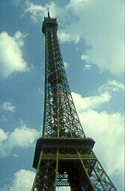
Structures
A struct is an object with named fields:
struct {
char *name;
int x, y;
int h, w;
} box;
Accessed using “dot” notation:
box.x = 5;
box.y = 2;

Slide 145
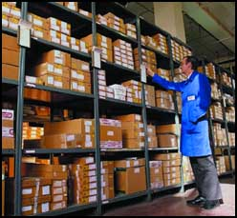
Struct bit-fields
Way to aggressively pack data in memory
struct {
unsigned int baud : 5;
unsigned int div2 : 1;
unsigned int use_external_clock : 1;
} flags;
Compiler will pack these fields into words
Very implementation dependent: no guarantees of ordering, packing, etc.
Usually less efficient
  Reading a field requires masking and shifting

Slide 146
Unions
Can store objects of different types at different times
union {
int ival;
float fval;
char *sval;
};
Useful for arrays of dissimilar objects
Potentially very dangerous
Good example of C’s philosophy
  Provide powerful mechanisms that can be abused

Slide 147
Alignment of data in structs
Most processors require n-byte objects to be in memory at address n*k
Side effect of wide memory busses
E.g., a 32-bit memory bus
Read from address 3 requires two accesses, shifting
1
4
3
2
4
3
2
1

Slide 148
Alignment of data in structs
Compilers add “padding” to structs to ensure proper alignment, especially for arrays
Pad to ensure alignment of largest object (with biggest requirement)
struct {
char a;
int b;
char c;
}
Moral: rearrange to save memory
a
b
b
b
b
c
Pad
a
b
b
b
b
c

Slide 149
Storage Classes

Slide 150
Storage Classes
Linker-visible. Allocated at fixed location
#include <stdlib.h>
int global_static;
static int file_static;
void foo(int auto_param)
{
static int func_static;
int auto_i, auto_a[10];
double *auto_d = malloc(sizeof(double)*5);
}
Visible within file. Allocated at fixed location.
Visible within func. Allocated at fixed location.

Slide 151
Storage Classes
#include <stdlib.h>
int global_static;
static int file_static;
void foo(int auto_param)
{
static int func_static;
int auto_i, auto_a[10];
double *auto_d = malloc(sizeof(double)*5);
}
Space allocated on stack by caller.
Space allocated on stack by function.
Space allocated on heap by library routine.

Slide 152
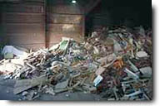
malloc() and free()
Library routines for managing the heap
int *a;
a = (int *) malloc(sizeof(int) * k);
a[5] = 3;
free(a);
Allocate and free arbitrary-sized chunks of memory in any order

Slide 153
malloc() and free()
More flexible than automatic variables (stacked)
More costly in time and space
  malloc() and free() use complicated non-constant-time algorithms
  Each block generally consumes two additional words of memory
    Pointer to next empty block
    Size of this block
Common source of errors
  Using uninitialized memory
  Using freed memory
  Not allocating enough
  Neglecting to free disused blocks (memory leaks)

Slide 154
malloc() and free()
Memory usage errors so pervasive, entire successful company (Pure Software) founded to sell tool to track them down
Purify tool inserts code that verifies each memory access
Reports accesses of uninitialized memory, unallocated memory, etc.
Publicly-available Electric Fence tool does something similar

Slide 155
Dynamic Storage Allocation
What are malloc() and free() actually doing?
Pool of memory segments:
Free
malloc(
)

Slide 156
Dynamic Storage Allocation
Rules:
  Each segment contiguous in memory (no holes)
  Segments do not move once allocated
malloc()
  Find memory area large enough for segment
  Mark that memory is allocated
free()
  Mark the segment as unallocated

Slide 157
Dynamic Storage Allocation
Three issues:
How to maintain information about free memory
The algorithm for locating a suitable block
The algorithm for freeing an allocated block

Slide 158
Simple Dynamic Storage Allocation
Three issues:
How to maintain information about free memory
  Linked list
The algorithm for locating a suitable block
  First-fit
The algorithm for freeing an allocated block
  Coalesce adjacent free blocks

Slide 159
Simple Dynamic Storage Allocation
First large-enough free block selected
Free block divided into two
Previous next pointer updated
Newly-allocated region begins with a size value
Next
Next
Size
Size
Size
Free block
Allocated block
malloc(
)

Slide 160
Simple Dynamic Storage Allocation
Appropriate position in free list identified
Newly-freed region added to adjacent free regions
free(a)

Slide 161
Dynamic Storage Allocation
Many, many variants
Other “fit” algorithms
Segregation of objects by sizes
  8-byte objects in one region, 16 in another, etc.
More intelligent list structures

Slide 162


Slide 163

References
Banahan, M.; Brady, D.; Doran, M. (1991). The C Book (2nd ed.). Addison-Wesley.
King, K. N. (April 2008). C Programming: A Modern Approach (2nd ed.). Norton. ISBN 978-0-393-97950-3.
Ritchie, Dennis M. (1993). "The Development of the C Language". The second ACM SIGPLAN History of Programming Languages Conference (HOPL-II) (ACM): 201–208. doi:10.1145/154766.155580 . ISBN 0-89791-570-4.
Thompson, Ken. A New C Compiler. Murray Hill, New Jersey: AT&T Bell Laboratories. Feuer, Alan R. (1998).
The C Puzzle Book (1st, revised printing ed.). Addison-Wesley. ISBN 978-0-201-60461-0.

