Slide 1
METAL FORMING
The process in which the desired shape and size are obtained through plastic deformation of the material.
Very economical process as the desired shape, size and finish can be obtained without significant loss of material.
Also improves the strength of the product through strain hardening.

Slide 2
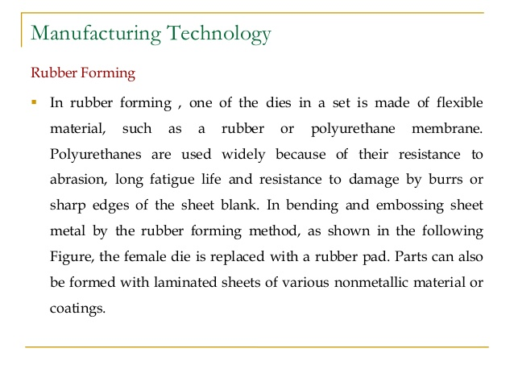
Rubber pad forming
Rubber pad forming (RPF) is a metalworking process where sheet metal is pressed between a die and a rubber block, made of polyurethane.

Slide 3
Under pressure, the rubber and sheet metal are driven into the die and conform to its shape, forming the part.
The rubber pads can have a general purpose shape, like a membrane. Alternatively, they can be machined in the shape of die or punch.
Due to the material properties of the rubber, the pad will regain its original shape when retracted from the tool.

Slide 4
Rubber pad forming can be accomplished in many different ways.
In general, an elastic upper die, usually made of rubber, is connected to a hydraulic press.
A rigid lower die, often called a form block, provides the mold for the sheeted metal to be formed.
The rubber exerts nearly equal pressure on all work piece surfaces due to its incompressibility.
The multidirectional nature of the force from the rubber pad produces variable radius during forming and thus enhances uniform elongation of the work piece.

Slide 5
Types of Rubber pad forming processes
Guerin process
Marform deep drawing process
Verson Hydroform process
Masleennikov’s process

Slide 6
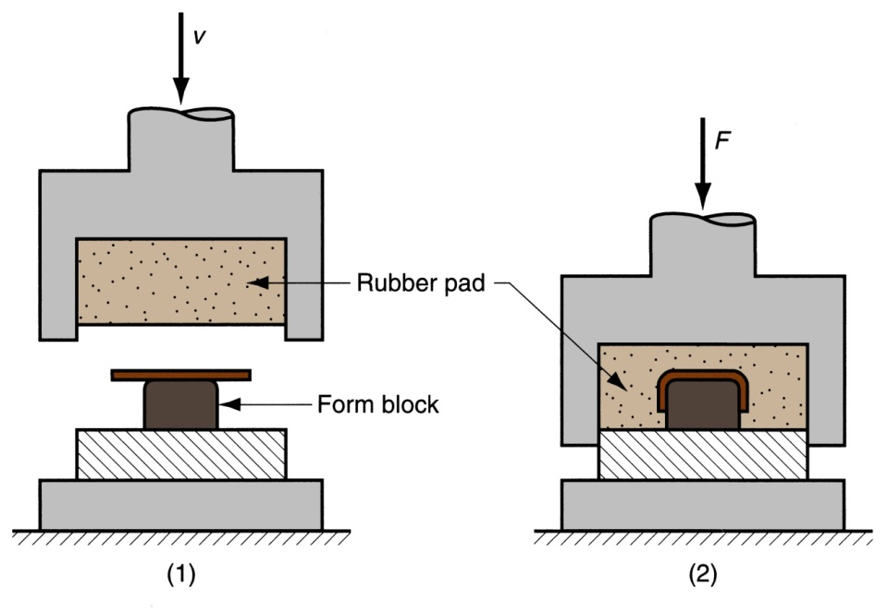
Guerin process
Oldest and simplest rubber pad forming process.
Aluminum alloys, Austenitic Stainless Steels and titanium alloys can be shallow drawn using this process.
As the ram descends, the rubber presses the blank around the form block, thus forming the work piece.
The rubber-pad retainer fits closely around the platen, forming an enclosure that traps the rubber as pressure is applied.
The pressure produced in the Guerin process is ordinarily between 6.9 and 48 MPa.

Slide 7
Guerin process
This process is however limited to forming moderately shallow, recessed parts, having simple flanges and having simple configuration due to lower strength of rubber.

Slide 8
Guerin Process
Advantages of Guerin Process
Low tooling cost
Form block can be made of wood, plastic, or other materials that are easy to shape
Rubber pad can be used with different form blocks
Process attractive in small quantity production

Slide 9
Marform process
In Marform process, deep-recessed parts with either vertical or sloped walls can be formed.
Compared with Guerin process, tooling includes a steel blank holder supported
by a hydraulic actuator equipped with a valve controlling pressure.

Slide 10
Verson Hydro form process
In this process, hydraulic pressure under control would act on rubber membrane covering the blank.
Verson Hydroform process is different than other processes in the sense that it contains the die cavity which is partially filled with hydraulic fluid.
The forming pressure is balanced by fluid pressure.
More severe draws can be made by this method than in conventional draw dies because the oil pressure against the diaphragm causes the metal to be held tightly against the sides as well as against the top of the punch.

Slide 11
Maslennikov’s process
In 1957, Masennikov introduced a punch less drawing technique using annular technique.
It is a deep drawing technique that uses annular rubber pad to draw very deep cups.
The punch squeezes the rubber ring and makes it deform radially inward.
It develops a radial frictional force between the rubber ring and the blank and causes the blank to draw inside the die cavity.

Slide 12
ADVANTAGES
Because the upper (male) die can be used with separate lower (female) dies, the process is relatively cheap and flexible.
Due to low hardness of the rubber pad, the worked metal is not worn as quickly as in more conventional processes such as deep drawing.
The great advantage is that only one tool is needed, the rubber takes over the function of the counter die and the blank holder.
This results in low tooling costs, a short time to market and minimal damage of the material surface.

Slide 13
LIMITATIONS
Since the amount of pressure exerted by rubber is limited by the strength of rubber itself, forming of sheet metal parts with small forming radius may not be possible.
The wear of the rubber is an issue in larger quantity manufacturing.
Lower forming pressure and consequently large amount of wrinkles.
Low production rate

Slide 14
APPLICATIONS
Rubber pad forming has been used in production lines for many years.
Up to 60% of all sheet metal parts in the aerospace industry are fabricated using this process.
The most relevant applications are aerospace, automotive and defense fields.
It is frequently used in prototyping and production of small quantities of sheet metal parts.

