Slide 1
Entrepreneurship Development
SMALL SCALE INDUSTRY

Slide 2
Functions of Entrepreneurs
Idea generation
Determination of Objectives (nature & type of business)
Raising of funds
Procurement of raw materials
Procurement of machinery
Market research
Determination of form of enterprise
Recruitment of Manpower
Implementation of the project

Slide 3
Stages for setting up Small Scale Unit
Decision to be self-employment
Identification of opportunities
Idea generation
Screening product / service idea
Concept testing
Selection of the line of business
Business Analysis

Slide 4
Stages for setting up Small Scale Unit
Selection of Product (Product Development)
Selection of Site (Location)
Purchase / lease of land / shed in industrial estate
Development of plot
Building the factory
Selection of ownership form
Preparation of the project report

Slide 5
Business Analysis
Market Analysis
Technical Analysis
Financial Analysis
Economic Analysis
Market and Demand Analysis

Slide 6
Market Analysis
Demand estimation, analysis, factors affecting demand
Derived and autonomous demand
Forecasting methods
Marketing methods
Marketing feasibility
Market research

Slide 7
Technical Analysis
Proper location of the unit
Proper size of the plant
Suitable process of manufacture
Factory layout
Organizational set-up

Slide 8
Financial Analysis
Fixed assets of units
Requirement of working capital
Manufacturing cost of the product
Source of finance
Repayment schedule
Profitability and productions statements
Cash flow statements
Break-even point
ROI in each year

Slide 9
Economic Analysis
Social cost benefit analysis
Economic benefits and costs measured in terms of efficiency, impact project on distribution of income in society, level of saving and investment in society.
Contribution of project towards fulfillment of merit wants, e.g., employment, self-sufficiency, social orders

Slide 10
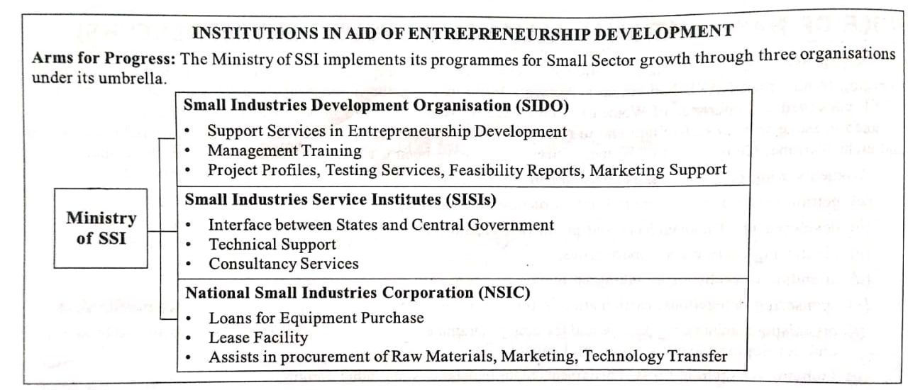
Institutions in Aid of Entrepreneurship Development

