Slide 1
Hydroforming
Hydroforming is a specialized type of die forming that uses a high pressure hydraulic fluid to press room temperature working material into a die.
It allows complex shapes with concavities to be formed, which would be difficult or impossible with standard solid die stamping.
Metals capable of hydroformed, including aluminum, brass, carbon and stainless steel, copper, and high strength alloys.

Slide 4
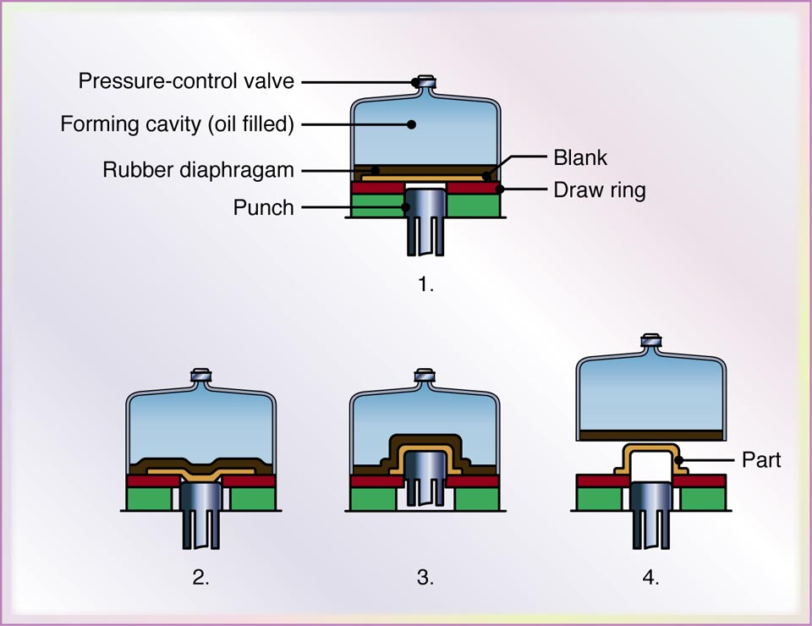
Hydro form Process
The first step is forming a punch in the shape of the desired part.
The metal blank is then placed onto a ring, located on top of the punch.
A hydraulic chamber is then closed over the sheet metal blank and fluid pressure is applied to the top side of the unit.

Slide 5
At the same time, the punch is pushed up into the blank and the pressure is increased.
As a result, the pressure causes the blank to form and take the shape of the punch.
In contrast to the ordinary deep-drawing process, the pressure in the dome forces the cup walls against the punch.
The cup travels with the punch; in this way, deep drawability is improved.

Slide 6
Complex shapes: This process allows us to form complex shapes with concavities that would be nearly impossible to create with traditional die stamping methods.
No need of pressure testing or X-ray: Hydroformed metal parts are made from one piece of sheet metal, the results are seamless, so there's no need for additional pressure testing or X-rays.
Less Expensive: The hydroforming process is also less expensive than other metal forming methods, such as deep drawing, when producing small quantities.

Slide 8
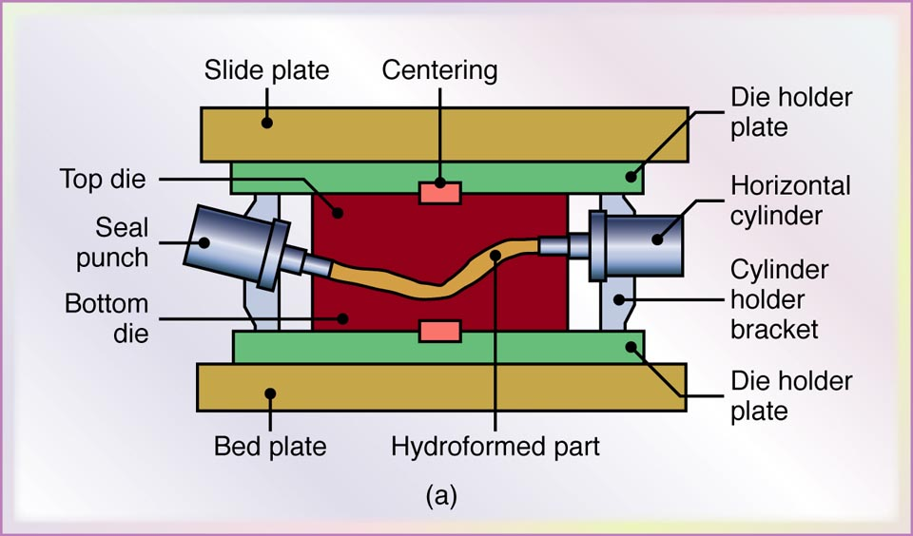
Tube-Hydroforming
Automotive exhaust and structural components, bicycle frames, and hydraulic and pneumatic fittings are produced through tube hydroforming.

