Slide 1
Series Compensation
Series compensation is basically a powerful tool to improve the performance of EHV lines.
It consists of capacitors connected in series with the line at suitable locations.

Slide 4
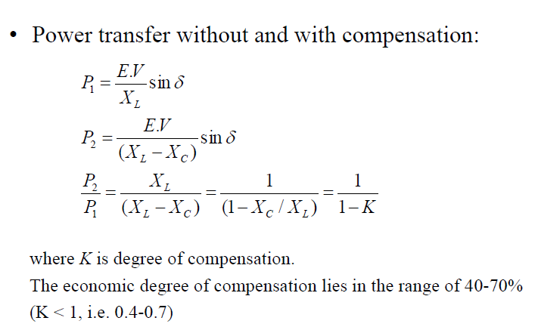

Slide 9
OBJECTIVES OF SERIES COMPENSATION
The basic idea behind series capacitive compensation is to decrease the overall effective series transmission impedance from the sending end to the receiving end,
i.e., X in the P : (V ² / X) Sin ȿ
relationship characterizing the power transmission over a single line.

Slide 10
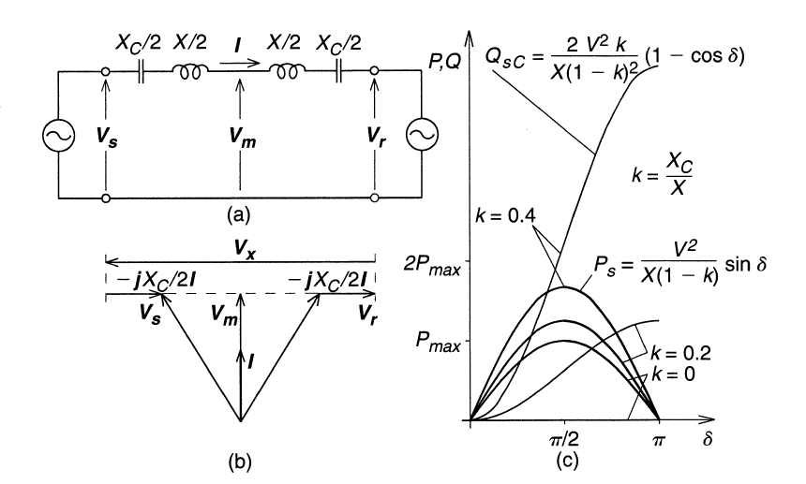

Slide 11
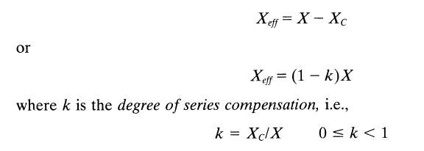
Vs=Vr=V

Slide 12
The transmittable power rapidly increases with the degree of series compensation k . Similarly, the reactive power supplied by the series capacitor also increases sharply with k and varies with angle ȿ in a similar manner as the line reactive power.

Slide 13
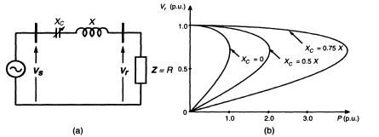
VOLTAGE STABILITY:
Series capacitive compensation can also be used to reduce the series reactive impedance to minimize the receiving-end voltage variation and the possibility of voltage collapse.
Clearly, both shunt and series capacitive compensation can effectively increase the voltage stability limit. Shunt compensation does it by supplying the reactive load demand and regulating the terminal voltage. Series capacitive compensation does it.

Slide 14
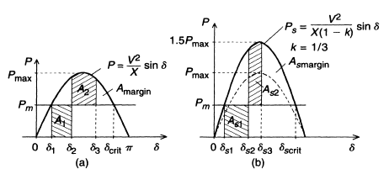
IMPROVEMENT OF TRANSIENT STABILITY:
The powerful capability of series line compensation is to control the transmitted power can be utilized much more effectively to increase the transient stability limit and to provide power oscillation damping. The equal area criterion, to investigate the capability of the ideal shunt compensator to improve the transient stability, is used again here to assess the relative increase of the transient stability margin attainable by series capacitive compensation.

Slide 15
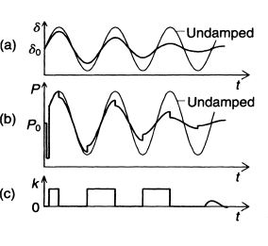
POWER OSCILLATION DAMPING:
Controlled series compensation can be applied effectively to damp power oscillations, for power oscillation damping it is necessary to vary the applied compensation so as to counteract the accelerating and decelerating swings of the disturbed machine(s). That is, when the rotationally oscillating generator accelerates and angle δ increases (dδ/dt > 0), the electric power transmitted must be increased to compensate for the excess mechanical input power. Conversely, when the generator decelerates and angle δ decreases (dδ/dt < 0), the electric power must be decreased to balance the insufficient mechanical input power.

Slide 16
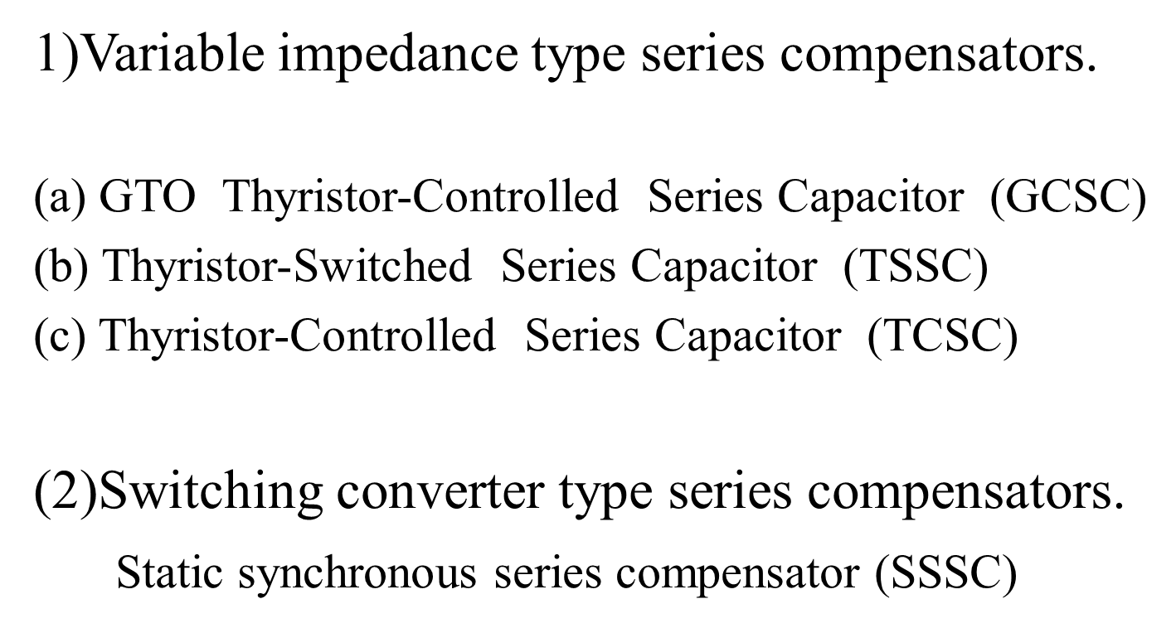
Types of Series Compensators

Slide 18
A capacitor is inserted by turning off Thyristor Valve
And It is bypassed by turning on the corresponding thyristor valve.

Slide 20
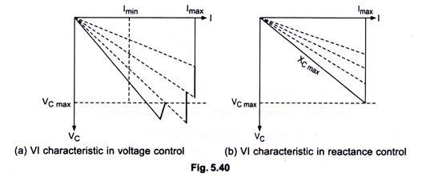
Basic VI characteristic with is series connected components are as follows:
In voltage control mode, capacitive banks are progressively by passed by the thyristor valves to reduce the overall capacitive reactance in a step like manner, as the current is increased from I_{min} to I_{max}. Thus it maintains a compensating voltage with increased line current.
In Impedance compensation mode, TSSC is applied to maintain the maximum rated compensating reactance at any line current upto the rated maximum. In practice, TSSC is operated with a current limiting reactor in series.

Slide 21
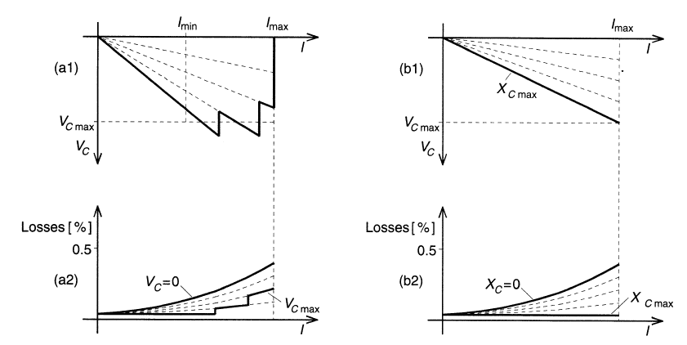

Slide 22
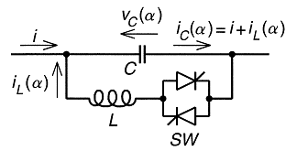
Thyristor-Controlled Series Capacitor (TCSC)
It consists of the series compensating capacitor shunted by a TCR. In a practical TCSC implementation, several such basic compensators may be connected in series to obtain the desired voltage rating and operating characteristics. This arrangement is similar in structure to the TSSC and, if the impedance of the reactor, X_{L}, is sufficiently smaller than that of the capacitor, X_{C}, it can be operated in an on/off manner like the TSSC.
Basic TCSC Scheme

Slide 23
The TCSC concept is that capacitor is inserted directly
in series with the transmission line and the thyristor
controlled inductor is mounted directly in parallel
with the capacitor.
Thus no interfacing equipment like high voltage
transformer is required.
So TCSC is more economic than some other challenging FACTS technologies.

Slide 24
TCSC plays vital roles in the operation and control of power systems such as
1. Enhancing power flow
2. limiting fault current
3. Enhancing transient
4. Dynamic stability
Uses of TCSC
Increases power transmission capability
Improves system stability
Reduces system losses
Improves voltage profile of the lines

Slide 25
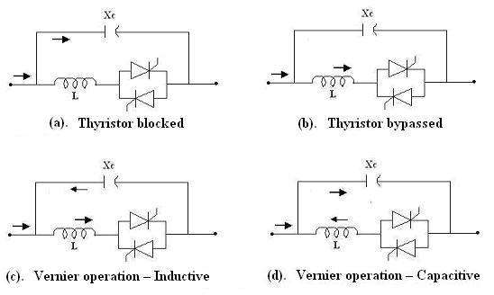
Operating modes of TCSC
1. Blocking mode
2. Bypass mode
3. Capacitive boost mode(Capacitive Vernier mode)
4. Inductive boost mode(Inductive vernier mode)

Slide 26
However, the basic idea behind the TCSC scheme is to provide a continuously variable capacitor by means of partially canceling the effective compensating capacitance by the TCR.

Slide 27
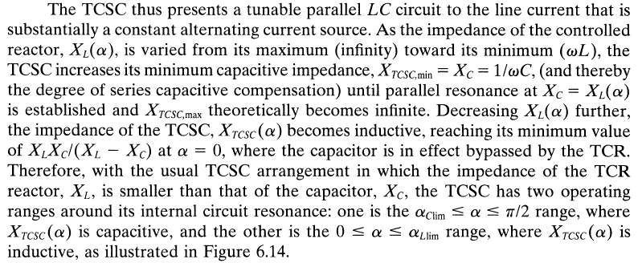

Slide 28
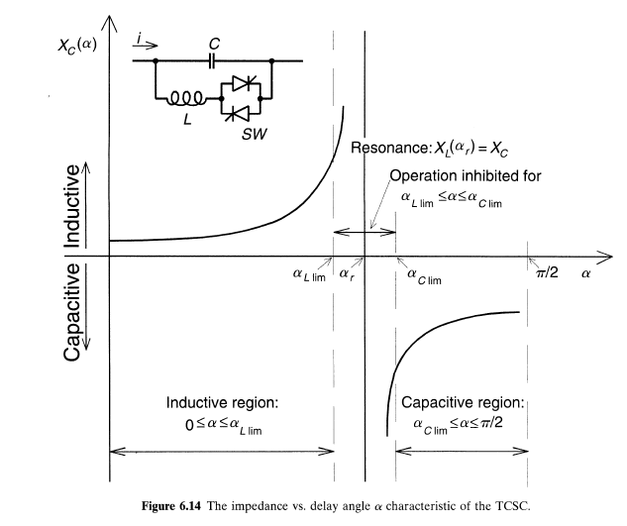
CHARACTERISTICS OF TCSC:
Below Figure shows the characteristics of TCSC. α is the delay angle measured from the crest of the capacitor voltage or equivalently, the zero crossing of the line current. Therefore, with the usual TCSC arrangement in which the impedance of the TCR reactor X_{L} is smaller than that of the capacitor, X_{C}, the TCSC has two operating ranges around its internal circuit resonance.

Slide 29
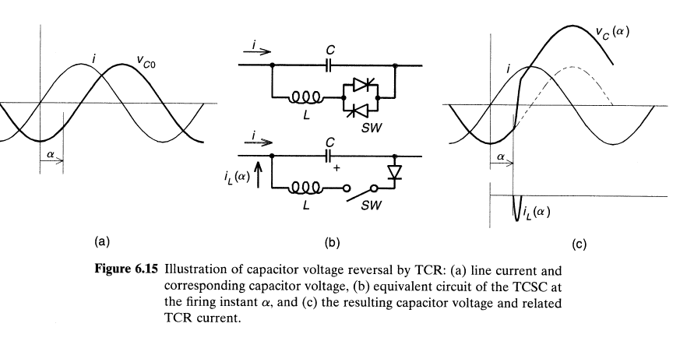

Slide 30
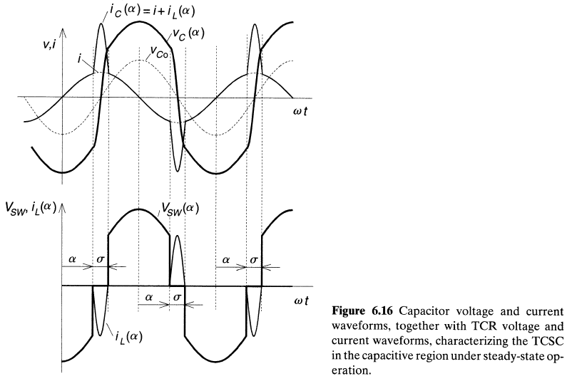

Slide 31
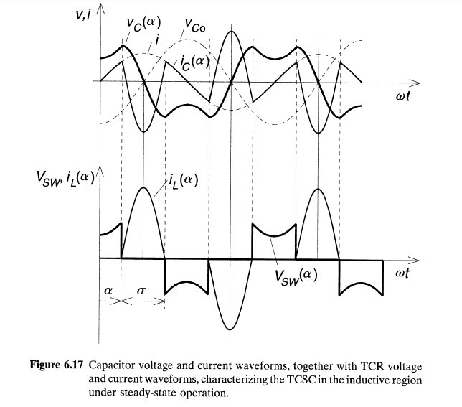

Slide 32
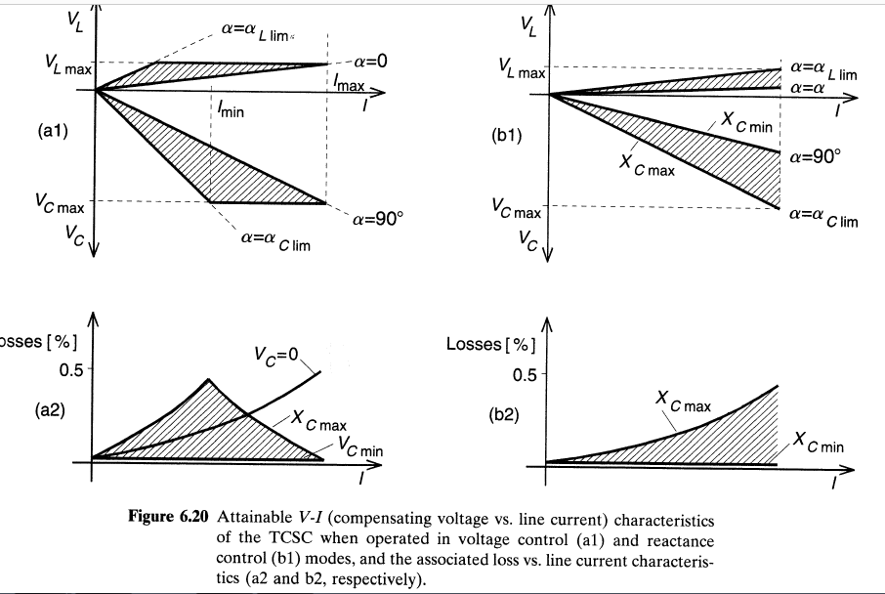

Slide 33
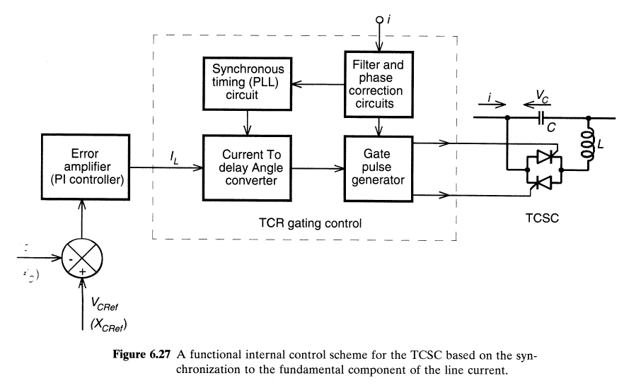
CONTROL SCHEMES of TCSC

Slide 34
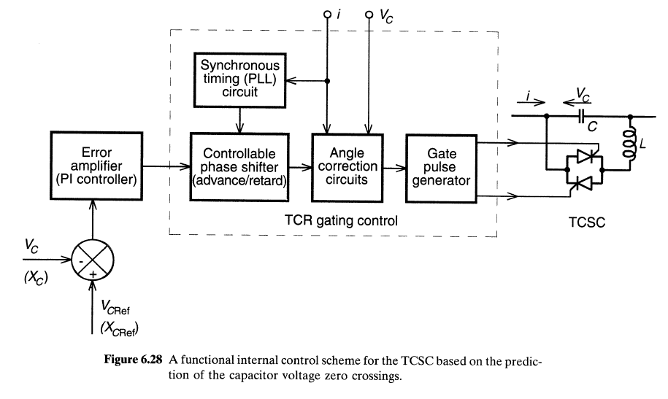

Slide 35
Advantages of TCSC
Increase power transmission capability
Improve system stability
Reduce system losses
Improve voltage profile of the lines
Optimize power flow between parallel lines
Damping of the power swings from local and inter area
oscillations
Application of TCSC
Accurately regulating the power flow on a transmission line
Damping inter area power oscillations
Mitigating sub-synchronous resonance (SSR)
Improving transient stability

Slide 36
Static Synchronous Series Compensator (SSSC)
The SSSC is one of the most recent FACTS devices for power transmission series compensation. It can be considered as a synchronous voltage source as it can inject an almost sinusoidal voltage of variable and controllable amplitude and phase angle, in series with a transmission line. The injected voltage is almost in quadrature with the line current. A small part of the injected voltage that is in phase with the line current provides the losses in the inverter.
Most of the injected voltage, which is in quadrature with the line current, provides the effect of inserting an inductive or capacitive reactance in series with the transmission line. The variable reactance influences the electric power flow in the transmission line.

Slide 37
Voltage sourced converter based series compensator is called static synchronous series compensator (SSSC)
Basic Operating Principle:
It can be explained with reference to conventional series capacitive compensator.
SSSC can provide capacitive or inductive compensatory voltage independent of the line current upto its specified current rating in voltage control mode.
In reactance control mode, SSSC is established to maintain the maximum rated capacitive or compensating reactance at any line current upto rated maximum. The basic configuration of a SSSC is shown in Fig.

Slide 38
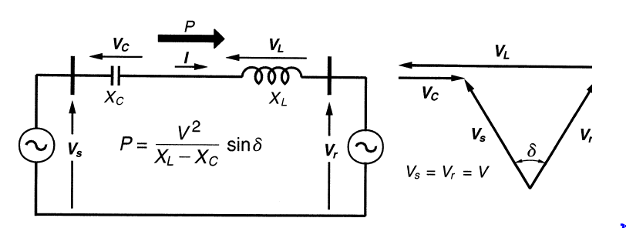
Basic two-machine system with a series capacitor compensated line and associated phasor diagram.

Slide 39
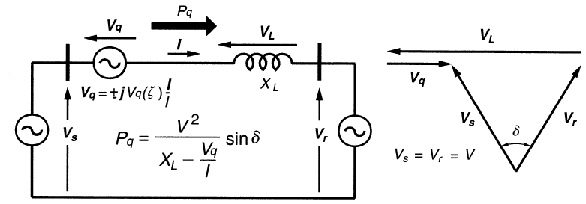
With synchronous voltage source replacing the series capacitor

Slide 40
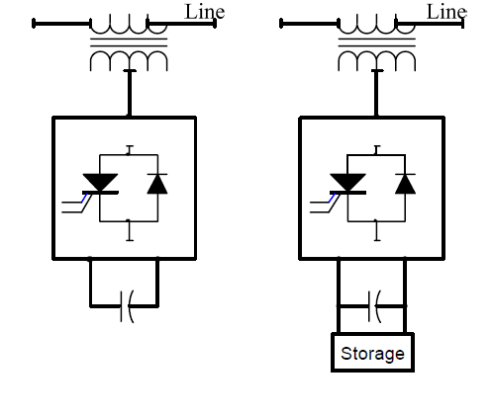
SSSC (a)WITH OUT STORAGE and (b)WITH STORAGE

Slide 41
A Static Synchronous Series Compensator operated without an external energy source as Reactive Power with output voltage is in quadrature with and fully controllable independently of the transmission line current for the purpose of increasing or decreasing the overall reactive voltage drop across the transmission line and thereby controlling the electric power flow.
The SSSC FACTS device can provide either capacitive or inductive injected voltage compensation.
If SSSC-AC injected voltage (Vs), lags the line current IL by 90º, a capacitive series voltage compensation is obtained in the transmission line and
If leads IL by 90º, an inductive series compensation is achieved.

Slide 42
Theory of the SSSC
Figure shows a single line diagram of a simple Transmission line with an inductive transmission reactance, XL, connecting a sending end voltage source, and a receiving end voltage source, respectively.

Slide 43
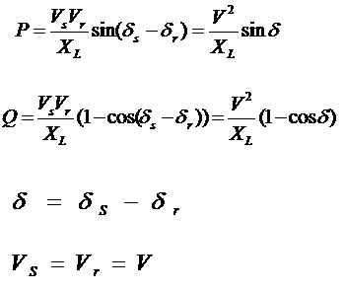

Slide 44
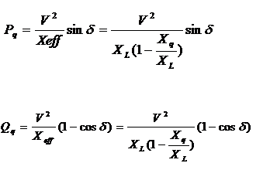
The expression of power flow is given by

Slide 45
Where Xeff is the effective total transmission line reactance between its sending and Receiving power system ends, including the equivalent “variable reactance” inserted by the equivalent injected voltage (Vs) (Buck or Boost) by the SSSC-FACTS Compensator.

Slide 46
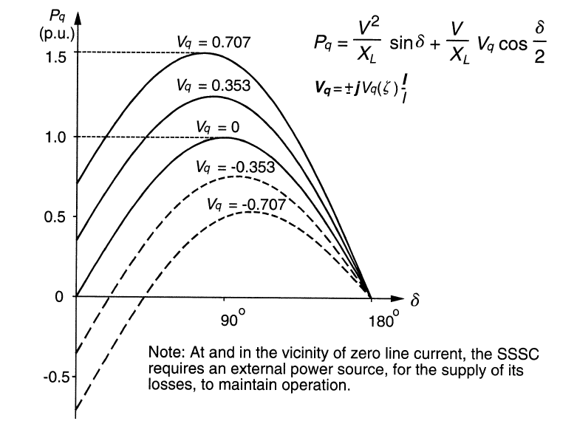
Transmitted Power Versus Transmission Angle Characteristic

Slide 47
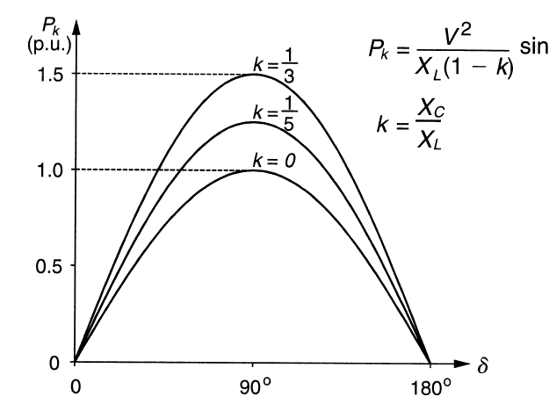
Transmitted Power vs. Transmission angle attainable with series capacitive
compensation as a parametric function of the degree of series compensation

Slide 48
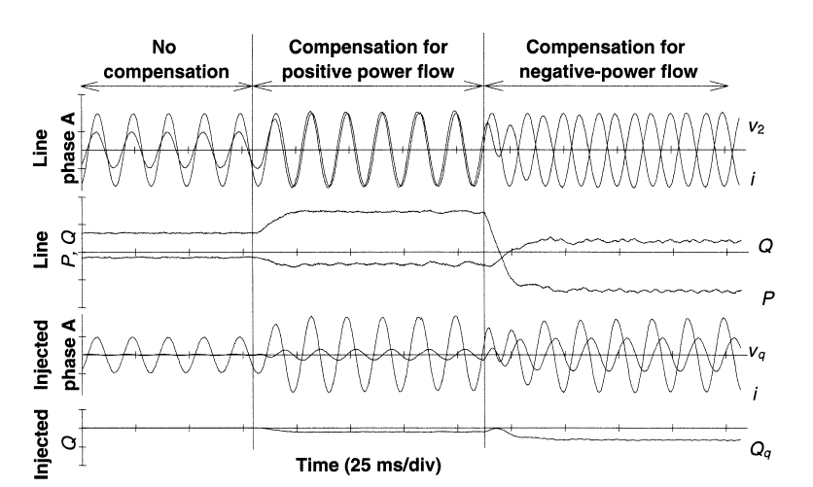
SSSC provides bidirectional Power flow Compensation

Slide 49
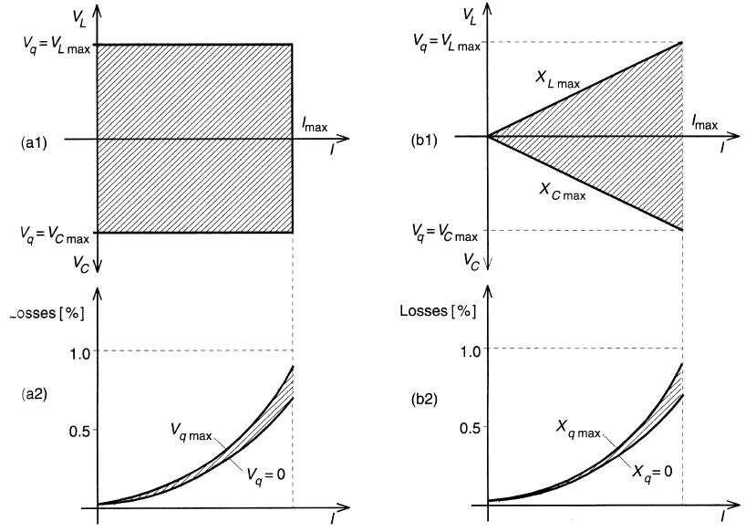

Slide 50
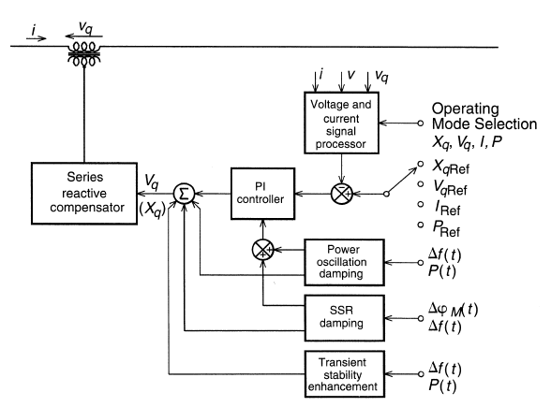
EXTERNAL (SYSTEM) CONTROL

Slide 51
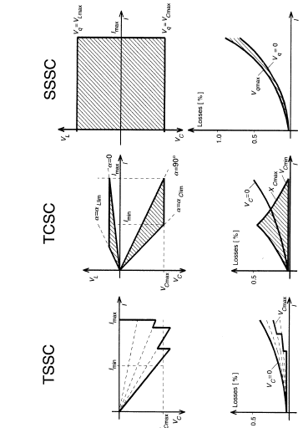
Comparison of V-I Characteristics of Series Compensators

