Slide 1
Conventional Tubes
Conventional Device tubes cannot be used for frequencies above 100MHz
High Frequency Limitations of Conventional Tubes:
1. Circuit reactance
i) Inter electrode capacitance
ii) Lead Inductance effects
2. Transit time effect
3. Gain Bandwidth limitation
4. Effect of RF losses (Conductance, dielectric)
5. Effect due to radiation losses

Slide 2
Generation and amplification of Microwaves, there is a need of some special tubes called as Microwave tubes. Of them all, Klystron is an important one.
Two groups of microwave devices
i) Semiconductor devices
Ex: Gunn Diode, Impatt diode, Schottky diode, Tunnel diode, Varacter diode, Transistors, IC’s.
ii) Tube devices
Ex: Klystron, Reflex Klystron,TWT,BWO
Efficient Microwave tubes usually operate on the theory of electron velocity modulation concept.
The electron transit time is used in the conversion of dc power to RF power.
There are two basic configurations of klystron tubes
1. Reflex Klystron used as a low-power Microwave oscillator.
2. Two/Multi cavity klystron used as low-power microwave amplifier.

Slide 4
KLYSTRONS
The essential elements of Klystron are electron beams and cavity resonators.
Electron beams are produced from a source and the cavity klystrons are employed to amplify the signals.
A collector is present at the end to collect the electrons.

Slide 5
Velocity Modulation
Electric field from microwaves at buncher alternately speeds and slows electron beam
This causes electrons to bunch up
Electron bunches at catcher induce microwaves with more energy
The cavities form a slow-wave structure

Slide 7
Principle
Velocity modulated tube
High velocity electron beam is generated by an electron gun and sent down along a gas tube through an input cavity (BUNCHER), drift space (FIELD FREE) and an output cavity (CATCHER) to a collector electrode anode.
The anode is kept positive to receive the electrons, while the output is taken from the tube via resonant cavities with the aid of coupling loops.
Two grids of the buncher cavity are separated by a small gap A while the two grids of the catcher cavity are separated by a small gap B.

Slide 8
OPERATION
The input buncher cavity is exited by the RF signal, (the signal to be amplified) which will produce an alternating voltage of signal frequency across the gap A.
This voltage generated at the gap A is responsible to produce bunching of electrons or velocity modulation of the electron beam.

Slide 9
Applegate Diagram

Slide 10
CHARACTERISTICS
Frequency : 250 MHz to 100 GHz
Power: 10 Kw-500 Kw (CW)
30 Mw (pulsed)
Power Gain: 15 dB – 70 dB (60 dB normal)
Bandwidth: limited
Noise figure: 15 – 20 dB
Efficiency: 58%

Slide 12
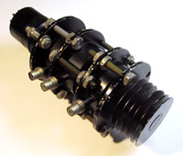
Multicavity Klystron

Slide 13
REFLEX KLYSTRON

Slide 17
REFLEX KLYSTRON
Single Re-entrant cavity as a resonator.
The electron beam emitted from the cathode is accelerated by the grid and passes through the cavity anode to the repeller space between the cavity anode and the repeller electrode .
The feedback required to maintain the oscillations within the cavity is obtained by reversing electron beam emitted from the cathode towards repeller electrode and sending it back through the cavity.
The electrons in the beam are velocity modulated before the beam passes through the cavity the second time and give up the energy to the cavity to maintain oscillations.
This type of a Klystron is called a Reflex Klystron because of the reflex action of the electron beam.

Slide 18
CHARACTERISTICS
Frequency : 4 GHz to 200 GHz
Power: 1mw to 2.5 w
Theoritical Efficiency: 22.78%
Practical Efficiency: 10% to 20%
Tuning Range: 5 GHz to 30 GHz

Slide 20
REFLEX KLYSTRON

Slide 21
TRAVELLING WAVE TUBE (TWT)
Traveling Wave Tube (TWT) is the most versatile
microwave RF power amplifiers.
The main virtue of the TWT is its extremely wide
band width of operation.
TWT’s are broadband devices in which there are no cavity resonators.

Slide 31
BACK WARD WAVE OSCILLATOR (BWO)

Slide 32
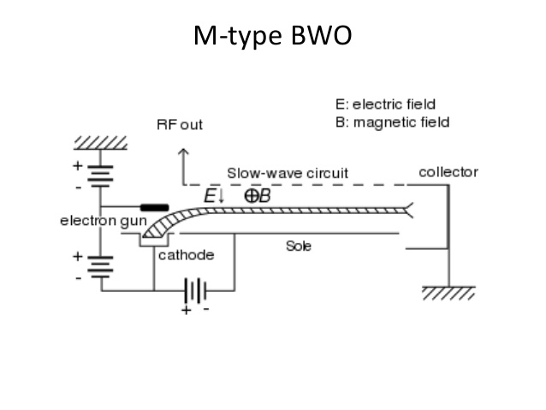

Slide 35
CHARACTERISTICS OF BWO
Frequency Range: 1 GHz to 1000 GHz
Power Output: 10 mw to 150 mw (CW)
20 W (at high frequencies)
250 kw (pulsed)
Tuning Range: upto about 40 GHz

Slide 36
APPLICATIONS OF BWO
Signal sources in instruments and transmitters
Broad band noise sources (for enemy radar
confusion)
A noiseless oscillator with good bandwidth in the frequency range 3-9 GHz.

Slide 40
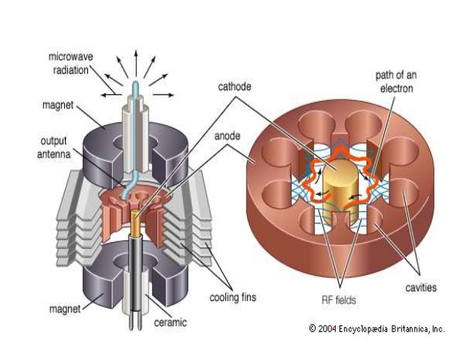

Slide 43
Voltage tunable magnetrons are used in sweep oscillators in telemetry and in missile applications
Fixed frequency, CW (continuous wave) magnetrons are used for industrial heating and microwave ovens

