Slide 1
UNIT-IV ROBOT VISION

Slide 2
Robot vision

Slide 3
Robot vision

Slide 4
Robot vision

Slide 5
Robot vision

Slide 6
Robot vision

Slide 7
Robot vision

Slide 8
Robot vision

Slide 9
Robot vision

Slide 10
Robot vision

Slide 11
Robot vision

Slide 12
IMAGE PROCESSSING AND ANALYSIS
Consider a vision system having a pixel density of 350 pixels per line and 280 lines(total of 98000 picture elements).
A 6-bit register for each pixel element to represent various gray levels.
This would require a total of 98000*6=588000 bits of data for each 1/30 sec.
So large amount of data to be processed in short period of time.
This led to various techniques to reduce the magnitude of the image processing problem.

Slide 13
IMAGE PROCESSSING AND ANALYSIS
Image data reduction
Segmentation
Feature extraction
Object recognition

Slide 14
Image data reduction
Objective is to reduce the volume of data.
Two schemes have been found
Digital conversion
Windowing
Digital conversion reduces the number of gray levels used by the machine vision system.
A 8-bit register used for each pixel would have 2⁸ =256 gray levels
Digital conversion can be used to reduce the number of gray levels.
Four bits would reduce the number of gray levels to 16.

Slide 15
Image data reduction
Windowing involves using only a portion of the total image stored in the frame buffer for image processing and analysis.
This portion is called the window.
A rectangular window is selected to surround the component of interest and only the pixels within the window are analysed.
The rationale of the window is proper recognition of an object requires only certain portions of the total scene.

Slide 16
SEGMENTATION
Segmentation is a general term which applies to various methods of data reduction.
Objective is to group areas of an image having similar characteristics in to distinct entities representing parts of the image.
For example boundaries(edges) or regions(areas)represent two natural segments of an image.

Slide 17
SEGMENTATION
Three important techniques to segment an image are
Thresholding
Region growing
Edge detection

Slide 18
Thresholding
Thresholding is a binary conversion technique in which each pixel is converted in to a binary value, either black or white.
This is done by establishing a frequency histogram of the image and establishing what intensity(grey level) should be the border between black and white.
The histogram plots the frequency(the number of pixels) versus grey for the image.
Since we are trying to differentiate between the object and the background the procedure is to establish a threshold and assign, for example, a binary bit one for the object and 0 for the background.
when it is not possible to find a single threshold for an entire image for example if many different objects occupy the same scene each having different levels of intensity one approach is to partition the total image into small rectangular areas and determine the threshold for each window being analysed

Slide 19
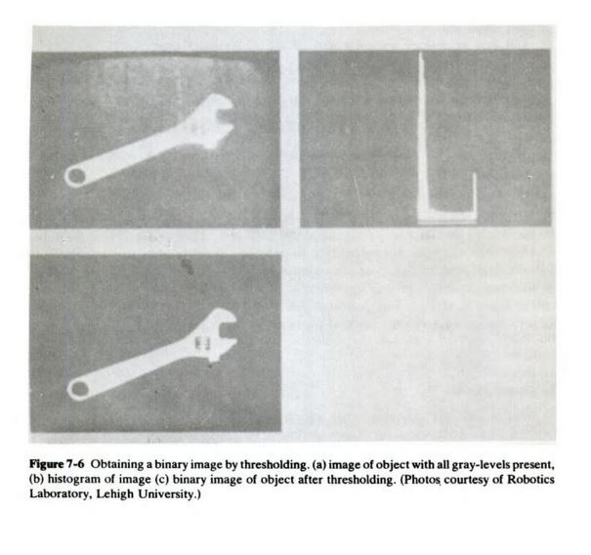
Thresholding

Slide 20
REGION GROWING
Region growing is a collection of segmentation techniques in which pixels are grouped in to regions called grid elements based on attribute similarities.
Defined regions can then be examined as to whether they are independent or can be merged to other regions by means of an analysis of the difference in their average properties and spatial connectiveness.
To differentiate between the object and the background assign one for any grid element occupied by an object and 0 for background elements

Slide 23
Edge detection
Edge detection considers the intensity change that occurs in the pixels at the boundary or edges of a part.
Given that a region of similar attributes has been found but the boundary shape is unknown, the boundary can be determined by a simple edge following procedure.
For the binary image the procedure is to scan the image until a pixel within the region is encountered.
For a pixel within the region turn left and step otherwise turn right and step.
The procedure is stopped when the boundary is traversed and the path has returned to the starting pixel.

Slide 24
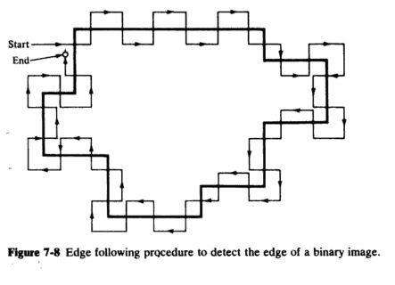
Edge detection

Slide 25
Feature extraction
In machine vision applications it is necessary to distinguish one object from another.
This is accomplished by means of features that uniquely characterize the object.
Features of objects that can be used in machine vision include area, diameter and perimeter.
A feature is a single parameter that permits ease of comparison and identification.
The techniques available to extract feature values for two dimensional cases can be roughly categorised as those that deal with boundary features and those that deal with area features
The various features can be used to identify the object or part and determine the part location or orientation.

