Slide 1
UNIT-V
DISASTER RISK MANAGEMENT IN INDIA

Slide 2
India is vulnerable, in varying degrees, to a large number of disasters.
More than 58.6 per cent of the landmass is prone to earthquakes of moderate to very high intensity;
over 40 million hectares (12%) of its land is prone to floods and river erosion;
close to 5,700 kms, out of the 7,516 kms long coastline is prone to cyclones and tsunamis;
68% of its cultivable area is vulnerable to droughts; and,
its hilly areas are at risk from landslides and avalanches. Moreover,
India is also vulnerable to Chemical, Biological, Radiological and Nuclear (CBRN) emergencies and other man-made disasters.

Slide 3
Disaster risks in India are further compounded by increasing vulnerabilities related to changing demographics and socio-economic conditions, unplanned urbanization, development within high-risk zones, environmental degradation, climate change, geological hazards, epidemics and pandemics.
Clearly, all these contribute to a situation where disasters seriously threaten India’s economy, its population and sustainable development.

Slide 4
Components of Disaster relief
Relief refers to the provision of essential, appropriate and timely humanitarian assistance to those affected by a disaster, based on an initial rapid assessment of needs and designed to contribute effectively and speedily to their early recovery.

Slide 5
Red Cross or Red Crescent National Societies through their presence in the communities are the front line providers of relief.
The International Federation brings all its resources together to ensure relief is provided as rapidly as possible.

Slide 6
Food
Food supplies are frequently part of the Red Cross/Red Crescent response to emergencies.
food supply is a correct response
it is necessary to ensure that food donations are culturally and nutritionally appropriate for the affected population
costs of their purchase, transportation, storage and distribution is kept to a minimum.

Slide 7
Three main types of food assistance
Short-term assistance - need for short-term food relief, rapidly followed by rehabilitation and development activities, is typical of many “sudden” disasters, including floods, earthquakes, high winds, fires, pest attacks, short-term civil disturbances etc.

Slide 8
Deferred assistance. Assistance deferred – until just before the next harvest, for example –events which have destroyed crops or food stocks,

Slide 9
Long-term assistance - assistance is provided over a long period and combines both relief and self-reliance development activities.
due to successive crop failures and most situations involving refugees or displaced people.

Slide 10
Shelter
necessary for security and personal safety, protection from the elements and resistance to ill health and disease.
Shelter assistance is provided to individual households for the repair or construction of dwellings or the settlement of displaced households within existing accommodation or communities.
When it is not possible to provide individual shelter, collective shelter is provided in suitable large public buildings or structures, such as warehouses, halls or barracks, or in temporary planned or self-settled camps.

Slide 11
Non-food items
When people have lost everything in a disaster, they require basic and culturally appropriate goods and supplies to maintain their health, privacy and dignity, to meet their personal hygiene needs, to prepare and eat food and to achieve necessary levels of thermal comfort.
These might include clothing, blankets, bedding, stoves and kitchen sets, water containers and hygiene products.

Slide 12
STAKEHOLDERS IN DISASTER MANAGEMENT
stakeholders are the institutions, agencies, organizations, communities and individuals involved in the task of disaster management.

Slide 13
Who are the stakeholders in disaster management in India?
Government Institutions/Agencies
National Disaster Response Force
Armed Forces
Police
Fire Services
Communities at Risk
Corporate Sector and Market Associations
Media
Donors, including the UN and other International Agencies

Slide 14
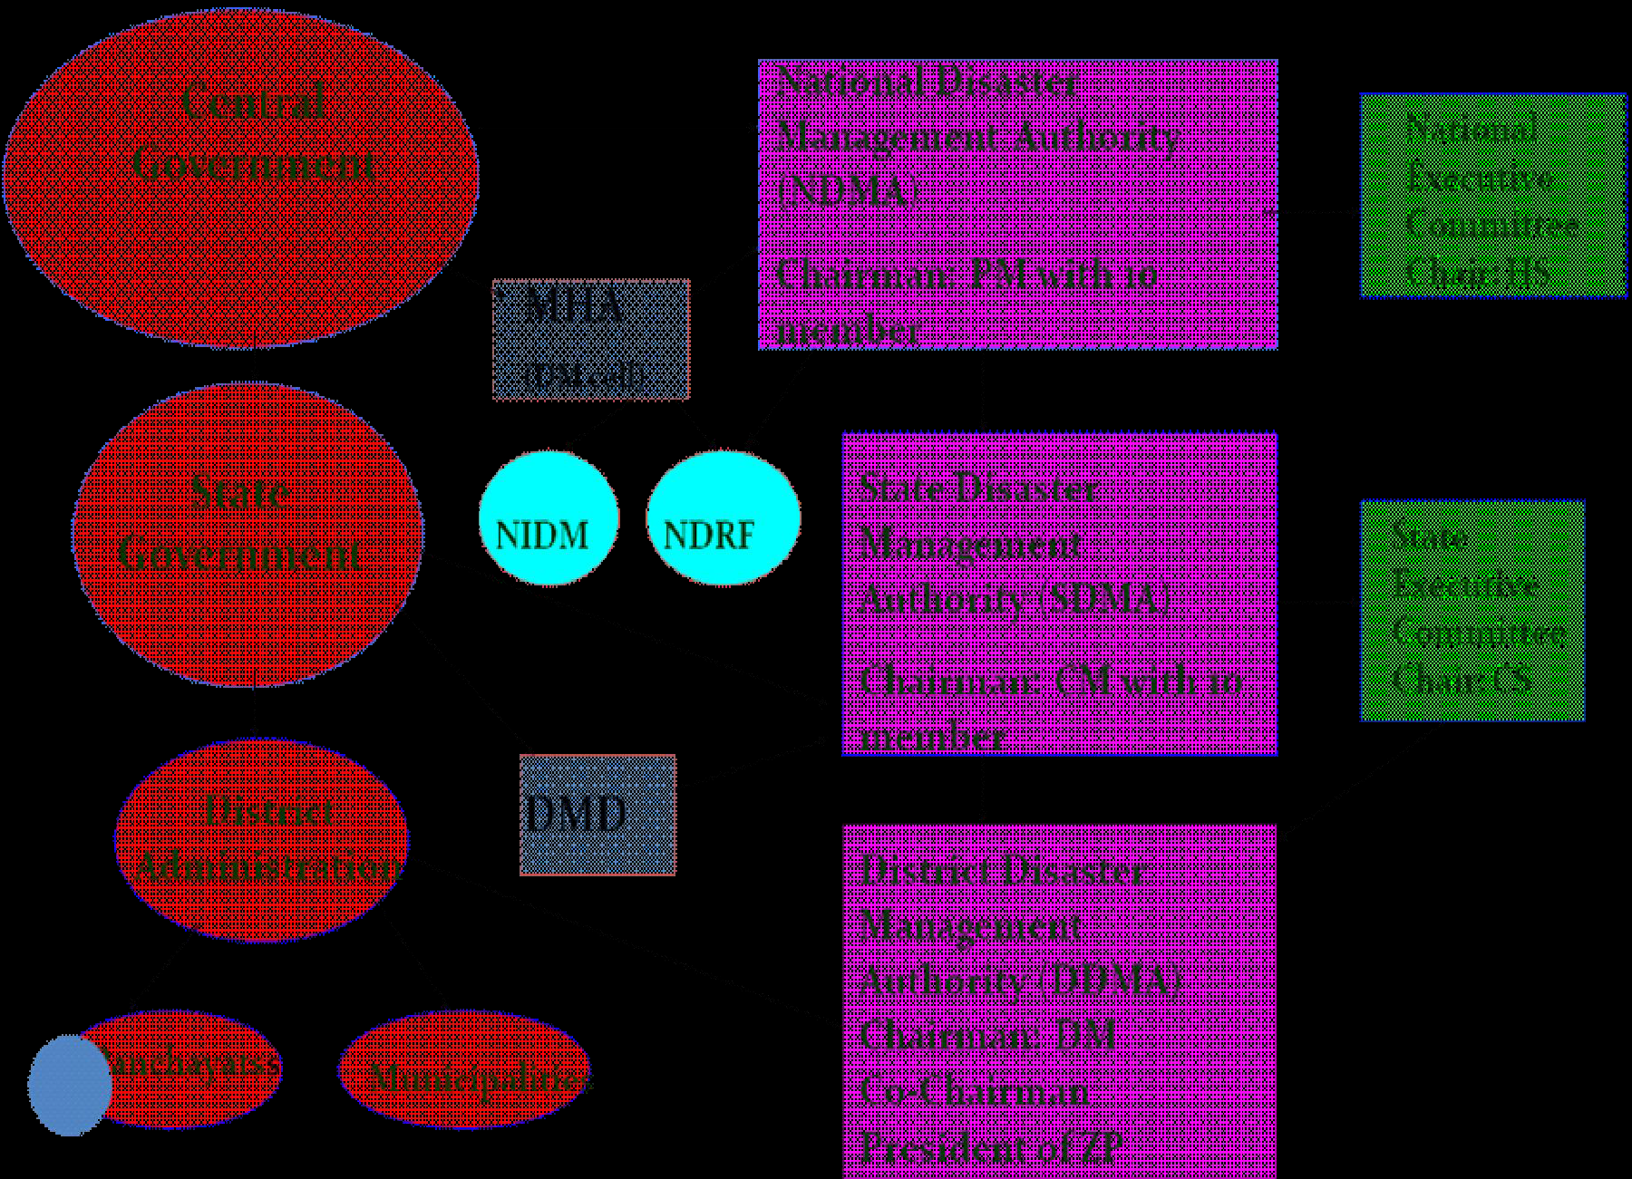
Institutional Framework

Slide 15
Ministry of Home Affairs (MHA)
National Institute of Disaster Management (NIDM)
National Disaster Response Force (NDRF)
Disaster Management Dept (DMD)

Slide 16
Disaster Management (DM) Act 2005
National Authority - Chairman and other members, not exceeding nine, as may be prescribed by the Central Government
The Prime Minister of India, shall be the Chairman of the National Authority , Other members, not exceeding nine, to be nominated by the Chairman of the National Authority.

Slide 17
Functions of National Authority
Responsibility for laying down the policies, plans and guidelines for disaster management for ensuring timely and effective response to disaster

Slide 18
Advisory committee - consisting of experts in the field of disaster management and having practical experience of disaster management at the national, state or district levels to make recommendations on different aspects of disaster management.

Slide 19
National Authority shall constitute a National Executive Committee to assist it in the performance of its functions

Slide 20
Functions of National Executive Committee
Functions of National Executive Committee
Coordinating and monitoring the implementation of National Policy,
laying down guidelines for ministries for preparing disaster management plans, providing necessary technical assistance,
monitoring the
implementation of the guidelines laid down by the National Authority; and
promoting general education and awareness on disaster management.

Slide 21
Mainstreaming disaster management into the developmental planning process.
Establishing institutional and techno-legal frameworks to create an enabling environment and a compliance regime.

Slide 22
Ensuring efficient mechanism for identification, assessment and monitoring of disaster risks.
Developing contemporary forecasting and early warning systems backed by responsive fail-safe communication with information technology support.
Ensuring efficient response and relief with a caring approach towards the needs of the vulnerable sections of the society.

Slide 23
Undertaking reconstruction as an opportunity to build disaster resilient structures and habitat for ensuring safer living.
Promoting a productive and proactive partnership with the media for disaster management.

Slide 24
National Institute of Disaster Management (NIDM)
set up in October, 2003 by Government of India
located at Indian Institute of Public Administration

Slide 25
Develops training modules at different levels.
Undertakes training of trainers programmes; and
Organizes training programmes for planners, administrators etc

Slide 26
National Disaster Response Fund (NDRF)
Fund constituted under Section 46 of Disaster Management Act, 2005.
It covers calamities of cyclone, drought, earthquake, fire, flood, tsunami, hailstorm, landslide, avalanche, cloud burst and pest attack.

Slide 27
State Disaster Response Fund (SDRF)
Fund constituted under Section 48 of Disaster Management Act. The SDRF shall be used only for meeting the expenditure for
providing immediate relief to the victims of Disasters, as identified for NDRF grant.

