Slide 1
Shunt Compensation
For high voltage transmission line the line capacitance is high and plays a significant role in
voltage conditions of the receiving end.
When the line is loaded then the reactive power
demand of the load is partially met by the reactive
power generated by the line capacitance and the
remaining reactive power demand is met by the
reactive power flow through the line from sending
end to the receiving end.

Slide 2
Shunt Compensation (continued…)
• When load is high (more than SIL) then a large reactive power flows from sending end to the receiving end resulting in large voltage drop in the line.
• To improve the voltage at the receiving end shunt capacitors may be connected at the receiving end to generate and feed the reactive power to the load so that reactive power flow through the line and consequently the voltage drop in the line is reduced.

Slide 3
Shunt Compensation (continued…)
• To control the receiving end voltage a bank of
capacitors (large number of capacitors connected in parallel) is installed at the receiving end and suitable number of capacitors are switched in during high load condition depending upon the load demand.
• Thus the capacitors provide leading VAr to partially meet reactive power demand of the load to control the voltage.

Slide 4
Shunt Compensation (continued…)
• When load is small (less than SIL) then the load reactive power demand may even be lesser than the reactive power generated by the line capacitor. Under these conditions the reactive power flow through the line becomes negative, i.e., the reactive power flows from receiving end to sending end, and the receiving end voltage is higher than sending end voltage (Ferranti effect).
• To control the voltage at the receiving end it is necessary to absorb or sink reactive power. This is achieved by connecting shunt reactors at the receiving end.

Slide 5
Shunt Compensation (continued…)
• To control the receiving end voltage generally one shunt rector is installed and switched in during the light load condition.
• To meet the variable reactive power demands requisite number of shunt capacitors are switched in, in addition to the shunt reactor, which results in adjustable reactive power absorption by the combination.

Slide 8
OBJECTIVES OF SHUNT COMPENSATION
Steady-state transmittable power can be increased.
2. Voltage profile can be controlled.
3. Shunt connected reactors (fixed or mechanically
switched) are applied to minimize line over voltage
under light load conditions.
4. Shunt connected capacitors are applied to maintain
voltage levels under heavy load conditions.

Slide 15
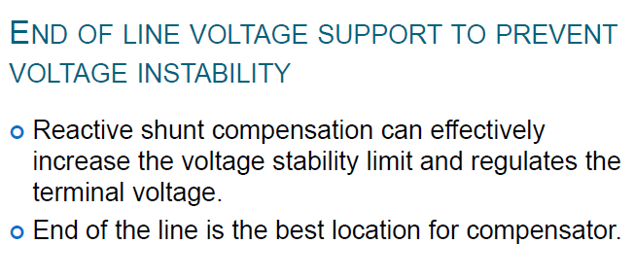

Slide 16
The potential effectiveness of shunt Compensator on transient stability improvement can be conveniently evaluated by “EQUAL AREA CRITERION”.
Assume that both the uncompensated and compensated systems are subjected to the same fault for the same period of time. The dynamic behaviour of these systems is illustrated in the figures.

Slide 17
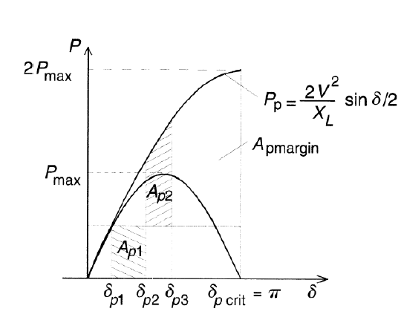
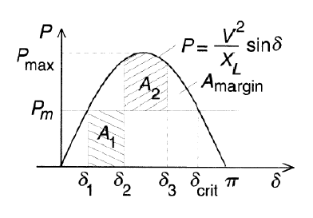

Slide 18
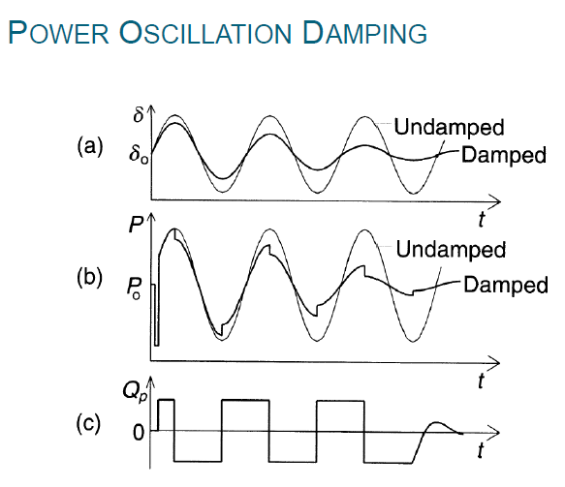

Slide 19
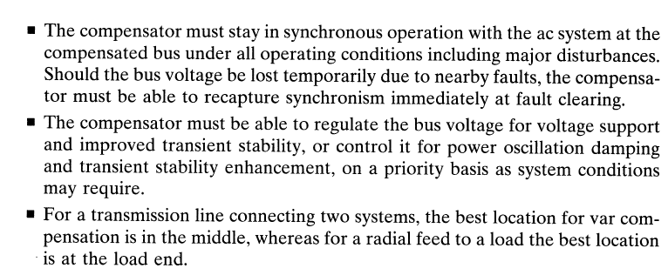

Slide 20
Methods of Controllable VAR Generation:
Capacitors generate and inductors (reactors)absorb reactive power when connected to an ac power source.
They have been used with mechanical switches for controlled VAR generation and absorption.
Continuously variable VAR generation or absorption for dynamic system compensation as originally provided by
Over or under-excited rotating synchronous machines
Saturating reactors in conjunction with fixed capacitors
Using appropriate switch control, the VAR output can be controlled continuously from maximum capacitive to maximum inductive output at a given bus voltage.
More recently gate turn-off thyristors and other power semiconductor devices with internal turn off capacity have been use of ac capacitors or reactors.

Slide 23
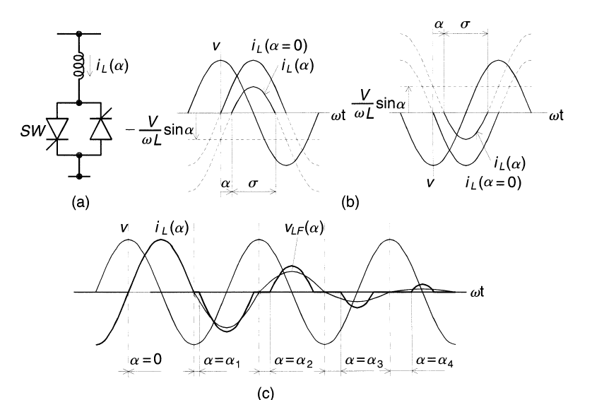

Slide 24
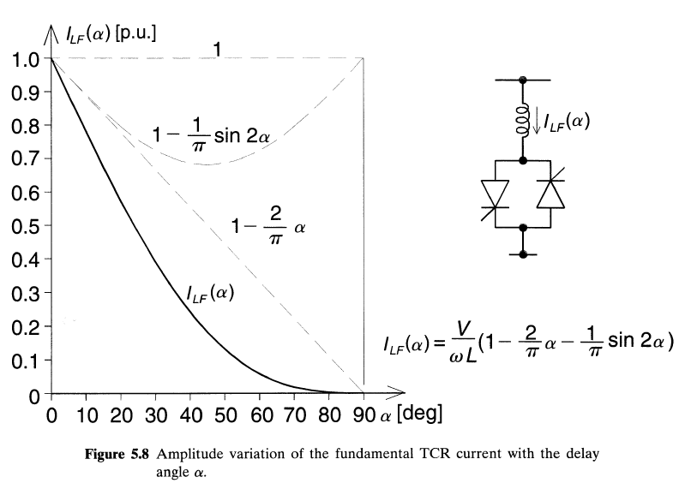

Slide 25
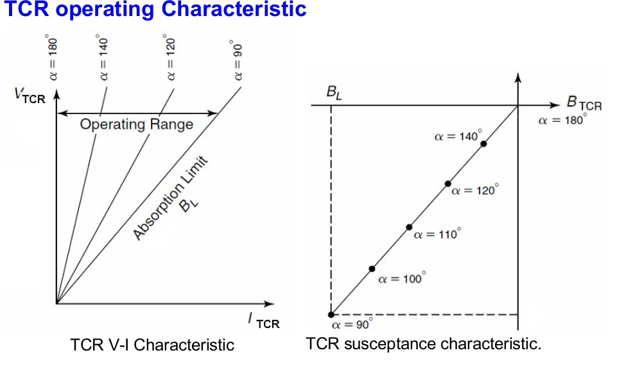

Slide 26
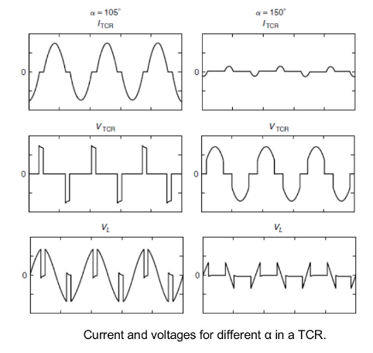

Slide 27
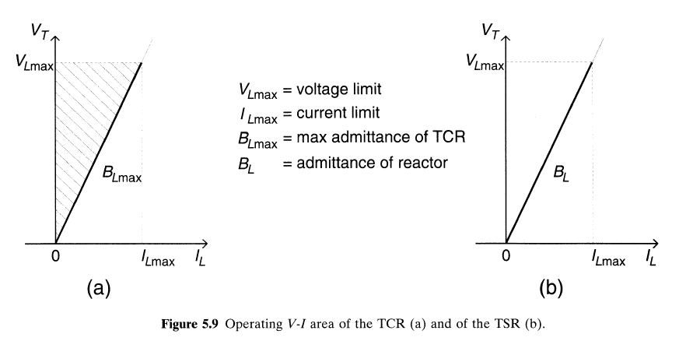

Slide 28
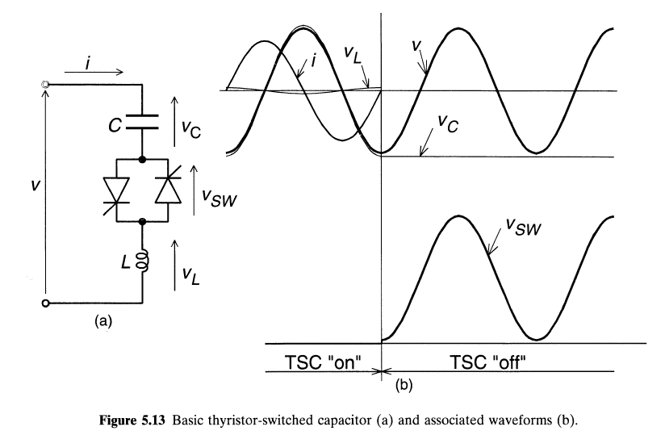
Thyristor Switched Capacitor (TSC)

Slide 29
A thyristor switched capacitor (TSC) is a type of equipment used for compensating reactive power in electrical power systems. It consists of a power capacitor connected in series with a bidirectional thyristor valve and, usually, a current limiting reactor (inductor).
The thyristor switched capacitor is an important component of a Static VAR Compensator(SVC), where it is often used in conjunction with a thyristor controlled reactor (TCR). Static VAR compensators are a member of the Flexible AC transmission system (FACTS) family.
It consists of a capacitor, a bidirectional thyristor valve, and a relatively small surge current limiting reactor.
This reactor is needed primarily to limit the surge current in the thyristor valve under abnormal operating conditions .
It may also be used to avoid resonances with the ac system impedance at particular frequencies.

Slide 30
Under steady-state conditions, when the thyristor valve is closed and the TSC branch is connected to a sinusoidal ac voltase source.
V =V_{m} sin wt.
the current in the branch is given by
The TSC branch can be disconnected ("switched out") at any current zero by prior removal of the gate drive to the thyristor valve. At the current zero crossing, the capacitor voltage is at its peak value. The disconnected capacitor stays charged to this voltage and, consequently, the voltage across the non conducting thyristor valve varies between zero and the peak-to-peak value of the applied ac voltage.

Slide 31
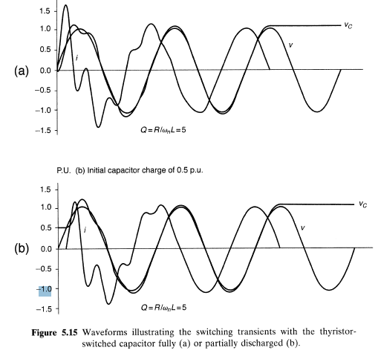

Slide 32
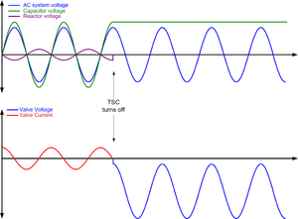
Off-state voltage
When the TSC is switched off, or ‘’blocked’’, no current flows and the voltage is supported by the thyristor valve. After the TSC has been switched off for a long time (hours) the capacitor will be fully discharged, and the thyristor valve will experience only the AC voltage of the SVC busbar. However, when the TSC turns off, it does so at zero current, corresponding to peak capacitor voltage. The capacitor only discharges very slowly, so the voltage experienced by the thyristor valve will reach a peak of more than twice the peak AC voltage, about half a cycle after blocking. The thyristor valve needs to contain enough thyristors in series to withstand this voltage safely.

Slide 33
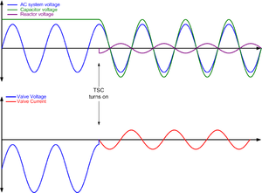
Deblocking – normal conditions
When the TSC is turned on ("deblocked") again, care must be taken to choose the correct instant in order to avoid creating very large oscillatory currents. Since the TSC is a resonant circuit, any sudden shock excitation will produce a high frequency ringing effect which could damage the thyristor valve.
The optimum time to turn on a TSC is when the capacitor is still charged to its normal peak value and the turn-on command is sent at the minimum of valve voltage. If the TSC is deblocked at this point, the transition back into the conducting state will be smooth.

Slide 34
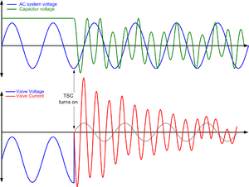
Deblocking – abnormal conditions
Sometimes, however, the TSC may turn on at an incorrect instant (as a result of a control or measurement fault), or the capacitor may become charged to a voltage above the normal value so that even at the minimum of valve voltage, a large transient current results. The current in the TSC will then consist of a fundamental-frequency component (50 Hz or 60 Hz) superimposed on a much larger current at the tuned frequency of the TSC. This transient current can take hundreds of milliseconds to die away, during which time the cumulative heating in the thyristors may be excessive.

Slide 35
(1) if the residual capacitor voltage is lower than the peak ac voltage (V_{c} < V), then the correct instant of switching is when the instantaneous ac voltage becomes equal to the capacitor
voltage;
and
(2) if the residual capacitor voltage is equal to or higher than the peak ac voltage (Vc > V), then the correct switching is at the peak of the ac voltage at which the thyristor valve voltage is minimum.

Slide 36
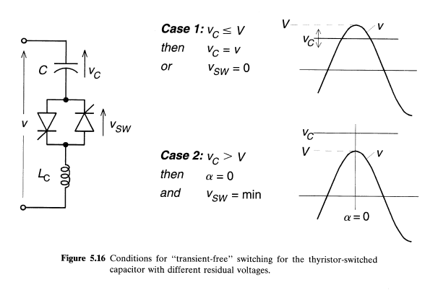

Slide 37
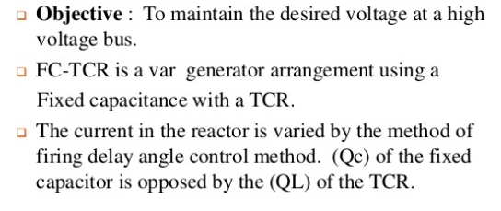
FC-TCR
Fixed Capacitor, Thyristor-Controlled Reactor Type Var Ganerator

Slide 39
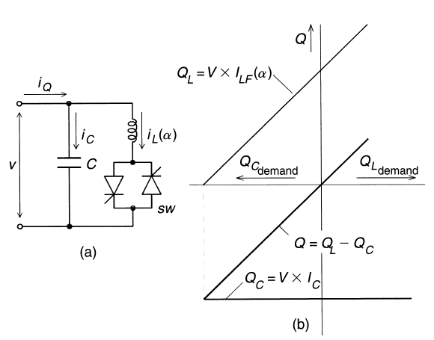
Basic FC-TCR type static var generator and its var demand versus var output characteristic

Slide 40
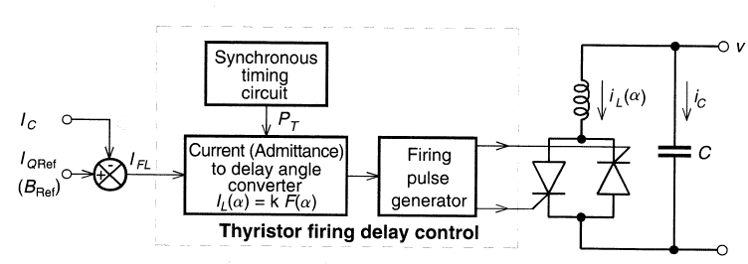
Functional control scheme for the FC-TCR type static var generator
provide four basic functions
Synchronous Timing: Uses PLL and so runs in synchronism with the ac system voltage
Reactiue current (or admittance) to firing angle conuersion
Computation of the required fundamental reactor current I_{FL},
Thyristor firing pulse generation

Slide 41
The constant capacitive var generation (Qc) of the fixed capacitor is opposed by the variable var absorption (Q) of the thyristor-controlled reactor, to yield the total var output (Q) required.
At the maximum capacitive var output, the thyristor-controlled reactor is off (α = 90").
To decrease the capacitive output, the current in the reactor is increased by decreasing delay angle α.
At zero var output, the capacitive and inductive currents become equal and thus the capacitive and inductive vars cancel out.
With a further decrease of angle α (assuming that the rating of the reactor is greater than that of the capacitor), the inductive current becomes larger than the capacitive current, resulting in a net inductive var output. At zero delay angle, the thyristor-controlled reactor conducts current over the full 180 degree interval, resulting in maximum inductive var output that is equal to the difference between the vars generated by the capacitor and those absorbed by the fullv conducting reactor.

Slide 42
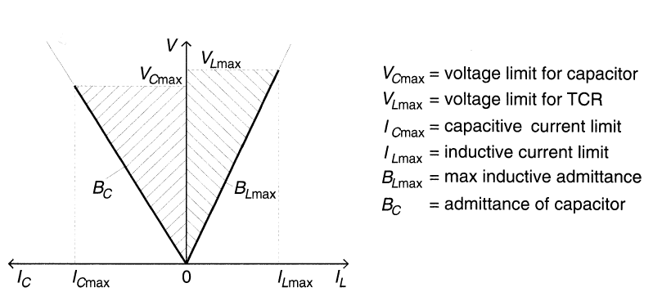

Slide 45
Static Var Compensator(SVC)
• The SVC is an excellent tool for achieving dynamic voltage control of power systems. Increased efficiency in power systems
• The global trend is towards ever larger power networks, longer transmission lines, and higher consumption. Energy is also becoming increasingly expensive. To cope, power transmission and distribution systems have to become more efficient. It has increasing power transmission and distribution capacity at a lower cost.

Slide 46
SVC used as a voltage stabilization
• SVC is the preferred tool for dynamic reactive power support in high voltage transmission grids. it will counteract the often hazardous voltage depressions that follow in conjunction with faults in the grid. These highly dynamic events, where the ever increasing use of induction motors (like those in air-conditioning units and wind power turbine-generators) stresses the grid, will need an SVC to maintain the grid voltage and safeguard the fault ride-through capability.
• Static var compensator includes the following major components
1. Control system
2. Thyristor valves
3. Capacitor banks
4. Reactors

Slide 47
Basic SVC schemes
• Thyristor controlled reactor and fixed capacitor,
TCR/FC TCR/FCs are characterized by
– Continuous control
– No transients
– Elimination of harmonics by tuning the FCs as filters
– Compact design
• Thyristor switched capacitor( TSC)
TSCs are characterized by
– Stepped control
– No transients
– No harmonics
– Low losses
– Redundancy and flexibility

Slide 48
The Benefits Of SVC To Power Transmission
• Stabilized voltages in weak systems
• Reduced transmission losses
• Increased transmission capacity, to reduce, defer or eliminate the need for new lines.
• Higher transient stability limit
• Increased damping of minor disturbances
• Greater voltage control and stability
• Power oscillation damping

Slide 49
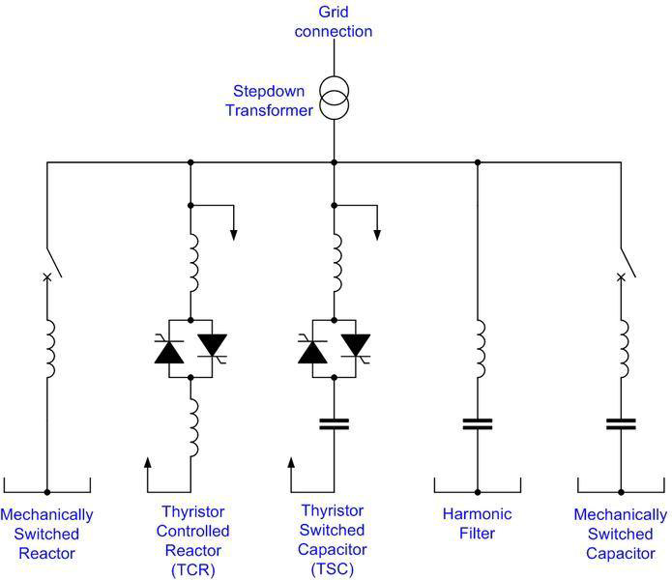
Fig. shows Static Var Compensator(SVC)

Slide 50
An SVC comprises one or more banks of fixed or switched shunt capacitors or reactors, of which at least one bank is switched by thyristors.
Elements which may be used to make an SVC typically include:
Thyristor controlled reactor (TCR), where the reactor may be air- or iron-cored Thyristor switched capacitor (TSC)
Harmonic filter(s)
Mechanically switched capacitors or reactors (switched by a circuit breaker)
The SVC is an automated impedance matching device, designed to bring the system closer to unity power factor.
SVCs are used in two main situations:
Connected to the power system, to regulate the transmission voltage ("Transmission SVC")
Connected near large industrial loads, to improve power quality ("Industrial SVC")

Slide 51
In transmission applications, the SVC is used to regulate the grid voltage.
If the power system's reactive load is capacitive (leading), the SVC will use thyristor controlled reactors to consume vars from the system, lowering the system voltage.
Under inductive (lagging) conditions, the capacitor banks are automatically switched in, thus providing a higher system voltage. By connecting the thyristor controlled reactor, which is continuously variable, along with a capacitor bank step, the net result is continuously-variable leading or lagging power.

Slide 52
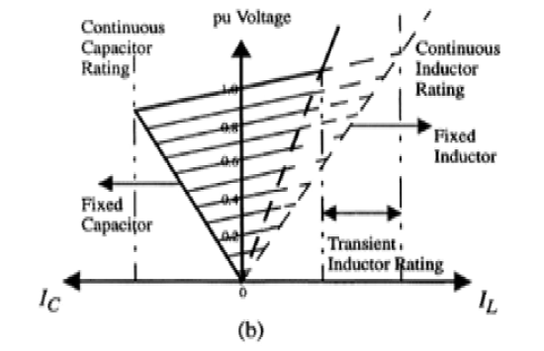
In industrial applications, SVCs are typically placed near high and rapidly varying loads, such as arc furnaces, where they can smooth flicker voltage.

Slide 53
STATCOM or Static Synchronous Compensator
It is a power electronic device using force commutated devices like IGBT, GTO etc. to control the reactive power flow through a power network and thereby increasing the stability of power network.
STATCOM is a shunt device i.e. it is connected in shunt with the line. A Static Synchronous Compensator (STATCOM) is also known as a Static Synchronous Condenser (STATCON). It is a member of the Flexible AC Transmission System (FACTS) family of devices.

Slide 54
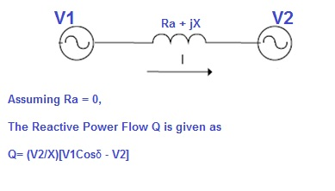
The terms Synchronous in STATCOM mean that it can either absorb or generate reactive power in synchronization with the demand to stabilize the voltage of the power network.
δ is the angle between V1 and V2. Thus if we maintain angle δ = 0 then Reactive power flow will become Q = (V2/X)[V1-V2]
active power flow will become P = V1V2Sinδ / X =0

Slide 55
If the angle between V1 and V2 is zero, the flow of active power becomes zero and the flow of reactive power depends on (V1 – V2). Thus for flow of reactive power there are two possibilities.
1) If the magnitude of V1 is more than V2, then reactive power will flow from source V1 to V2.
2) If the magnitude of V2 is more than V1, reactive power will flow from source V2 to V1.

Slide 56
STATCOM has the following components:
1) A Voltage Source Converter, VSC The voltage-source converter is used to convert the DC input voltage to an AC output voltage. Two of the common VSC types are as below.
a) Square-wave Inverters using Gate Turn-Off Thyristors: In this type of VSC, output AC voltage is controlled by changing the DC capacitor input voltage, as the fundamental component of the converter output voltage is proportional to the DC voltage.
b) PWM Inverters using Insulated Gate Bipolar Transistors (IGBT): It uses Pulse Width Modulation (PWM) technique to create a sinusoidal waveform from a DC voltage source with a typical chopping frequency of a few kHz. In contrast to the GTO-based type, the IGBT-based VSC utilizes a fixed DC voltage and varies its output AC voltage by changing the modulation index of the PWM modulator.
2) DC Capacitor
DC Capacitor is used to supply constant DC voltage to the voltage source converter, VSC.
3) Inductive Reactance
A Transformer is connected between the output of VSC and Power System. Transformer basically acts as a coupling medium. In addition, Tranformer neutralize harmonics contained in the square waves produced by VSC.
4) Harmonic Filter
Harmonic Filter attenuates the harmonics and other high frequency components due to the VSC.

Slide 57
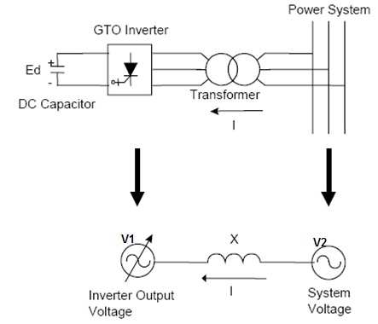
A simplified diagram along with equivalent electrical circuit of STATCOM

Slide 58
If demand increases in the power system, STATCOM increases its output voltage V1 while maintain the phase difference between V1 and V2 to zero (it shall be noted here that there will always exists small phase angle between V1 and V2 to cater for the leakage impedance drop in the interconnecting Transformer).
As V1 > V2, reactive power will flow from STATCOM to the power system. Thus STATCOM, supplies reactive power and acts as reactive power generator.
Again, if the voltage of power system increases due to load throw off, STATCOM will reduce its output voltage V1 and therefore will absorb reactive power to stabilize the voltage to normal value.
The above mode of operation of STATCOM is called Voltage Regulation Mode.

Slide 59
There exists a limitation and this limitation is imposed by the current carrying capacity of force commutated devices like IGBT, GTO etc.
Therefore, if the operation of STATCOM reaches their limitation, it does not further increases or decreases its output voltage V1 rather it supplies or absorbs fixed reactive power equal to its limiting value at a fixed voltage and current and acts like constant current source. This mode of operation of STATCOM is called VAR Control Mode.

Slide 60
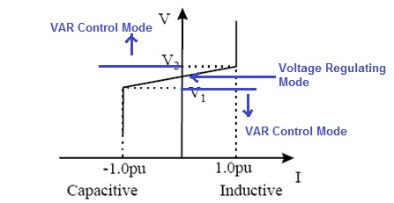
The operation of STATCOM can be classified into two modes:
1) Voltage Regulation Mode
2) VAR Control Mode
V-I Characteristics of STATCOM
As seen in Fig, voltage regulation capability of STATCOM is from V1 (in lower side) to V2 (in upper side of power system). If the voltage of power system goes below V1 or above V2, STATCOM acts in VAR Control mode. Here V1 and V2 are just taken for example, it should not be confused with the V1 (used for output voltage of STATCOM) and V2 (Voltage of power system).

Slide 61
Usually a STATCOM is installed to support electrical networks that have a poor power factor and often poor voltage regulation. The most common use of STATCOM is for voltage stability.
A STATCOM is a voltage source converter (VSC) based device, with the voltage source behind a reactor.
The voltage source is created from a DC capacitor and therefore a STATCOM has very little active power capability. However, its active power capability can be increased if a suitable energy storage device is connected across the DC capacitor.

Slide 62
