Slide 1
Welding Defects – Types, Causes and Remedies
Welding Defects
Irregularities formed in the given weld metal due to wrong welding process or incorrect welding patterns, etc.
The defect may differ from the desired weld bead shape, size, and intended quality.
Welding defects may occur either outside or inside the weld metal.
Some of the defects may be allowed if the defects are under permissible limits but other defects such as cracks are never accepted.

Slide 2
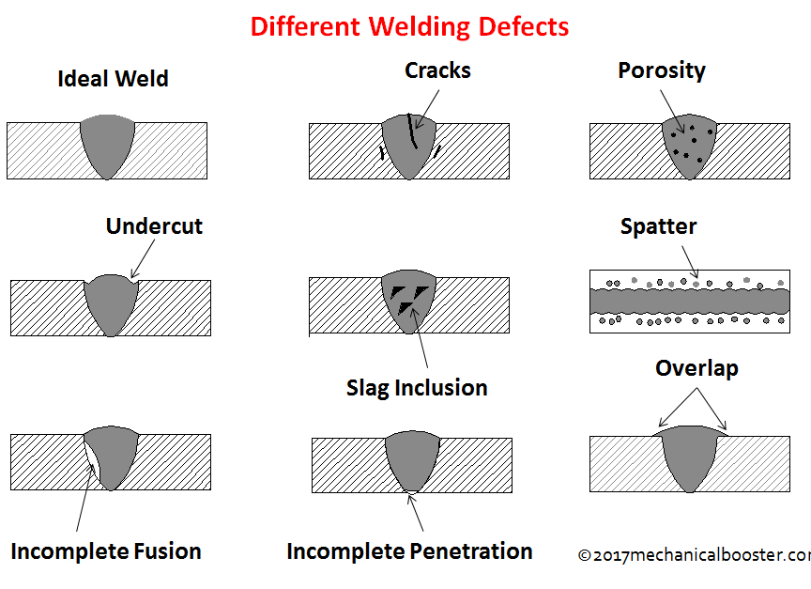
Welding Defects -Types

Slide 3
Welding defects can be classified as:
External Welding Defects:
Weld Crack
Undercut
Spatter
Porosity
Overlap
Crate
Internal Welding Defects:
Slag Inclusion
Incomplete Fusion
Incompletely filled groove or incomplete penetration
While welding, it is very important to remove all the defects of welding present in the work piece, otherwise the components of the material would fail in severe conditions which may lead to loss of property and sometimes also life.

Slide 4
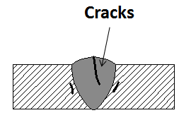
External Welding Defects
Weld Crack
Most unwanted defect of all the other welding defects.
Welding cracks can be present at the surface, inside of the weld material or at the heat affected zones.
Crack can also appear at different temperatures:
Hot Crack – It is more prominent during crystallization of weld joints.
Cold Crack – This type of crack occurs at the end of the welding process where the temperature is quite low.
Sometimes cold crack is visible several hours after welding or even after few days.

Slide 5
Causes of Weld Crack:
Poor ductility of the given base metal.
The presence of residual stress.
The rigidity of the joint.
If there is high content of sulfur and carbon then also the cracks may appear.
Using hydrogen as a shielding gas while welding ferrous materials.
Remedies for Weld crack:
Use of appropriate materials may decrease the chances of crack.
Preheating the weld and reducing the cooling rate.
Reduce the gap between the weld joints.

Slide 6
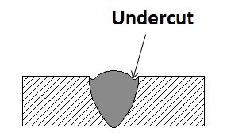
2. Undercut
When the base of metal melts away from the weld zone, then a groove is formed in the shape of a notch, known as Undercut. It reduces the fatigue strength of the joint.
Causes of Undercut:
Very high arc voltage.
Use the wrong electrode or wrong angle of electrode.
Using a large electrode.
High electrode speed.
Remedies for Undercut:
Reduce the arc length or lower the arc voltage.
Keep the electrode angle from 30 to 45 degree.
Use of small diameter electrode.
Reduce the travel speed of the electrode.

Slide 7
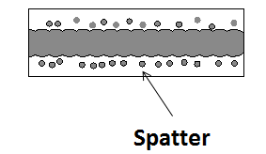
3. Spatter
When some metal drops are expelled from the weld and remain stuck to the surface, then this defect is known as Spatter
Causes Of Spatter:
High Welding current.
Longer arc.
Incorrect polarity.
Improper gas shielded.
Remedies for Spatter:
Reducing the arc length and welding current
Using the right polarity.
Increasing the plate angle and using proper gas shielding.

Slide 8
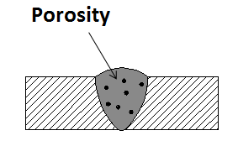
4. Porosity
Porosity is the condition in which the gas or small bubbles gets trapped in the welded zone.
Causes of Porosity:
Improper electrode coating.
Using a longer arc may also increase its chances.
Increased welding currents.
Rust or oil on the welding surface.
Remedies for porosity:
Proper selection of the electrode.
Decreasing the welding current.
Using smaller arc and slowing the process to allow the gases to escape.
Remove rust or oil from the surface and use a proper technique.

Slide 9
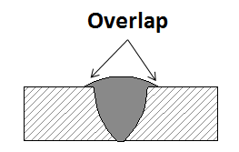
5. Overlap
When the weld face extends beyond the weld toe, then this defect occurs. In this condition the weld metal rolls and forms an angle less than 90 degrees.
Causes of Overlap:
Improper welding technique.
By using large electrode.
High welding current
Remedies for Overlap:
Using a proper technique for welding.
Use small electrode.
Less welding current.

Slide 10
6. Crater
It occurs when the crater is not filled before the arc is broken, which causes the outer edges to cool faster than the crater. This causes a stress and then crack is formed.
Causes of the crater:
Incorrect torch angle.
Use of large electrode:
Improper welding technique
Remedies for crater:
Using a proper torch angle may reduce the stress on the metal
Using a small electrode.
Use a proper technique.

Slide 11
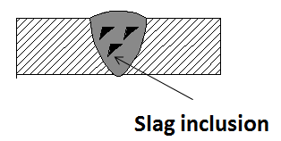
Internal Welding Defects
Slag Inclusion
Slag is formed on the surface of the weld or
between the welding turns.
Causes of Slag:
Slag is formed if the welding current density is very small, as it does not provide the required amount of heat for melting the metal surface.
High welding speed.
Improper cleaning of the weld surface.
Improper welding angle and travel rate of welding rod.
Remedies for Slag Inclusion:
Increase the current density
Adjusting the welding speed.
Clean the weld edges and remove the slag of previous weld.
Have a proper electrode angle and travel rate.

Slide 12
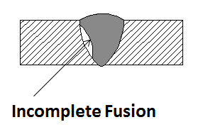
2. Incomplete Fusion
Incomplete fusion occurs when the welder does not accurately weld the material and the metal pre solidifies which leads to a gap which is not filled with the molten metal.
Causes of Incomplete fusion:
It occurs because of the low heat input.
When the weld pool is very large and runs ahead of the arc.
When the angle of the joint is too low.
Incorrect electrode and torch angle.
Improper bead position.
Remedies for Incomplete Fusion:
Increasing the welding current and decreasing the travel speed.
Reducing the deposition rate.
Increasing the joint angle.
Position the electrode and torch angle properly.
Positioning the bead properly so that the sharp edges with other beads can be avoided.

Slide 13
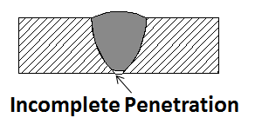
3. Incompletely Filled Groove or Incomplete Penetration
These defects occur only in the butt welds where the groove of the metal is not filled completely. It is also called as incomplete penetration defect.
Causes of an Incomplete filled groove are:
Less deposition of the weld metal
Use of improper size of the electrode
Improper welding technique
Remedies for Incomplete filled groove are:
More deposition of the weld metal.
Use a proper size of the electrode.
By using a proper welding technique.

Slide 14
Weldability
The ease with which welding of a given material can be done without producing any defect is called Weldability.
Weldability can also be defined as the capability of metal to be welded under the fabrication conditions imposed satisfactorily on the intended surface.
The metal should not require expensive or complicated or extracting procedures to produce a sound joint.
The American Welding Society defines weldability as, “the capacity of a metal to be welded under the fabrication conditions imposed into a specific, suitably designed structure and to perform satisfactorily in the intended service.”

Slide 15
Weldability …..
When nearly any process can be used on a metal and minimal effort is necessary to produce a sound weld, the metal is said to have “good weldability.”
In cases where a welder can choose from only a limited number of processes and must carefully prepare the joint and execute the welding procedure to create a strong weld, the metal is considered to have “poor weldability.”

Slide 16
Factors affecting Weldability:
Melting point of metal: Materials with a medium melting point can be welded very easily.
Thermal conductivity: Material with high thermal conductivity (K) are treated as difficult to weld materials.
Reactivity: If the material reacts with air, water or surroundings it becomes difficult to weld.
The coefficient of thermal expansion of metals: Material with high thermal expansion coefficient, it becomes difficult to weld.
Electrical resistance: Higher the electrical resistance of the material, it becomes difficult because it requires a lot of heat energy.
Surface condition: The material with the dirty surface it becomes difficult to weld.

Slide 17
How to Improve Weldability
The heating and cooling cycles inherent to most forms of welding can create strains and stresses in the weld.
They also affect physical, chemical, and metallurgical changes in the metal.
When such changes make a metal prone to poor weldability, adjustments can be made to improve the quality of the weld.

Slide 18
THANK YOU

