Slide 2
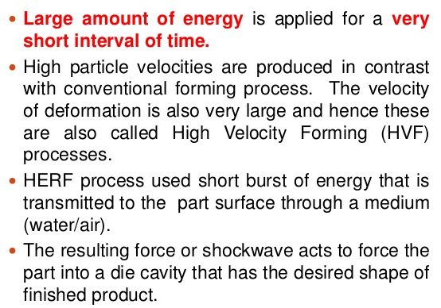

Slide 20
A sudden electrical discharge in the form of sparks is produced between electrodes.
This discharge produces a shock wave in the water medium.
The shock wave deforms the work piece and the work piece collapses into the die cavity.

Slide 22
CONSTRUCTION DETAILS
A typical configuration of EHF includes:
A Discharge chamber
Electrodes
Forming Die
Pulse Generator which consists of a high –voltage low inductive bank of Capacitors, a high voltage / high current discharge switch and a charging / amplifying / rectifying circuit.

Slide 23
CONSTRUCTION DETAILS

Slide 32
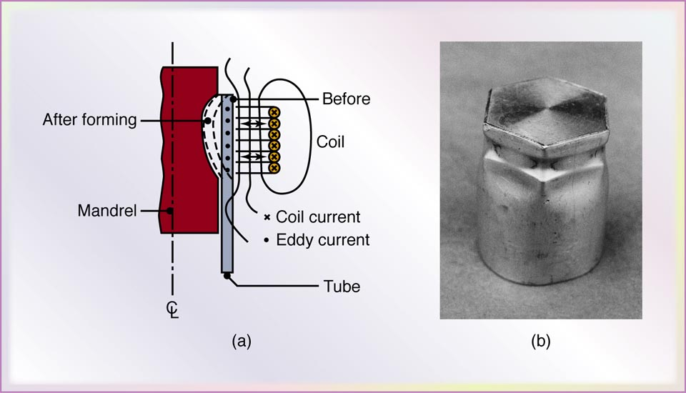
(a) Schematic illustration of the magnetic-pulse forming process used to form a tube over a plug. (b) Aluminum tube collapsed over a hexagonal plug by the magnetic-pulse forming process.

Slide 41
